Slide 1
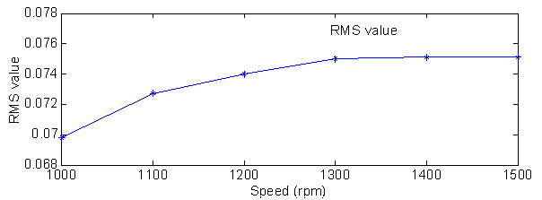
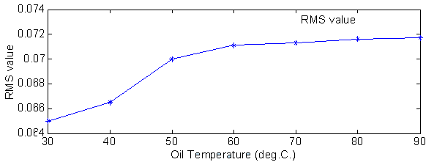
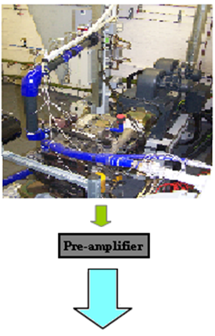
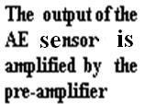
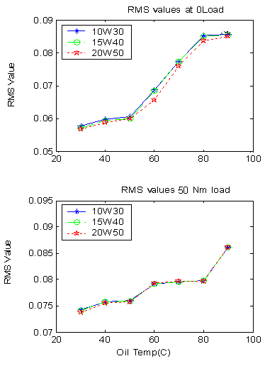
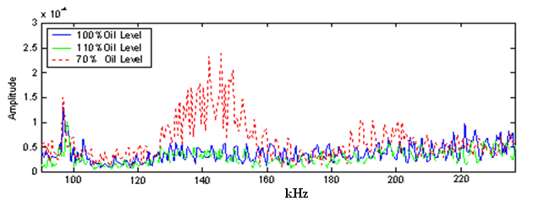
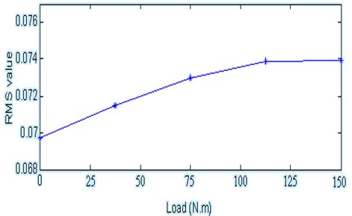
Computing and Engineering
Diagnostic Engineering Research Group
Lubricating Oil Condition Monitoring Using Acoustic Emission
Fathi_Elamin, 2nd Year PhD supervised by Prof. A. Ball and Dr. F.Gu
Aim
Engine Speed
This study has been conducted aiming at engine oil condition monitoring and quality evaluation by analyzing the engine acoustic emission signals.
The acoustic emission signals were measured using an acoustic emission sensor mounted on the engine block.
The acoustic emission signals increase linearly with the engine speeds. At higher engine speed, the in-cylinder pressure and force increase due to the piston inertia, resulting in to increase of piston slap.
Introduction
Diesel engines are a kind of power source widely used in many fields. Combustion, fuel injection and mechanical impacts are the main AE sources in a diesel engine. Mechanical impacts consists of piston slap impacts, timing gear rattle, bearing impact, valve system and accessories impacts. Piston slap plays an important role in AE and is defined as an impact phenomenon between the piston and cylinder wall caused by changes in the side force acting on the reciprocating piston. It was found that the thickness of the oil film in clearance is very important in reducing piston slap.
Oil Temperature
Increase in oil temperature had the effect of increasing the piston slap intensity. Oil viscosity decreases at higher temperature, which result in worse damping characteristics in the oil film between the piston and cylinder walls.
Another factor to be considered is that increase in the oil temperature also cause an increase in the cylinder liner temperature, which can enlarge the clearance between the piston and liner. Consequently, with a bigger clearance, the motion of the piston would be less restricted and the slap intensity increases.
Test Rig and Instrumentations
Oil Type
This influence of oil viscosity on AE signal generated by piston slap were studied by changing the oil viscosity using three different types of engine oil, 10W-30, 15W-40 and 20W-50.
The engine speed was constant. It was difficult to observe any change in the spectrum.
By filtering the signals and calculate the RMS values of the signals clear differences could be observed especially at temperature below 55 Celsius degree.
The intensity of the impact is less when using higher viscosity oil, because of the higher damping characteristics.
Tests was conducted on a JCB 444 four-cylinder four-stroke, in-line OHV, direct injection, turbocharger diesel engine. AE data is acquired using AE sensor placed on cylinder block and high speed AE data acquisition system (PCI-2).
Preliminary Results
Engine was tests with three different oil levels. No clear difference in the time domain. By taking the Fourier transform of the signals, a distinctive change was observed. The AE remarkably increased when the oil level reduced, and decreased when oil level increased.
Interim Conclusion
This experiment study has found that the condition of the engine lubrication in terms of oil quantity and oil quality has a noticeable influence on acoustic emission signals.
In general, reduction in the oil level and/or the use of poor quality oil causes an increase in acoustic emission.
It is possible to monitor engine lubrication conditions using acoustic emission.
Engine Load
Previous studies prove that the piston slap increases as the load increases. The load affects the shape and the magnitude of the cylinder pressure, which is directly related to the driving side force on the piston. Thus increase in the engine load results in higher piston slap intensity.
Future Work
Optimization of sensor placement.
Comparison AE with other detection and diagnosis techniques.
Investigation AE characteristics of different faults.
Develop more advanced methods such as Wigner-Ville Distribution and wavelet to analyze AE signals.
The University of Huddersfield, Queensgate, Huddersfield HD1 3DH, UK

