Slide 1
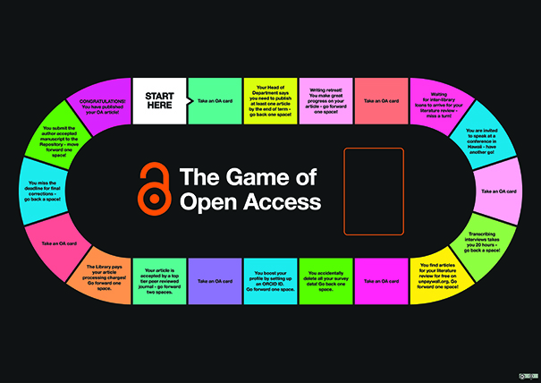
The Game of Open Access: making mandates more memorable
Kate McGuinn & Alison McNab
University of Huddersfield
@hudlib / @AlisonMcNab

Slide 2
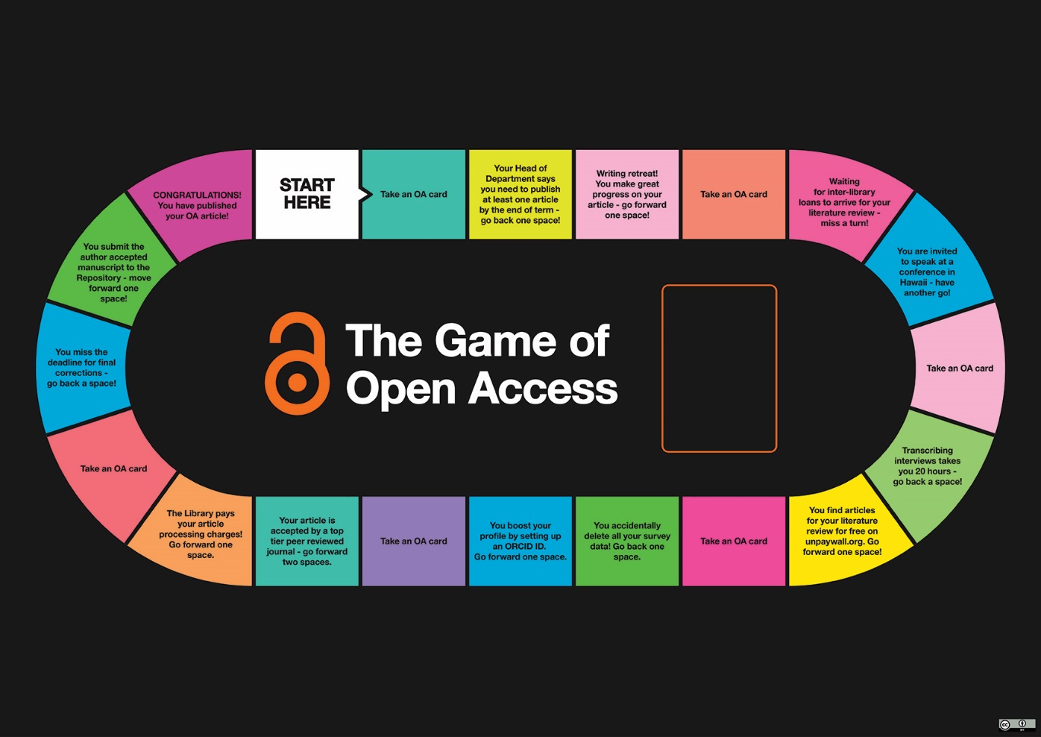
The Game of Open Access
What?
Why?
When?
So what?
Notes:
The "Game of Open Access" was created by library staff at the University of Huddersfield to engage researchers with the key concepts and tools required to meet Open Access mandates. Through the use of playful learning, it aims to develop an understanding of the role of Open Access through the initial idea for an article to its acceptance for publication.
Developed in spring 2017, the game has been played by researchers and librarians in the context of library roadshows and in Open Access information sessions.
This presentation will give a brief overview of the game itself, our learning objectives, and the modifications which resulted from evaluation by players.

Slide 3
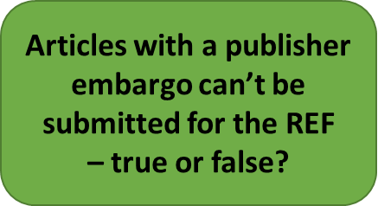
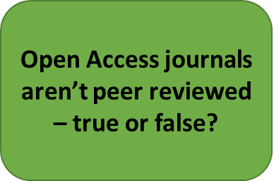
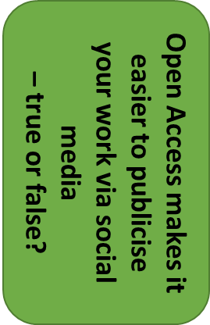
Let’s play……

Slide 4
What did our researchers say?
I got round the board too quickly because I threw two sixes, therefore didn’t manage to collect many cards
The Game of Open Access is an innovative training method that encourages imaginative thinking, it allows participants to reflect on the Open Access course and be able to apply what has been learnt. I was inspired by it usefulness.
A fun way to test my knowledge of Open Access

Slide 5
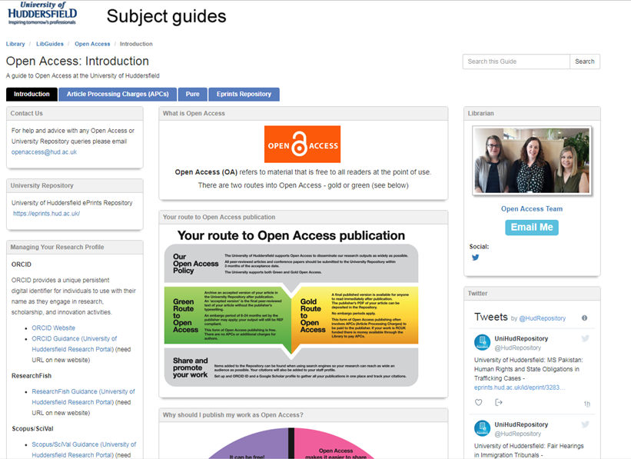
Open Access support material
http://hud.libguides.com/openaccess /

Slide 6
You can play The Game of Open Access!
CC-BY license
Download from: http://eprints.hud.ac.uk/id/eprint/33874
You’ll need:
A3 copy of the Game
Set of cards and instructions
Dice
Playing counters
Content: Kate McGuinn / Graphics: Mike Spikin. Computing & Library Services, University of Huddersfield

Slide 7
Any questions? A.McNab@hud.ac.uk

