Slide 1
What younger children, parents and teachers really think about online safety: Using creative methods within a phenomenological framework.
By Lindsey Watson
Senior Lecturer in Early Years
FHEA, MA by Research, PGDip, BA Hons

Slide 2
Aims of the presentation
To provide an overview of the context of the proposed PhD research project
To examine the proposed research aims
To discuss the proposed methodological approach and how this impacts on younger children’s autonomy within the research environment

Slide 3
Background
Multiple perspectives, a mother, an early years practitioner, a researcher
Attitudes and Emotions to Internet Safety: Trust and Digital Literacy in Mothers of Reception Aged Children
Lower digital literacy parents
[Parent asked regarding technical internet safety]
Higher digital literacy parents
[Do you sit with your child at the computer?]
“... but I don’t know how I can stop her from going on it [Netflix]. When it comes to Netflix I don’t think there is anything? I don’t know I have no idea. I think she can just go on it, it’s a case of supervising her and stuff like that.” (Leanne)
“...when she is on the PC then we are mostly not with her, it is a small room and she wouldn’t want you to sit with her...” (Gayle)

Slide 4
Background
Lower child digital literacy
[When asked about influences from the mesosystem that encourage child digital literacy.]
Higher child digital literacy
[Encouragement of child digital literacy within the microsystem.]
“... you see I wouldn’t want that, don’t teach them how to use the internet, no I don’t like that.” (Leanne)
“... so like for example we looked up ‘Whoops-a-daisy’ on You Tube, which is quite sweet. So it just meant I knew what the songs were and we could sing it together and it was quite nice. He is too young to do that on his own, just because he can’t type yet and stuff like that.” (Jane)

Slide 5
Background
https://www.researchgate.net/profile/Lindsey_Watson6

Slide 6
Proposed research aims
Critically interrogate how the home and school environments work together to tackle the issues of child online safety
• Apply a phenomenological approach to deepen understanding of possible differences between younger children’s and adult’s perspectives on online safety, gaining insights into how best to support younger children with online safety
• Critically analyse the effectiveness of storytelling and roleplay in eliciting the views of younger children in the research environment
Critically evaluate how Ecological Systems Theory can be applied to deepen understanding of younger children’s, parent’s and teacher’s contemporary perceptions of online safety.

Slide 7
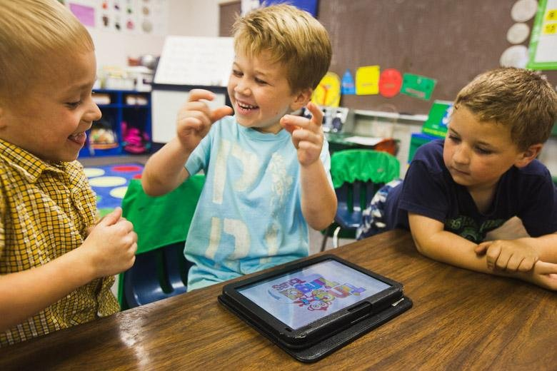
Younger children’s digital engagement
What are the issues?
What does the literature say?
There are many stakeholders involved in younger children’s digital engagement, who recognise that children are accessing the internet at younger ages and for longer periods of time (Sharkins, Newton, Albaiz & Ernest, 2015, p.437)
Much of the research focuses on the engagement of older children over the age of nine (Chaudron, 2015, p.11)
Widening gap, demonstrating a lack of understanding in how best to support younger children’s digital engagement (Holloway, Green & Livingstone, 2013, p.4; Ólafsson, Livingstone and Haddon, 2013, p.32)
Notes:
Mention benefits and risks

Slide 8
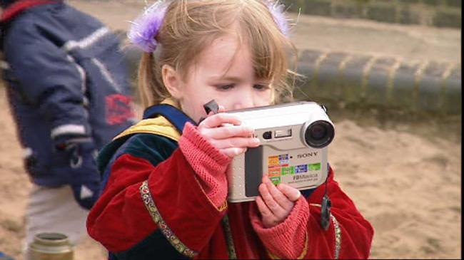
What can younger children add to our knowledge?
Chaudron (2015) suggests younger children show limited understanding of what the internet is, or the associated benefits and risks
There has been a plethora of research regarding child online safety issues over the last decade and some of this research has attempted to include the child’s voice (Livingstone, 2013)
The current lack of research surrounding younger children’s online engagement may reflect difficulties in research involving the perceptions of younger children (Olfasson, Livingstone, & Haddon, 2013, p.20)
Are there more creative ways to genuinely attempt to include children in the production of knowledge? (Lomax, 2012)

Slide 9
Different stakeholders
Different perspectives: Home and school environments
Children’s, parents and teachers perceptions of the potential risks and benefits of online engagement are an important aspect of understanding child online safety (Kanthawongs & Kanthawongs, 2013)
Sharkins et al. (2015) suggest that there is a lack of research that includes the perspectives of caregivers, such as parents and teachers regarding younger children’s use of digital technologies
Shipton (2011) suggests teachers and parents’ views of online safety often differ, potentially causing barriers
Notes:
Highlight children’s views

Slide 10
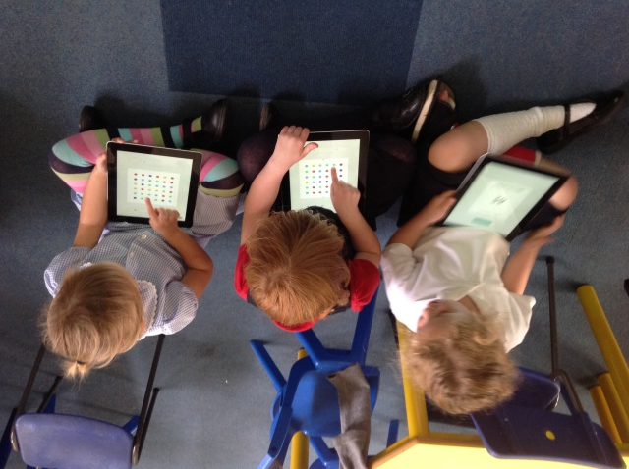
Different stakeholders
Different perspectives: Home and school environments cont...
The British Government recognises the influential position of parents and encourages them to take responsibility for child internet safety through ideals surrounding effective parenting (Byron, 2008, 2010; Lewis, 2014).
Parents of younger children recognise the importance of taking responsibility for child online safety and are willing to share this with teachers (Chaudron, 2015)
Holloway et al. (2013) suggest that sharing responsibility for online safety with teachers may lead to some parents of younger children having less support through a lack of communication
Notes:
Highlight children’s views

Slide 11
Theory
MACROSYSTEM
Ecological Systems Theory
EXOSYSTEM
To encourage further understanding of younger children’s perspectives surrounding online safety, multiple environments need to be analysed (Chaudron, 2015)
Opportunities to examine how individual’s views and perceptions are potentially influenced through interactions between different environments (Bronfenbrenner, 1977)
Interactions between different perspectives to further examine and understand younger children’s digital autonomy, digital literacy and possibly leading to a safer digital environment (Chaudron, 2015)
MESOSYSTEM
MICROSYSTEM
Child
Notes:
Highlight children’s views

Slide 12
School and Curriculum
British society revolves around technology, recognising that children need the skills, competences and enthusiasm to function digitally (Plowman, Stephen & McPake, 2012)
UK Government and schools have responded over the last decade by implementing strategies focusing on preparing younger children to be effective and safe digital users (Pinto & Younie, 2015)
Changes to school curricula find computing and online safety taught much earlier, putting more emphasis on schools to develop children’s online safety (Adams, 2013).
Notes:
Skills needed for good digital literacy fit well with the COEL
Logic reasoning
Spotting patterns
Breaking down problems
Finding and fixing errors
Evaluating making judgements
Tinkering – time to explore
Focus on creation rather than as a tool for consuming information
2015 England intro computational thinking into its NC (First in Europe)
One of two countries to add coding
EYFS – failed to keep pace – guidance LIMITED

Slide 13
School and Curriculum
The EYFS (Department for Education, 2017) Early learning goal; children recognise that a range of technology is used in places such as homes and schools. They select and use technology for particular purposes.
Development Matters (Early Education, 2012) and Early Years Outcomes (Department of Education, 2013a), suggests younger children are supported to understand that information can be retrieved from computers and are able to complete a simple computer programme through interacting with age-appropriate software
Ofsted suggests that younger children are taught about safeguarding risks, including those associated with being online (Ofsted, 2015)
National Curriculum, Key Stage One - use technology safely and respectfully, keeping personal information private; identify where to go for help and support when they have concerns about content or contact on the internet or other online technologies (Department for Education, 2013b).
Notes:
Lorraine Kaye – young children in a digital age discontinuity between the EYFS and NC
Need a focus on the COEL not the ELG
More positive focus, creativity, not fear

Slide 14
Methodology
Children
Parents
Findings
Teachers
By focusing on individual experiences of younger children, parents and teachers, to help understand social reality, the research aims support a qualitative phenomenological and interpretivist approach (Gray, 2014; Smith, Flowers & Larkin, 2009)
The in-depth phenomenon data will be gathered from those who are immersed within it (Denzin, 1978; Henn, Weinstein, & Foard, 2013)
Employing different research methods encourages triangulation and facilitates critical analysis through exploration as opposed to description, which assists when trying to uncover potential relationships between participants and contexts (Gray, 2014).
Notes:
Highlight children’s views

Slide 15
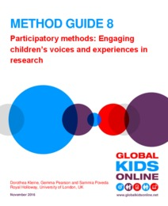
Children’s Voices Within Research
Research that views children as respondents rather than competent potentially limits research quality (Kleine et al., 2016)
United Nations Convention on the Rights of the Child (UNCRC) (Unicef, 1989) recommend that children have a right to participate within research that affects them in an age appropriate way
Giving children their own voice rather than voicing opinions for them (Clark, 2010).
Child-friendly methods to mediate issues of marginalised status and power hierarchies (Harcourt, Perry & Waller, 2011).
(Kleine, Pearson & Poveda, 2016)
Notes:
Highlight children’s views

Slide 16
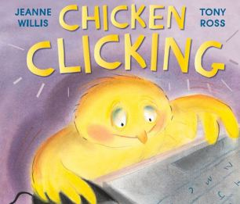
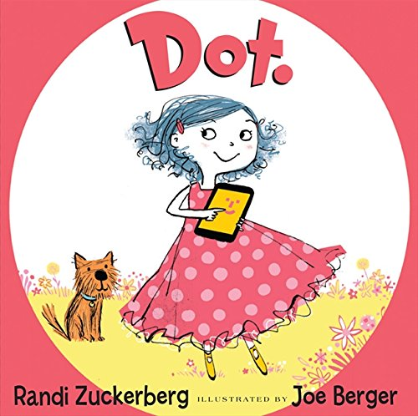
Proposed methodological approach (1) Storytelling
As a pedagogical strategy, storytelling capitalises on children’s desire to interact and talk to others
Engaging in storytelling is a way of motivating young children to engage within an activity
Storytelling has a potential ability to motivate children and to connect with the content
(Miller and Pennycuff, 2008).
Jug &Vilar (2015) storytelling with pre-school children
Audio recording
Age appropriate storytelling five children (reception and year one)
Notes:
Mention different ways of accessing stories. Online for Digiducks big decision, PDF and interactive app.
Penguin pig – i bookstore
Webster’s email – kindle edition
Chicken Clicking – kindle edition
Dot PDF available
Do I produce my own book?

Slide 17
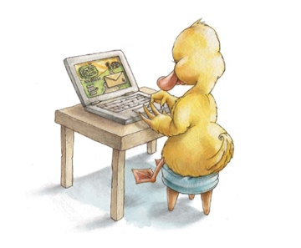
Proposed methodological approach (2) Role play
Role play enables children to communally explore and assign meaning to their worlds and themselves in it
A pretend world that is reality grounded, where children are able to recreate aspects of their everyday world
A medium of expression to demonstrate their current levels of understanding, anxieties and fears
(Papadopoulou, 2012)
Notes:
A highly complex interactive world and a developing individual, agency and expression

Slide 18
Proposed methodological approach (3) Role play
Revisiting roleplay data with children
Research with children continues to examine how their perspectives can help add to the body of knowledge about various issues in their lives (Einarsdottir & Harcourt 2011; Lansdown 2005).
Increased use of video recording has also contributed to a paradigm shift within early childhood educational research, where the child is viewed as a competent research participant (Rayna & Laevers, 2011)
A clear rationale for video recording, ethical considerations, confidentiality, anonymity, data storage
Data analysis
Thematic Phenomenological Analysis

Slide 19
Asking Questions Ethically of Children
Children are asked to express their life reality through the medium of words within the framing of the questions they are asked (Kleine et al., 2016)
In comparison with classic interviews, the storytelling and roleplay activities will place less pressure on children to answer questions, potentially creating receptive and spontaneous participation (Đurić, Meško, & Popović Ćitić, 2010, cited in, Jug & Vilar, 2015)
Participatory methods that allow for co-construction, may help to shape children’s futures, including their digital futures (Kleine et al., 2016)
So how will the methodological approach of storytelling support these views?

Slide 20
Let’s have a think about this…
How can these books could support data collection?
What are the key aspects to consider?
Role play area capability?
Suitability
of content?
Age appropriateness?
What useful prompts could the book support?
Ethics?
Ability to facilitate children’s voices?
Links to the research aims?

Slide 21
Conclusion
Provided an overview of the context of the proposed research
Examined the proposed research aims
Discussed the proposed methodological approach and how this impacts on younger children’s autonomy within the research environment

Slide 22
References
Adams, R. (2013). New national curriculum to introduce fractions to five-year-olds. The Guardian. Retrieved from http://www.theguardian.com/politics/2013/jul/08/michael-goveeducation-curriculum-fractionsBronfenbrenner, U. (1977). Toward an experimental ecology of human development. American Psychologist, 32(7), 513-531.
Byron, T. (2008). Safer Children in a Digital World. The Report of the Byron Review. Nottingham: DCSF & DCMS Publications.
Byron, T. (2010). Do we have Safer Children in a Digital World? A Review of Progress Since the 2008 Byron Review. Nottingham: DCSF Publications.
Chaudron, S. (2015). Young Children (0-8) and Digital Technology: A Qualitative Exploratory Study Across Seven Countries. Ispra: Joint Research centre – European commission.
Clark, A. (2010). Young children as protagonists and the role of participatory, visual methods in engaging multiple perspectives. American Journal of Community Psychology 46(1–2), 115–123.
Denzin, N. (1978). The Research Act; A Theoretical Introduction to Sociological Methods. Transaction Publishers: New Jersey.
Department for Education. (2017). Statutory framework for the early years foundation stage Setting the standards for learning, development and care for children from birth to five. Manchester: Department for Education.

Slide 23
References
Department for Education. (2013a). Early years outcomes A non-statutory guide for practitioners and inspectors to help inform understanding of child development through the early years. Manchester: Department for Education.
Department for Education. (2013b). The National Curriculum in England Key stages 1 and 2 framework document. Manchester: Department for Education.
Early Education. (2012). Development Matters in the Early Years Foundation Stage (EYFS). London: Early Education.
Einarsdottir, J., & D. Harcourt. (2011). “Introducing Children’s Perspectives and Participation in Research.” European Early Childhood Education Journal 19(3), 301–307.
Gray, D. (2014). Doing Research in the Real World. 2nd Edition. London: Sage Publications Ltd.
Harcourt, D., Perry, B., & Waller, T. (2011). Researching Young Children’s Perspectives: Debating the Ethics and Dilemmas of Educational Research with Children. New York: Routledge.
Henn, M., Weinstein, M., & Foard, N. (2013). A Critical Introduction to Social Research. 2nd Edition. London: Sage Publications Ltd.
Holloway, D., Green, L., & Livingstone, S. (2013). Zero to Eight, Young Children and their Internet Use. London: London School of Economics and Political Science & EU Kids Online.
.

Slide 24
References
Jug, T., & Vilar, P. (2015). Focus Group interview through storytelling: Researching pre-school children’s attitudes towards books and reading. Journal of Documentation, 71(6), 1300-1316.
Kanthawongs, P., & Kanthawongs, P. (2013). Perception of Primary School Students, Parents and Teachers toward the Use of Computers, the Internet and Social Networking sites. Procedia - Social and Behavioral Sciences, 88, 282-290.
Kleine, D., Perason, G., & Poveda, S. (2016). Participatory methods: Engaging children’s voices and experiences in research. London: Global Kids Online Lansdown, G. (2005). ‘Can you hear me? The right of young children to participate in decisions affecting them’, Working Paper 36. The Hague: Bernard van Leer Foundation.
Lewis, B. (2014). Raising Children in a Digital Age: Enjoying the best avoiding the worst. Oxford: Lion Hudson plc.
Livingstone, S. (2013). Online risk, harm and vulnerability: Reflections on the evidence base for child Internet safety policy. ZER Journal of Communication Studies, 18(35), 13-28.
Lomax, H. (2012). Contested voices? Methodological tensions in creative visual research with children. International Journal of Social Research Methodology 15(2), 105–117.
Miller, S., & Pennycuff, L. (2008). The power of story: Using storytelling to improve literacy learning. Journal of Cross-Disciplinary Perspectives in Education, 1(1), 36-43.

Slide 25
References
Ofsted. (2015). Inspecting safeguarding in early years, education and skills settings. Guidance for inspectors undertaking inspection under the common inspection framework. Manchester: Ofsted.
Olfasson, K., Livingstone, S., & Haddon, L. (2013). Children's Use of Online Technologies in Europe: A Review of the European Evidence Database. London: London School of Economics and Political Science and EU Kids Online.
Papadopoulou, M. (2003). An attempt to establish a developmental phenomenology employing a case studies’ approach to ‘understanding’ and ‘organised learning’. PhD thesis, University of Portsmouth
Pinto, T., & Younie, S. (2015). Developing E-Safety in the Primary School. In Younie, S.,Leask, M., & Burden, K (Eds) Teaching and Learning with ICT in the Primary School (225-237) (2nd Ed). Oxon: Routledge.
Plowman, L., Stephen, C., & McPake, J. (2012). Extending Opportunities for Learning: The role of digital media in early education. In Suggate, S., & Reese, E (Eds), Contemporary Debates in Child Development and Education (95-104). Abingdon: Routledge.
Rayna, S., & F. Laevers. (2011). “Understanding Children from 0 to 3 Years of Age and its Implications for Education. What’s New on the Babies’ Side? Origins and Evolutions.” European Early Childhood Education Research Journal 19(2), 161–172.

Slide 26
References
Sharkins, K. A., Newton, A. B., Najla Essa A Albaiz, & Ernest, J. M. (2016). Preschool children's exposure to media, technology, and screen time: Perspectives of caregivers from three early childcare settings. Early Childhood Education Journal, 44(5), 437-444. doi:10.1007/s10643-015-0732-3
Shipton, L. (2011). Improving e-safety in primary schools: A guidance document. Retrieved from http://www4.shu.ac.uk/_assets/pdf/improving-esafety-in-primary.pdf
Smith, J., Flowers, P., & Larkin, M. (2009). Interpretative Phenomenological Analysis: Theory, Method and Research. London: Sage Publications Ltd.
Smith, J., Flowers, P., & Larkin, M. (2009). Interpretative Phenomenological Analysis: Theory, Method and Research. London: Sage Publications Ltd.
Unicef. (1989). United Nations Convention on the Rights of the Child. Retrieved from http://www.unicef.org.uk/Documents/Publication-pdfs/UNCRC_PRESS200910web.pdf

Slide 27
Lindsey Watson
Senior Lecturer in Early Years
FHEA, MA by Research, PGDip, BA Hons
l.watson2@hud.ac.uk
@Lje1994
https://www.bera.ac.uk/blog/what-younger-children-really-think-and-understand-about-internet-safety-the-value-of-stories-and-role-play-as-research-methods

