Slide 1
Prescribing Safely
Margaret Culshaw – SAPP
Steve Hemingway and John Stephenson - HHS

Slide 2
Aims
To share some experience of designing and delivering inter-professional teaching
To share some outcomes of evaluating inter-professional teaching
To support your development of inter-professional teaching where students can benefit

Slide 4
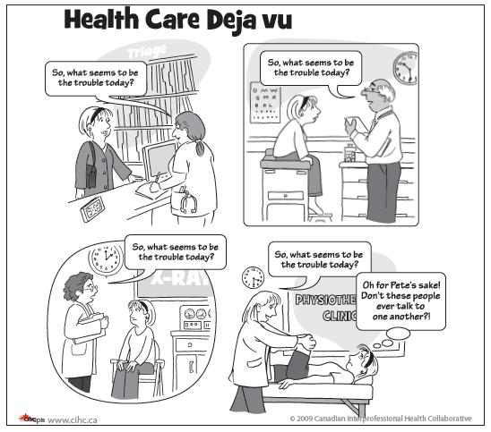
Relationships and communication can be a problem!

Slide 5
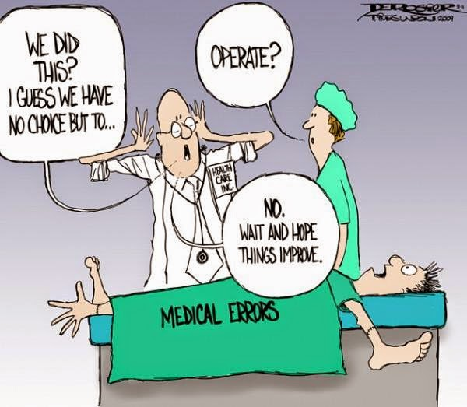
When it all goes wrong….
It’s never a joke…
Professional silos
No / poor / ineffective communication
Medical errors
Patients suffer
Staff suffer
Time and resources wasted
Frustration

Slide 6
Prescribing Safely – teaching and assessing Simulations and not real life
Knowledge
Processes
Patient
Safety
Relationships
Can teach (and assess) knowledge and processes
Relationships have to grow

Slide 7
Workshop design – prescribing safely and avoiding errors
Small groups – mixed professions – experienced and inexperienced
Staff from different professions
Three prescriptions (illustrating different prescribing issues)
Swift feedback
Safe environment
Not too difficult
Exit cross sectional
questionnaire

Slide 8
Exit questionnaire – key results
Likert scale questionnaire (9 six-point items)
Questionnaire results and analysis from 337 students over 2 years
131 MPharm students
206 NMPs
Negligible missing responses
Responses on all items heavily skewed towards more favourable options.
Most favourable option (scoring 6) most frequently chosen in all 9 items
Second most favourable option (scoring 5) was second most frequently chosen in 8 out of the 9 items.
Reported data variability correspondingly low in all domains.

Slide 9
Key workshop results-stats
In both groups of students:
Relationships domain scores higher than Process domain scores
Process domain scores higher than Knowledge domain scores
NMP students reported higher scores than MPharm students in all 3 domains
NMP mean scores 1.5 points higher in the Knowledge domain
1.1 points higher in the Process domain
0.4 points higher in the Relationships domain.

Slide 10
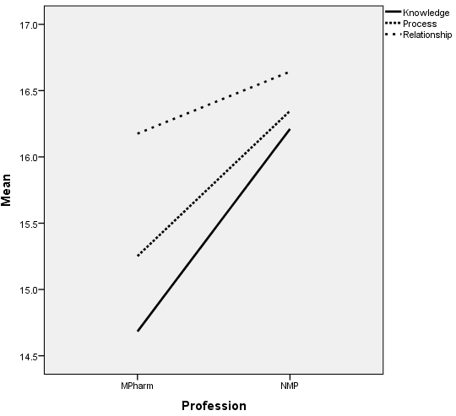
Key workshop results
Domain | Mean (SD) participant scores
 | MPharm | NMP | All
Knowledge | 14.7 (2.23) | 16.2 (2.25) | 15.6 (2.36)
Process | 15.3 (1.99) | 16.4 (2.07) | 15.9 (2.11)
Relationships | 16.2 (2.05) | 16.6 (2.12) | 16.5 (2.10)

Slide 11
Key workshop results-stats
All outcome measures mutually correlated.
Correlation pattern → multivariate treatment of data required
Multivariate analysis → student status significantly associated with a linear combination of outcome measures (p<0.001)
Effect low-to-moderate in magnitude (partial-η²=0.146).
Follow-up univariate analyses → between-group differences existed in all three domains
p<0.001 for Knowledge; p<0.001 for Process; p=0.046 for Relationships.
Effects were small (partial-η²=0.100 or less for each domain)

Slide 12
Interpretation (1)-stats
All students valued the workshop highly,
Relationships valued most highly; Process slightly less so and Knowledge slightly less still.
Student groups are significantly different from each other
“Significance” relates to the strength of the evidence for a difference, not the magnitude of the actual differences
Group effects actually quite small in magnitude
Small effect sizes may be due in part to consistently very high scores recorded overall: little room for improvement!

Slide 13
Relationships and Process
In terms of relationships and process both sets of students reported positively about undertaking such workshops and their value to their learning
‘Working alongside pharmacy students was very useful as they approach prescribing from a different angle’ (NMP)
‘It was good with a group discussion after each script allowing an insight into different views’ (NMP)
And specifically the session structure was
‘designed well was able to interact with NMPs’ (pharmacy)’
In terms of learning pharmacy students enjoyed particular aspects of learning together
‘It was good to see how different professions view prescribing and prescriptions’ (pharmacy)

Slide 14
Knowledge
In terms of knowledge as with the statistical scores both sets of students overall valued the workshop:
‘Better understanding of how others (NMP) work’
‘Yes I now have an understanding of other professions’ knowledge’ (pharmacy)
However there was certainly a variance as to the value of knowledge gained

Slide 15
Knowledge –Variance (1)
One pharmacy student commented about the content of the session was:
‘Somewhat like a revision session, went through stuff we already knew’
This was further echoed but with a student able to see the benefit for them as a pharmacist
‘I felt more as a pharmacy student that I was teaching more than learning, but this helped to identify areas of knowledge that needs work but also made me more confident that I have a lot of knowledge’

Slide 16
Knowledge –Variance (2)
NMP students had just started their course the value of interacting with pharmacy students who have been exposed widely to drugs, how they work and the British National Formulary (BNF) the benefit was much more explicit:
‘Yes I learnt a lot from the pharmacy students about deeper issues with drugs’ (NMP)
Furthermore NMP participants clearly valued the use in the session and learning about how to use the BNF, something not stated by any pharmacy student:
‘Yes increased knowledge about the BNF layout’ (NMP)
‘Useful to talk to 4th year pharmacy students who have more knowledge on the drug and BNF’ (NMP)
Thus how this contributed to their future role:
‘Yes increased knowledge about writing prescriptions’ (NMP)

Slide 17
Knowledge, process and relationships
The students gave an insight into why the supported their understanding of the process of prescribing, facilitated a working relationship and developed their knowledge of the therapeutic use of medicines.
Pharmacy students
‘We worked as a team’ and ‘it was nice to learn things from each other’ and about the workshop outcome ‘went very well, was able to get along and discuss options easily’
NMP students
‘Good example of MDT (multidisciplinary team) working, good as we could learn from each other’s skills’ and ‘good much more useful than theory’
Both groups of students felt positive about the session
‘Very interactive’ (Pharmacy) and ‘enjoyable, fun and informative’ (NMP)

Slide 18
Ways to improve – student feedback
We asked participants about how to improve the content
‘Need to include inpatient charts, one example could be an inpatient scenario’ (NMP)
Hospital drug charts rather than FP10s (pharmacy)
Or more inclusive of specific fields of practice:
‘Include a child example’ (NMP)
Comments received also indicated a desire for more rather than less of these sessions.
‘More of these sessions, very interesting and assist learning, more than lectures with regard to Pharmacology’ (NMP)

Slide 19
Contribution to Knowledge
Only workshop that included undergraduate/preregistration pharmacy and post graduate/post registration NMP students
Knowledge, process and relationship determinants, how they interact and how we can plan sessions to facilitate a transfer to clinical practice and safe prescribing
Both sets of students will have a key role in ensuring the safe supply of medicines within their own clinical environment.
Our workshop shows a clinically based content enhances the learning of the student and fosters inter-professional understanding of each others roles.
Such workshops that are meaningful but also enjoyable are more likely to transfer to the day to day working (real life) of the prospective professionals
Evidence of some growth in professional relationships for students in clinical practice

Slide 20
Contribution to knowledge-literature
Inter-professional working in terms of effective relationships to provide an outcome that is inherently safer than one achieved by professionals working in isolation (Abu-Rish et al, 2012; Creswell et al, 2013).
The primary aim was to support the relationships between professional groups a concept championed as a major facilitator for patient safety (Lawlis et al, 2014; Wilson et al, 2016).
Mirrors the positive results from previous studies supporting the value of students learning together as a social element (roles and responsibilities) (Courteney et al, 2013; Paterson et al 2015) and as a determinant of future safe practice (Achike, et al, 2014; Thom et al, 2016; Wibur and Kelly, 2016)
Small groups enabled all the students to interact in comfort and to contribute to the problem-solving, which we anticipate will create an expectation that working together is a strength, a workshop design feature that mirrors other reported studies (Achike et al, 2014; Brock et al, 2013; Paterson et al, 2015; Hardisty et al, 2014; Brock et al, 2013).

