Slide 1
From Mann-Whitney to cognitive mapping: using ethnographic research methods to storify the data and increase library usage of international Business School students Alison Sharman University of Huddersfield @asharman
Notes:
We’d tried running focus groups with Chinese students before but felt they were telling us what they thought we wanted to hear but we wanted to find out what the students were REALLY doing so where better to turn than…

Slide 2
Background
Notes:
LIDP is a Jisc funded project that started as a collaboration between 8 universities, finding a correlation between library use and degree result attained, but as it progressed to later phases focussing on Huddersfield’s students, we learnt that international, and particularly Chinese students, were comparatively low users of the library. This table shows that generally non-UK students visited the library less, but all that red for Chinese students made us question where they were getting information from… This chart doesn’t refer to attainment as we had already proved that. If you could increase usage could you also increase attainment?
Rest of the world: numbers were too small to drill down.

Slide 3
LIDP 3
https://www.flickr.com/photos/rossyyume/7772794404/
Notes:
Next steps required targeted interventions to increase library usage (and ultimately improve student attainment and retention) and to achieve this we realised we needed to find out the story behind the data to reveal why usage was low in two Schools and amongst international students, the Chinese in particular.

Slide 4
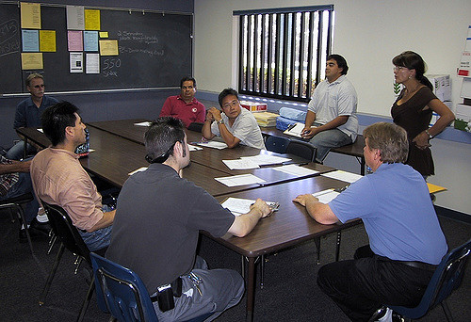
We didn’t want to listen to what students thought we wanted to hear...
https://www.flickr.com/photos/scubasteveo/296747958/
https://www.flickr.com/photos/scubasteveo/296747958/i
We wanted to find out the ‘lived experience’ of studying

Slide 5
Ethnography in libraries
Foster, N.F. and Gibbons, S.L. (2007). (Eds), Studying Students: The Undergraduate Research Project at the University of Rochester, Association of College and Research Libraries, available at: http://www.ala.org/acrl/sites/ala.org.acrl/files/content/publications/booksanddigitalresources/digital/Foster-Gibbons_cmpd.pdf “What do students really do when they write their research papers?”
Asher, A. and Miller, S. A (2011). So you want to do anthropology in your library or A Practical Guide to Ethnographic Research in Academic Libraries. http://www.erialproject.org/publications/toolkit/
Ramsden, B (2016). Ethnographic methods in academic libraries: A review. New Review of Academic Librarianship, 22 (4). pp. 355-369.
UXLibs: http://uxlib.org/
Notes:
Ethnography is the study of cultures/practices, normally in their own environment, and stems from anthropology, using a variety of methods including observation, in-depth qualitative interviews, and more. It’s about telling the stories of the people you are working with or studying. The methods are becoming more commonly used in libraries now, with key pieces of research from the US kicking things off a bit.

Slide 6
UX Research Group endorsed by Senior Management
Notes:
At University of Huddersfield awareness of ethnographic research in libraries has been slowly growing and a UX research group endorsed by the Senior Management team has been established

Slide 7
Retrospective process interviews
Cognitive mapping
https://www.flickr.com/photos/kevinl8888/3568123204/
Notes:
The methods of cognitive mapping and retrospective process interviews were chosen because the outcomes are driven by what participants produce themselves without questions from the researcher. What the participant produces form the basis of subsequent conversation. These methods ensure that the participants’ experience and meaning making is at the centre of the research and frames the data produced in the interview. We interviewed 8 students – mixture of Chinese, Iraq, Thailand, Morroco and Vietnam.

Slide 8
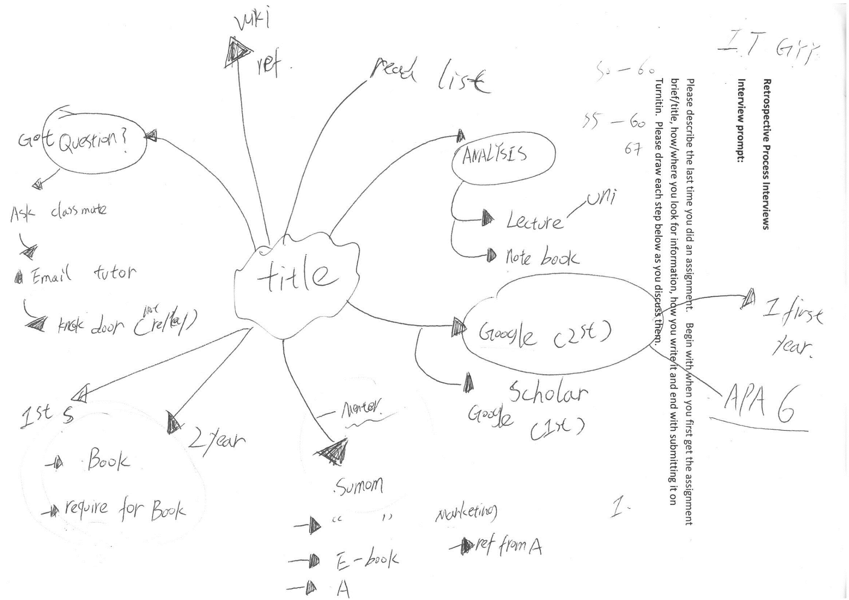
Notes:
Get them to draw the process. They then explain it and I ask them questions which I created after we got the survey results.
Ask classmates then tutor for help
First year: used Google and then tutor told him he needed to use more academic sources and reference them using APA6th
Second year he started using Books and then he found them too heavy to carry so in the third year he started using Summon to find journal articles and eBooks. He reckons Summon is powerful but said he struggled to use it in his first two years. It’s only now when he has some more experience that he has got to grips with it. His grades have gone up in his three years. First year he got 45-55, second year 50-60 then 55-60 for third year. Even got a 67

Slide 9
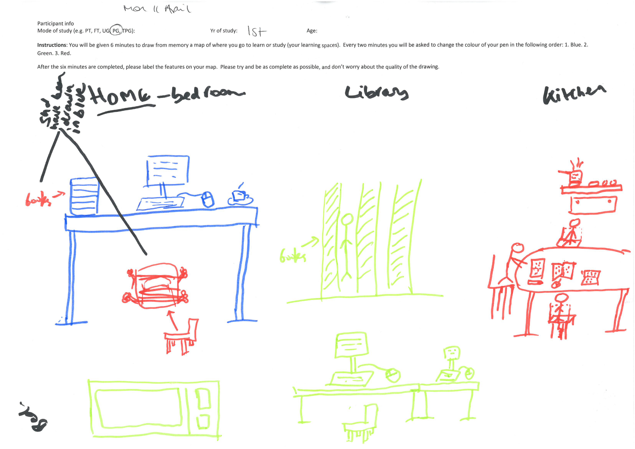
Notes:
Used the Library as book warehouse

Slide 10
Main Findings

Slide 11
…with this number on the row I don’t know how to use it properly it take me times I really don’t know how to use it so if the library they show students especially International Students or they make guidelines on how to use it properly because it took me time to find a book with a number and name with 3 letters so many times I think more that 3 times I ask them [student helpers working on Floor 3] to help find me a book because it’s hard for me...they just take me there and they take it and that’s it
Notes:
He has asked for help but the person helping him would just go and get the book for him without showing him to do it for himself.

Slide 12
Online library
“The online library we don’t have this so it is easy for us to search the materials, the books”
Notes:
One student said where he came from you have card catalogues for books and you just pass the card to the librarian to retrieve it. Generally the students had a positive view of Summon – they have access to lots of content for free and it makes referencing easier. Used resources outside of Summon such as FAME, Mintel and Business Source but it wasn’t clear how they found out about them. They certainly weren’t aware of the subject guides created by their librarians. Many students did use Google but were aware of the differences between the quality of information they can find using Google Scholar. Worryingly some students were being asked to pay for articles and struggled to work out how to locate them for free.

Slide 13
Help and support
So these are the steps I follow to write my assignments. I started by reading the assignment brief, decorticate it so I can understand the components I will have to tackle. And then I try to define a structure. I went to my tutor to have some advice, to confirm the structure I have written. And then I start reading.
Sometimes I ask classmates. Communication on Facebook – we share the data or I might ask where did you find this data and he or she will recommend a book or chapter maybe.
Notes:
The Tutors played a central role in supporting students with their studies. Help from peers was also important although one Chinese student outlined that the help he would receive from other Chinese students would vary from the help he received from the UK students. The Chinese students would give him the exact answer whereas the UK students would refer him to a particular chapter in a book

Slide 14
Did you know you can ask for research help from a librarian?
Really? How could that be? [Said in a very surprised way!] Maybe I’m a final student so the first [sic] students might ask a question on how to find information.

Slide 15
Night time study
Different attitudes to studying at night:
Interviewee 8 “if you spend all night for study the second day you feel tired for lectures.” Brain processing is “just 50%”.
Interviewee 7 works until 6am “Yes it’s more efficient for me. There is more room and I can use the group areas of this floor [6] and there is space for my friends”.
Interviewee 4 “you can say I’m night owl. I don’t like studying during the day so usually I work at the night and usually from 7pm to 8pm to 2am 3am sometimes until 6am…and then I sleep until maybe 12…this is my life, this is my nature.”

Slide 16
Space/use of space
Home was a favourite place to study
Didn’t have to change their clothes
Can go to bed if feeling sleepy
Ready access to food and drink
Can dance
Can’t concentrate in the library
Library seen as a book storage warehouse/bookable meeting space/social study space
Notes:
A contrast between students. Some students felt uncomfortable in the library – it wasn’t their space. Others like the buzz of working with other students.

Slide 17
Struggle adapting to the UK Academic way of writing
...tutor says you have to paraphrase the paragraph and change your structure and you have to put the name, authors name and year – phew!
He [tutor] highlighted that I should have more statistics to support my report. And I think as many Chinese students do, my report is too descriptive so he suggested that I should justify the statistics
I don’t know how they mark it’s not my business
Notes:
Many students experienced difficulties adapting to the academic way of writing in the UK, in particularly having to engage with critical thinking and referencing their work,.

Slide 18
Future plans

Slide 19
Recommendations
Promote role of Librarian: research support
Observations of students using/getting to Summon
Refocus information literacy training to emphasise that using references is not about quantity, but about demonstrating appropriate appraisal of scholarly reading
Training for students on navigating Dewey and also for staff on how best to help students
Allow eating and drinking in the Library
Purchase lockers/enable students to have storage spaces within the Library

Slide 20
Finally...
Conduct further research with UK students to find out how their experiences compare with their international peers

Slide 21
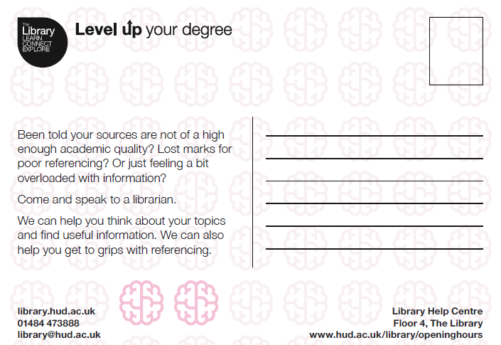

Slide 22
Find out more...
Ramsden, Bryony (2017) Using ethnographic methods in international student UX research. In: Mercian Collaboration Staff Development Day, 23rd March 2017, Warwick, UK. http://eprints.hud.ac.uk/31637/
Sharman, A. (2017) Using ethnographic research techniques to find out the story behind international student library usage in the Library Impact Data Project. Library Management, 38 (1). pp. 2-10.
Stone, G., Sharman, A., Dunn, P., and Woods, L. (2015) Increasing the Impact: Building on the Library Impact Data Project. Journal of Academic Librarianship, 41 (4). pp. 517-520.

Slide 23
Thanks also to…
The CLS UX Research Group
Jess Haigh: @BookElfLeeds
Kathrine Jensen: @kshjensen
Bryony Ramsden: @librarygirlknit

Slide 24
https://www.flickr.com/photos/84568447@N00/2123376519/

