Slide 1

Heritage Quay and the RFL archive
David Smith
Participation and Engagement Officer
University of Huddersfield Archives

Slide 2
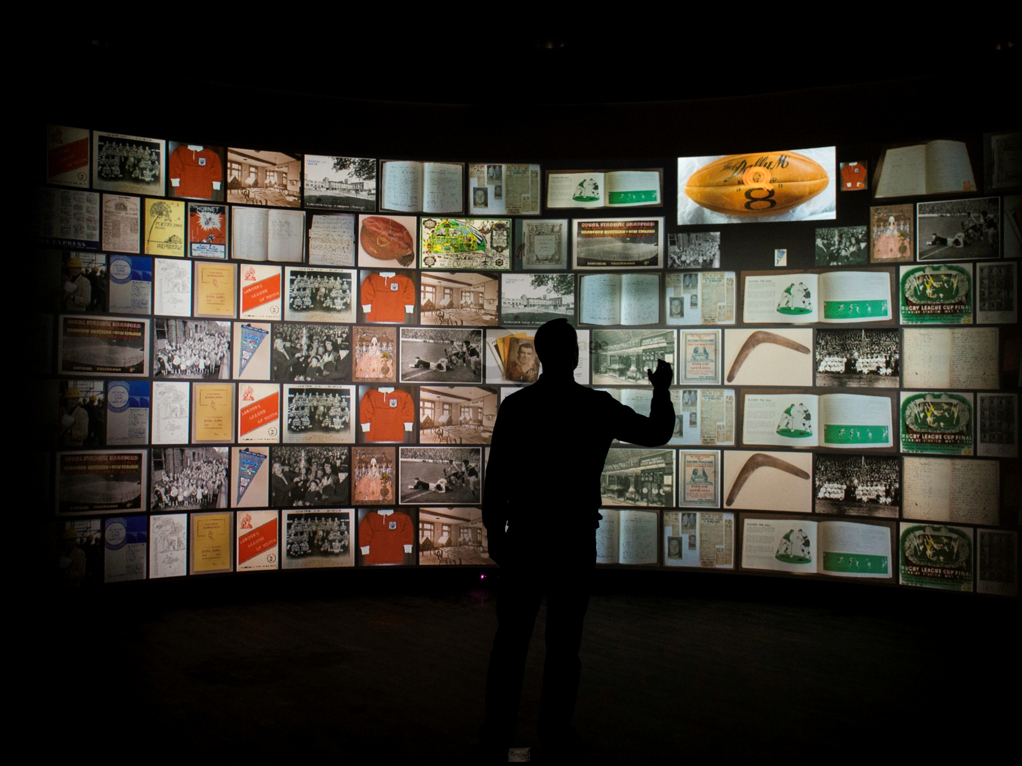
What is Heritage Quay?

Slide 3
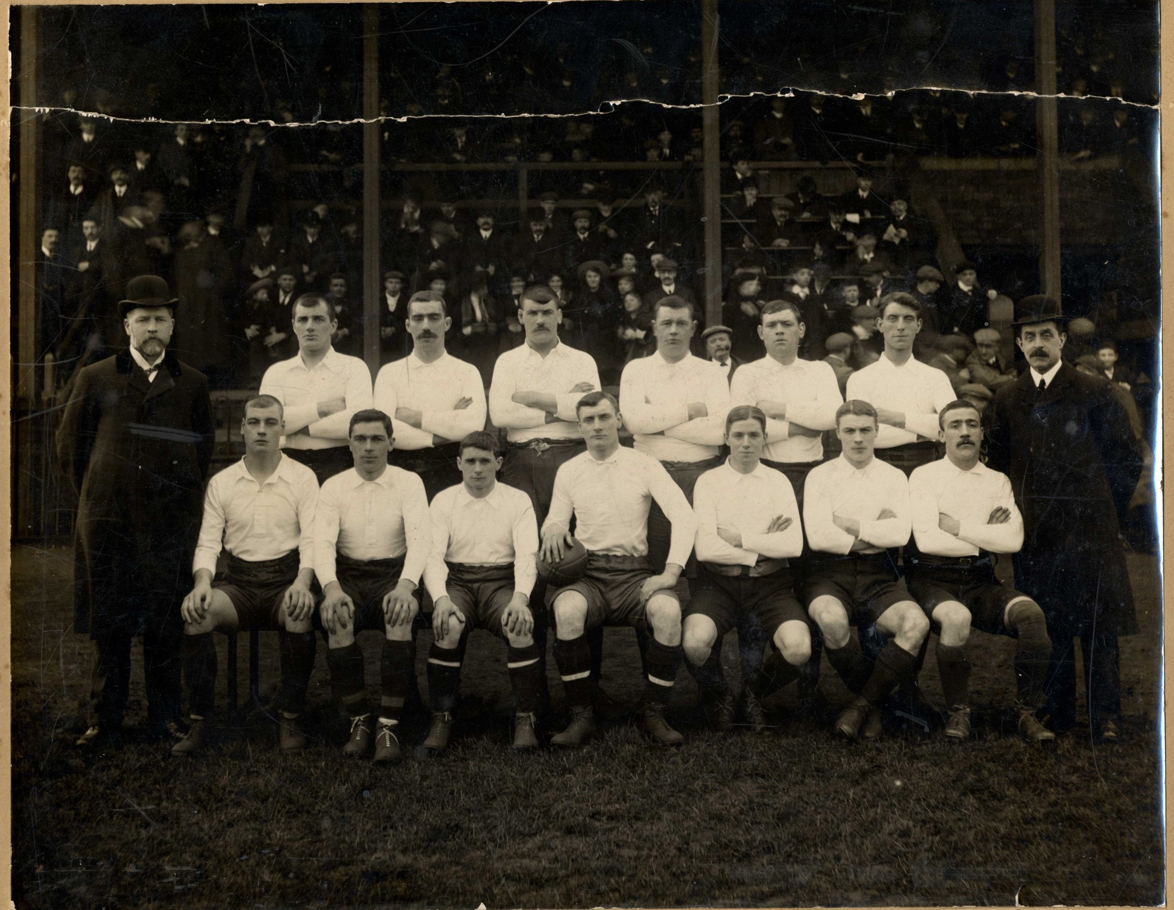
The RFL archive

Slide 4
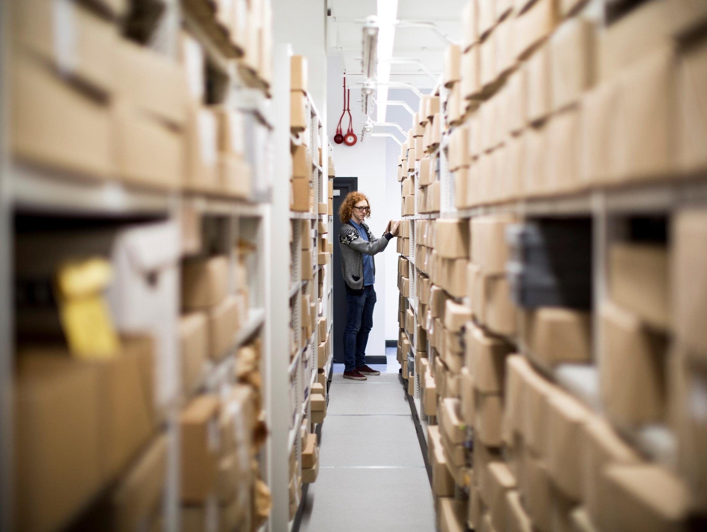
What are we doing with it? Cataloguing, researchers and volunteers

Slide 5
Building a sense of community
The home of rugby league history
Heritage Forums and skills sharing
The shadow of the George

Slide 6
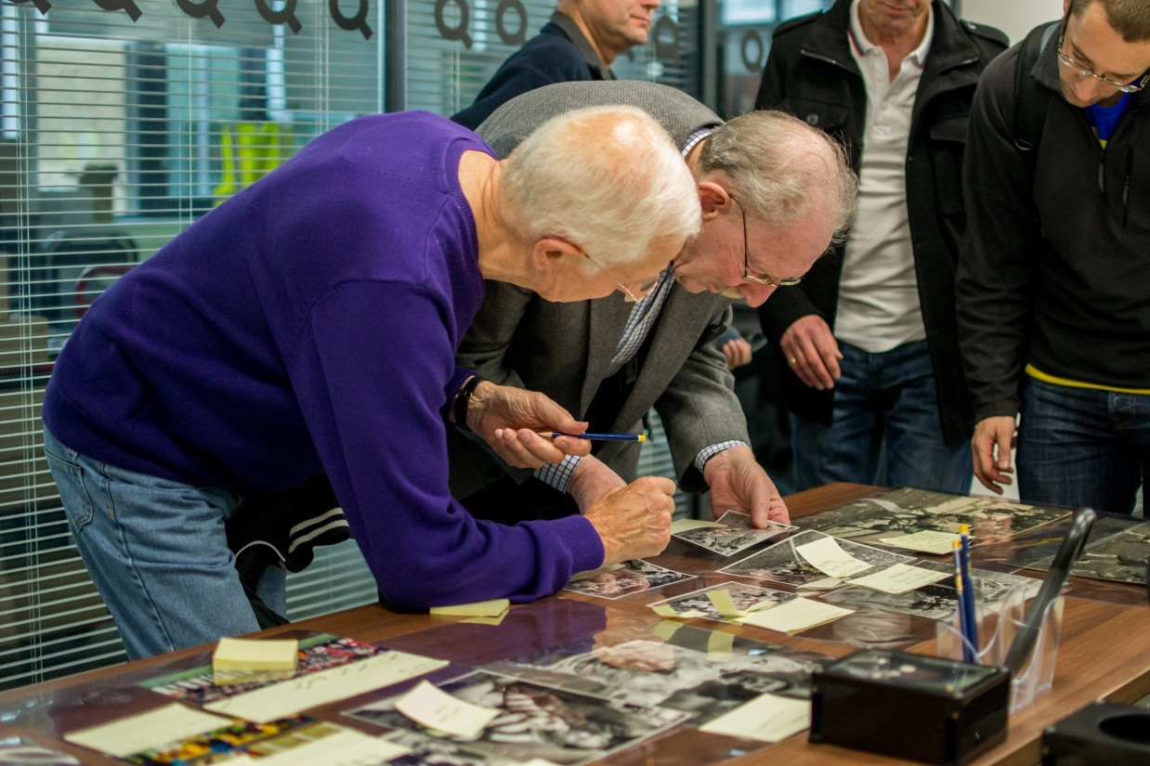
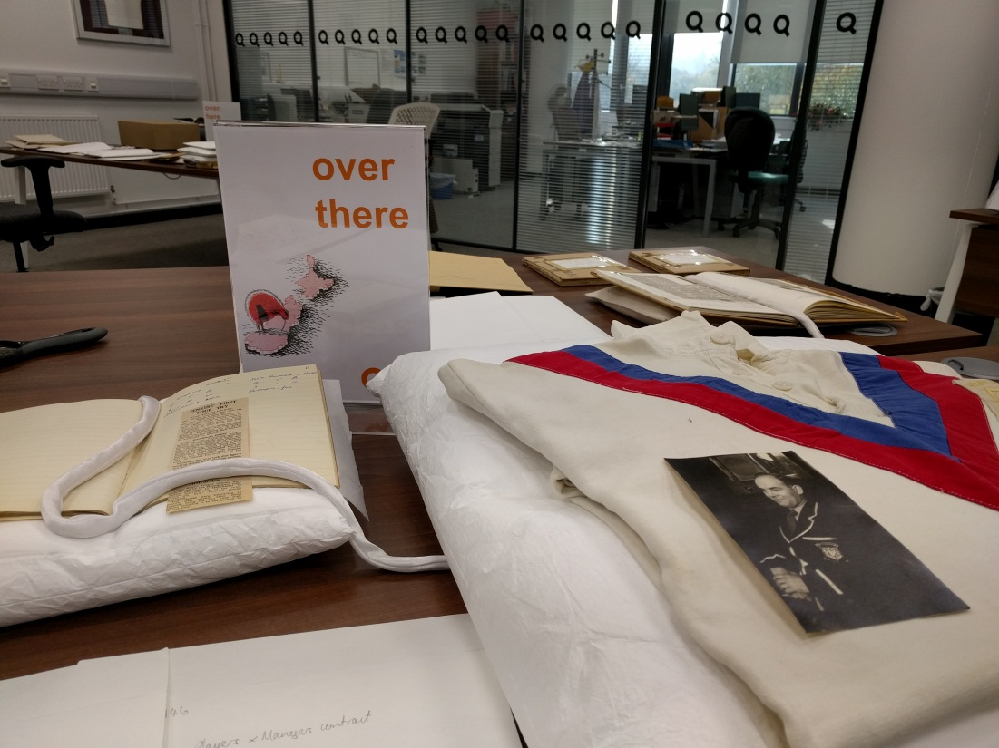
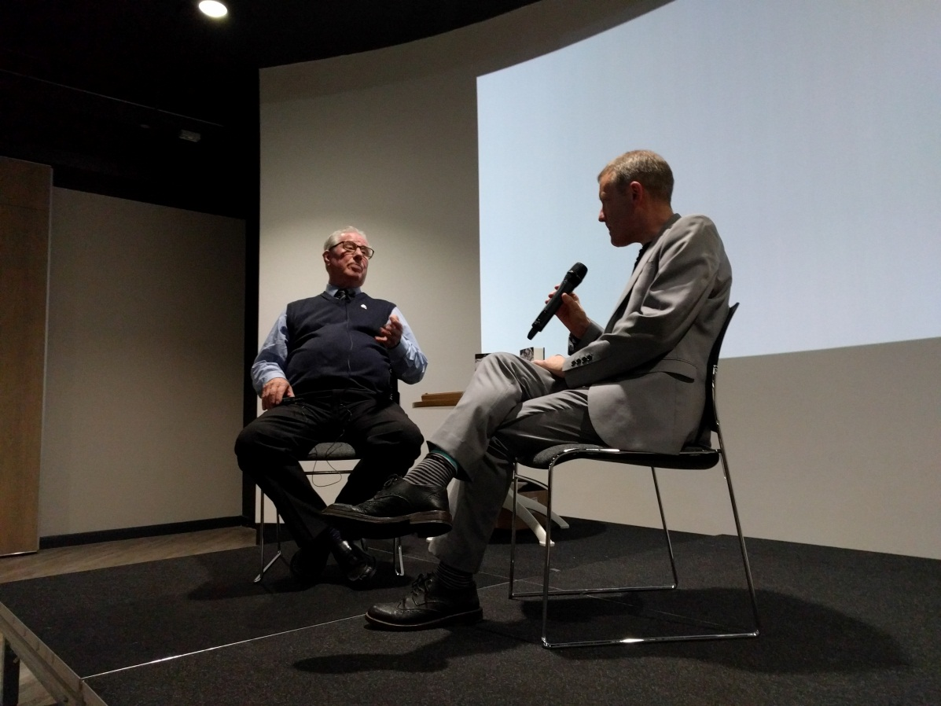
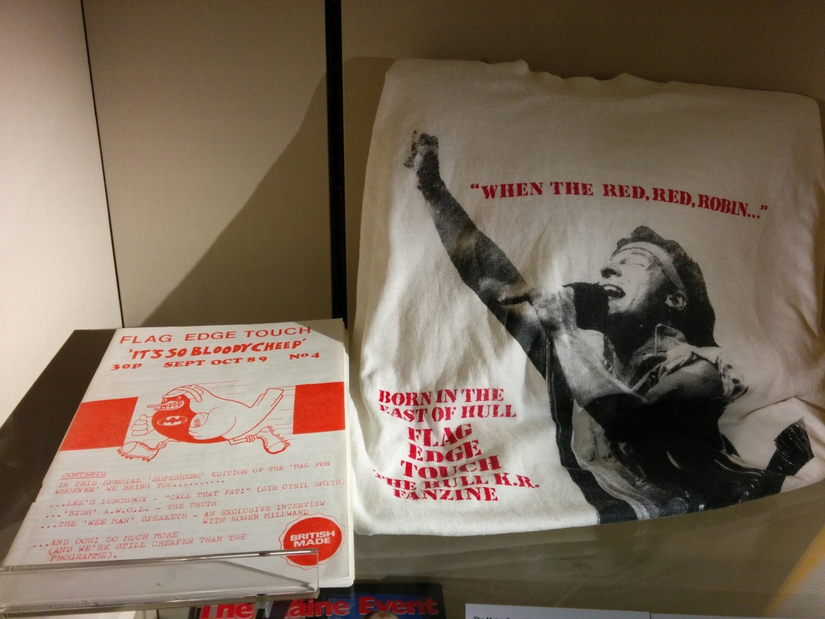
What are we doing with it?
Co-produced events programme

Slide 7
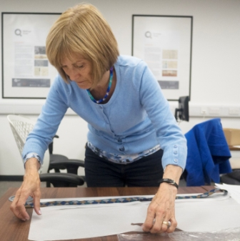
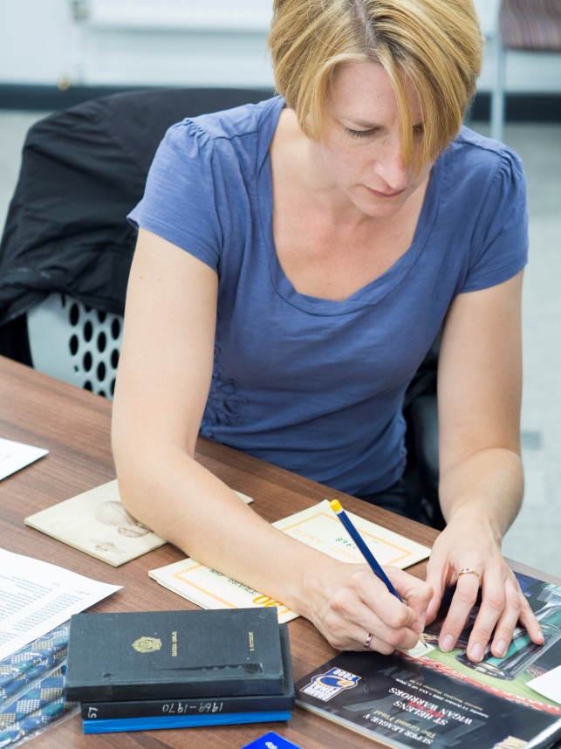
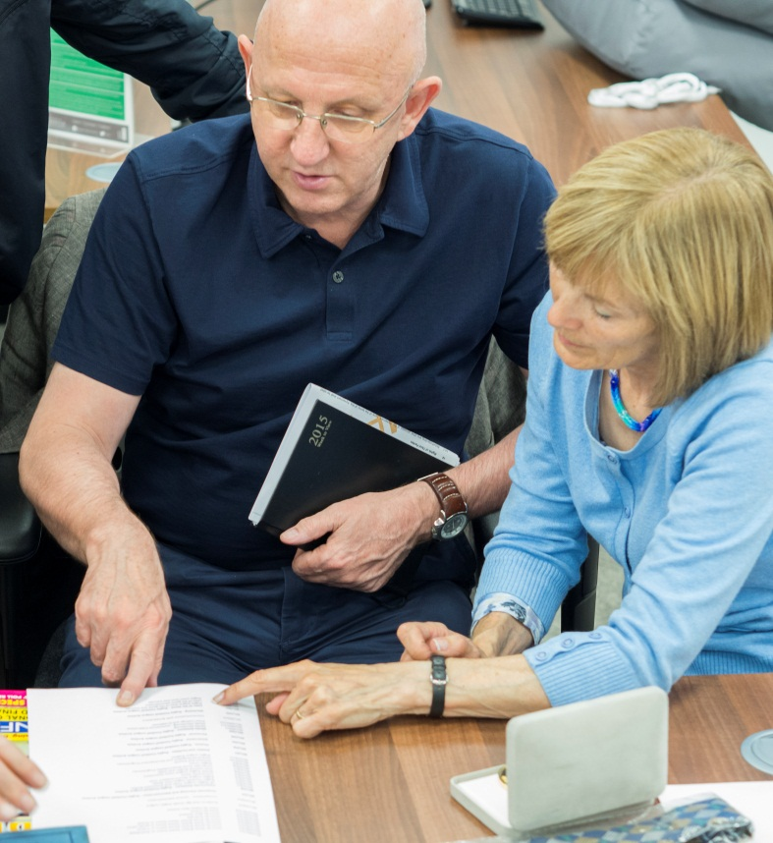
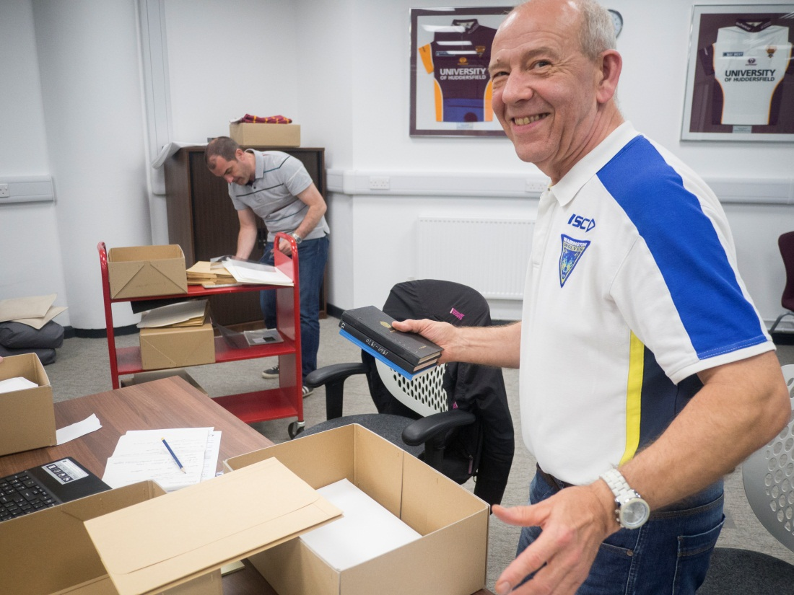
What are we doing with it?
Adult learning and training

Slide 8
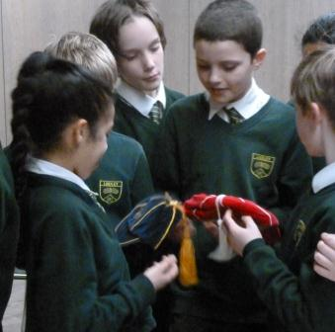
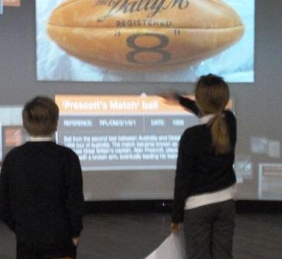
What are we doing with it?
Schools

Slide 9
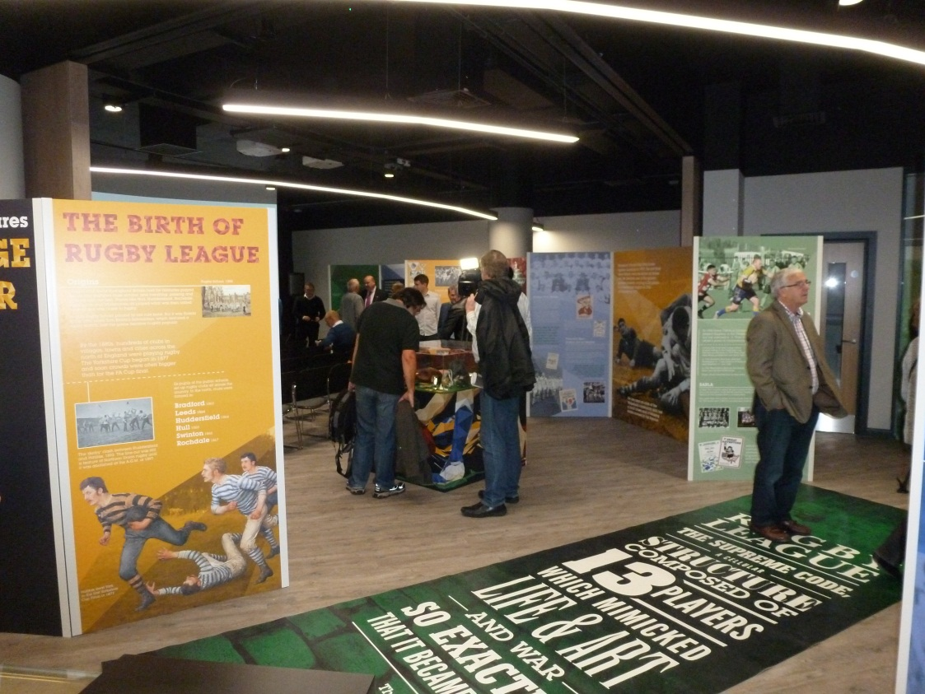
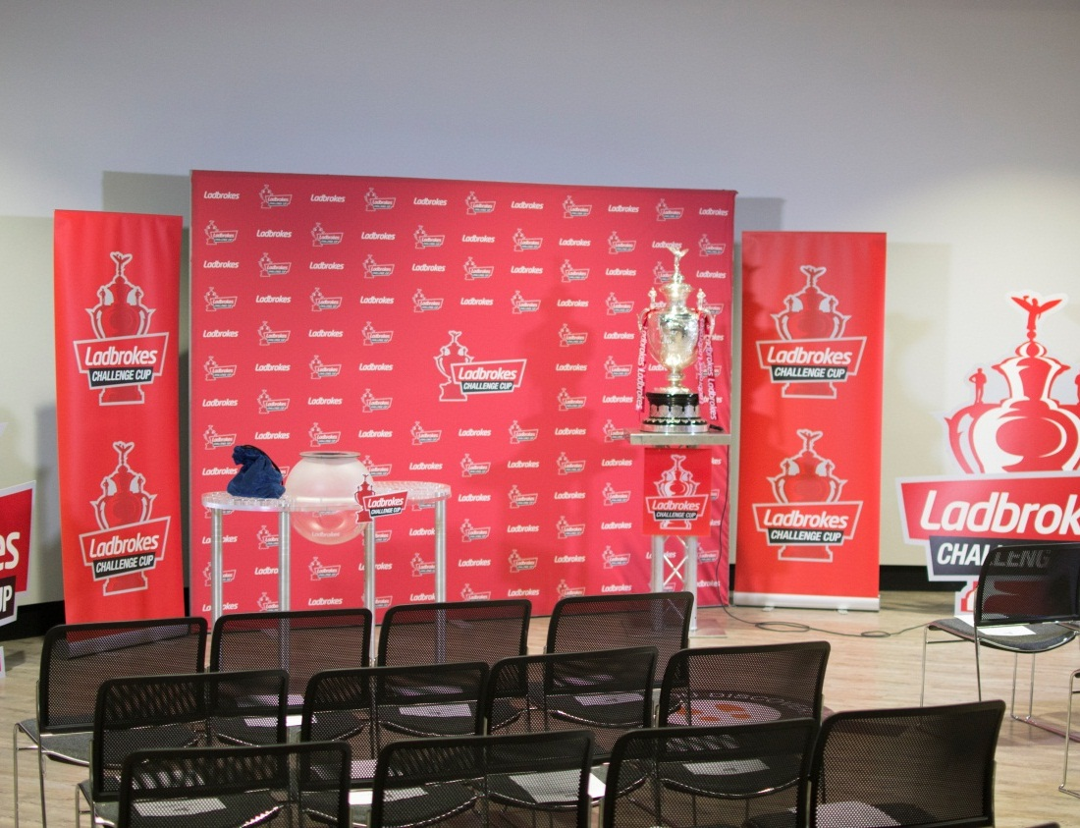
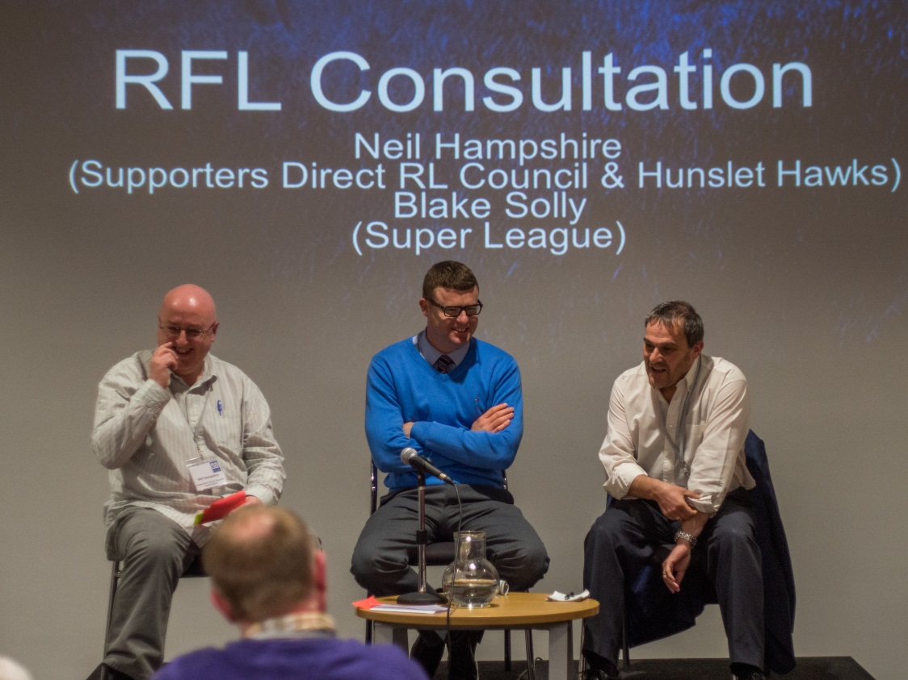
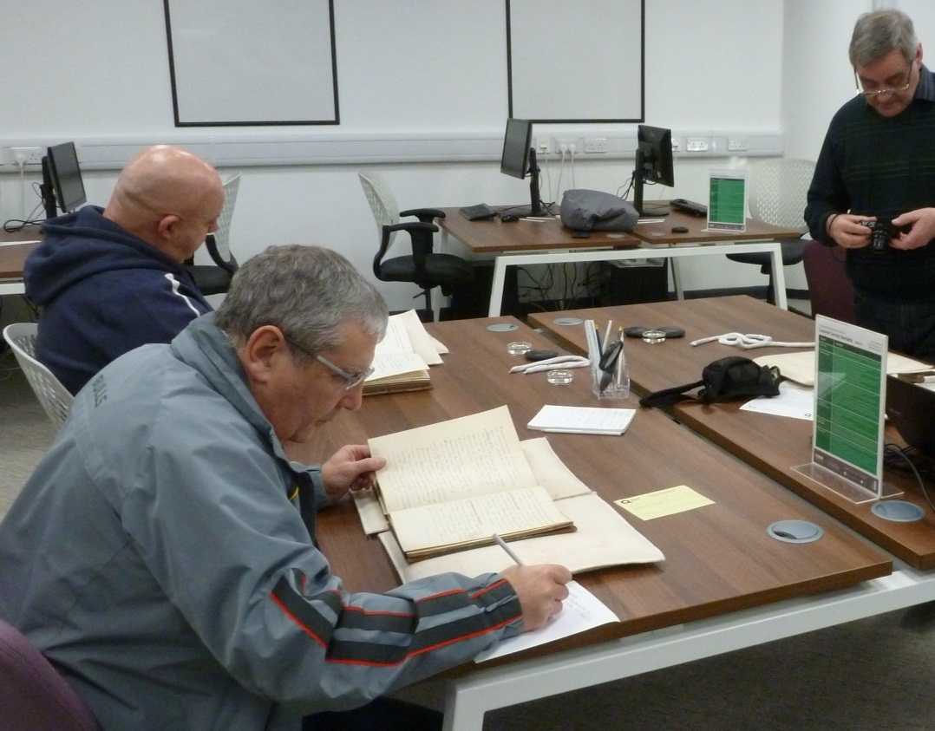
What are we doing with it? Partnership

Slide 10
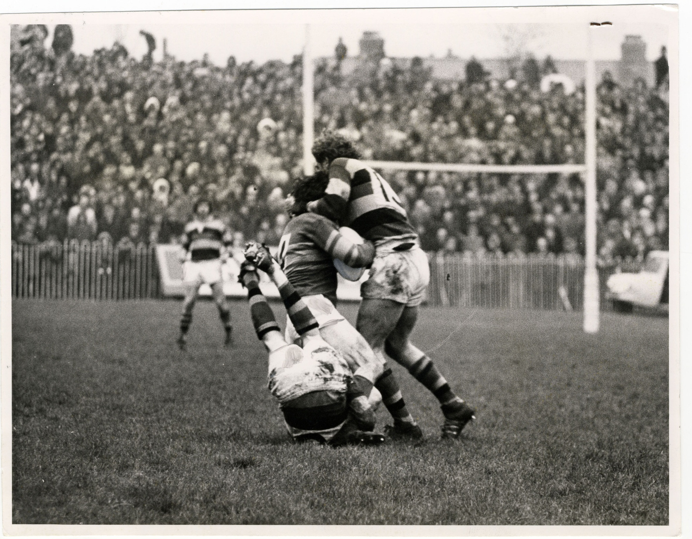
Impact!

Slide 11
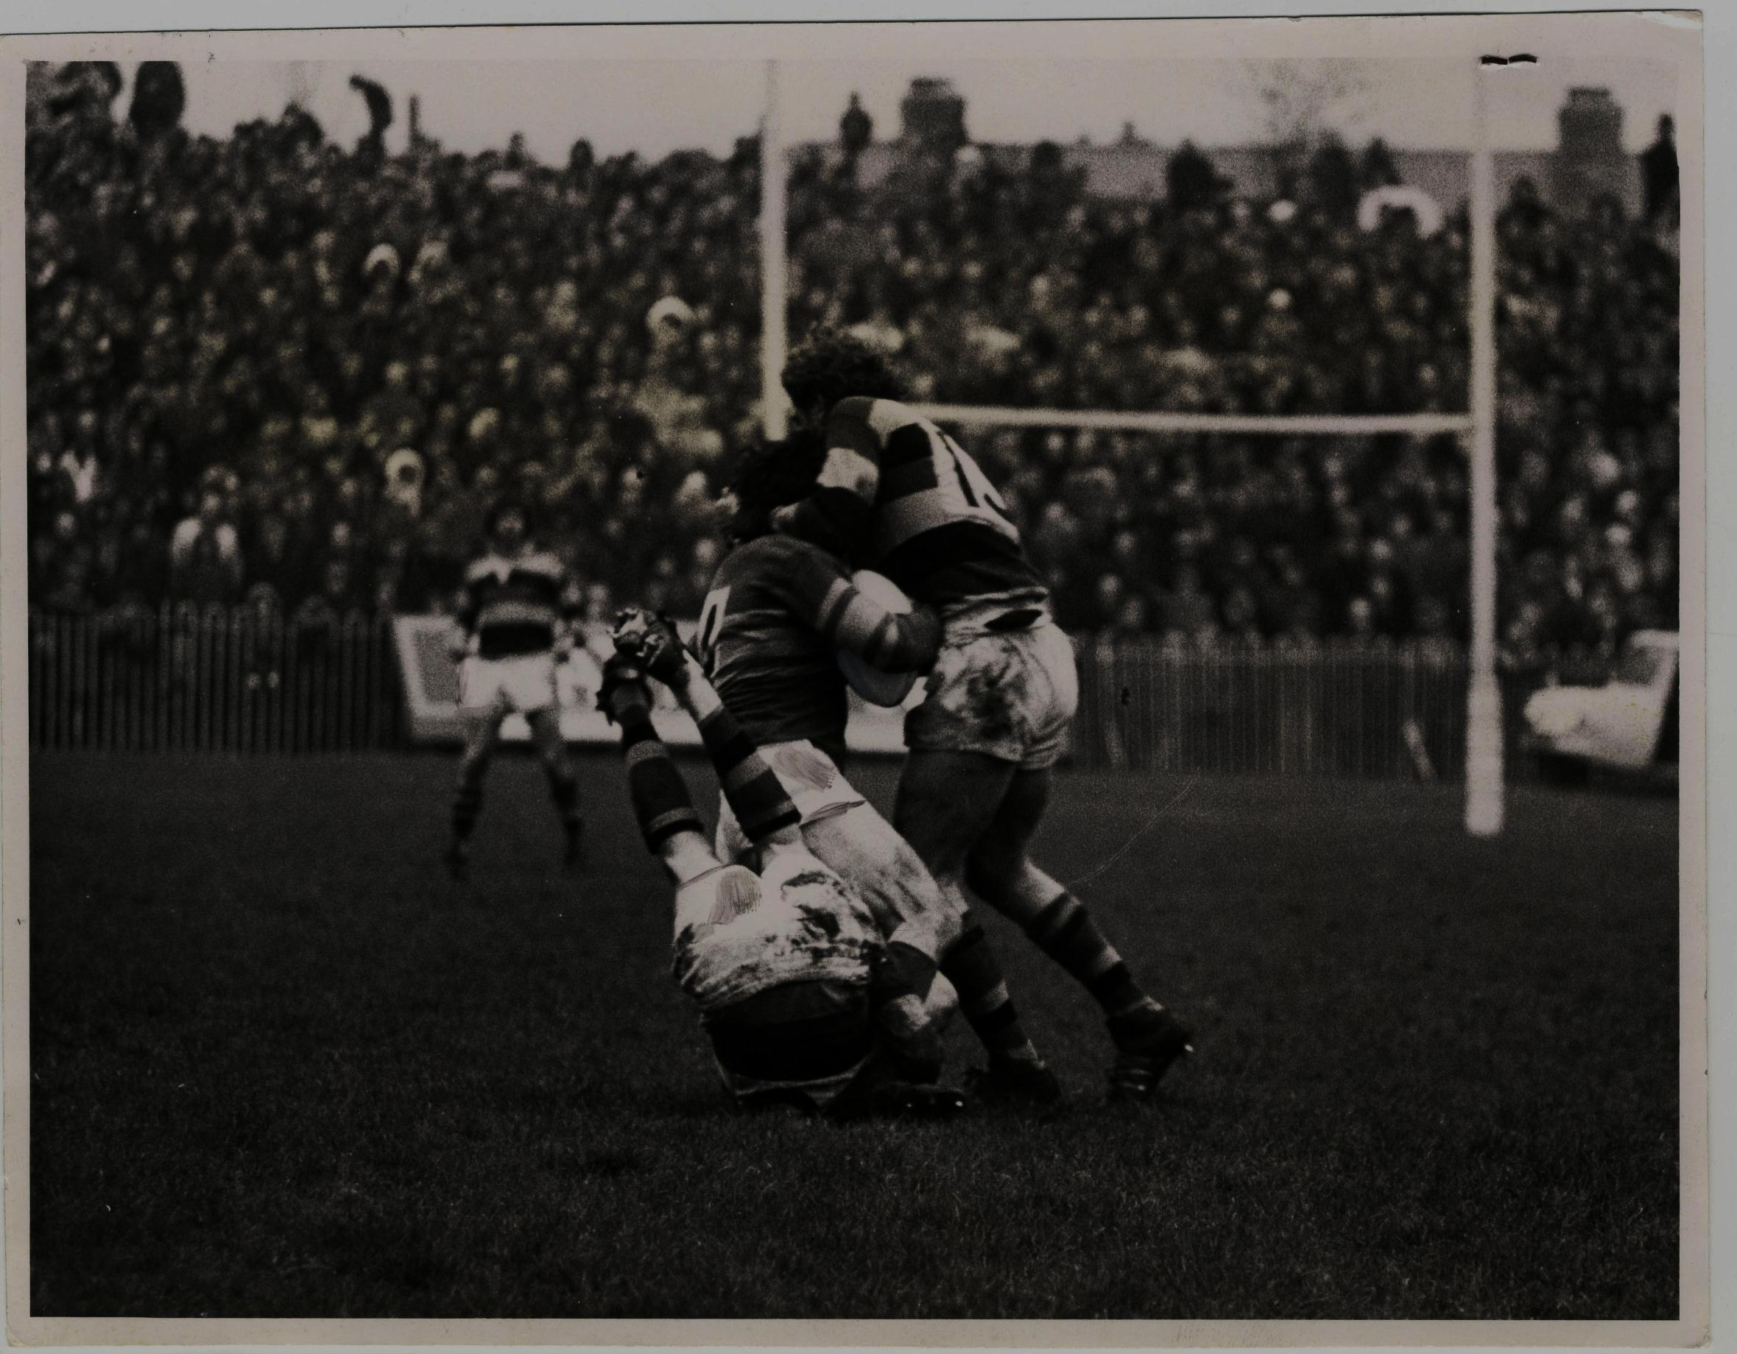
Impact!
Around 500 visits for a Rugby League event or workshop so far
Photo IDing – 684 images with more information
New Collections deposited by event attenders

Slide 12
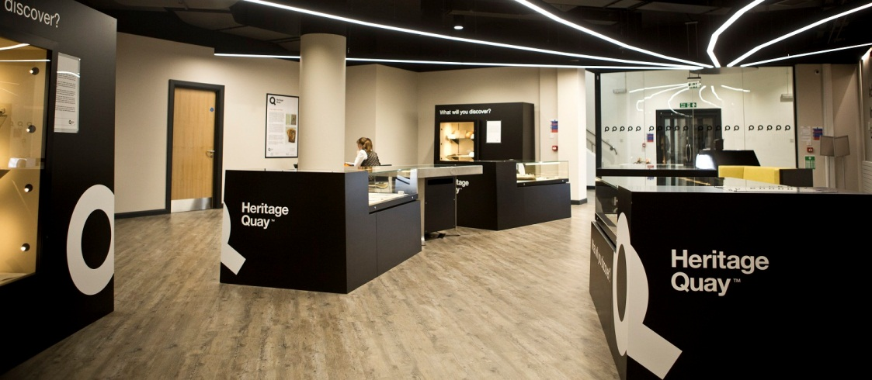

Future plans
More events to come
Appealing to the broader RL fanbase

Slide 13
Any Questions?

