Slide 1
Second Skin An investigation into the production of contoured patterns via mould making. Liz Garland

Slide 2
The aims of this research is to investigate:
The effectiveness of the Second Skin process to produce accurate patterns for contoured garments and for clothing that manipulates the body without requiring fitting.
The potential usefulness of the process within the costume industry.
The development of the process as a teaching aid to enhance the understanding of pattern cutting.

Slide 3
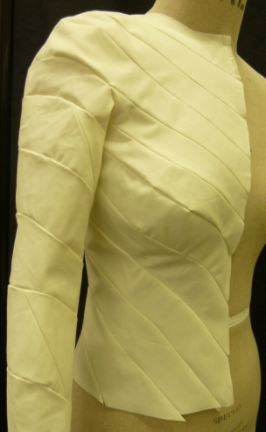
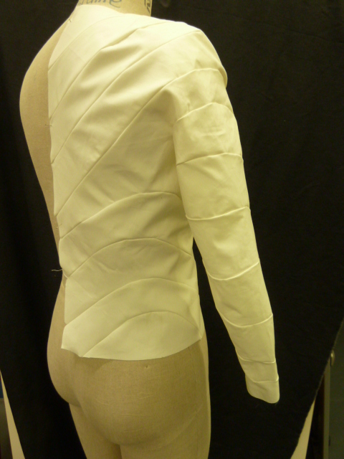
The basic mould is made by covering the body with cling film and then masking tape. The seam lines are then drawn directly on the body.

Slide 4
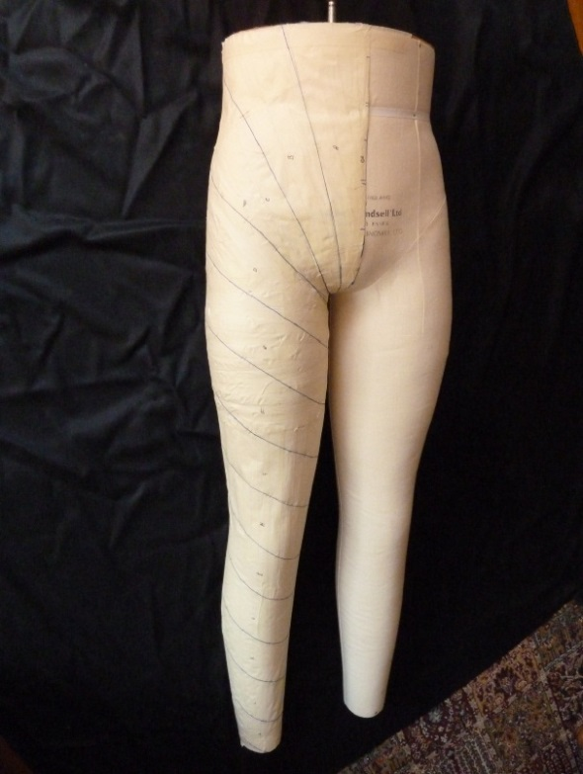
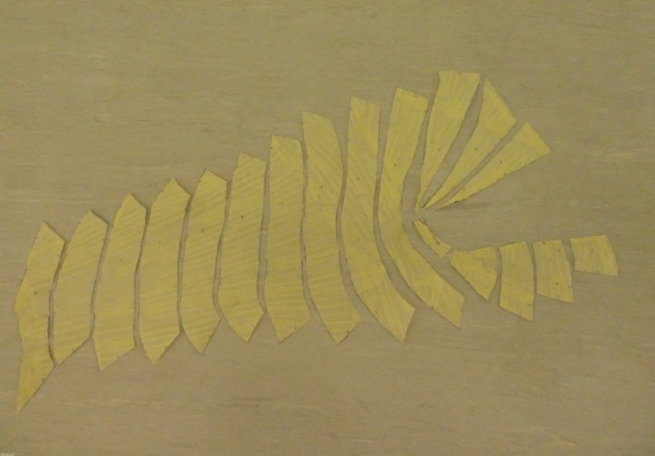
The mould is cut up to produce the pattern.

Slide 5
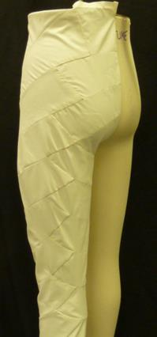
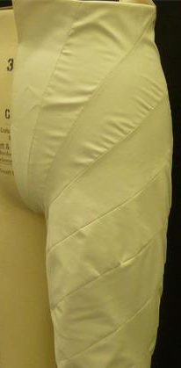
Accurately achieving patterns that fit close to the body

Slide 6
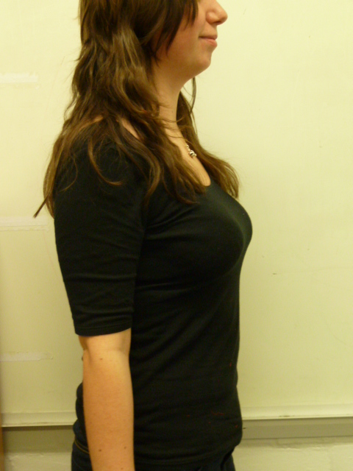
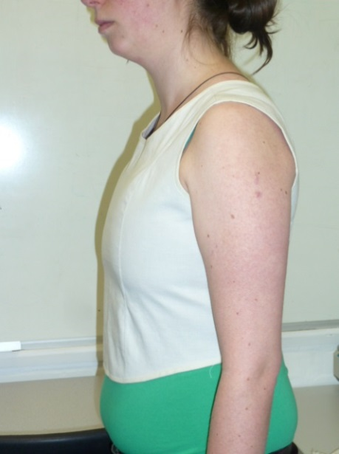
Experiments explored the techniques ability to manipulate the body shape.

Slide 7
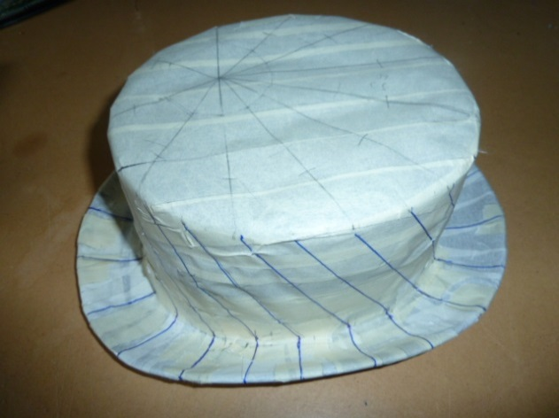
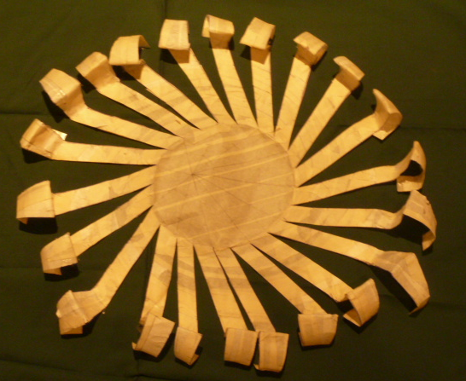
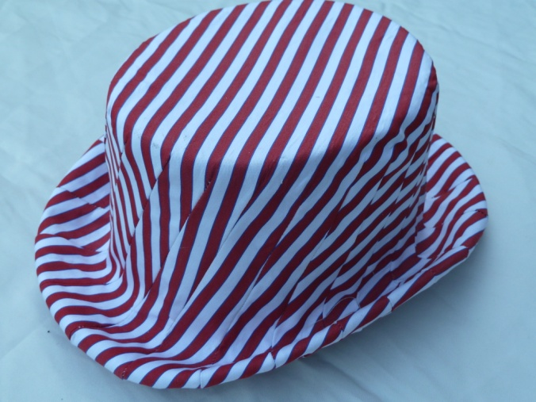
This method enabled the production of complicated patterns.

Slide 8
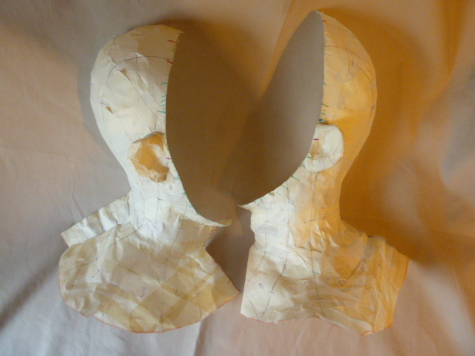
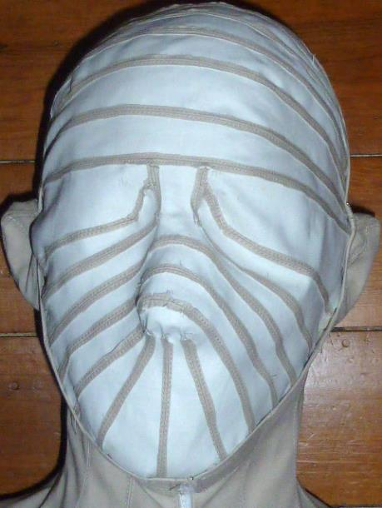
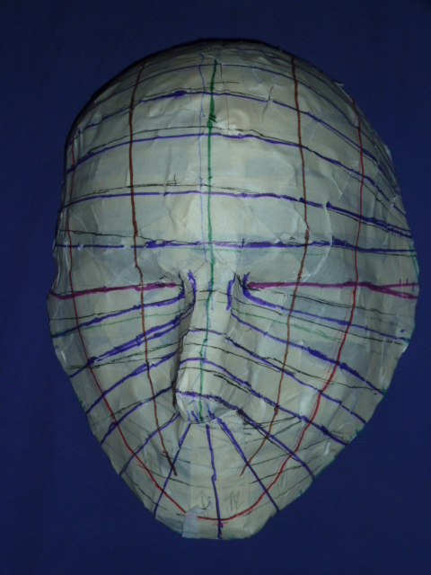
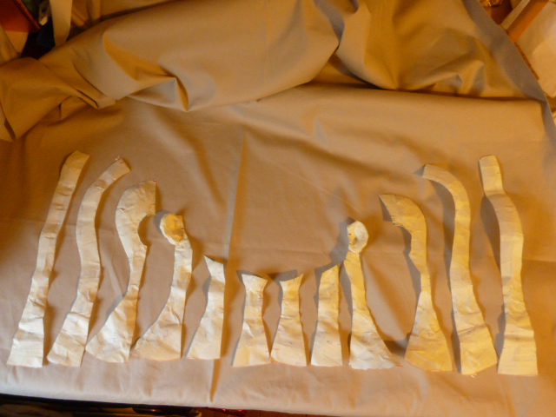

Slide 9
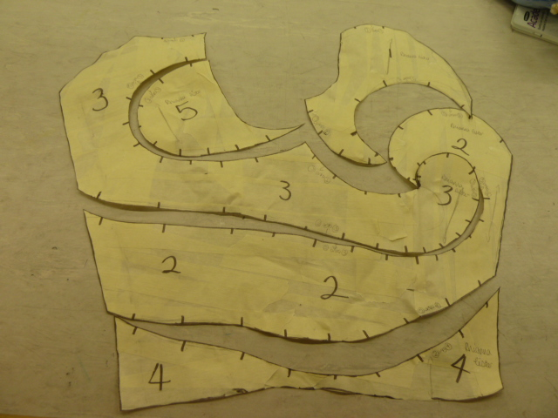
The second skin technique enabled students with limited experience to develop creative style lines and enhance their understanding of pattern construction.

Slide 10
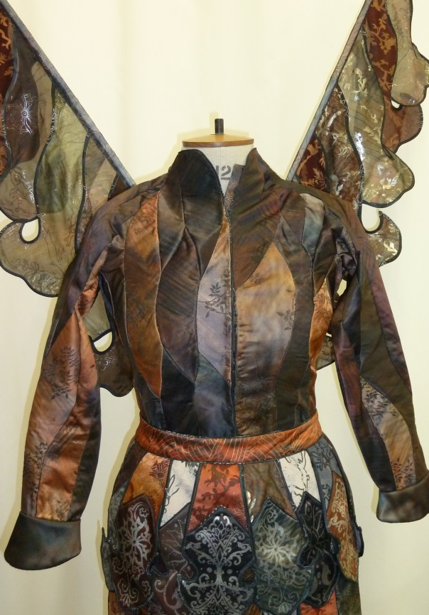
Students from Costume with Textiles Degree course utilised the technique in costume production

