Slide 1
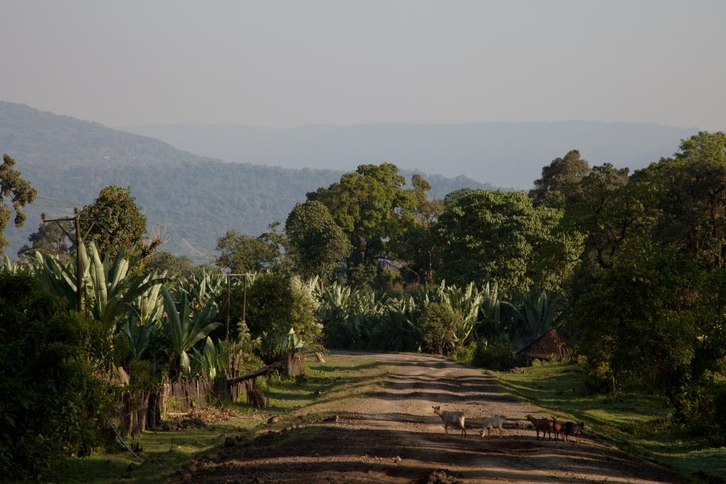
Wild Coffee Conservation in SW Ethiopia
Professor Adrian Wood, Dr Motuma Tolera, Peter O’Hara and Dr Mulugeta Lemenih
Business School, University of Huddersfield, UK

Slide 2
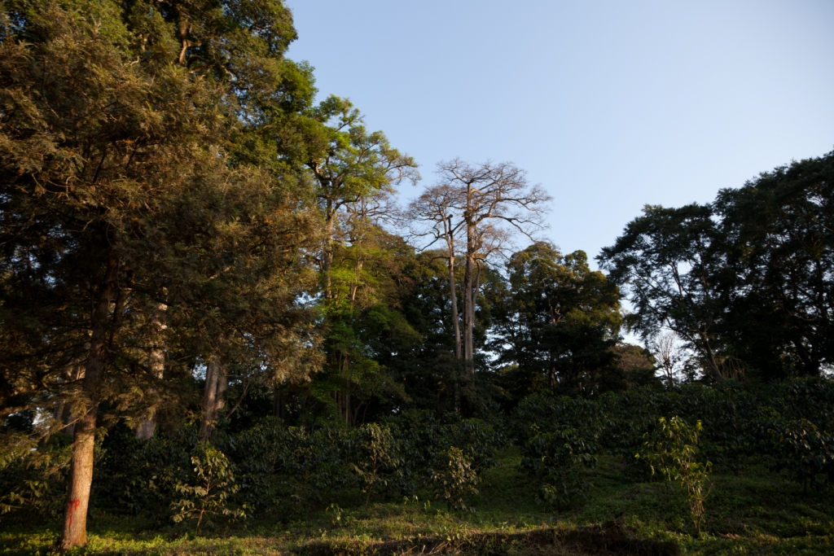
Wild Coffee & SW Ethiopian Forests
Arabica coffee grows wild in forests of SW Ethiopia – 900-1800m
Global gene pool
Mostly secondary forest
60% canopy preference of coffee
Also transplanted wild plants “coffee forest”
Two gene pools natural forest & “coffee forest”

Slide 3
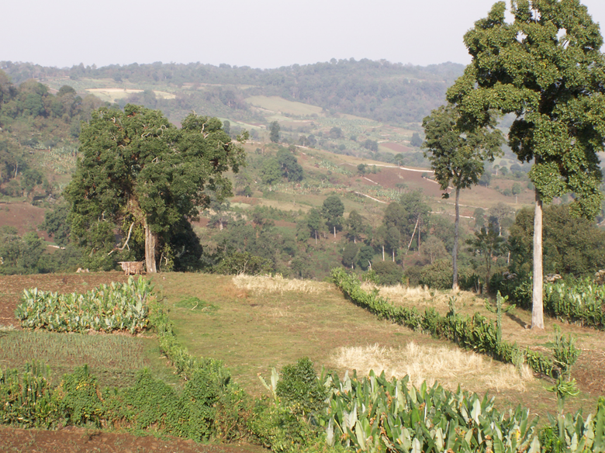
Forest Loss & Threat to Gene Pool
Forest fluctuations over time, reduction since 1930s
Govt tenure & institutions create “open access”
Lack of value in the forest & its NTFPs, honey, spices etc
Population growth & in-migration
Investment allocations

Slide 4
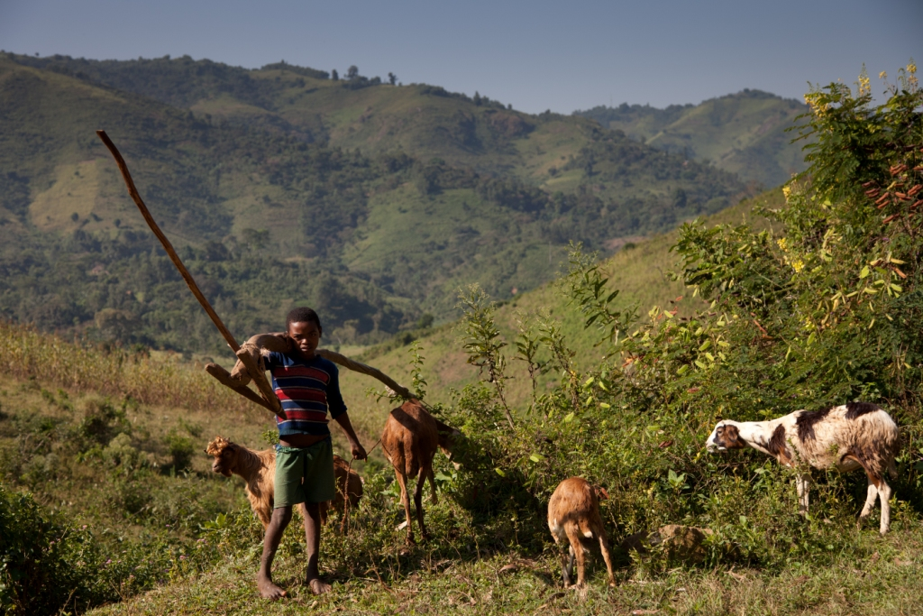
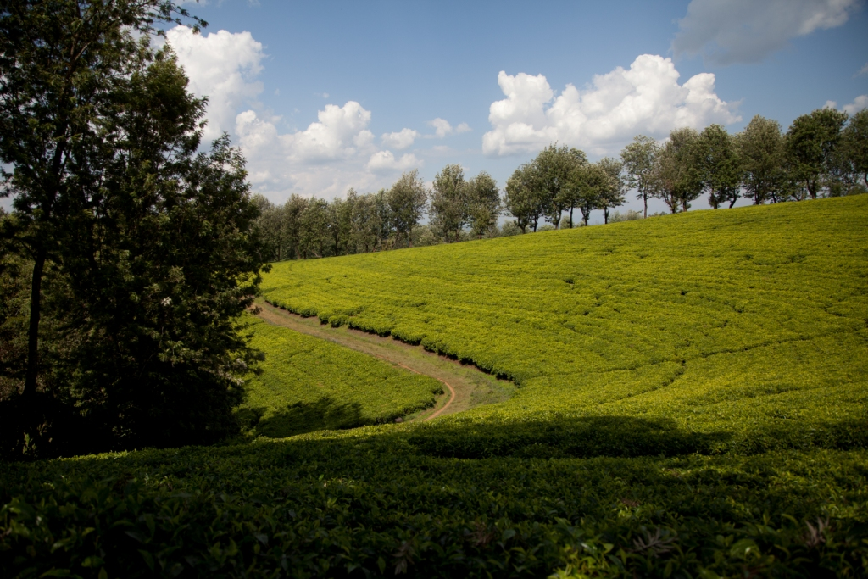
Forest Loss to farmland and estates

Slide 6
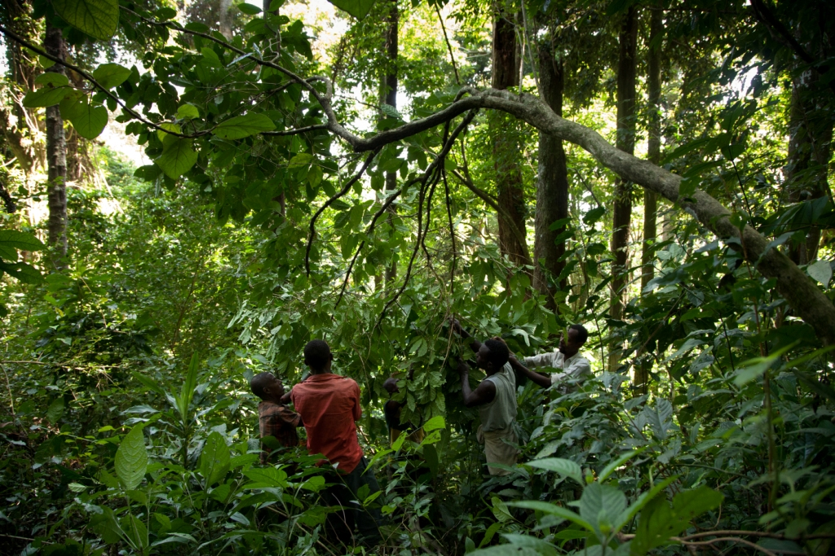
Maintaining the “in situ” opportunities
Importance of the “coffee forest” gene pool <90% of plants
Greater importance of the natural forest coffee stands >10% plants for genetic conservation but in situ
Key disease and pest risks in the “coffee forest”

Slide 7
Approaches followed
Exclusionary – local government led, EU funded, imposed boundaries of protected area, no access for communities
Biosphere Reserve – core area with no access, buffer zone with limited use, taking the pressure off the forest with development focus in transition zone
PFM – increasing value of all forest for the communities with devolved management, use rights and responsibilities, with management plans agreed with govt, jointly monitoring of sustainable use, overall empowering the communities

Slide 8
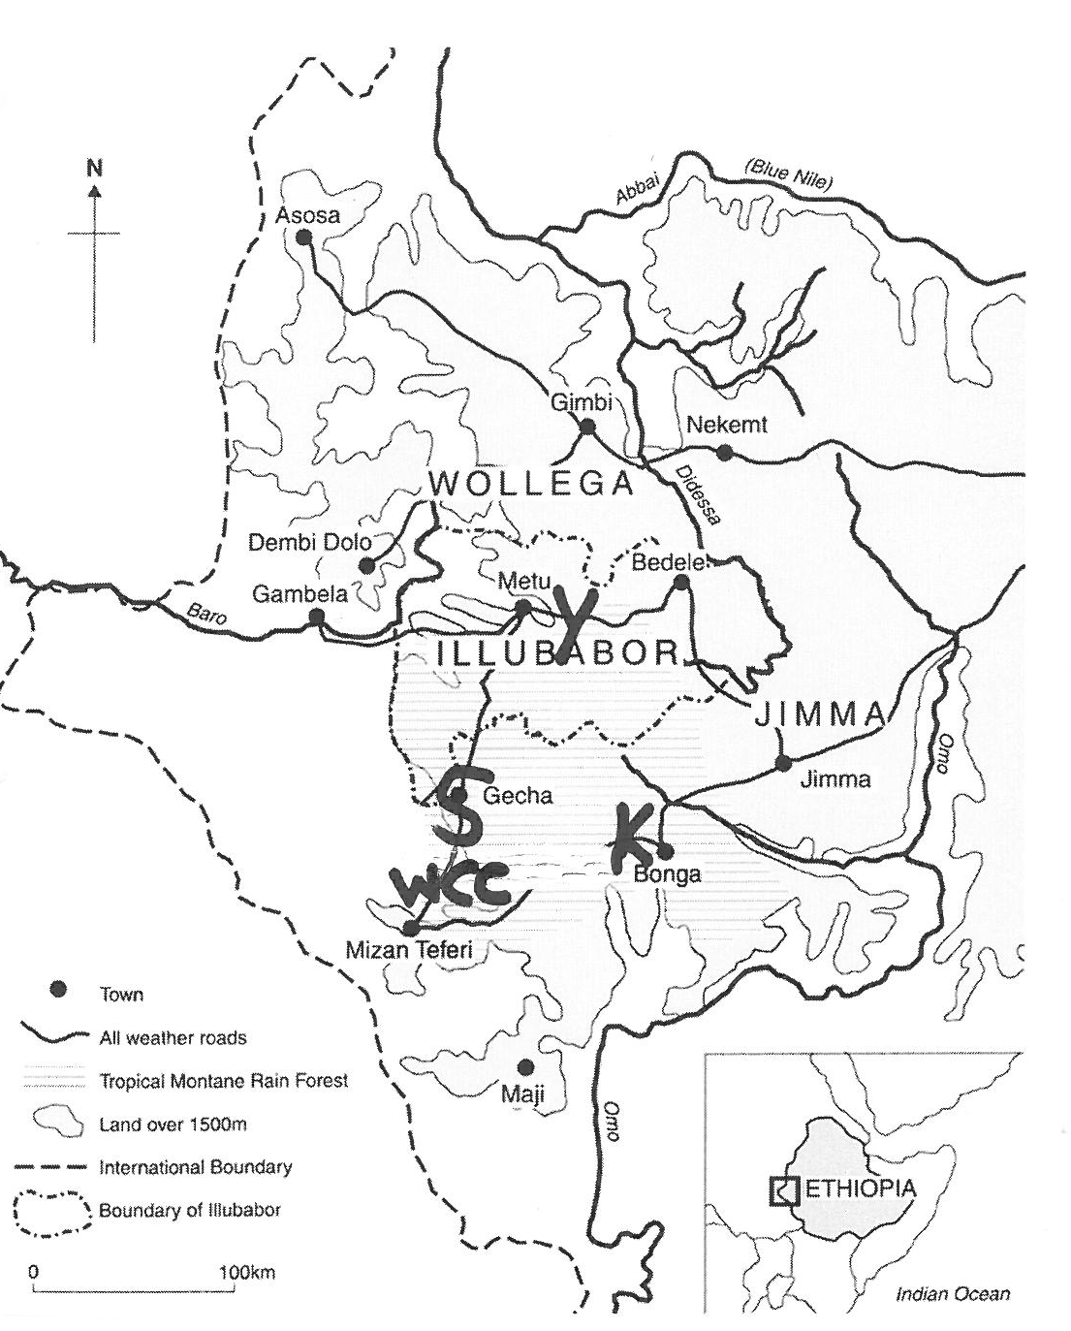
BRs & PFM
3 Biosphere Res
  Yayu - 2010
  Kafa - 2010
  Sheka - 2012
WCC-PFM Project
  Sheko - formerly exclusion approach
BR area c 1.1m ha
WCC-PFM c 0.2m ha

Slide 9
Experiences - Exclusionary
Strengths
  Enforceable action
  Effective demarcation
  Quick achievements on the ground
Weaknesses
  Poor relations with communities – no engagement except as workers
  Conflicts over traditional uses of forest – honey etc
  Dependence on armed guards
  People are the problem

Slide 10
Experiences – BioSphere Reserve
Strengths
  Legal basis at regional government level through proclamation
  UNESCO registration gives official recognition which may attract donors to fund both BR costs & development
  Legal status helps repel investors
Weaknesses
  Core area issue with local communities & tradnl use
  “Open access” core areas
  Externally driven priorities v local ones
  Dependence on external funds for guards
  Trust for PFM areas can be undermined

Slide 11
Experiences – Devolved PFM
Strengths
  Community fully engaged in planning and actions on ground - costs reduced
  Forest based economic drivers – making forest competitive land use
  Active forest managt for regeneration etc
  Sustainability from local sources
Weaknesses
  Forest manipulation by communities alter biodiv, but always dynamics
  Community engagement and interest groups, elite capture and time needed
  Inconsistent government responses – regional & local, trust undermined

Slide 12
Field Data – 3 Rs Exercise
Community with land in Core Zone of Sheka BR and PFM Forest

Slide 13
Lessons to learn – consensus?
Comparative experience is needed
Lessons to share and monitoring to be done to identify impacts
Analysis of reasons for impacts
Long term sustainability is needed
Engaging communities – participation not enough
Economic rationality of communities

Slide 14
