Slide 1

Is it just a guessing game? Assessing the application of CPTED
Dr Leanne Monchuk

Slide 2
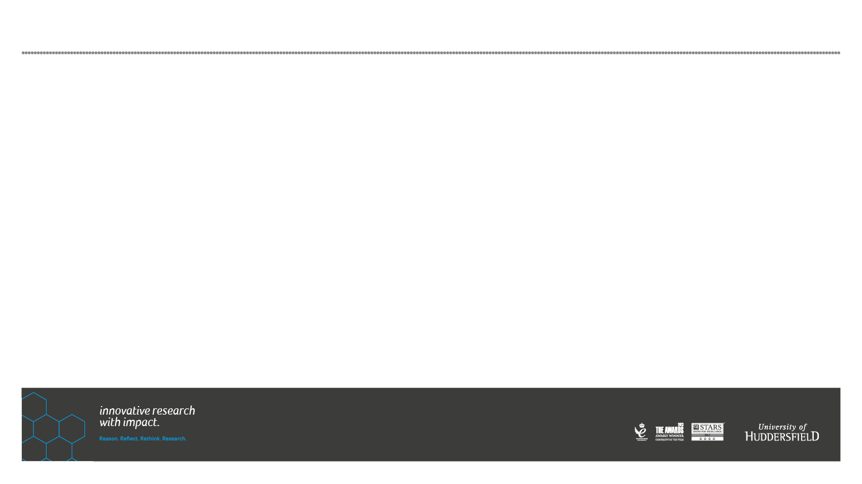
CPTED
“The proper design and effective use of the built environment, that can lead to a reduction in the fear or incidence of crime and an improvement in the quality of life” (Crowe, 2000 p. 46)

Slide 3
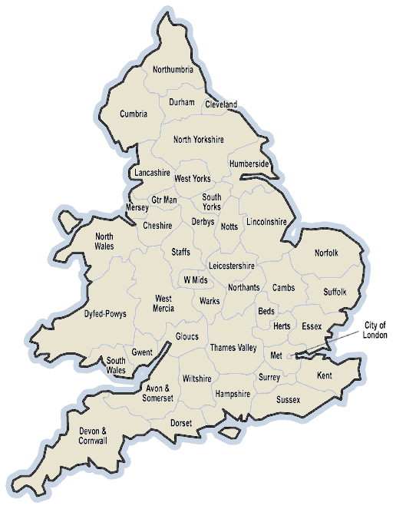
Delivery of CPTED
43 police forces
1 dedicated officer in each force
Designing our Crime Officers (DOCOs)
Work within an active police station
Serving police officers, retired officers or police staff

Slide 4
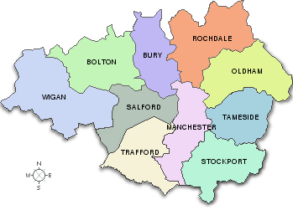
Delivery of CPTED
Over 300 local authorities in England and Wales

Slide 5
Delivery of CPTED
National planning policy - crime prevention should be considered in the design and build of new dwellings
No obligation that the police must be involved in the planning process
No systematic process to ensure that the police are involved in the design of new developments
This applies across police forces and within the forces:
There is no force policy. There is no direction…Whatever
level of operation we have is down to individual development
and partnerships…

Slide 6
CPTED & the planning process
Planning Application submitted to Local Authority
Planning Permission Granted or Refused
Client
Development
…a lot of developments will bypass us at the pre-planning stage and we won’t see them until it gets to the planning application – which is far too late down the line...
    [Police Force]

Slide 7

Greater Manchester Police (GMP)
Design-led consultancy
Design stage/pre-planning application stage
Crime Impact Statement (CIS) process – charge a fee

Slide 8
CPTED & the CIS process
Planning Application submitted to Local Authority
Planning Permission Granted or Refused
Client
Development
All 10 planning authorities in Manchester stipulate that major planning applications must include a Crime Impact Statement

Slide 9

Key questions!
Before thinking about how DOCOs deliver crime prevention advice, need to ask two key questions:
Is there a skill?
How is the skill applied?
Evaluations of SBD up to now overlook this basic question

Slide 10

Consistency of application?
Concerns about the application of CPTED advice by DOCOs
“Inconsistency with which it is applied, depending upon the DOCO involved (p.17)”
Is there a skill?
How is the skill applied?

Slide 11
CPTED – is it just a guessing game?
In medicine, medical science is no good unless GPs apply it
In crime prevention, the principles of CPTED are no good unless DOCOs apply them
To date, emphasis placed on evaluating initiatives
Gap - how the principles of CPTED are actually applied
Prior to thinking about the delivery of CPTED, need to evidence whether there is a skill
“Need to know whether DOCOs are more like astronomers or astrologers”

Slide 12
Developed an exercise
The way I chose to do it was to take an already built development that DOCOs didn’t know
Ask them to predict where crime would have occurred
Not perfect - the exercise I did could be improved
Whatever its imperfections, something of this kind is essential to situational crime reduction
Giving people a medical education and failing to test what they have learned is unthinkable. So it should be with crime prevention practitioners

Slide 13
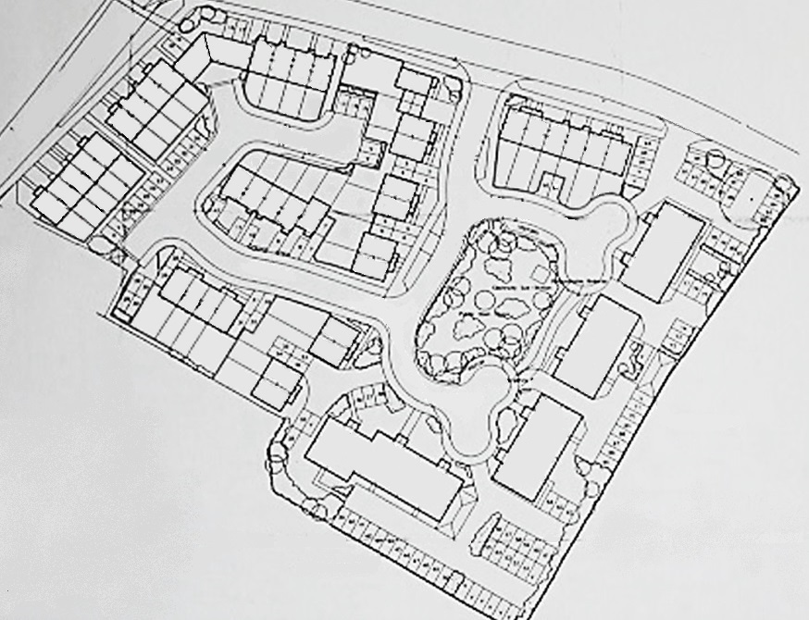
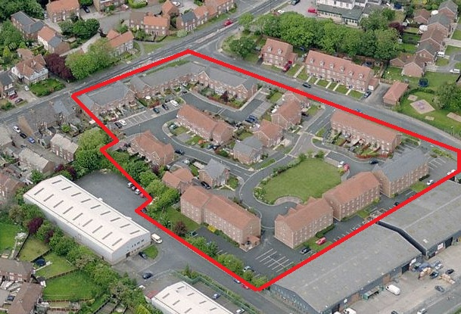
Assessing the application of CPTED
28 of the most experienced ALOs in England & Wales

Slide 14
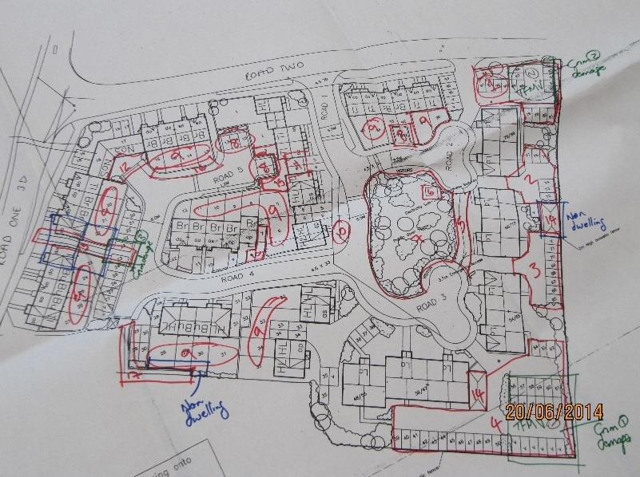
Assessing the application of CPTED
Property crime:
  Burglary dwelling
  Burglary other
Vehicle crime:
  Theft of motor vehicle
  Theft from motor vehicle

Slide 15
3 key questions
Do DOCOs identify different numbers (and hence proportions) of locations in the development as problematic?
Was there consensus in the locations chosen?
Were the locations chosen actually victimised?

Slide 16
WARNING!
Place structure is not the only determinant of crime
Would not expect perfect place identification
However, if place structure is a key factor, performance should be better than chance…

Slide 17
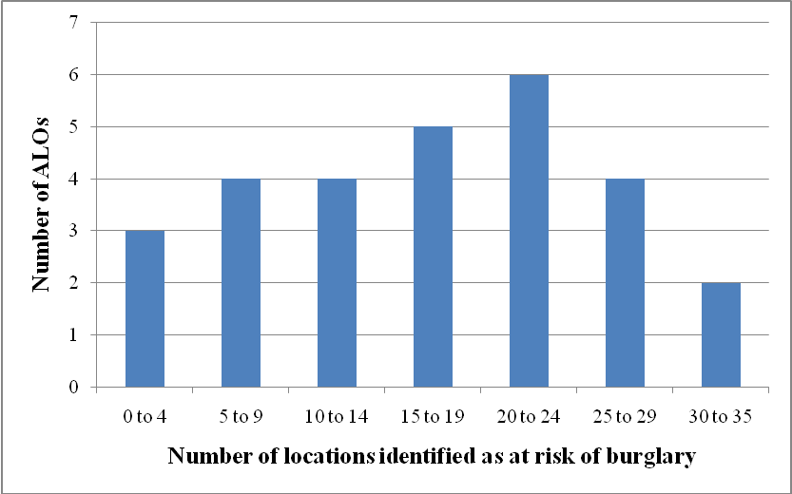
Property crime

Slide 18
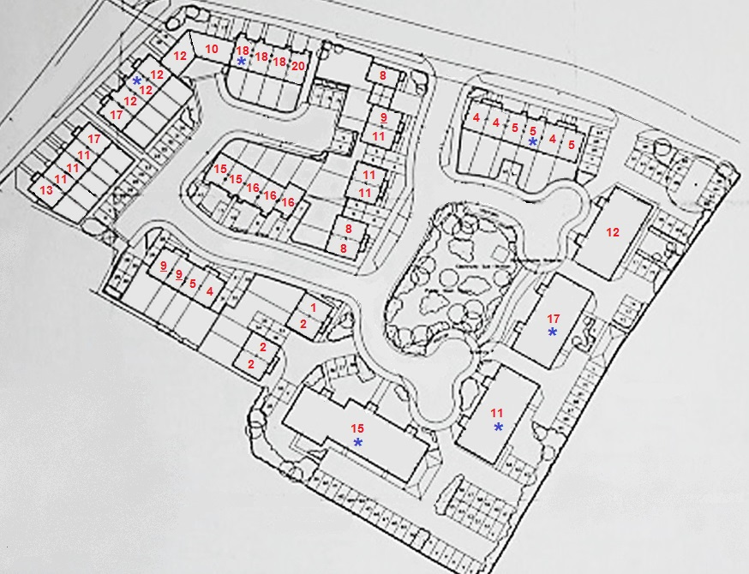
Property crime

Slide 19
Property crime

Slide 20
So what?
Many factors may determine victimisation, but if there is a skill, prediction has to be better than chance
There is a skill (better than chance) BUT variation across sample
Non-police tended to perform better
Concerns regarding inconsistent assessment of vulnerability are founded
Radical overhaul of training and CPD required to help improve predictive skill
Training based on knowledge and results - VR/CAD/case studies
Way forward? GMP - strong case for being a model of delivery
However, income generated must remain incidental (sustain and improve)

Slide 21

Thank you
Dr Leanne Monchuk
+44 (0)1484 472670
l.y.monchuk@hud.ac.uk
@leannemonchuk

