Slide 1
What is CPTED?
Reconnecting theory with application in the words of users and abusers
Dr Leanne Monchuk

Slide 2
Content of presentation
The importance of CPTED
2. Re-considering CPTED
3. Methodology – burglars and police
Key findings
Moving forward

Slide 3
Defining CPTED
“The proper design and effective use of the built environment, that can lead to a reduction in the fear or incidence of crime and an improvement in the quality of life” (Crowe, 2000 p. 46)
“The design, manipulation and management of the built environment to reduce crime and the fear of crime and to enhance sustainability through the process and application of measures at the micro (individual building/structure) and macro (neighbourhood) level” (Armitage, 2013 p. 23)

Slide 4
Importance of CPTED: Policy
Increasing emphasis upon deregulation – Safer Places cancelled
National Planning Policy Framework (2012) and Planning Practice Guidance state importance of crime prevention
Modern Crime Prevention Strategy (2016) highlights important of CPTED – opportunity defined as 1 of the 6 drivers of crime
HMIC’s 2014 inspection of crime prevention, police attendance and use of police time – Core Business
Notes:
Opportunity – Removing or designing out opportunities for criminals to offend, offline and online.
Character – Intervening early with those exposed to factors that might lead to a high propensity to commit crime.
Effectiveness of the CJS – Ensuring that the CJS acts as a powerful deterrent to would-be offenders.
Profit – Making it harder for criminals to benefit financially from their crimes
Drugs – Restricting the supply of drugs and tackle the organised crime behind the drugs trade, prevent drug misuse, support people dependent on drugs.
Alcohol – making the night time economy safe so that people can consume alcohol safely without fear of becoming a victim.

Slide 5
Importance of CPTED: Research
Previous research confirms the importance of design in the reduction of burglary:
Limiting through movement (Armitage et al, 2011; Johnson & Bowers, 2010)
Enhanced natural surveillance (Armitage 2006; Armitage et al, 2011)
Demonstrated in evaluations of interventions that implement CPTED features in combination – e.g. UK’s Secured by Design initiative (Armitage & Monchuk, 2011)

Slide 6
Secured by Design (SBD)

Slide 7
Re-considering CPTED
Reconnect with practice – terminology, definitions, application
Reconnect with the crime problem – changes in patterns of offending, MO
Needs to reconnect with Crime Science and Environmental Criminology – regain intellectual credibility
How can success be achieved and measured?
CPTED needs to be defined and definable
Open to interpretation
“There is the tendency to use the label CPTED indiscriminately to cover everything that aims to prevent crime in the built environment” (Ekblom, 2009 p.9)

Slide 8
Principles of CPTED
Poyner (1983) | Cozens et al (2005) | Armitage (2013) | Montoya et al (2014)
Surveillance | 1) Surveillance | Surveillance | Surveillance
2) Movement control | 2) Access control | 2) Movement control | 2) Access control
3) Activity support | 3) Activity support | 3) Management & maintenance | 3) Activity support
4) Motivational reinforcement | 4) Defensible space | 4) Defensible space | 4) Territoriality
 | 5) Target hardening | 5) Physical security | 5) Target hardening
 | 6) Image |  | 6) Image & maintenance
 | 7) Territoriality

Slide 9
Research rationale
1. Need to clarify the terminology used by practitioners (specifically principles/components)
2. Need to ensure that principles reflect those abusing CPTED (burglars) believe to be most influential in their decision making processes

Slide 10
Research
Brings together two research projects
1. Monchuk (2016) Investigating the application and delivery of CPTED across England and Wales
2. Armitage and Joyce (2016) Why my house? Exploring offender perspectives on risk and protective factors in residential housing design

Slide 11
Monchuk (2016)
Testing the application of CPTED
Semi-structured interviews with 28 experienced Designing Out Crime Officers across England & Wales
Serving police officers, retired police & police staff
Asked to review a site plan

Slide 12
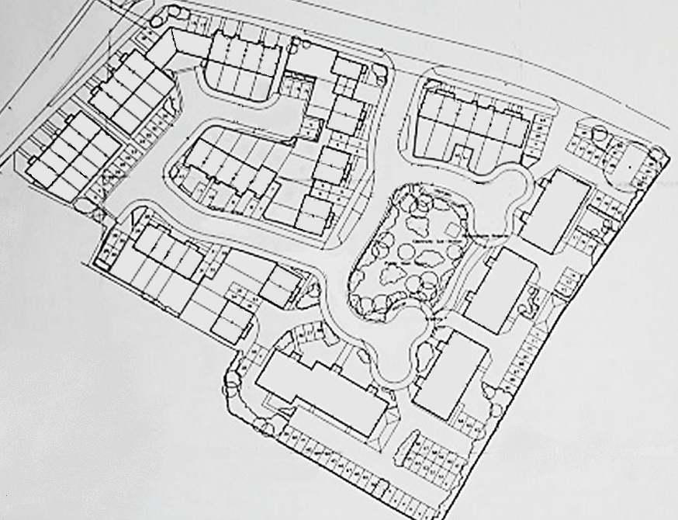
Monchuk (2016)

Slide 13
Monchuk (2016)
From looking at the site plan, what initially do you like from a crime prevention perspective and why?
2. From looking at the site plan, what don’t you like about from a crime prevention perspective and why?

Slide 14
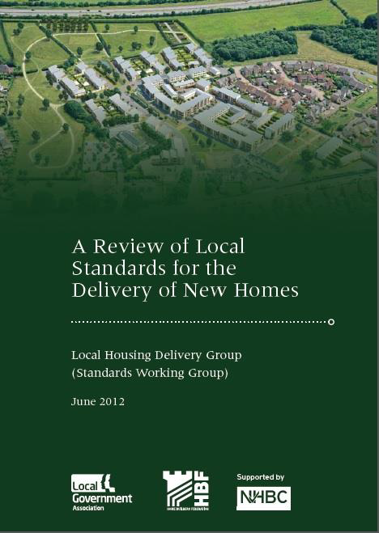
Consistency of application?
“Inconsistency with which CPTED is applied, depending upon the officer involved (p.17)”

Slide 15
Armitage & Joyce (2016)
Interviews with incarcerated adult males convicted of burglary
Identified by the prison’s Integrated Offender Management Team to be prolific
Asked to look at a series of 16 images of residential housing

Slide 16
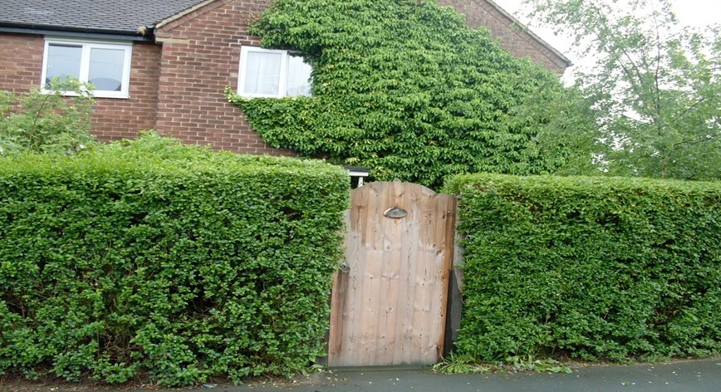

Slide 17
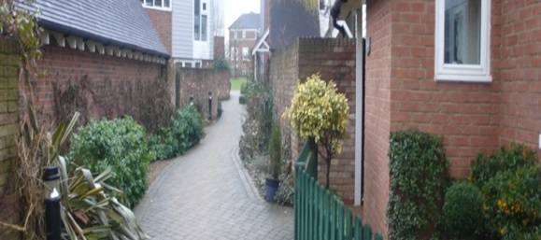

Slide 18
Armitage & Joyce (2016)
From what you can see from the photo, can you describe what would attract you to this property when selecting a target for burglary
2. From what you can see from the photo, can you describe what would deter you (put you off) from selecting this property as a target for burglary

Slide 19
Research questions
1. When describing the features of housing design that influence their decision making, do burglars refer to some features more regularly than others? | When describing the features of housing design that they believe will influence crime risk, do police refer to some features more regularly than others?
2. When describing the features of housing design that influence their decision making, do burglars reference the same concepts/principles that are presented in existing CPTED literature/theory? | When describing the features of housing design that they believe influence crime risk, do police reference the same concepts/principles that are presented in existing CPTED literature/theory?

Slide 20
Research questions
3. Is there consistency between burglars in the terminology used to describe the concepts/principles of design that are associated with heightened crime risk? | Is there consistency between police in the terminology used to describe the concepts/principles of design that they think are associated with heightened crime risk?
4. Is there consistency between police and offenders when describing the principles/concepts of design that influence crime risk?

Slide 21
This paper…
Exploratory and inductive!
20 participants (police and burglars) encouraged to express their perceptions of housing design features and burglary risk
2 separate studies
Plans? Photographs?

Slide 22
Key findings
CPTED principle | Offender sample | Police sample
Surveillance | 0% | 90%
Movement control | 0% | 0%
Physical security | 0% | 10%
Management & Maintenance | 10% | 10%
Defensible space | 0% | 30%

Slide 23
Key findings
CPTED ‘concept’ | Offender sample | Police sample
Surveillance | 100% | 100%
Movement control | 100% | 100%
Physical security | 100% | 70%
Management & Maintenance | 80% | 30%
Defensible space | 40% | 100%

Slide 24
Key findings
CPTED principle | Offender sample | Police sample | Total
Surveillance | 0 | 55 | 55
Movement control | 0 | 0 | 0
Physical security | 0 | 1 | 1
Management & Maintenance | 1 | 1 | 2
Defensible space | 0 | 3 | 3

Slide 25
Key findings
CPTED ‘concept’ | Offender sample | Police sample | Total
Surveillance | 68 | 44 | 112
Movement control | 28 | 48 | 76
Physical security | 52 | 13 | 65
Management & Maintenance | 20 | 5 | 25
Defensible space | 7 | 48 | 55

Slide 26
Surveillance: offenders
Offenders considered the risk of being seen to play a vital role in influencing their decision-making
Concerned about being seen by a resident, neighbour or passer-by
Size of windows, position of rooms within property, obstruction of sightlines (shrubbery, fencing and walls)

Slide 27
Surveillance: offenders
The front windows are nice and big too, so it’d mean that I could be seen easier if I was inside
The adults have the main bedroom at the front, so if they hear something and look out of the window, it’ll be at the front, not where the burglar is. Kids bedrooms are usually at the back
No-one can see you amongst the high walls. I’d feel more exposed if the walls and fence were lower [CONFLICT]
This is a burglar’s dream. There are high trees at the back, the hedge is high so blocks the view from the road, the gate is high so no-one can see you

Slide 28
Surveillance: police
Surveillance important in preventing burglary
Discussed layout and orientation of dwellings, types and placement of rooms and number and position of windows
Habitable or active rooms located to front and rear – tended to be ground floor, not bedrooms

Slide 29
Surveillance: police
I mean, how often are you in your upstairs window? I suspect these will be the bedroom windows looking out, but the routinely habitable rooms will be downstairs
People don’t usually misbehave when they can be seen misbehaving
Active rooms are: lounge, kitchen, probably stretch it to a dining room, but certainly not bedrooms and downstairs toilets and things like that
For me, that’s the crux of the matter. To get things more visible…

Slide 30
Movement control: offenders
Considered lack of through movement as a deterrent
Prefer to know how to exit the development prior to committing the offence
Deterred by a true cul-de-sac
Legitimate movement through a development provides them with an excuse for being in a location
Opportunity to assess a property before committing an offence

Slide 31
Movement control: offenders
If I was there and the police came, I would be boxed in and I wouldn’t have an excuse for being there. I couldn’t say, I am just walking home officer
Cul-de-sacs put me off. There is no reason to be on a cul-de-sac unless you live there. You aren’t going anywhere so you are a stranger. If it is a through road, you can just keep walking through
I would first walk up and down the footpath and have a look at what I could see in the houses. The houses are on a public footpath, no-one would give me a second glance if I walked up and down. It’s a footpath, no-one can question you

Slide 32
Movement control: police
Restricting both pedestrian and vehicular movement
Limit pedestrian access – helps offenders select targets and move around whilst remaining anonymous
Gate rear parking courtyards to restrict unauthorised access

Slide 33
Movement control: police
That’s a footpath and so you have got a large degree of anonymity if you walk down there because you could be going to this parking area at the back or you could be making out that you are going anywhere else in the development
OFFENDER: The fence wouldn’t deter me. In actual fact, it would put me at ease as I could hear the fence rattle if someone was coming in
To me, they would have to provide some other form of security measure, so it could be a barrier system across there to stop unwanted visitors getting in

Slide 34
Physical security: offenders
Prioritised assessing levels of security on the images
Distinguish between poor and good quality door locks and estimated time/level of effort
Able to identify Europrofile locks
Not deterred by gates or grilles – viewed as excessive security – suggestive of something worth taking
Not deterred by burglar alarms - don’t trigger a response

Slide 35
Physical security: offenders
If I smashed a window and the alarm went off, I might scuttle away and then come back ten minutes later to see if anyone had bothered dealing with it. From personal experience, eight out of ten won’t bother doing anything with them

Slide 36
Physical security: police
Focus on gating/barriers for car parking and access control into flats
One participant stated that physical security should not be a principle of CPTED…

Slide 37
Physical security: police
To be honest, that is secondary as far as I am concerned – the physical security. If we get the design of the estate right with CPTED, then the actual physical property, they hopefully won’t get that far, so that doesn’t really matter

Slide 38
Management & Maintenance: offenders
Majority of responses contradicted the assumption - untidy houses will attract offenders
Poorly maintained properties deemed unattractive targets - untidy external space equates to a lack of money
Attracted to tidy, well maintained properties

Slide 39
Management & Maintenance: offenders
If they have a neat garden, you know they have something to steal. You know they look after themselves and the house
It doesn’t look worth breaking into as there is nothing to take. It looks scruffy
That’s an ideal house for a burglar, it’s secluded, hedge is neat and tidy, good maintenance

Slide 40
Management & Maintenance: police
Rarely mentioned, but references tended to relate to vegetation
How tall are these trees going to grow? What sort of obstruction will they eventually be?

Slide 41
Defensible space: offenders
Creation of a closed community acts as a deterrent
However, some methods attract offenders
One photo = narrowing of the road, change in road colour and texture…
Gave impression of exclusivity, wealth and indicated owner-occupied housing

Slide 42
Defensible space: offenders
The private road sign and the change in road colour and texture give me the impression that it’s an exclusive area – they have more money and that would attract, not deter me

Slide 43
Defensible space: police
30% specifically referred to ‘defensible space’
Other terms: ‘territoriality’, ‘ownership’, ‘demarcation’, ‘barriers’, ‘private and public space’
Referred to importance of rumble strips, change in road colour and texture

Slide 44
Defensible space: police
I would either have a rumble strip, a change in colour or road surface, something like that, some pillars to define that you are going onto an estate…If you put something there like that, it’s saying to a criminal out there ‘that’s a public space and in here is private space’. A bit of psychology so they are reluctant to cross that boundary

Slide 45
Key findings
Principles not used consistently across police sample
Not one principle exactly referred to
Exact term: Surveillance (90%); defensible space (30%); 10% physical security; management and maintenance (10%) and movement control (0%)
Concept: Surveillance, movement control and defensible space (100%), but only 70% referenced physical security and 30% management and maintenance

Slide 46
Key findings
Discrepancy between emphasis participants placed on each principle
Both police and offenders refer to surveillance and movement control but…
Offenders placed more emphasis on physical security
Police appeared to over-emphasise defensible space

Slide 47
Key findings
Surveillance – high fences recommended by police but are more attractive to offenders
Surveillance – police consider rooms on ground floor important but offenders consider the positioning of bedrooms as a key decision making factor
Defensible space – police recommend change in colour/texture, offenders warned of portraying wealth and exclusivity
Management and maintenance – as a component of CPTED should be reviewed - well maintained interpreted as sign of wealth

Slide 48
Moving forward
Need to reshape, refocus and clarify CPTED
Need to enhance the scientific credibility of CPTED
Clearer description of the principles that can be defined, implemented and measured
Imperative for service delivery and consistency
Principles not used consistently across police sample
Confusion and frustration amongst built environment professionals
Training – to assist those on ground with application

Slide 49
Thank you
Dr Leanne Monchuk
+44 (0)1484 472670
l.y.monchuk@hud.ac.uk
@leannemonchuk

