Slide 1
Creative Approaches to Teaching ‘Love’ as an Act of Transformation
“ … a little laborious at times …
… but well worth it … ”
INSPIRE Conference
21st June 2016
Martin Purcell
School of Education & Professional Development
University of Huddersfield

Slide 2
Introduction
I want to use this session to explore with you:
key principles underpinning my pedagogical approach.
how ‘love' as an element of professional practice with young people can be liberating, healing and catalytic for both young people and practitioners.
the extent to which using LEGOTM facilitates my aspirations for the students, especially in addressing ‘wicked’ issues such as this.

Slide 3
Education as Transformation
“Education either functions as an instrument which is used to facilitate integration of the younger generation into the logic of the present system and bring about conformity or it becomes the practice of freedom, the means by which men and women deal critically and creatively with reality and discover how to participate in the transformation of their world” (Freire, 2000: 34).
“Education is inherently directive and must always be transformative” (Macedo, in Freire, 2000: 25)

Slide 4
Education as Dialogue
Co-operative learning (i.e. from others and from oneself) based on mutual deliberation and argumentation, characterised by the absence of coercive force, the mutual search for understanding and the compelling power of the better argument … by reflecting on their premises and thematizing aspects of their cultural background knowledge to critique accepted norms (Habermas, 1984).
Dialogue cannot exist “in the absence of a profound love for the world and for people. The naming of the world, which is an act of creation and re-creation, is not possible if it is not infused with love. Love is at the same time the foundation of dialogue and dialogue itself” (Freire, 1993: 89).

Slide 5
Education as an Act of Love
“It is impossible to teach without a forged, invented, and well-thought-out capacity to love”
“Dialogue cannot exist in the absence of a profound love for the world and for people. The naming of the world, which is an act of creation and re-creation, is not possible if it is not infused with love. Love is at the same time the foundation of dialogue and dialogue itself”
“The act of love is commitment to others. No matter where the oppressed are found, the act of love is commitment to their cause – the cause of liberation. And this commitment, because it is loving, is dialogical”
(Freire, 1997)

Slide 6
Education as an Act of Love
“our work is not merely to share information but to share in the intellectual and spiritual growth of our students. To teach in a manner that respects and cares for the souls of our students is essential if we are to provide the necessary conditions where learning can most deeply and intimately begin” (hooks, 1994: 13)
“love is an act of courage, not fear.... a commitment to others.... [and] to the cause of liberation” (Freire, 1970: 78)

Slide 7
‘Professional Love’
“The experience of ‘pedagogical loving’ requires deep motivational displacement and involves developing deep, sustaining, respectful and reciprocal relationships”
“Practitioners who know, understand and are secure in their reciprocal relationships with young children for whom they are responsible do so with the rights of the child wholly embedded at the centre of every aspect of their practice”
(Page, 2011)

Slide 8
‘Professional Love’
“The carer must be able to shift their thinking in order to intellectualise the experience as a loving caring experience”
“Children who have experienced poorly attached relationships are even more in need of quality and sensitivity from their key person”
“What young infants require most is sensitive, skilled, loving, special adults with whom they have formed a deep and sustaining relationship”
Page (2014)

Slide 9
Creativity in Higher Education
Creativity lies at the heart of performing, learning and developing in any contexts” (Jackson, 2014)
Educators should provide the following catalysts for developing creativity in others (Amabile & Kramer, 2012):
setting clear goals
allowing autonomy
providing resources and adequate time
offering help
learning from problems and successes
allowing ideas to flow

Slide 10
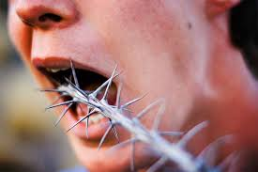
The INSPIRE Session: Design & Delivery

Slide 11
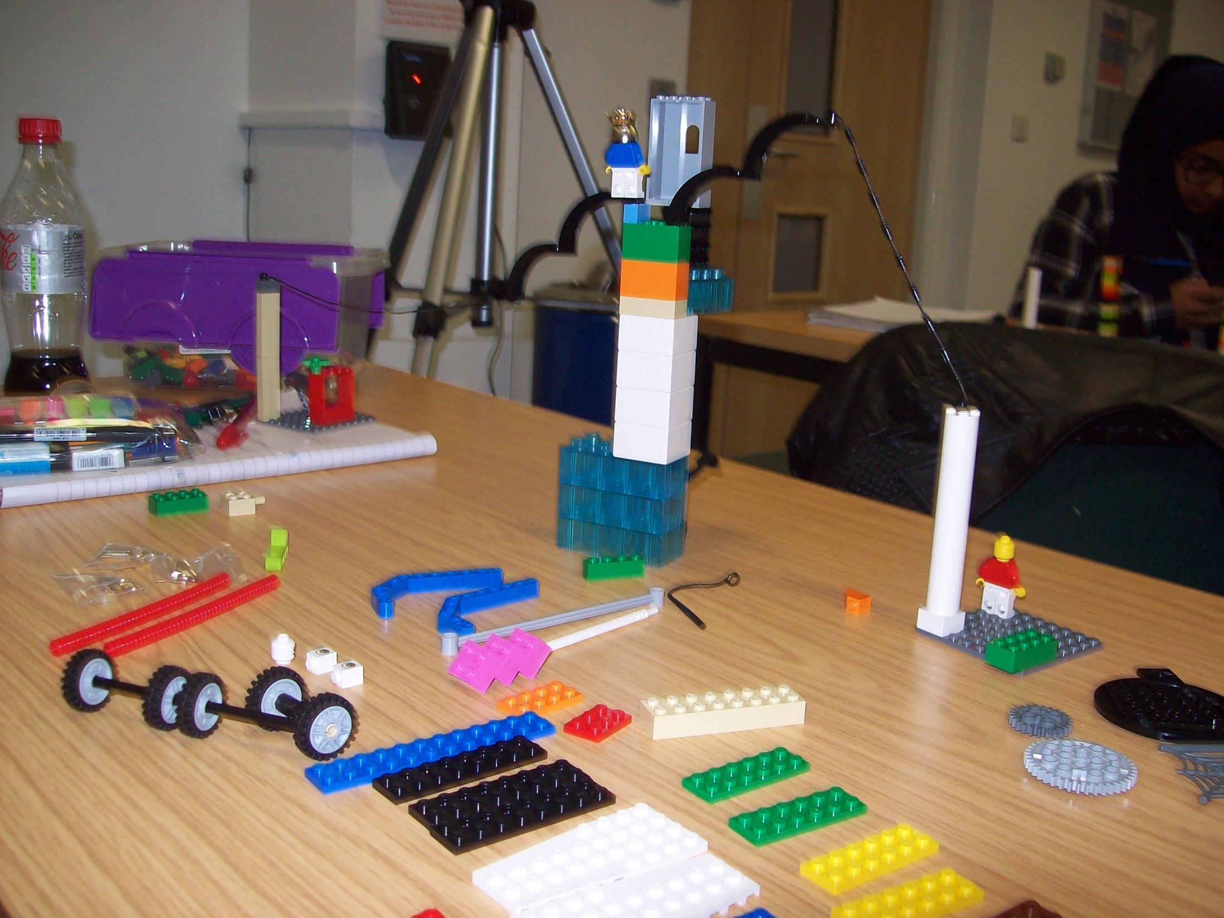
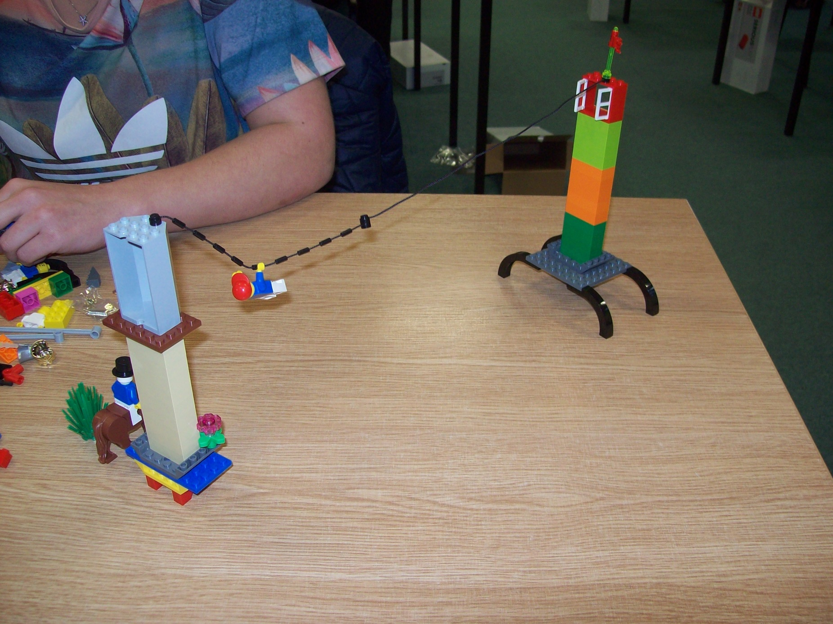
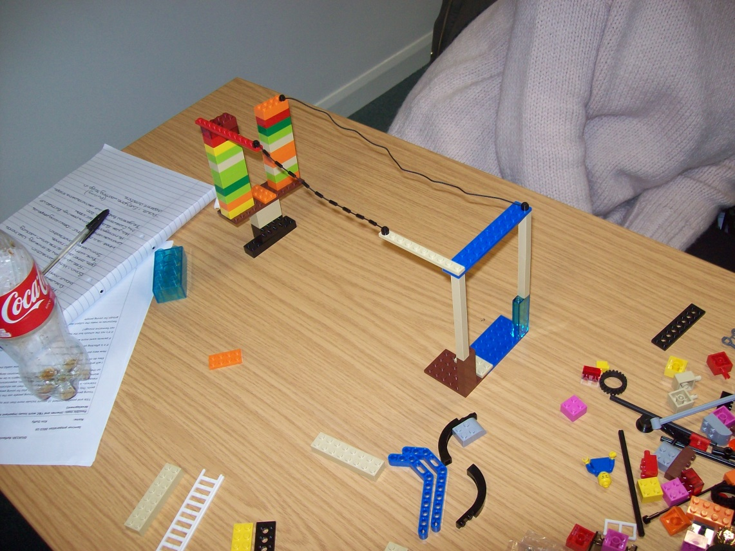
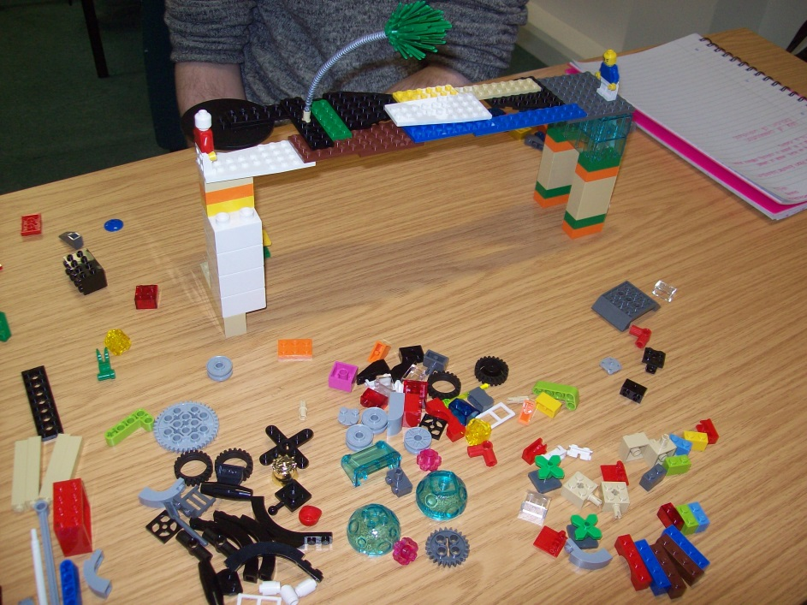
Bridges: Curious

Slide 12
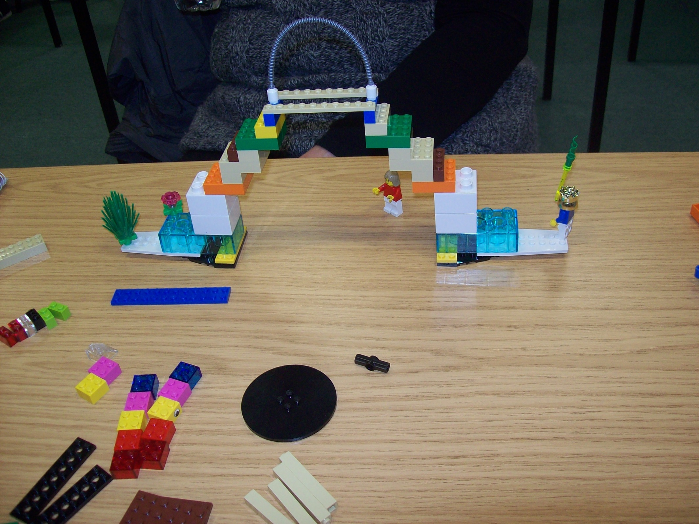
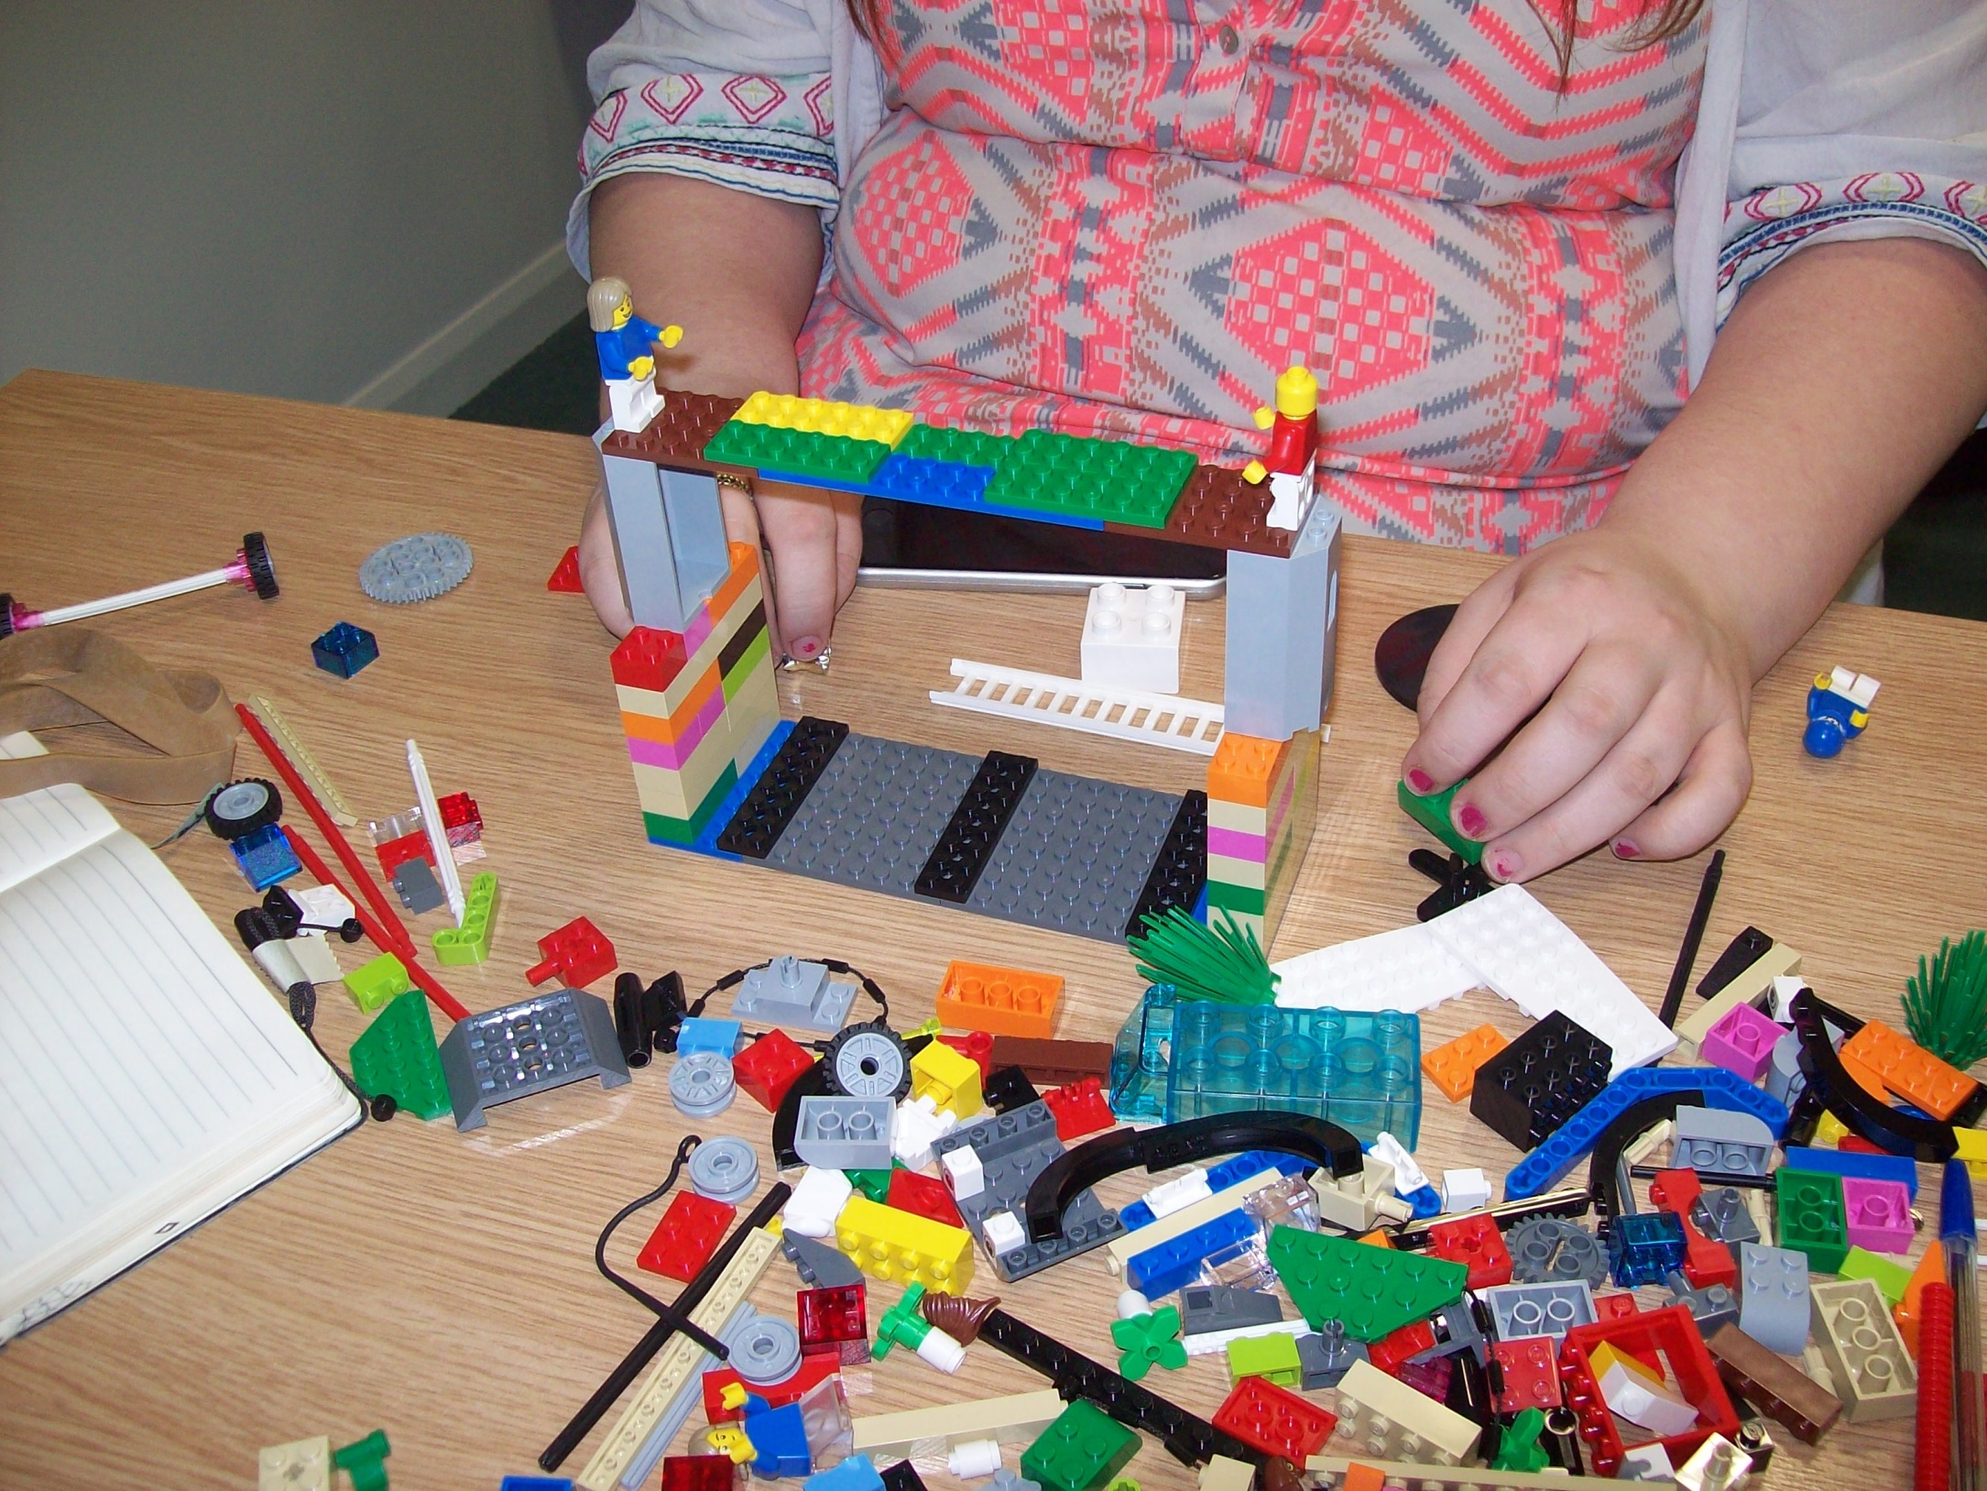
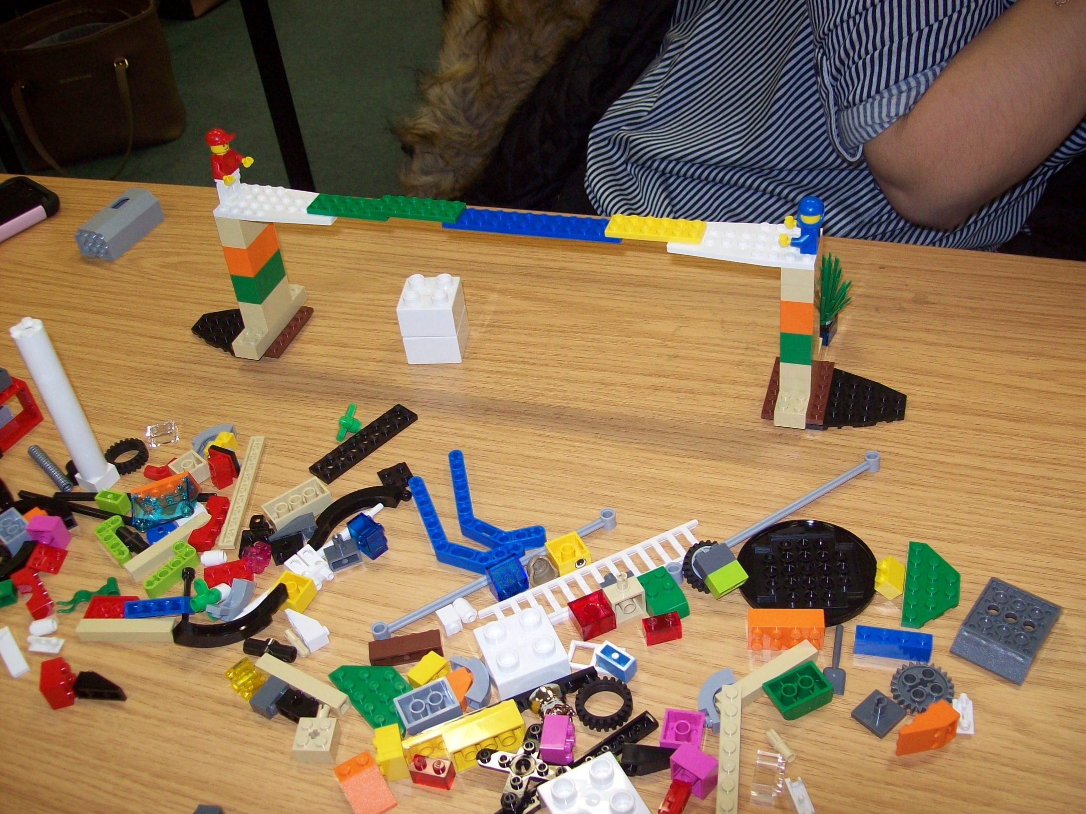
Bridges: Symmetry

Slide 13
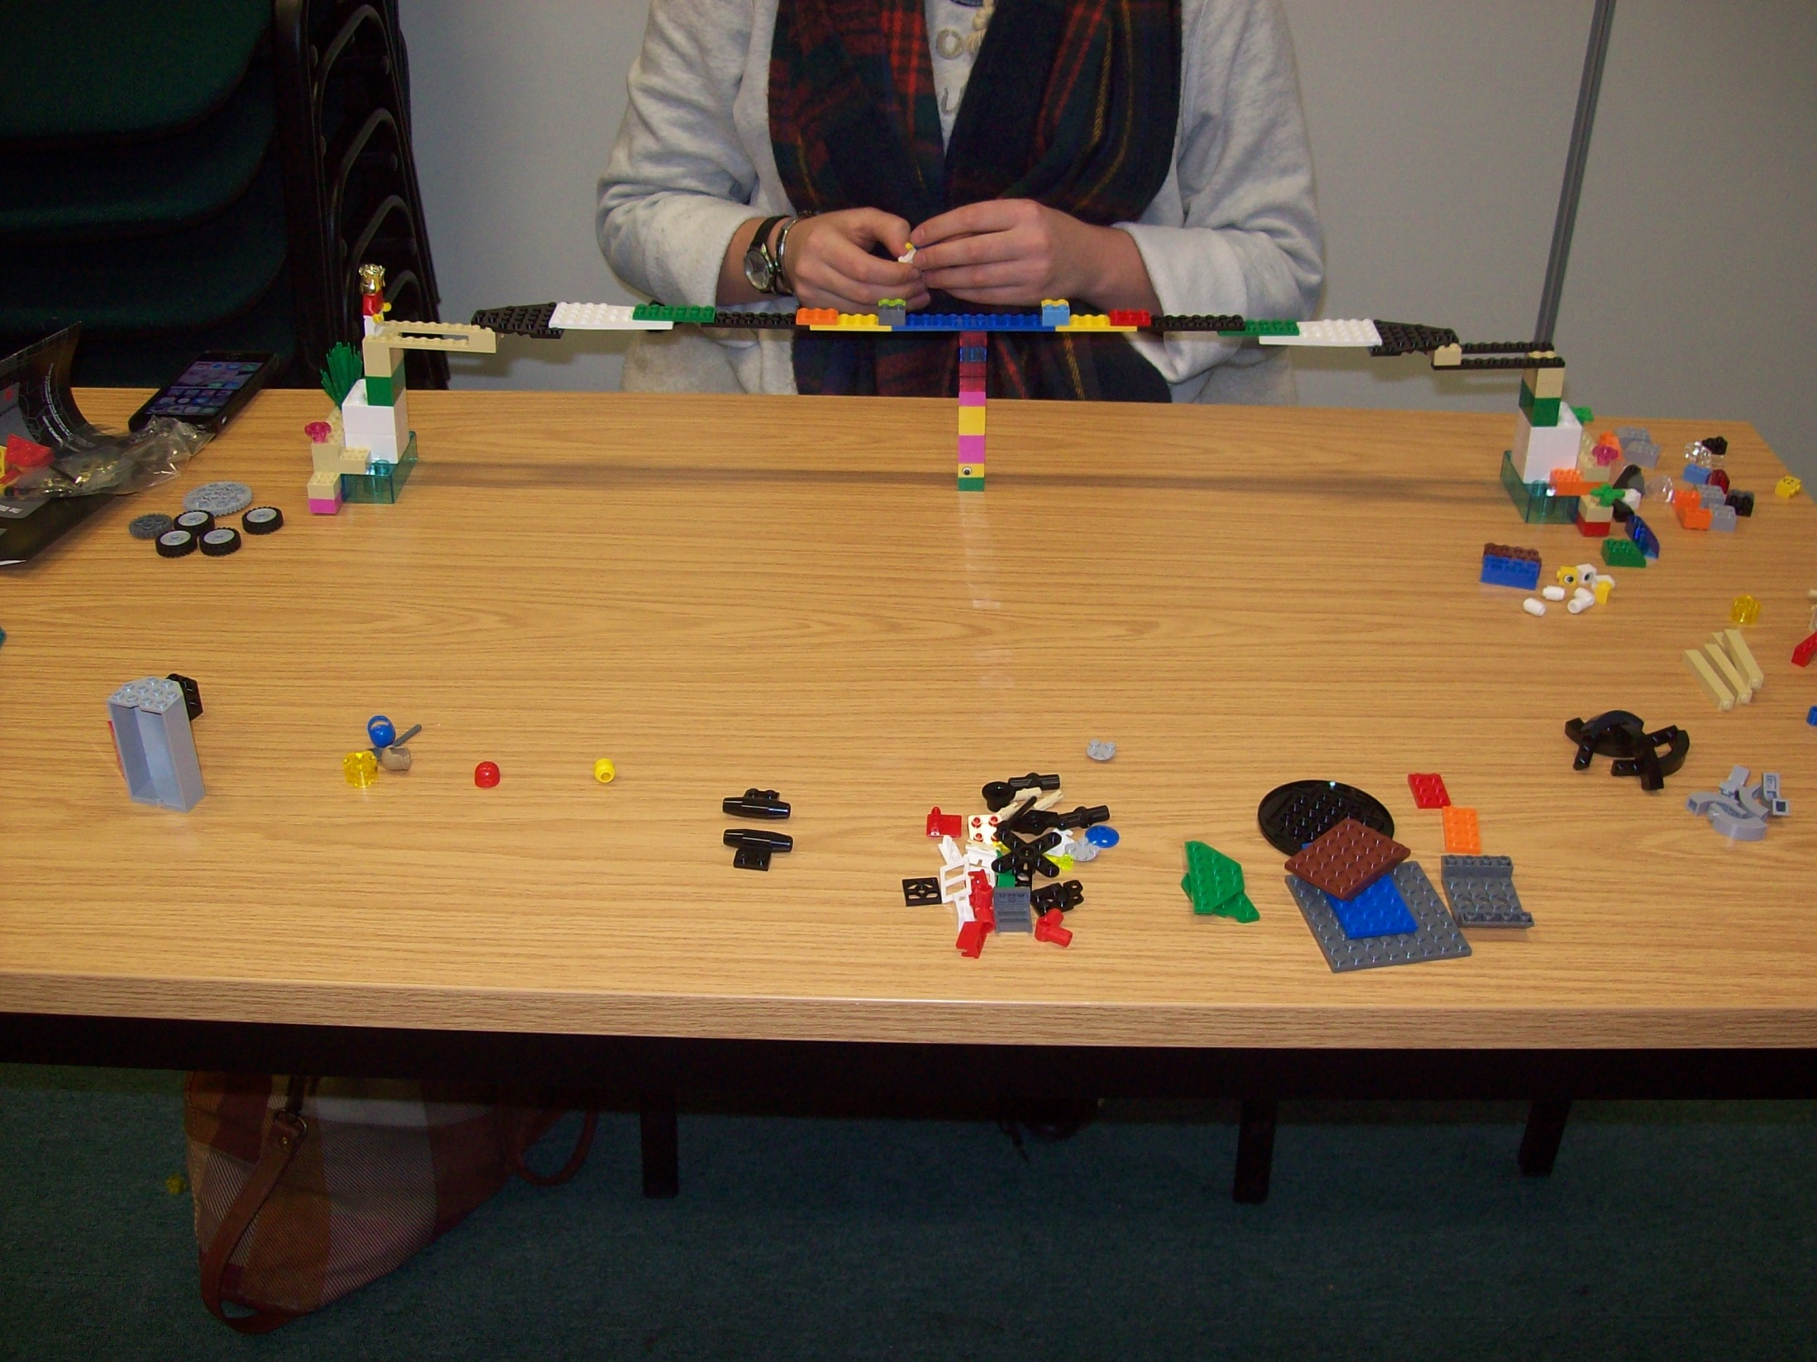
Bridges: ‘Winners’?

Slide 14
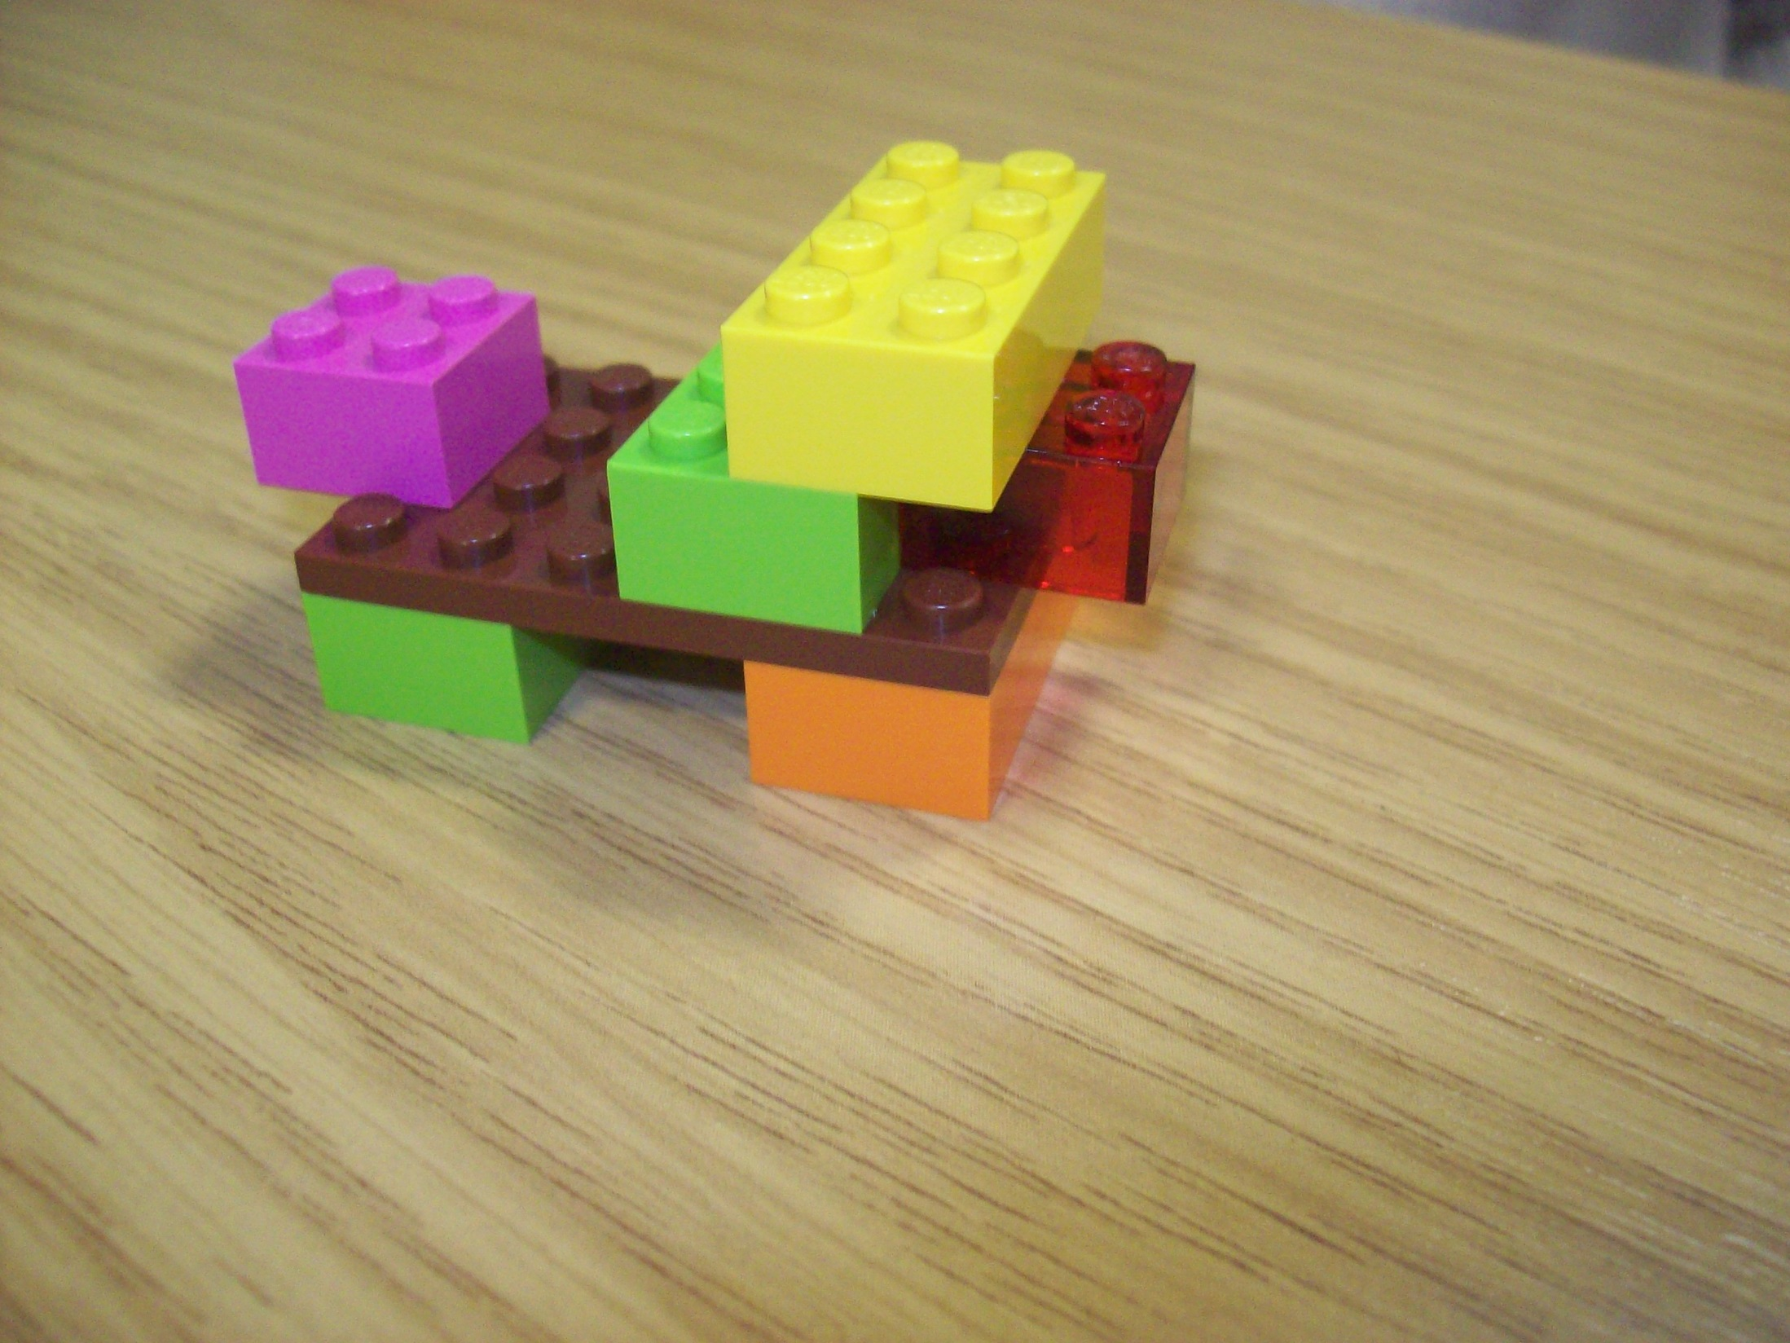
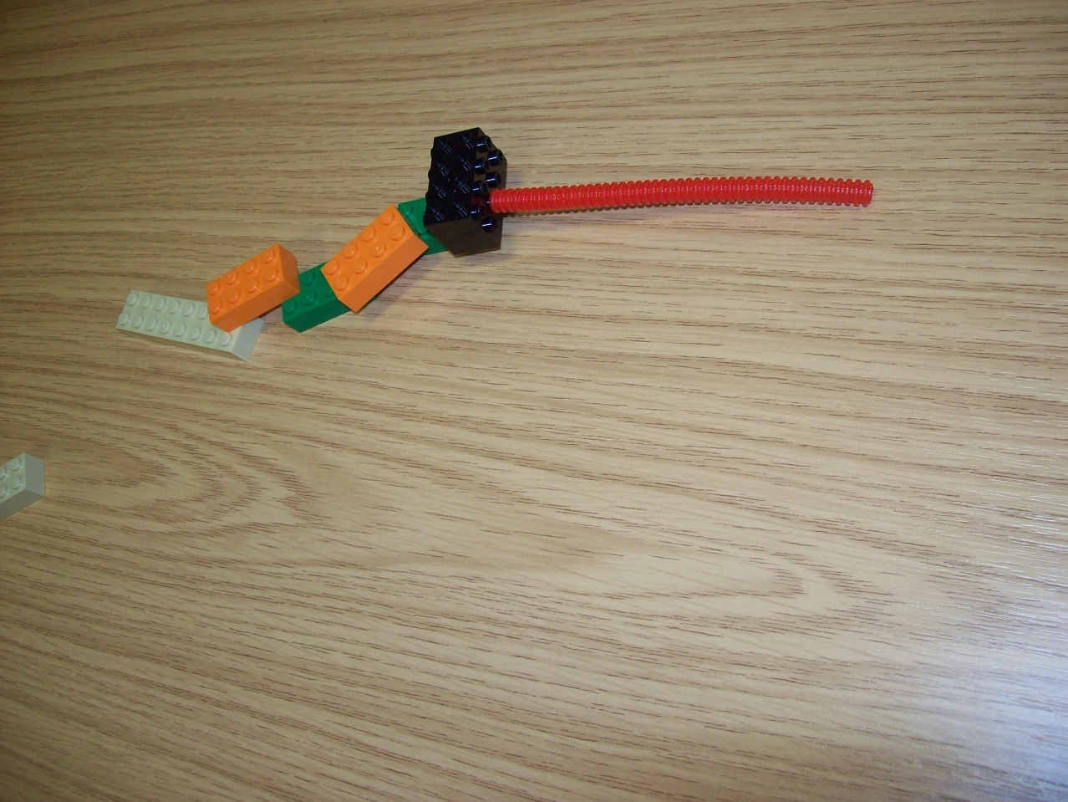
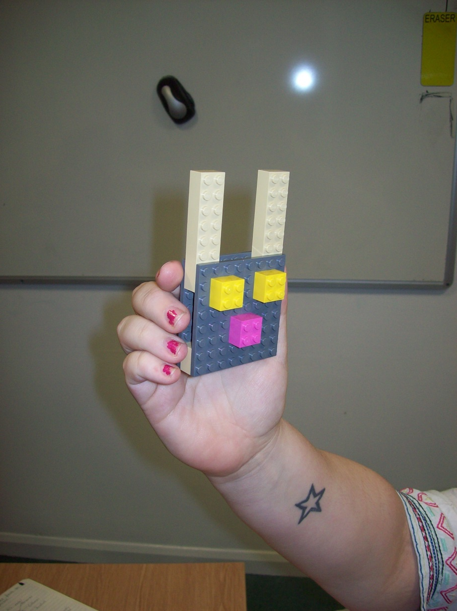
Animals

Slide 15
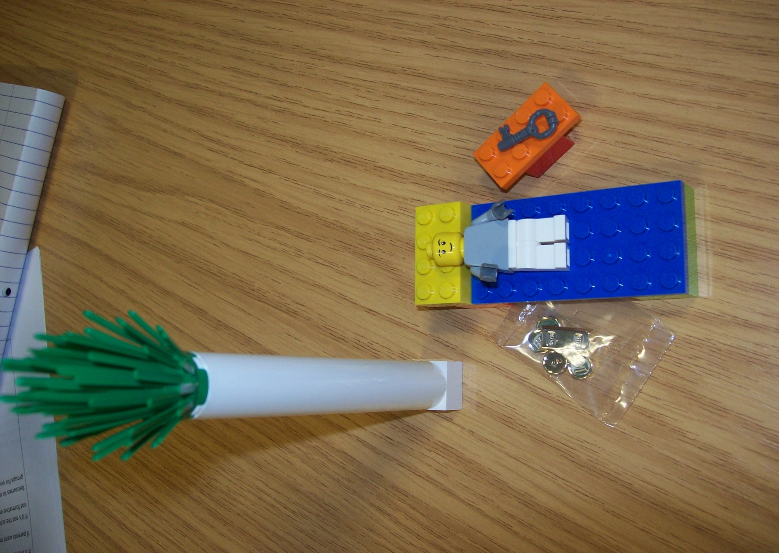
Practitioners:

Slide 16
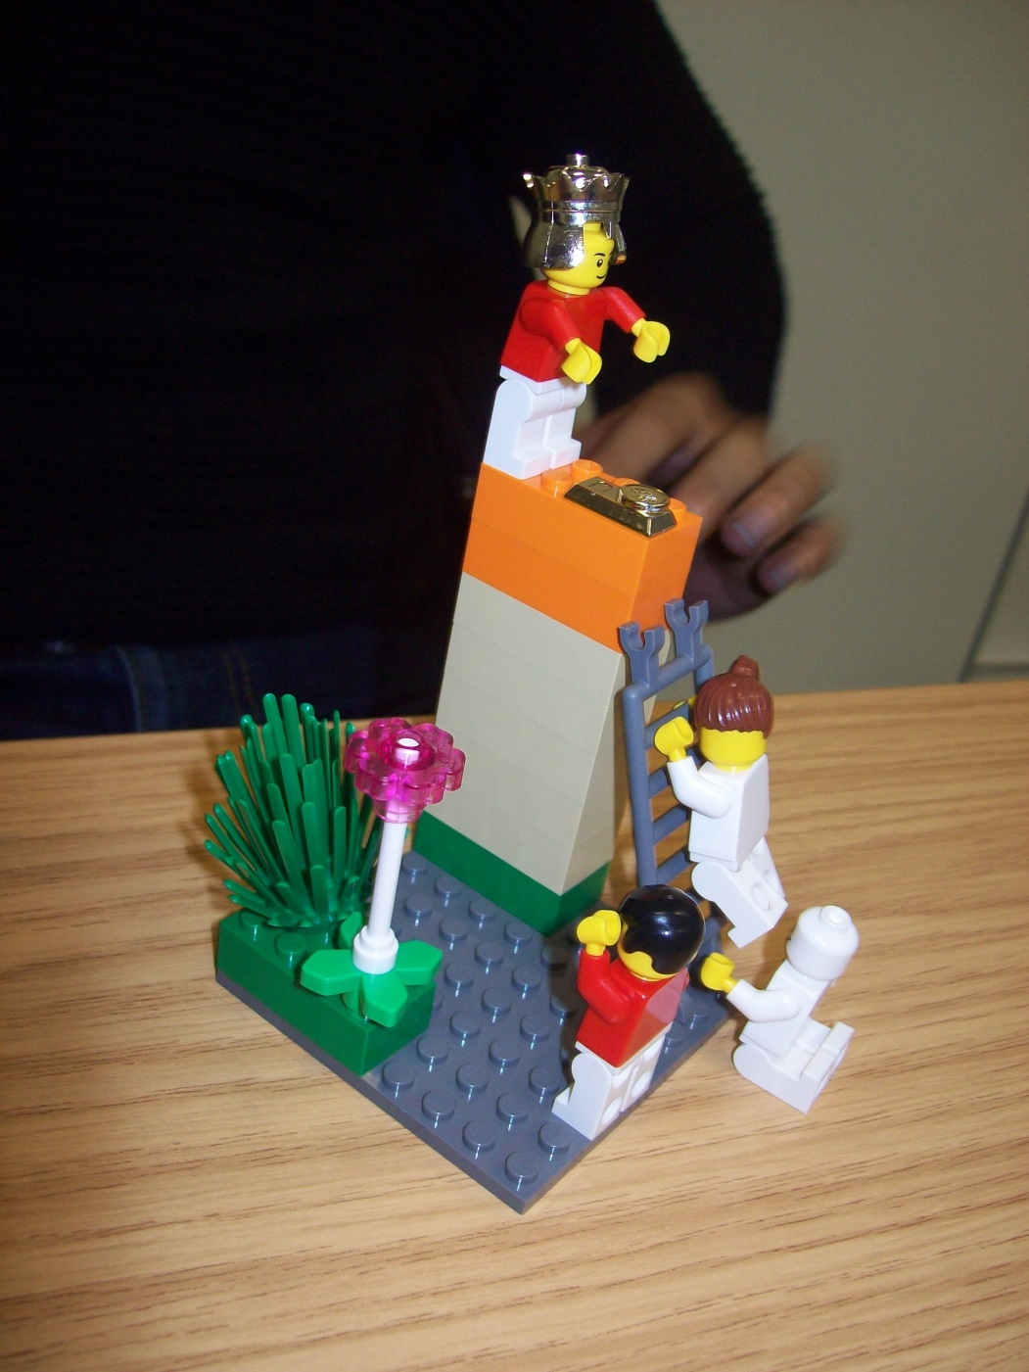
Practitioners:

Slide 17
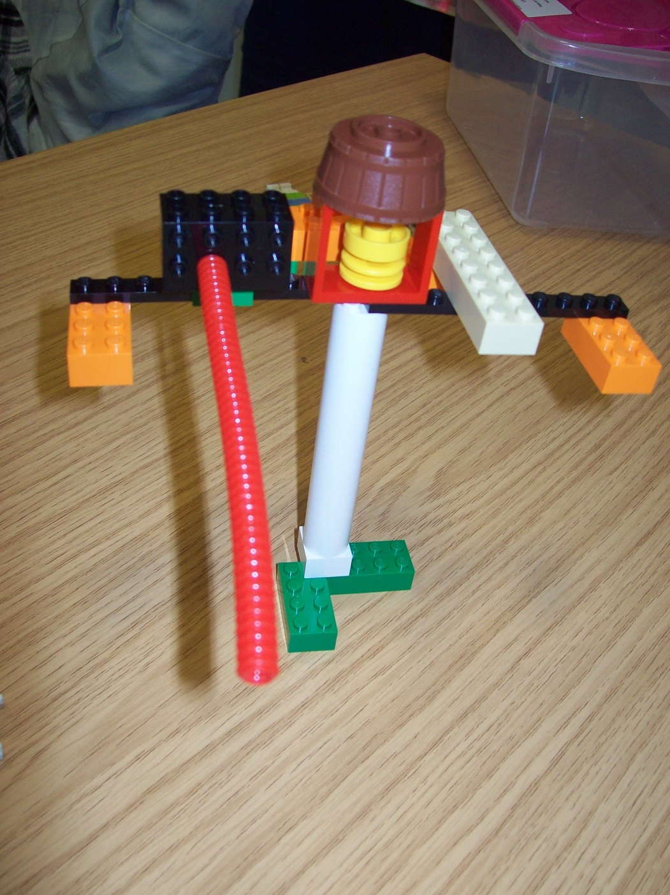
Practitioners:

Slide 18
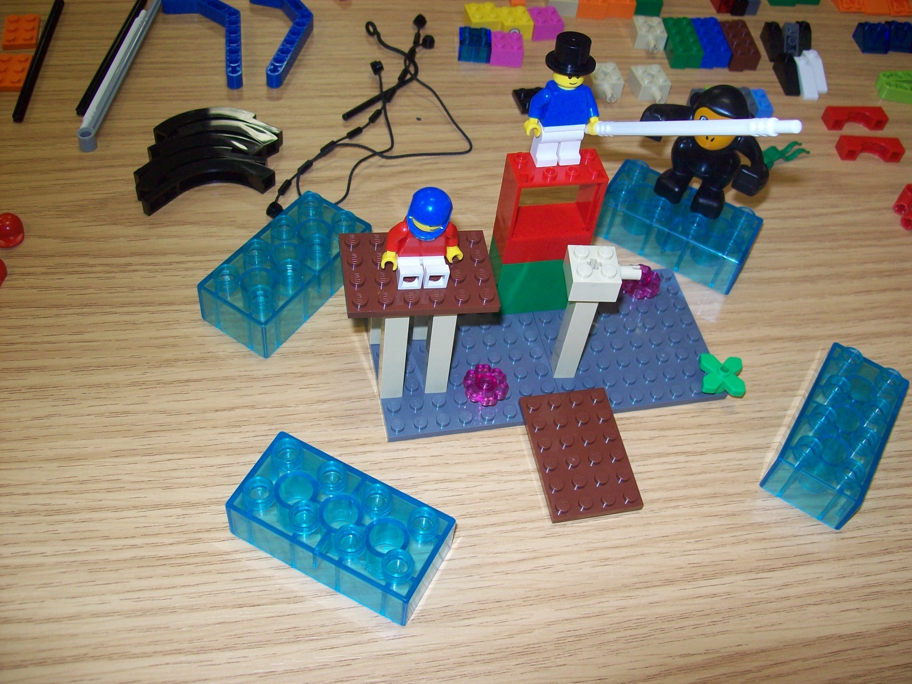
Practitioners:

Slide 19
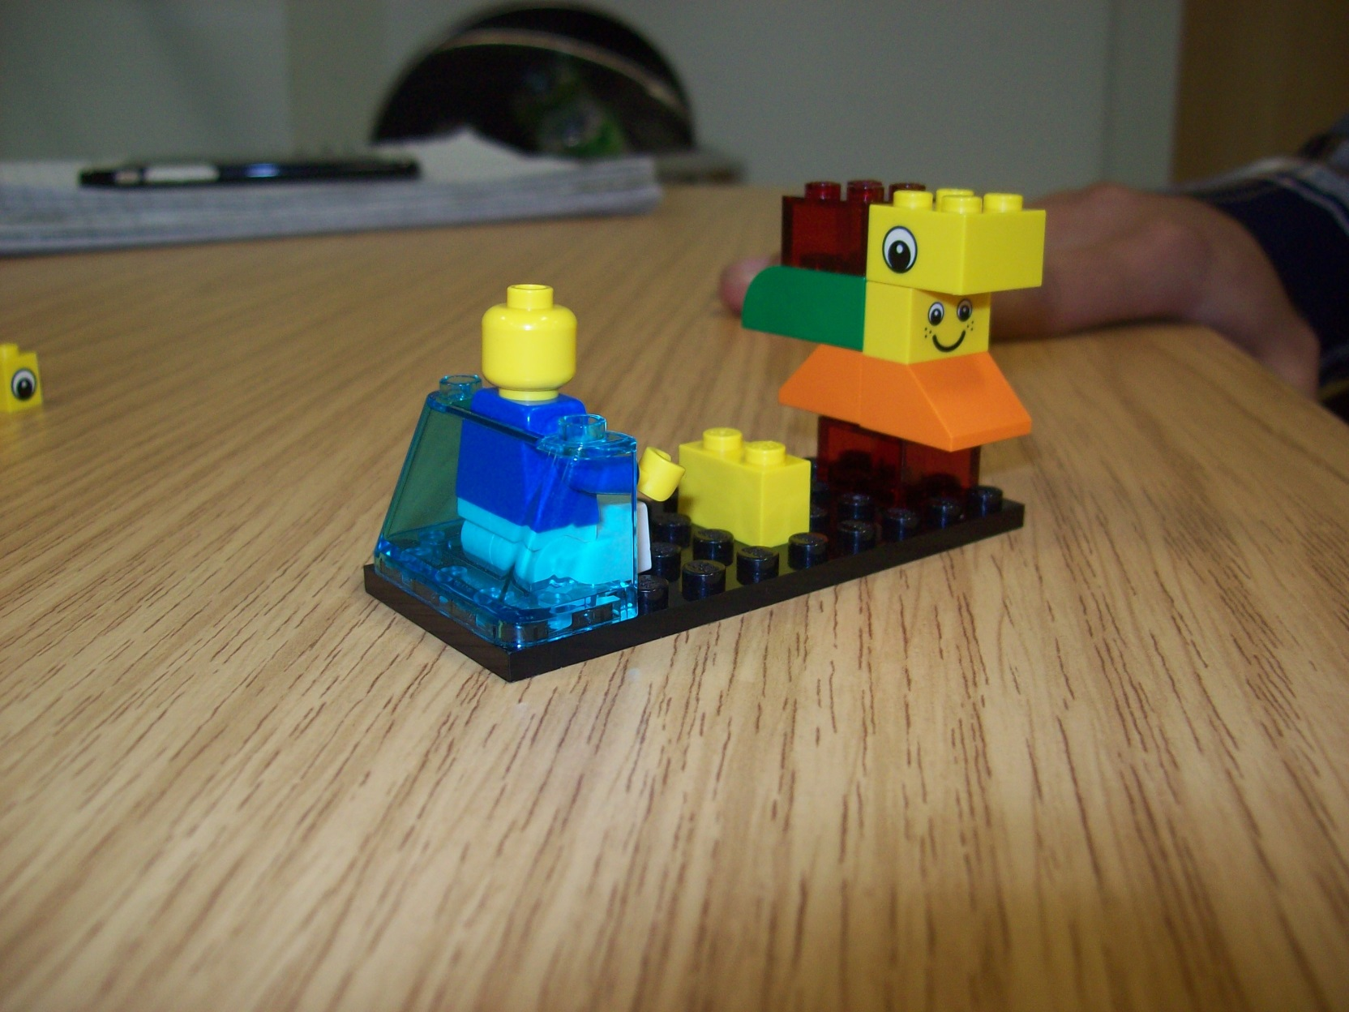
Practitioners:

Slide 20
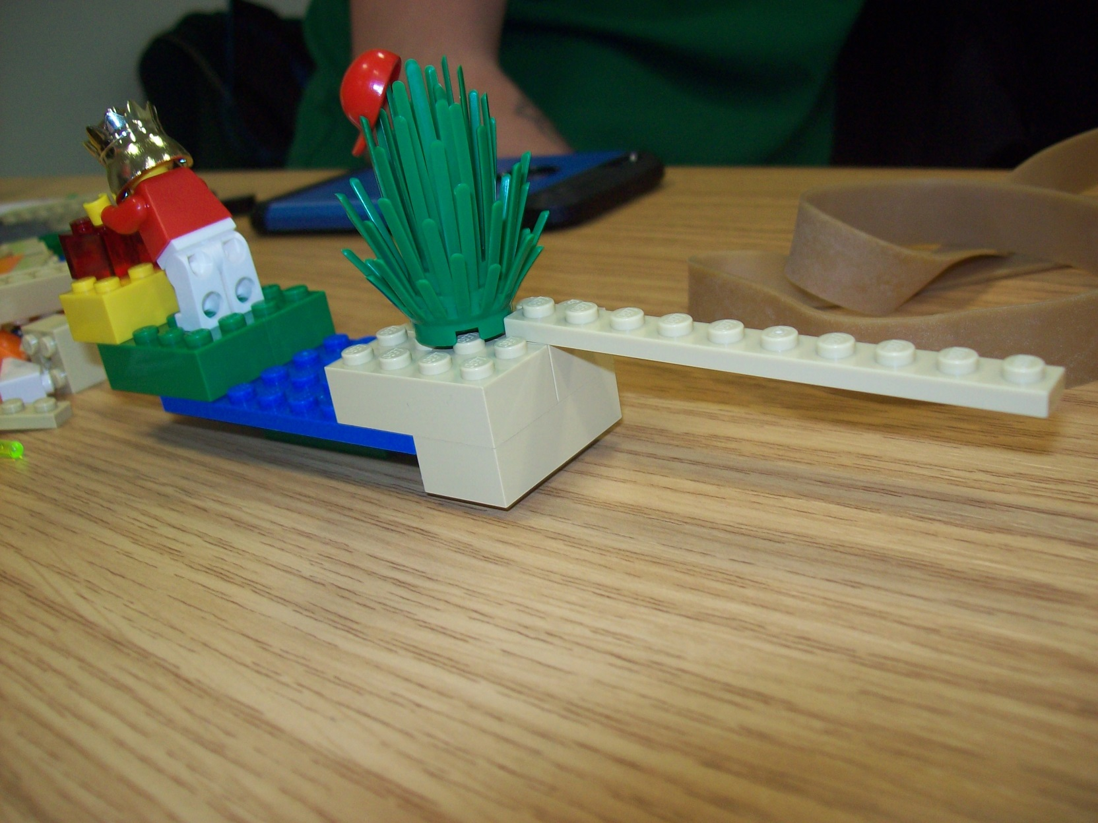
Practitioners:

Slide 21
Practitioners:

Slide 22
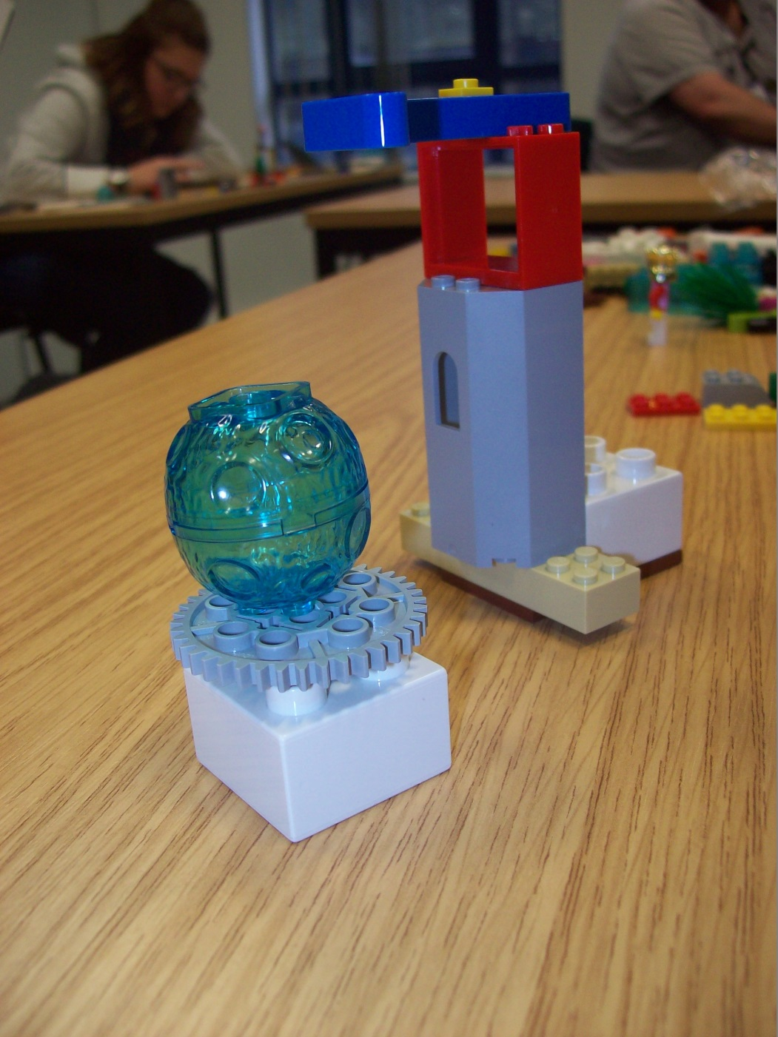
Practitioners

Slide 23
Practitioners

Slide 24
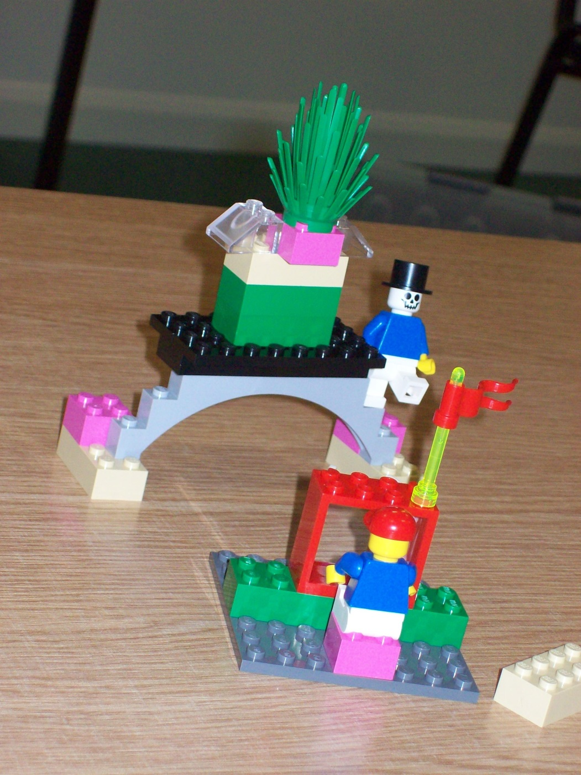
Practitioners

Slide 25
Practitioners

Slide 26
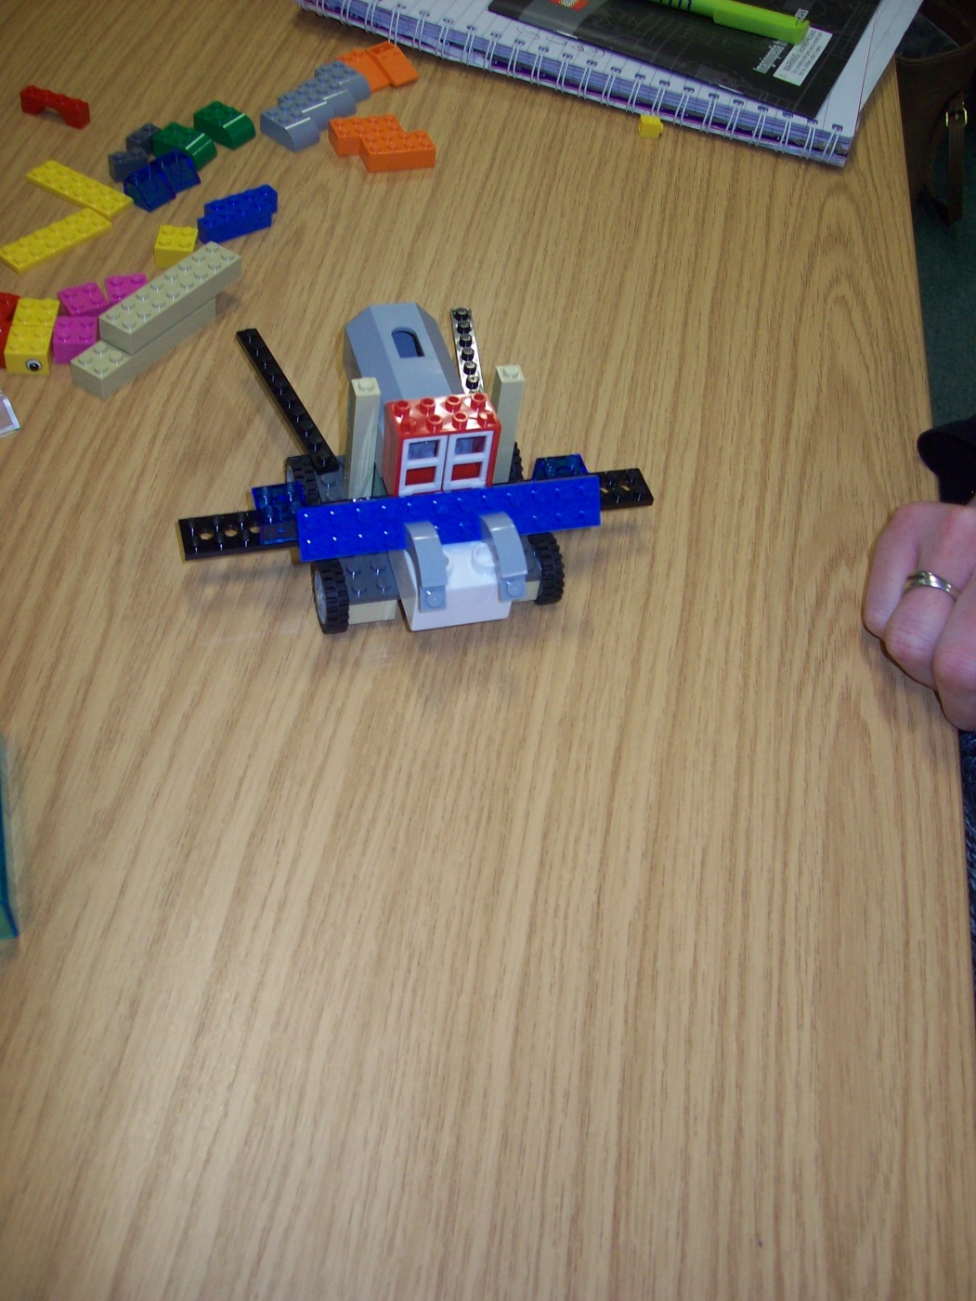
Practitioners

Slide 27
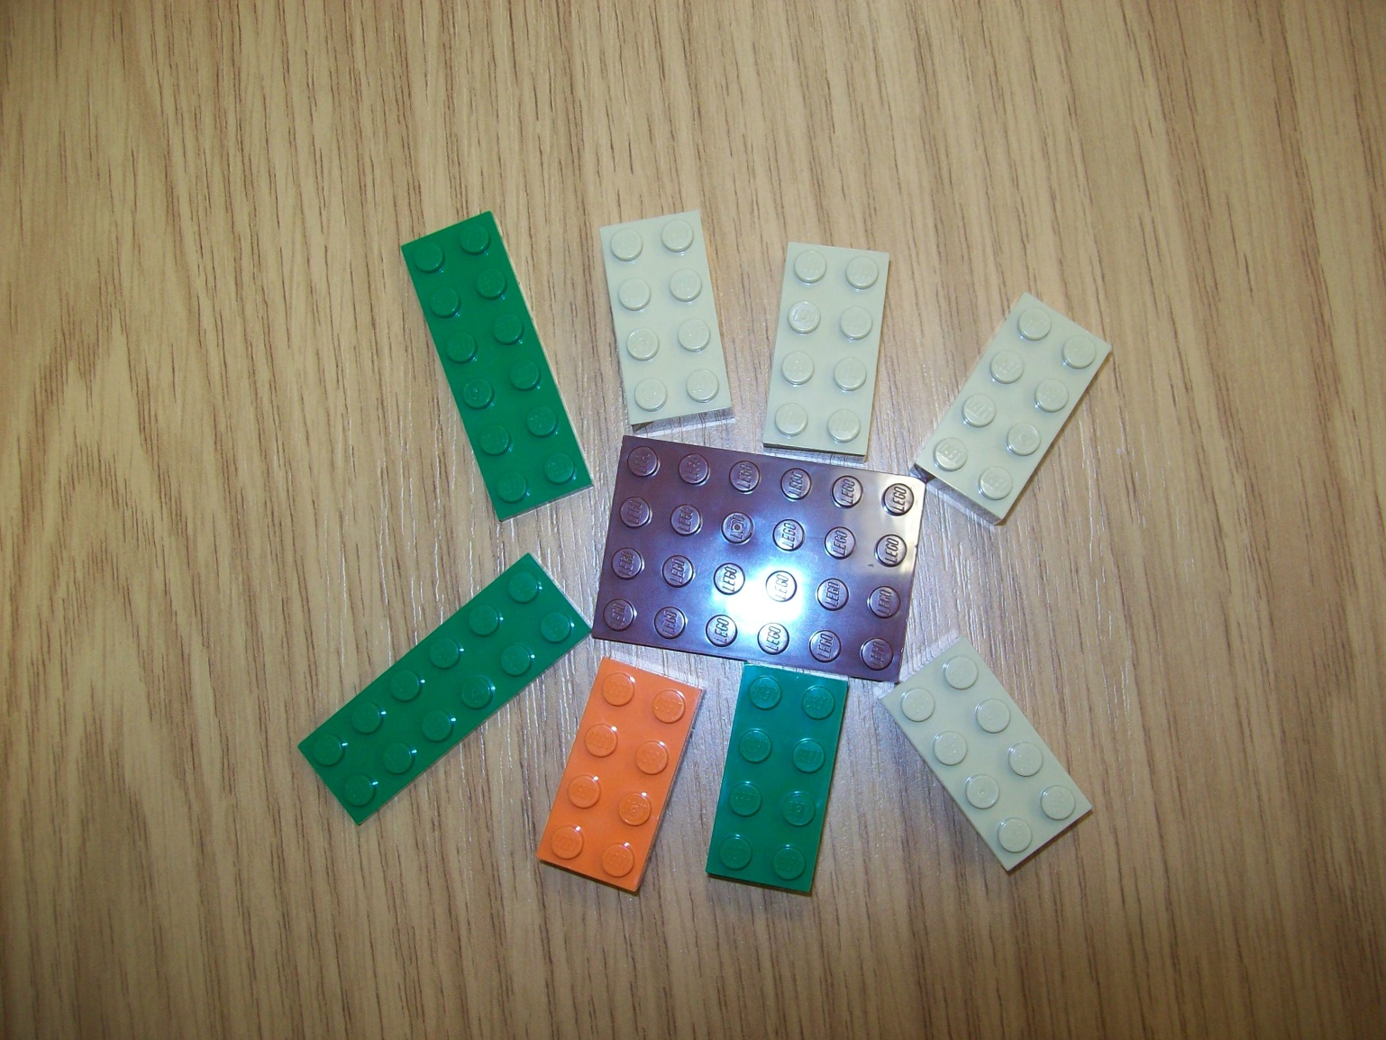
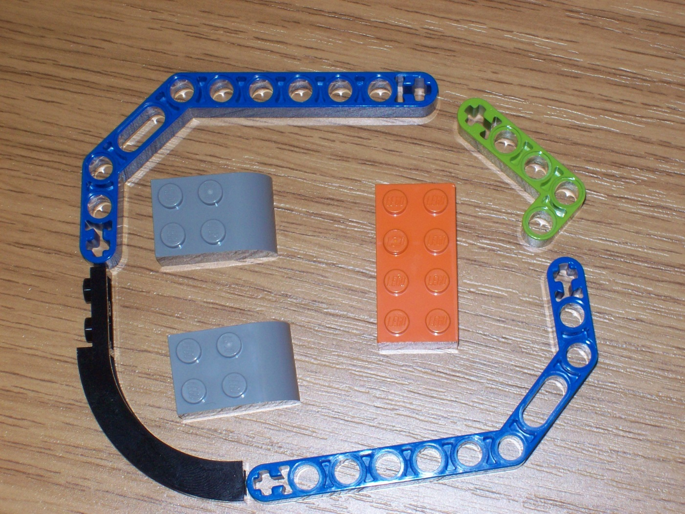
‘Strugglers’ ... ???

Slide 28
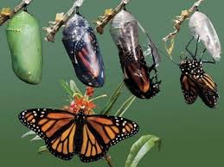
Evaluation & Conclusions

Slide 29
References
Amabile, TM & SJ Kramer (2012); The Progress Principle: Using Small Wins to Ignite Joy, Engagement and Creativity at Work; Harvard: Harvard Business Review Press.
Darder, A (2003); Teaching as an Act of Love: Reflections on Paulo Freire and His Contributions to Our Lives and Our Work; in A Darder, M Baltodano & RD Torres (Eds.); The Critical Pedagogy Reader; New York, NY: Routledge Falmer.
Freire, P (1970; 2000); Pedagogy of the Oppressed; New York, NY: Continuum.
Freire, P (1997); Pedagogy of the Heart; New York, NY: Continuum.
Fromm, E (1957); The Art of Loving; London: Unwin.
Habermas, J (1984); The Theory of Communicative Action; Boston, MA: Beacon Press.
hooks, b (2000); All About Love: New Visions; New York, NY: Morrow.
Jackson, NJ (2014); Developing Students' Creativity through Higher Education; in A Xie & L Lei (Eds) International Symposium on ‘The Cultivation of Creativity in University Students’; Macao: Macao Polytechnic Institute.
Page, J (2011); Do Mothers Want Professional Carers to Love their Babies?; Journal of Early Childhood Research, 9(3): 310-323.
Page, J (2014); Developing Professional Love in Early Childhood Settings; in LJ Harrison & J Sumsion (Eds.); Lived Spaces of Infant-Toddler Education and Care: Exploring Diverse Perspectives on Theory, Research and Practice; London: Springer.

