Slide 1
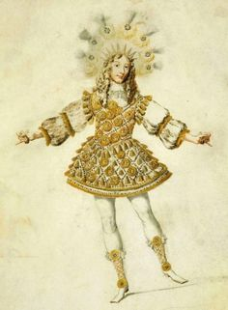
Ballet for the Sun King: power, talent and organisation
John Lever and Stephen Swailes
University of Huddersfield Business School, UK
32nd EGOS Colloquium, July 7-9th 2016, Naples.
Sub-theme 40: The Power of Ideas and Habitus: Organizing from the Past to the Present

Slide 2


Notions of ‘talent’, much like ‘celebrity’ (van Krieken 2012), dominate popular culture. Whether on TV shows, in popular media, or in the workplace, people talk about ‘talent’ as something that generates or leads to prosperity and success (Adamsen 2016).

Slide 3

Modern history of talent in Organizations
Talent has a long history (Adamsen 2016)
1950s – US research on ‘promotability’
1970/80s – emergence of HRM & SHRM
1980s/90s – interest in the high performance work place
1997 - “War for talent” mantra captured practitioner imagination & created a new discourse
1990s ‘Resource-based view’ of the firm became influential in explaining performance

Slide 4
Elitist view of TM
TM – using complimentary HRM practices to attract, develop and retain high performers and high potentials, and fit them into key positions
Talent – people who you perceive as delivering outstanding results in relation to what you want to achieve.

Slide 5
Core assumptions of elitist TM
Some skills & attributes contribute more than others
These skills can be described and assessed
Some positions contribute more than others
Talent in key positions is critical
Talent is scarce
Talent identification is fair and unbiased
Failure to manage talent compromises organizational performance

Slide 6

9 box grid example
Timescale for promotion
Unknown 12-18 months 0-12 months
Emerging star Under performs but has potential | Future star Performs well, has potential | Superstar Exceptional performer with high potential
Potential star Under performer with potential | Rising star Performs OK and has potential | Star Exceptional performer with potential
Under performer | Solid performer | Strong performer
Potential rating
Unsatisfactory Good Excellent
Performance appraisal rating

Slide 7
Why has TM caught on? (A sticky meme)
The idea is simple, seductive, and fits with other ideas about leadership and change
The idea warns of danger and taps into fears of inaction
Lack of a competing idea, except inaction
Ambiguity – adapting to fit organizations

Slide 8
Stickiness continued..
TM short-cuts the complexity of managing large organizations
TM satisfies the need for execs to ‘consume’ the same talent.
People don’t actually need to be more talented.
TM is spread by successful people

Slide 9
TM & Elias
TM is a strategy to maintain order via the creation of differences, distinctions and differentiation.
Competitive relations among the talented paralyse rebellion from within (de Swaan 1990).
TM plays to dominant, powerful discourses
  The ‘talented’’ need the execs, and execs need the ‘talented’.

Slide 10
‘Elitist’ and ‘subjective’ talent management
The ‘elitist’ approach is founded on a view of human capacities, in which, very broadly speaking, the top 20% of employees in a given organizational context are recognized as high performing talents and seen to be responsible for 80% of all positive outcomes (Adamsen 2016).
The ‘subject’ view is very similar in that it equates ‘the term talent to high performers – i.e., ‘the best of class’’ (Gallardo-Gallardo et al. 2013, 296).
We argue that Louis XIV was the first to institutionalise ‘elitist’ and ‘subjective’ approaches to talent management in the 17th century (Elias 1983) and that this approach has a much longer history that is currently recognised!

Slide 11

At first sight it may appear that the courts of the nobility in the 17th century offer little towards our understandings of the development of the modern world.
On the contrary, however, Elias (1983; 2000) shows that courts were a central node in the European civilizing process.
Arguably these insights are still relevant today and we suggest that the work of Elias (1983; 2012) provides important insights into the origins and persistence of institutionalized forms of ‘elitist’ & ‘subjective’ talent management…

Slide 12
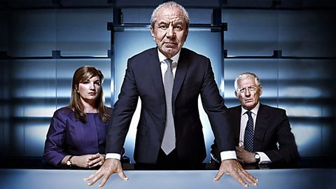
One can see the dominance of contemporary social processes related to ‘celebrity’ and ‘talent’ on the UK reality TV show The Apprentice.
Aspiring ‘talents’ are encouraged by the business celebrity Lord Alan Sugar to perform at a level high enough to win his favours and maintain their position at his court of celebrity – otherwise they will be dropped!

Slide 13

‘The court itself was perpetually performative and subject to intense and constant competition according to ever shifting rules and norms… leading to… the production of ever-changing favourites surrounded by their own networks of patronage and favouritism’ (Van Krieken 2012, 22).
Van Krieken argues that courtly rationality – based on a particular psychological disposition, a certain habitus, organized around heightened visibility, both upwards to one’s superiors, and downwards to one’s inferiors – now underpins the emergence of an embryonic celebrity rationality.

Slide 14
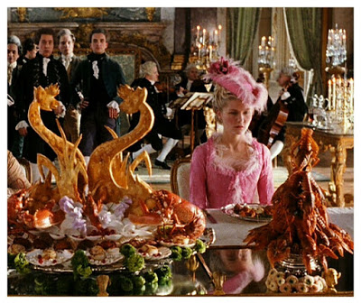
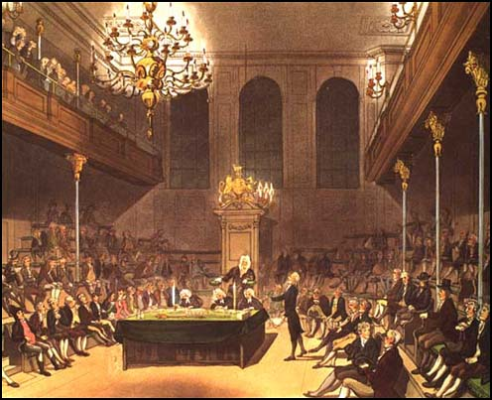
Much as Weber (1978) argued that discipline escaped the monastery and barracks to spread ever more widely, so van Krieken (2012) argues that celebrity rationality jumped the walls of court society through various social forms and intermediary institutions during the civilizing process…
Throughout the sixteenth and seventeenth centuries he argues that the courtier thus became ‘differentiated into a number of different social types – the public servant, the politician’s advisor, the manager, but also the celebrity, the witty, beautiful and talented focus of public scrutiny and attention with access to power’.

Slide 15

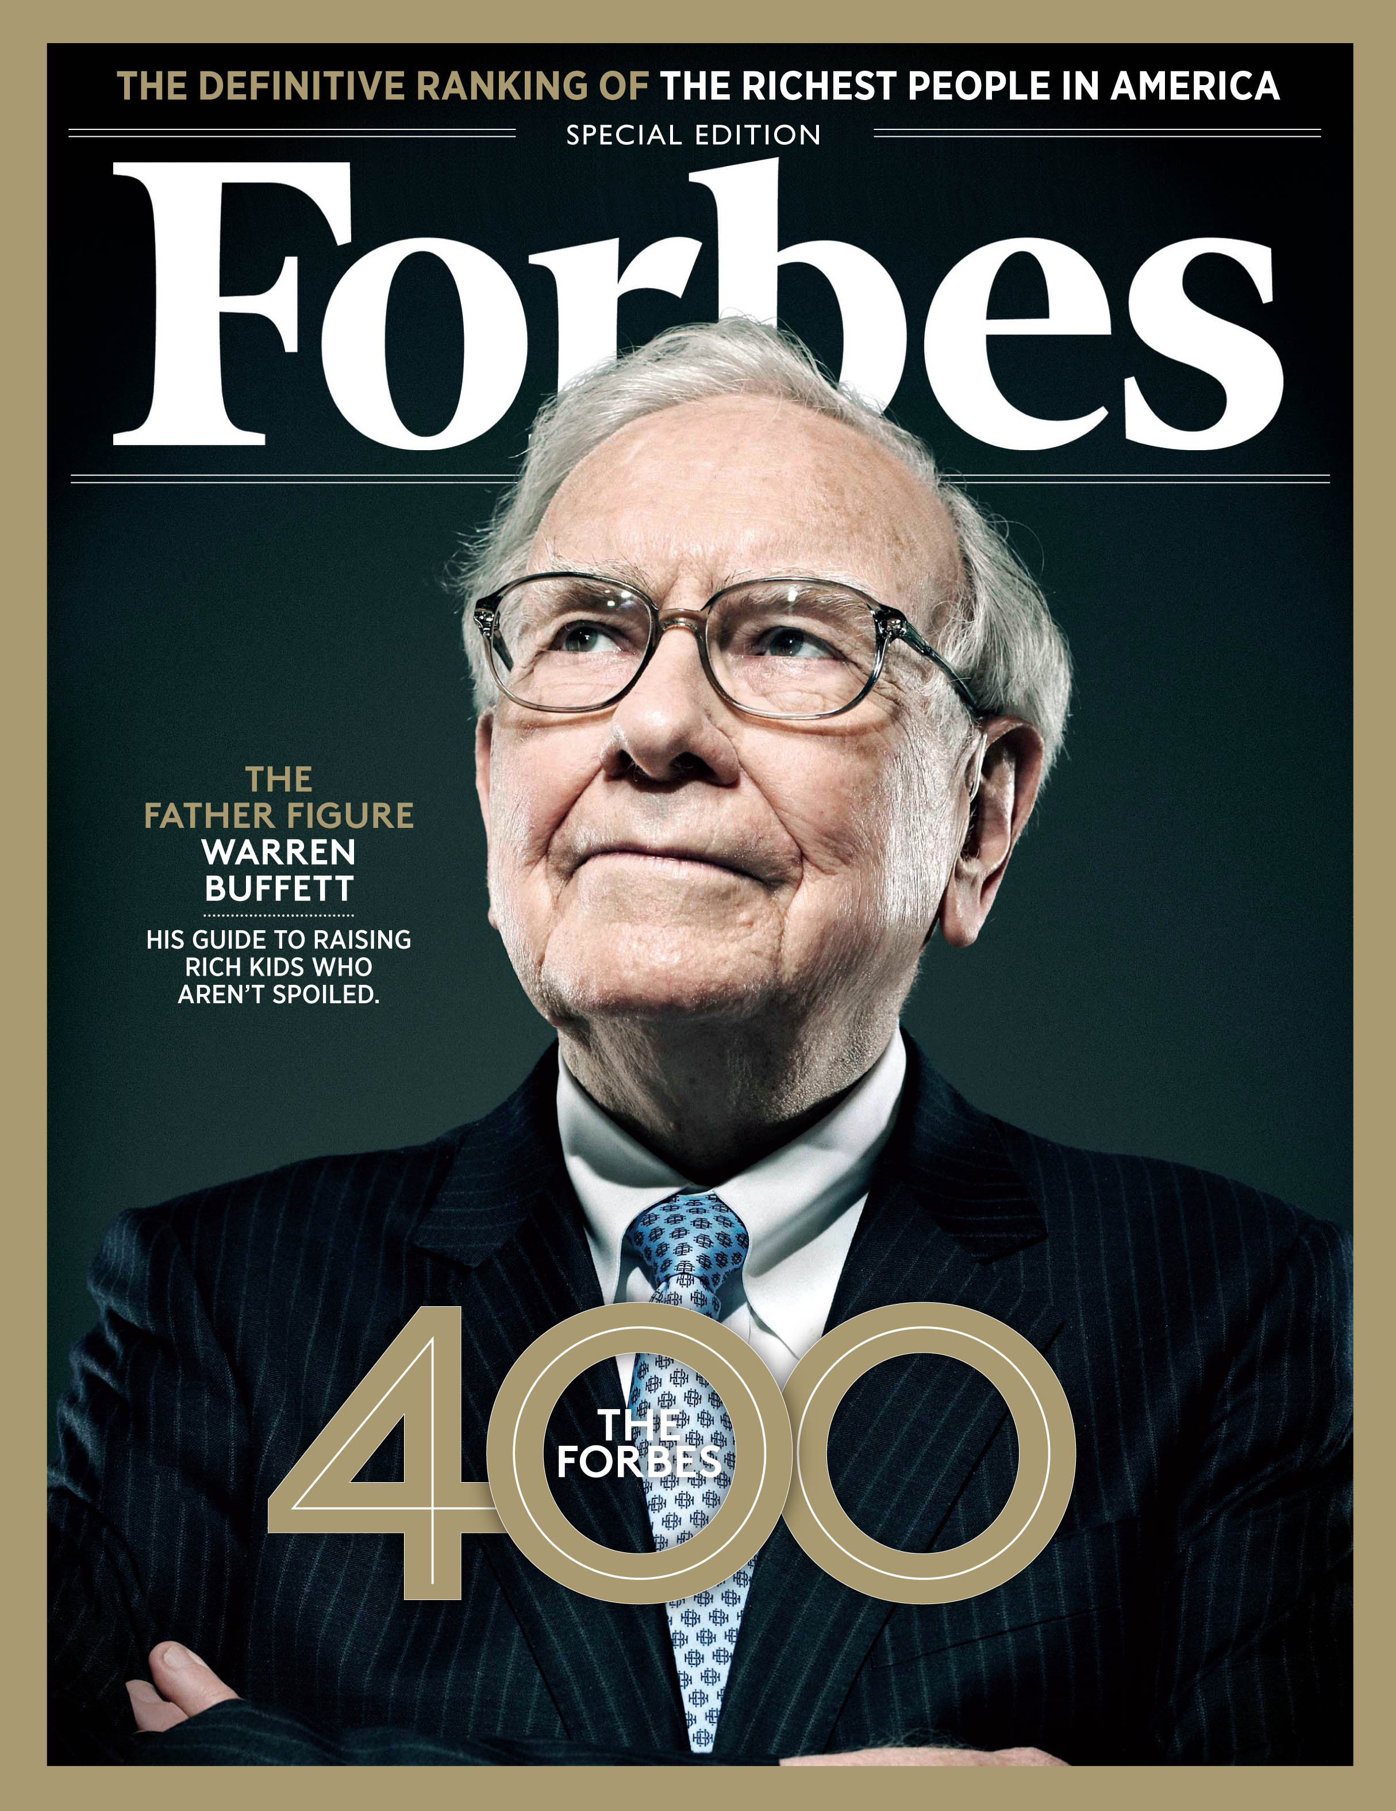
On this account, CEOs in the 1980s and 1990s became celebrities when positive firm performance or distinctive firm behaviour was attributed solely, or at least largely, to them at the expense of all the other possible factors effecting firm performance (Hayward et al., 2004).
In the late 1950s, C. Wright Mills made this argument in The Power Elite (Mills 1957, 74), stating that movie, theatre and TV stars are not celebrated because they are in positions of prestige, but rather that ‘they occupy positions of prestige because they are celebrated.’

Slide 16

Sennett discusses the consequences of these developments in The Fall of Public Man.
He argues that the rise of personality has corrupted social and political life and led to a situation in which the public focus on selected social elites means that individuals below this level are in danger of disappearing altogether.
Sennett suggests that adding a recognisable name to a performance does not only attract a larger audience, but has become the major of way of attracting an audience at all…

Slide 17

There are parallels here with the economics of attention…
In a context where there is a gross oversupply of information, this is an approach to the management of information through which human attention is treated as a scarce commodity...
In this context, names that are well known attract more attention and resources for work comparable in quality to that produced by others who are less well known.
In a world stuffed full of information, ‘what is in short supply is the means to discriminate between what is on offer, and the capacity to attract attention’ (van Krieken, 2012, p.55).

Slide 18
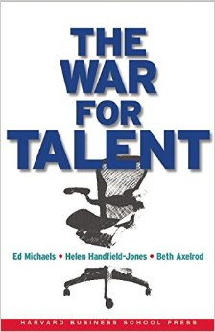
As these processes were gradually normalised throughout the 1980s and 1990s, we argue that most people below the level of the CEO within business organisations began to suffer from a lack of attention, thus giving the quest for ‘talent’ a new significance.
The defining moment in the rise of contemporary talent management came early in the new millennium with the publication of The War for Talent (Michaels et al. 2001).
From this point onwards the ‘elitist’ and ‘subjective’ forms of talent management identified earlier came to the fore (see Adamsen 2016).

Slide 19
This approach to TM allows organisations to control individuals by observing their performance in rituals where particular forms of etiquette are required, and where favoritism, discrimination and subjective bias are at play (Adamsen 2016).
Much as they were at the court, individuals in talent pools must develop their own individual strategies and alliances, and perform in the right way if they are to be recognised as being useful for management.
‘I've had quite a lot of opportunity until now, with lots of roles and types of opportunities to change jobs which is motivating, but things are changing and now I don't think that support is fairly shared, and that… the talent pool… brings about bias into who gets what...’

Slide 20

The dance itself, we contend, is structured by a plethora of management technologies and performance measures that allow senior management to maintain the boundaries of the permissible and ward off dissent before it threatens the established order.
Arguably this undermines the upwards and downwards process of differentiation that drives the process on civilization…
Bintley (2015) has shown that Louis XIV – The Sun King – established the use of ballet as a social pastime at the court in order to keep the nobility busy and suppress internal tension and dissent.
We argue that talent management reflects a new form of organisational ballet and control brought about by the growth of ‘elite power’ and ‘inequality’ both inside and outside organisations (Pikkety 2013).

Slide 21
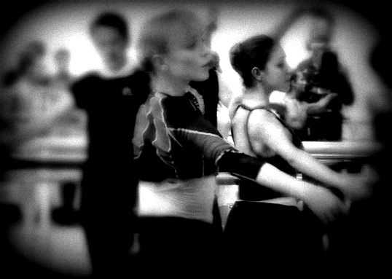
As we argue through an analogy with ‘the politics of professional ballet’, the decision making process involved in TM pools and programmes often places individuals in a ‘double bind’ whereby they have to internalize negative emotions and damaged self esteem by continuing to dance for the company in lesser roles, thus participating in their own oppression (Milling-Robbins 2007) .

Slide 22

Le roi danse - Ballet de la nuit (1653)

Slide 23
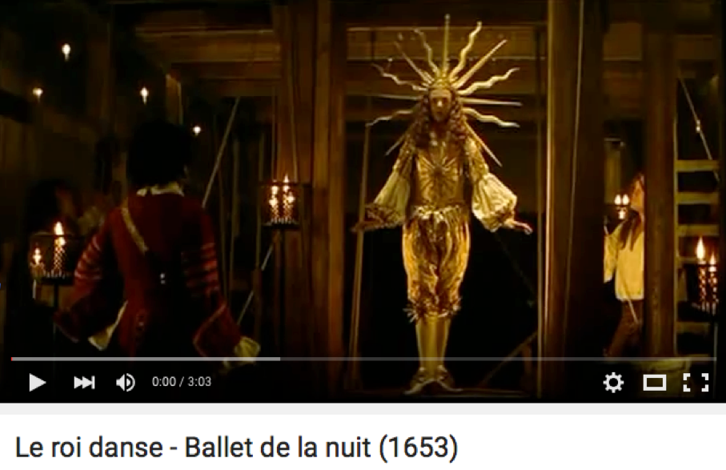
Thank you!

