Slide 1
What to test at C1? Susan Sheehan

Slide 2
Acknowledgement
This project was funded by the British Council through the Assessment Research Grant scheme. The views expressed in this presentation are those of the presenter and do not represent those of the British Council.

Slide 3
Contents
Project background
Methodology
Results
Conclusions

Slide 4
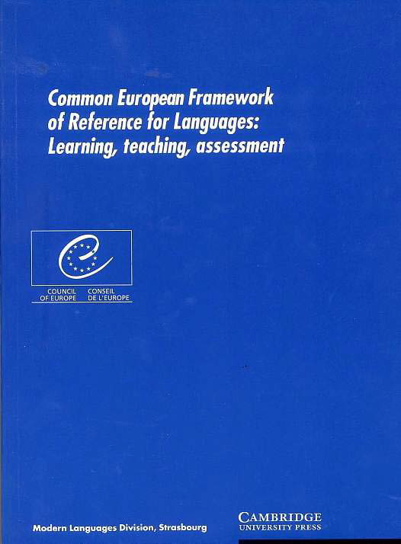
Project Background
First came the “Blue Book”

Slide 5
Project Background
Then came

Slide 6
Project background
The project aimed to identify key criteria of written and spoken English at C1. The project hoped to bring clarity to our understanding of an under-specified and under-described level (Weir, 2005, Green, 2012). The project was an extension of the British Council / EAQUALS Core Inventory for General English (Core Inventory).

Slide 7
Problematic nature of C1
C1 is a challenging CEFR level to investigate as there is a lack of consensus around what makes a person a C1 level language user (Weir, 2005b).
When writing the Core Inventory the C levels were the most problematic. Indeed, the lack of consensus around what should be taught at C levels led to C2 being excluded from the project. Limited consensus was found around C1

Slide 8
Problematic nature of C1
North (2014:50) states that: “Level C1 is characterised by access to a broad range of language that results in fluent, spontaneous communication …They (C1 speakers) are also very accurate, with a solid grasp of the main grammatical structures of the language…”

Slide 9
Problematic nature of C1
C1 is a level which is requested by various authorities. For example, for a teacher certification agency C1 is the required level for someone wishing to English as a foreign language

Slide 10
Methodology
MA TESOL students with IELTS scores of 6.5 or above were invited to take a test of written and spoken English. The test had been created to satisfy the requirements of an external validation agency. The scripts were analysed with ATLAS ti software to identify which of the features described as core in the Core Inventory are found in the scripts and with what level of frequency. The software was used on both the written and audio data

Slide 11
The participants
The participants were all aspiring teachers of English. Participants came from China, Libya, Kurdistan, Vietnam and Pakistan. The first two countries in the list provided the most participants. The participants were all aged between 25 and 35. The majority of the participants were female. This reflects the gender balance of the course. All participants aspired to careers as English teachers upon completion of their studies.

Slide 12
Materials
Participants were asked to complete a written test and an oral interview.
Written test included multiple-choice grammar test, lexis test and an extended writing task
Oral interview – questions based on past language learning experiences and reasons for being a teacher

Slide 13
Data analysis
The tests of grammar and lexis were marked using a key of correct answers.
The extended writing task and interview data were analysed using ATLAS.ti software. The codes used were based on the Core Inventory. The codes were then applied to data. So, for example, ‘Critiquing and reviewing, 33’ was used to code all examples of participants using such language.

Slide 14
Data Analysis
Following the practice established by the Core Inventory writers language points were considered to be criterial if they reached the appropriate level of frequency.

Slide 15
Results – grammar test
Generally participants responded correctly.
Two test items were answered incorrectly by most of the participants. These were:
30 expressing certainty, probability doubt – I rather doubt that he’ll come.
181 collocations – The suspense is palpable.

Slide 16
Results lexis
C1 words were correctly identified 55 times. This compares to 37 correctly identified words at B2 level and 16 words at C2.
The highest average scores were found at C1 level with the exception of A1.

Slide 17
Results – writing and interview
Nearly one quarter of the language points included at C1 occurred with sufficient frequency to suggest that they could be considered criterial for the level.
The language points which could be considered criterial tended to be those relating to argumentation and expressing feelings and attitudes precisely. There is some evidence to suggest that giving advice could be considered to be criterial.

Slide 18
Conclusions
Perhaps the significance of the project lies in the creation of an approach to identifying criterial features by using the Core Inventory.
This project may indicate that C1 level users share more in common than has previously been thought to be the case.

Slide 19
References
Capel, A, 2012, ‘Completing the English Vocabulary Profile: C1 and C2 Vocabulary’, English Profile Journal vol 3 pp 1-14
Council of Europe, 2001, Common European Framework of Reference for Languages: learning, teaching, assessment, Cambridge University Press, Cambridge
Gad, L, Geranpayeh, A, Khalifa, H, and Buckendahl, C, ‘Standard Setting to an International Reference Framework: Implications for Theory and Practice’, International Journal of Testing, vol 13, pp 32-49

Slide 20
References
Green, A, 2012, Language Functions Revisited Theoretical and empirical bases for language construct definition across the ability range, Cambridge University Press, Cambridge
Jones, G, 2015, A Validation Study of the British Council – EAQUALS Core Inventory for General English, British Council, London

Slide 21
References
North, B, Ortega, A and Sheehan, S, 2010, British Council – EAQUALS Core Inventory for General English, British Council, London
North, B, 2014, The CEFR in Practice, Cambridge University Press, Cambridge
Weir, C, 2005b, ‘Limitations of the Common European Framework for developing comparable examinations and tests’ Language Testing, vol 22, pp 282-300

