Slide 1
Sustaining the growth of library scholarly publishing
ELPUB2016
7–9 June 2016, Göttingen
Graham Stone
Collections and Scholarly Communications Librarian
http://eprints.hud.ac.uk/28509/
This work is licensed under a Creative Commons Attribution 4.0 Unported License

Slide 2
University of Huddersfield Press Re-Launched 2010
Press re-launched as a primarily open access press
scholarly monographs
peer reviewed journals
sound recordings

Slide 3
University of Huddersfield Press Drivers and principles
Drivers:
Scholarly monograph crisis
Funder mandates, RCUK, HEFCE, COAF
Early career researchers
Principles governing the Press:
All publications to be of high quality and peer reviewed
Material should be published on Open Access via the University Repository to maximise the potential for dissemination
Managed by the Library, academically led
The business model is one of scholarly communication not profit, with any surplus being reinvested into the Press

Slide 4
University of Huddersfield Press Open Access Monographs
12 monographs published since 2010
Fully OA since 2014
6 OA monographs
PDF on OA
Print on sale via the University online store, Amazon etc.

Slide 5
University of Huddersfield Press OA journals
Based on the Jisc HOAP project (Stone, 2011)
7 current Journals
3 in preparation
1 archived title
Hosted via the University Repository
Preserved in Portico

Slide 6
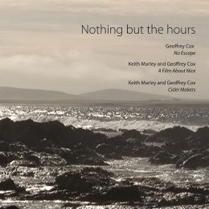
Huddersfield Contemporary Records
8 CDs & 1 DVD
1 Digital download album
Published with CeReNeM and /hcmf
Distributed via NMC

Slide 7
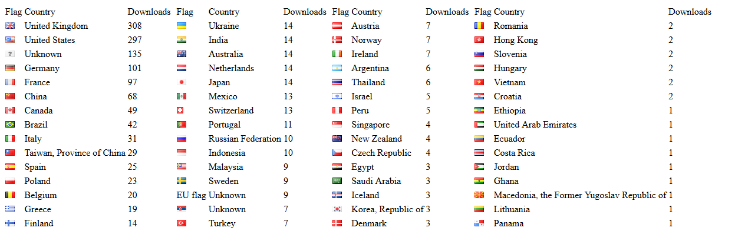
University of Huddersfield Press Noise in and as music
Published Oct 2013
85 copies sold
3,368 copies downloaded

Slide 8
The business model An area that needs significant work
The business model is one of scholarly communication not profit, with any surplus being reinvested into the Press
Clearly unsustainable if open access is pursued
Like many Presses, Huddersfield developed without a clear business plan
Inhibits growth and creates scalability issues

Slide 9
The business model An area that needs significant work
Hahn (2008) suggests two levels of business plans
Programme level planning
Publication level planning
Huddersfield (and many other presses) was operating at publication level
Moving from one publication to another without a clear plan
Leading to sustainability/scalability issues as the Press grows

Slide 10
The business model Programme level planning
Without programme level planning greater demand could lead the Press to become a victim of its own success
Staffing – difficulty in supporting authors/editors
Funding models – a developing area, each model has its own strengths, weaknesses, opportunities and threats (Beech & Milloy, 2015)
Publication level planning – with programme level planning in place, the Press can continue to expand

Slide 11
Sustainability plan Institution/funder pays funding model
Sustainability paper taken to the Press Editorial Board in 2015, which suggested
An increase in staffing to £40K (incl. new 0.6 FTE post) covered by Computing and Library Services
A 5 year cash flow and profit forecast including
Growth by 2 journals a year
2 monographs published in 2016, increasing to 5 a year by 2019
Recurrent costs, e.g. marketing budgets, memberships etc.
Based on known cost this was set at £15K for 2016
Allows for a fee waiver model for peer reviewed publications

Slide 12
University of Huddersfield Press Monograph costs
£4,000 for up to 100,000 words
UCL have similar charges
Costs to be paid by institution
Admin/staffing costs met by CLS
OA with PoD restricted to around £25 per copy
70 sales would give a surplus of £1,750
This surplus would then be used for marketing and recurrent expenditure for the Press

Slide 13
University of Huddersfield Press Journal costs
Set up costs
£750 for landing page and coding
Recurrent costs
£2750 + £50 per year for DOIs
Staffing costs – CLS
Maintenance costs included in Repository hosting charges
Membership | Costs
CrossRef membership | £220
COPE Membership | £190
DOAJ membership | £400
Portico publisher membership | £210
SPARC Europe membership | £1,430
OASPA membership | £200
Total | £2,750

Slide 14
Reputational Value and impact Long term benefits
The argument here is not how much a print run of 100 books will make in profit
But
How much reputational value and benefit there is to the University in publishing an output

Slide 15
Value and impact Research Excellence Framework 2014
UoA 35: Music, Drama, Dance and Performing Arts
100 research outputs
11% included a Press publication (sometimes as part of a portfolio item)
4th in UK for research impact
44% of the overall submission ranked as ‘World-Leading’ (4*)
QR funding (quality-related research funding) per item has been calculated, which shows the true return on investment for the Press

Slide 16
Value and impact QR funding
Press outputs were at least partly responsible for a little under £82.5K of the Music School’s QR funding in just one year
Shibusa, a book entirely funded by the Leverhume Press has brought in £7.5K of funding
Noise in and as Music, a title paid for by the School out of research funds and costing a little over £2K has helped to bring in around £15K of funding from HEFCE

Slide 17
Value and impact QR funding
If this is the income from just one Department within the University, what would be the contribution of Press publications in other research areas?
A modest investment by the University of £15K in 2016, rising to £30K in 2019 could have a large impact on future funding
The outcome of this is that funding has now been agreed for the next 2 years

Slide 18
Library led publishing Collaboration
The 2012 report to SPARC recommends that collaborations should be used to,
“…leverage resources within campuses, across institutions, and between university presses, scholarly societies, and other partners”

Slide 19
Library led publishing Collaboration
We don’t actually know how many UK university presses there are!
21 in 2002, 17 in 2004… (Hardy & Oppenheim, 2004)
In 2016
Oxford, Cambridge, Bristol (Polity Press), Wales, Manchester, Liverpool and Edinburgh (7)
Buckingham, Chester, Hertfordshire, Huddersfield, Imperial, Institute of Education, UCL, UCLan, Westminster, Cardiff, White Rose and St Andrew’s University (12?)

Slide 20
UK landscape study A Jisc funded project
Identify existing and future new university presses in the UK
Learn of the motivations behind their establishment
Determine the types of output being published
Gather information on governance and policies
Identify the publishing platforms being utilised
Ascertain what business models are being applied
Identify workarounds, gaps and frustrations in the workflows

Slide 21
UK landscape study Results?
The survey closed on Monday 6 June
Over 40 responses

Slide 22
References
Beech, D., & Milloy, C. (2015). Business models for open access monographs: a summary document. Retrieved from http://oapen-uk.jiscebooks.org/files/2015/04/Annex-A-OAPEN-UK-Business-Models-SWOT-Workshop-preparatory-document.docx
Collins, E., Milloy, C. & Stone, G. (2015). Guide to open access monograph publishing for arts, humanities and social science researchers. AHRC/Jisc Collections: London. http://dx.doi.org/10.5920/oapen-uk/oaguide
Hahn, K.L. (2008). Research library publishing services: new options for university publishing. Washington DC, Association of Research Libraries. Retrieved from http://www.arl.org/storage/documents/publications/research-library-publishing-services-mar08.pdf
Hardy, R., & Oppenheim, C. (2004). Research on university presses: An overview of UK university presses. Publishing Research Quarterly, 20(2), 18-31. http://dx.doi.org/10.1007/s12109-004-0021-2
Stone, G. (2011). Huddersfield Open Access Publishing. Information services and use, 31(3/4), 215-223. http://dx.doi.org/10.3233/ISU-2012-0651

Slide 23
University of Huddersfield Press
http://unipress.hud.ac.uk/
Graham Stone
@Graham_Stone
http://eprints.hud.ac.uk/28509/
This work is licensed under a Creative Commons Attribution 4.0 Unported License

