Slide 1
Optimising resources to develop a strategic approach to Open Access
Embedding Open Access; Northern Collaboration Learning Exchange 12th May 2016
Nick Woolley Ellen Cole
Head of Library Services Scholarly Publications Librarian

Slide 2
Outline
Background to project and Northumbria
Project work packages, activity and outputs
Case study findings on common practice
Wider Northumbria experience on OA
APCs
Key enablers
Problems and issues?

Slide 3
Northumbria OA Pathfinder
In partnership with the University of Sunderland
‘Optimising resources to develop a strategic approach to Open Access’
“This project will develop shared tools and best practice policies and procedures to enable HEIs with limited external funding to effectively and creatively respond to the challenges and opportunities presented by recent Open Access policies.”
Project team:
Nick Woolley (Project Director) Head of Library Services, Northumbria
David Young (Project Manager) Research Funding and Policy Manager, Northumbria
Ellen Cole (Project Officer) Scholarly Publications Librarian, Northumbria
Barry Hall (Project Officer) Repository Manager, Sunderland
Mark Harland (Planning Analyst) Senior Planning Analyst, Northumbria
www.oapathfinder.wordpress.com

Slide 4
Northumbria University
Since 1894 (Rutherford College of Technology)
Over 30,000 students from over 130 countries
Four faculties across two campuses
Tripled research power in REF2014
In Britain’s best university city – Newcastle upon Tyne
University Library
Part of a super-converged directorate of student-facing services
24/7 and Customer Service Excellence (CSE)
Two library divisions; Learning & Research Services; Collection & Digital Services
Single frontline for all directorate – ‘Ask4Help’
2013 refocus to a ‘next generation functional’ organisational design
Transitioned from Subject Librarians with broad portfolios to functional leads

Slide 5
Scholarly Publications Team
Specialist team in University Library’s Learning & Research Services
Scholarly Publications Librarian and team of assistants
Focused to deliver:
Advocacy and expertise for OA
Institutional repository ‘Northumbria Research Link’ (EPrints)
Management of publication fund and APC payment
Reporting on OA compliance (RCUK)
Supporting REF
Providing ‘Northumbria Journals’ service using OJS
Projects – e.g. JISC OA pathfinder, JISD ARMA ORCID pilot etc..
Bibliometrics – training, analysis, reporting and consultancy
Support for University CRIS project
Relevant face to face sessions in research skills programme
NRL - over 17,000 records – approx. 25% full text.

Slide 6
Project work packages, activity and outputs
Initial OA workshops
At Repository Fringe (July 2014)
At Northumbria (October 2014): University of Coventry; University of Hull; University of Lincoln
In depth case studies
Cost modelling tool
Excel-based tool providing multiple key variables including: FTE, number of articles, REF submission targets, and % Green vs Gold OA
Online decision tool for Faculty
Participation in Pathfinder workshops and events
Wider engagement with colleagues outside pathfinder
March 2016 Sheffield workshop with Sheffield Hallam University and Manchester Metropolitan University

Slide 7
Case studies
Stakeholders from four universities participated
Durham University; University of Hull; University of Lincoln; Teesside University
Each case study explored
1) Costs
2) Structure and Workflows
3) Institutional Policy and Strategy
4) Advocacy, training and awareness
5) Metadata, systems, and compliance
Common practice
Validation – few surprises
Approaches to cost management reflect funding situation
‘First come, first served’
Collaboration between research office and library key
Single point of contact for Faculty – usually library who also manage fund alongside repository etc..
Finding resource to scale support is challenging
Mixed approaches to advocacy – policy compliance v. wider benefits of OA
Local strategic context influences key decision making

Slide 8
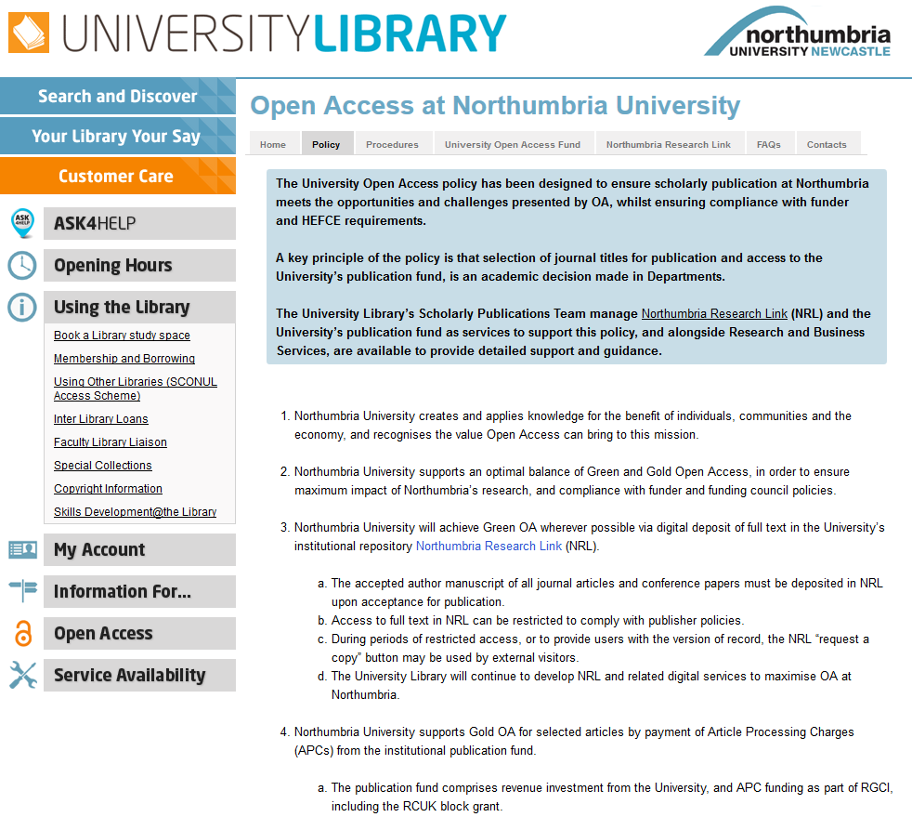
Northumbria’s OA policy

Slide 9
Our OA policy and funding journey
February 2013 Research and Innovation Committee discussion of library paper on implications of Finch report to Northumbria
March 2013 Cross-University working group on OA established. Chaired by Faculty Associate Dean, with Faculty, library, and research office membership
May 2013 Research and Innovation Committee discussion of library paper on straw man OA policy and the costs of OA at Northumbria
June 2013 University Executive discussion of library paper on proposed OA policy, request for more detail on governance and finance
February 2014 Research and Innovation Committee recommendation of library paper establishing Northumbria’s approach to OA
April 2014 University Executive approve policy and funding base don library presentation of a new paper on OA
October 2015 Letter to all academic staff from PVC Research & Innovation

Slide 10
 |  | FTE | Total articles | Articles per annum
REF2014 | Submitted | 342 | 891 | 149
 | REF-able | 469 | 1219 | 203
REF2020 | Target submission | 523 | 1360 | 227
 | Target REF-able | 715 | 1859 | 310
Annual institutional publication fund (£1,000’s) |  |  | £0 | £50 | £100 | £150 | £200 | £250 | £300 | £350 | £400
No. of articles made Gold OA (based on average APC of £1896) |  |  | 0 | 26 | 53 | 79 | 105 | 132 | 158 | 185 | 211
Gold OA (%) | REF 2014 | 149 articles submitted | 0% | 18% | 35% | 53% | 71% | 88% | 106% | 124% | 142%
 |  | 203 articles REF-able | 0% | 13% | 31% | 39% | 52% | 65% | 78% | 91% | 104%
 | REF 2020 | 227 articles submitted | 0% | 12% | 23% | 35% | 46% | 58% | 70% | 81% | 93%
 |  | 310 articles REF-able | 0% | 9% | 17% | 26% | 34% | 43% | 51% | 60% | 68%
Challenges and opportunities | £0 | RCUK non-compliance. Failure to use OA to maximise impact of Northumbria’s research globally. Risk to reputation in research community.
 | £50,000 | Gold OA for RCUK funded outputs but minimal publication impact for the majority of REF outputs.
 | £200,000 | RCUK compliance. Maximised impact for selected REF outputs. Contributing to a reputable research environment at Northumbria.
Notes:
Cost model: https://oapathfinder.wordpress.com/2015/07/06/cost-modelling-tool-now-available/

Slide 11
APCs at Northumbria
APCs managed by the University Library:
2013/14 – 1
2014/15 – 38
2015/16 – 115 so far
2015/16
APCs for 81 authors from 22 departments
RCUK block grant spend at approx. 300% for 15/16
Outstanding negative balance for 14/15
Over 40% of APCs made using vouchers, credits, discounts etc..
Use JISC template to record all activity – publish data on figshare
Complete RIOXX fields in Northumbria Research Link (NRL) repository
PO’s and invoices with senior sign-off

Slide 12
Key enablers at Northumbria?
Departmental planning and alignment with Corporate Strategy
Organisational design and focus – Scholarly Publications Team
Comprehensive institutional OA policy, senior buy-in, and responsive IAG
Evidence-base and data driven approach to making business case for publication fund
Effective professional relationships within the institution – particularly co-ordination between Library and Research Office
Delivering demonstrable impact and value
RCUK compliance 0% for Year One - 83% for Year Two
http://nrl.northumbria.ac.uk/25712/
..and wider research environment
Central management in Library with academic selection in Faculty

Slide 13
Problems and issues
What happens when RCUK funds are exhausted locally? Academic selection on publication title and requirements for Green?
Connecting funding with publication – role of the CRIS?
Understanding potential for more strategic publication title selection – but aversion to lists.
Understanding author contribution. Who pays?
Working around the author-publisher blackbox. Benefit if a Harvard-style licence?
Shifting policy landscape and funding for OA in the UK. Gold v. Green – influence of HEFCE policy and next REF. Green Paper and Nurse Review
Impact upon the Library Collection and total costs – prospect of rebalancing payment as part of transition from big deals? Could double dipping provide cheaper route for some HEI’s?
Assessing ROI from publication funds and APCs – bibliometrics? Timescales?
Losing sight of OA greater good?

Slide 14
Thanks for listening…

