Slide 1
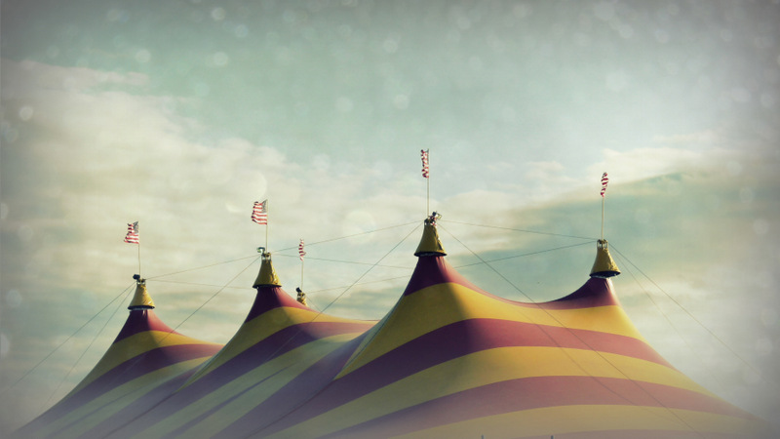
Transform-IT: On the magic roundabout of skills
A playful academic skills collaboration
Andrew Walsh, Teaching Fellow @andywalsh999
Jess Haigh, Subject Librarian @BookElfLeeds
University of Huddersfield
Photo from: https://www.flickr.com/photos/vsanderson/7651717898

Slide 2
About the project…
Librarians
University
Academic Skills Tutors
College Partners
Students
Lecturers
Aim: To work collaboratively with Consortium colleagues and their students, to identify strategies that support students in the lower grade bands and on borderlines, in order to raise achievement.
Mainly BA Education and Development students.
With a little bit of money from:

Slide 3
What we did… the planning.
All about the collaboration….
So lots of us in:
2 group meetings in Huddersfield
2 days (and an overnight) at Northern College

Slide 4
Terrible hardship was endured…
https://www.flickr.com/photos/dinksi/8360448625

Slide 5
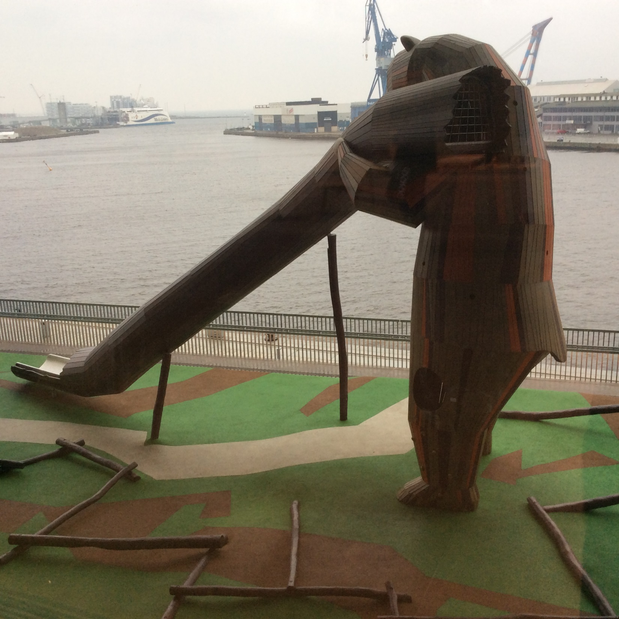
Ended up with a playful, creative, constructivist / constructionist approach.
Pedagogical approach matched the desire to deal with lack in “problem solving and critical understandings” identified.
As well as being what the students on the group thought would work!

Slide 6
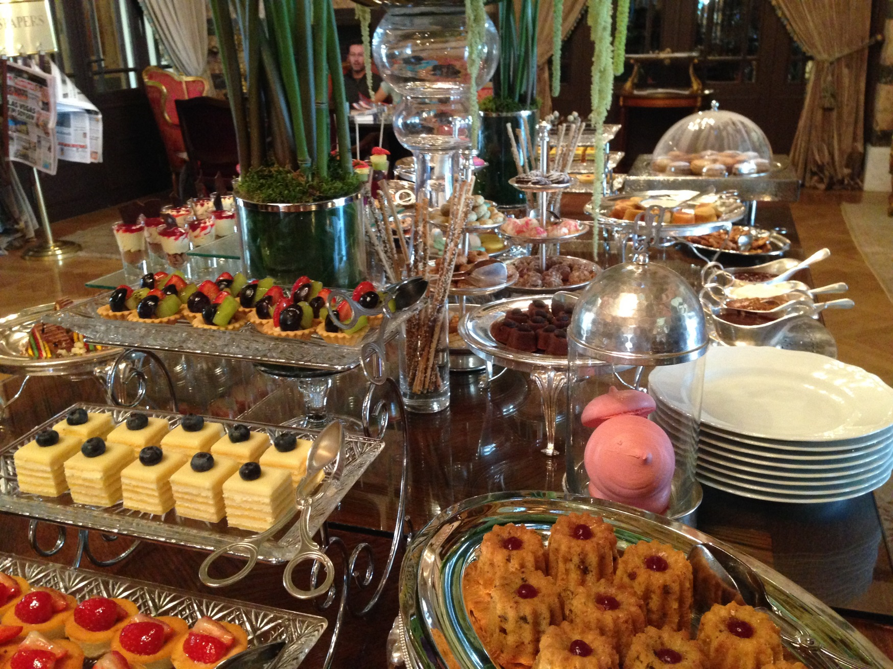
The content…
Writing Boot Camp
SEEK!
Building essays with Lego
Referencing games
A leap of confidence
Time management
Analysing a journal article…
… through collage.

Slide 7
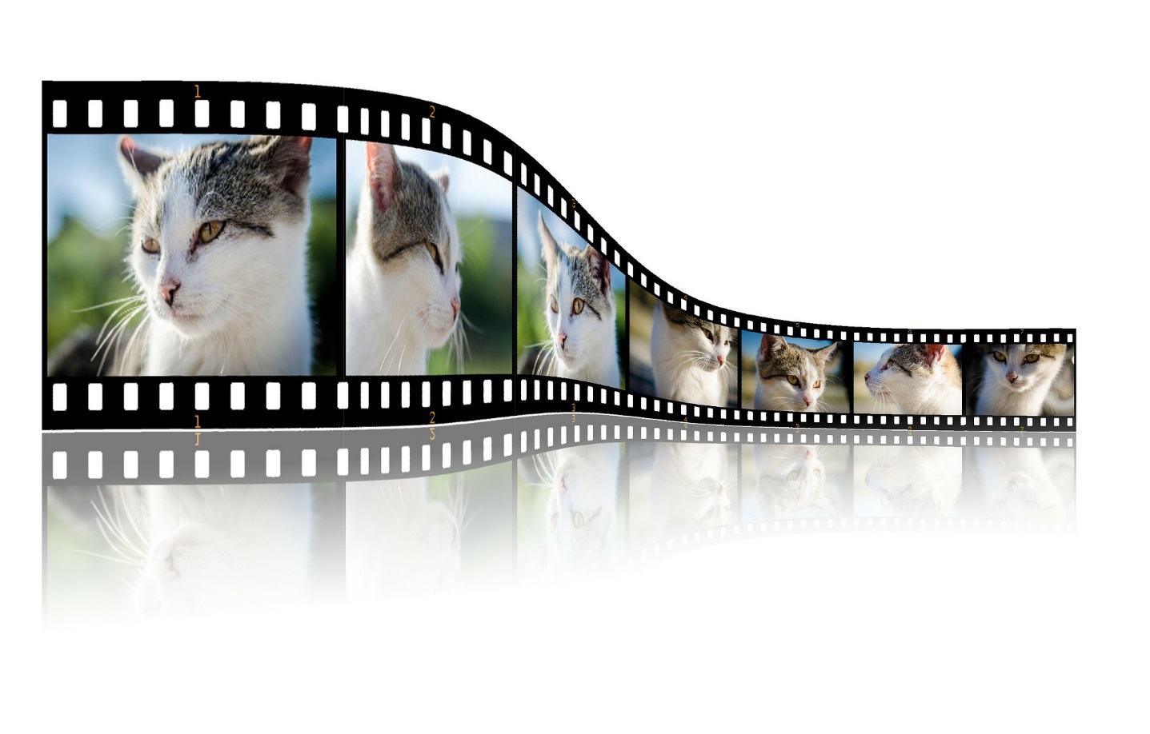
For the video please visit
https://www.magisto.com/album/video/MXd_WlADGlsjLCwEDmEwCXh3?l=vsm&o=i&c=e?utm_source=magisto&utm_medium=email&utm_campaign=producer_shared_movie

Slide 8
What we found…
Easily identifiable theme encourages “playful” atmosphere
Increases engagement
More “open” to joining in, even if they initially do not understand the tasks
“safe space” “liminal space”
http://www.loc.gov/pictures/item/2002695269/ Attribution 2.0 Generic (CC BY 2.0)

Slide 9
What worked?
Students were involved in requested/designing sessions
Academic skills tutors/lecturers and librarians working cooperatively
Flexible lesson planning/design!
Attribution 2.0 Generic (CC BY 2.0)
hbp_pix

Slide 10
When you have to frog it…
This working depends on commitment to the theme-without a ‘story arc’ the sessions do not knit together
Some of the sessions did not ‘match’ the others in terms of flexibility and style-and some just confused the students!
Being a project we have worked on over time, and being a flexible safe space allows us to rip up sections and start again without fear.

Slide 11
Confused? You will be…
Attribution 2.0 Generic (CC BY 2.0)
Matthew Nelson

Slide 12
Our plan is to evaluate the whole project during Summer 2016
To continue to think about more interactive and playful sessions for a greater range of information/academic skills
Use the materials for other sessions

Slide 13
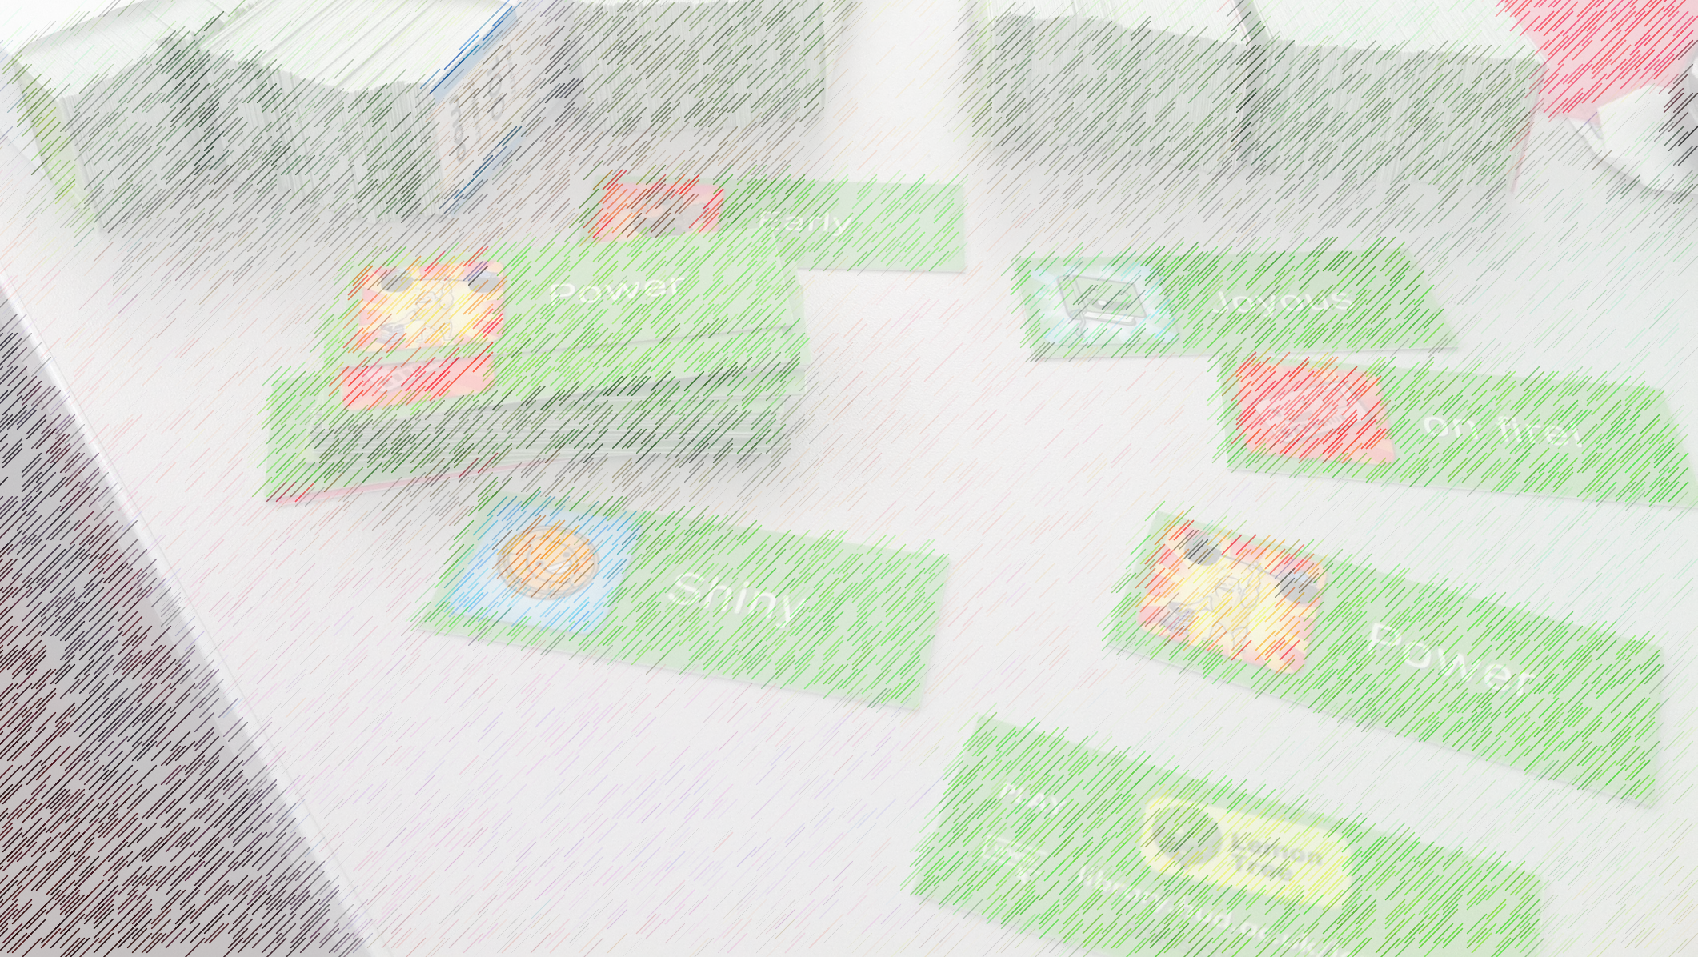
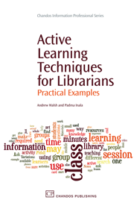
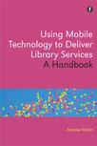
Other stuff from Andrew
http://innovativelibraries.org.uk/
Some of my books on the right…
Other stuff from Jess
https://jesshaigh.wordpress.com/
Questions?
Slides are at:
Andrew Walsh, Teaching Fellow @andywalsh999
Jess Haigh, Subject Librarian @BookElfLeeds
University of Huddersfield

