Slide 1
Take your degree to the next level: marketing MyReading at the University of Huddersfield
Alison Sharman and Kate McGuinn
CILIP/PPRG Marketing Excellence Awards 2015

Slide 2
MyReading – the background
In 2008…
Library received reading lists for only 40% of modules
Many lists contained out of date or inaccurate information
Manual processes for reading list management were laborious and outdated
A systematic, automated approach was required
MyReading project groups launched
Notes:
Processes – lists arrived in paper form and were scanned by librarians to see what needed to be ordered, orders were then placed manually. There was no good system in place for checking whether individual titles were included in more than one list.
Project groups comprise Steering group, made up of senior stakeholders including the Pro-Vice Chancellor for Teaching and Learning and Technical Group, made up of library & computing staff.

Slide 3
Drivers for design of MyReading
Improve the student experience:
comprehensive availability of reading lists
Better access to reading list items – full text where possible
Inform collection development
Integrate reading list management with library acquisition processes
Make best use of resources and ensure value for money
To ensure the provision of reading lists is a managed, positive experience for staff and students
Notes:
Collection development – too much of our stock was sitting on the shelves and not being borrowed because in many cases we didn’t know what academics were recommending.

Slide 4
Early marketing strategy from 2011
Launch activities to students:
Huge posters screen printed onto windows of Central Services Building
Leafleting around campus
MyReading pens distributed
Articles in staff and student newsletters
MyReading promoted in new student inductions and refresher sessions for returning students

Slide 5
Evaluation of launch
Notes:
The figures show a sharp early rise as you would expect during the launch period but this then levels out somewhat between 2011-12 and 2012-13 as we slackened off our marketing effort.

Slide 6
Evaluation of launch
Usage figures were plateauing after an early sharp rise
Student focus groups in 2013 revealed a lack of awareness of MyReading
The project team realised that the task of marketing MyReading was not yet complete
A dedicated marketing sub-group was launched with a brief to increase student and staff engagement with MyReading

Slide 7
Our promotional objectives
To promote MyReading to students who are not yet using the software
To increase student usage of MyReading
To highlight to students the benefits of using MyReading:
Saves them time and effort finding reading list materials
Makes it easier to find resources in the library or online, or source a copy to purchase
To employ a story-telling narrative to resonate with the student experience
Notes:
To increase student usage of MyReading, especially as research carried out at the university, the Library Impact Data Project, showed that students who use more books and articles may also get better degrees (Stone and Ramsden, 2013)

Slide 8
Our promotional objectives
To produce a 90 second animation to promote MyReading in a memorable and attractive way
To produce supplementary materials (pencils, posters and pamphlets) using the same graphics/colours used in the animation
To use these marketing tools in inductions and information literacy sessions and recommend them to academic staff for them to use with their students
To measure the impact of the campaign – did it provide value for money?

Slide 9
Marketing matrix
Designed by the marketing department
A university-wide tool which we use to plan marketing campaigns
Helped us to think about key aspects of the campaign, including…
The different channels of communication available to us, including social media
Face to face interactions outside the library which could be used to promote our campaign
Notes:
Face to face interactions which could be leveraged included the School Teaching and Learning Committee meetings, student panels and course committees where the video could be shown to raise staff awareness so that they could use it themselves to promote their reading lists to students. A key part of our student promotional strategy is actually to get lecturers to do most of the work! After all, they are their reading lists and they have put work into them, so they have a great reason to promote them too!

Slide 10
A branding problem: Reading Lists or MyReading?
Focus groups in 2013 revealed that students didn’t recognise MyReading as a brand
MyReading seen as an extension of UniLearn by students
Lecturers refer to it as MyReading!
But is this really a big problem?
Project group decided to avoid confusion and refer to MyReading as “Reading lists” for student marketing purposes
Notes:
Blank faces when we started asking student focus groups about MyReading!
An added complication is that the Learning Technology Advisors in Schools, who are very protective of UniLearn as a brand, have always been reluctant for us to promote MyReading as a separate brand to students! Thus the less than ideal situation has arisen where the “back end” of the product is promoted to lecturers as MyReading but the front end which students see, is promoted as “Reading lists”

Slide 11
Narrative marketing approach
Adopted as our preferred approach early in the planning stage
Inspired by the Registry and SU’s successful “Are you present” campaign
Desire to create a campaign with an authentic student voice
Our narrative: despite the overwhelming amount of information available, reading lists are there to help students find the material they really need to be successful
Notes:
“Are you present” campaign – raising the profile of attendance monitoring. Not a particularly popular subject and a hard sell to students but using a narrative approach they were able to get the advantages across in an appealing way.
One of our principal aims was to create a campaign with an authentic student voice using language that students would understand, relate to and find motivating. To this end, we commissioned Fifth Planet, a company set up by two recent graduates of the university to create the animation which underpinned the campaign. We came to them with a storyline in mind, but the script was developed by them so that we were able to leverage their student experience in the creation of the animation’s language and images.

Slide 12
Narrative marketing approach
Narrative marketing approach was backed up by further reading in the marketing literature:
“Service brand image” is best communicated in a way which creates connections with customers’ own experiences of using a service (Padgett and Allen, 1997)
Service stories should demonstrate understanding of customer needs and show how the service can meet those needs (Germano, 2010)
Notes:
As library professionals with a bit of marketing theory picked up “on the job” we felt that we needed to do a bit of reading around the subject of narrative marketing in order to understand it better. Two key articles which inspired us were by Padgett and Allen and Germano – full references will be given at the end of the presentation.
Padgett and Allen also said that as narrative thought is a cognitive process which people use to understand their experiences, narrative, story-based advertising should therefore be a highly effective means of marketing services to consumers.

Slide 13
Narrative marketing approach
A “well honed value proposition”
Student focus group input
Our value proposition:
“Take your degree to the next level”
Notes:
Germano further advised that a “targeted service story that includes a well-honed value proposition” is an essential component of any service marketing strategy. Again when we considered our value proposition, it was important to choose one which reflected students’ own priorities, not ours. For this campaign, our value proposition is “Take your degree to the next level.”

Slide 14
The animation
Notes:
We decided early on that the animation would be a cornerstone of the campaign to promote and inform students. We chose an animation because we felt it would be useful in so many ways, at induction, on plasma screens in the library, on youtube and also that it would be immediately appealing to students.

Slide 15
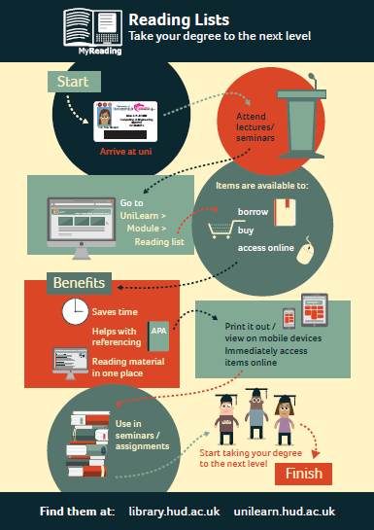
Notes:
Because Fifth Planet were happy to provide us with all the images they had developed during their work on the animation, it was really easy for us to produce high impact print items as well, at little extra cost.
We placed these posters on the backs of toilet doors in the library at the beginning of the 2014 and 2015 academic years.

Slide 16
Leaflets

Slide 17
Leaflets

Slide 18
Building a bigger picture
Survey to gather data on students use of MyReading
Survey ran for 4 weeks
Embedded into MyReading software
Prize draw to incentivise students to complete it
https://www.flickr.com/photos/kodamapixel/5656712570/

Slide 19
772 Questionnaire Responses

Slide 20
Split between Schools
University School | Percentage
Applied Sciences | 9.8%
Art, Design and Architecture | 4.4%
Business | 25.6%
Computing and Engineering | 1.7%
Education and Professional Development | 9.6%
Human and Health Sciences | 28.6%
Music, Humanities and Media | 20.3%

Slide 21
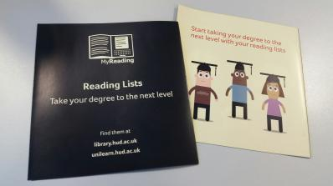
Which of the “Taking your degree to the next level” promotional materials have you seen?

Slide 22
Impact of the promotional materials
One third of students not seen any of the promotional materials
94 first years
76 second years
83 third years
Yes 236/260 using their reading lists so getting the info from other sources.
Notes:
Go through each item in turn:
Posters were the most widely distributed resource, displayed both in the library and in academic schools so it is no surprise that the posters were the “most seen” of our promotional materials. [Mention the back of toilet doors]
The animation/video was not seen as much as we would have thought, as it was displayed on plasma screens in the library and a link to it was on Summon, our library search engine. However, despite the fact that a lot of the respondents of this survey had not seen it, it is the most popular video on the university library’s YouTube account (hudlibrary) with 4,461 views in the 10 months it has been online.
Leaflets: distributed in info skills sessions and displayed next to the library catalogues

Slide 23
Don’t use MyReading
In 2015, only 4.2% of students surveyed had NEVER consulted a reading list.
Compared to
19.2% in 2012

Slide 24
Chart showing MyReading use from Jan 2012 – April 2015
Notes:
We were able to gather statistics on MyReading usage; we define usage as the number of times a list is accessed and how many times items in the lists are clicked on. The statistics show that there has been a marked increase in usage since the launch of our new marketing materials.
The usage does follow a similar pattern to the previous year but there was considerable growth in October 2014 where uses increased by over 40,000 on October 2013.

Slide 25
MyReading usage over the last two academic years
Notes:
As we are looking at the impact of our marketing project which is new in this academic year we only have data up to April 2015, therefore we’ve have compared the usage for September to April period over the past two academic years:
We would expect an increase in usage year on year however, this leap in usage figures - an increase of 49% in one year, is really positive. We can speculate that our new promotional materials may well have been a factor in this growth.
What is also encouraging is that usage for January - April 2015 has almost doubled from the same period in 2014, indicating that the marketing campaign is having a lasting impact on usage figures.

Slide 26
Future Marketing Strategy
Use data from the survey to inform future marketing strategies

Slide 27
Future Marketing Strategy
Market MyReading during pre-enrolment
Promote MyReading to academics and encourage them to sell it to their students “The only way they are going to [realise reading lists are a useful resource] is if lecturers say “this is available, we expect you to use these tools”, but they just don’t” Comment from a student focus group

Slide 28
Getting the academics on board
Rewarding MyReading champions
Notes:
Offered a prize to the academic with the “best” reading list
Metrics used include:
book loans: a measure of how likely students enrolled on the module are to borrow books
item views: the average number of items on the reading list that students enrolled on the module have looked at
Variety of item types
Last update
Percentage of items with annotations

Slide 29
Notes:
Produced a leaflet for staff. Highlighted the winning reading lists for each School complete with a URL for staff to get inspiration for the design of their lists./
You’ll notice too that we have used the same graphics.

Slide 30
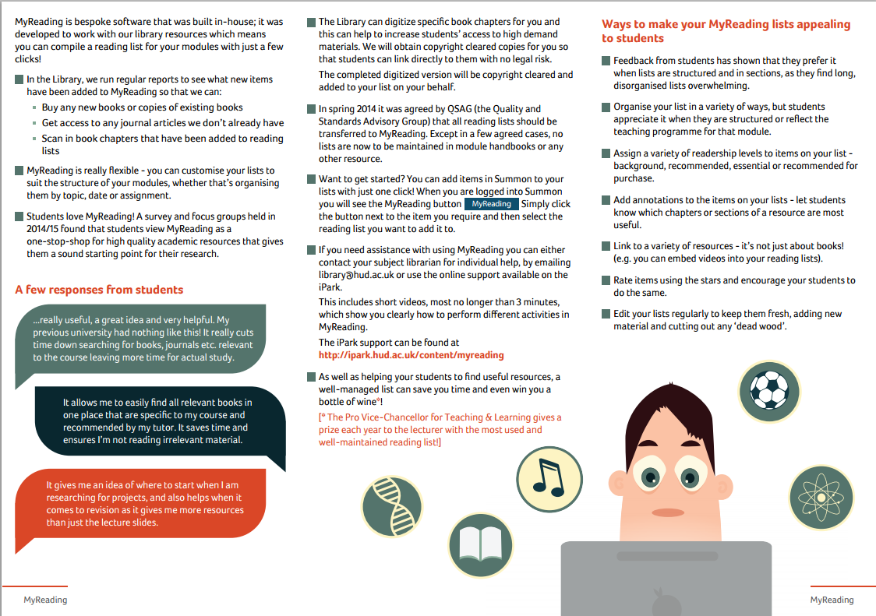

Slide 31
Teaching and Learning Festival 2015

Slide 32
Engage your students with MyReading
Research conducted by the library has shown that students like reading lists which are annotated and divided into well-structured sections. MyReading can be seen as a positive pedagogical resource which inspires students to read more.
If you would like to learn how to take your reading lists beyond the basics or would just like a refresher on MyReading, this session is for you.
It will be a practical, hands on workshop so participants are advised to bring some material with them which they would like to add to MyReading.
Notes:
Technology Enhanced eLearning Education

Slide 33
Get academics to promote best practice
Notes:
In this session the winners’ of the 2015 prize for best use of a MyReading list on a Unilearn module will explore the principles of reading list construction and organisation and will discuss ways in which barriers to student usage can be minimised.

Slide 34
New Business School Post
Reading List and Collection Development Librarian in post
Funded by the Business School
Started with Economics as a pilot, will then roll out to other subjects

Slide 35
References
Germano, M.A. (2010). Narrative-based library marketing: selling your library’s value during tough economic times. The Bottom Line - Managing Library Finances, 23(1), 5-17. doi: 10.1108/08880451011049641
Padgett, D., & Allen, D. (1997). Communicating experiences: a narrative approach to creating service brand image. Journal of Advertising, 26(4), 48-62. doi: 10.1080/00913367.1997.10673535
Stone, G. & Ramsden, B. (2013) Library Impact Data Project: looking for the link between library usage and student attainment. College and Research Libraries, 74(6). pp. 546-559. doi: 10.5860/crl12-406
University of Huddersfield (2013). Are you present? Retrieved from https://www.hud.ac.uk/news/2013/october/areyoupresent.php.

Slide 36
Any questions?

