Slide 1
Centre for Applied Psychological & Health Research
Return to work is a family decision?
The influence of ‘significant others’ on work participation for those with chronic musculoskeletal pain
Dr Serena McCluskey

Slide 2
Why do some people become work-disabled?
They do not have a more serious health condition or more severe injury
So, it’s not about what has happened to them; rather its about why they don’t recover
Chronic non-specific musculoskeletal pain is a leading cause of sickness absence and work disability in Western society.
In the UK, only 2% of those who receive disability benefit will return to work

Slide 3
Psychosocial Flags Framework
Person - psychosocial factors associated with unfavourable clinical outcomes and the transition to persistent pain and disability
Workplace - stem largely from perceptions about the relationship between work and health, and are associated with reduced ability to work and prolonged absence
Context - in which the person functions; includes relevant people, systems and policies. These may operate at a societal level, or in the workplace. They are especially important since they may help or hinder the recovery process.

Slide 4
The influence of ‘significant others’
Significant others (spouses/partners/close family members) have been shown to have an important influence on an individual’s pain behaviour and disability
Largely based on operant (reinforcement), cognitive-behavioural (thoughts about patient behaviour), communal coping (response to patient catastrophizing) and empathy (own experience influencing response) models of pain

Slide 5
Family and work participation
Department for Work and Pensions, UK (2011) – “family has an important role to play in facilitating RTW”
Relationships with ‘significant others’ and ‘family life’ are highlighted in review studies of work participation
Social networks are important for recovery of chronic pain and continued work participation

Slide 6
Gaps in the existing research
Significant others are rarely the main/sole focus of research
Data is rarely collected from significant others themselves
The influence of significant others on work participation has not been directly examined
The focus is largely on those who are unable to work due to musculoskeletal pain

Slide 7
Qualitative Studies
Chronic musculoskeletal pain (CMP) patients and their significant others in the UK (n=28) & the Netherlands (n=21):
(1) Condition Management Programme (all work-disabled);
(2) Hospital-based pain clinic (half work-disabled, half still at work)
(3) ‘Working with pain’ study (all at work)
Data from studies 2 and 3 were assimilated to explore the relevant factors around continued work participation with CMP

Slide 8
Method
Almost identical questions were asked in both studies about the support of significant others
Thematic analyses applied to both sets of data independently; themes were identified
Data were then assimilated and final themes checked for consensus

Slide 9
Significant other responses: UK & Netherlands – Significant others
‘Connectivity’ – encouraging communication
‘Activity’ – encouragement to keep active
‘Positivity’ – encouraging a positive outlook

Slide 10
Significant other responses: ‘Connectivity’
“Make sure that I am always open to discussion”
“It is important to let them determine when to talk about the pain”
“Take the pain seriously, be patient, and avoid patronizing”
“Always have a listening ear and sympathize”
“Try to show understanding as much as possible…they might get grumpy because they are so tired from working and being in pain, but you have to be understanding”

Slide 11
Significant other responses: ‘Activity’
“Ensure that they remain active despite the pain”
“I tell him to continue with his activities and do not give in to the pain quickly”
“Try to keep doing the things that are important and use your energy for that”
“Just continue, the pain is there whether you work or not”
“If you’re at work then you have no time to brood”
“Don’t lie down, exercise and carry on as normal”.

Slide 12
Significant other responses: ‘Positivity’
“Don’t be a whiner”
“Try to enjoy the things that you can and emphasise these. Go out to do fun things to keep you socially involved”
“I always say there are worse things in life”
“Try and be as positive as much as you can, don’t be miserable about it”
“Do not resign yourself to a situation…be hopeful that it will improve”
“Someone has to remain positive…I think positivity breeds positivity”

Slide 13
Summary
Novel insights about the positive and supportive influence of significant others in context of chronic pain and work
Significant others and workers beliefs are congruent
Significant others have their own information needs
Some discrepancies – highlighting complexity involved
Relationship quality, socio-demographic characteristics and significant other health also important factors

Slide 14
Conclusions
Adding to the under-researched ‘social’ component of the ‘biopsychosocial’ model of chronic pain.
Support of significant others may be usefully harnessed in pain management and/or vocational rehabilitation programmes.

Slide 15
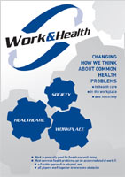
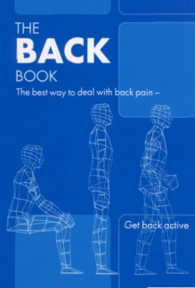
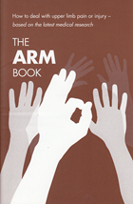
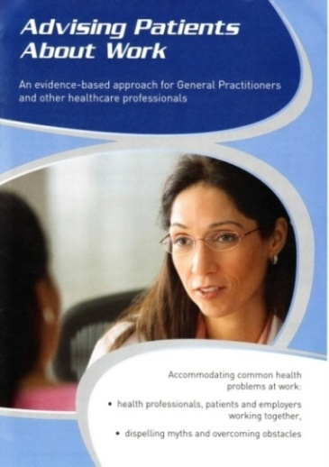
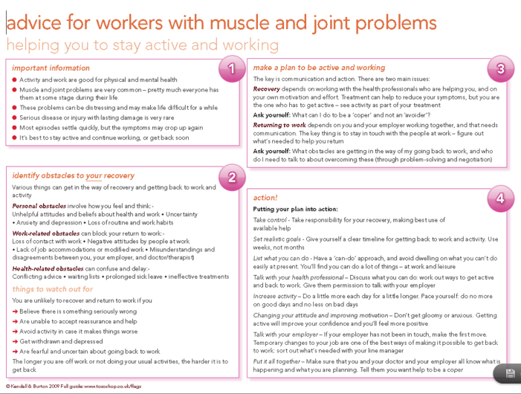
How best to include ‘significant others’?
Evidence-informed material
workplace
worker
healthcare
Practical advice on return to work processes
Facilitate communication and understanding
Synchronous distribution
Free PDFs
www.tsoshop.co.uk/evidence-based

Slide 16
Policy and practice
Healthcare alone is not enough
Harnessing the support of others
Reinforcing continued work participation

Slide 17
Acknowledgements
Dr Joanna Brooks; Professor Nigel King & Professor Kim Burton (University of Huddersfield)
Dr Haitze de Vries; Professor Michiel Reneman & Dr Sandra Brouwer (University of Groningen)

Slide 18
McCluskey et al., BMC Musculoskeletal Disorders, 2011;12, 236
Brooks et al., BMC Musculoskeletal Disorders, 2013; 14, 48
McCluskey et al., WORK, 2014; 48, 391-398.
McCluskey et al., BMC Family Practice, 2015;16, 85
Thanks for listening!
s.mccluskey@hud.ac.uk

