Slide 1
The University of Huddersfield experience
What’s my motivation, darling?
November 4-7, 2015, Charleston Conference
Graham Stone
Information Resources Manager
http://eprints.hud.ac.uk/25643/
This work is licensed under a Creative Commons Attribution 3.0 Unported License

Slide 2
Setting the scene University of Huddersfield
Medium sized University in the North of England
24,000 FTE students
On target to achieve its goal of becoming an internationally recognised research-led institution

Slide 3
Institutional drivers Strategy and Key Performance Indicators
Increase publications at international level
Grow citations
Increase quality of output
Increase the number of researchers and research active staff

Slide 4
Research strategy The role of the library
Liaison in all the usual places
Subject teams, academic librarians, research librarian
Web pages, LibGuides
Research Committees
Desk top visits

Slide 5
Research strategy The role of the library
We liaise with research marketing to help researchers choose the right article and to grow impact
Discover magazine

Slide 6
Staff Development The informed researcher
Training sessions for PhD students and academic staff
Citations count: how to use citations to increase your research impact
Managing research data
Open access publishing: increase your audience
Organising your references
Online research networks: share your work and connect with others

Slide 7
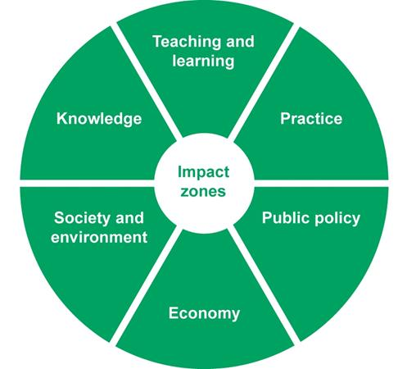
Making an impact 6 ways to boost citations
Identify yourself
Collaborate
Reach your audience
Be discoverable
Be accessible
Disseminate
National Coordinating Centre for Public Engagement
Notes:
Megan
NCCPE have identified 6 keys areas for creating research impact – impact zones
We have used elements of this guidance, together with information from a range of organisations including Vitae and HEFCE to create a 6 step guide for researchers and PGRs. Covers 6 main aspects, designed so you can pick and choose what works for you.
(Refer to printed ones).

Slide 8
Making an impact 6 ways to boost citations
Identify yourself
Collaborate
Reach your audience
Be discoverable
Be accessible
Disseminate

Slide 9
Disseminate
Notes:
Graham
Run through basics of:
Author dashboard
My publications
Manage Account

Slide 10
Disseminate
Notes:
Graham
Run through basics of:
Author dashboard
My publications
Manage Account

Slide 11
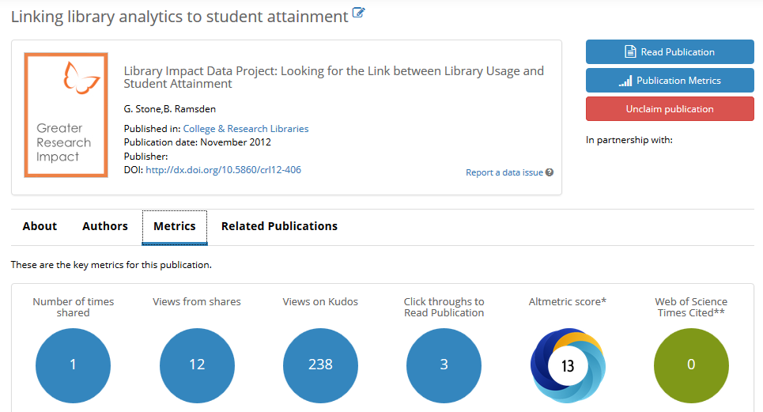
Disseminate
Notes:
Graham
Run through basics of:
Author dashboard
My publications
Manage Account

