Slide 1
The experience of student use of eBooks on mobile devices
Graham Stone
Information Resources Manager
This work is licensed under a Creative Commons Attribution 3.0 Unported License

Slide 2
A group of 25 higher education libraries in the north of England
Established in 2011
SCONUL regional group from 2014
Northern Collaboration Content Group
Forum for sharing best practice

Slide 3
The problem
Student and academic staff experience of eBooks is very poor
https://flic.kr/p/7KRgsP

Slide 4
Previous work
University of Huddersfield
Investigating the eBooks experience for mobile users and accessibility issues for users with a disability
Hull York Medical School (HYMS)
Work underway to understand mobile use
University of Hull
Working on an eBooks evaluation matrix, which arose from robust student feedback as part of implementing an “eBook first” policy

Slide 5
Participants
Authors
Amy Devenney (University of Huddersfield)
Maggie Sarjantson (University of Hull)
Graham Stone (University of Huddersfield)
Sarah Thompson (University of York)

Slide 6
Scope
eBooks bought from Askew and Holts (VLeBooks), Coutts (MyiLibrary), Dawson (DawsonERA), EBL and Ebrary
All of which are in the National Books Framework Agreement
eBooks bought directly from publishers were out of scope
The libraries had received few, if any, complaints about using these eBooks

Slide 7
Aims and objectives
To produce a number of recommendations to the NC Directors Group
To facilitate a constructive dialogue between libraries and vendors
Ultimately to improve the student experience with eBooks
https://flic.kr/p/fQFaCW

Slide 8
eBooks matrix
Licence
If the licence prohibits a certain use then the fault is not with the interface, e.g. DRM
Platform
Online reader as a control. If the platform did not allow a certain action, then the mobile experience may not either
Mobile interface
Testing of the mobile experience
Accessibility
A series of questions to be asked as part of workshops with users with disabilities. To gather a body of user experience

Slide 9
Testing
Tests were conducted using the following
PC (as a control)
iPad Air
ASUS Transformer Android tablet
Samsung Galaxy Android tablet
Kindle Fire
https://flic.kr/p/a5LhrM

Slide 10
Licenses
https://flic.kr/p/mzXj9

Slide 11
Licences (1)
Licence | Dawsonera | MyiLibrary (Coutts) | EBL | VLeBooks (Askews & Holts) | ebrary
Download allowance | 100% - for a specific period of time | Can choose to activate a download option | 100% - for a specific period of time | 100% - for a specific period of time | No information
Copy allowance | usually 10% - restricted by DRM | Yes - subject to publishers restrictions | 5% - must be through the on-line system to create a 'hit' | usually 10% - restricted by DRM | No information
Print allowance | usually 10% - restricted by DRM | Yes - subject to publishers restrictions | 20% - must be through the on-line system to create a 'hit' | usually 10% - restricted by DRM | No information
Emailing of results | No | No | Yes | Yes | No information

Slide 12
Licences (2)
Although suppliers are working with, broadly, the same publishers there are different interpretations of DRM
A less restrictive approach would benefit students, and, ultimately, may therefore improve sales to libraries
Licences are inconsistent across the five suppliers
Licences rarely detail important access and DRM information

Slide 13
Online reader (platform)
https://flic.kr/p/7GBSRK

Slide 14
Online reader (platform) (1)
A key finding is that the functionality and experience of using a supplier’s online reader is the same whether it is accessed from a PC or mobile device (iPad, Android, or Kindle Fire)
All suppliers’ online readers require third-party software to be enabled in the web browser (e.g. Adobe Reader, Adobe Digital Editions, JavaScript)
This software is not available as standard on all universities student desktops, however, if available users can easily access eBooks through the online readers on-campus.

Slide 15
Online reader (platform) (2)
Inconsistencies

Slide 16
Device (download)
https://flic.kr/p/u3K3kE

Slide 17
Device (download)
The app/software is consistent regardless of supplier
 | Dawsonera | MyiLibrary (Coutts) | EBL | Ebrary | VLeBooks
PC | Adobe Acrobat | Not known | Adobe Digital Editions | Adobe Digital Editions | Adobe Digital Editions
iOS | Adobe Reader/ Bluefire Reader | Bluefire Reader | Bluefire Reader | Bluefire Reader | VLeBooks App
Android | Bluefire Reader | Bluefire Reader | Bluefire Reader | Bluefire Reader | Bluefire Reader, or VLeBooks App

Slide 18
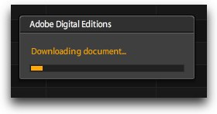
PC Downloads
Adobe Digital Editions on the PC
Very limited functionality
Compares poorly to the features available in the suppliers’ online readers
These limitations diminish the experience of using the eBook
https://flic.kr/p/8uJZuk

Slide 19
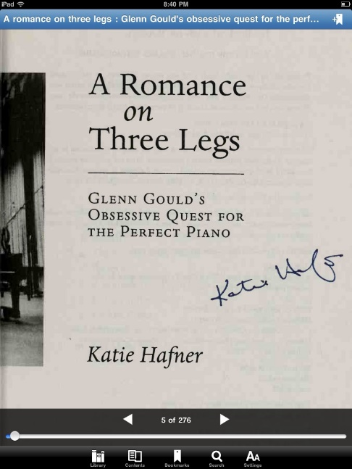
iOS downloads
Bluefire Reader
Dawson use PDFs via Adobe Reader
Free to download with an Adobe ID
Reasonable functionality, but…
Cannot copy
Keyword search results are not displayed as snapshots of the text with the keyword highlighted
Anti-virus software on users’ devices can issue warnings that deter people from completing the downloading process
Libraries cannot support user issues with Adobe IDs
https://flic.kr/p/924pVS

Slide 20
Android downloads
The app on the Android device often froze, timed out or closed down - regardless of the supplier
The team did not feel confident that they could use an Android device to read an eBook for a continuous period of time
Explains the poor user experience
https://flic.kr/p/3k6vHA

Slide 21
Conclusions (1)
Licences are inconsistent and often lack important information
The online platform is far superior regardless of device
However, online reading is affected by the functionality of the aggregators’ individual eBook readers
Users have to learn how each online reader works
They are not intuitive

Slide 22
Conclusions (2)
Offline downloading is not recommended due to the third party software
Android devices are virtually unusable in download mode
The poor user experience is down to the third party software, rather than the supplier

Slide 23
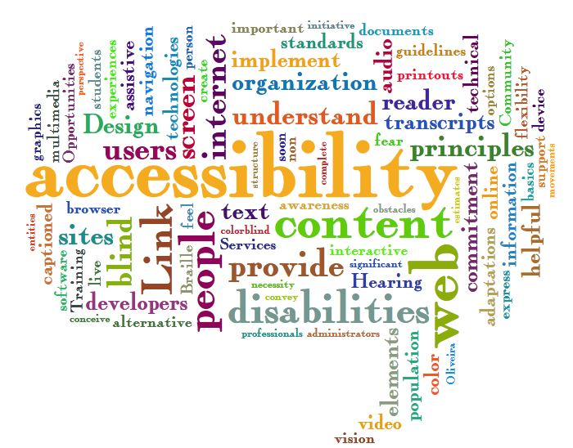
Accessibility
https://flic.kr/p/9iLp6N

Slide 24
Accessibility
To be taken forward as a separate project between the Content and Enabling SIGs
To refine a set of exercises
By using the same format/questions in focus groups/workshops across the 25 NC libraries we hope to build up a body of evidence regarding disabled users experience

Slide 25
Recommendations
For suppliers
A model eBook licence would be beneficial to libraries
There seem to be a lack of standards
Suppliers need to work with third party software vendors to improve the student experience
https://flic.kr/p/5Eo9XU

Slide 26
Recommendations
For libraries
Stop blaming the suppliers ;)
Libraries should reconsider their eBooks support activities and documentation, e.g. online vs downloads
NC Learning Experience in December at Hull
https://flic.kr/p/5Eo9XU

Slide 27
Final thoughts
Our research has shown that it is the use of the suppliers’ online readers vs. the downloaded eBooks that is the issue
…rather than the mobile device itself
…and this is not device dependent
https://flic.kr/p/29iJCV

Slide 28
It’s Gin’O’Clock
Thank you!
Graham Stone
g.stone@hud.ac.uk
@Graham_Stone
http://eprints.hud.ac.uk/25379
This work is licensed under a Creative Commons Attribution 3.0 Unported License
https://flic.kr/p/5eNvDN

