Slide 1
‘Cauda Equina Syndrome’ The Prelude to an Evidence-Based Scoring System
Navraj S Nagra^{1,2}
Badge R², Siddique I², Stephenson J^{2,3}, Mohammad S², Verma R²
¹Oxford University Clinical Academic Graduate School (OUCAGS), Oxford
²Spinal Surgery Department, Salford Royal NHS Foundation Trust, Manchester
³Department of Statistics, University of Huddersfield

Slide 2
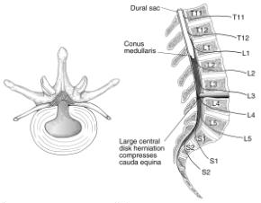
Cauda Equina Syndrome (CES): Background
Challenging clinical diagnosis, MR mainstay of diagnosis
Lack of clinical correlation (Fairbank et al., Bell et al.)
Categories:
CES-S Suspected
CES-I Urinary Difficulties
CES-R Painless retention
Poor outcome in late diagnosis and decompression (Shepherd et al., Ahn et al., MacFarlane et al., Todd et al.)
Large litigation cost to the NHS – need for objective ‘score’
Notes:
As name suggest it’s a compression of Cauda Equina due to various pathology with lumbar disc herniation
It’s a rare clinical condition with associated diagnostic challenges due to spectrum of symptoms and Signs motor, sensory and sphincteric dysfunction and timing of presentation
2 broadly recognised categories CES-R
CES-I
Fairbank et al study revealed that there is very little correlation of symptoms and signs in dignosing CES
Traditionally DRE has been considered crucial but recent studies contradicted that
Role of DRE is dubious calthorpe et al
CES: Compression of Lumbo-Sacral Coccygeal nerve root in lumbar canal
With early reported cases from 1950, Shepherd et al BMJ 1956
Rare diagnosis 1:33000 – 1:100000 slovenia study
With broad range of symptoms and signs, devastating consequences
Missed or delay in diagnosis has serious impact on patient and health system
CES a diagnostic and surgical emergency
Although Findings of Anal tone on DRE is dubious it still forms important assessment criteria
MR forms Gold standard with reported true + ve 14-40%
Costly, not many units have out of hrs services
Macfarlane 2 categories
Poor documentation more damage
2 categories cES-R and CES-I
Due to poor clinical confirmation MR mainstay
Extensive literature to emphasis the
It not only add to physosocial stress to patient but also cost to health care system with litigation
Morley et al identified the poor documentation during patient management
Morley et al (Eur Spine J- 2011)
MPS: 63 (46 in UK) claims (2003-2007)
Average payment £117,331 (max £584,000)
68% against GP
17% against orthopaedics
NHS Litigation Authority : 78 cases (2003-2008)
Average Claim: £211,758 (max £2,041,000)
50% against Orthopaedics
Diagnosis and Prognosis of Cauda Equina Syndrome Produced by Protrusion of Lumbar Disk R H Shepherd
Br Med J. Dec 26, 1959; 2(5164): 1434–1439.

Slide 3
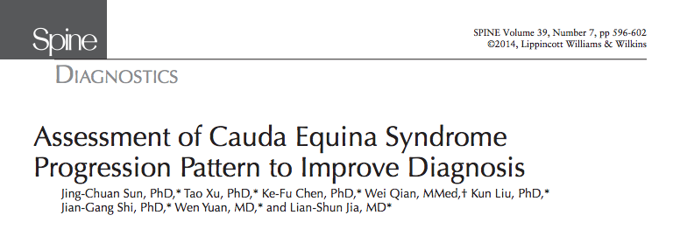
Literature of Note
Meta-analysis (Spine 2014)
Progression Pattern of Cauda Equina
264 cases from 198 publications
‘Red flag’ symptom prevalence such that:
Bilateral Sciatica: 31%
Peri-anal Paraesthesia: 22%
Sphincter Dysfunction: 12.6%
99% progressed from CES-S to CES-I/CES-R

Slide 4
Objective
Establish value of clinical symptoms and signs in confirmation of suspected CES
Patients and Methods
Observational Study over a 24-month period
Review of clinical findings, MR scan, operation notes
Salford Neurosurgical Database
Correlation clinical symptoms/signs with MR proven CES

Slide 5
Results
n=158 patients (♂:♀ 72:86, 42.3 years)
Two Groups
Proven CES on MR, underwent decompression (n=76)
Suspected CES but MR negative (n=82)

Slide 6
Results continued
Variable | Cases (n=76) | Controls (n=82) | All patients (n=158)
Sciatica status No sciatica Unilateral sciatica Bilateral sciatica | 5 (6.6%) 46 (60.5%) 25 (32.8%) | 38 (48.1%) 36 (45.6%) 5 (6.3%) | 43 (27.7%) 82 (52.9%) 30 (19.4%)
Variable | Cases (n=76) | Controls (n=82) | All patients (n=158)
Sciatica status No sciatica Unilateral sciatica Bilateral sciatica | 5 (6.6%) 46 (60.5%) 25 (32.8%) | 38 (48.1%) 36 (45.6%) 5 (6.3%) | 43 (27.7%) 82 (52.9%) 30 (19.4%)
Perianal paraesthesia status No perianal paraesthesia Perianal paraesthesia | 48 (63.2%) 28 (36.8%) | 77 (98.7%) 1 (1.3%) | 104 (67.5%) 50 (32.5%)
Variable | Cases (n=76) | Controls (n=82) | All patients (n=158)
Sciatica status No sciatica Unilateral sciatica Bilateral sciatica | 5 (6.6%) 46 (60.5%) 25 (32.8%) | 38 (48.1%) 36 (45.6%) 5 (6.3%) | 43 (27.7%) 82 (52.9%) 30 (19.4%)
Perianal paraesthesia status No perianal paraesthesia Perianal paraesthesia | 48 (63.2%) 28 (36.8%) | 77 (98.7%) 1 (1.3%) | 104 (67.5%) 50 (32.5%)
Weakness (Foot drop) status No weakness Weakness | 66 (86.8%) 10 (13.2%) | 75 (96.2%) 3 (3.8%) | 141 (91.6%) 13 (8.4%)
Sphincter dysfunction status No dysfunction Dysfunction | 37 (48.7%) 39 (51.3%) | 26 (32.9%) 53 (67.1%) | 63 (40.6%) 92 (59.4%)
Notes:
Bilateral sciatica had an odds ratio of 64 with a p<0.001
Unilateral sciatica 8.54
Perianal paraesthesia 26.4

Slide 7
Results continued
Opposite trends occur with:
Altered perianal sensation
Altered dermatomal sensation
Dermatomal motor weakness
Reduced/Absent DRE
Variable | Cases (n=76) | Controls (n=82) | All patients (n=158)
DRE status Intact Reduced or absent | 51 (67.1%) 25 (32.9%) | 48 (59.3%) 33 (40.7%) | 99 (63.1%) 58 (36.9%)
Notes:
In the interest of time, here is one salient example.

Slide 8
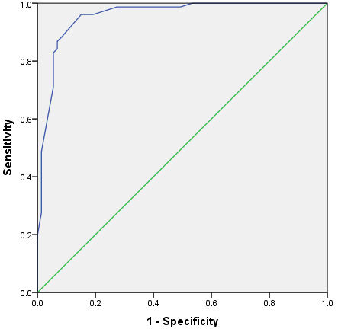
Predictive model for CES
Where: x₁=unilateral sciatica; x₂=bilateral sciatica; x₃=perianal paraesthesia status;
x₄=perianal sensation; x₅=motor weakness status; x₆=dermatomal sensation
ROC curve for predicted probabilities
p=0.96 (95% CI: 0.93-0.99)
Notes:
Logistic regression analyses
Uncontrolled analyses as a screening procedure – symptoms that were most predictive were used in a -
Multiple logistic regression model
backward elimination modeling strategy based on likelihood ratio considerations was utilised to derive a parsimonious model, to minimise the potential for model over-fitting

Slide 9
Conclusion
Largest Single Centre Study
Sciatica and Perianal Paresthesia are the most predictive symptoms of CES
DRE findings have no correlation with CES
We have developed a Predictive Scoring System, which preludes a practical model to be used as a Referral Guide for GPs, DGHs
Guide the need for urgent MR
Medico-Legal Stand

Slide 10
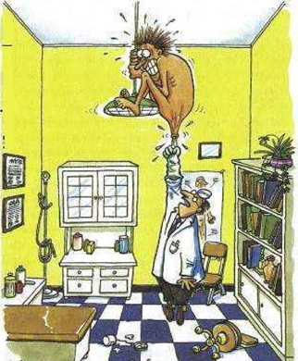
Any Questions?

