Slide 1
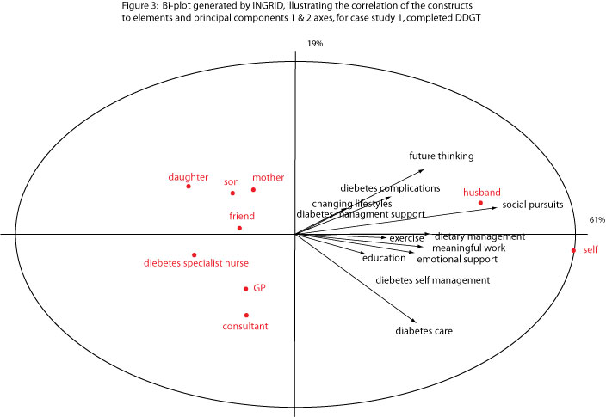
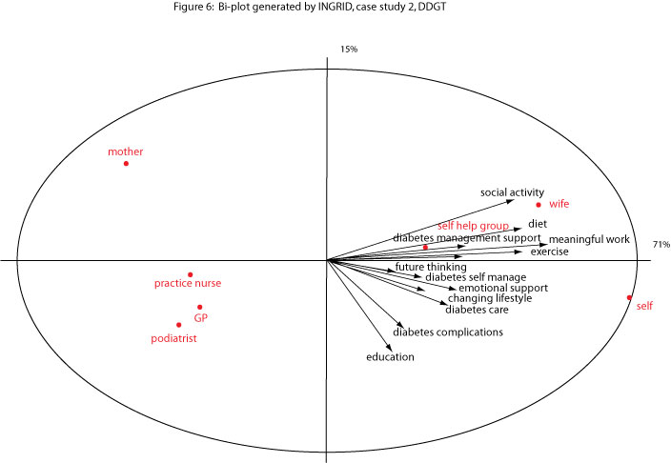
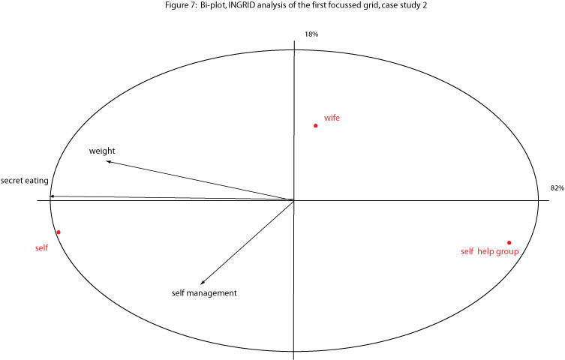
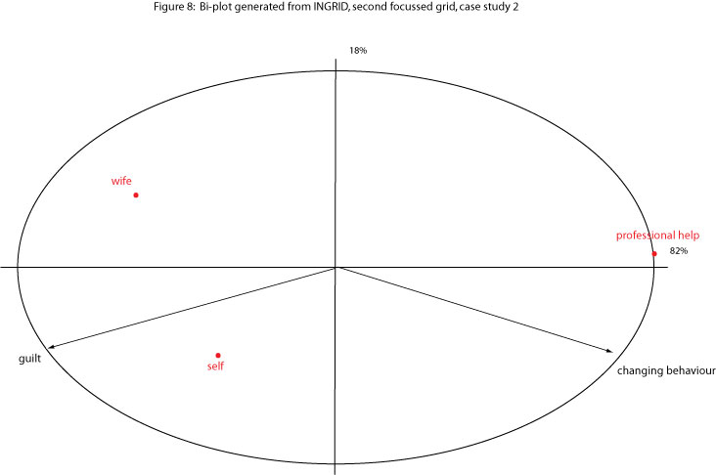
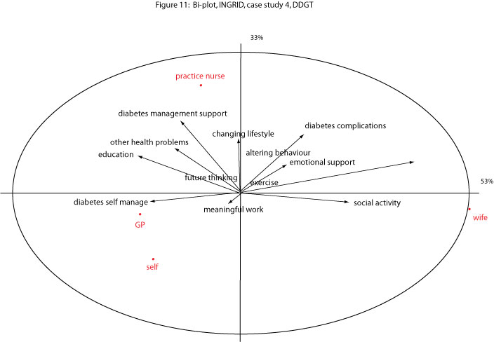
An exploration of personal constructs in people with type 2 diabetes in the community.
￼
Dr. Warren Gillibrand
University of Huddersfield
w.p.gillibrand@hud.ac.uk
http://www.hud.ac.uk/ourstaff/profile/index.php?staffuid=shumwpg
INTRODUCTION
There is an emerging theoretical framework for the psychosocial focussed experience of type 2 diabetes and indeed for the formation of interventions aimed at aiding self-management (Vermiere et al. 2002, Ridder et al. 2008, Peyrot et al. 2013).
Dependency, and its relationships ,and effect on the person-centred model of care, remains a relatively unexplored issue in people with type 2 diabetes. The degree of dependency, and the predominant use of the bio-medical model of care, and its effect on people with type 2 diabetes, psychologically, and socially, has received little attention.
Finding, and developing, a reliable and valid methodology to answer these questions, is complex and also not readily answered.
Aim: To explore and investigate personal constructs in adults with type 2 diabetes under primary care services.
RESULTS
19 participants completed the sequential interviews, with DDGT grids, and in some cases, further laddered dependency grids (n=48), from a sample of 23, who completed the initial interview. The major construct of interdependence identified, had strong or weak association with diabetes related constructs, depending on how each individual participant had rated them, and the explanation they gave of the ratings. The following results are 3 example case studies from the series, to demonstrate the dependency grid and personal construct identification in 3 participants (cases).
Case Study 1: 53 year old white woman with type 2 diabetes (pseudonym ‘Dorothy’).
Dorothy has had type 2 diabetes for 10 years, treated with exercise, diet and oral hypoglycaemic agents.
Personal construct identified (label): ‘Diabetes associated interdependence’. (Figure 3 below)
Construct | Element | Transcript quote
Diabetes complications | Husband Rating = 10 | “I do get worried about hypo (hypoglycaemic) attacks and I worry about going too high (hyperglycaemia). I and my husband sort these out when they happen but I don’t know what I’d do if he could not help me”.
Social pursuits | Husband Rating = 10 | “It’s only I and my husband. We do things together and we plan if the diabetes is involved.. you know if we are going out for a meal he (husband) will check that I am not going to be given something sweet”.
Altering behaviour | Husband Rating = 3 | “At my age I’m not going to change the way I think and the way I am and neither is my husband. If he said though, let’s stop going out as much then I would do that”.
Future thinking | Husband Rating = 10 | “I do worry about my blood pressure and if that goes up what effect later that will have on my health and so does my husband. I know he worries about that and wants to know what it was when I was at the Doctors”.
Emotional support | Husband Rating = 10 | “He supports me in everything- helps me when I worry about something with the diabetes”.
METHODS
Purposive sample of adults with type 2 diabetes, cared for in the community, identified as cases.
Participants (cases) completed an initial exploratory qualitative interview, followed by sequential interviews using a laddered dependency grid technique, (The Diabetes Dependency Grid Test - DDGT), where each participant rated constructs (aspects of living with diabetes) against elements (people involved in the participants’ living with diabetes), on a scale of 0-10, within a grid. The data was analysed using a modified principal component analysis technique, (INGRID programme) and plotted on bi-plot diagrams to show the relationship strength, via angle of association, to the element, and vector length from the construct.
These calculations were then triangulated against the individual rating comments given by the participants to provide identification of personal constructs, and presented as a case study series.
LES
E-Consultation
Managing Injectables Course
&
mentorship
Case Study 2: 59 year old white male who has had type 2 diabetes diagnosed for 10 years, treated with exercise, diet and oral hypoglycaemic agents (Pseudonym ‘Brian’).
The 2 further bi-plot diagrams are the result of focussing the initial grid into exploring in greater depth identified end spectrum grid ratings of a particular construct to element.
The tables below shows example transcript quotes to the grid ratings explanation by the participant.
Personal construct identified (label): ‘ Diabetes Independence’. (Figure 6 below).
Construct | Element | Transcript quote
Diabetes self - management | Self Rating = 9 Wife Rating = 8 | “I can manage the diabetes fine by myself. I know what I am doing and can do all the things needed , you know, adjust my tablets, take the blood sugar readings, my own blood pressure.” “I know more than my wife about It - she’s learning and wants to get involved more I think.”
Diabetes complications | Self Rating = 9 | “I know I may be developing a problem with neuropathy in the fee t- I am having checks with the podiatrist. This is down to me - I need to get the control better and my weight down so that doesn’t happen.”
Construct | Element | Transcript quote
Diabetes management support | Self Rating = 7 GP/practice nurse Rating = 0 | “I don’t bother the GP or the nurse with much about my diabetes. I sort it out for myself- I change the amount of my glibencamide as I need to, you know if my blood sugars have been up.”
Altering behaviour | Self Rating = 6 GP/practice nurse Rating = 2 | “Like I said its down to me to change things. I know I’ve got to do something about my weight and I will if I can stop binge eating. I know I’ll never tell the GP or practice nurse- I mean they’re not going to help with that are they?”
Foot care
Course
&
mentorship
CONCLUSIONS
The findings suggest that in this sample, some of the participants with type 2 diabetes did not always consider primary care services as appropriate to enable self-management and achievement of their life goals.
Each individual had developed their own level of interdependence with some of the participants being self-reliant or using family members/friends more than professional health services.
Recommendations include further exploration of interdependence in people with type 2 diabetes.
The dependency grid method can be illuminating, however is complex and time-consuming for the participant.
The DDGT, or other in-depth methods, could be a useful means of addressing individual, person-centered care planning, but needs further research.
Case Study 4: 60 year old white male with type 2 diabetes, (pseudonym ‘Harold’).
Harold has had type 2 diabetes for 12 years, treated with dietary alteration, oral hypoglycaemic agents and recommended exercise.
Personal construct identified (label); ‘ Core cognitive diabetes interdependence’. (Figure 11 below).
REFERENCES
Peyrot M, Kovacs K, Davies M et al. (2013) Diabetes Attitudes Wishes and Needs 2 (DAWN2): a multinational, multi-stakeholder study of psychosocial issues in diabetes and person-centred diabetes care. Diabetes Research & Clinical Practice, 99,2,pp.174-184.
Ridder D, Geenen R, Kuijer R, Middendorp H (2008) Psychological adjustment to chronic disease. The Lancet, 372,pp.246-255.
Vermeire, E., Wens, J., Van Royen, P., & Hearnshaw, H. (2002), Interventions for improving adherence to treatment recommendations in people with type 2 diabetes mellitus, Cochrane Database of Systematic reviews, Issue 2.

