Slide 1
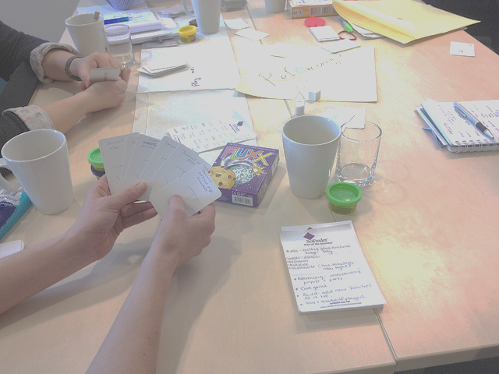
Gaming in the library ARLIS Conference 2014
Andrew Walsh, Academic Librarian / Teaching Fellow
Twitter - andywalsh999
http://innovativelibraries.org.uk/
Notes:
Play, games & gamification. What are they, why should you care and what you can do about ‘em.
45 minutes.
This workshop will cover the uses of play, games and gamification in a library setting. Using examples such as Lemontree at the University of Huddersfield, non-digital games, particularly card games such as SEEK!, and play materials such as Lego and Playdough, we will show how these ideas can work in a practical library setting. Attendees will work hands on to consider how they can create and use play and games within their own library settings.

Slide 2
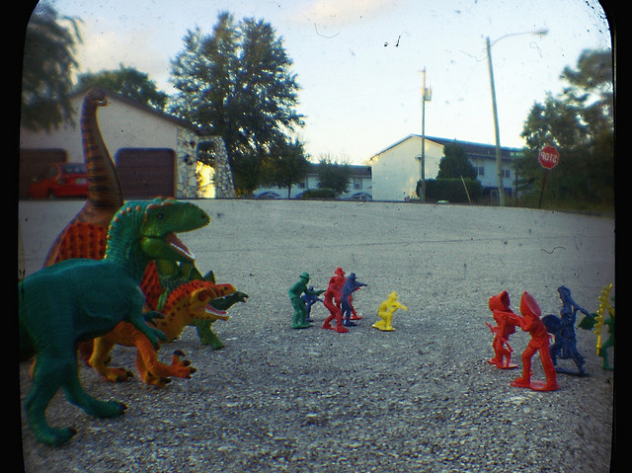
What is play?
:
Picture from : http://www.flickr.com/photos/judeanpeoplesfront/
Notes:
"Summing up the formal characteristic of play, we might call it a free activity standing quite consciously outside 'ordinary' life as being 'not serious' but at the same time absorbing the player intensely and utterly. It is an activity connected with no material interest, and no profit can be gained by it. It proceeds within its own proper boundaries of time and space according to fixed rules and in an orderly manner. It promotes the formation of social groupings that tend to surround themselves with secrecy and to stress the difference from the common world by disguise or other means.“
Huizinga (1955) Homo Ludens
play is Apparently Purposeless (done for its own sake); Voluntary; has Inherent Attraction; Freedom from time; Diminished consciousness of self; Improvisational potential; and Continuation desire.
Brown & Vaughan (2010) Play: How it shapes the brain, opens the imagination, and invigorates the soul.
Essentially play is something that steps outside normal life – it sits within its own place that players agree (any children’s librarian have a special place for storytime?). People can forget themselves and do or create things they normally wouldn’t feel able to do.
Looking at these definitions of play, bringing more play into the library seems an attractive proposition.
If we could bring this completely voluntary, apparently purposeless activity into the library, with its own inherent attraction and continuation desire it may help to reduce library anxiety for our low users...
So, I’m going to ask you to play with some modelling dough during the rest of these slides… play with it, try and create a model that shows the challenge you’d like to address with a game.
sers, as well as increase activity within the library for many users

Slide 3
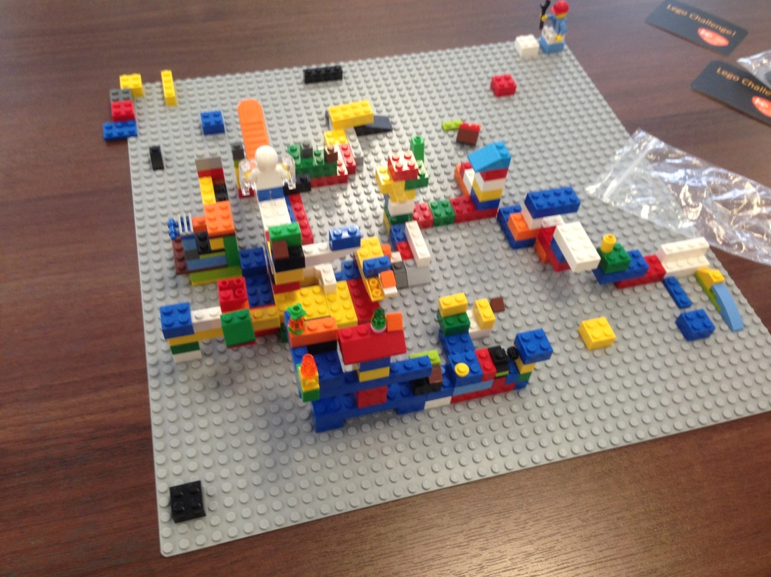
Eh?
Good for exploring ideas
Safe
Creative
Inviting
Low risk (for participants)
Think with your hands
Notes:
So what is play good for…
Lego, playdough, drawing, collage, etc.
Example – make a model of achallenge in your library that you’d like to meet using play.

Slide 4
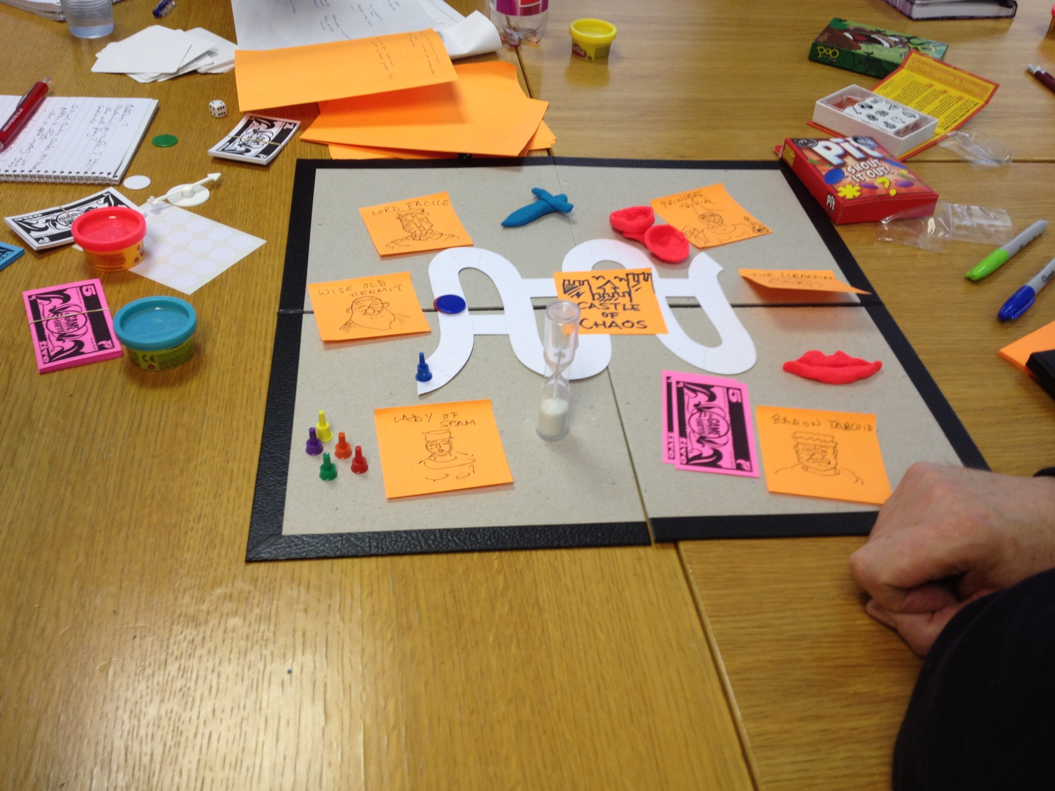
What are games?
Notes:
Play with rules?
“All games share four defining traits: a goal, rules, a feedback system, and voluntary participation.”
McGonigal (2012) Reality is broken: Why games make us better and how they can change the world.
Replace with game image like above?
Essentially games are what happens when you formalise play! Hard to describe, but we know what a game is when we see one…
Great to bring more play (or fun?) into the library, but often more useful to be thinking about GAMES – that is when you start to enable better learning…

Slide 5
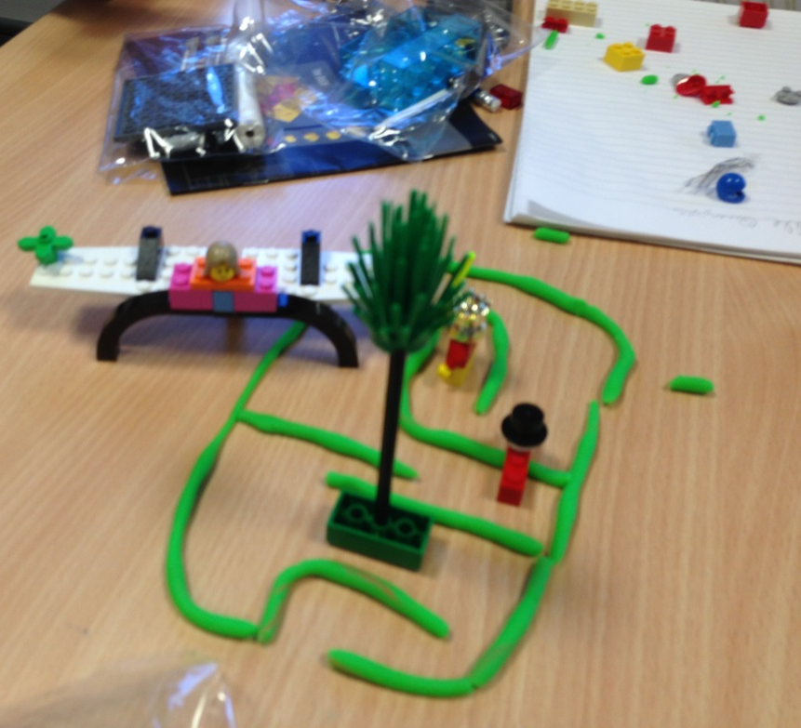
Eh?
Good for active learning
Construct own knowledge
Expose people to new ideas
Reinforce facts by repetition
Memorable!
Notes:
Just treat like any learning object to drop into a session?
Same strengths of lots of active learning objects, plus overlap with play benefits (safe, low risk, inviting etc.)
BUT – largely about either “active learning” OR reinforcement by repetition.
Show SEEK! And outline how it works. (need URL at the end)

Slide 6
What is Gamification?
Notes:
What is gamification:
The application of typical elements of game playing (e.g. point scoring, competition with others, rules of play) to other areas of activity, typically as an online marketing technique to encourage engagement with a product or service.’
(OED definition)

Slide 7
Eh?
Good for engagement
Behaviour change
Marketing
Very lightweight
Notes:
Not really the same thing as games or play, but has some overlapping features.
Outline how Lemontree works.

Slide 8
Different types of games for learning
Model from ALT-GLSIG / N. Whitton
Notes:
From Nic Whitton’s initial model – subject to change! Just included this to show the different angles you could come at games for libraries from. Should it be “play”, “engagement”, or “Active learning”? Or some combination of any 2 (or all 3)....
Mainly – why not overlap! Lots of different things are valid, they just concentrate on different angles.

Slide 9
Exercise
What challenges do you think you could meet in your libraries using either play, games or gamification?
OR
Pick a letter card that best describes the challenges you face in your library – tell the person next to you why this letter represents those challenges.

Slide 10
Making games… a process.
Set learning objectives
Consider your key constraints
Decide on game mechanics
Pick a theme or feel for the game
Prototype
Playtest & improve (several times!)
Write the rules
Finish the design and print.
Notes:
Expand on each!

Slide 11
Game mechanics
Acting
Action Point Allowance System
Area Control / Area Influence
Area Enclosure
Area Movement
Area-Impulse
Auction/Bidding
Betting/Wagering
Campaign / Battle Card Driven
Card Drafting
Chit-Pull System
Co-operative Play
Commodity Speculation
Crayon Rail System
Deck / Pool Building
Dice Rolling
Grid Movement
Hand Management
Hex-and-Counter
Line Drawing
Memory
Modular Board
Paper-and-Pencil
Partnerships
Pattern Building
Pattern Recognition
Pick-up and Deliver
Point to Point Movement
Press Your Luck
Rock-Paper-Scissors
Role Playing
Roll / Spin and Move
Route/Network Building
Secret Unit Deployment
Set Collection
Simulation
Simultaneous Action Selection
Singing
Stock Holding
Storytelling
Tile Placement
Time Track
Trading
Trick-taking
Variable Phase Order
Variable Player Powers
Voting
Worker Placement
From “Board game Geek” http://boardgamegeek.com/
Notes:
Lots & lots – instead of looking at a detailed list, think of games you enjoy planning and reflect on the mechanics these games introduce.

Slide 12
Game mechanics
“Game Mechanics are constructs of rules and feedback loops intended to produce enjoyable gameplay.“
From Gamification Wiki - http://gamification.org/wiki/Game_Mechanics
Notes:
Rather than trying to force people into considering lots of different “official mechanics”, that’s why I’ve brought some games along! Consider the games you’ve played today, the many games you’ve played in the past, and think about how they work. Can you take elements from them and re-work them into a new game?
So, what sort of things did people write down from the playing the games earlier? Ask for some … these are the types of things we might mean by game mechanics – you build these up to make a game, often together with a narrative of some sort to hold the game together.

Slide 13
Exercise
What would stop you following this process and creating games to use in your work?
Notes:
Just talked about challenge – this would be turned into your learning objective!
So you’ve started… what would stop you carrying on?
2 minute exercise

Slide 14
Exercise
How could you overcome these barriers?
Notes:
Assuming you want to do these things, how could you overcome the barriers you’ve just identified?

Slide 15
Generating ideas & prototypes

Slide 16
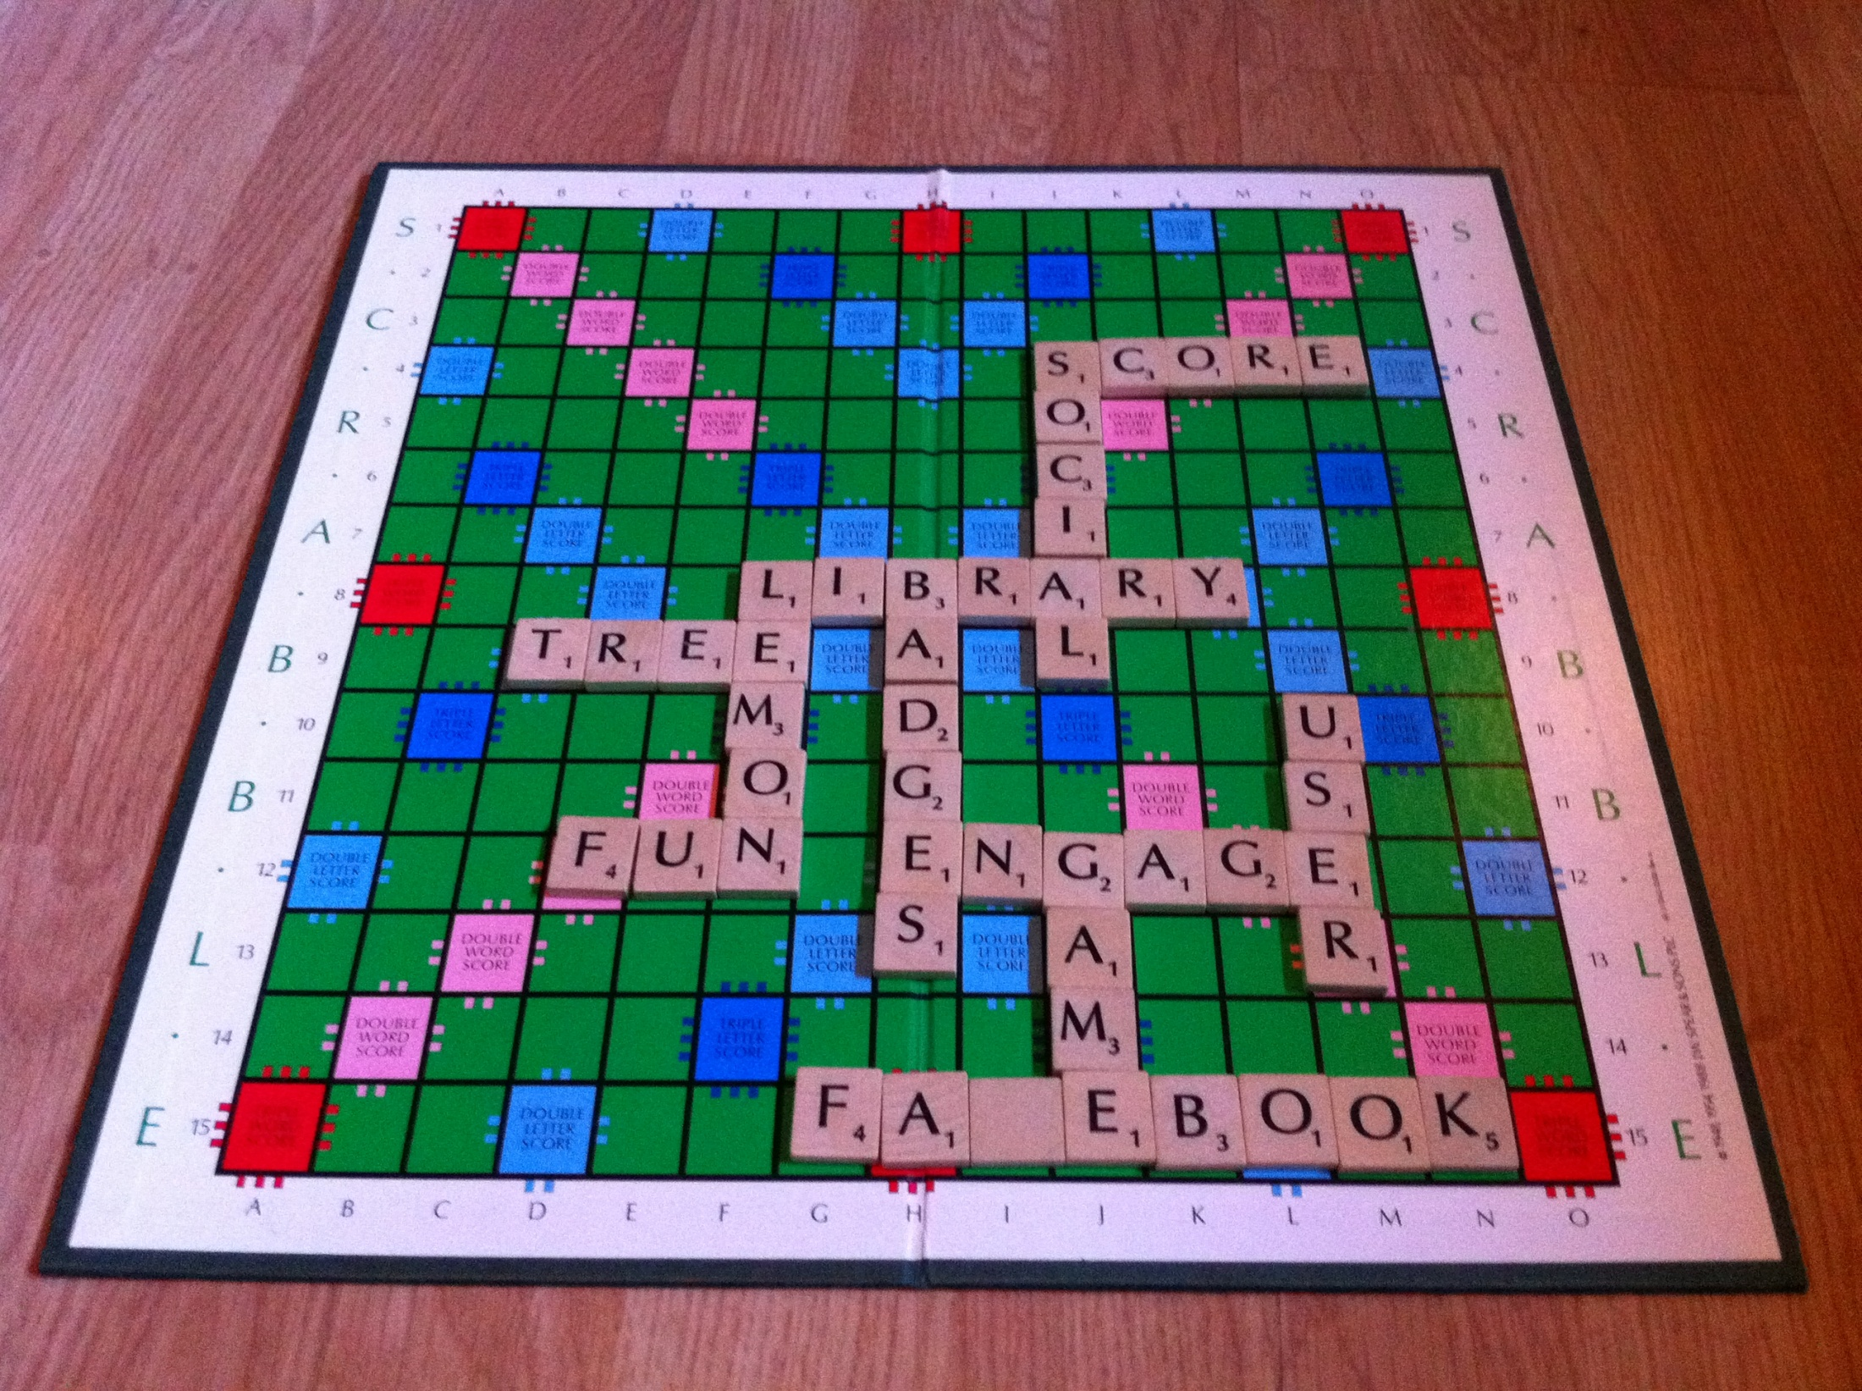
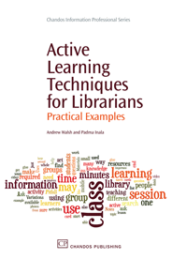
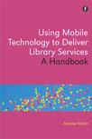
Thanks for listening…
More stuff from me at:
http://innovativelibraries.org.uk/
As well as my books --->
Download SEEK!
http://eprints.hud.ac.uk/19345/
Making Games for Libraries Workshops
http://gamesforlibraries.blogspot.co.uk/
I’m at a.p.walsh@hud.ac.uk
or @andywalsh999 on Twitter
Notes:
Sum up main points here ...

