Slide 1
The potential impact of Open Access repositories and library scholarly publishing on ‘traditional’ publishing models
Graham Stone
Information Resources Manager

Slide 2
Customers as competitors The abstract paints a confusing picture
Tech savvy authors are self publishing?
Libraries are publishing
FT final versions in Repositories deliberately shifting usage from journal sites?
https://flic.kr/p/9fwoMs

Slide 3
FT final versions in Repositories Isn’t this missing the point?
Ultimately, what is more important?
Usage via a publishers journal platform, or
Impact of the research
Multiple access points only make your impact greater!

Slide 4
About stealing your lunch Gold OA
If the final version is in a Repository its because:
We’ve paid you for Gold OA, or
You’ve allowed the final version in after embargo

Slide 5
Thanks to Char for the photo!
http://www.flickr.com/photos/kstatelibrarian/9050728837/sizes/o/in/photostream/

Slide 6
About stealing your lunch Gold OA
If the final version is in a Repository its because:
We’ve paid you for Gold OA, or
You’ve allowed the final version in after embargo
If it’s a hybrid journal and we also subscribe…

Slide 7
This work is licensed under a Creative Commons Attribution-NonCommercial-NoDerivs 2.0 Generic License

Slide 8
Repositories Copyright
More importantly
We’ve added the content legally
We’ve linked to your platform and are driving usage

Slide 9
The publisher platform
Why is access through the platform so important?
We’ve been telling you to stop investing in flashy platforms for years
Researchers require stuff
At that point they don’t care about the publisher, they just want to consume
A version in a Repository is just as good to them

Slide 10
Driving usage Opportunities, not threats
https://flic.kr/p/aazNCs

Slide 11
PIRUS A standard for usage statistics

Slide 12
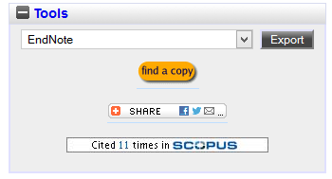
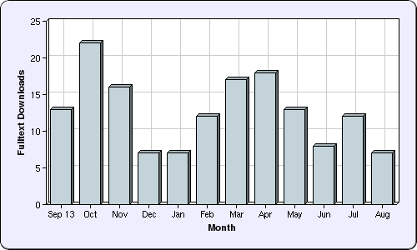
IRUS-UK and Repositories A rich vein of information

Slide 13
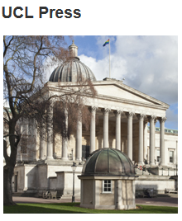
Scholarly publishing in the library open-access scholarship

Slide 14
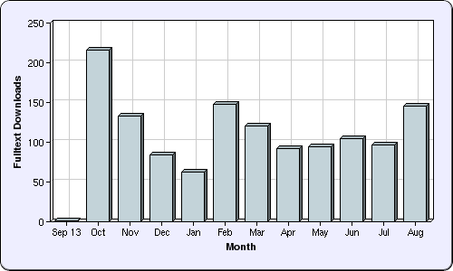
Scholarly publishing in the library University of Huddersfield Press
To encourage new and aspiring authors to publish in their areas of subject expertise
Not necessarily competing
Growing the author pool
Attracting societies, charities and
research institutes

Slide 15
Some final thoughts
Academic Publishing is a professional industry
It has to adapt to changes in scholarly practice
It has to adapt to changes in the needs of the scholarly community
Publishers need to think about the actual role they fulfil

Slide 16
Thank you!
Graham Stone
g.stone@hud.ac.uk
@Graham_Stone
http://eprints.hud.ac.uk/21215
This work is licensed under a Creative Commons Attribution 3.0 Unported License

