Slide 1
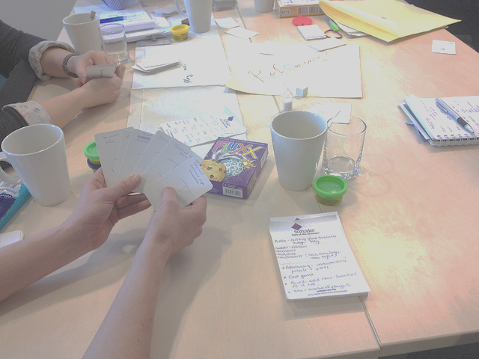
Game Based Learning for Information Literacy Instruction.
ECIL, 2013.
Andrew Walsh, Academic Librarian / Teaching Fellow
Twitter - andywalsh999
http://innovativelibraries.org.uk/

Slide 2
What is play?
"Summing up the formal characteristic of play, we might call it a free activity standing quite consciously outside 'ordinary' life as being 'not serious' but at the same time absorbing the player intensely and utterly. It is an activity connected with no material interest, and no profit can be gained by it. It proceeds within its own proper boundaries of time and space according to fixed rules and in an orderly manner. It promotes the formation of social groupings that tend to surround themselves with secrecy and to stress the difference from the common world by disguise or other means.“
Huizinga (1955) Homo Ludens
play is Apparently Purposeless (done for its own sake); Voluntary; has Inherent Attraction; Freedom from time; Diminished consciousness of self; Improvisational potential; and Continuation desire.
Brown & Vaughan (2010) Play: How it shapes the brain, opens the imagination, and invigorates the soul.
Notes:
Perhaps replace in presentation with playground image? Cowboys and indians? Then this text can be for repository?
Essentially play is something that steps outside normal life – it sits within its own place that players agree (any children’s librarian have a special place for storytime?). People can forget themselves and do or create things they normally wouldn’t feel able to do.
Looking at these definitions of play, bringing more play into the library seems an attractive proposition.
If we could bring this completely voluntary, apparently purposeless activity into the library, with its own inherent attraction and continuation desire it may help to reduce library anxiety for our low users...
So, I’m going to ask you to play with some modelling dough during the rest of these slides… play with it, try and create a model that shows the challenge you’d like to address with a game.
sers, as well as increase activity within the library for many users

Slide 3
What are games?
Play with rules?
“All games share four defining traits: a goal, rules, a feedback system, and voluntary participation.”
McGonigal (2012) Reality is broken: Why games make us better and how they can change the world.
Notes:
Replace with game image like above?
Essentially games are what happens when you formalise play! Hard to describe, but we know what a game is when we see one…
Great to bring more play (or fun?) into the library, but often more useful to be thinking about GAMES – that is when you start to enable better learning…

Slide 4
What is Gamification?
‘The application of typical elements of game playing (e.g. point scoring, competition with others, rules of play) to other areas of activity, typically as an online marketing technique to encourage engagement with a product or service.’
(OED definition)

Slide 5
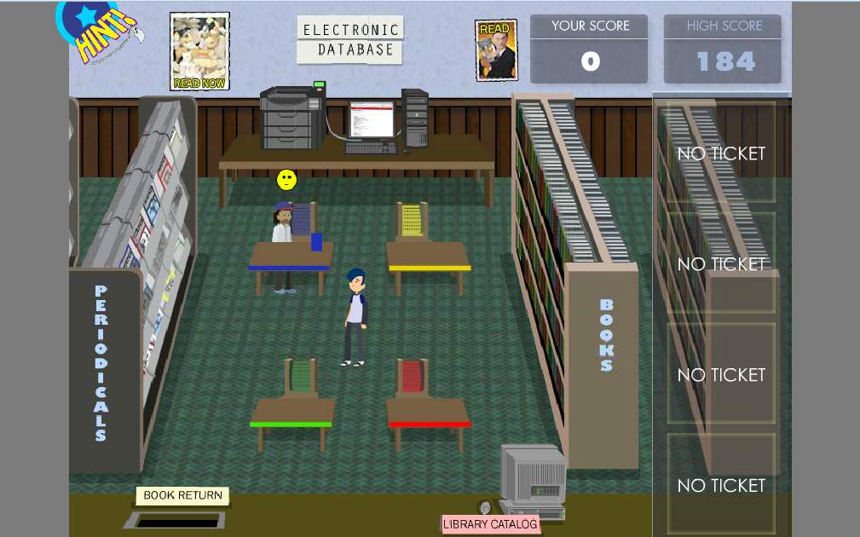
Why use games for learning libraries?
https://libwebspace.library.cmu.edu:4430/libraries-and-collections/Libraries/etc/game2/game2.swf
Notes:
Three reasons I’ll talk about here! Engagement. Deeper, better learning. Promotion, variety, FUN!
Constructivist approach ☺
Learning by doing…
Games give them a chance to play in an environment where you’ve set the objectives, rules and environment to help scaffold learning – so can be about “fun”, but most importantly about taking an active (not passive) role in their own learning.

Slide 6
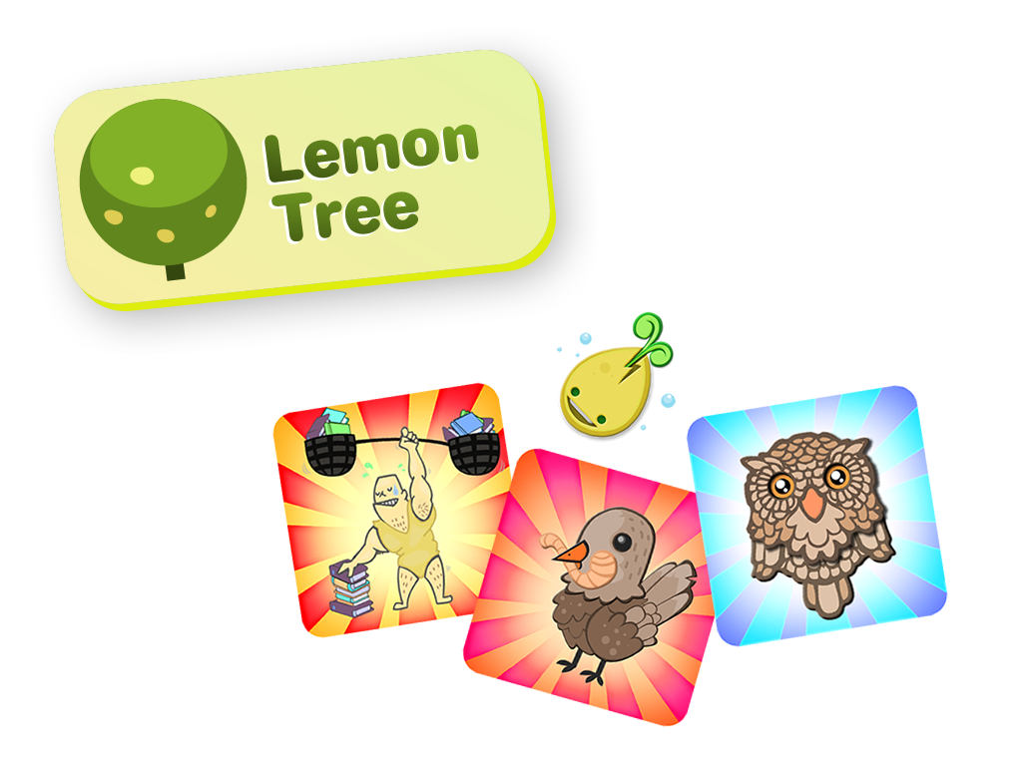
Engagement
Notes:
First reason for using it? Engagement.
TBH – more gamification than games.
Lots of people talk about games as being naturally engaging – so in a library context, if you use games it will make people excited about learning those information literacy skills that we’re talking about at this conference. If you create an online game to teach referencing, it will automatically engage students. They’ll flock to your website to play the game … No. It doesn’t work like that.
Good, well thought out games can be engaging, but they don’t have to be. They can be frustrating, challenging, annoying and still meet your learning objectives. It’s incredibly hard to create a library game that people would want to play because it’s there (i.e. “engages” the user). Commercial deisgners put a lot of work into getting the balance correct between something that is too easy and too challenging to get that “fiero” moment when the player is challenged just enough but is succeeding none the less… And that’s once you’ve persuaded them to play the game in the first place! The visuals, marketing, look and feel, etc all have to be good to naturally engage users.
So realistically, don’t think of games as being naturally engaging. Just because you create one, it doesn’t mean that students will want to play it!
However, engagement is what Gamification is all about – few minutes on Lemontree here? Include stuff on feedback – 60% of survey respondents said it changed their behaviour? “Nudging behaviour change”. Nudging them to use the library in better ways. Perhaps nudging towards behaviour we see as more information literate.

Slide 7
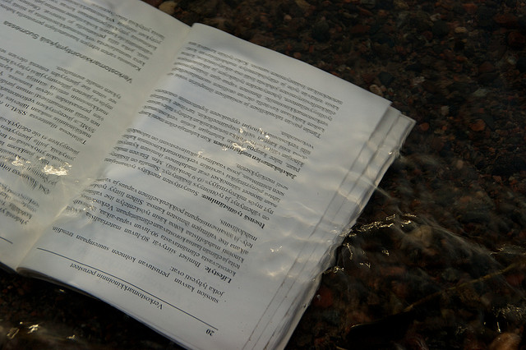
Deeper / ‘Better’ Learning
Enable Reflection
Practice Skills
Make Connections
Background Image from Teemu Ylikoski on Flickr, http://www.flickr.com/photos/ylikoski/
Notes:
I’d say this should be the key reason for using game based learning and play.
Can allow thing like, enabling reflection, practicing skills and making connections between ideas / concepts.
Two examples!
SEEK! Simple card game, introduces lots of ideas around constructing a search strategy. Need to think about how to answer questions such as pulling words from an assignment title to decide on keywords, think of synonyms for terms, think about where they may look for information and more. So rather than me telling them these ideas they are thinking them through themselves. The start to construct their own knowledge and mental models to win the game. Afterwards the game, we then spend 5 or 10 minutes reflecting on the questions / issues raised in the game – they can gain some knowledge from the game itself, then deepen it through reflection in discussion around the game. So the game becomes one element in an active learning class.
Lots of games involve repetitive actions, these can enable skills to become more embedded through practice – for example creating referencing jigsaws?
A lovely use of “play” rather than games is to use elements like lego or modelling clay to help people “think with their hands” – they can make connections between ideas, explore concepts and deepen learning through creating simple models. E.g. “the model lit review” or my activity in games workshops?

Slide 8
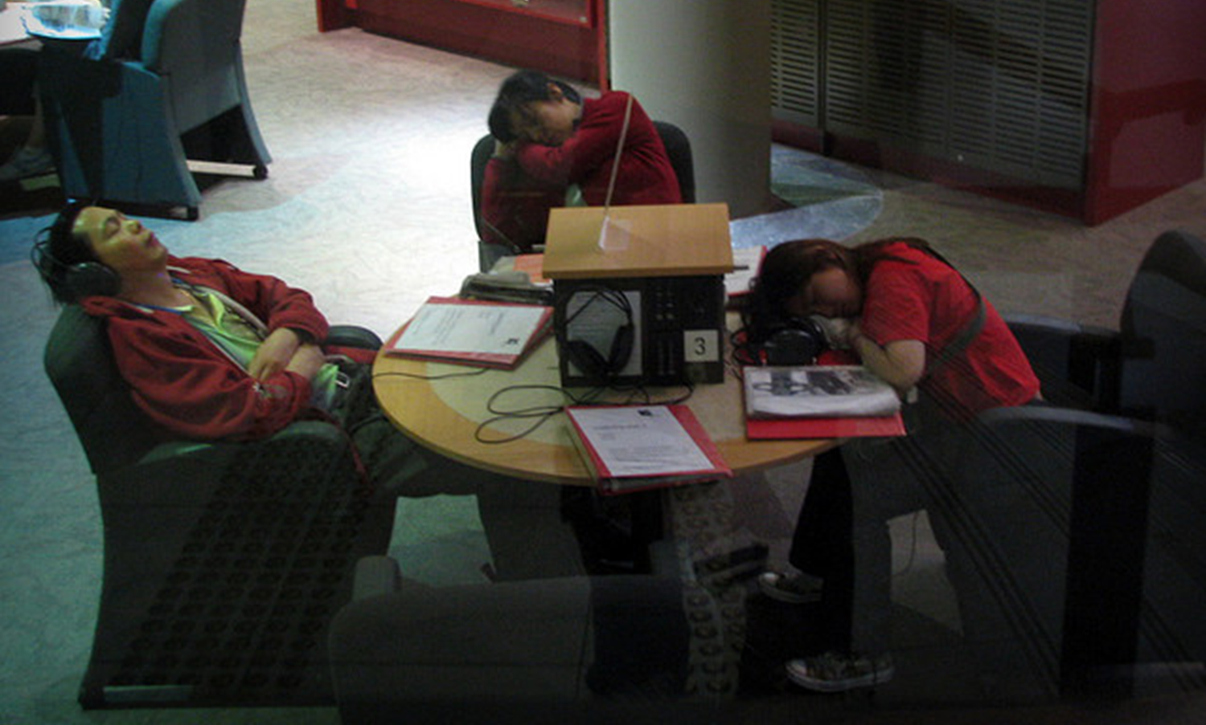
Fun?
. Promotion, variety, promotion, FUN!
Notes:
Last of all, I suppose the fringe benefits of using play, games and gamification!
Promotion, variety, promotion, FUN!
Libraries tend not to be thought of as the most exciting of places … I’m a fan of mixing things up a little to challenge perceptions! Playing games in libraries? That has to help with our promotion of libraries, surely? Anything that brings a bit more fun into library settings not only stops me being bored as a librarian, it hopefully helps with student perceptions of libraries. From a serious point of view, that must include people who are anxious about using libraries, especially large academic libraries like my own.
Talk about creative workshops I’ve planned?

Slide 9
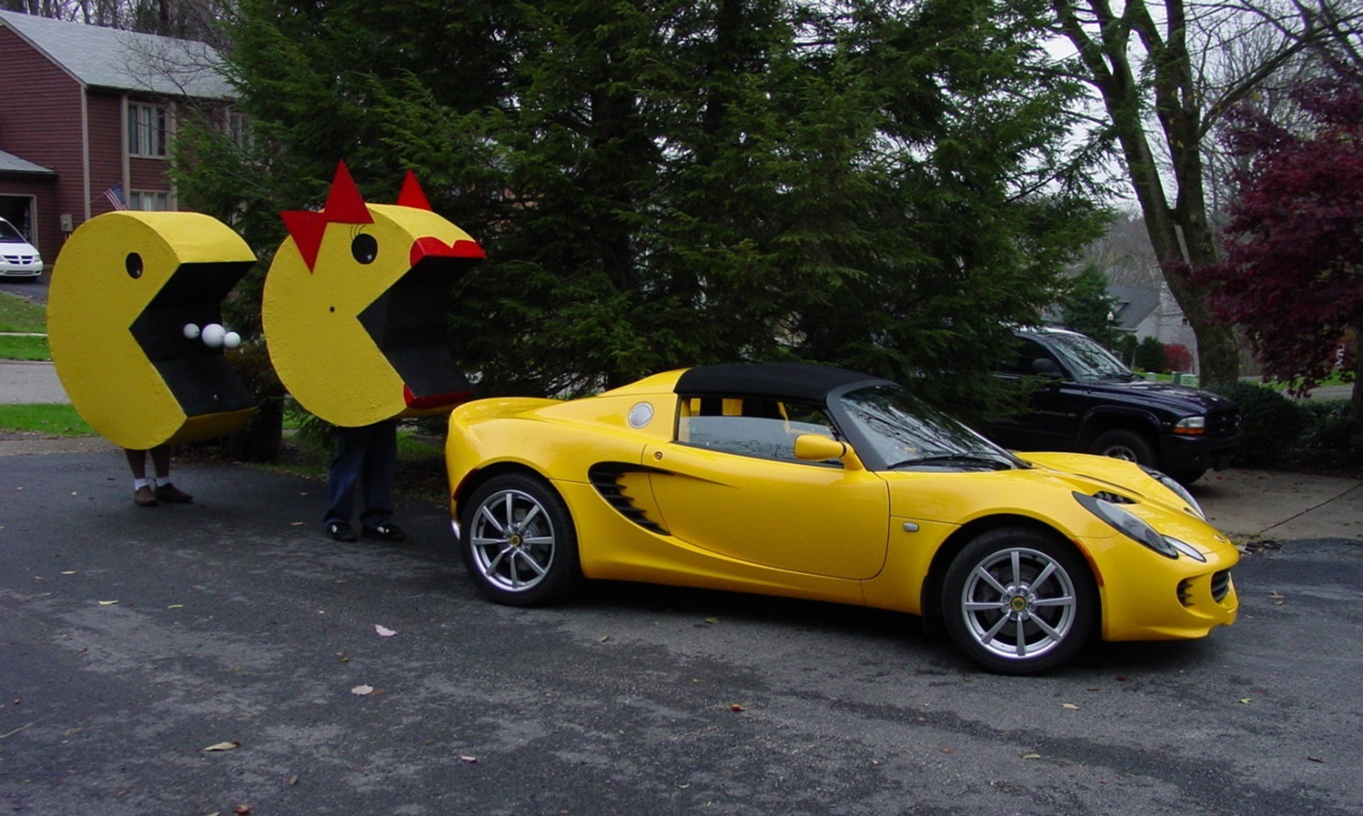
How can you introduce play / games?
Notes:
Lots of money? Pay someone to create some wonderful digital / non-digital games?
Most of us? Start small & cheap?
Introduce small game like activities into teaching sessions.
Use creative activities in a playful way to help students make connections and learn in a “safe” way
Copy games from others and adapt as needed (SEEK! is creative commons for example!).
Use cheap materials like blank cards to prototype games – which you can leave “rough & ready” or turn into more professional looking games.

Slide 10
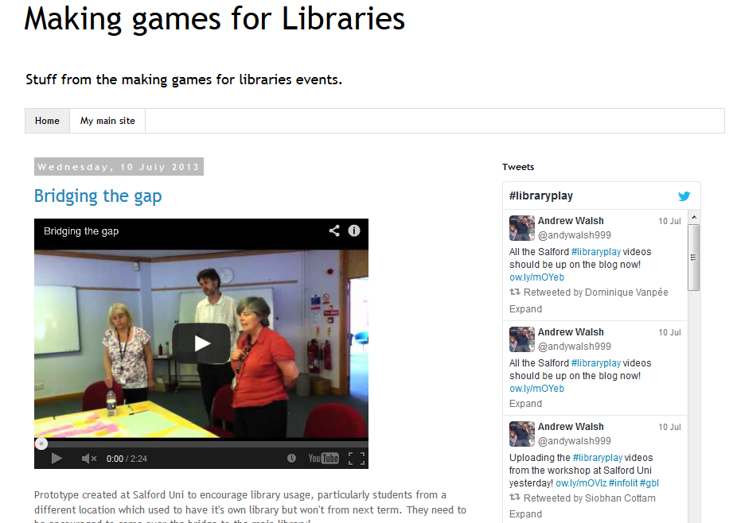
Generating ideas & prototypes
http://gamesforlibraries.blogspot.co.uk/
Notes:
Pinch other peoples! Big source here – talk about workshops.
Also, please take the idea behind these workshops. Often what you really need is time and space to do this, with someone to impose a structure on you!
Would love to hear about people doing this with library users –information literacy games created by your users ☺
Talk about resources online to print games?
Need to create / edit handout that goes with this…

Slide 11
Examples of library games
Notes:
Possibly talk about realistic targets? Don’t feel you have to do big online games?
Finish with some examples of other library games and gamification… brought along a copy of seek, mainly to show it can be done fairly easily! Social Media game? Bibliobouts? Treasure hunts (from mlibs in Brisbane)? Others…
Notice that many people go with online games! Tend to think this means they get distracted by the thought of doing a “computer game”… often look quite bad and are unlikely to be seriously played ☹ Look & feel is important to engaging the player… would recommend people consider gameplay and story first. Try to create simple, good looking games you can use in your own teaching… these can then get converted to online games if you want, but none of us would have the budget to create a proper, good looking computer game from scratch…

Slide 12
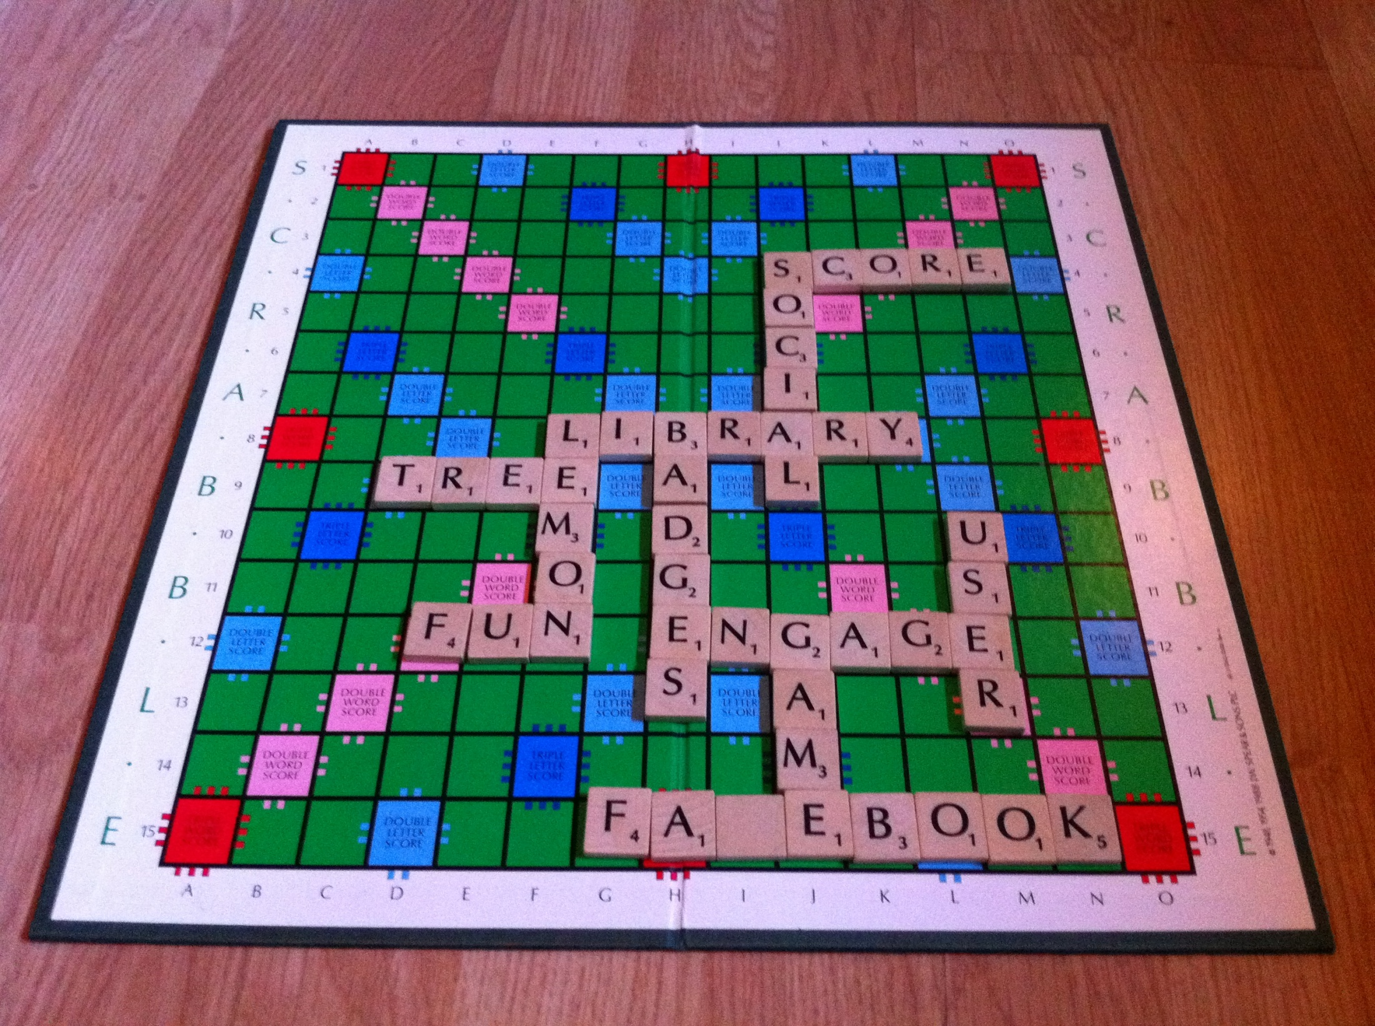
Thanks for listening…
More stuff from me at: http://innovativelibraries.org.uk/
As well as my books --->
Download SEEK!
http://eprints.hud.ac.uk/15377/
Making Games for Libraries Workshops
http://gamesforlibraries.blogspot.co.uk/
I’m at a.p.walsh@hud.ac.uk or @andywalsh999 on Twitter
Notes:
Add link to repository for these slides `(Deposited without slides – waiting for URL to insert! Then put slides in...)
Sum up main points here ...

