Slide 1
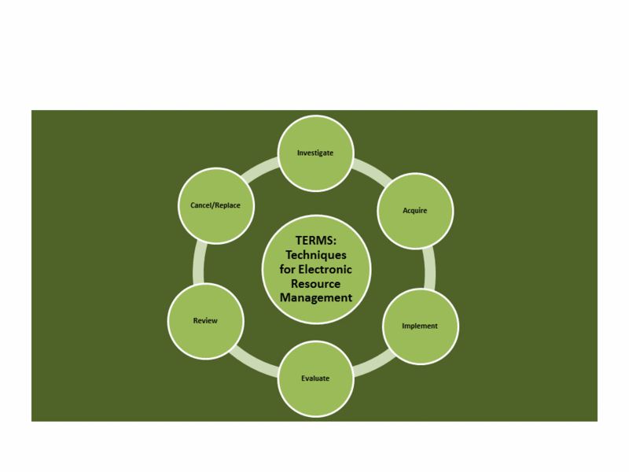
#6terms
TERMS: Techniques for Electronic Resource Management: Crowdsourcing for Best Practices
This work is licensed under a Creative Commons Attribution 3.0 Unported License

Slide 2

Introducing TERMS
#6terms
Librarians and information specialists have been finding ways to manage electronic resources for over a decade now. However, much of this work has been an ad hoc and learn-as-you-go process
The literature on electronic resource management is segmented into many different areas of traditional librarian roles within the library
Techniques in Electronic Resource Management (TERMS) is an attempt to create an on-going and continually developing set of management best practices for electronic resource management in libraries

Slide 3
Needs assessment
#6terms
Collection development
“Over half of the libraries tried to address ER [Electronic Resources] in some way. However, most policies contain traditional language with a section on library ER inserted into the latter portion of the document”
Mangrum and Mary Ellen Pozzebon (2012)
“a lack of established policies and procedures for assessment puts a library at risk for financial loss…”
Thomas (2012)
“Many procedures are not documented and rely on informal channels of communication”
Adlington (2006)
Notes:
Librarians and information specialists have been finding
ways to manage electronic resources for over a decade
now. However, much of this work has been an ad hoc
and learn-as-you-go process. Chapter 1 of Library Technology
Reports (vol. 49, no. 2)”Techniques for Electronic
Resource Management” shows that the literature on
electronic resource management is segmented into many
different areas of traditional librarian roles within the
library. In addition, the literature shows how management
of these resources has driven the development of various
management tools in the market, as well as serving as
the greatest need in the development of next-generation
library systems. Techniques in Electronic Resource Management
(TERMS) is an attempt to create an ongoing and
continually developing set of management best practices
for electronic resource management in libraries

Slide 4

Needs assessment
ERMs and workflows
“less like a silver bullet and more that a round of buckshot.”
Collins and Grogg (2011)
“[o]ver a third of librarians surveyed prioritized workflow or communications management, and they called it one of the biggest deficiencies (and disappointments) of ERMS functionality.”
Collins and Grogg (2011)
“rethinking e-resources workﬂows and developing practical tools to streamline and enhance various inelegant processes have become the priorities.”
Han and Kerns (2011)
Notes:
Librarians and information specialists have been finding
ways to manage electronic resources for over a decade
now. However, much of this work has been an ad hoc
and learn-as-you-go process. Chapter 1 of Library Technology
Reports (vol. 49, no. 2)”Techniques for Electronic
Resource Management” shows that the literature on
electronic resource management is segmented into many
different areas of traditional librarian roles within the
library. In addition, the literature shows how management
of these resources has driven the development of various
management tools in the market, as well as serving as
the greatest need in the development of next-generation
library systems. Techniques in Electronic Resource Management
(TERMS) is an attempt to create an ongoing and
continually developing set of management best practices
for electronic resource management in libraries

Slide 5
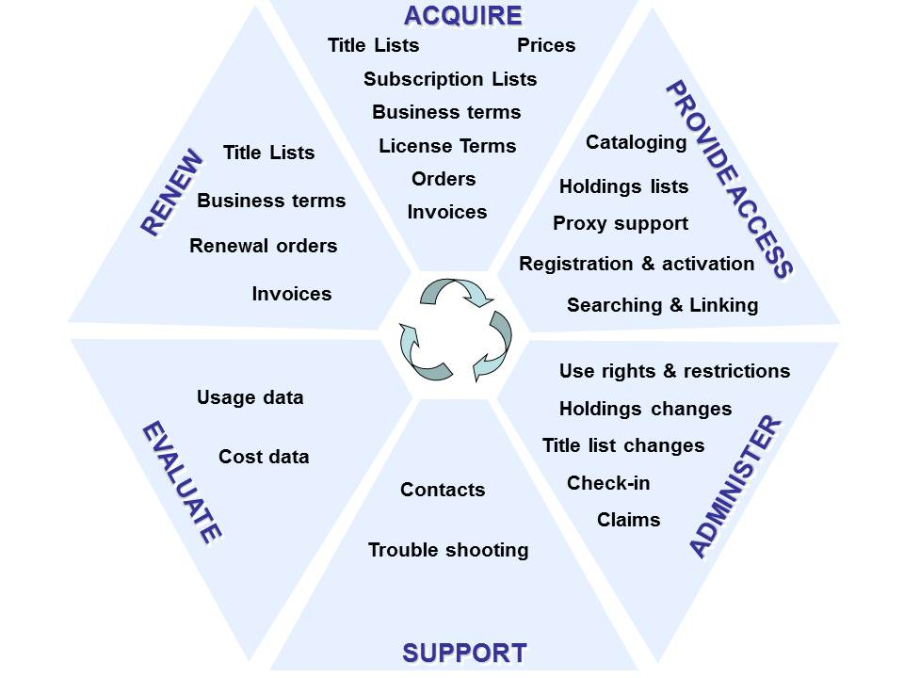
#6terms
Pesch’s electronic resources life cycle. Source: Oliver Pesch,
“Library Standards and E-Resource Management: A Survey
of Current Initiatives and Standards Efforts,” Serials Librarian
55, no. 3 (2008): 482, doi:10.1080/03615260802059965.

Slide 6
Techniques in E-Resources Management
TERMS 1
  Investigating New Content for purchase
TERMS 2
  Acquiring New Content
TERMS 3
  Implementation
TERMS 4
  Ongoing Evaluation and Access
TERMS 5
  Annual Review
TERMS 6
  Cancellation and Replacement Review

Slide 7
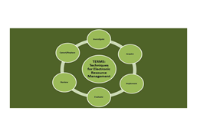
Program
Welcome & Introduction
TERMS 1
  Hands-on activity
TERMS 2
  Hands-on activity
Morning Break
TERMS 3
  Hands-on activity
Morning Wrap-up

Slide 8
Program
Lunch
TERMS 4&5
  Hands-on activity
TERMS 6
  Hands-on activity
Afternoon Break
Workflow Developments
Wrap up/Questions

Slide 9
Introductions and hands-on activities
5 groups of 4
Areas to choose from:
  E-book platform or package
  E-journal package
  Database
  Service, e.g. discovery tool
  Journal archive
  Others?
We don’t need to have 1 group for each, but stick with the areas throughout the day in order to build up the processes to take back with you
We would like your permission to share your thoughts today on the TERMS wiki

Slide 10
#6terms
TERMS 1: Investigation of New Content
This work is licensed under a Creative Commons Attribution 3.0 Unported License

Slide 11
TERMS 1: Investigation of New Content
Know what you want to achieve
Write Your Specification Document
Get the Right Team
Do a Desktop Review of Market and Literature and Then a Trial Set-Up
Talk to Suppliers or Vendors
Make Your Choice
Notes:
Chapter 2 of Library Technology Reports (vol. 49, no.
2) ”Techniques for Electronic Resource Management”
presents a basic framework that should be considered
with every new purchase or addition to content selected
for inclusion in the twenty-first-century library. While
collection management and development policies help
outline the general aspects for collection purchase, in
today’s libraries, many of the standard rules applied to
print acquisition are no longer sufficient. This is especially
true with the advent of patron-driven purchasing models
for e-books. The selection of purchasing models in themselves
now plays a role in how and why specific content
is selected for inclusion in any given collection of library
material. Before any e-resources are purchased or selected
for addition, there are some basic guidelines to consider
when making selection decisions for content.

Slide 12
TERMS 1:
Know what you want to achieve
Need new/different content
Specialized funding request
Need new service
Want to fill gap in collection with demand driven option
Investigating new platform offer
Investigating new model of scholarship
Notes:
Chapter 2 of Library Technology Reports (vol. 49, no.
2) ”Techniques for Electronic Resource Management”
presents a basic framework that should be considered
with every new purchase or addition to content selected
for inclusion in the twenty-first-century library. While
collection management and development policies help
outline the general aspects for collection purchase, in
today’s libraries, many of the standard rules applied to
print acquisition are no longer sufficient. This is especially
true with the advent of patron-driven purchasing models
for e-books. The selection of purchasing models in themselves
now plays a role in how and why specific content
is selected for inclusion in any given collection of library
material. Before any e-resources are purchased or selected
for addition, there are some basic guidelines to consider
when making selection decisions for content.

Slide 13
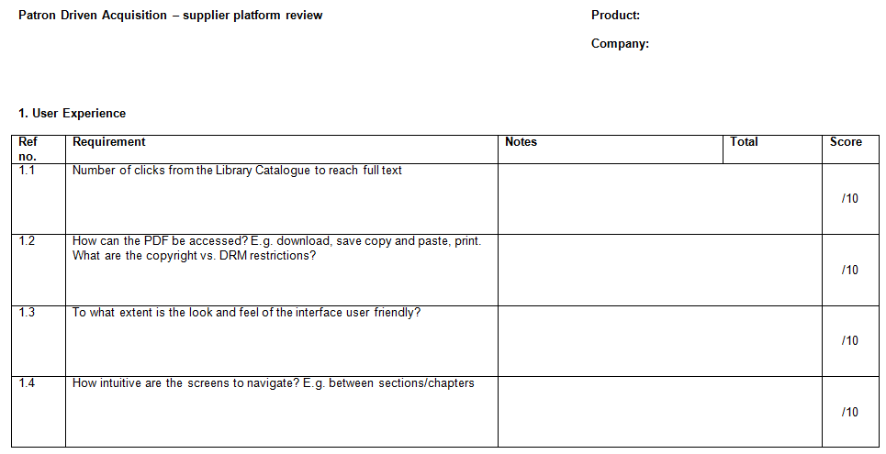
TERMS 1:
Write your specification document
Notes:
Chapter 2 of Library Technology Reports (vol. 49, no.
2) ”Techniques for Electronic Resource Management”
presents a basic framework that should be considered
with every new purchase or addition to content selected
for inclusion in the twenty-first-century library. While
collection management and development policies help
outline the general aspects for collection purchase, in
today’s libraries, many of the standard rules applied to
print acquisition are no longer sufficient. This is especially
true with the advent of patron-driven purchasing models
for e-books. The selection of purchasing models in themselves
now plays a role in how and why specific content
is selected for inclusion in any given collection of library
material. Before any e-resources are purchased or selected
for addition, there are some basic guidelines to consider
when making selection decisions for content.

Slide 14

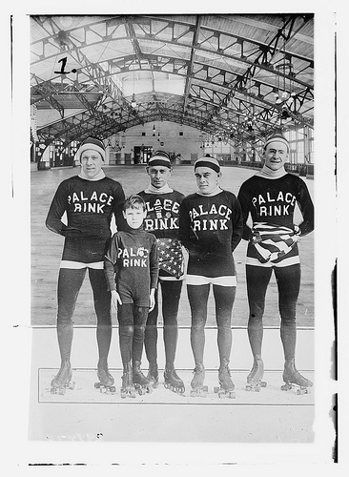
TERMS 1:
Get the Right Team
ER Person
Subject team or liaison
Budget holder
Faculty
IT personnel

Slide 15

TERMS 1: Desk top review and trial
Fiscal responsibility
  Check the product hasn’t already been purchased
  Use overlap tool available from the vendors
Multiple platforms
  Is there a preferred choice?
Trial
  1 month is not enough!
    Sponsored trials?
  Timing and dissemination are crucial
  Record the feedback
http://www.flickr.com/photos/dalboz17/209945979/
Notes:
Chapter 2 of Library Technology Reports (vol. 49, no.
2) ”Techniques for Electronic Resource Management”
presents a basic framework that should be considered
with every new purchase or addition to content selected
for inclusion in the twenty-first-century library. While
collection management and development policies help
outline the general aspects for collection purchase, in
today’s libraries, many of the standard rules applied to
print acquisition are no longer sufficient. This is especially
true with the advent of patron-driven purchasing models
for e-books. The selection of purchasing models in themselves
now plays a role in how and why specific content
is selected for inclusion in any given collection of library
material. Before any e-resources are purchased or selected
for addition, there are some basic guidelines to consider
when making selection decisions for content.

Slide 16
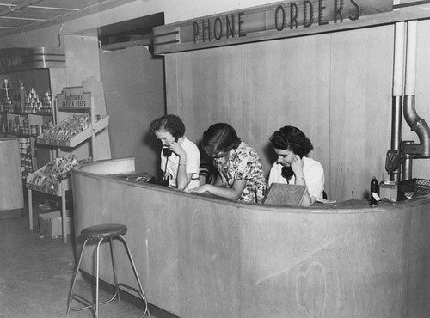
TERMS 1: Talk to Suppliers/Vendors
Review pros and cons with the provider
Begin negotiation for price
Ask for consortia pricing
Be firm on specifications

Slide 17



TERMS 1: Sustainability
What kind of resource are you buying?
Does it need to be sustainable?
How do you measure sustainability
  Publisher platforms vs. aggregators
  Post cancellation access
  LOCKSS, CLOCKSS or Portico
Notes:
Chapter 2 of Library Technology Reports (vol. 49, no.
2) ”Techniques for Electronic Resource Management”
presents a basic framework that should be considered
with every new purchase or addition to content selected
for inclusion in the twenty-first-century library. While
collection management and development policies help
outline the general aspects for collection purchase, in
today’s libraries, many of the standard rules applied to
print acquisition are no longer sufficient. This is especially
true with the advent of patron-driven purchasing models
for e-books. The selection of purchasing models in themselves
now plays a role in how and why specific content
is selected for inclusion in any given collection of library
material. Before any e-resources are purchased or selected
for addition, there are some basic guidelines to consider
when making selection decisions for content.

Slide 18
TERMS 1: Hands-on activity

Slide 19
#6terms
TERMS 2: Acquisition
This work is licensed under a Creative Commons Attribution 3.0 Unported License

Slide 20
TERMS 2: Acquisition
Compare specifications
Negotiate license
Review the license
Renegotiate the license
Sign the agreement
Record metadata

Slide 21
TERMS 2: Compare Specifications
Purchase order needed for invoice?
DDA-need a deposit account?
Contract that outlines purchasing terms?
Request a license for review
Annual review process?
Discounts for multiyear deals?

Slide 22
TERMS 2: Negotiation Points
Definition of site
Definition of users
Remote access
IP authentication
Article-level linking
Mutual indemnification
Privacy clauses
Provision of usage statistics
Content transfer
Use of third party discovery tools
Funding out clause
Venue definition
Perpetual access clause
Price cap allowance

Slide 23
TERMS 2: License Review
Have changes incorporated into a “clean copy”
Always make sure to have an out-clause
Re-read entire document
Pay close attention to addendums
“In the case of a significant decline in financial support to (X library) by their main funding source, (X library) reserves the right to cancel significant portions and potentially cancel this subscription with 30 day notification.”

Slide 24
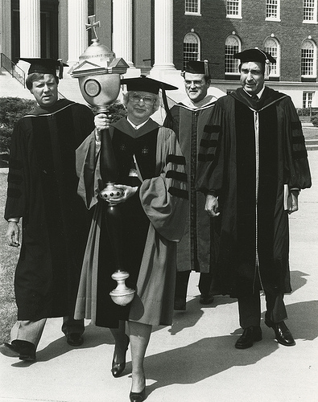
TERMS 2: Re-negotiate license as needed
Negotiation lasts up until signature
Do not be afraid to pick up the phone
Do not feel pressured/rushed by demanding patrons/faculty

Slide 25
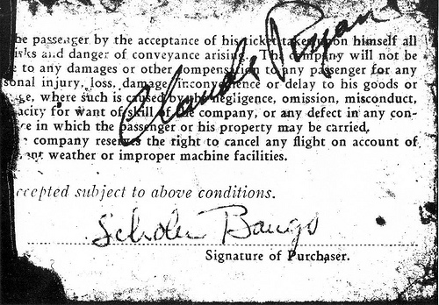
TERMS 2:
Signing Authority
Know your signing authority/signatory at your organization
Do not feel obligated to pursue products/resources signed for by others on campus

Slide 26
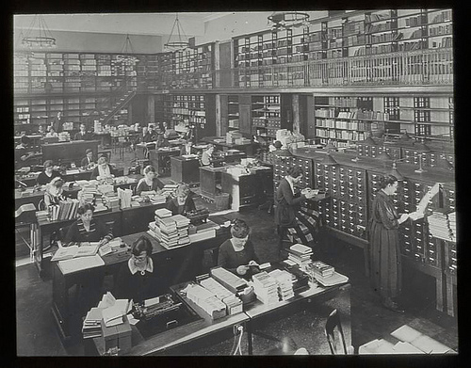
TERMS 2: Record Administrative Metadata
Payment terms/time periods of access
License terms
Funding sources
Provider & contact information for troubleshooting

Slide 27
TERMS 2: Hands-on activity
Top fourteen deal breakers for academic institutions
Definition of site
Definition of users
Remote access
Access should be IP
Ability to provide access and connectivity to other resources
Indemnification should be mutual
Restrictive privacy clauses
Usage statistics
Content transfer
Third party discovery tools
Loss of funding out clause.
Venue should be applicable to your location
Ability to maintain perpetual access to content.
Price cap allowance

Slide 28
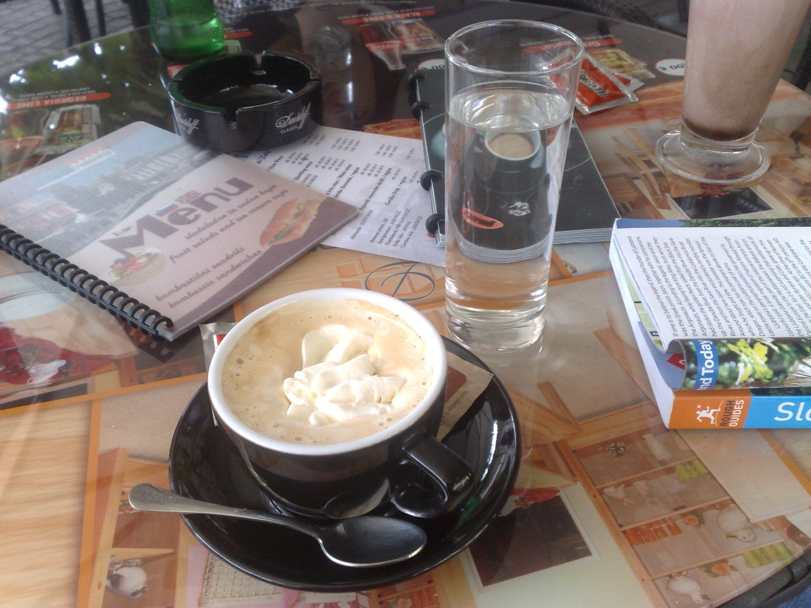
TERMS: Morning break
http://www.flickr.com/photos/grahamstone/4946289210/sizes/o/in/photostream/
This work is licensed under a Creative Commons Attribution-NonCommercial-NoDerivs 2.0 Generic License

Slide 29
#6terms
TERMS 3: Implementation
This work is licensed under a Creative Commons Attribution 3.0 Unported License

Slide 30
TERMS 3: Implementation
Test
Market
Train and Document
Do a Soft Launch
Assess Feedback
Launch

Slide 31
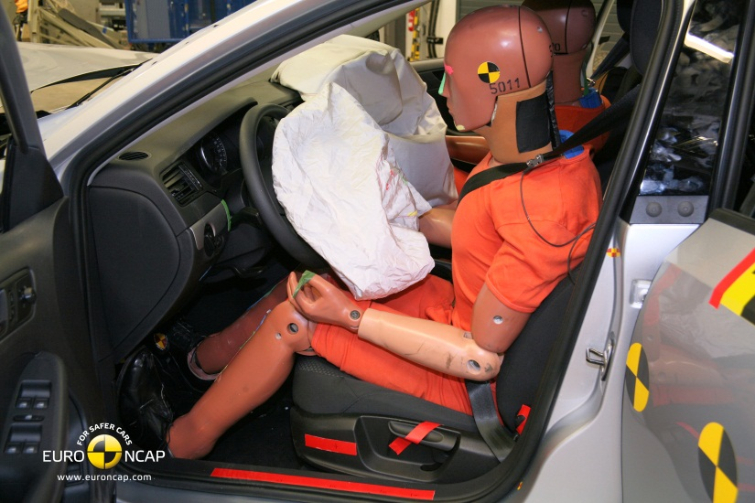
TERMS 3: Test
Does the URL work?
Has authentication been set up?
  On and off campus?
Is it in the knowledge base/link resolver, federated search etc.
Have other points of access been checked?
Are there MARC records?
  Do they need editing?
http://farm7.staticflickr.com/6201/6073263569_00d3508d7a_o_d.jpg

Slide 32

TERMS 3: Marketing plan
Essential to have a marketing plan of some sort
Who are the main group(s) of users?
Have they been told?
http://www.flickr.com/photos/18946008@N06/2220871410/

Slide 33
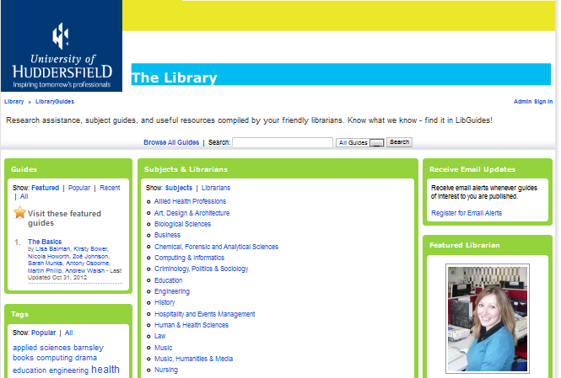
TERMS 3: Train and document
Use the free training
  You’ve paid for it
  Webinars
  Face to face training
  Train the trainer
  Documentation
Libguides

Slide 34
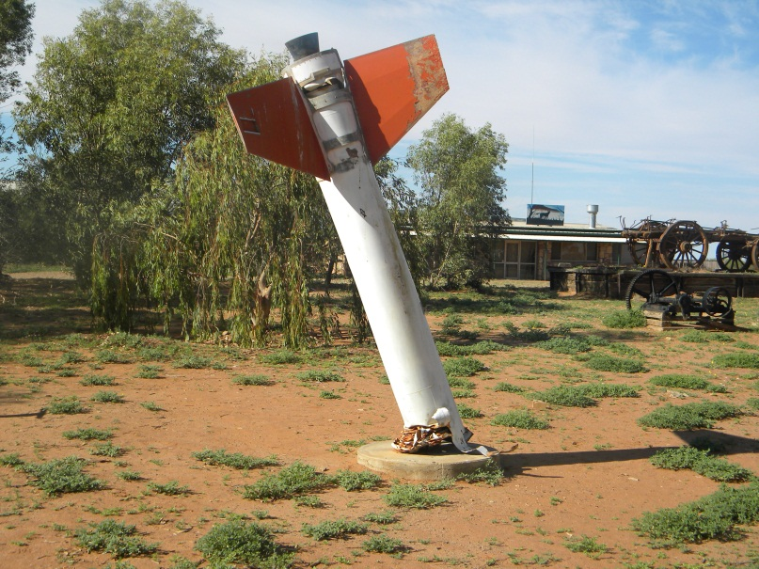
TERMS 3: Soft launch
A short lead in time may create problems down the line
Depending on the scale and type of resource
  PDA may only be a soft launch
  A platform may a soft launch to gather feedback
  A new system may need alpha and beta stages
http://www.flickr.com/photos/seven_resist/7522567846/

Slide 35
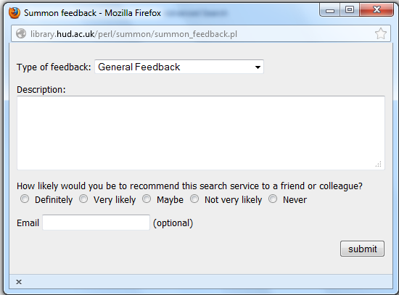
TERMS 3: Assess Feedback
After soft launch or between acquisition and feedback
  Questionnaires
  Surveys
  Focus Groups etc.
Compare this to evaluation in TERMS 4

Slide 36

TERMS 3: Launch
Depending on the scale and type of resource
  Timing is important regardless
  Subscriptions: as soon as the guides are ready
  Major changes at the beginning of an academic year?
Check the marketing plan
  Who is your audience?

Slide 37
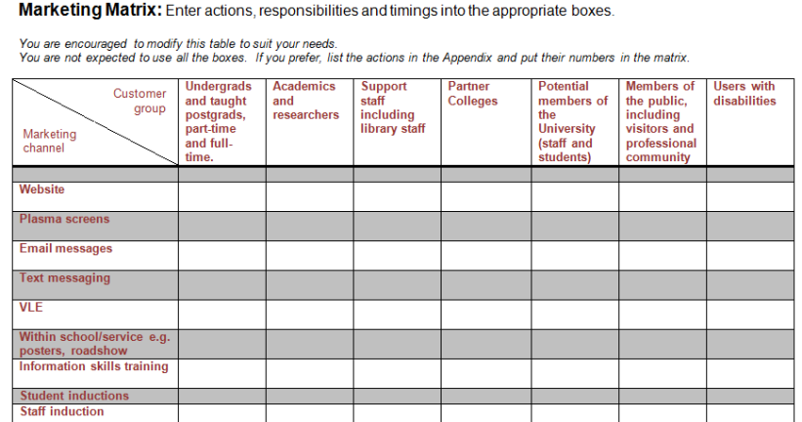
TERMS 3: Hands-on activity

Slide 38
#6terms
TERMS: Morning wrap-up
This work is licensed under a Creative Commons Attribution 3.0 Unported License

Slide 39

TERMS: Morning wrap-up
Any questions before lunch?
Thanks to Char for the photo!
http://www.flickr.com/photos/kstatelibrarian/9050728837/sizes/o/in/photostream/

Slide 40
#6terms
TERMS 4: Ongoing Evaluation & Access
This work is licensed under a Creative Commons Attribution 3.0 Unported License

Slide 41
TERMS 4: Ongoing Evaluation & Access
Types of Evaluation
Check the Implementation
Ask Your Users
Check Changes to Coverage of Resources or Platform Migration
Track Downtime and Availability
Communicate with the Vendor

Slide 42

TERMS 4:
Types of evaluation
COUNTER stats
Impact Factors
Altmetrics
Web page stats, discovery stats, OpenURL stats
User feedback

Slide 43
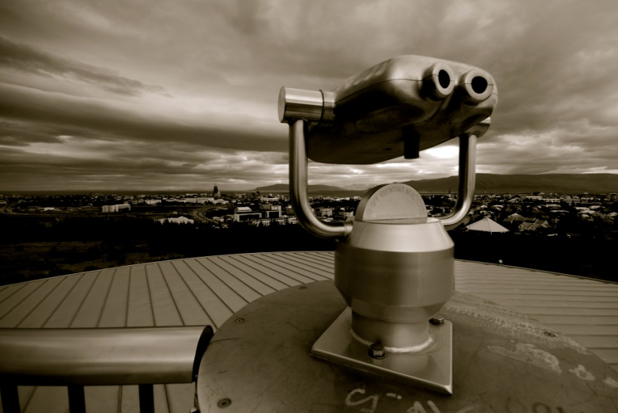
TERMS 4: Check the implementation
Around 1 month in…
  Check the access points including remote access
…then afterwards on a monthly, quarterly or half yearly basis
http://www.flickr.com/photos/vestman/3871170258/
Notes:
Chapter 2 of Library Technology Reports (vol. 49, no.
2) ”Techniques for Electronic Resource Management”
presents a basic framework that should be considered
with every new purchase or addition to content selected
for inclusion in the twenty-first-century library. While
collection management and development policies help
outline the general aspects for collection purchase, in
today’s libraries, many of the standard rules applied to
print acquisition are no longer sufficient. This is especially
true with the advent of patron-driven purchasing models
for e-books. The selection of purchasing models in themselves
now plays a role in how and why specific content
is selected for inclusion in any given collection of library
material. Before any e-resources are purchased or selected
for addition, there are some basic guidelines to consider
when making selection decisions for content.

Slide 44
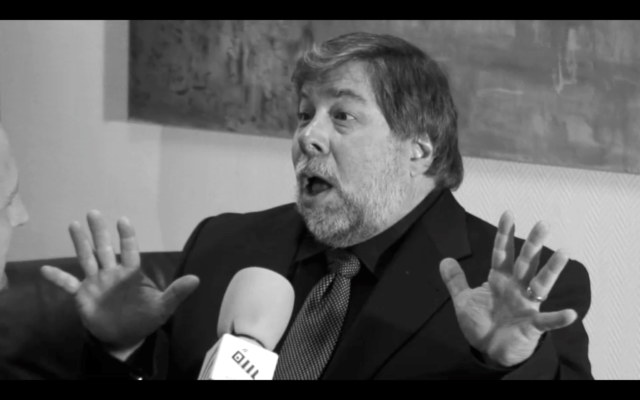
TERMS 4: Ask your users
Use evaluation tools such as:
  LIBQUAL+, National students Survey results (UK) or other survey techniques
Record comments and access queries
  Comments pages
  Emails
  Student panels
http://www.flickr.com/photos/gabenl/2617316249/
Notes:
Chapter 2 of Library Technology Reports (vol. 49, no.
2) ”Techniques for Electronic Resource Management”
presents a basic framework that should be considered
with every new purchase or addition to content selected
for inclusion in the twenty-first-century library. While
collection management and development policies help
outline the general aspects for collection purchase, in
today’s libraries, many of the standard rules applied to
print acquisition are no longer sufficient. This is especially
true with the advent of patron-driven purchasing models
for e-books. The selection of purchasing models in themselves
now plays a role in how and why specific content
is selected for inclusion in any given collection of library
material. Before any e-resources are purchased or selected
for addition, there are some basic guidelines to consider
when making selection decisions for content.

Slide 45

TERMS 4:
Changes to coverage/platform migration
Annual content migration
A&I fulltext databases
Tools from jisc: http://adat.crl.edu/
Tools from CUFTS:
http://cufts2.lib.sfu.ca/MaintTool/public/compare

Slide 46
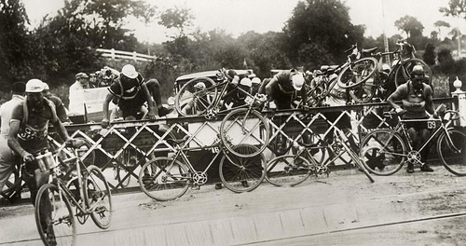
TERMS 4: Track Downtime/Availability
Publisher reported
Patron reported
Spot checks

Slide 47

TERMS 4: Communicate with the vendor
Keep a dossier of correspondence
  Problems, troubleshooting etc.
Talk to the community
  Listservs
  Shared notes on KB+ or consortia pages
User Groups
  Find out if there is one
  Talk to colleagues at regional and national meetings
  Feed back ideas
http://www.flickr.com/photos/lenore-m/467996341/

Slide 48
#6terms
TERMS 5: Annual Review
This work is licensed under a Creative Commons Attribution 3.0 Unported License

Slide 49
TERMS 5: Annual Review
Schedule
Confirm ongoing costs
Usage statistics
Report to stakeholders
Make choice
Renew or cancel

Slide 50

TERMS 5: Set a Schedule
August-October
November-January
February-April
May-July

Slide 51

TERMS 5: Confirm costs
Statements
Renewal Notices
Upgrade access
Content upgrade
Multi-year options

Slide 52

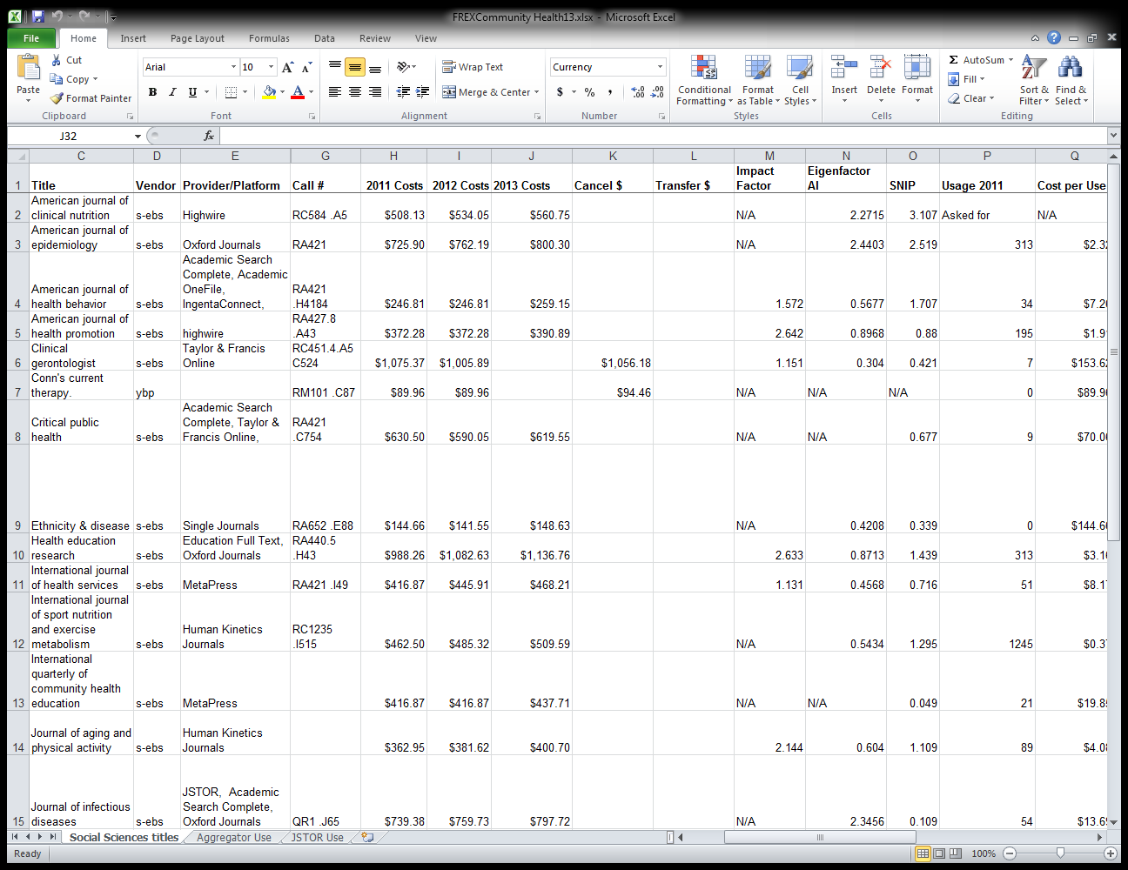
TERMS 5:
Usage Statistics
Need to contextualize
Multi-year statistics works better
Raw COUTNER data is confusing

Slide 53
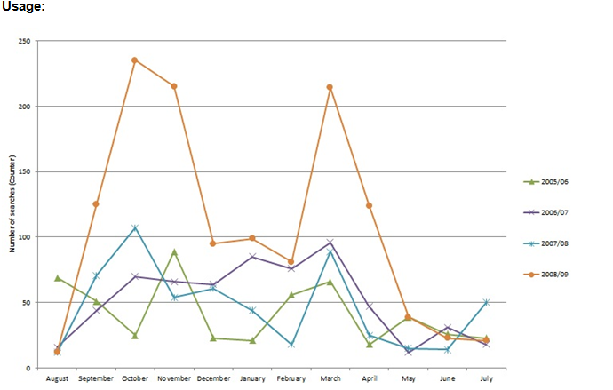
TERMS 5: Example of resource report

Slide 54
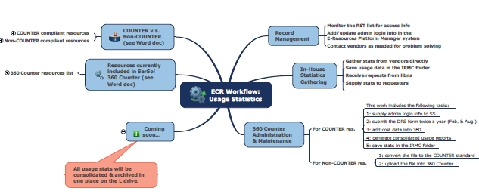

TERMS 5: Example of usage workflow

Slide 55
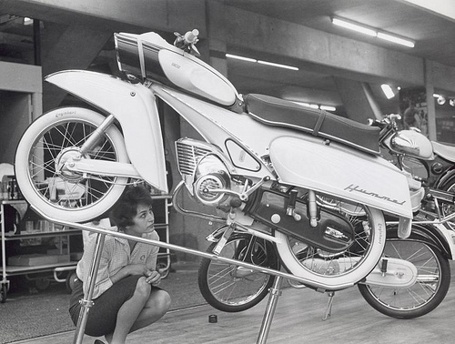
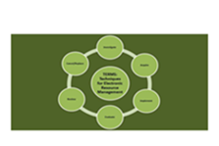
TERMS 5: Make choice/renegotiate or cancel
Talk to provider
Renegotiate
Process renewal
Cancel

Slide 56
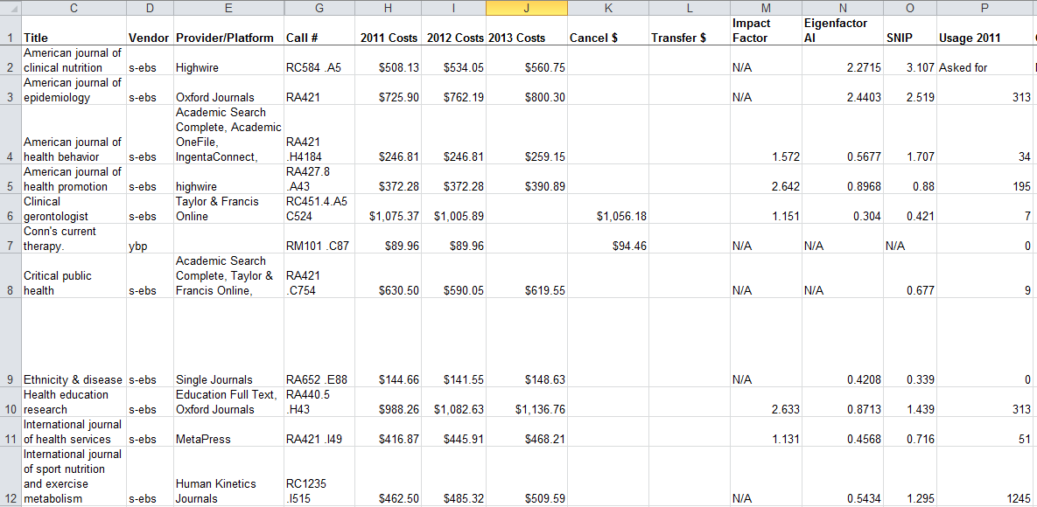
TERMS 4&5: Hands-on activity

Slide 57
#6terms
TERMS 6: Cancellation & Replacement
This work is licensed under a Creative Commons Attribution 3.0 Unported License

Slide 58
TERMS 6: Cancellation & Replacement
Consult with stakeholders
Notify provider/vendor
Notify patron base
Notate records
Investigate open access options
Evaluate replacement options

Slide 59

TERMS 6: Consult with stakeholders
Get the wider view
  Share your reasons for the decision
If there is a vocal minority
  Talk to the Dean
  Review board
Include usage reports and other access issues
Discuss post cancellation rights
http://farm1.staticflickr.com/10/16427383_3dfe49724c_o.jpg

Slide 60

TERMS 6: Notify provider/vendor
Inform the vendor as soon as possible
Explain why you are cancelling
  Let them know if it is down to cost
  You may get a better deal!
Don’t burn you bridges!
Understand you post cancellation rights
http://farm5.staticflickr.com/4115/4865344581_f770820a11_o.jpg

Slide 61
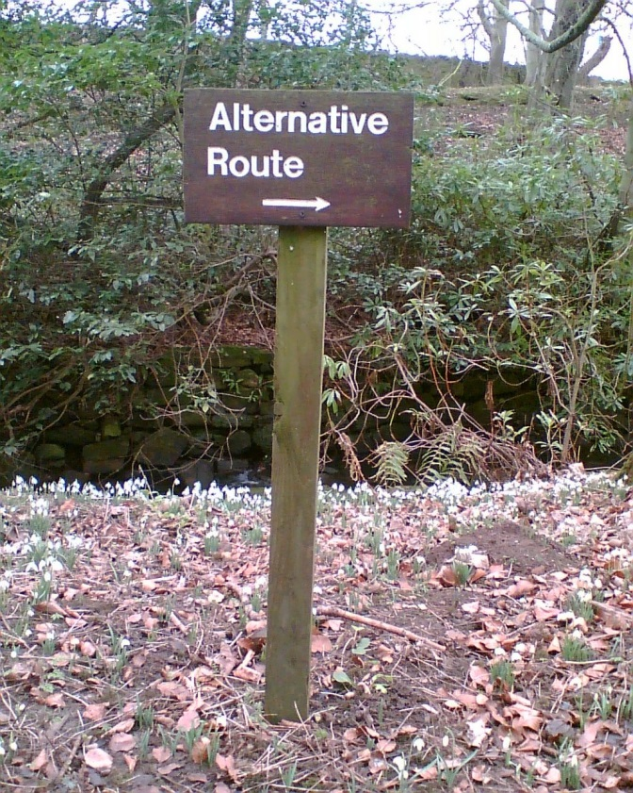
TERMS 6: Notify patron base
Annotate holdings records
Provide a cancellation list
Do this in advance to give your patrons notice and allow them to remove notes and saved searches
Offer alternatives if possible
http://farm1.staticflickr.com/39/99309944_99d41e4802_o.jpg

Slide 62
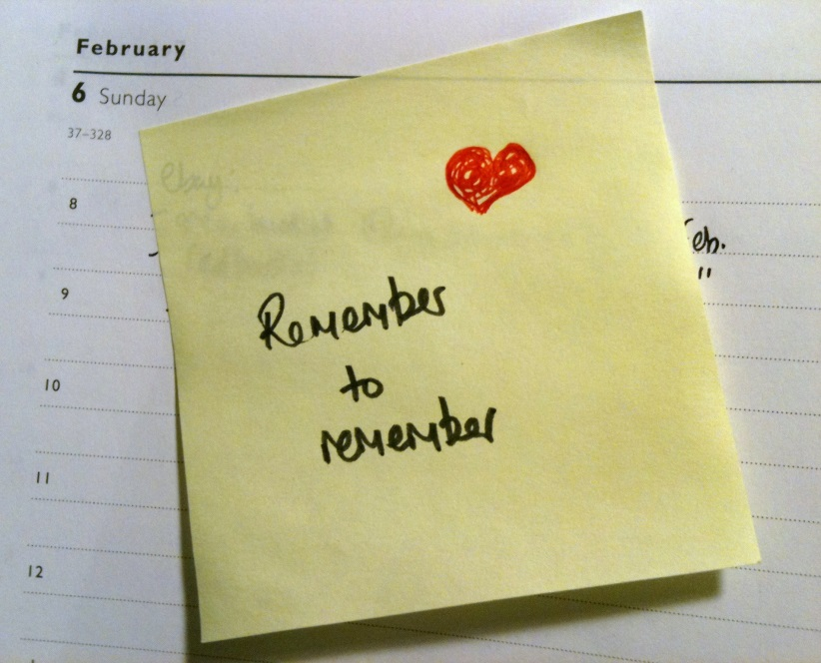
TERMS 6: Notate records
Mark the items in you ILS, ERM etc.
  Reason for cancellation
Review post cancellation
  To ensure there are no dead links
  Titles often re-appear
If cancelled in advance
  Set up a reminder to cancel access
http://farm6.staticflickr.com/5179/5430939866_f2f01afe40_o.jpg

Slide 63

TERMS 6: Explore OA Options
DOAB
DOAJ
Digital Humanities Now
University Presses
Repository Publishing
http://www.flickr.com/photos/24343741@N06/4049306395/

Slide 64

TERMS 6: Evaluate replacement options
Now start all over again!
http://farm5.staticflickr.com/4089/5187736495_b2cf3087f7_o.jpg

Slide 65
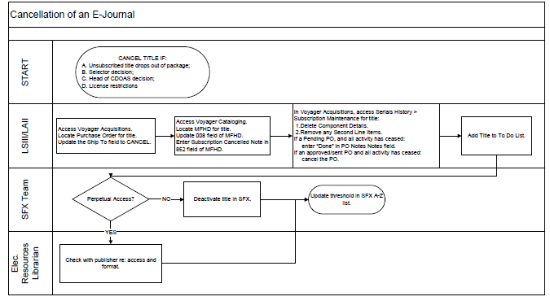
TERMS 6: Hands-on activity
Shared by staff at Texas A&M University

Slide 66

TERMS: Afternoon break
This work is licensed under a Creative Commons Attribution-NonCommercial-NoDerivs 2.0 Generic License

Slide 67
#6terms
TERMS: Workflow Developments
This work is licensed under a Creative Commons Attribution 3.0 Unported License

Slide 68
TERMS: Workflow Developments
Try to devise a workflow for your chosen area:
  E-book platform or package
  E-journal package
  Database
  Service, e.g. discovery tool
  Journal archive
  Others?
Refer back to the 6 TERMS

Slide 69

TERMS: Workflow Developments
We hope you can further develop this back at your home institution
  Talk about these workflows with your team
  Identify the pressure points in the system
To help you manage the change needed to adopt to new systems and work practices
http://farm9.staticflickr.com/8384/8528610850_3863e64a35_o.jpg

Slide 70
#6terms
TERMS: Afternoon wrap-up
This work is licensed under a Creative Commons Attribution 3.0 Unported License

Slide 71

Future Considerations
E-Book Management
New Forms of Scholarship
Article Publishing
Article Processing Charges
Next-Gen Library Management Systems/Library Service Platforms
Web Scale Management
Workflow Versions
http://www.flickr.com/photos/chrisinplymouth/4408009361/

Slide 72
Contact Information
TERMS1 EDITOR: Ann Kucera (akucer01@baker.edu)
TERMS2 EDITOR: Nathan Hosburgh (nathan.hosburgh@montana.edu)
TERMS3 EDITOR: Stephen Buck (stephen.buck@dcu.ie)
TERMS4 EDITOR Anita Wilcox (a.wilcox@ucc.ie)
TERMS5 EDITOR: Anna Franca (anna.franca@kcl.ac.uk)
TERMS6 EDITOR: Eugenia Beh (ebeh@library.tamu.edu)
Jill Emery jemery@pdx.edu
Graham Stone g.stone@hud.ac.uk

Slide 73
Where to find us
TERMS Tumblr blog
  http://6terms.tumblr.com
TERMS Facebook group
  https://www.facebook.com/groups/174086169332439
6TERMS on Twitter
  https://twitter.com/6terms
TERMS Wiki: Main Page
  http://library.hud.ac.uk/wikiterms/Main_Page
Library Technology Reports
  http://dx.doi.org/10.5860/ltr

Slide 74
References
Suzanne Mangrum and Mary Ellen Pozzebon, "Use of collection development policies in electronic resource management," Collection Building 31, no.3 (2012: 113. http://dx.doi.org/10.1108/01604951211243506.
Marcia L. Thomas, “Disruption and Disintermediation: A Review of the Collection Development and Management Literature, 2009–10,” Library Resources and Technical Services 56, no. 3 (2012): 192.
Janice Adlington, “Electronic Resources Management Systems: Potentials for Eresource Management,” White paper to Vanderbilt Library (Nashville, TN, Vanderbilt Library, 2006), http://libstaff.library.vanderbilt.edu/rs/techserv/E-Resources/ERMSystems_Jan2007.pdf
Maria Collins and Jill E. Grogg, “Building a better ERMS,” Library journal 136, no.4 (2011): 22.
Ning Han and Rick Kerns, “Rethinking Electronic Resources Workflows,” Serials Librarian, 61, no.2 (2011): 208. http://dx.doi.org/10.1080/0361526X.2011.591042.
This presentation: http://eprints.hud.ac.uk/17790

Slide 75

TERMS: Afternoon wrap-up
Any further questions?
http://www.flickr.com/photos/grahamstone/7765912666/sizes/o/in/photostream/
This work is licensed under a Creative Commons Attribution-NonCommercial-NoDerivs 2.0 Generic License

