Slide 1

Library analytics and value:
The Library Impact Data Project
Dave Pattern
Library Systems Manager
University of Huddersfield
d.c.pattern@hud.ac.uk
www.daveyp.com/blog/
Graham Stone
Information Resources Manager
University of Huddersfield
g.stone@hud.ac.uk
@Graham_Stone
#lidp
eprints.hud.ac.uk/16436/
This work is licensed under a Creative Commons Attribution 3.0 Unported License

Slide 2
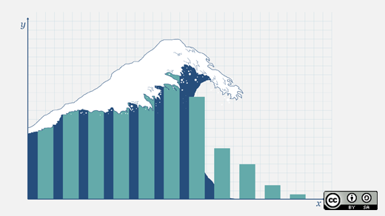
Warning!
You may experience data overload from this presentation
http://www.flickr.com/photos/opensourceway/5755219017/

Slide 3

Library Data at Huddersfield

Slide 4
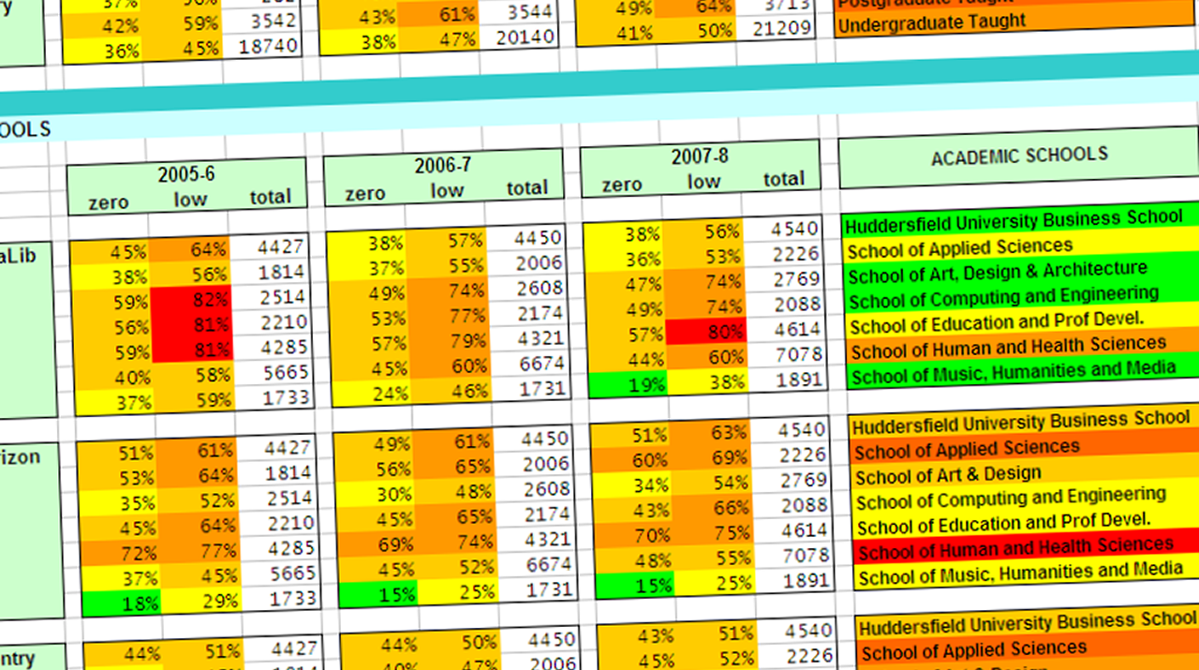
Non & Low Usage Project (2005)
4

Slide 5
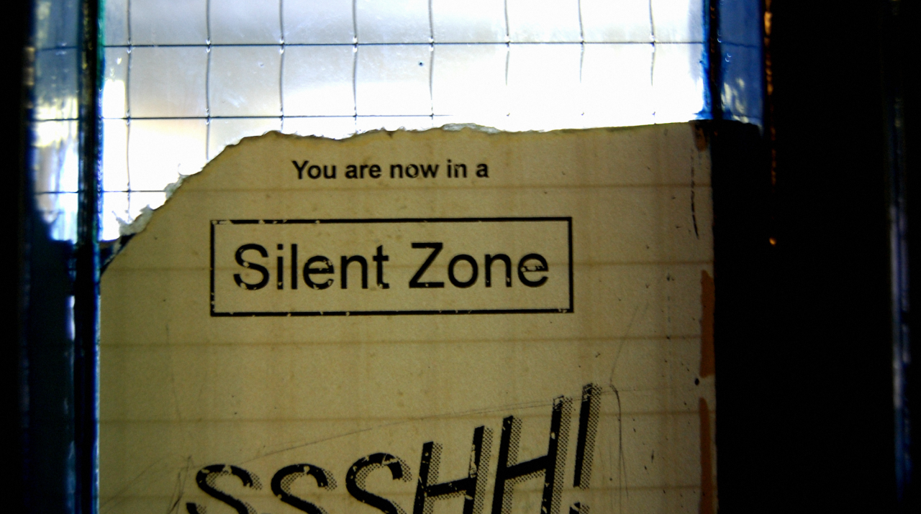
“Is there a link between library usage and final grade?”

Slide 6
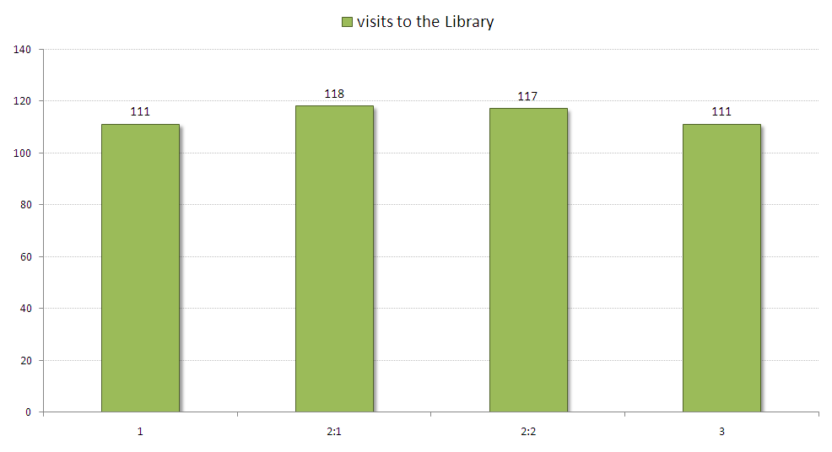
2007/8 & 2008/9 Honours Graduates
1
2:1
2:2
3
6

Slide 7
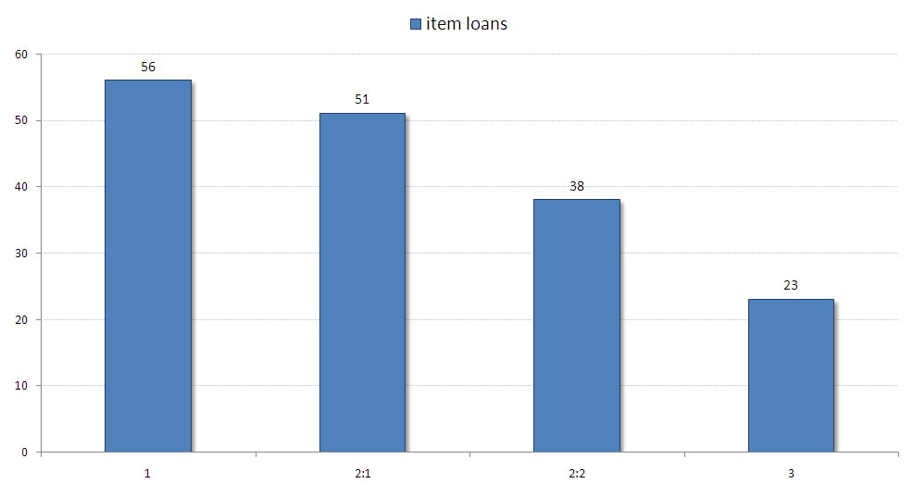
2007/8 & 2008/9 Honours Graduates
1
2:1
2:2
3
7

Slide 8
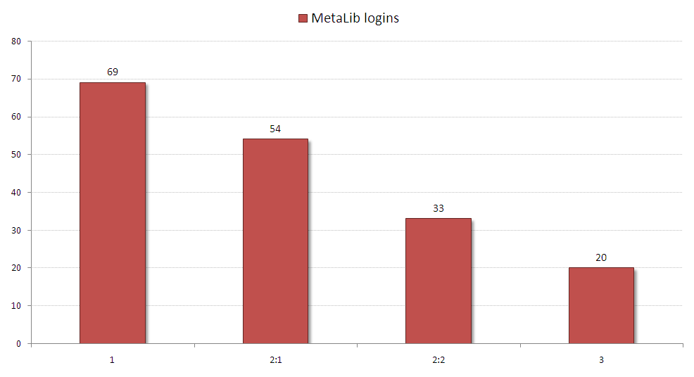
2007/8 & 2008/9 Honours Graduates
1
2:1
2:2
3
8

Slide 9

JISC Library Impact Data Project
9

Slide 10
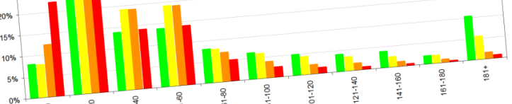
To support the hypothesis that…
“There is a statistically significant correlation across a number of universities between library activity data and student attainment”

Slide 11








Project Partners

Slide 12
Library Impact Data Project 1
Original data requirements
For each student who graduated in a given year, the following data was required:
  Final grade achieved
  Number of books borrowed
  Number of times e-resources were accessed
  Number of times each student entered the library, e.g. via a turnstile system that requires identity card access
  School/Faculty

Slide 13
Findings from Phase One
Huddersfield’s usage data is broadly representative of UK HE libraries
Highly statistically significant link between usage (books and e-resources) and final degree level...
...however, as data wasn’t continuous, we couldn’t support a correlation

Slide 14
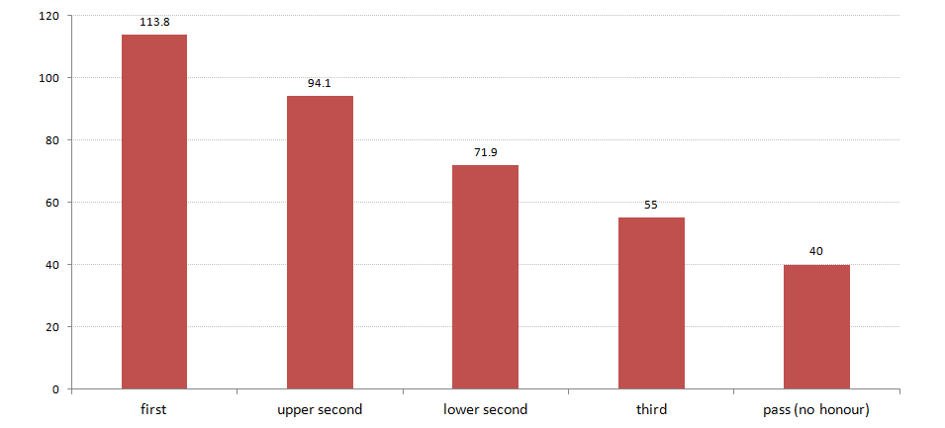
Average Book Loans (All Partners)
average number of books loans for all project partners (inc. renewals from some partners)
1
2:1
2:2
3

Slide 15
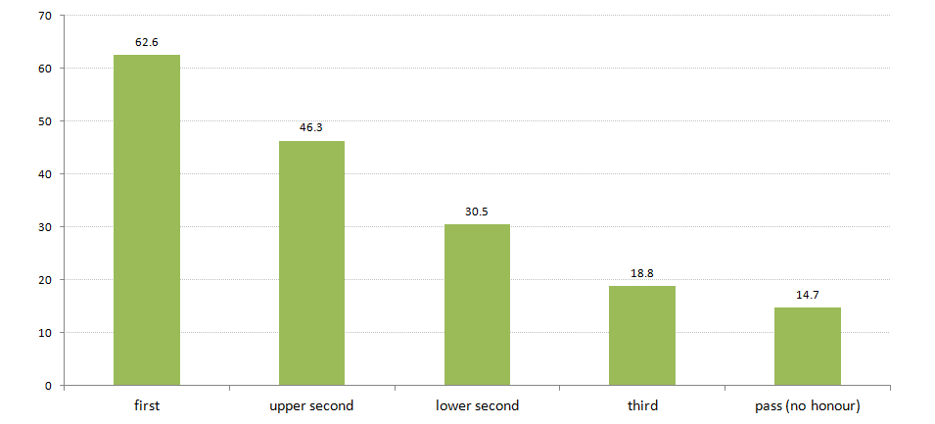
Avg E-Resource Logins (All Partners)
average number of e-resource logins for all project partners
1
2:1
2:2
3

Slide 16
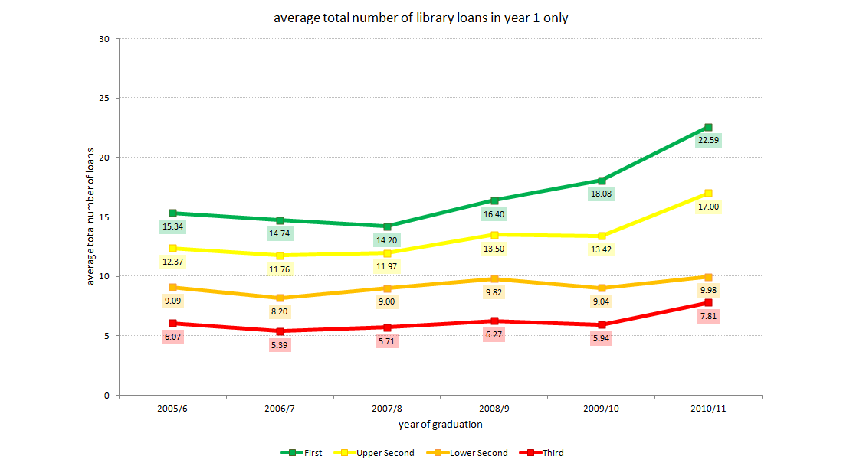
Huddersfield 1st Year Loan Trend
16
Notes:
Average number of books borrowed by students graduating with an honour for the last 6 years. For each student, only their 1st year of loans are including in the average.

Slide 17
Library Impact Data Project
Phase II (Jan-Oct 2012)

Slide 18
Library Impact Data Project
Phase II (Jan-Oct 2012)
Phase I looked at over 33,000 students across 8 universities
Phase II looks at around 2,000 FT undergraduate students at Huddersfield

Slide 19
Library Impact Data Project 2
Additional data
We had some new library usage metrics which weren’t available during Phase I
  Demographics
  Overnight usage
  Off campus usage
  The number of e-resources accessed
    as distinct from the hours spent logged into e-resources
    the number of e-resources accessed 5 or more times
    the number of e-resources accessed 25 or more times.

Slide 20
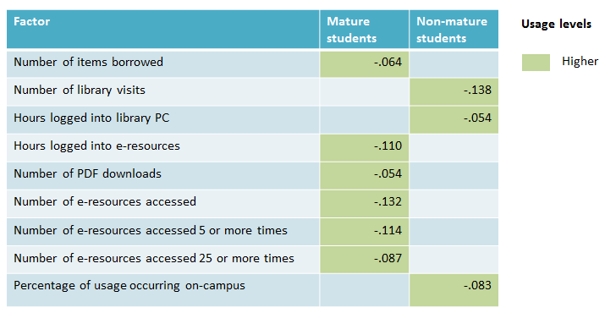
Library usage
Age
Notes:
‘Mature’ = 21 or over on entry.

Slide 21
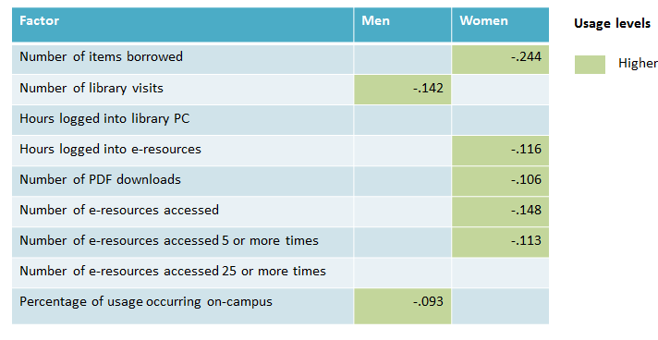
Library usage
Gender

Slide 22
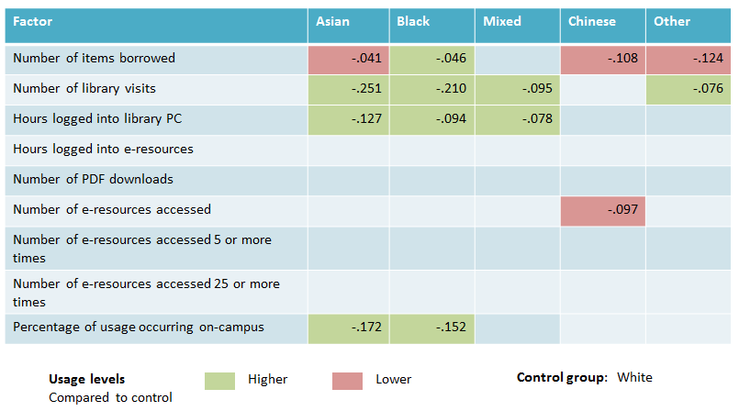
Library usage
Ethnicity

Slide 23
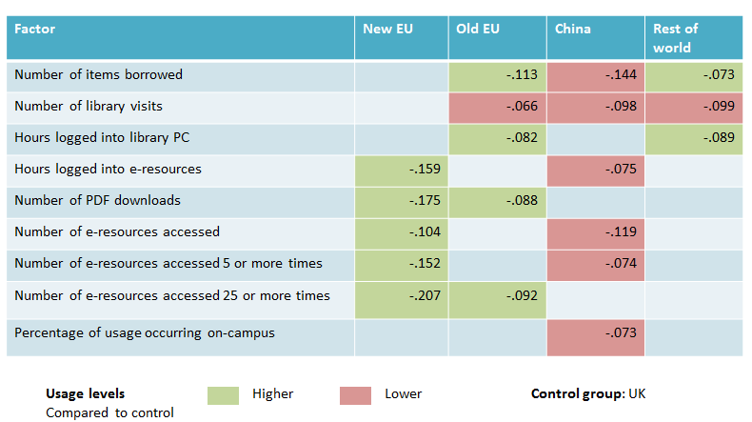
Library usage
Country of domicile

Slide 24
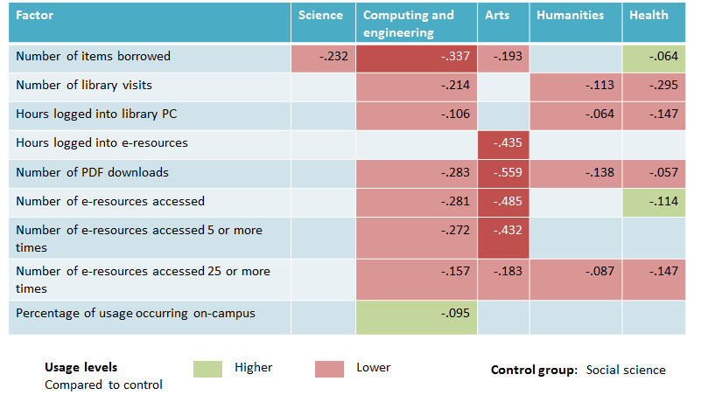
Library usage
Aggregated subject groups

Slide 25
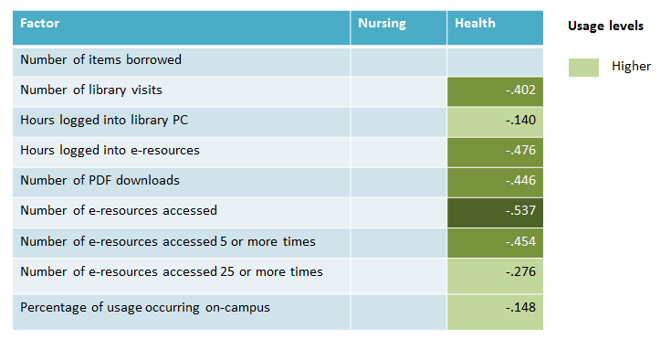
Library usage
Health group

Slide 26
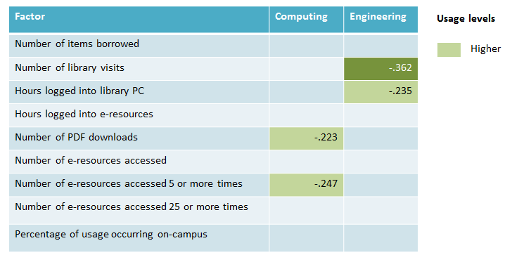
Library usage
Computing and Engineering group

Slide 27
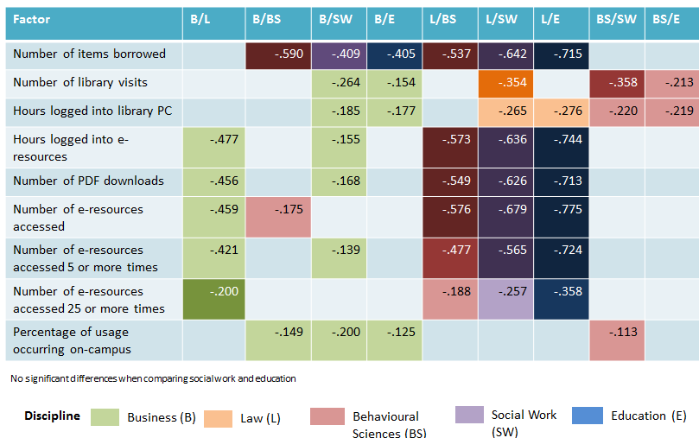
Library usage
Social Science group

Slide 28
Library usage
Retention
Looking at one year of data for every student
Using a cumulative measure of usage for the first two terms of the 2010-11 academic year
Only looking at people who dropped out in term three
All the students included in this study were at the university in the first two terms, and they have all had exactly the same opportunity to accumulate usage.

Slide 29
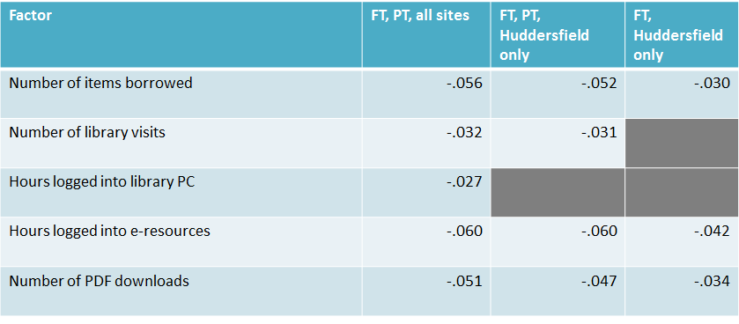
Library usage
Retention

Slide 30
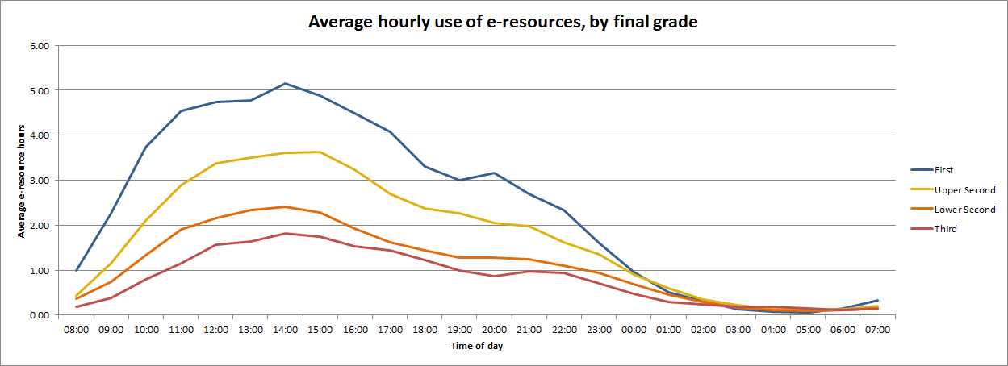
Time of day of usage and outcomes average hourly use

Slide 31
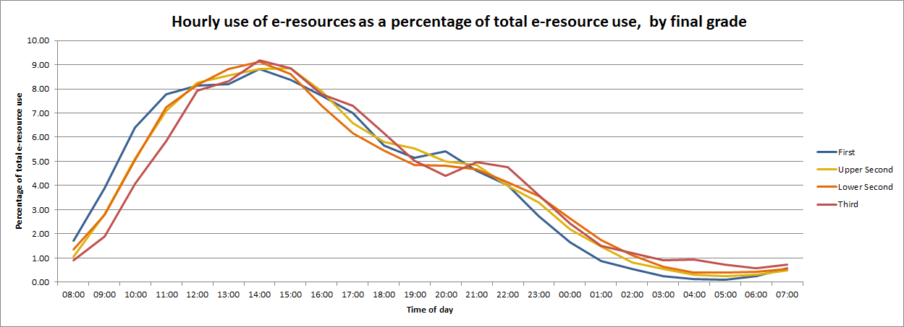
Time of day of usage and outcomes average hourly use as percentage

Slide 32
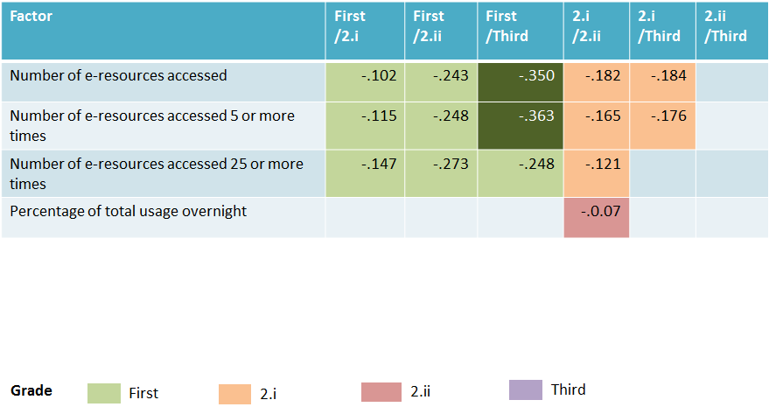
Number of e-resources accessed
Depth and breadth

Slide 33
Other factors
Value added
Rank UCAS points on entry and final grade as percentage
Does the difference correlate with measures of usage?
WARNING! This needs further testing!
Methods are untried
Missing data
Initial results are very encouraging ☺

Slide 34

Library Analytics Survey
We asked:
How important will analytics be to academic libraries now and in the future, and what is the potential for a service in this area?
With thanks to Joy Palmer and the team at MIMAS for the initial survey analysis

Slide 35
In principle, would your institution be willing to contribute data that could be linked to anonymised individuals?
Significant appetite for analytics services among this sample (96%)
  But more hesitation over sharing UCAS and student data than other forms of usage data
Strong willingness to share a broad range of data
  preference to be identified by JISC band (91% in favour)
  as opposed to named institution (47%)

Slide 36
What would prevent you from sharing this data?
Concerns over privacy (91%)
Concerns over divulging business intelligence (85%)
Technical barriers (e.g. resource for extracting data, lack of the skills required to benefit from this activity) (76%)
Reservations over the quality of data (55%)
Institutional focus is on other goals/projects (41%)

Slide 37
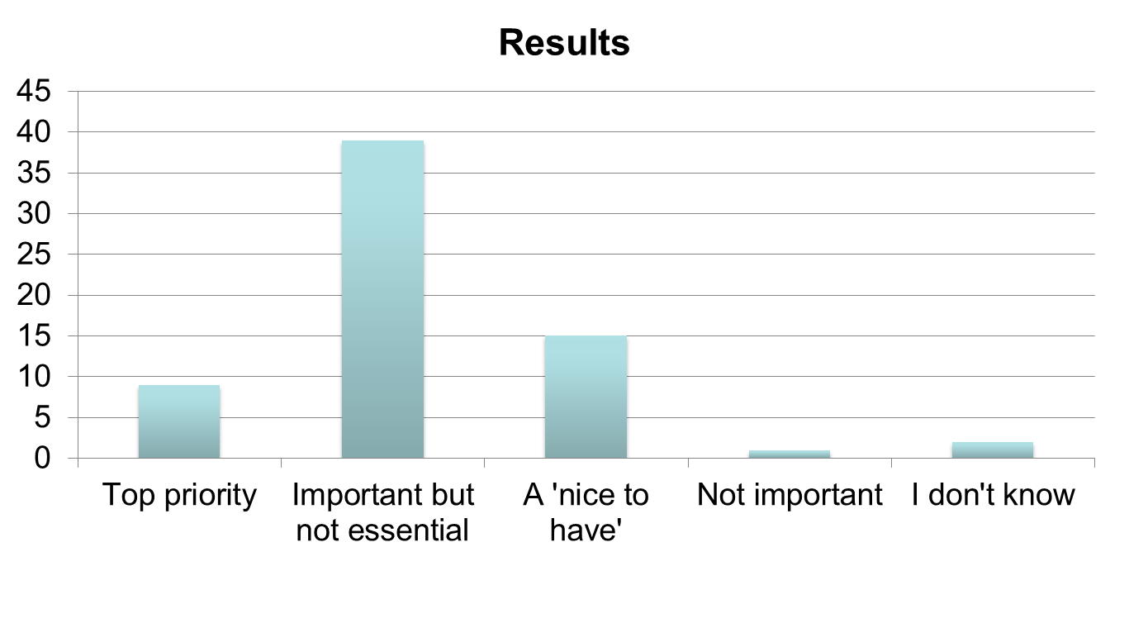
Is this a current strategic priority?

Slide 38
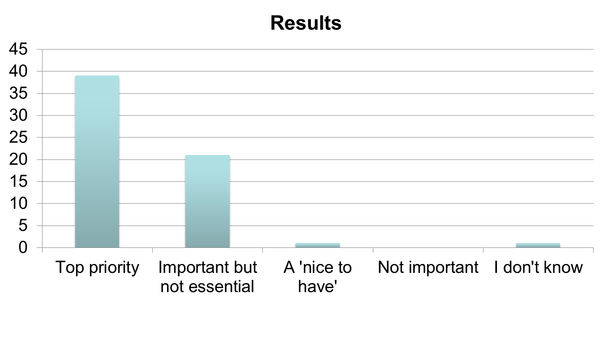
What about the next five years?

Slide 39
Key strategic drivers
Enhancing the student experience
Demonstrating value for money
Supporting research excellence

Slide 40


A shared service for Library Analytics
An analytics service providing libraries with actionable data to transform the services and support institutions provide to students and researchers.

Slide 41
Final Outputs (October 2013)
Prototype Library Analytics Suite
Business plan/model evaluation
Development of a prototype library analytics dashboard providing libraries with a single interface onto a range of data and intelligence services. The project will initially focus on the work of Library Impact data and Copac Activity data.
Develop a business case (and potential model) to ensure the prototype is developed on a sure economic footing. The evaluation will also measure and assess what the project produces.
Future development report
A report recommending whether the prototype should be developed further, and with what priorities and business model(s).

Slide 42

…and finally
Ellen Collins
Research Information Network
ellen.collins@researchinfonet.org

Slide 43
Thank you
Library Impact Data Project blog
http://library.hud.ac.uk/blogs/projects/lidp/
#lidp
eprints.hud.ac.uk/16436/
This work is licensed under a Creative Commons Attribution 3.0 Unported License

