Slide 1
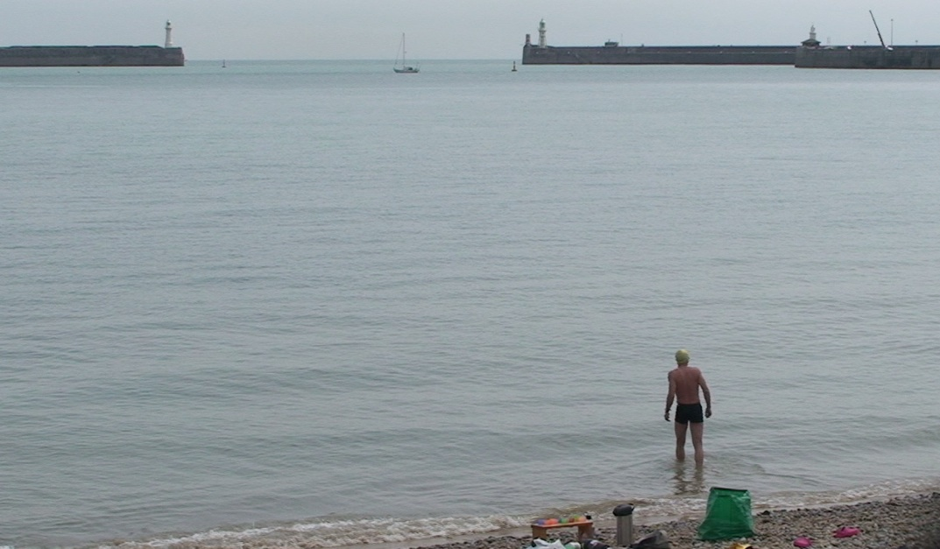
Dr Lisa Stansbie
University of Huddersfield
Testing the Limits: Contemporary Art and Channel Swimming
This paper discusses how the rituals, apparatus and experience of channel swimming (and open water swimming) forms the basis of research that is developed into concept based contemporary art work.
How channel swimming in particular forms a rich basis for working creatively in using approaches from conceptual art.

Slide 2
Introduction
Practice based research in Contemporary Art
Research by and through practice. Artists and designers develop their own epistemological and methodical approaches to concrete problems/research areas which differ from purely scientific approaches. Usually interdisciplinary in nature, using hybrid forms of knowledge.
Through practice based art research it is possible to capture process and share findings to diverse audiences and disseminate findings outside of solely academic (and artistic) circles. This can also enable shifting meanings for the art work as it is disseminated in different contexts.
‘…studio art as a site for conducting transformative research that has individual and cultural relevance’ (Sullivan 2010) Art as Research: Enquiry in the Visual Arts.

Slide 3
‘…in my search for texts on sports and art, I began to suspect at some point that , at least since the 1990’s the relationship between the two was one of mutual scepticism or lack of interest’ (Jahn 2006) Body Power: Power Play: Views on Sports in Contemporary Arts
The research draws together two seemingly disparate disciplines, art and sport and seeks to cross-pollinate and collaborate with sports men and women. The relationship between art and sport is full of tension and ambivalence. Artists that have created work around sport issues do so often through residencies and an attempt to ‘capture’ the essence of the sport they are researching through observation and documentation. The notion of sport ‘in’ art rather than ‘through’ it. Examples of how artists respond via direct involvement are less well documented.
From a hybrid channel swimmer position, having trained and swam a relay (A standard relay is six swimmers each swimmer swimming an hour at a time) but not having swam the channel solo, my position is one of slippage.. between the objective artist observer and the artist participant.
The most successful recent example of artist participant is perhaps Leanne Shapton’s book Swimming Studies (2012) based on her own experiences of competitive swimming and drawing. It contains intimate recollections that detail the personal narratives via text and visuals.
Notes:
Jason Minsky, Daria Martin, I-Move sea swim project, 2012 Cultural Olympiad

Slide 4
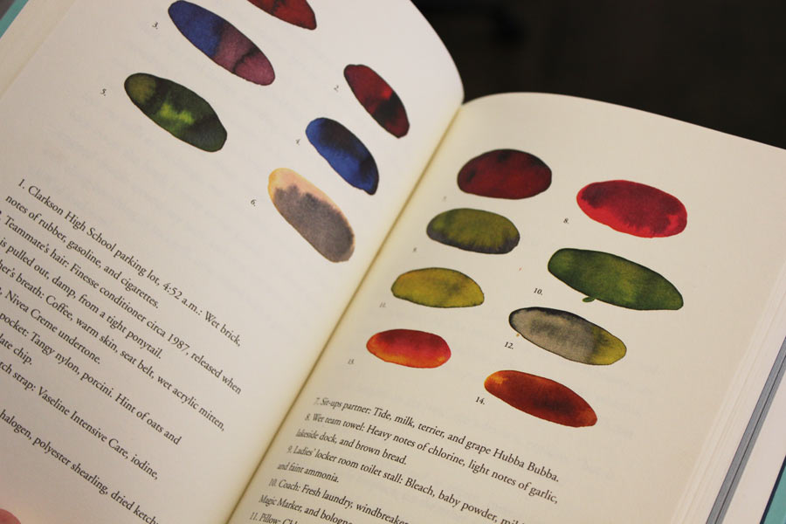

Slide 5
The Sport of Channel Swimming as a fertile ground for artistic production
The development into a channel swimmer is one one of learning the behaviour, languages and becoming part of the channel swimming community.
The art works that form this body of research attempts to make apparent the rituals, processes and experiences of channel swimming. The works are split into two categories namely apparatus, which include the symbolic object based sculptures (Totemic Objects?) These objects are developed from information collected from swimmer donated images. The second group of works are subjective film and photography works, based on my own experiences.

Slide 6
Time (based)
There are strong links between the sport of channel swimming and performance art/endurance art. Performance art often involves an emphasis on ‘time’ whereby the passing of time becomes the measure of the performance/act itself. The genre of endurance art is disseminated largely through video and photography documentation of feats of extreme acts of physical endurance and pain.
Channel swimming has a systematic and accepted process of preparation (unlike the more generalised sport of open water swimming) including a testing of the bodies limits to deal with cold water. Channel swimmers training is measured by time spent in the water.
Similar to time-based processes for the recording of performance art ‘time based’ has become an important part of the spectacle of channel swimming. The ‘channel swimming video’, an individuals filmed and edited documentation of their swim, reinforces the acknowledged rituals and processes of a channel swim and stages the performance for a particular audience. There is also digital documentation over a period of the channel swim itself – the Twitter update, information from the swimmers crew on the progress of the swim, with particularly details pertaining to ‘feeding’.

Slide 7
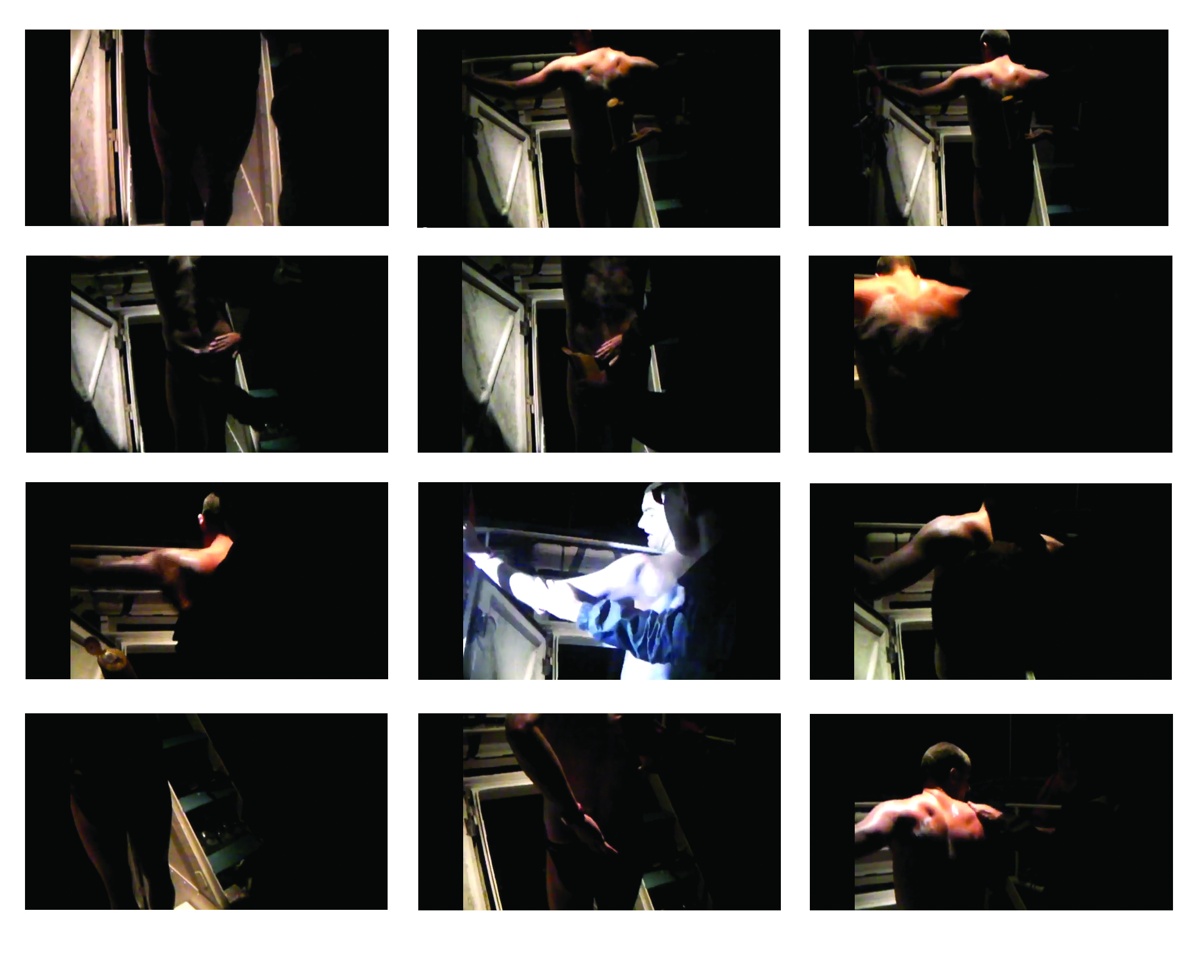
Notes:
Greasing Up (Nick Adams). Series of large digital prints. The distortion of the prints large-scale creates an almost religious feel with the chariscuro effect of the light.

Slide 8
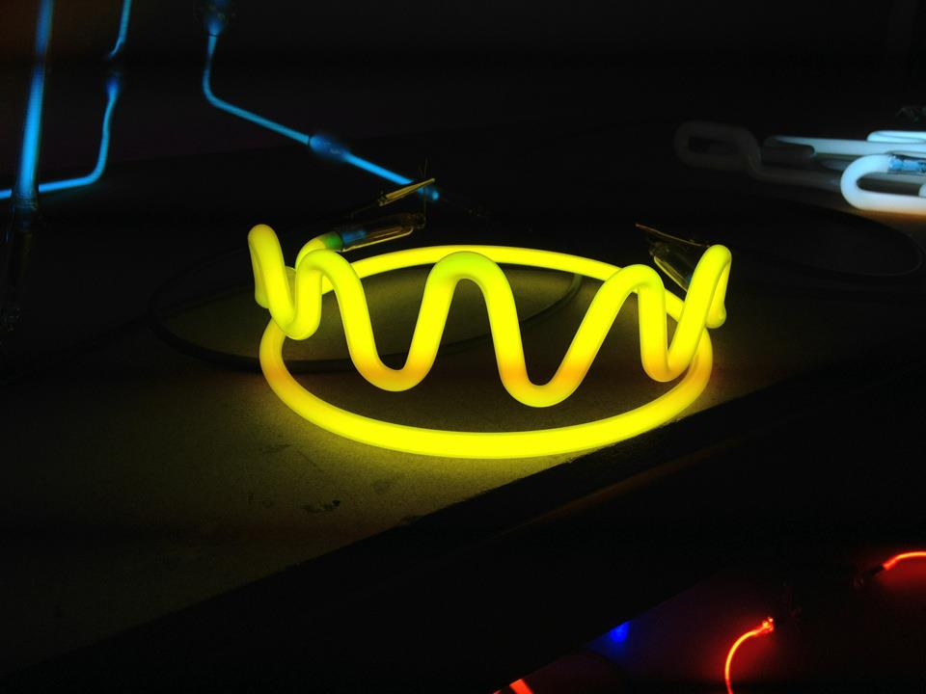
Notes:
King of The Channel (2012) Language

Slide 10
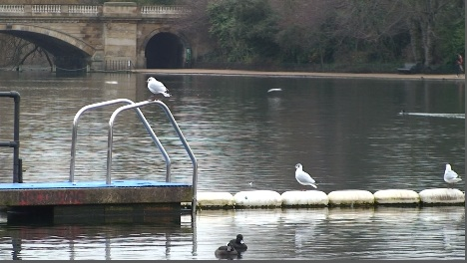
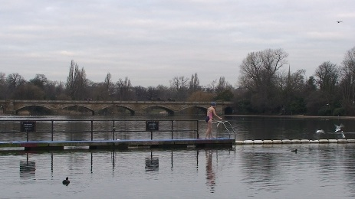
Notes:
Training Ground. Serpentine Winter swimming. Sound piece (play excerpts)

Slide 11
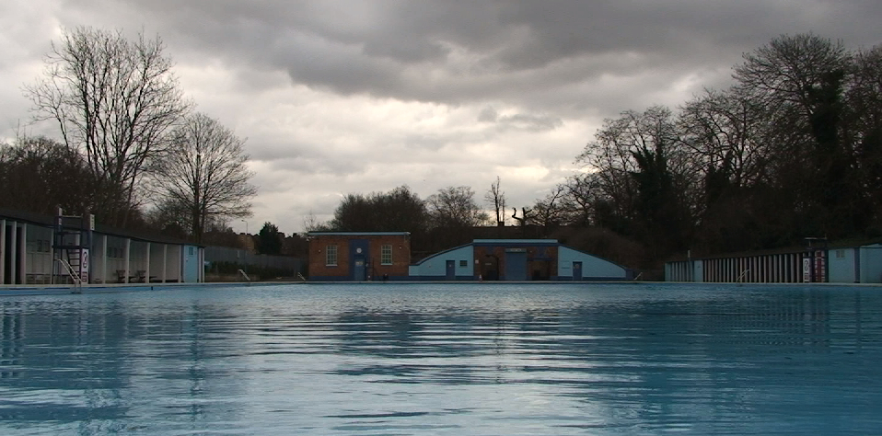
Notes:
Tooting (Tooting Bec lido) Sound and film piece (play excerpt). “Haunted Resonance’ and the writing of David Toop.

Slide 12
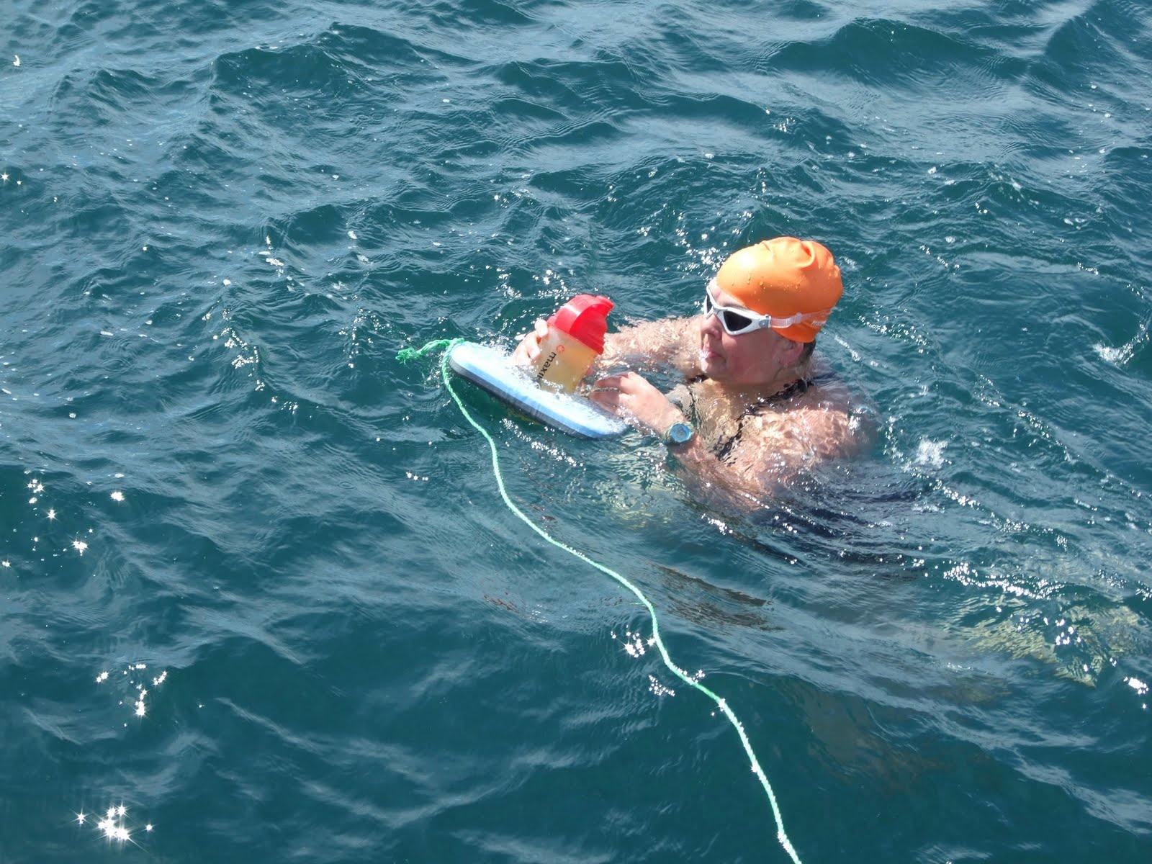
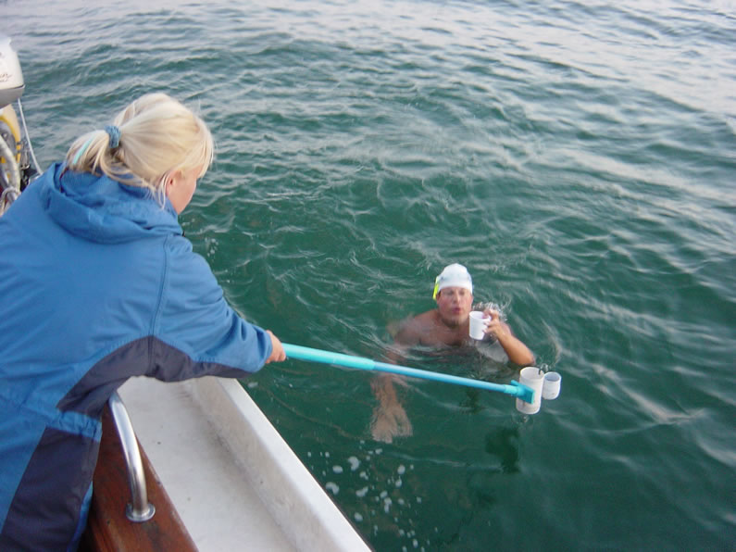
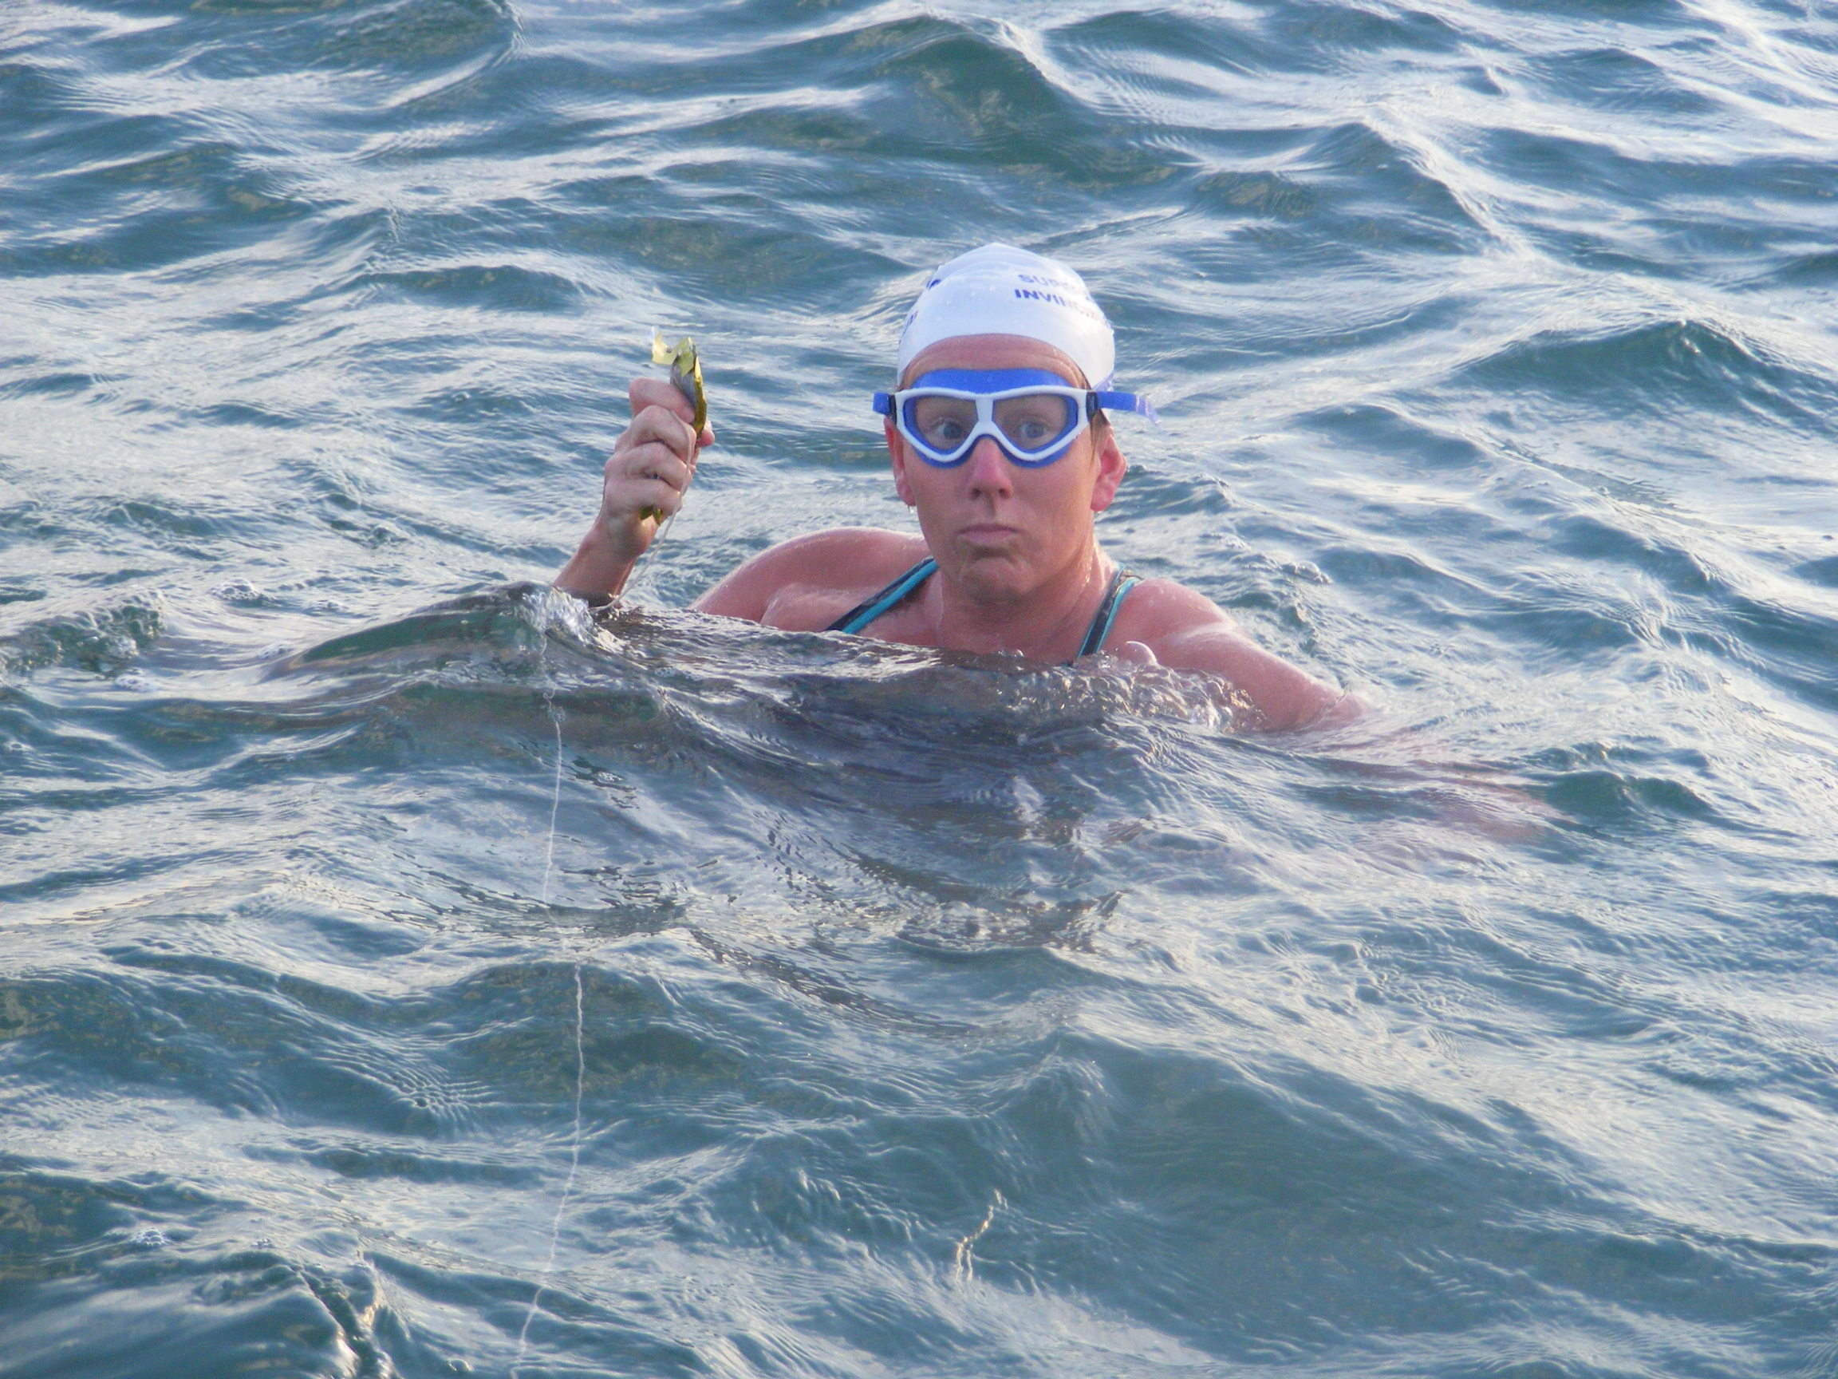
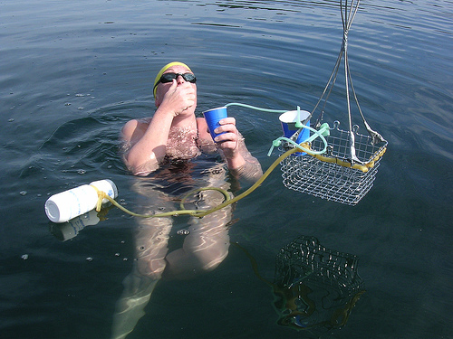
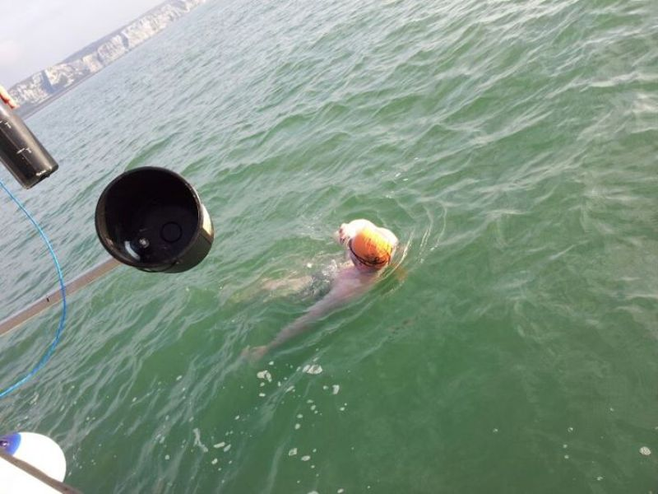
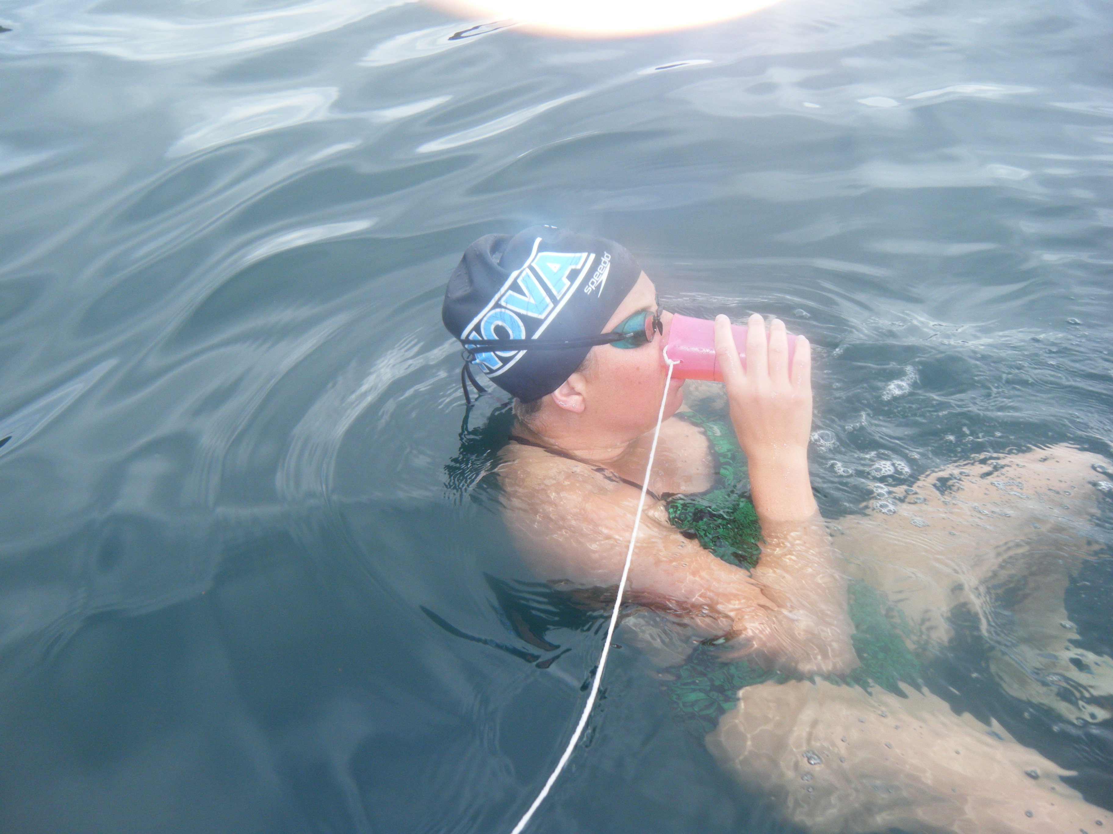
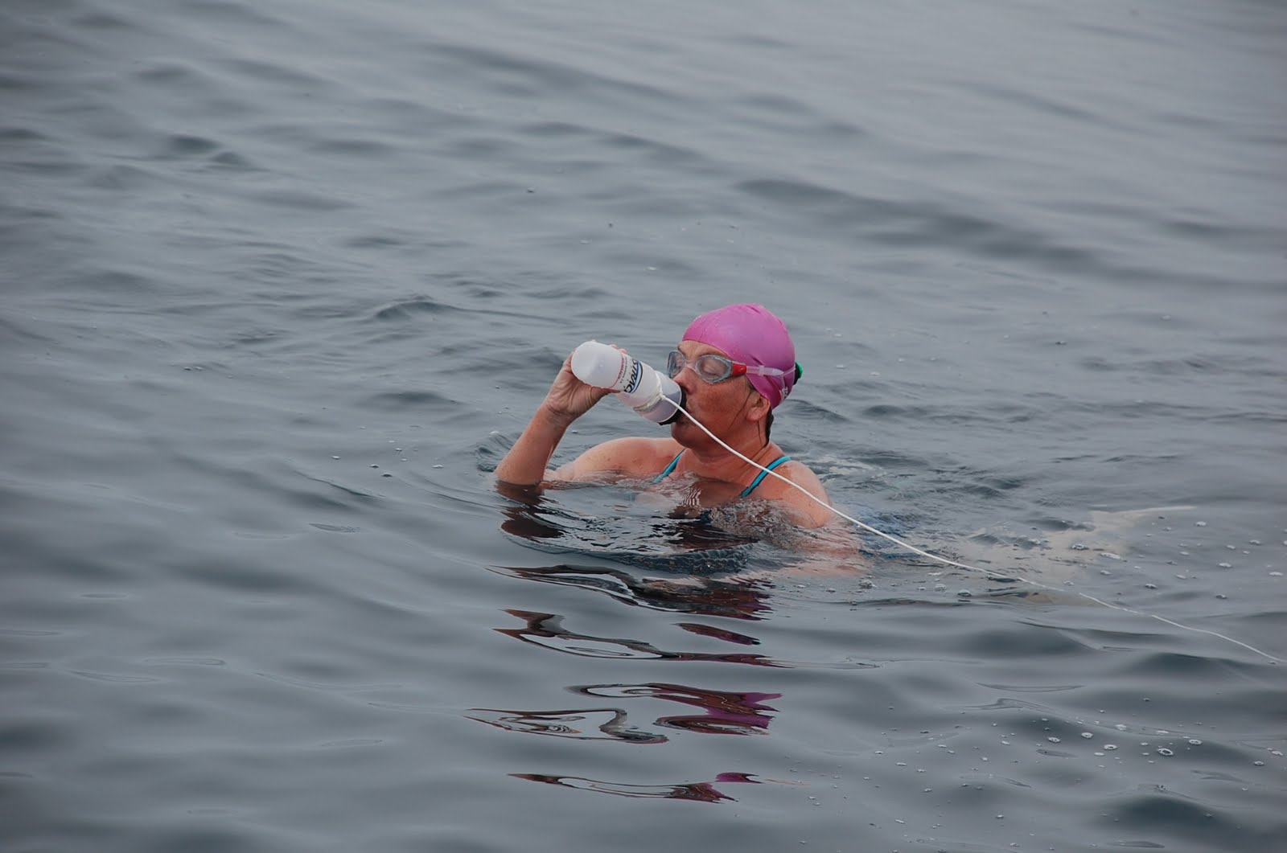
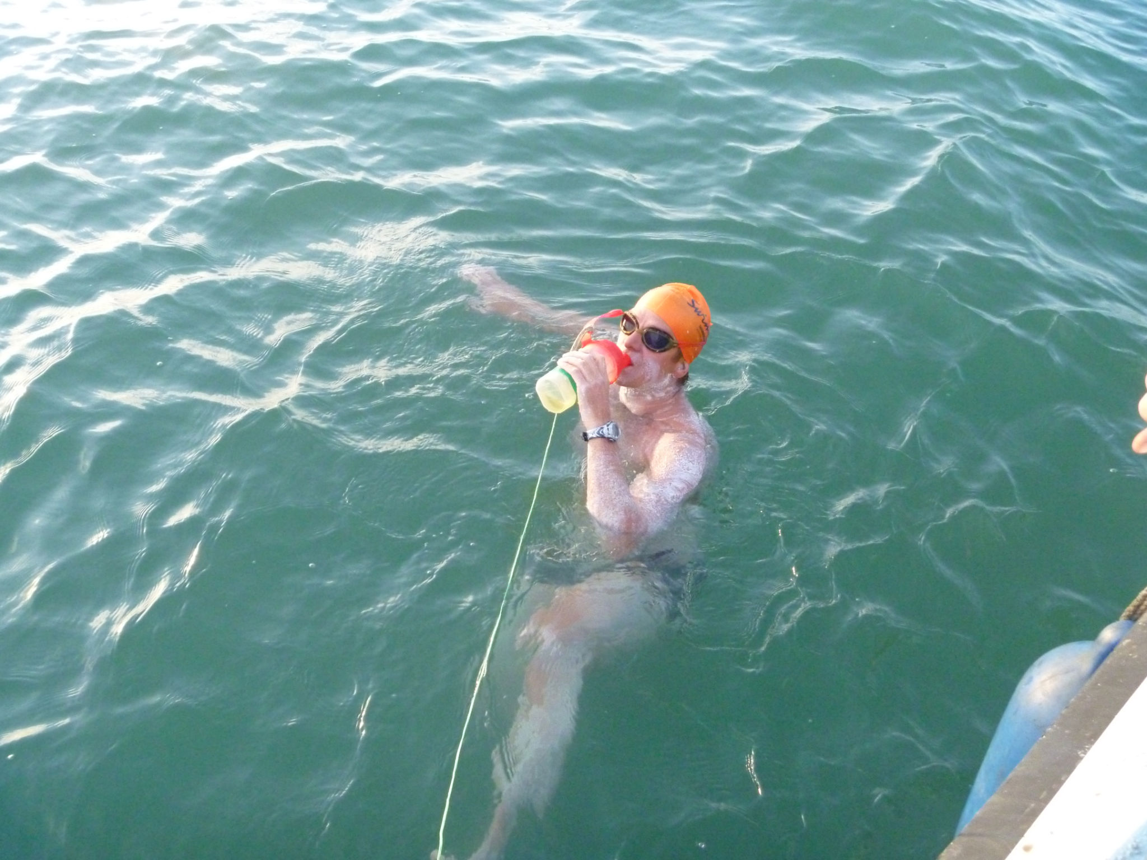
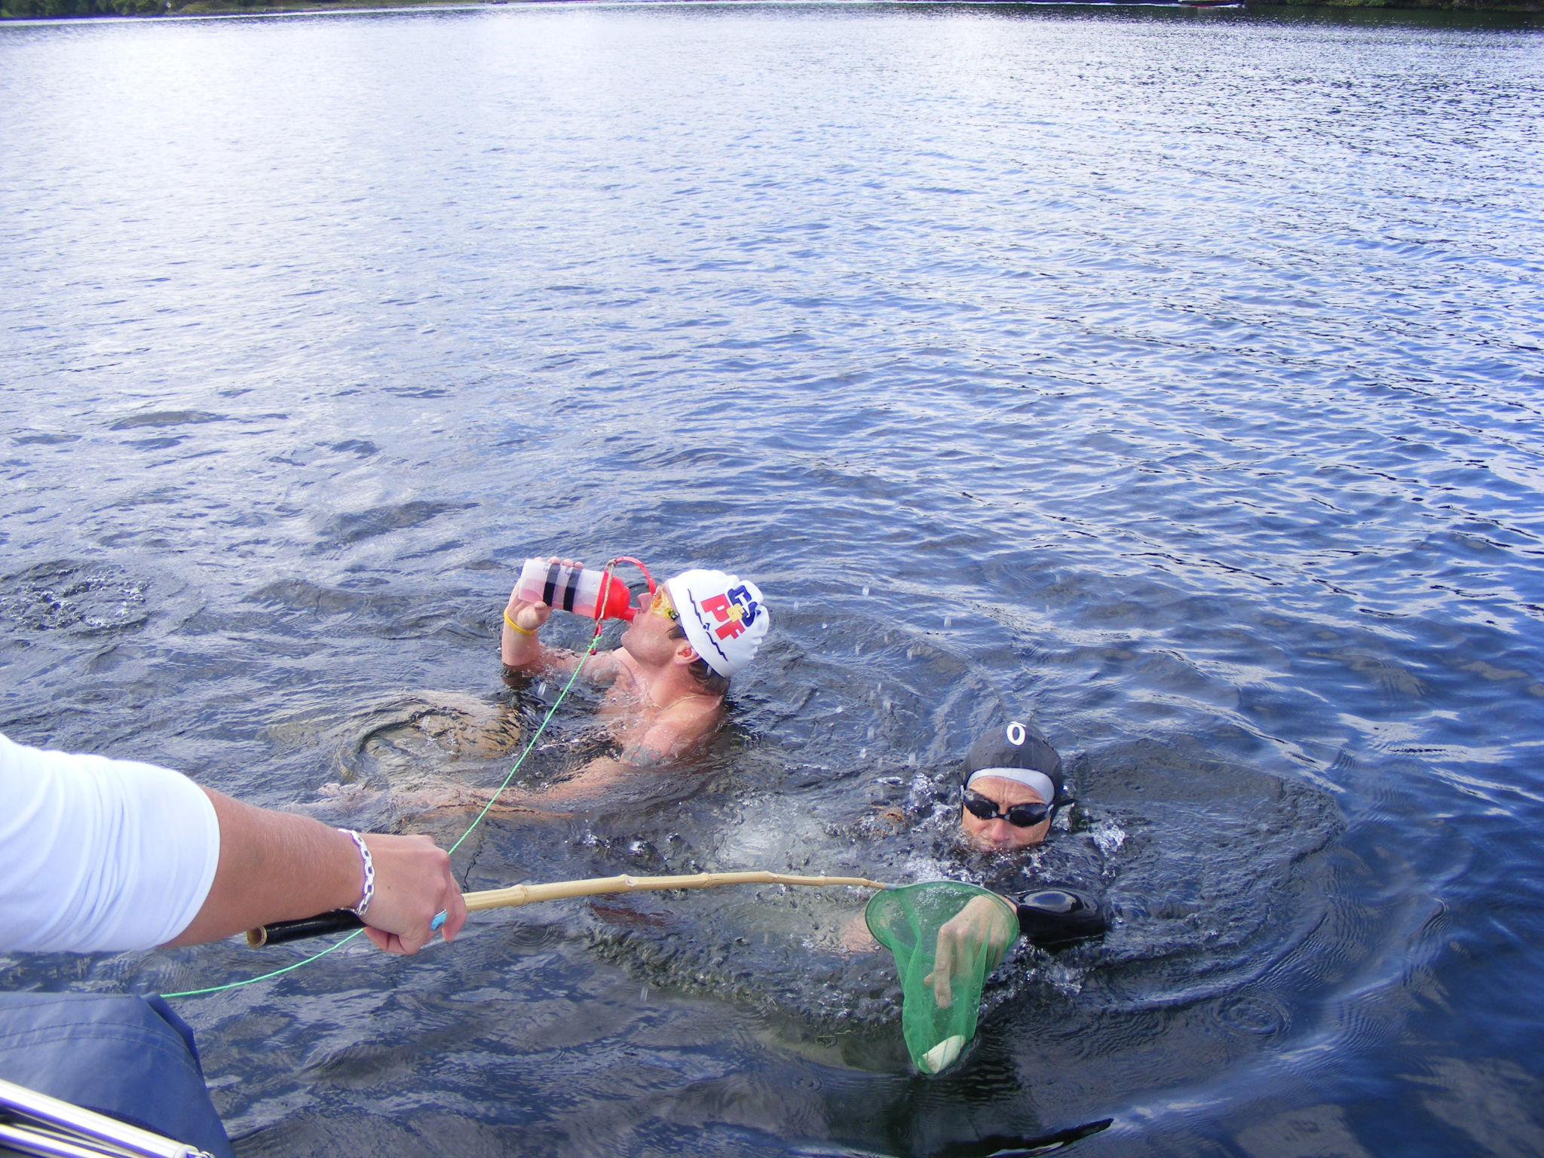
Notes:
Research from swimmers. Homemade feeding apparatus, images donated from around the world.

Slide 13
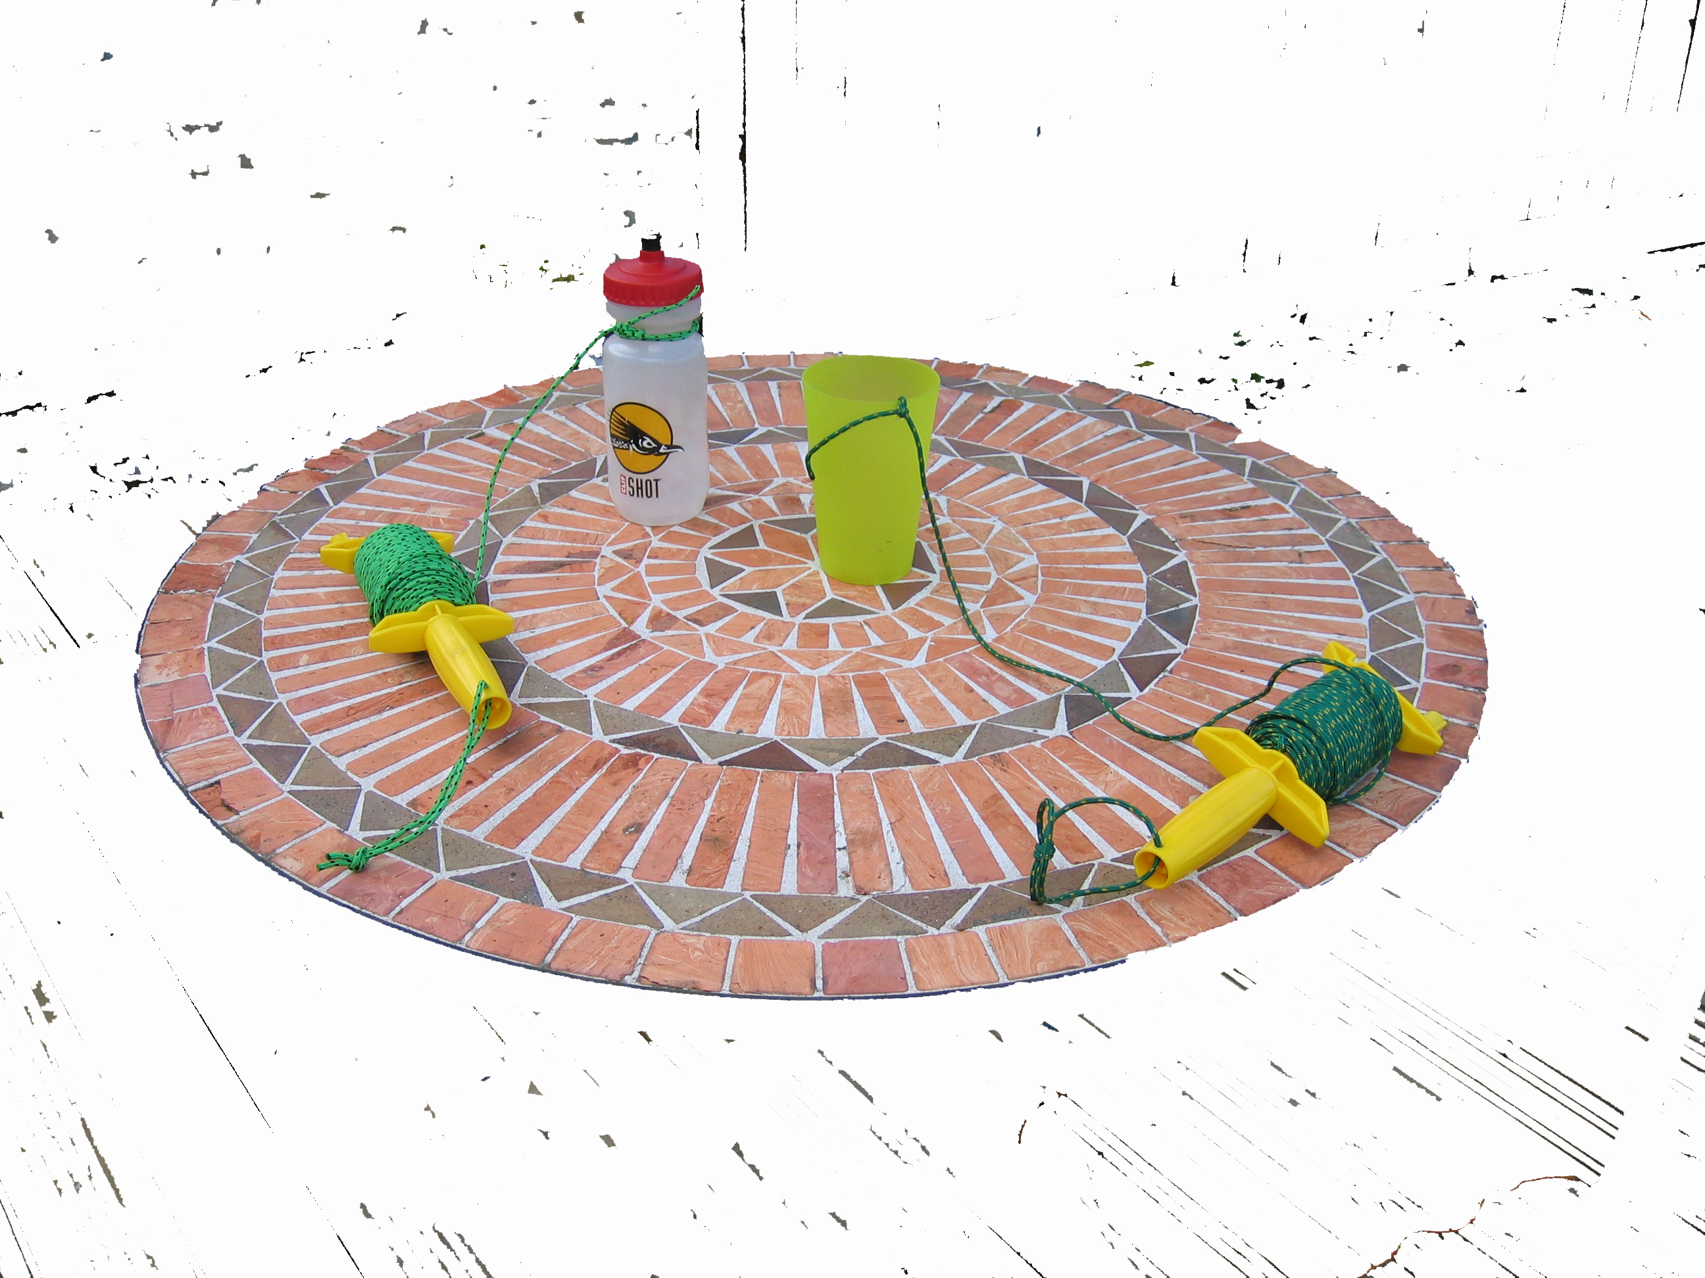

Slide 14
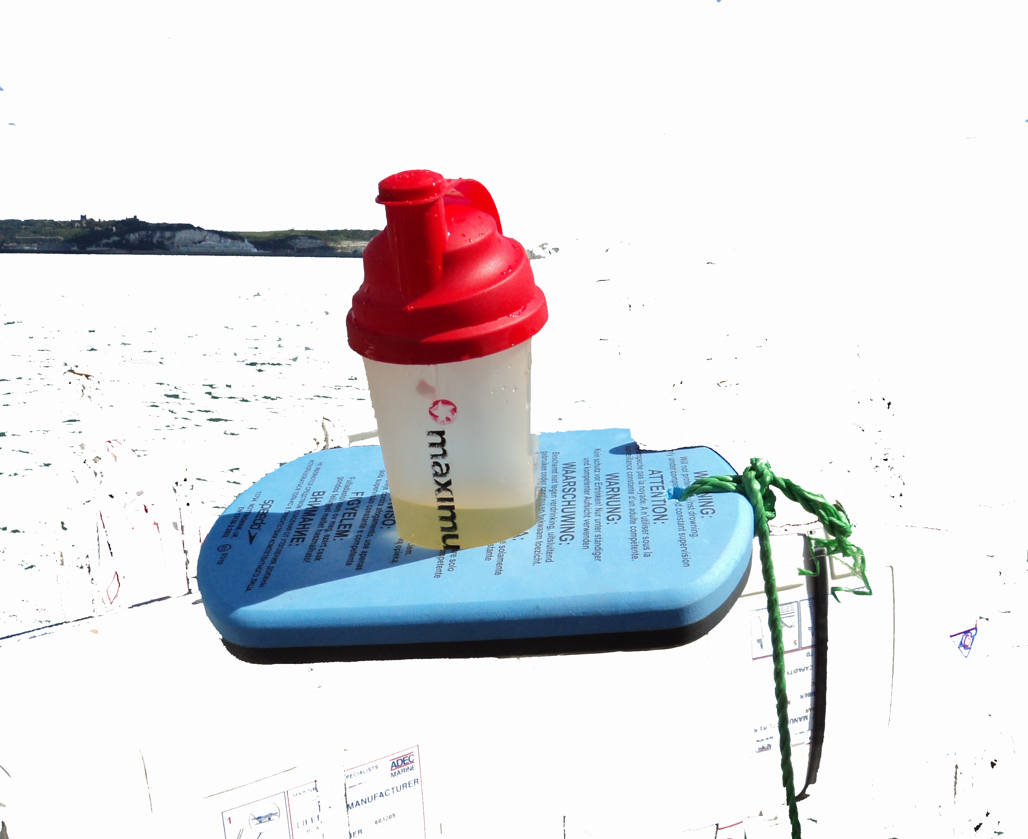

Slide 15
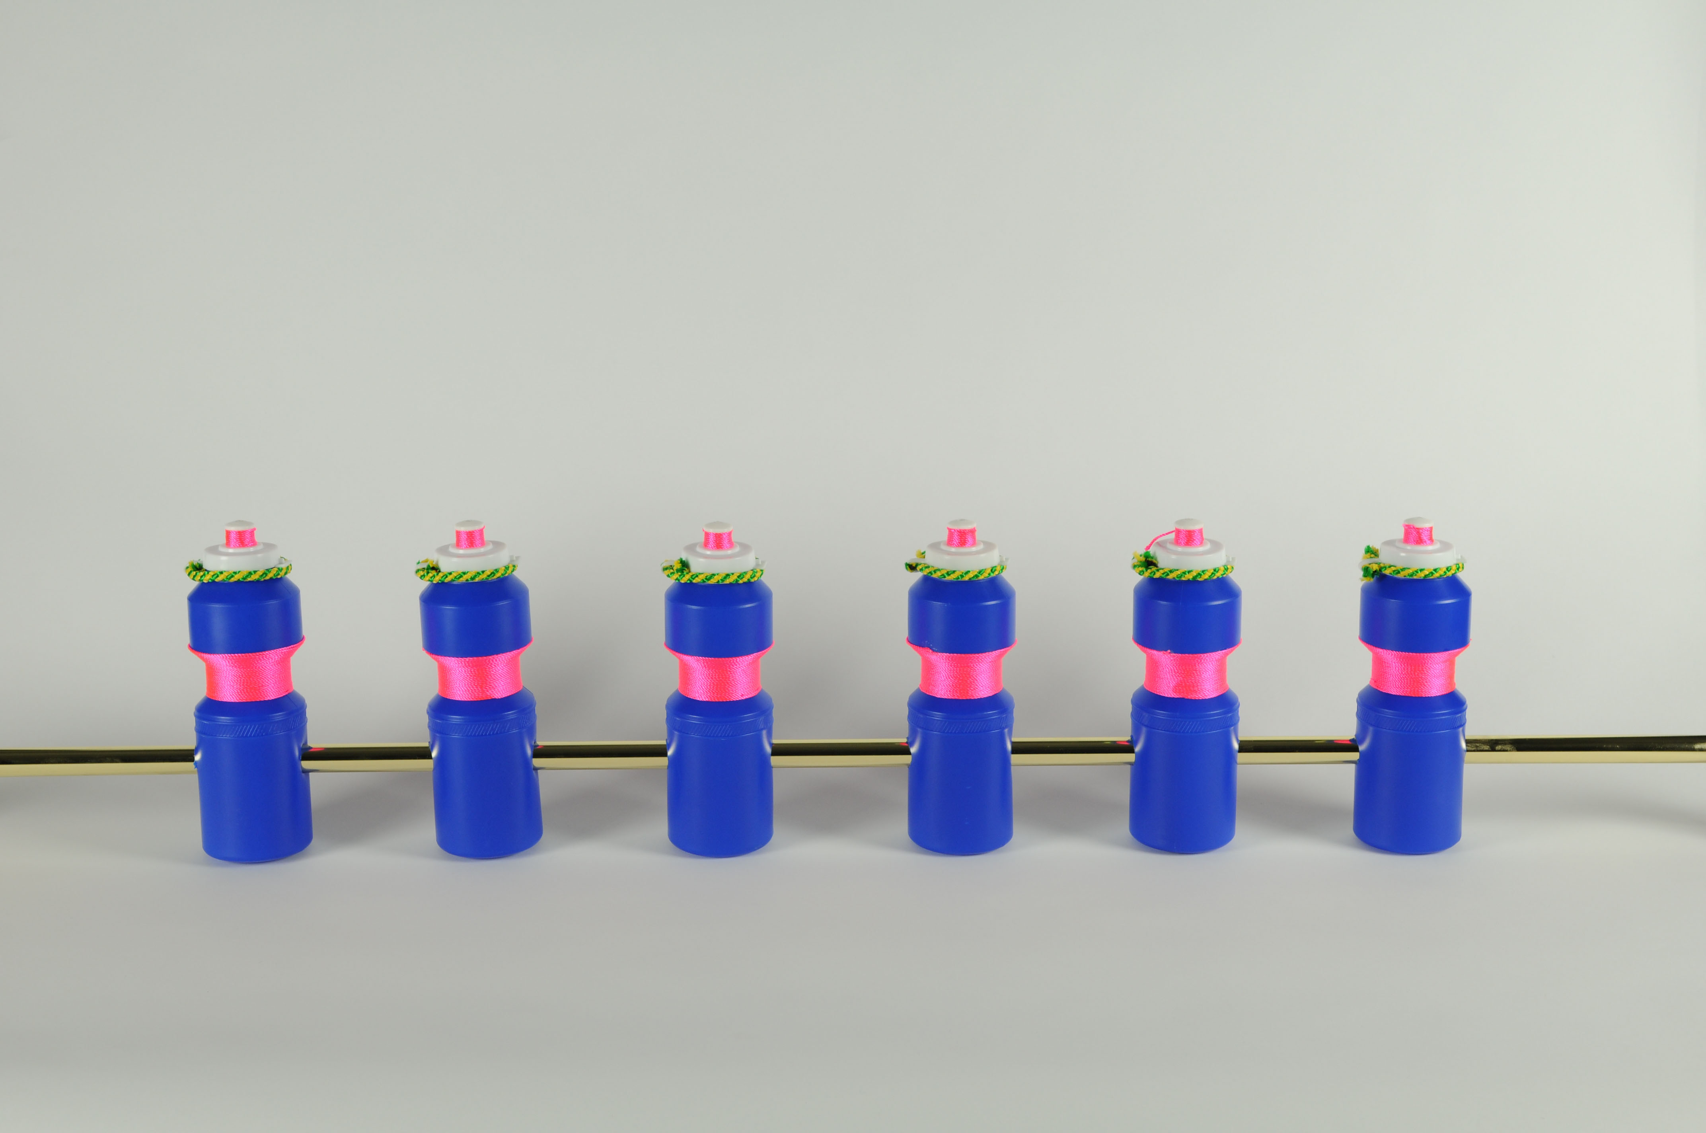
Notes:
Standard Relay (2012) Film Still.

Slide 16
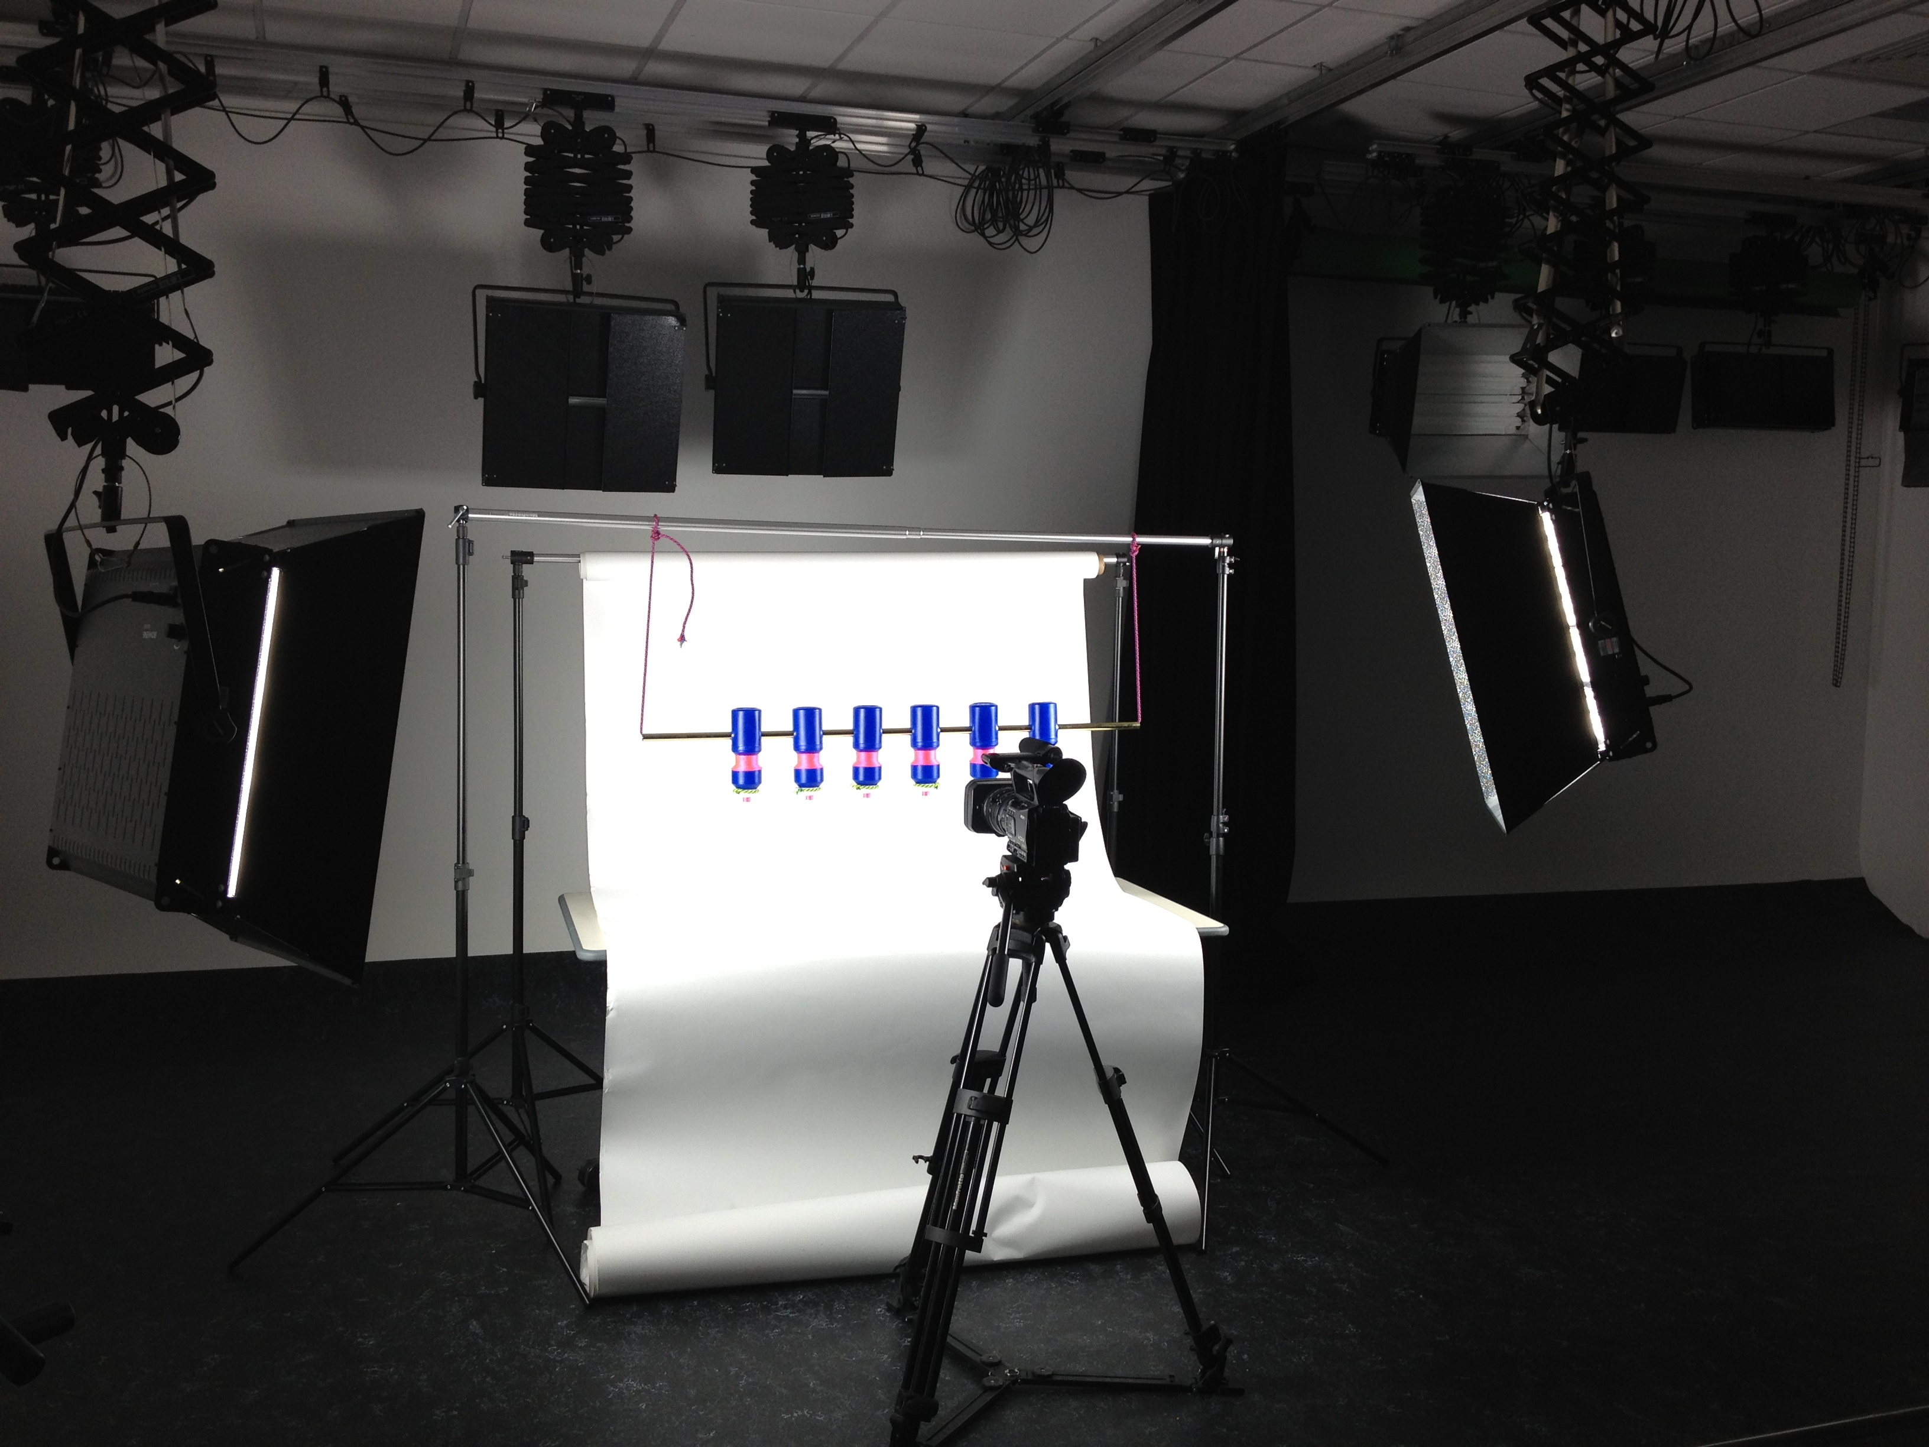
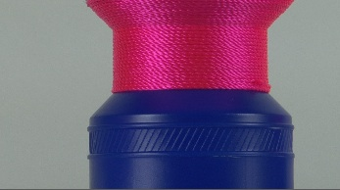
Notes:
Standard Relay (2012) Film stills and production shot.

Slide 17
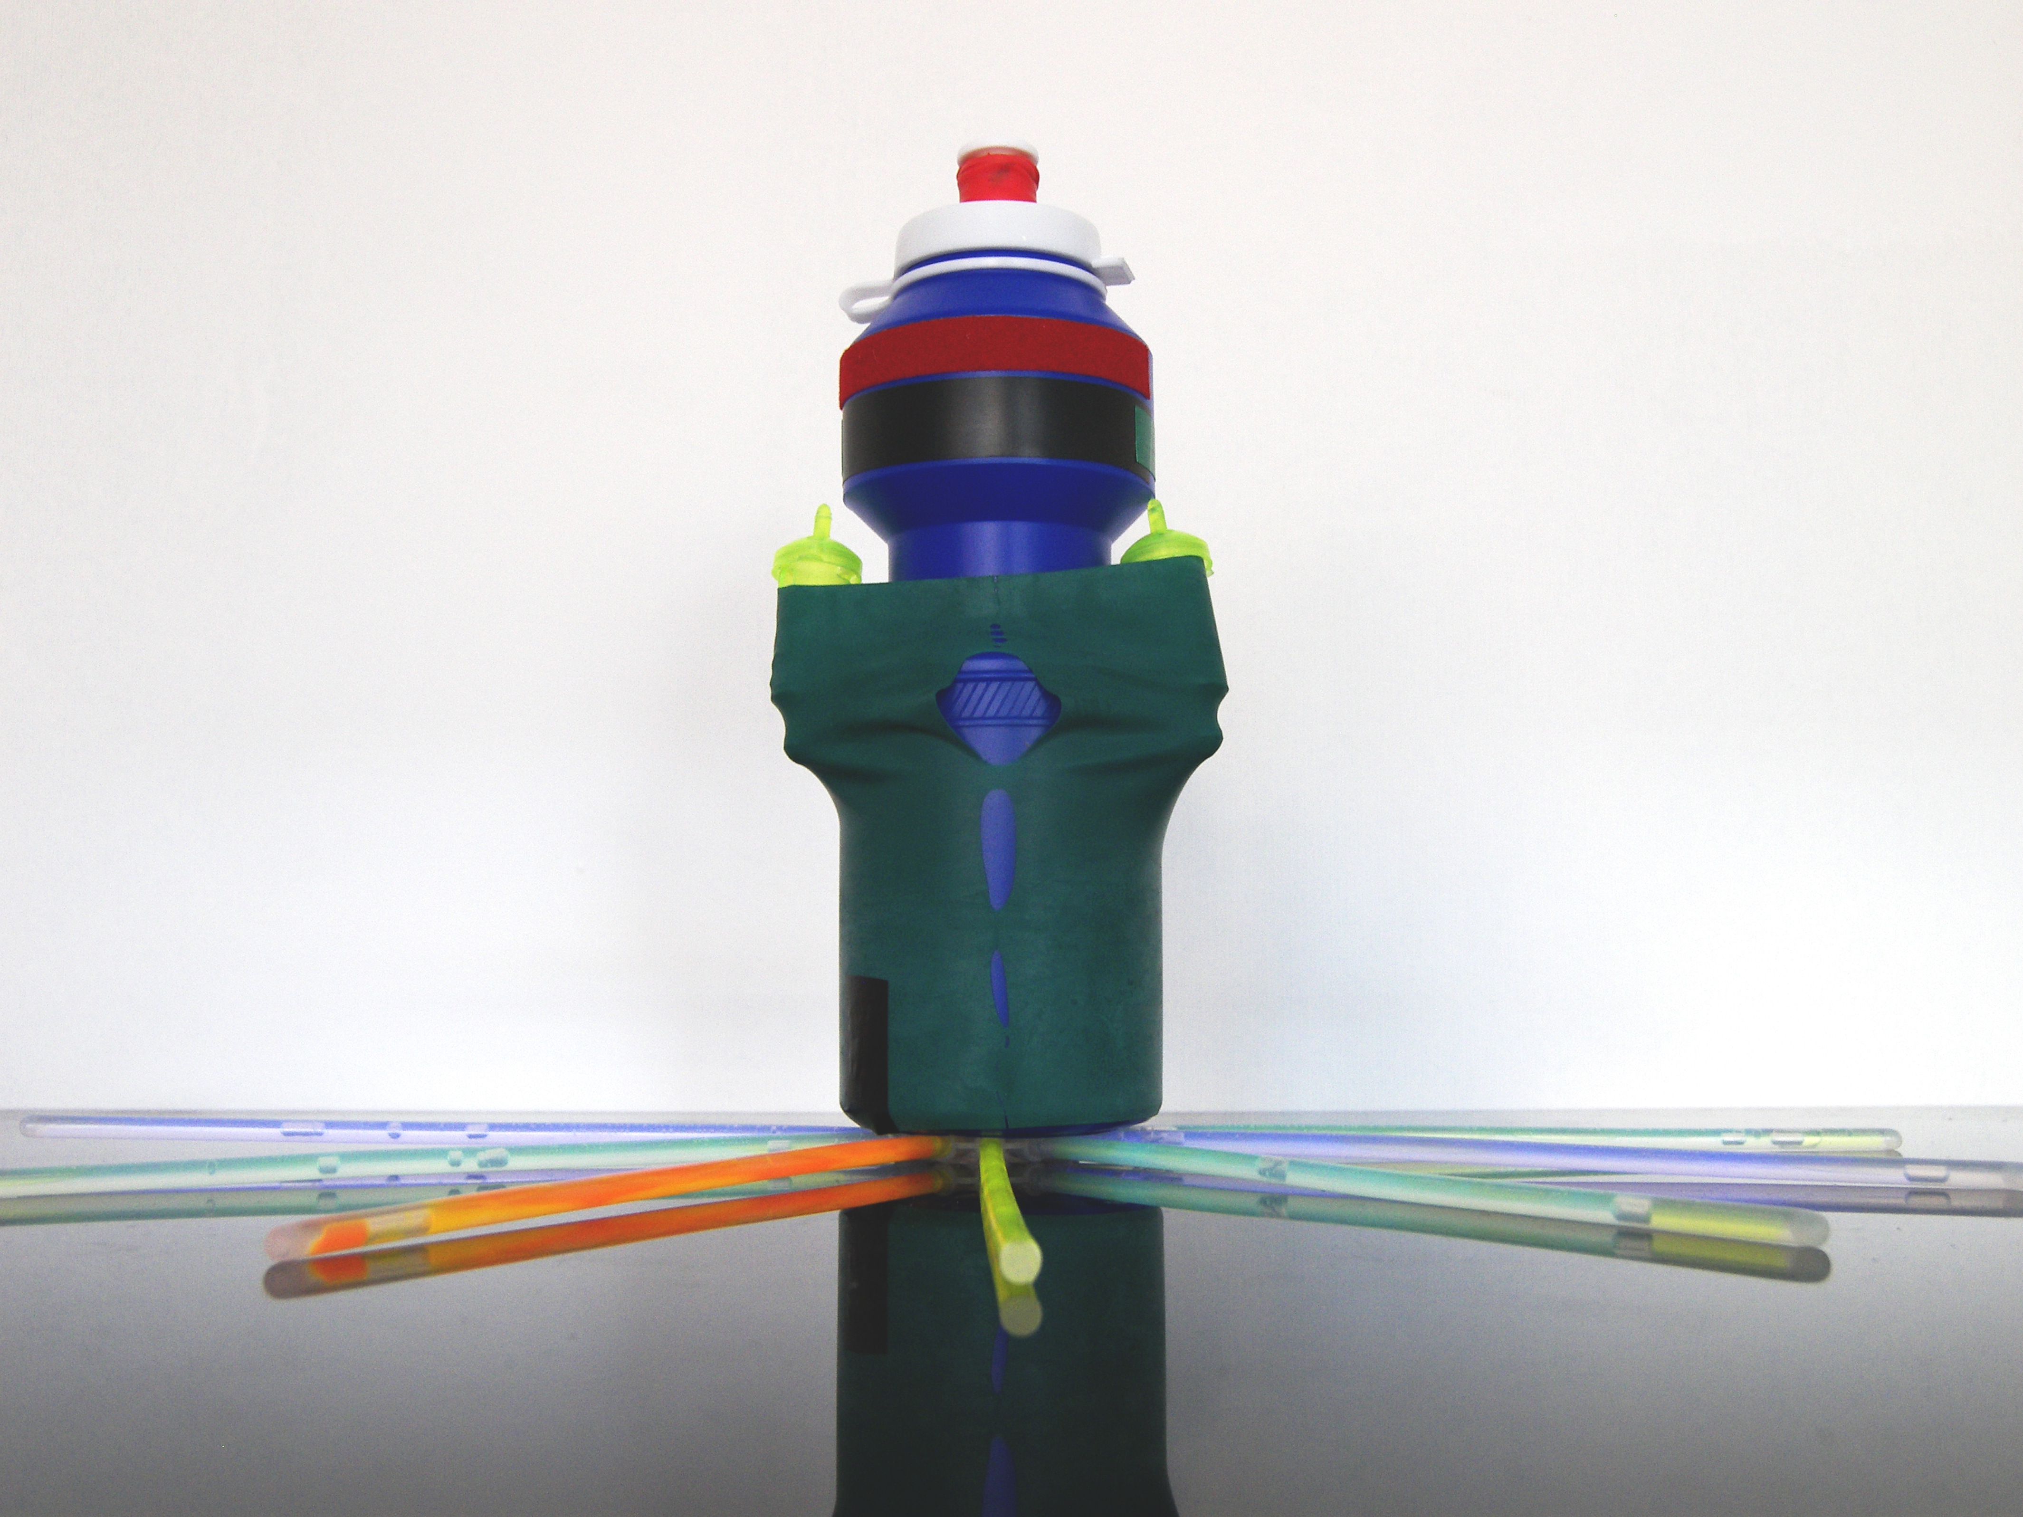
Notes:
Sandettie Lightship (2012). The name of a lightvessel in the English Channel used fro weather predictions.

Slide 18
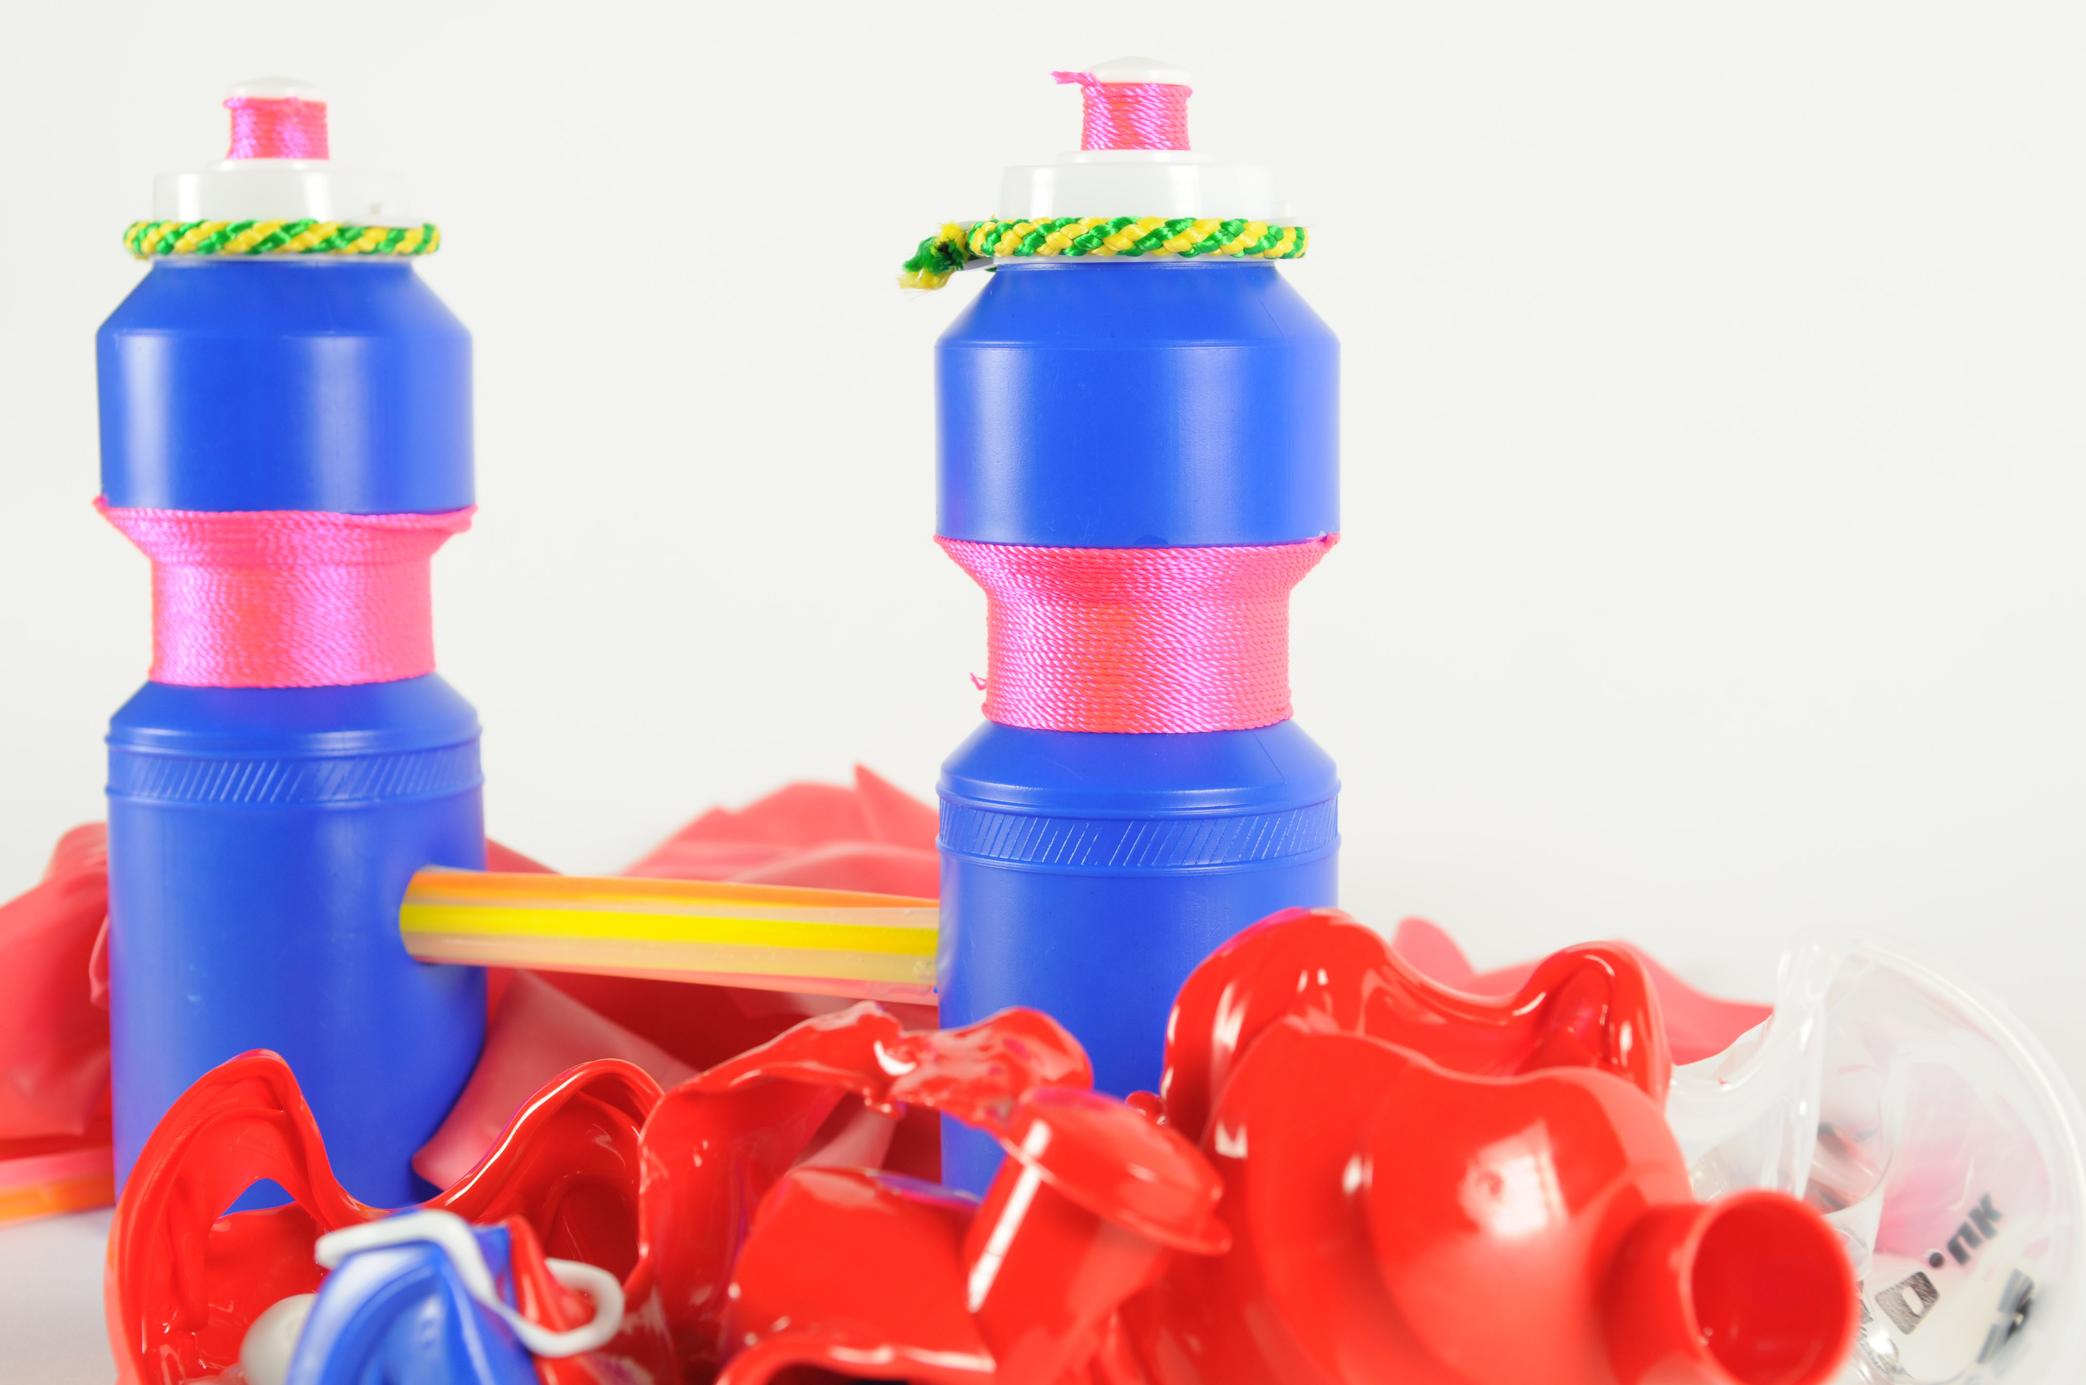
Notes:
Shipping Lane (2012) Photograph.

Slide 19
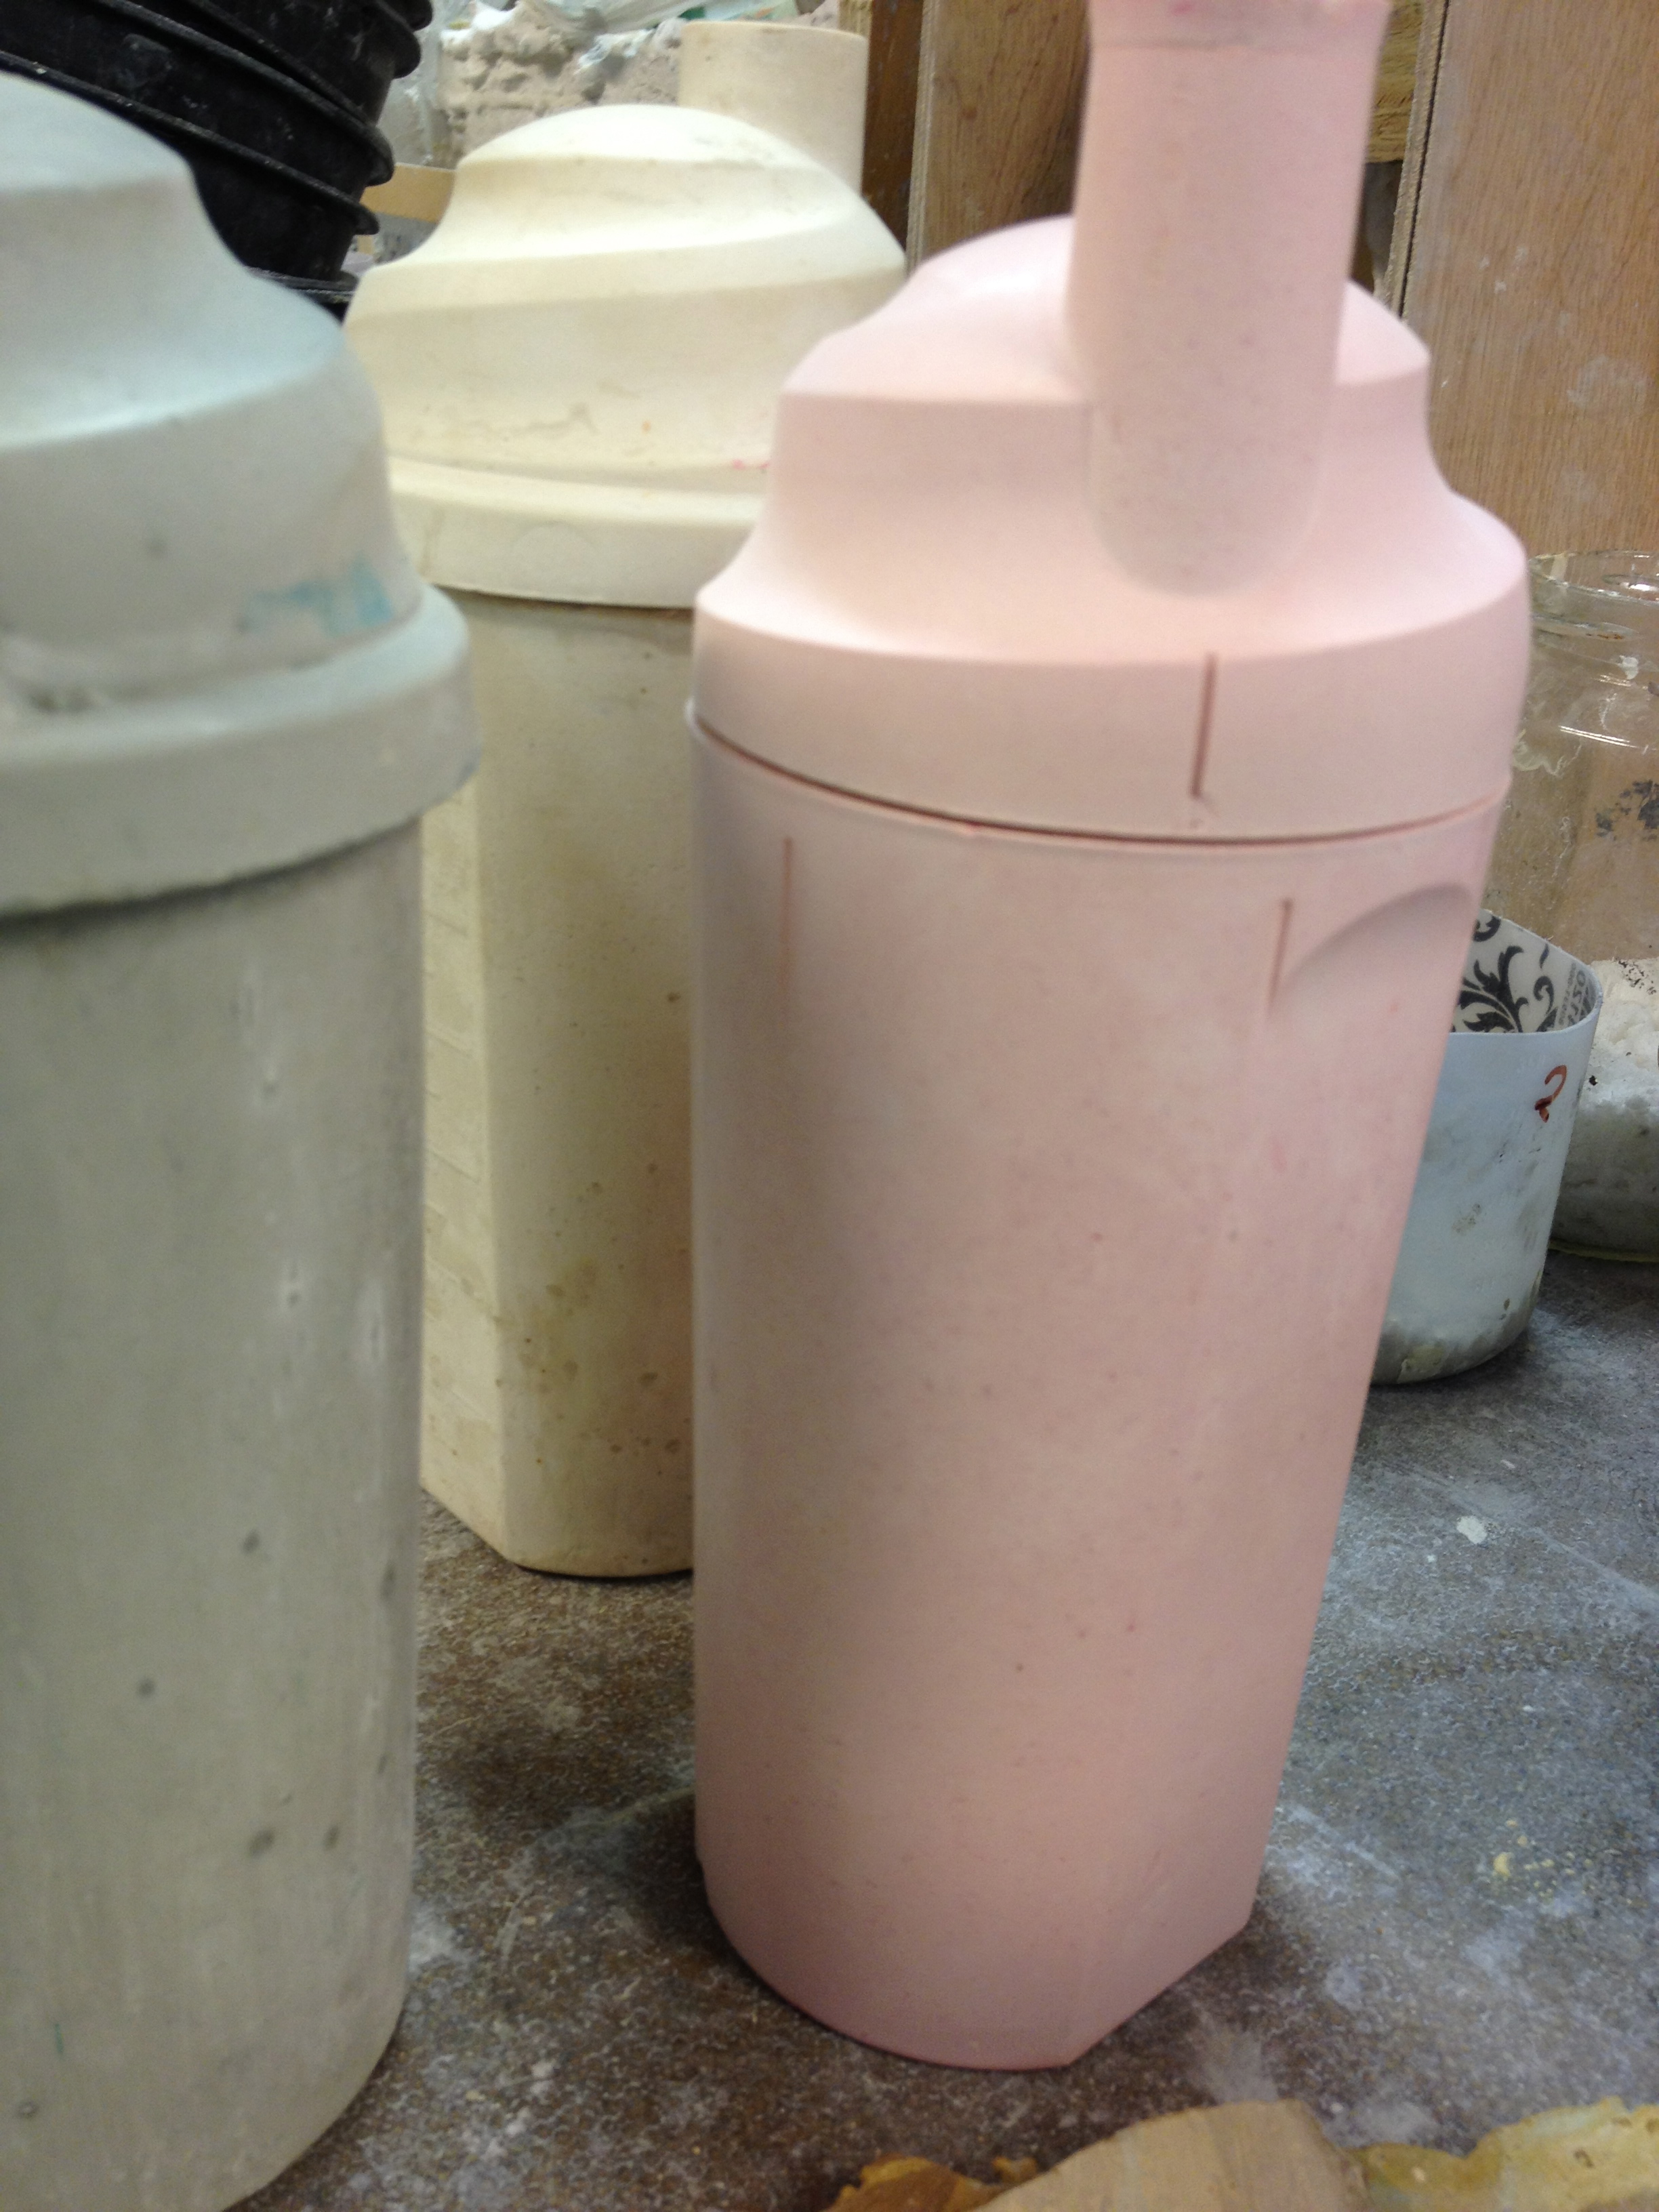
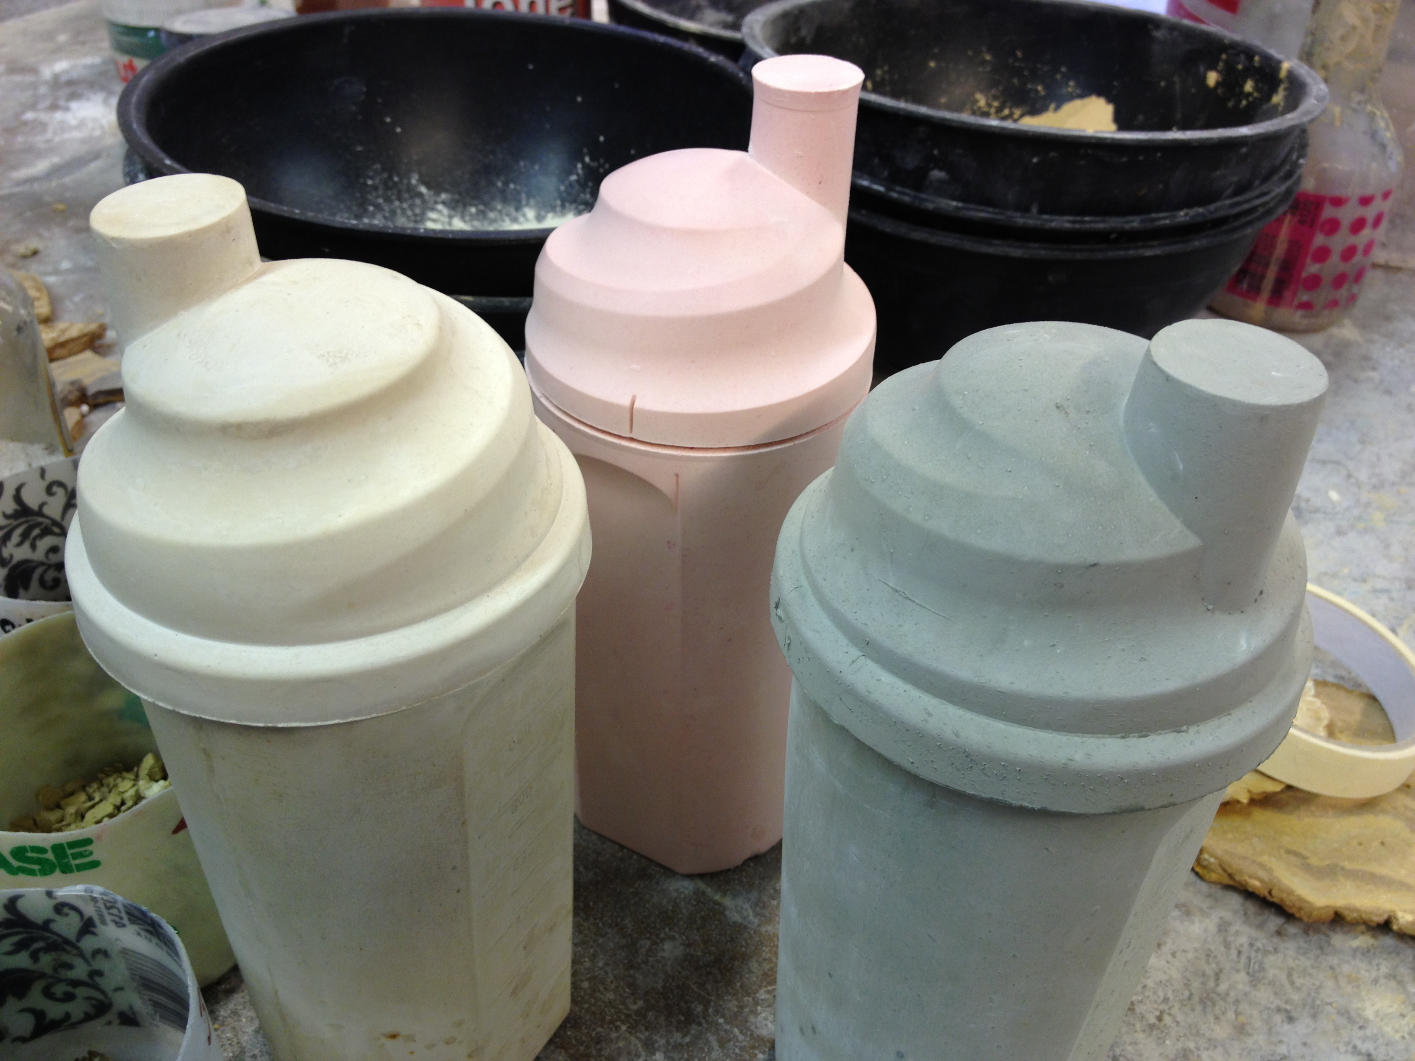
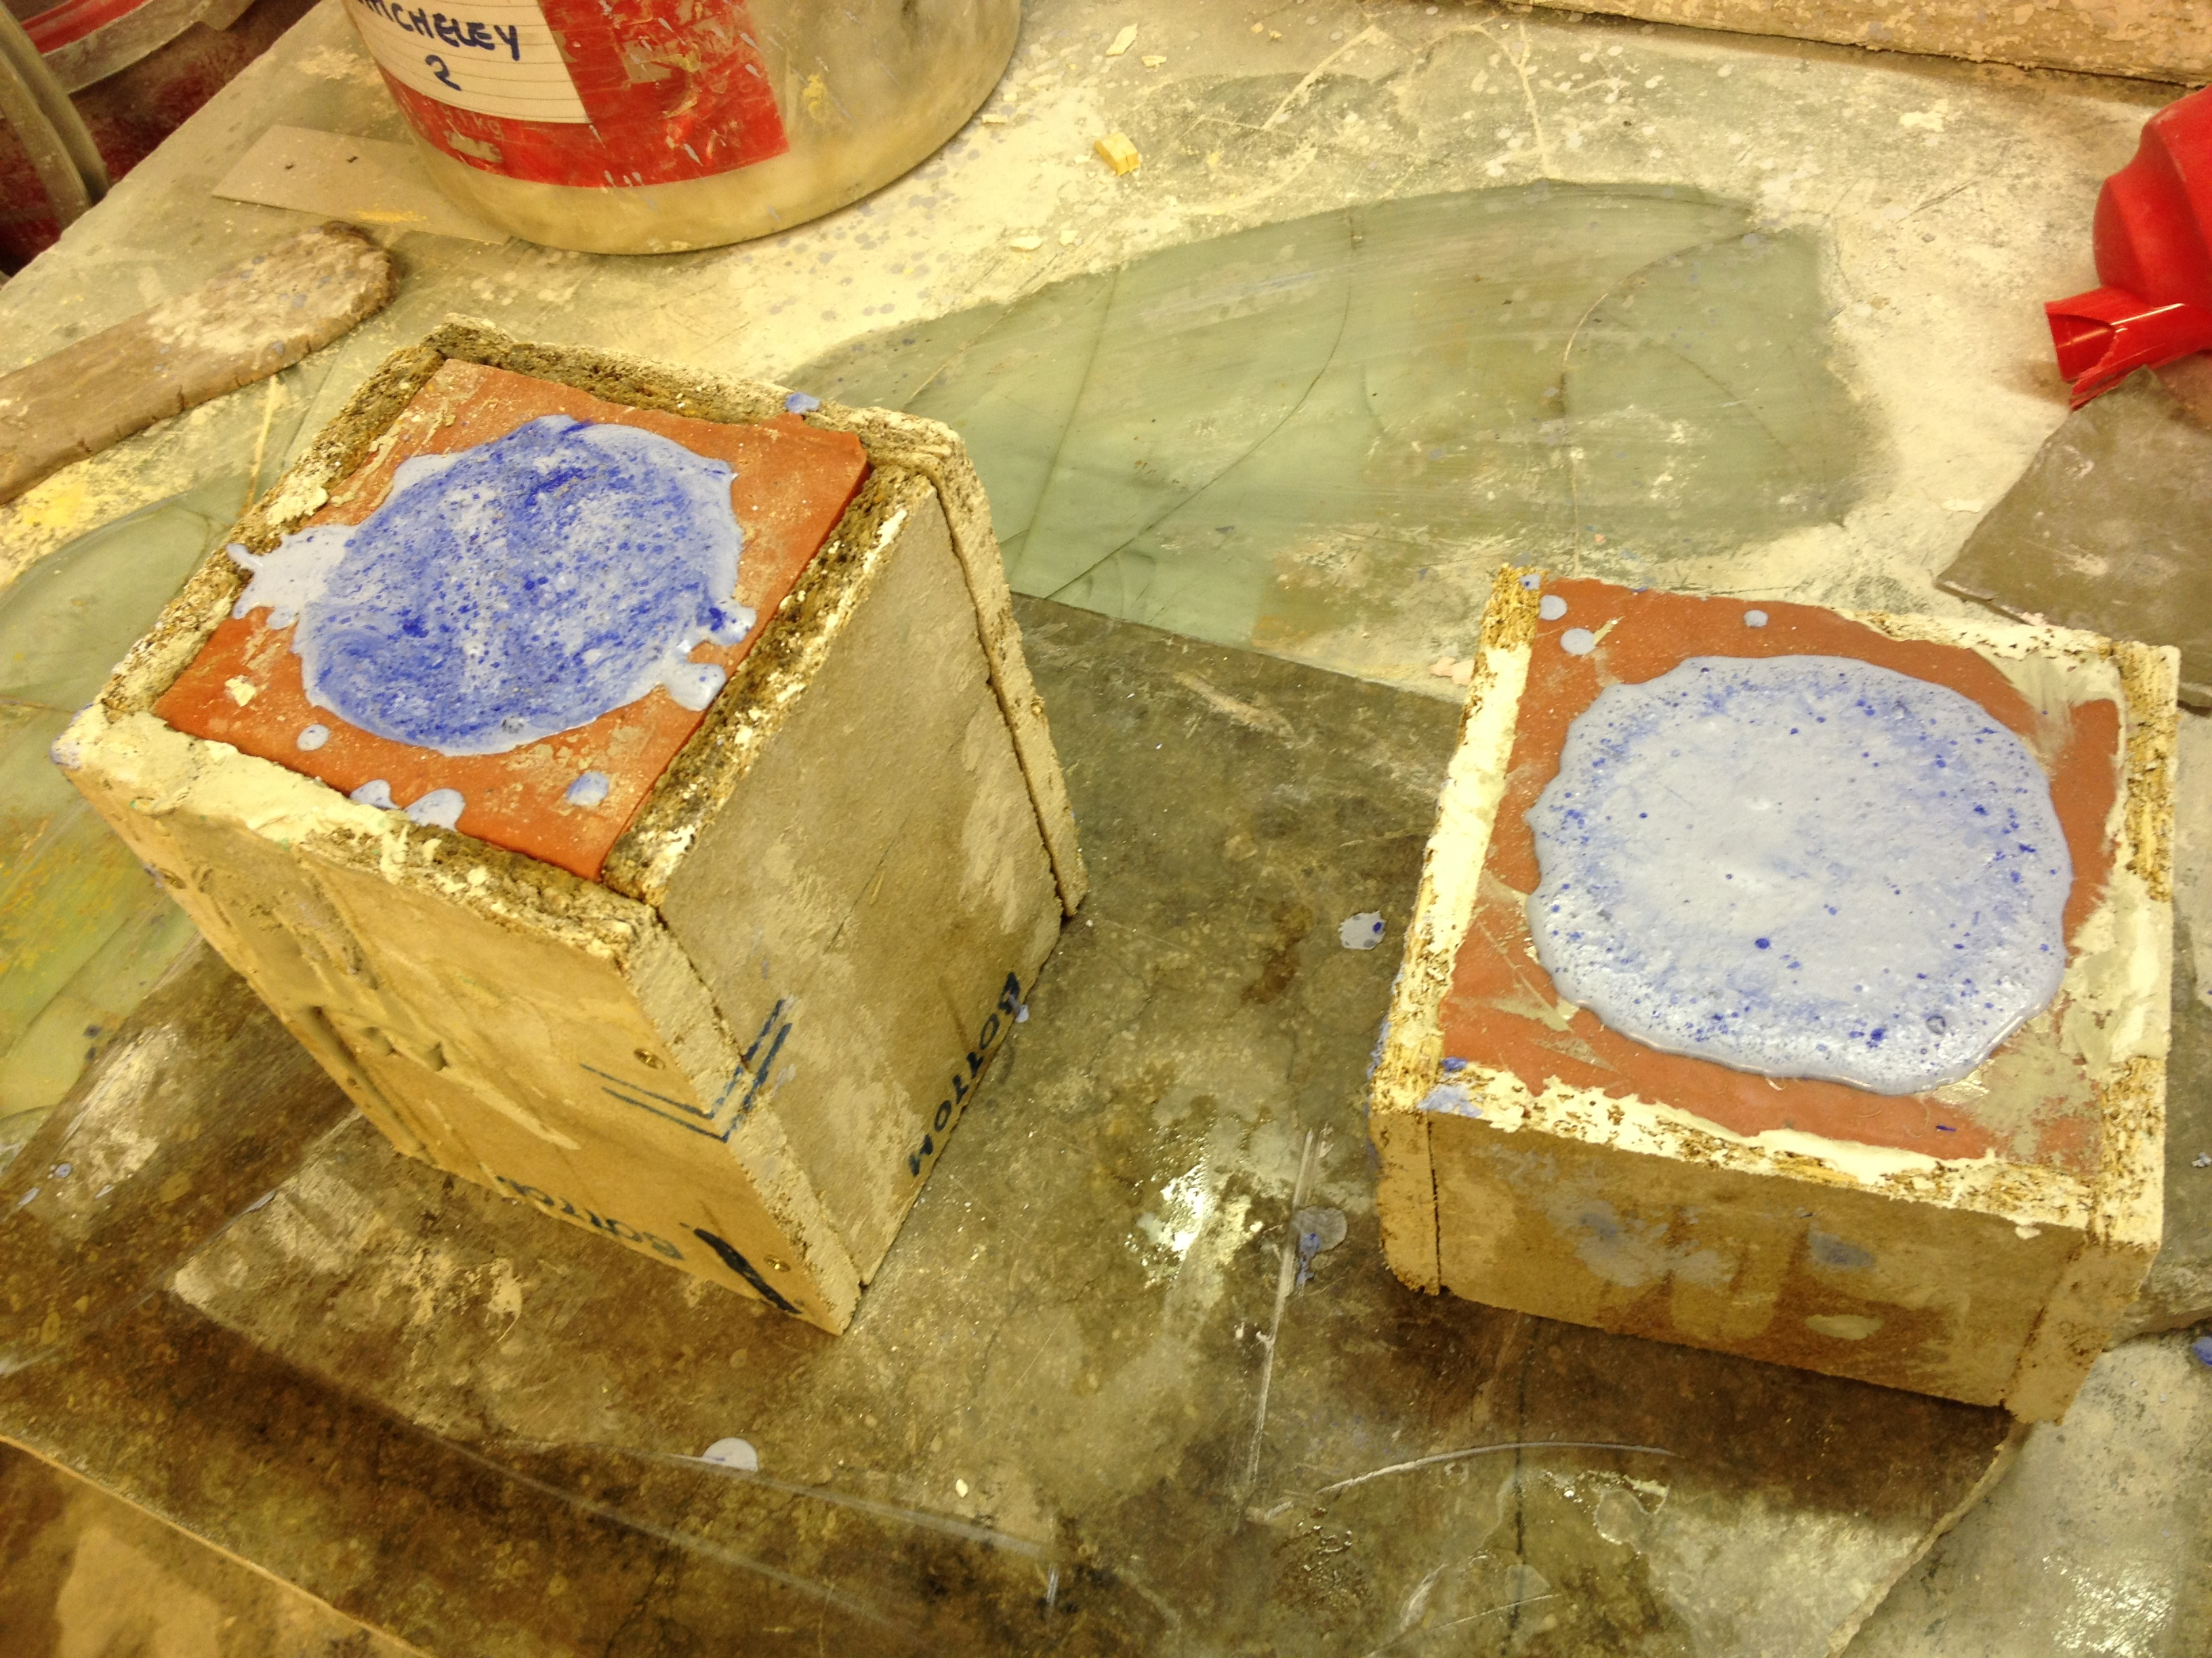
Notes:
Casts of feeding bottles in production for large installation. Studio shot/hot rubber moulding.

Slide 20
Acclimatisation (2012)
Video Excerpt (7 min)
Documentary processes and re-enactment are also engaged, with myself as
the subject of the study. The piece documents the body’s physical response to
cold-water immersion and the method of acclimatising (habituation) over a set
period of time, a process that is core to channel swimming training.
Notes:
Play film

