Slide 1
Caren Milloy,
Ellen Collins & Graham Stone
Notes:
About me
Today I’m going to introduce you to a project I am running called OAPEN-UK which is exploring open access scholarly monograph publishing in the humanities and social sciences. When you hear people talking about open access it usually relates to journals and research in the STEM subjects. Indeed, when the Finch group report on their discussions, I expect that most of the recommendations will relate to the journal market. But for humanities and social science researchers, the key way that they share their research is not through writing journal articles, but through the publication of scholarly monographs. So it is important that when we talk about open access, which by its very nature aims to be inclusive rather than exclusive, we don’t ignore or leave behind HSS research.

Slide 2
‘Scholars do not work in a vacuum; research is based on work from others and new discoveries must be disseminated in order to be used.’
Snijder,Ronald. 2010. The profits of free books - an experiment to measure the impact of Open Access publishing. http://sites.google.com/site/theprofitsoffreebooks/home
Notes:
My project, OAPEN-UK is joint funded by JISC and the Arts and Humanities Research Council (AHRC) and is a 4-year research project, that is gathering evidence to help stakeholders make informed decisions on the future of Open Access (OA) scholarly monograph publishing in the humanities and social sciences (HSS).
It is a very much a collaborative project, working with publishers, research councils, authors, researchers and institutions to gather a range of qualitative and quantitative data which will be analysed as we go through to help us understand what the challenges are and what developments would be required to support open access scholarly monographs.
So why are we doing this project now?
I’ve already mentioned that the academic monograph is very important to HSS researchers as it is how they share and disseminate their research but it is also closely linked to prestige and career progression.
But over the last decade, there is a concern that the dissemination of the monograph, in print format, is being restricted and readership reduced. Sales to libraries have been in decline and costs have risen, to the point that some academics are suggesting that what is being published is being driven by financial pressures, and that as a result, important, but unprofitable research, is being ignored.
At the moment, there is a lot of activity around the monograph, with a push to making electronic versions the key format for dissemination. We have seen a lot of collaboration and shared platforms being developed - the launch of UPCC Book Collections on Project Muse, the launch of OUP and CUP’s scholarly platforms are all examples, and these new models may be the way to support the future of the monograph. But they do continue to rely on library budgets which are themselves under pressure and there are still limits on dissemination and readership to those subscribing institutions and individual purchases.
Open access publishing doesn’t limit dissemination or readership and given the current financial pressures of the market we think it is worth exploring to see if it is a model that is financially viable, that could be adopted by researchers and whether it would support a vibrant research environment in the HSS.
OAPEN-UK is going to do just that - explore the challenges, risks and potential opportunities of an open access model for scholarly monographs. The project isnt going to be able to prove open access, but it will provide us with a wealth of data and understanding to enable stakeholders to make some informed decisions about a move to an open access model.
So how are we going to do it?

Slide 3
58 HSS titles: 2006 - 2011
Experimental Group
(29 titles)
Control Group
(29 titles)
OA with CC licence
OAPEN Library
Publishers website
Institutional Repository
Google Books (100%)
Standard e-book agreements
Publishers website
E-book aggregators
Google Books (10%)
Print version available for sale
E-book device friendly version available for sale
Notes:
We are piloting the model used by the OAPEN project which was an EU project whereby a grant is paid to the publisher who publish a PDF of the monograph available under a creative commons licence but can also generate revenue through sales of print and ebook device friendly editions such as epub.
What we have done though is set up two groups in our pilot – the open access group and the control group. Publishers were invited to submit titles for inclusion in the pilot but they had to submit pairs of titles matched on subject area, publication date, sales etc. The pairs were then selected by the project’s Steering Group and one from each pair randomly selected to go into the experimental group and one into the control group.
The titles in the OA pot are made available under a CC licence from the publishers website, the OAPEN Library website and IRs. The control group titles are made available for sale under the publishers normal route such as for sale to libraries as part of packages, via aggregators.
All the titles, whether OA or Control are available for purchase in print format and some are also available in epub or specific e-formats such as amz.
We have 58 tiles from Palgrave Macmillan, Taylor & Francis, Berg Publishers, Liverpool University Press and University Wales Press and over the next three years we will gather and compare sales and usage data for each group to measure the effects on OA.
The pilot is just one part of OAPEN UK, we are also running a large programme of research

Slide 4
The research programme
How policies, processes and mechanisms need to change in order to enable OA publication of monographs?
What are the measurable effects of a move to OA monographs?
How do perceptions of OA monograph publication change among participants during the project?
Notes:
A core part of OAPEN-UK is data gathering. We have learnt from previous projects that it is necessary to gather data over at least a three year period if you are going to have anything useful to say, especially when dealing with citations and research.
We have condensed the research into three questions:
1. How policies, processes and mechanisms need to change in order to enable OA publication of monographs?
Business model will include looking at prices, variation in prices by publisher, e-only OA as a viable strategy and the potential ongoing need or demand for print, the most effective way to manage OA fees, licensing regimes, IPR and reuse rights and royalties.
Organisational policies will include changes that funders make to their OA policies, that libraries make to their purchasing and selection policies, that repositories make to their depositing policies and that institutions make to comply with all of the above.
Technical changes will include back- and front-end system changes made by publishers, integration into existing library systems, changes to funder systems for awarding grants and discoverability
2. What are the measurable effects of a move to OA monographs?
On readership/ usage, sales, citation - These issues should all be covered by the hard data that we are collecting – they are about things that can be measured by counting something. Changes in attitudes and perceptions should be covered in question 3.
3. How do perceptions of OA monograph publication change among participants during the project?
Perceived risks and benefits might include issues such as business models, readership, academic reward, discoverability, quality, depending upon who we are talking to.

Slide 5
Research process
2. Annual benchmarking survey
3. Initial focus groups
4. Initial scoping interviews / survey
9. Final evaluation and report
5. Quantitative data analysis
2. Annual benchmarking survey
6. Annual participant focus groups
8. Additional year 3 activities
1. Literature review
3. Initial focus groups
7. Planning for year 3
4. Initial scoping interviews / survey
9. Final evaluation and report
5. Quantitative data analysis
1. Literature review
6. Annual participant focus groups
8. Additional year 3 activities
7. Planning for year 3
Initiation
OAPEN-UK Research Plan
Year 1 end
Ellen Collins, Research Information Network
Year 2 end
Project end
http://www.flickr.com/photos/stewart/461099066/
Notes:
The research plan includes workshops, surveys, interviews, focus groups, data analysis of usage and sales data with those that are participating in the project such as the authors of the titles, the publishers and the funders.
We are also aware, that as we are doing a long term project, we need to keep up with developments in the ebooks environment which is constantly adapting, innovating and so we are taking an agile approach and have the opportunity to explore new developments during year three.
We have undertaken the literature review, the annual benchmarking survey with project participants including the authors of our titles, the focus groups with key stakeholders and we are running the researcher survey at the moment and will share some of our findings from the focus groups and indicators from the researcher survey with you later.
We are gathering sales, usage and citation data from the publishers and the platforms where the titles are available…
I think the key here is that we will be gathering a huge amount of data, both qualitative and qualitative under our three research questions and we hope that we will be able to come up with a good overview of the UK HSS scholarly monograph environment.

Slide 6
Focus groups
Institutional representatives including librarians, institutional repository staff, research managers
Publishers
Learned Societies
Researchers (as both authors & readers)
E-book aggregators
Research Funders
Notes:
In a project like this, it is really important that we understand the issues and challenges faced by each stakeholder – some we may already know about as they are similar to the journals market, or perhaps the ebooks market in general, but many are distinct to the format and disciplines.
The qualitative packages began with a series of six focus groups with key stakeholders to understand how they might be affected by open access monograph publications. The stakeholders were academics; institutional staff including librarians, repository managers, and research managers; publishers; learned societies; e-book aggregators; and research funders.
We had not originally planned to talk to the ebook aggregators, but we decided that it was important to include them as a key part in the current ebook discovery and access chain.
In each focus group we used a series of exercises to identify the risks, opportunities and questions that each group might experience in moving towards a more open access system for publication. The focus groups were extremely interesting and helped us identify key themes and areas that need further testing and discussion.
Although we have completed the annual benchmarking survey and the researcher survey, today I am going to mostly stick to the findings from the focus groups as I believe that they provide the best and most unbiased overview of the challenges and issues of open access in the humanities and social sciences. Where I have some figures from the benchmarking survey and the researcher survey I will show these, but these have not yet been fully analysed.

Slide 7
Focus Groups: Key themes
Metadata: What is the metadata required to support discovery, purchase, libraries, research funders? | Versioning, preservation & archiving: What is the version of record, how is it preserved (centrally?) and who provides archival access?
Usage: data collection methods and standards to support comparability of data | Methods of delivery: where should OA monographs sit, in what formats, with what functionality and using what standards?
Quality & prestige: impact of perceptions on adoption of a OA model and need to maintain excellence | What do authors want: readership, research dissemination, academic prestige and reward including the REF
Notes:
So after we had completed the focus groups, we spent a day surrounded by post it notes, categorising them into key themes.
Metadata was mentioned in most of the focus groups and was recognised by all as critical to the discovery of OA monographs. Participants discussed what fields metadata for an open access book should contain and how these might be standardised – for example, should it include the ‘funder’ of the research, should it include details about the CC licence it is released under? But perhaps one of the more interesting areas of discussion was around who should be creating the metadata in the first place – which could differ depending on the model applied. Should the authors be creating the metadata or does it remain a role for the publisher? What if the model is through a IR, does the creation of metadata rest with librarians or the IR managers or the authors? For ebook aggregators- was this perhaps where they might have a role – in creating and maintaining metadata?
There were also discussions about how the metadata is released into the supply chain if based on a model like we are using where the print and ebook device editions are available to purchase? Who is in charge of this and in what format. Who makes sure that OA mono metadata (and content) is indexed by the discovery services? Is this through a central service?
The importance of metadata in terms of the supply chain is very important as two questions in the researcher survey show:

Slide 8
Focus Groups: Key themes
Copyright: ownership, licensing and rights associated with images | Benefits of OA: how to articulate opportunities; access and costs savings?
International issues: not just UK market, need to account for territories, translation etc. | Changing roles: who does what in an OA model, what are the roles for publishers, librarians etc., which to keep, which to start and which to discontinue?
Impact on processes: policies, mandates, funding routes, payment and behaviour | Consistency: should licensing, standards, peer review be standardised? Does one size fit all?
Notes:
So after we had completed the focus groups, we spent a day surrounded by post it notes, categorising them into key themes.
Metadata was mentioned in most of the focus groups and was recognised by all as critical to the discovery of OA monographs. Participants discussed what fields metadata for an open access book should contain and how these might be standardised – for example, should it include the ‘funder’ of the research, should it include details about the CC licence it is released under? But perhaps one of the more interesting areas of discussion was around who should be creating the metadata in the first place – which could differ depending on the model applied. Should the authors be creating the metadata or does it remain a role for the publisher? What if the model is through a IR, does the creation of metadata rest with librarians or the IR managers or the authors? For ebook aggregators- was this perhaps where they might have a role – in creating and maintaining metadata?
There were also discussions about how the metadata is released into the supply chain if based on a model like we are using where the print and ebook device editions are available to purchase? Who is in charge of this and in what format. Who makes sure that OA mono metadata (and content) is indexed by the discovery services? Is this through a central service?
The importance of metadata in terms of the supply chain is very important as two questions in the researcher survey show:

Slide 9
Focus Groups: Key themes
Ways to make OA profitable: how can publishers / ebook aggregators add value to content? Overlay services | Risk: how will the financial, reputational and quality risks be overcome?
Funding: who pays and how? | Calculating costs: what is the cost of an OA monograph and is it the same for all publishers, subjects?
Notes:
So after we had completed the focus groups, we spent a day surrounded by post it notes, categorising them into key themes.
Metadata was mentioned in most of the focus groups and was recognised by all as critical to the discovery of OA monographs. Participants discussed what fields metadata for an open access book should contain and how these might be standardised – for example, should it include the ‘funder’ of the research, should it include details about the CC licence it is released under? But perhaps one of the more interesting areas of discussion was around who should be creating the metadata in the first place – which could differ depending on the model applied. Should the authors be creating the metadata or does it remain a role for the publisher? What if the model is through a IR, does the creation of metadata rest with librarians or the IR managers or the authors? For ebook aggregators- was this perhaps where they might have a role – in creating and maintaining metadata?
There were also discussions about how the metadata is released into the supply chain if based on a model like we are using where the print and ebook device editions are available to purchase? Who is in charge of this and in what format. Who makes sure that OA mono metadata (and content) is indexed by the discovery services? Is this through a central service?
The importance of metadata in terms of the supply chain is very important as two questions in the researcher survey show:

Slide 10
What do authors want
Notes:
In both groups, most were aware but not familiar. Experiment group more likely to say both never heard and familiar with. But n.b. small samples – don’t place too much credence on this.

Slide 11
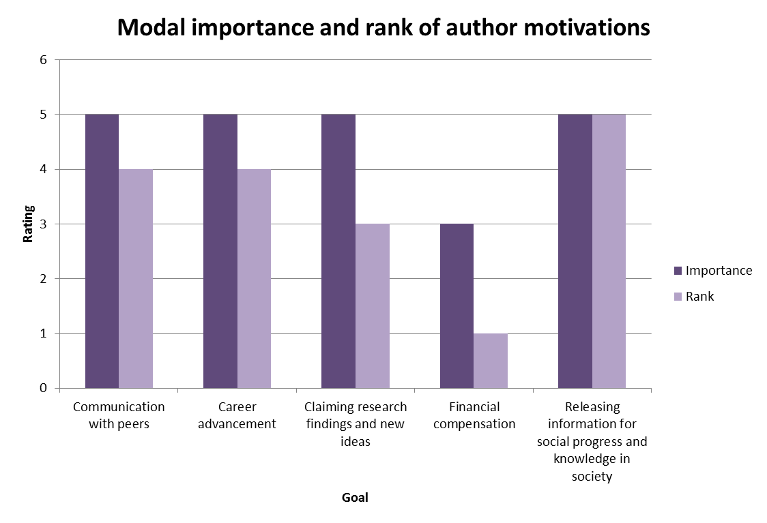
Author motivations
Notes:
Nb mode therefore ranking is not 1,2,3,4,5.
Importance is high for most. Financial compensation is least important, and given lowest priority – but nb it is not completely unimportant to people – some still find it important.

Slide 12
Changing Roles
Institutions driving policy and change
New university presses and reputation
Disciplinary repositories
4. Publisher motivations re upfront payment
5. Add on services
Notes:
A core part of OAPEN-UK is data gathering. We have learnt from previous projects that it is necessary to gather data over at least a three year period if you are going to have anything useful to say, especially when dealing with citations and research.
We have condensed the research into three questions:
1. How policies, processes and mechanisms need to change in order to enable OA publication of monographs?
Business model will include looking at prices, variation in prices by publisher, e-only OA as a viable strategy and the potential ongoing need or demand for print, the most effective way to manage OA fees, licensing regimes, IPR and reuse rights and royalties.
Organisational policies will include changes that funders make to their OA policies, that libraries make to their purchasing and selection policies, that repositories make to their depositing policies and that institutions make to comply with all of the above.
Technical changes will include back- and front-end system changes made by publishers, integration into existing library systems, changes to funder systems for awarding grants and discoverability
2. What are the measurable effects of a move to OA monographs?
On readership/ usage, sales, citation - These issues should all be covered by the hard data that we are collecting – they are about things that can be measured by counting something. Changes in attitudes and perceptions should be covered in question 3.
3. How do perceptions of OA monograph publication change among participants during the project?
Perceived risks and benefits might include issues such as business models, readership, academic reward, discoverability, quality, depending upon who we are talking to.

Slide 13
Technical
Metadata
Standards
3. Version of record
4. Preservation
Notes:
A core part of OAPEN-UK is data gathering. We have learnt from previous projects that it is necessary to gather data over at least a three year period if you are going to have anything useful to say, especially when dealing with citations and research.
We have condensed the research into three questions:
1. How policies, processes and mechanisms need to change in order to enable OA publication of monographs?
Business model will include looking at prices, variation in prices by publisher, e-only OA as a viable strategy and the potential ongoing need or demand for print, the most effective way to manage OA fees, licensing regimes, IPR and reuse rights and royalties.
Organisational policies will include changes that funders make to their OA policies, that libraries make to their purchasing and selection policies, that repositories make to their depositing policies and that institutions make to comply with all of the above.
Technical changes will include back- and front-end system changes made by publishers, integration into existing library systems, changes to funder systems for awarding grants and discoverability
2. What are the measurable effects of a move to OA monographs?
On readership/ usage, sales, citation - These issues should all be covered by the hard data that we are collecting – they are about things that can be measured by counting something. Changes in attitudes and perceptions should be covered in question 3.
3. How do perceptions of OA monograph publication change among participants during the project?
Perceived risks and benefits might include issues such as business models, readership, academic reward, discoverability, quality, depending upon who we are talking to.

Slide 14
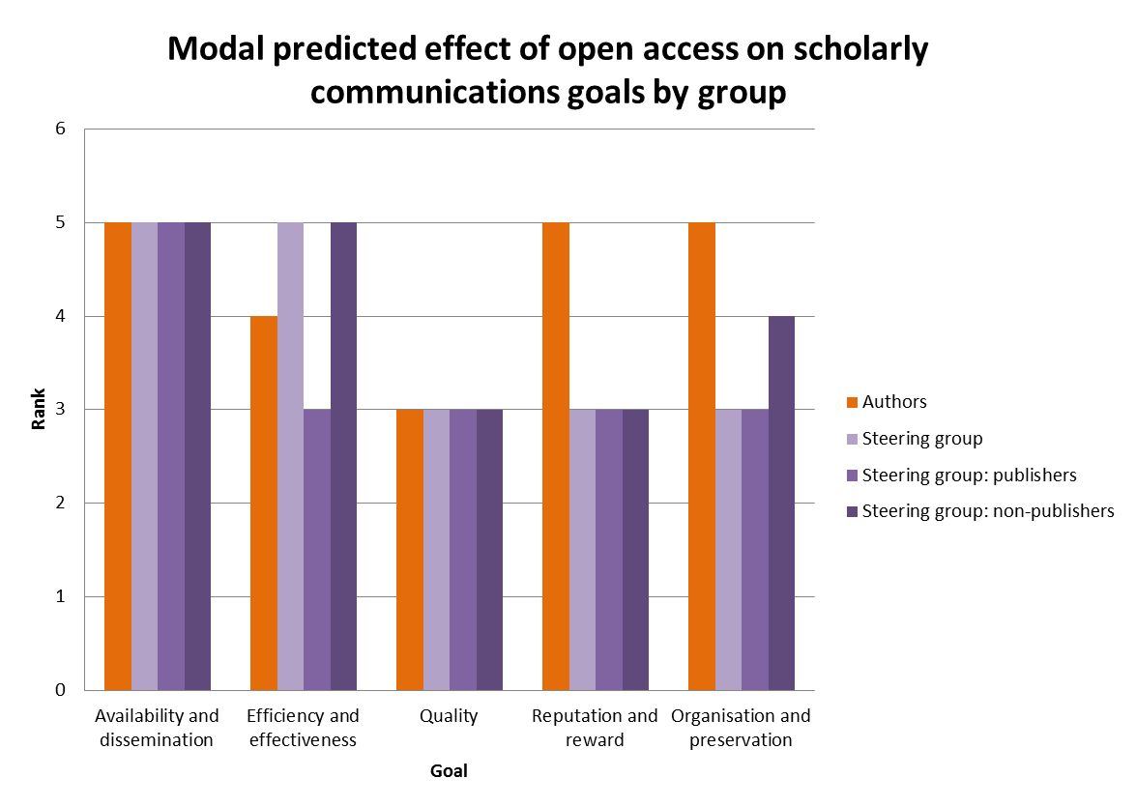
Scholarly communications goals
Notes:
5= ‘very positive’ and 1=‘very negative’. Majority of opinions here are 3 - ‘neither positive nor negative’. Nb we did give people a don’t know option, so this reflects genuine opinion, rather than lack of it.
On the whole, authors are more positive about OA effects than AG, except as relates to efficiency and effectiveness. Big divide on this one between publishers and non-publishers. Same for organisation and preservation.
Clearly there is a barrier to overcome in terms of perception of impact on quality and, linked I suspect, reputation – although interesting that scholars think that OA publishing will have a very positive effect on reputation while others aren’t convinced!

Slide 15
Next up
Publisher interviews
Institutional case studies
VC meeting
DOAB
PIRUS

Slide 16
Thank you & Further Info
OAPEN-UK website:
http://oapen-uk.jiscebooks.org/
Twitter:
@oapenuk
Diigo Group:
OAPEN-UK
Caren Milloy
c.milloy@jisc-collections.ac.uk
Ellen Collins ellen.collins@researchinfonet.org

