Slide 1
Leadership and self in modern and contemporary literature: Should leadership thought re-conceive self through literature discourse and representations?
Stephen Gibbs
University of Huddersfield
BAM Conference 2011, Aston University, Birmingham UK
http://bloggulentgreytripe.wordpress.com/
s.p.gibbs@hud.ac.uk

Slide 2
Leadership self in textual representations
Phd research: Can leaders only lead through their selves
Senior (political level) leaders lead ‘through’ their selves (essences of who they are)
Are they finding self through leading primarily?
Plus freedom, liberation, transcendence etc?
Modern leaders instinct, amongst many, are to Be-for-others (e.g. being an identity as an expedient to achieve a goal) with resultant loss
Problems: What is leadership and self in this sociohistorical and political-ideological period?
This is a tangent paper: Exploring new meaning around leadership and self via textual representations of leadership-self

Slide 3
Critchley (2010) states: “…Wittgenstein represents what might be called ‘an overcoming of overcoming’, where we would put aside the dogmas of logical analysis and return to ordinary language and the human social life expressed in that language in all its messy but rich everydayness” (p. 108).

Slide 4
Leadership is not an object that can be pointed to directly
Ellis and Bochner observe:
“The walls between social sciences and humanities have crumbled… social science may be closer to literature than physics” (1996: 18).

Slide 5
Concern for modern leadership self
Modern conceptions of self framed by short structures of thought
Technical language (fact) vs. Holistic meaning
Denotative (literal) vs. Connotative (universal)
Resistance to all vagaries and nuance (fine but loss of self?)
Ability to share nuances of language restricted by loss of irony, paradox and hidden meaning
Self reduced to typologies – these types are not the individual but objects that self might become as there are few alternatives (dissonance)
Leadership too diffuse and contested to offer a coherent shared understanding – to be re-described by leaders leading

Slide 6
Common leadership paradox (or difficulties of speaking ‘leadership’)
As Rivkin and Ryan (literary theorists) observe: “The practical denotative language of science… is limited to the naming of positive empirical facts that can be grasped by the senses. The realm of universal meaning, however, is beyond the sensory experience and cannot be analysed using scientific methods. It can only be alluded to in poetic language and cannot be paraphrased in literal, denotative speech” (1998: 6).

Slide 7
Modern leadership dilemma
The life conditions in question prompt men and women to seek examples, not leaders.
Zygmunt Bauman, Liquid Modernity, 2000: 71
Life conditions = followers’ changing conceptions of leaders in complex industrial societies and resist the models of leadership on offer
Liquid modernity = institutions no longer offering meaning / individuals finding few reference points (Existential problem – “I’m free, but what now?”)

Slide 8
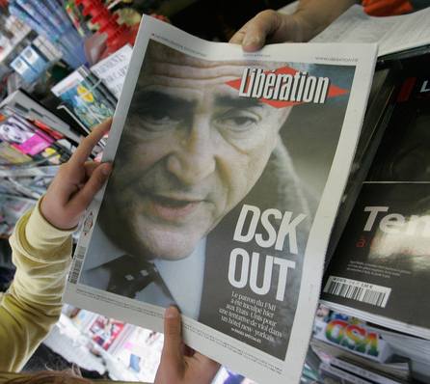
Modern dualities
John Berger in The Scotsman:
"The situation with Dominique Strauss-Khan (the former managing director of the International Monetary Fund, charged with sexually assaulting a chambermaid in a high-class New York hotel), whatever else it's about, it's about not seeing, it's losing that connection with the real. ... "It's as though that kind of suite which costs £3,000 for 24 hours that he hired, that blinds the occupant to any real sense of what is on the ground.""

Slide 9
‘Modern Beauty’ – discontinuities of modern life (grounded in real life)
“My name is Lester Burnham. …this is my life. I am 42 years old. Within a year I will be dead. Of course I don't know that yet, and in a way, I am dead already. Look at me, I j*** off in the shower, this will be the high point of my day. It's all downhill from here.” American Beauty
After 400 years of The Enlightenment in this country we now have call centres, Tescos and hairdressing as the ‘rich fruit’ of this journey

Slide 10
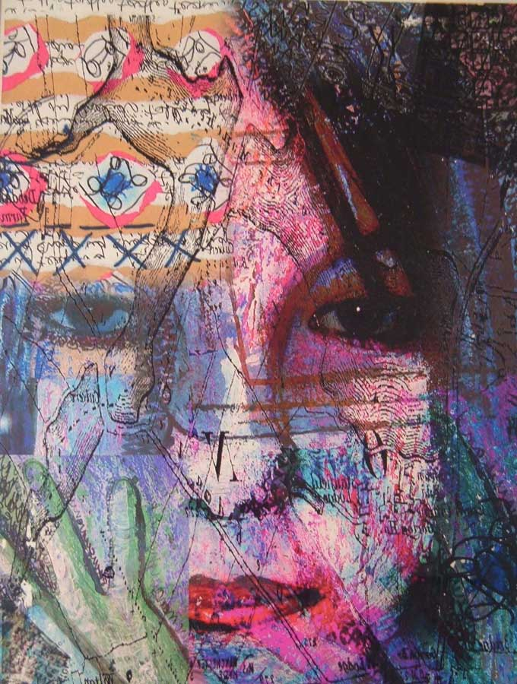
Emergent issues – standing outside of dominant leadership methodologies
Pre-understanding
Foucault asks: What is distinctive about our current [leadership] situation? (Foucault, 2005)
Nature of knowledge (its qualities): ‘continuously increasing rationality, on an abstract gradient, successive rules about our discourse; all problems have a knowledgeable answer to be found’ (Foucault, 1969)
Leadership is too diffuse and conflicted to propose models and theories of leadership. Models are modernity’s project of positioning self as a unitary closed system? (Ouch)

Slide 11
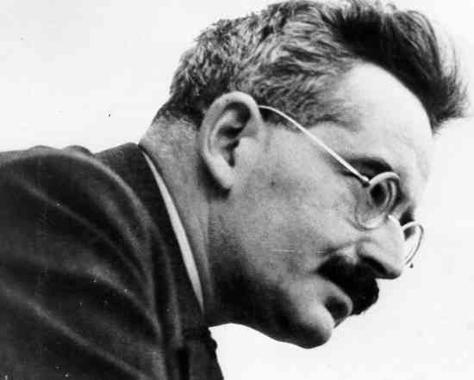
Walter Benjamin
‘[N]o event any longer comes to us without already being shot through with explanation. In other words, by now almost nothing that happens benefits storytelling; almost everything benefits information. Actually, it is half the art of storytelling to keep a story free from explanation as one reproduces it.’ (VI)
‘The Storyteller’ (1936)

Slide 12
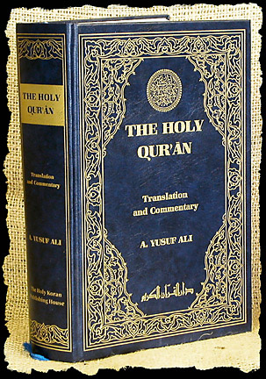
The Storyteller
Modern culture has witnessed a decline in the ‘ability to exchange experiences.’ (I)
Tradition = creative reworking of experience (meaning)
Storyteller
Modernity = passive reception of novelty
Newspaper
Storytelling requires interpretation of experience Information forestalls interpretation

Slide 13
‘A story [long structured thought] … does not expend itself. It preserves and concentrates its strength and is capable of releasing it even after a long time.’ (VI)

Slide 14
Literal leadership ‘facticity’
The facticity of leadership is the fact that leadership is not able to lead (Sartre might have said!)
That is leadership is For-itself
Suggestion here is we’re not able to have a knowledge of leadership or self as an entity

Slide 15
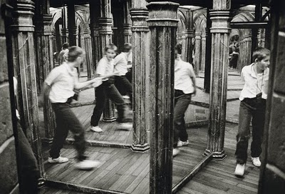
Leadership self favours long-structures
Kant suggests it is not possible for the self to become the object of consciousness as ‘I’ is looking out on the world, paraphrased as: “‘I’ is the expression of my perspective, but denotes no item within it” (Scruton, 1982: 71).
Wittgenstein appears to concur stating: “I look in the mirror. I can see my eyes but can I see the “I” that sees them?” (Rodin, 2008: 65).
Foucault offers that prior to the 18th century there was no concept of ‘man’ suggesting that although we (self) are critical to the production of knowledge we had difficulty conceiving of ourselves as knowable in any unitary form until later advances in consciousness (Gutting, 2005).

Slide 16
Literature and text is poor science?!
“Literature, Huxley [Darwin’s Bulldog Thomas Huxley, 1825-1895] asserted, was ‘neither moral or intellectual’; the ‘aesthetic faculty’ needed to be ‘roused, directed and cultivated’ by science; and literary culture, while imparting a ‘sense of beauty’ and ‘power of expression,’ was unable to furnish a ‘criterion of beauty’ or ‘anything to say beyond a hash of people’s opinions’.” (White, 2003).

Slide 17
Genova states: “…it should be clear why Wittgenstein never bluntly says: ‘I want to change your way of seeing.’ Like Kierkegaard before him, he learned the arts of indirection. Philosophy could only be a catalyst for change. It could only interpose itself between the picture and the believer in such a way as to disrupt the felt necessary connections between the two and hope for the best” (1995, p. 18-19).

Slide 18
Objective (objects of) Leadership
Short structures of expression
Utopian futures
Denotative
“Self-actualisation”
Transactional
Labels
Heroic
Certainty
Management?
Unitary
Charismatic
Classes, genus
Coherency
Transformational
Doing
Epistemological Self
Leadership-Self through textual representation
The Ontic Self
Change through planning
Interiority
Leadership?
Change through reflection
Plural
Being
Incoherency
Patterns
Uncertainty
Connotative
Long structures of thought
Courageous
Dystopian futures
Flourishing
Subjective (being) Leadership
Sacrificial

Slide 19
http://bloggulentgreytripe.wordpress.com/
s.p.gibbs@hud.ac.uk
07544 581601

Slide 20
References
Bauman, Z (2000) Liquid Modernity, Cambridge: Polity Press
Foucault, M. (1969) The Archaeology of Knowledge, London: Routledge
Robinson, J. (2011) Eric Schmidt, chairman of Google, condemns British education system, Schmidt criticises division between science and arts and says UK 'should look back to glory days of Victorian era, (online) [cited 20 August 2011] Available from the Internet: <http://www.guardian.co.uk/technology/2011/aug/26/eric-schmidt-chairman-google-education?CMP=twt_gu>
Rodin, N. A. (2008) Art as a Process of Delimitations: Essentialist and Non-Essentialist Approaches. In R. Osborne (Eds), Philosophy in Art. London: Zidane Press
Scruton, R. (1982) Kant, Oxford: Oxford University Press
SpiegelOnline (2011) The Destructive Power of the Financial Markets, (online) [cited 29 August 2011] Available from the Internet: <http://www.spiegel.de/international/business/0,1518,781590,00.html>
White, P. (2003) Thomas Huxley, Making the “Man of Science”, Cambridge: Cambridge University Press

