Slide 1
6th National Art Education Summit Yunnan Arts University 28-31 October 2011
Emma Hunt
Dean: Art, Design and Architecture
University of Huddersfield

Slide 2
An overview of UK Art and Design Education
The UK context
How Huddersfield fits in
Our national body ( CHEAD)
How we work with Government and ‘influencing the influencers’
Value and status of the subject
Strengthening our common futures

Slide 3
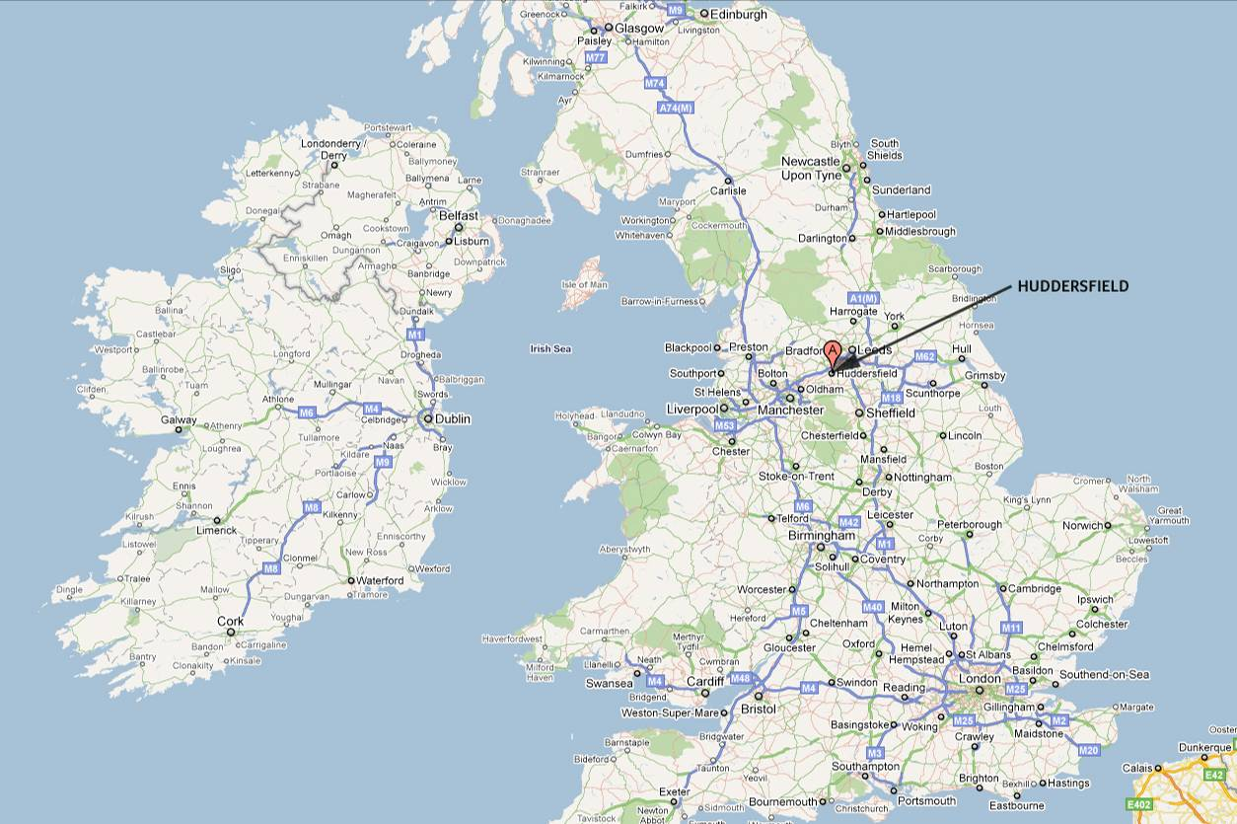

Slide 4
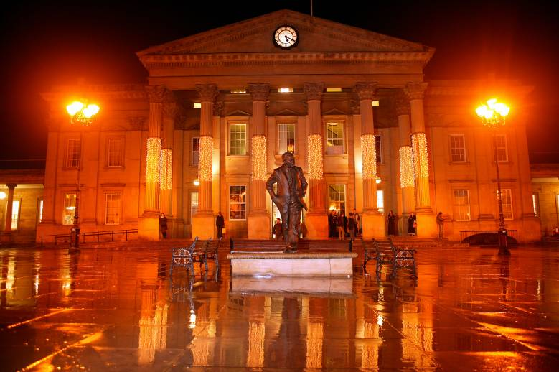
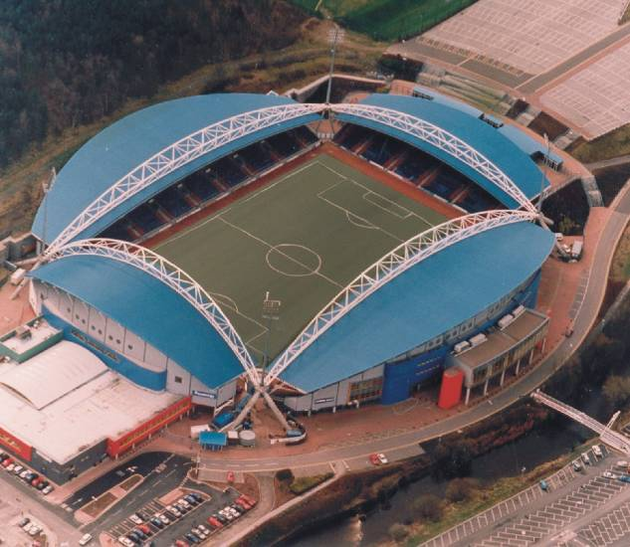
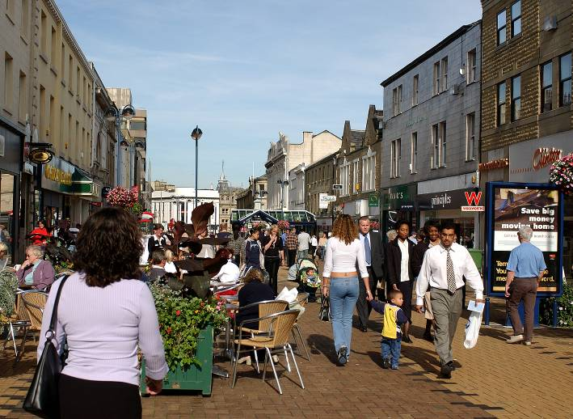
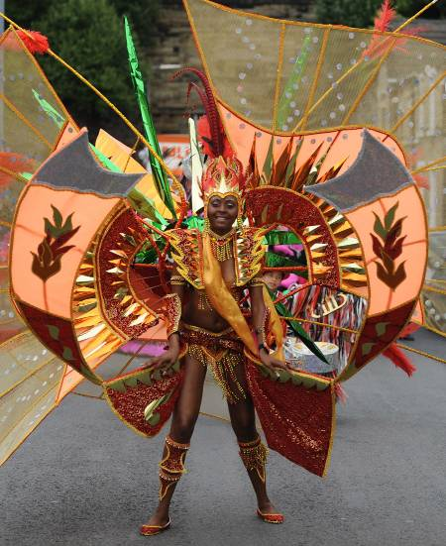
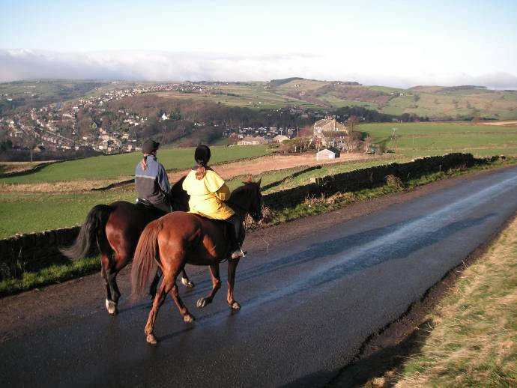
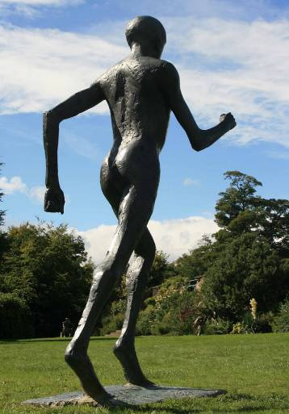
Views of Huddersfield

Slide 5
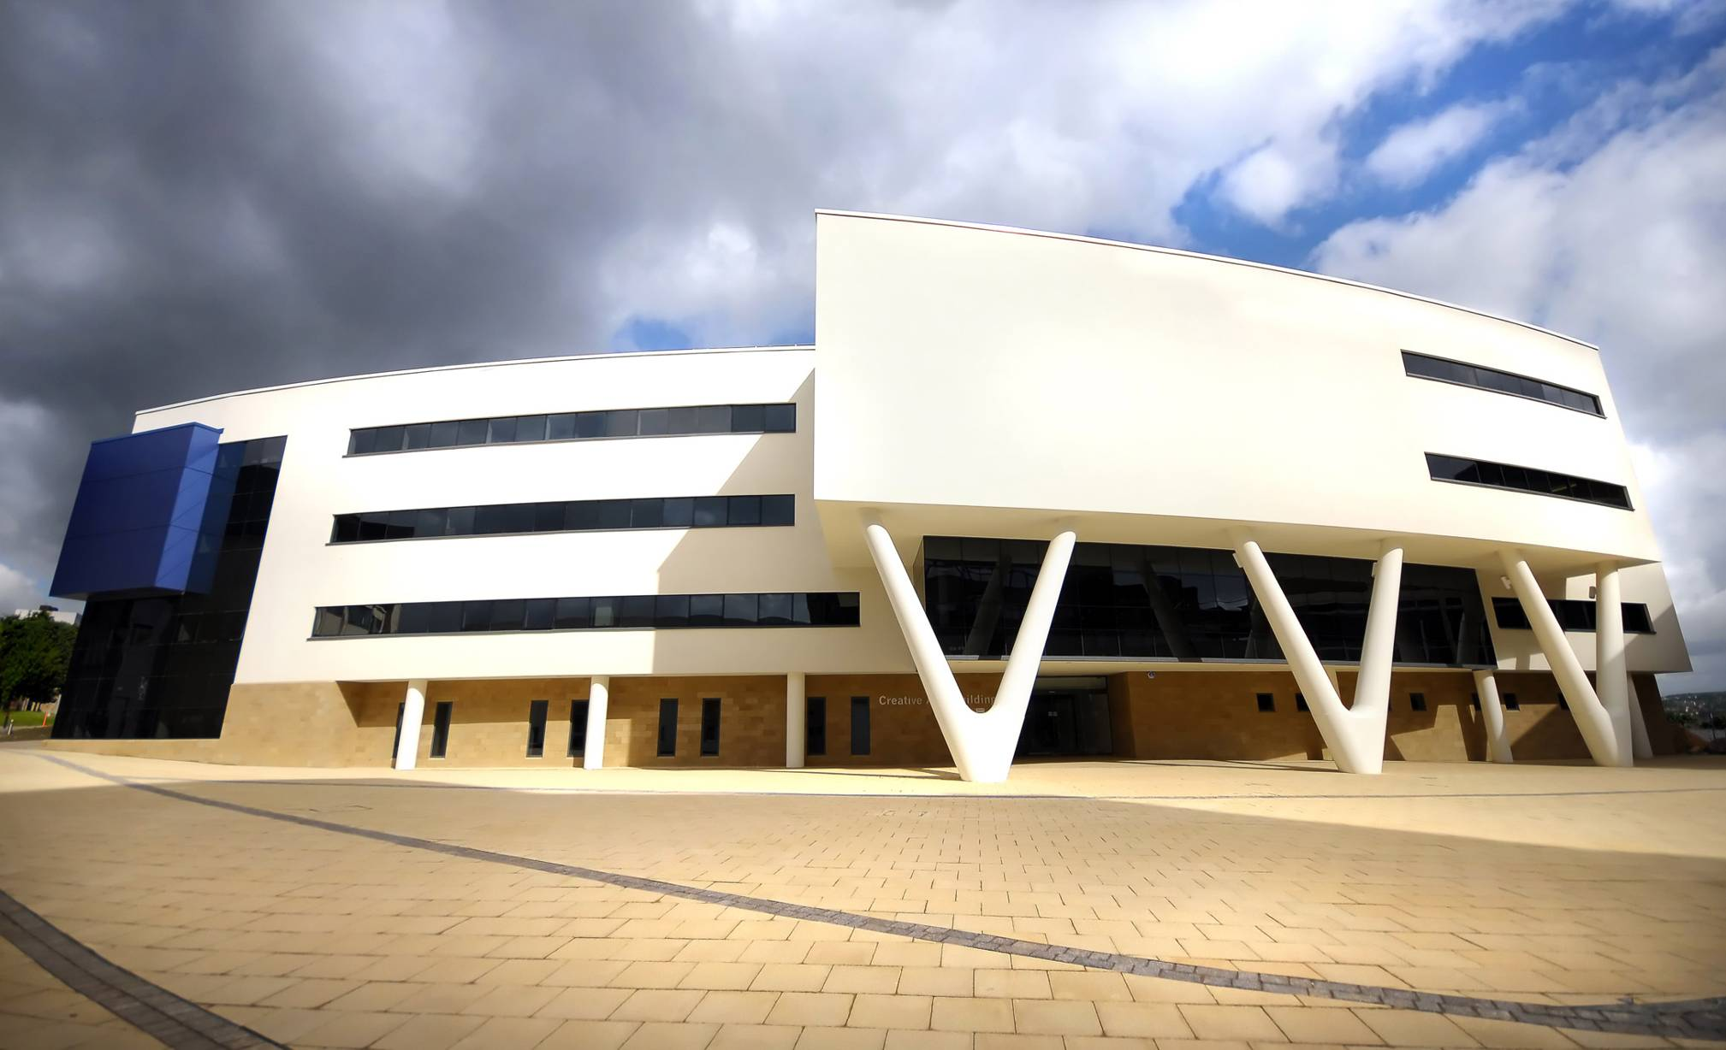

Slide 6
UK CREATIVE CONTEXT
Contribution of HE to the UK creative economy
Importance widely accepted:
1,165,500 employed in creative industries
Creative employment shown consistent growth
Fundamental part of knowledge economy
Institutional diversity of art schools
Graduate skills
Entrepreneurship
Department for Culture , Media and Sport
Interdisciplinary importance
CGCF project
UK Universities increasingly important
Global opportunities and partnerships

Slide 7
School of Art, Design and Architecture University of Huddersfield
Undergraduate ( BA/BSc Hons) courses in Fashion, Textiles, Architecture, Art, Graphics, Illustration, Animation, Interior Design, Product Design, Photography
Postgraduate courses in all of the above
Full Architecture Registration ( 6/7 years)
Research students – PhD, MREs

Slide 8
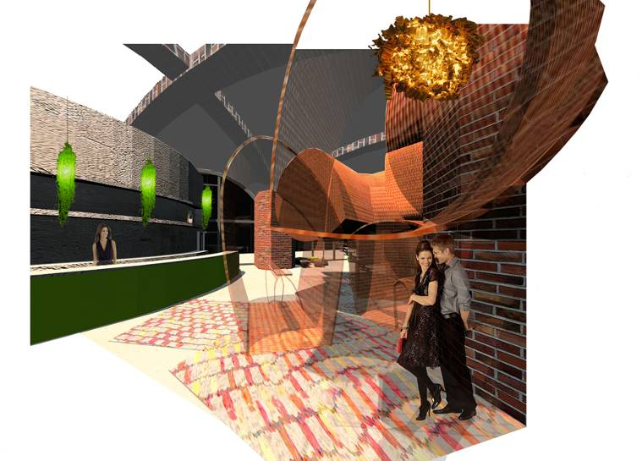
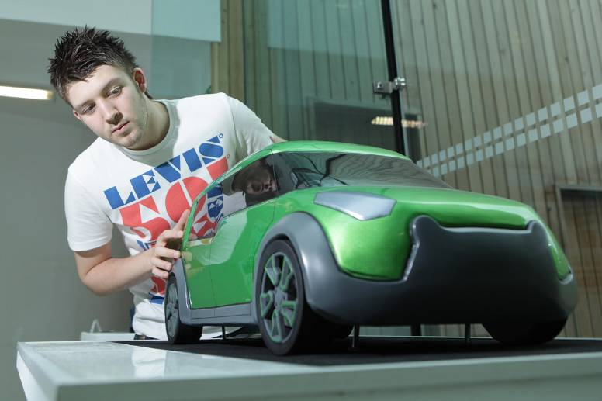
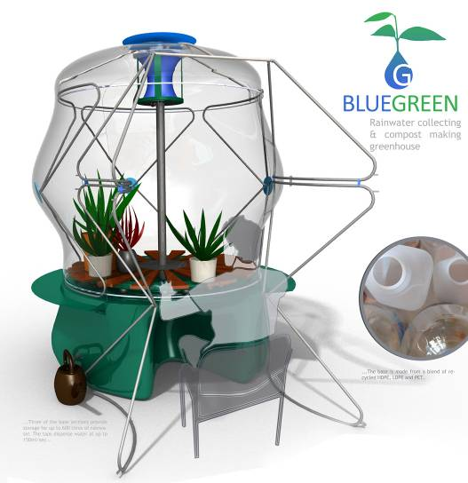
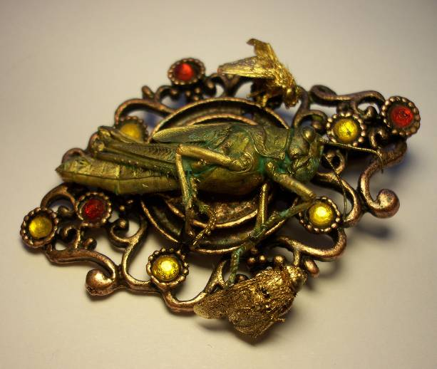
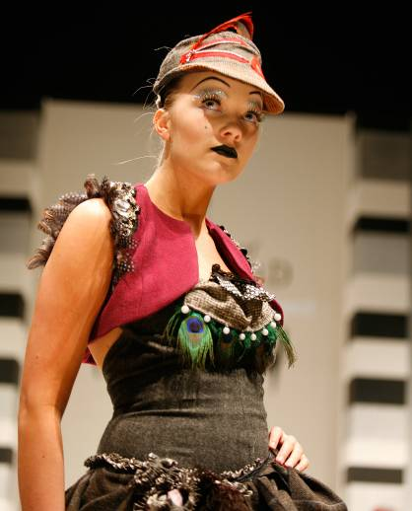
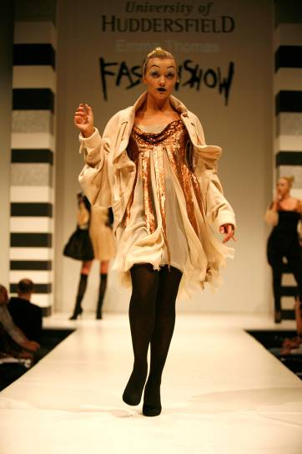

Slide 9
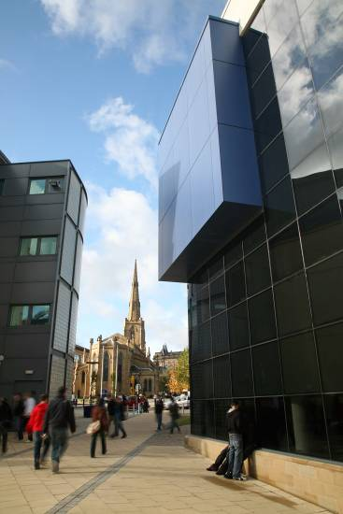
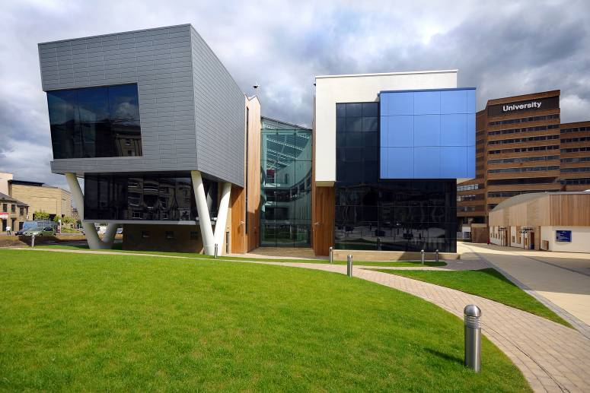
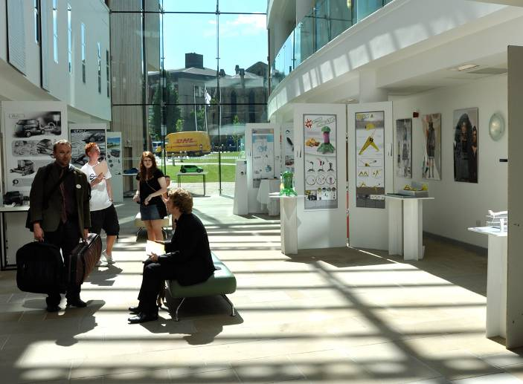
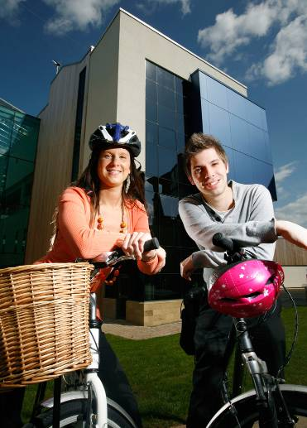
The Creative Arts Building

Slide 10
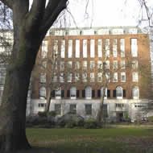
Council for Higher Education in Art and Design. (CHEAD)
CHAIR: Emma Hunt
CHEAD 3rd Floor, Woburn House 20 Tavistock Square, London
WC1H 9HB

Slide 11
CHEAD what we do
Longstanding association of institutions with HE in Art and Design
CHEAD seeks to inform, influence and initiate policy in HE Art and Design at national and other levels
VISION
To articulate and promote the value and contribution of HE in Art and Design to the creative economy in the UK and the wider world.
CHEAD shares with its members the objective of enhancing the student experience of HE in Art and Design, and respects the independent and diverse approaches adopted by members in this regard.
CHEAD aims to continue to provide multi-agency fora for the debate and exchange of information and ideas in HE Art and Design for key organisations and members to enable the interests of the sector to flourish.
To work with other groups and organisations to capture examples of best practice in research and to disseminate those to the sector through a series of events and seminars.

Slide 12
Facts and Figures
75 member institutions
216,000 students studying art and design in the UK
Partners :-
Arts Council England
The Design Council
Crafts Council and the Higher Education Academy.

Slide 13
Major longitudinal survey of early career patterns of 3,500 graduates
3 out of 4 graduates worked in their field
Portfolio careers well established
45% freelance
77% positive about their work
Placed high value on their educational experiences
72% undertaken further study

Slide 14
Projects and partnerships - influencing the influencers -
HE admissions reform
Leadership Development programme
Creative Graduates Creative Futures
Galleries Networking project
Research Exercise Framework 2014
CHEAD Annual Conference ( 14-16 March 2012) York

Slide 15
Advocacy – improving art and design education -
Parliamentary Design Commission with the UK Government ( House of Lords and House of Commons)
Associate Parliamentary Design and Innovation Group
Purpose to explore how design can drive economic and social improvement and how Government and business can better understand its importance – first inquiry Design Education.

Slide 16
The Parliamentary Design Inquiry into Design Education
This inquiry is an opportunity to investigate the economic and social rationale for design education, both specialised and embedded in other disciplines.
Is design strategically important to the UK – to the economy, to business, to society and the individual;
Is design education, and in what forms, could therefore be said to be strategically important to the UK – to the economy, to business, to society and the individual;
Is design education in any way ‘vulnerable’
The inquiry will therefore consider design in the whole education system, with a particular focus on areas where potential vulnerability has been identified.
Hypothesis
To improve public services and support economic growth in the UK, design education should have a role within the whole education system; both in relation to the Science Technology Engineering and Maths subjects, and embedded in a range of other disciplines and credentials.

Slide 17
Global issues we might share
Advocacy for the value of HE Art and Design
Importance to society and the economy
Partnerships for mutual benefit
World issues creating new subjects, and emerging subjects – eg sustainability,
Leadership development
Research development/PhD

Slide 18
THANKYOU!
Emma Hunt
e.hunt@hud.ac.uk

