Slide 1
Storytelling and role play to increase younger children’s autonomy within research. What younger children really think and understand about online safety
Presented at the TACTYC 2017 Annual Conference
By Lindsey Watson
Senior Lecturer in Early Years
FHEA, MA by Research, PGDip, BA Hons

Slide 2
Aims of the presentation
To contextualise creative methodologies within the proposed research
To examine the potential of storytelling as a methodological approach in increasing children’s autonomy within the research environment
Critically examine how stories related to online safety can help facilitate young children’s voices

Slide 3
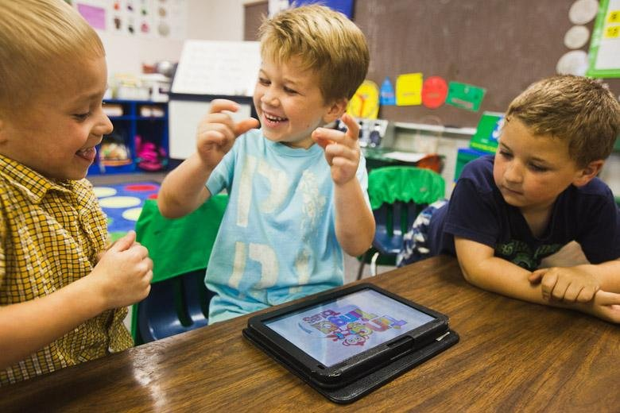
Research context
Why this research?
What does the literature say?
Children are accessing the internet at younger ages and for longer periods of time (Sharkins, Newton, Albaiz & Ernest, 2015, p.437)
Much of the research focuses on the engagement of older children over the age of nine (Chaudron, 2015, p.11)
Widening gap, demonstrating a lack of understanding in how best to support younger children’s digital engagement (Holloway, Green & Livingstone, 2013, p.4; Ólfasson, Livingstone and Haddon, 2013, p.32)

Slide 4
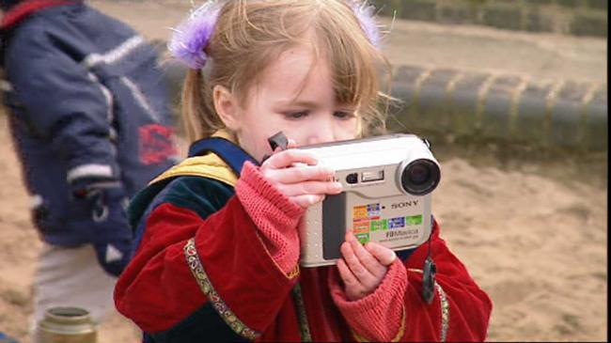
Research context
Chaudron (2015) suggests we need to know more about younger children’s understanding of the internet
Is the current lack of research due to perceived difficulties in research involving younger children? (Olfasson et al., 2013, p.20)
This suggests that we need to involve younger children in research. Research with children rather than on children (Pinter, Kuchah, & Smith, 2013)
Are there more creative ways to genuinely attempt to include children in the production of knowledge? (Lomax, 2012)

Slide 5
Proposed research aims
Critically interrogate how the home and school environments work together to tackle the issues of child online safety
Apply a phenomenological approach to examine the possible differences between younger children’s and adult’s perspectives, gaining insights into how best to support younger children with online safety
Critically analyse the effectiveness of storytelling and role play in eliciting the views of younger children in the research environment

Slide 6
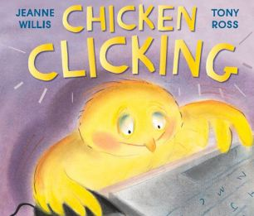
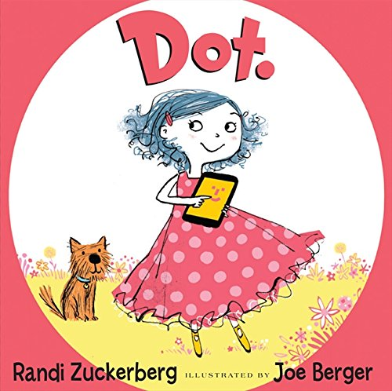
Proposed methodological approach (1) Storytelling
A pedagogical strategy that children are familiar with, motivating and engaging to connect with the content (Miller & Pennycuff, 2008)
Capitalises on children’s desire to interact and talk to others, relying on the relationship between the listener and the (Jug & Vilar, 2015; Mason, 1990; Miller & Pennycuff, 2008).
5 children reception
5 children year one
Age appropriate books regarding online safety
Audio recording
A more relaxed approach to asking children questions (Morgan, Gibbs, Maxwell & Britten, 2002; Shaw, Brady & Davey, 2011).
Notes:
Mention different ways of accessing stories. Online for Digiducks big decision, PDF and interactive app.
Penguin pig – i bookstore
Webster’s email – kindle edition
Chicken Clicking – kindle edition
Dot PDF available
Do I produce my own book?

Slide 7
Age appropriate storytelling considerations
Anthropomorphism? Conflicting evidence (Larsen, Lee & Ganea, 2017)
Research suggests younger are less likely to learn about social problems from anthropomorphised books (Richert, Shawber, Hoffman, & Taylor, 2009; Richert & Smith, 2011)
Larsen, Lee and Ganea (2017) suggest there is no difference in children’s preference for anthropomorphised or realistic books.
Notes:
Mention different ways of accessing stories. Online for Digiducks big decision, PDF and interactive app.
Penguin pig – i bookstore
Webster’s email – kindle edition
Chicken Clicking – kindle edition
Dot PDF available
Do I produce my own book?

Slide 8
Age appropriate storytelling considerations
Some of the stories available appear to convey only negative messages that may scare children from behaving morally (Lee et al., 2014)
Emphasising the positivity of honesty may be more effective than emphasising the negativity of dishonesty (Lee et al., 2014)
The aim is not to teach younger children, but to use the books ethically to gain more information about their understanding of online safety.
Notes:
Mention different ways of accessing stories. Online for Digiducks big decision, PDF and interactive app.
Penguin pig – i bookstore
Webster’s email – kindle edition
Chicken Clicking – kindle edition
Dot PDF available
Do I produce my own book?

Slide 9
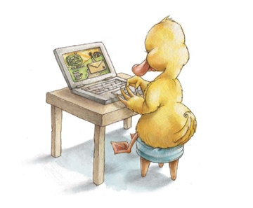
Proposed methodological approach (2) Role play
Role play enables children to communally explore and assign meaning to their worlds and themselves in it (Papadopoulou, 2012, p. 575)
A pretend world that is reality grounded, where children are able to recreate aspects of their everyday world (Papadopoulou, 2012, p. 576)
A medium of expression to demonstrate their current levels of understanding, anxieties and fears (Papadopoulou, 2012, p. 582)
Notes:
A highly complex interactive world and a developing individual, agency and expression

Slide 10
What else can the role play offer?
Provides a further opportunity to analyse the suitability of age appropriate books regarding online safety
How are children interpreting the moral messages? Positive or negative?
Potential development for creating new resources to support younger children’s understanding of online safety, informed by younger children
Recognition that creative methods facilitating ‘children’s efforts to portray their lives in ways which are meaningful to them’ Lomax, Fink, Singh and High (2011:238) may be affected by social constructions of childhood and adults, yet still aims to recognise children’s individuality, encouraging the use of multiple voices and experiences to collect data (Lomax, 2012).
Notes:
A highly complex interactive world and a developing individual, agency and expression

Slide 11
Proposed methodological approach (3) Role play
Revisiting roleplay data with children
Research with children continues to examine how their perspectives can help add to the body of knowledge about various issues in their lives (Einarsdottir & Harcourt 2011; Lansdown 2005).
Increased use of video recording has also contributed to a paradigm shift within early childhood educational research, where the child is viewed as a competent research participant (Rayna & Laevers, 2011)
A clear rationale for video recording, ethical considerations, confidentiality, anonymity, data storage
Data analysis
Thematic Phenomenological Analysis
Notes:
The difference between the two types is that the first, intentionality of acts, engages with an already constructed world of objects, whilst operative intentionality brings this inner world into existence in the first place. Intentionality of acts reflects the organism’s purposeful engagement with the world as this is expressed in different behaviours and interactions. Operative intentionality creates the horizon for intentional acts, it is unconscious and expresses our very basic, primordial, existential drives (Papadopoulou & Birch, 2009).
Through their intentional acts they experience their everyday settings and thus receive information about their world, others, their roles and functions, the use of objects, the meanings of behaviours, morality, values and, generally, ways of being in their world. At the same time children constantly Ecology of role play 579 try to make sense of and position themselves in their world in relation to others. This autopoietic process makes their adaptation to the environment possible.

Slide 12
Conclusion
Provided a rationale for the proposed research
Critically examined the proposed creative methodological approaches and younger children’s autonomy within the research environment
Discussed how storytelling and role play have the potential to gather younger children’s understanding of online safety and how this could possibly impact on how the online safety message is conveyed

Slide 13
References
Chaudron, S. (2015). Young Children (0-8) and Digital Technology: A Qualitative Exploratory Study Across Seven Countries. Ispra: Joint Research centre – European commission.
Einarsdottir, J., & D. Harcourt. (2011). “Introducing Children’s Perspectives and Participation in Research.” European Early Childhood Education Journal 19(3), 301–307.
Holloway, D., Green, L., & Livingstone, S. (2013). Zero to Eight, Young Children and their Internet Use. London: London School of Economics and Political Science & EU Kids Online.
Jug, T., & Vilar, P. (2015). Focus Group interview through storytelling: Researching pre-school children’s attitudes towards books and reading. Journal of Documentation, 71(6), 1300-1316.
Lansdown, G. (2005). ‘Can you hear me? The right of young children to participate in decisions affecting them’, Working Paper 36. The Hague: Bernard van Leer Foundation.
Larsen, N. E., Lee, K., & Ganea, P. A. (2017). Do storybooks with anthropomorphized animal characters promote prosocial behaviors in young children?. Developmental Science. Retrieved from http://onlinelibrary.wiley.com/doi/10.1111/desc.12590/full

Slide 14
References
Lee, K., Talwar, V., McCarthy, A., Ross, I., Evans, A., & Arruda, C. (2014). Can classic moral stories promote honesty in children? Psychological Science, 25, 1630–1636.
Lomax, H. (2012). Contested voices? Methodological tensions in creative visual research with children. International Journal of Social Research Methodology 15(2), 105–117.
Miller, S., & Pennycuff, L. (2008). The power of story: Using storytelling to improve literacy learning. Journal of Cross-Disciplinary Perspectives in Education, 1(1), 36-43.
Mason, J. M. (1990). Reading stories to preliterate children: A proposed connection to reading. Center for the Study of Reading Technical Report; no. 510. Retrieved from https://www.ideals.illinois.edu/bitstream/handle/2142/17536/ctrstreadtechrepv01990i00510_opt.pdf?sequence=1
Morgan, M., Gibbs, S., Maxwell, K., & Britten, N. (2002). Hearing children's voices: methodological issues in conducting focus groups with children aged 7-11 years. Qualitative Research, 2(1), 5-20.
Olfasson, K., Livingstone, S., & Haddon, L. (2013). Children's Use of Online Technologies in Europe: A Review of the European Evidence Database. London: London School of Economics and Political Science and EU Kids Online.

Slide 15
References
Papadopoulou, M. (2003). An attempt to establish a developmental phenomenology employing a case studies’ approach to ‘understanding’ and ‘organised learning’. PhD thesis, University of Portsmouth.
Pinter, A., Kuchah, K., & Smith, R. (2013). Researching with Children. ELT Journal, 67(4), 484-487.
Rayna, S., & F. Laevers. (2011). “Understanding Children from 0 to 3 Years of Age and its Implications for Education. What’s New on the Babies’ Side? Origins and Evolutions.” European Early Childhood Education Research Journal 19(2), 161–172.
Richert, R.A., Shawber, A.B., Hoffman, R.E., & Taylor, M. (2009). Learning from fantasy and real characters in preschool and kindergarten. Journal of Cognition and Development, 10, 41–66.
Richert, R.A., & Smith, E.I. (2011). Preschoolers’ quarantining of fantasy stories. Child Development, 82, 1106–1119.
Sharkins, K. A., Newton, A. B., Najla Essa A Albaiz, & Ernest, J. M. (2016). Preschool children's exposure to media, technology, and screen time: Perspectives of caregivers from three early childcare settings. Early Childhood Education Journal, 44(5), 437-444. doi:10.1007/s10643-015-0732-3
Shaw, C., Brady, LM., & Davey, C. (2011). Guidelines for Research with Children and Young People. London; National Children’s Bureau Research Centre.

Slide 16
Lindsey Watson
Senior Lecturer in Early Years
FHEA, MA by Research, PGDip, BA Hons
l.watson2@hud.ac.uk
@Lje1994
https://www.bera.ac.uk/blog/what-younger-children-really-think-and-understand-about-internet-safety-the-value-of-stories-and-role-play-as-research-methods

