Slide 1
Girls, ‘leaning in’ and faux-empowerment
Janet Batsleer, Grainne McMahon • 16.06.2017

Slide 2
Introduction
‘Lean in’ and find your ‘power’
Youth work with young women and girls
The future of ‘empowerment’

Slide 3
Just ‘lean in’
Speak up, look up
You can be ‘whatever you want to be’
Role models and ‘get empowered’ advice
@leanincommunity, facebook, 2nd June, 2017
“Ivanka’s is a feminism that utterly denies the existence of any sort of structural sexism, that refuses to hold men in any way responsible for women’s oppression, that places all the burden of change on the individual, who can, through hard work and sensible dating choices, slightly alter her own life along one narrow groove. It’s feminism for people who’ve been conned into believing that existing in a state of permanent sleep deprivation is the same as being woke.” – Laurie Penny

Slide 4
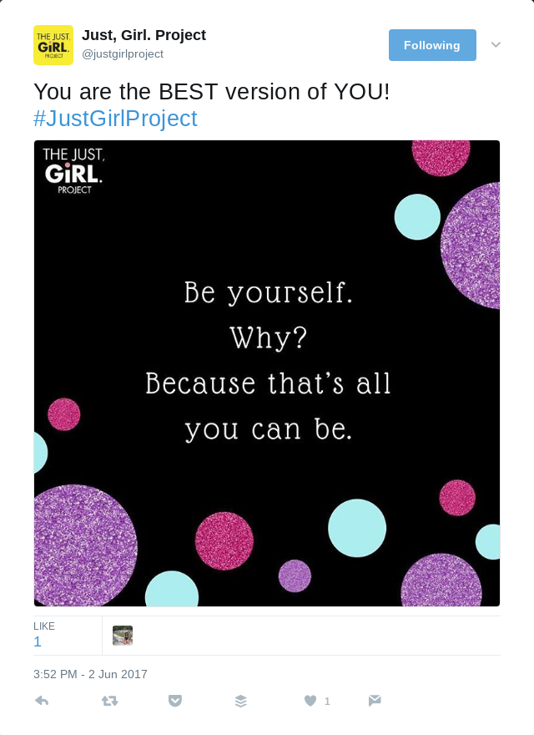
Faux-empowerment
Neo-liberal femininity
Diverts attention from criticism of patriarchal structures (and sustains capitalist superstructure)
‘Feminist disarticulation’ (McRobbie, 2008)
Be whatever you want, if...

Slide 5
Girl power!
UNICEF along with other global charities sees harnessing the power of girls as a key vehicle for transforming social conditions.
However, discourses of girl power which appear to offer unlimited possibilities to ambitious young women in effect close down what it is possible to become.
There is complexity in the range of possible futures young women imagine.

Slide 6
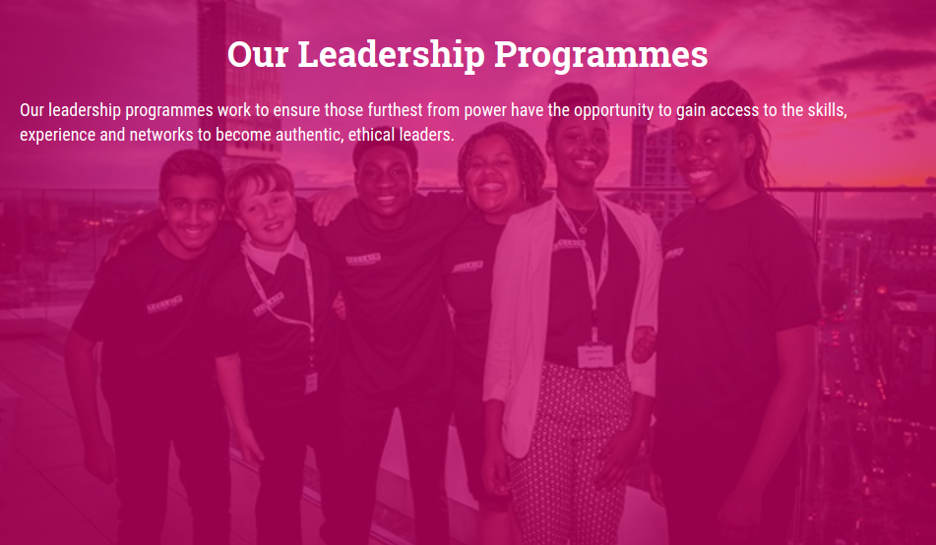
‘Step up to serve’
How are service, leadership and social action connected in current UK youth charities?
Do the figures of the good citizen/bad activist still play out? How does research on structure (such as that by Engender in Scotland) inform a focus on leadership?
How does relational agency become figured?

Slide 7
Reclaiming empowerment
Faux-empowerment/ another way of thinking about empowerment
Is there the possibility of escape from systems which shape and blame; escape from the logics of judgement?
What kind of creative, experimental and maybe intergenerational alliances can be traced?
What is the end-game? #smashpatriarchy

Slide 8
Conclusions

