Slide 1
Using ethnographic methods in international student UX research
Bryony Ramsden
Notes:
Intro, information about myself, and what I’m going to cover:
Background of the research we’ve been doing, method used, what data was returned and what did or didn’t work.

Slide 2
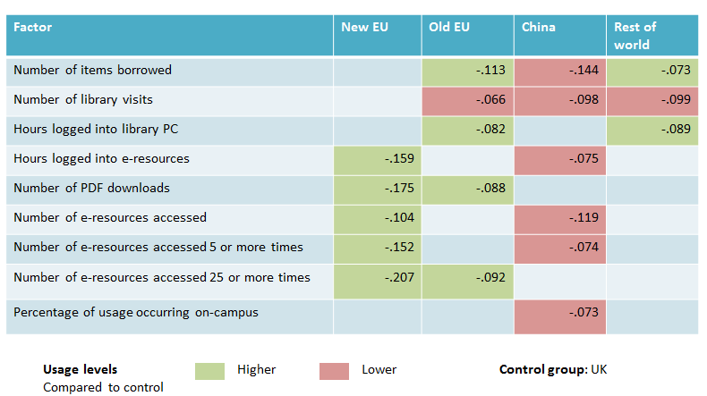
Background
Library Impact Data Project
Notes:
LIDP is a Jisc funded project that started as a collaboration between 8 universities, finding a correlation between library use and degree result attained, but as it progressed to later phases focussing on Huddersfield’s students, we learnt that international, and particularly Chinese students, were comparatively low users of the library. This table shows that generally non-UK students visited the library less, but all that red for Chinese students made us question where they were getting information from…

Slide 3

What we wanted to know
“Four eyes” by Kevin Lablanco licenced under CC BY-NC-ND 2.0
Notes:
We wanted to know more about why international students were such comparatively low users, with the Chinese foremost in mind, so we decided to ask them where they studied, whether they used reading lists, and what processes they undertook to complete their assignments so that we could work out how to improve engagement with library provisions and services. It was decided to use students from the business school as they had the largest group of international students studying on courses there.

Slide 4
Method of data collection
Initial survey of all international students
Cognitive mapping
Retrospective process interviews
Notes:
The survey had 372 responses, and asked students about what they used from library resources, and their preferences for types of resource overall. However, the survey was quantitative, and qualitative data was needed to learn more about usage patterns and how the linked to other services in the University. We adopted the use of cognitive mapping and retrospective process interviews to help gather more information on where and how international students used library resources and facilities, and if there were any issues we weren’t aware of. We emailed a number of students who provided contact details on the survey, but had problems actually recruiting them to the point of meeting with them, so only spoke to 8 students. Obviously this is a very small select sample!

Slide 5
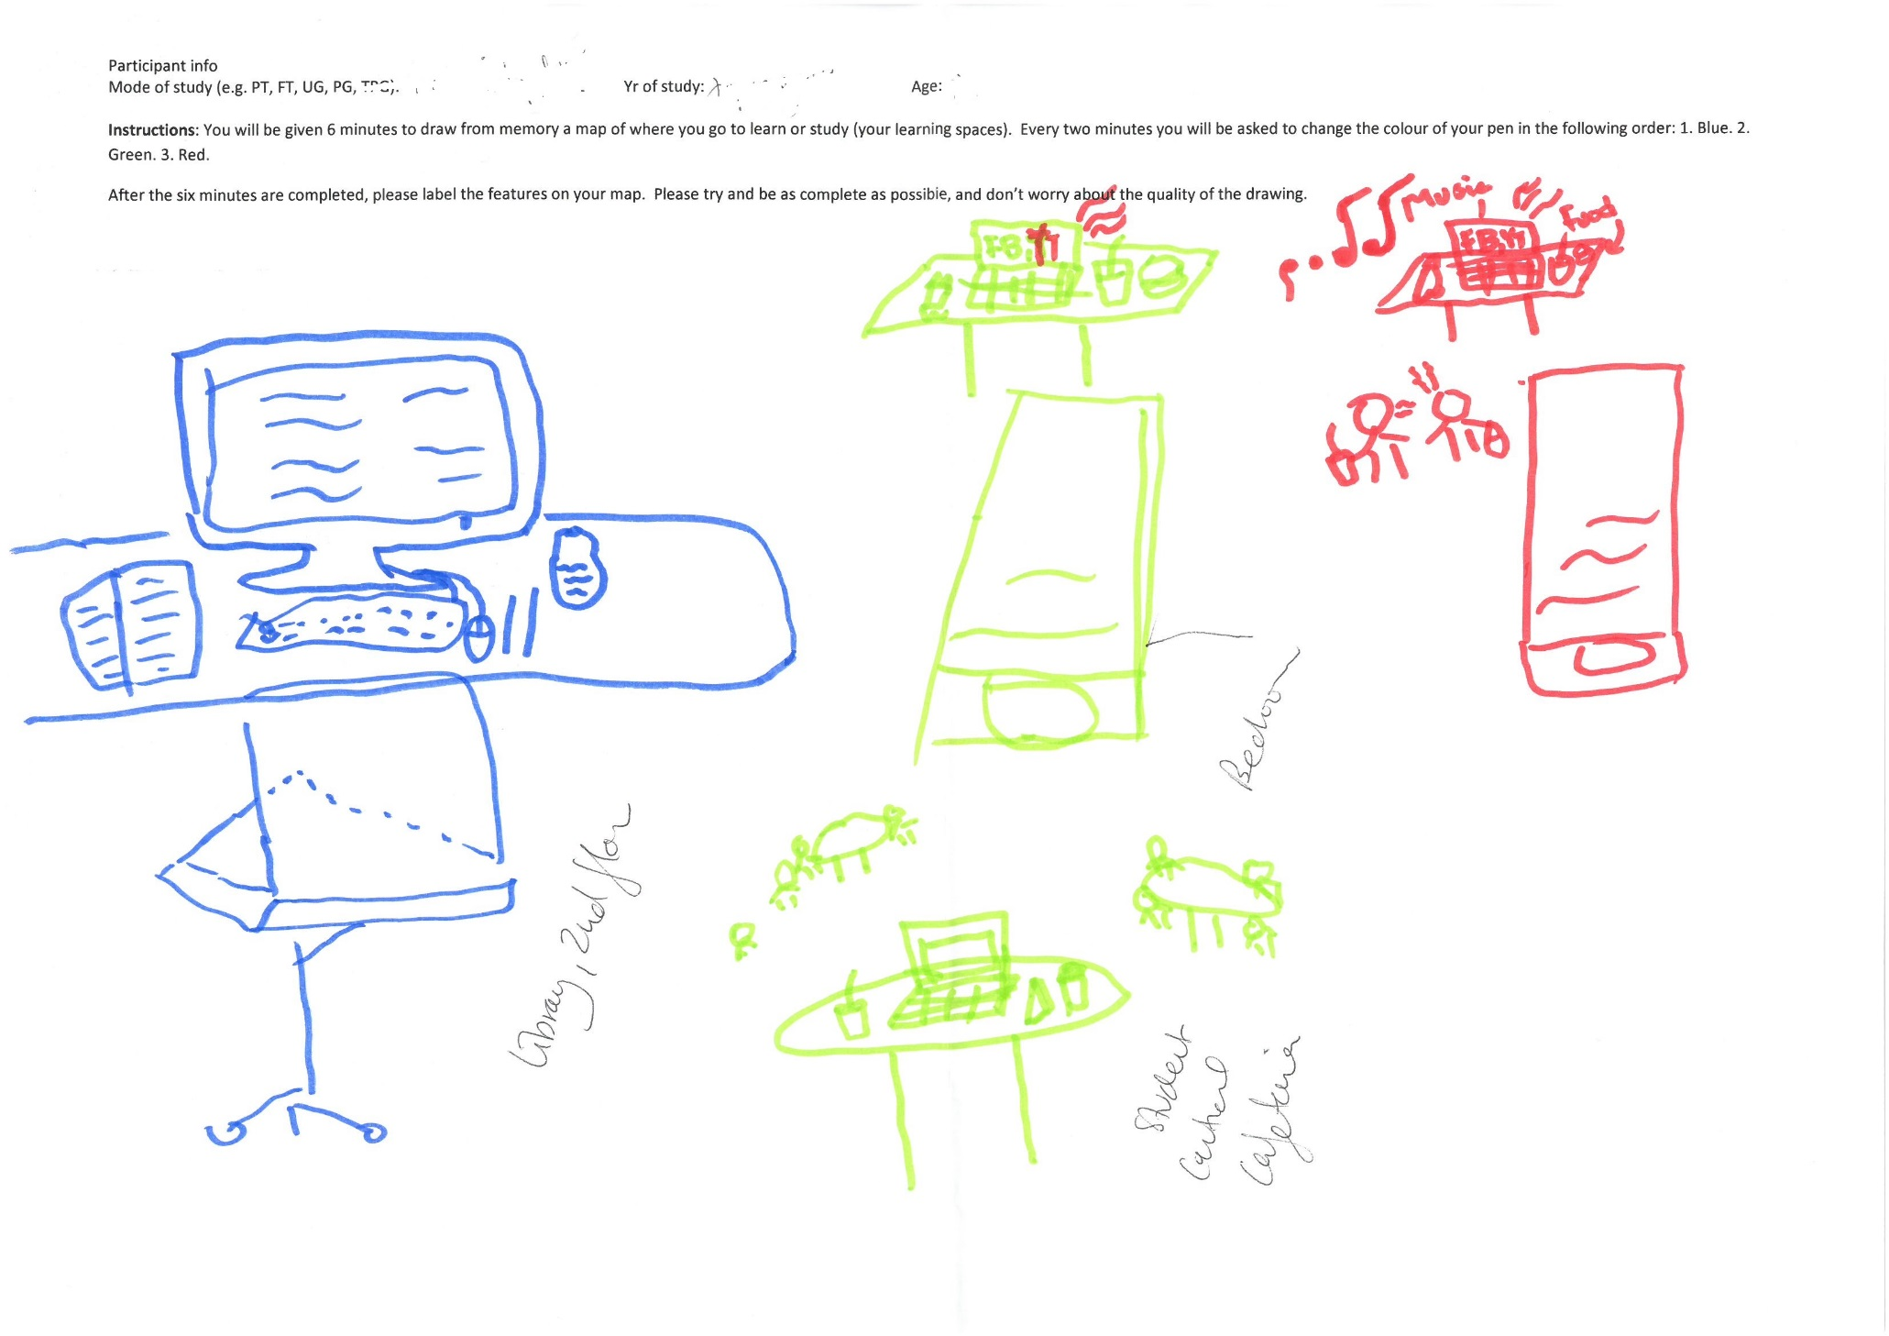
Notes:
For anyone who doesn’t know what a cognitive map is, this is a good example from the data we collected. Participants are asked to answer a research question, in this case to draw a map of where they go to study, but the map can be anything from a drawing like this, to a list or spider diagram. They were given 6 minutes, and 3 different coloured pens, changing the colour of the pen every two minutes. The idea is that the items you see drawn first in the map are either the most important/frequently accessed or the foremost in their mind when they think of their learning space. Once they had finished drawing, they were asked to label up each element and talk about it. We had prompts to encourage discussion on elements like what was included or missed out, and why, group work and whether that ever featured, and what would be different to working in their home country, if anything.
This student talked about how she would visit a specific PC lab because of the screen size they had available, saying they didn’t like places to be too quiet when she studied, and that the PC lab she preferred had just the right level of background noise she wanted. They would sometimes get distracted by FB, but given the PCs have no audio that helped minimise distractions! The middle section is their bedroom, with a table with their laptop on it – they get sleepy when studying so being near a bed is useful, but their room also provides a LOT of distractions. The bottom of the middle section is Student Central, the SU building at Huddersfield, again featuring a table with their laptop on it. They like going there because of the music and background noise, and because they can eat and drink, but sometimes they move to the library. Lastly the section on the right is their friend’s room, where they might meet to study, but often just chat and listen to music.

Slide 6
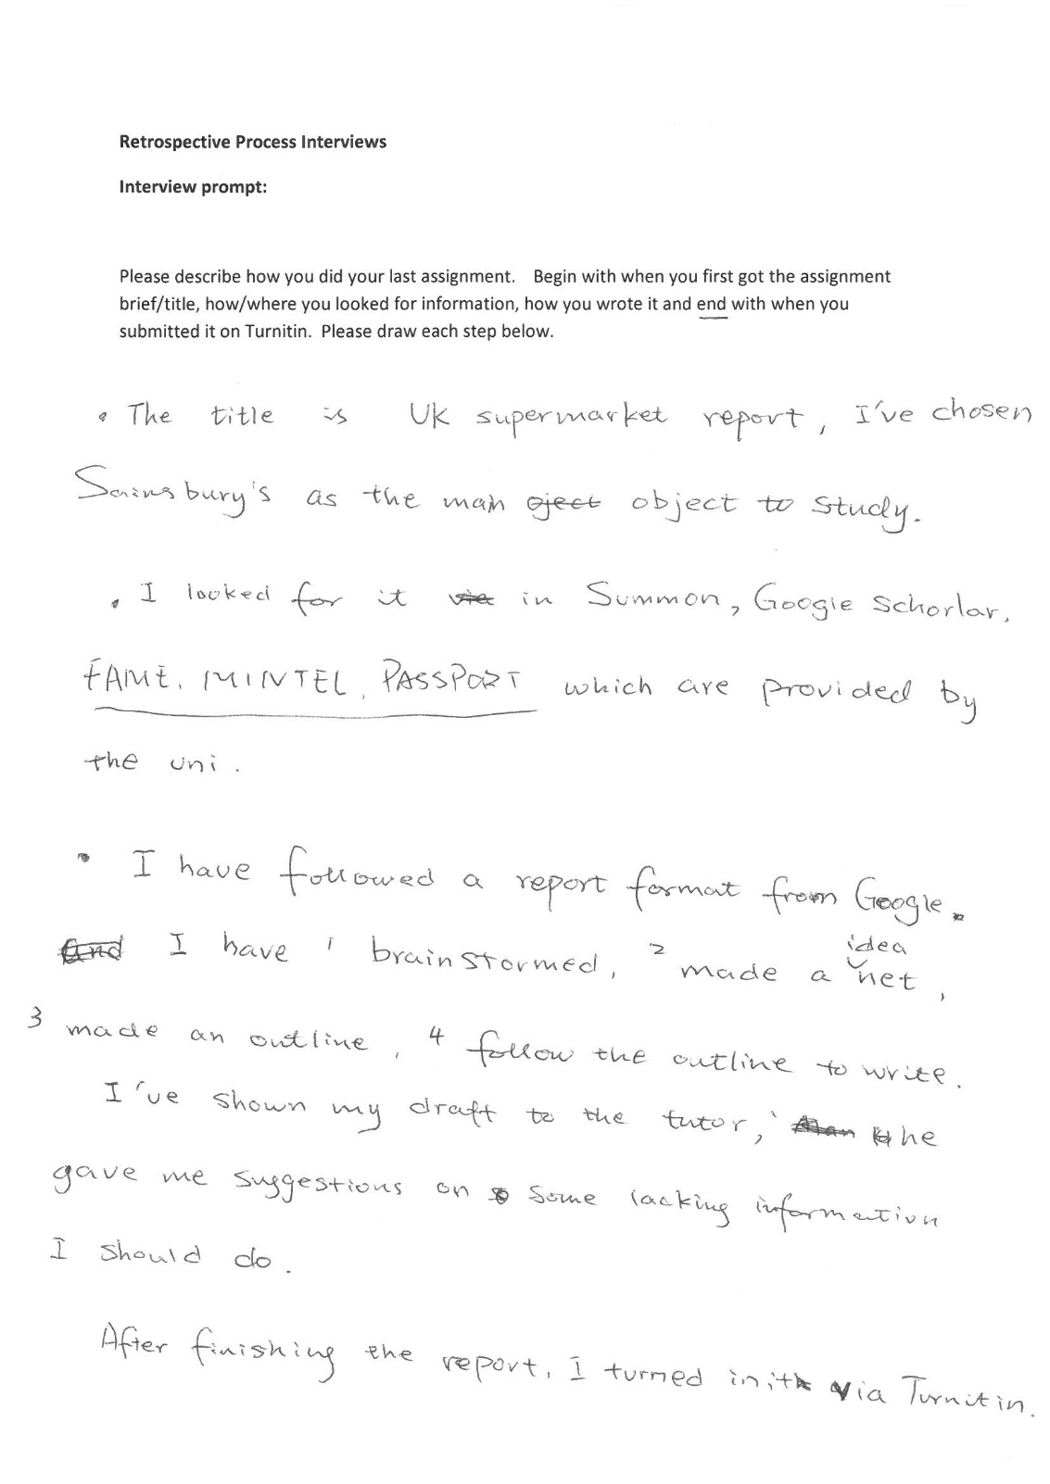
Notes:
Retrospective process interviews are similar. This is an example of one by the same student who completed the map on the last slide. Participants are encouraged to draw, list or describe how they undertook their last assignment, from the moment it was issued to the point it was submitted for marking, talking about the process as they complete it. Participants were encouraged to submit anything and that there was no right or wrong answer. As they completed it, they were asked about resources they might use, reading lists, the number of references, satisfaction with marks, and also where they would get help if they needed it.
This interview provided extra information that wasn’t included in the mapping exercise. The talked about how the assignment format was different in the UK to their home country, and so they spoke to a tutor about their assignment ideas. The tutor said the report was too descriptive and provided advice on how to improve it, but the student had difficulty understanding the advice. They also said they didn’t know about databases and got most information from their tutor, but also that they knew about the subject guides the library provide, which is where the databases are listed…

Slide 7
Results
Main points so far:
Librarians do what? But don’t need them because…
…tutors! But tutors don’t have time.
Peer support important if staff not .
Students don’t have time either.
Libraries/librarians make it more difficult.
Information about access isn’t clear
Students understand information sources are important.
Notes:
We are still analysing data in more detail, but the initial analysis shows the following:

Slide 8
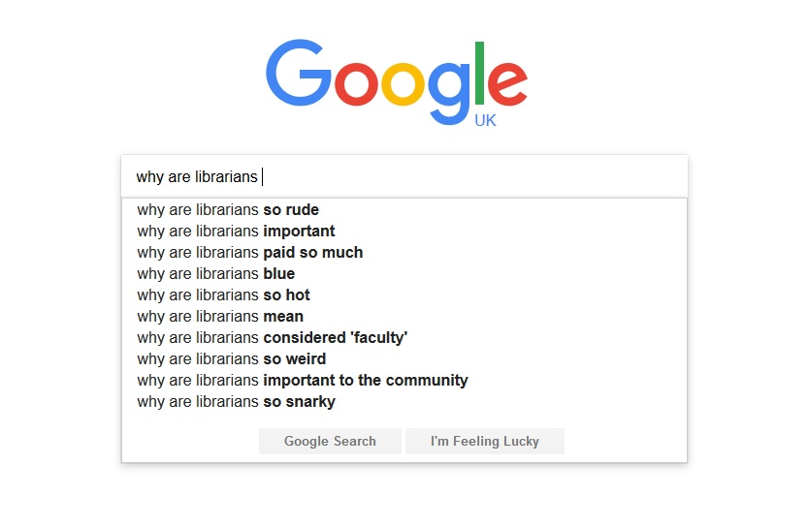
Results – librarians? Who what now?
Notes:
Students don’t know what librarians can do to help them

Slide 9

Results – nobody has any time!
“Time” by John Finn licenced under CC BY-NC-ND 2.0
Notes:
However, students would often refer to their tutors for support
Which was problematic because they only have limited availability to support students. Students find this frustrating.
Peer support is preferred by students who do not use librarian and tutor support systems, and visa versa (is this because of lack of awareness?)

Slide 10
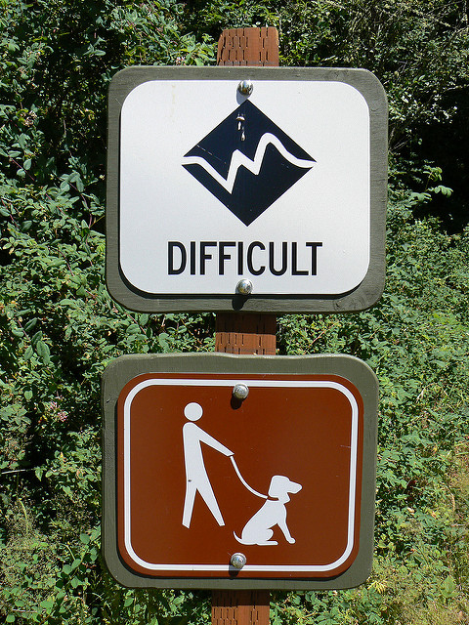
Results – Library =
“Difficult” by sea turtle licenced under CC BY-NC-ND 2.0
Notes:
Students struggle with the transition to UK education in spite of all the early instruction provided, which makes meeting deadlines harder, but they do still talk a lot about how helpful the support they have is.
Students don’t have an understanding of how to use our systems, and struggle with DDC.

Slide 11
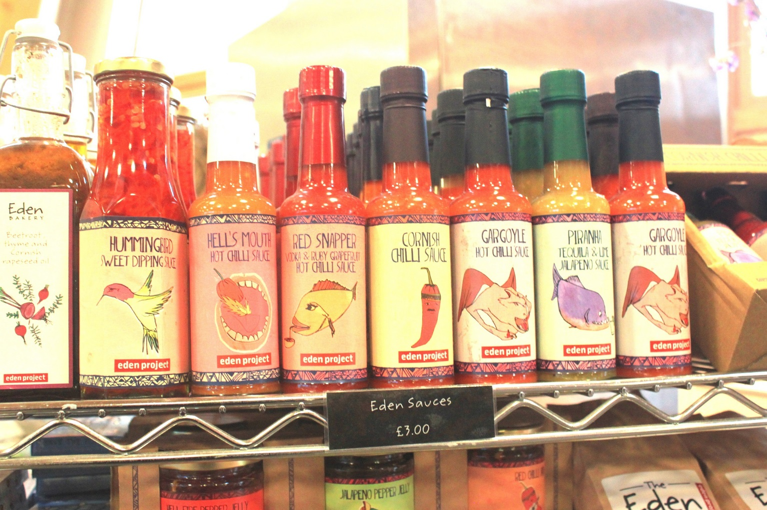
Results – source selection important
“sauces” by Jennifer C. licenced under CC BY 2.0

Slide 12

Results – unclear information
“Unclear warnining” by Sampo Pihlainen licenced under CC BY-NC 2.0
Notes:
They also don’t realise they don’t have to pay for access to articles when a site asks them to, plus our information on requesting articles from other libraries isn’t clear/obvious enough

Slide 13
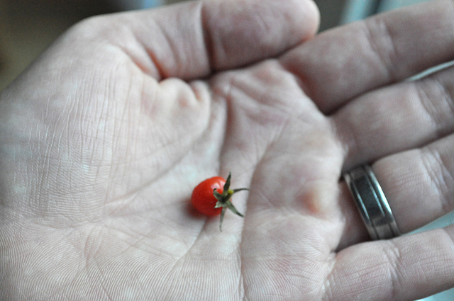
Problems
Small sample!
Difficulty recruiting participants
Applicable to ALL students?
“smallest” by Pleuntje licence by CC BY-SA 2.0
Notes:
The sample was VERY small! 8 students out of the 372 who responded to the survey. The data can’t be considered truly representative of all international students.
The small sample is a perfect example of the difficulty we had getting participants. Sometimes they would say they were interested and not turn up, Sometimes they misunderstood what they were being asked and thought it was a class!
Also, is the data unique to international students, or can it be applied to home students too?

Slide 14
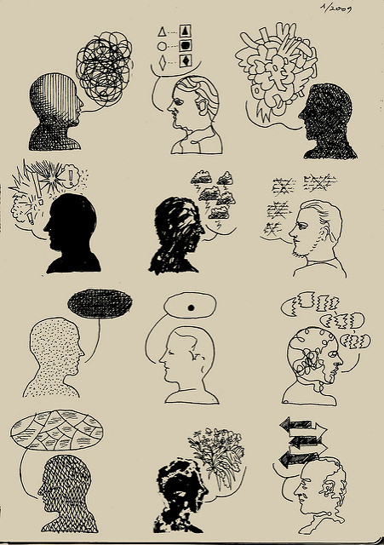
Positives
The mapping technique can help with communication
Small sample does NOT mean not informative
“12 ways of talking” by Joan M. Mas licenced by CC BY-NC 2.0
Notes:
The method was designed for students to adapt their responses to the most appropriate communication style for them, so if they felt it easier to draw or mind map or anything else they could. What they produced was then used to help create discussion where possible, so those not yet confident in verbal/conversational English could articulate themselves in more visual ways, or write it down to help clarify what they meant.
And while the sample was small, it was also quite interesting to see patterns emerging that could possibly be reflected in larger samples. Obviously we can’t say for sure, but what we can see in the data are things we can fix or improve on that would benefit more than those we spoke with.

Slide 15
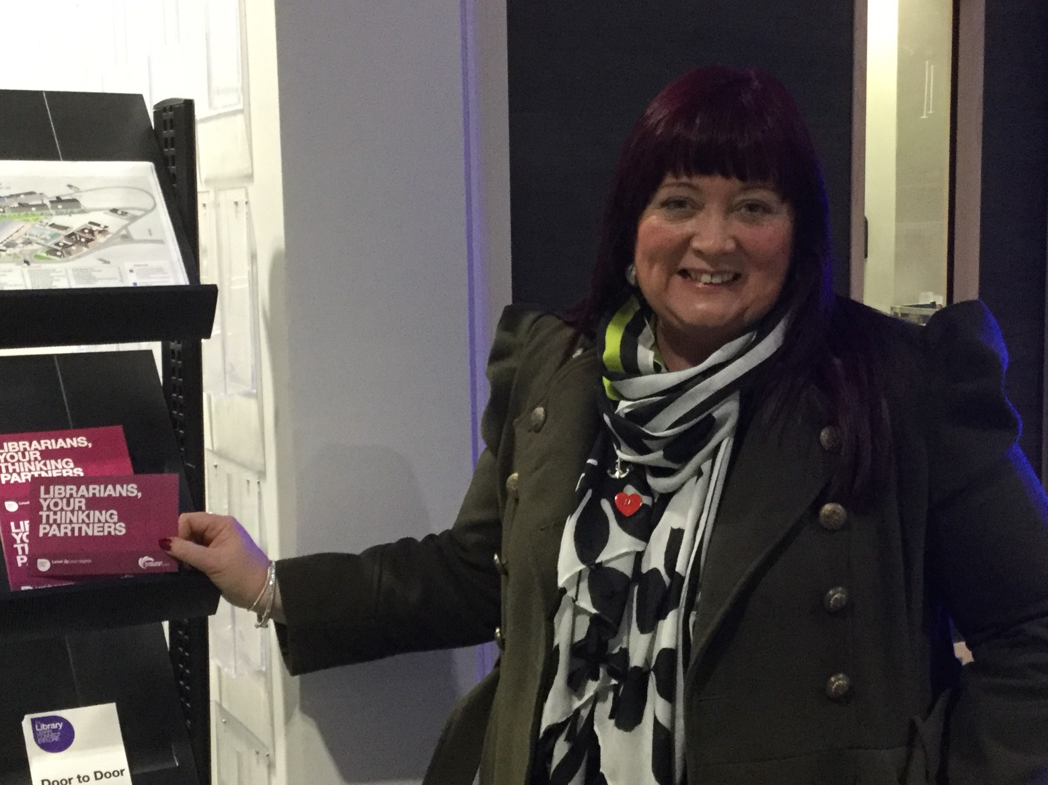
Actions - Meet Michelle ☺
Notes:
Meet Michelle ☺ She’s not an international student, but she provided feedback on her reference to librarians after achieving a first class degree. She told us that librarians were her thinking partners

Slide 16
Actions
Notes:
So we used that comment to help develop an outreach programme

Slide 17

Actions
Notes:
We created some postcards to distribute to staff to use as a referral option for students who could be struggling. We copied the style from some postcards created for student services that have proved very popular, and used it to create more awareness about what librarians are for.

Slide 18
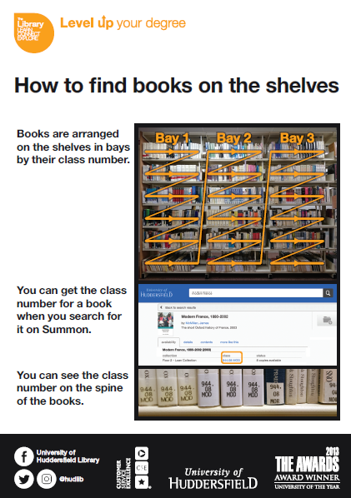
Actions
Notes:
We’ve improved our signage about how to find books, and are creating a video guide to explain how to do so too.

Slide 19
Actions
Increased liaison with Schools with high international population to problem solve
Video training on wayfinding/Dewey linked to within reading lists
More research!
  Home students for comparison
  Research specifically with Schools that don’t use library resources at all i.e. Computing and Engineering
Work on improving ourselves and our services.

Slide 20
Useful links
Library Impact Data Project
https://library.hud.ac.uk/blogs/lidp/
ERIAL Project (used cognitive maps and retrospective interviews)
http://www.erialproject.org/
Donna Lanclos’ work with cognitive maps
http://www.donnalanclos.com/?tag=cognitive-maps

