Slide 1
The NESTLED Project
Steve Prescott
Senior Lecturer (Adult Nursing)
University of Huddersfield

Slide 2
Objectives for this session
Provide an overview of the NESTLED project
  Initial discussions
  Literature review
  Funding
  Methodology
  Evaluations
  Outcomes
  The future

Slide 3

It all started with a cup of coffee
Notes:
It all started with a cup of coffee…..
At all interesting conferences interesting people meet and the coffee breaks seem to play an important role in this matter.
Our collaboration started at a conference held at Metropolia University of applied sciences in 20?? where some people from different parts of the world met over a cup of coffee and found out that they shared the same interest in simulation based learning and more specifically the need of education of educators undertaking simulation based learning.
Month later the same people set up a skype meeting and more people were invited in to join the group.
At this meeting we decided to start up an international research collaboration.

Slide 4
The first step
A literature review with the purpose of defining competences needed for educators when using simulation-based learning.
Notes:
This review revealed a lack in knowledge regarding educators needed competences and preparation for planning and using simlation based learning. It also revealed a pattern of competences needed to efficiently carying out the practice of simulation based learning

Slide 5
What do we know about educator competences?
Literature Review:
Knowledge competencies
Skills and behavioural competencies
Comportment and qualities
Notes:
Comportment in contrast to the more commonly used term attitudes. Comportment in the context of this review was deemed to more precisely describe the attributes and qualities demonstrable by an
educator orchestrating SBL. Whereas attitudes failed to fully capture the dimensions of professional demeanour that emerged from this review. The term comportment has been claimed by Benner et al.
(2009) and in this context describes those attitudinal attributes that the “effective” SBL educator adopts to present themselves. This may be unconscious but provides modelling of professional values and
knowledge that emerges through facilitation and demonstrates ethical and professional demeanour in pedagogical practice.

Slide 6
Precursor Competencies for Delivering Simulated Learning in Nursing Programs. (Topping et al., (2015)

Slide 8
What is NESTLED?
Nurse Educator Simulation-Based Learning Development
NESTLED project was a development and research project within the EU programme; Leonardo – Transfer of Innovation. The project started September 2013 and finished in February 2016.
The aim was to develop and transfer an existing program into other contexts.

Slide 9
Main Partners
VIA College, Aarhus and Randers, Denmark
University of Huddersfield, UK
Metropolia University, Helsinki, Finland
Laerdal Medical, Stavanger, Norway

Slide 10
Other key partners
The project also included Tallinn Health Care College, Estonia

Slide 11

Members with different skills and competencies
Notes:
The collaboration consist of people with different skills and competences – from highly skilled and experienced researchers, more junior researchers to academics with hands on using simulation based learning in health care education.
This diversity contributes to solid research with solid roots in the educational practice.

Slide 12

How to make an International collaboration work?

Slide 13
Methodology: Design-based research
The design-based research approach is well suited for research of learning environments
It offers a systematic and flexible approach and is used to improve teaching practices by analyzing, designing, developing and evaluating them
It aims to develop, test and implement innovative practices to improve teaching and learning
(Barab and Squire, 2004; Wang and Hannafin, 2005)

Slide 14
Phases of development
2. Analysis of current training
3. Prototype
4. Piloting prototype training
5. Analysis, reporting,
refining model
1. Systematic literature review
Cycle

Slide 15
NESTLED Evaluation

Slide 16
Evaluation
The Kirkpatrick model
First created by Donald Kirkpatrick in 1954 as the subject of his PhD dissertation
Published in 1959 in US Training and Development Journal
Updated in 1975 and 1994
Four levels
(Kirkpatrick & Kirkpatrick, 2006; Kirkpatrick Partners, 2014)

Slide 17
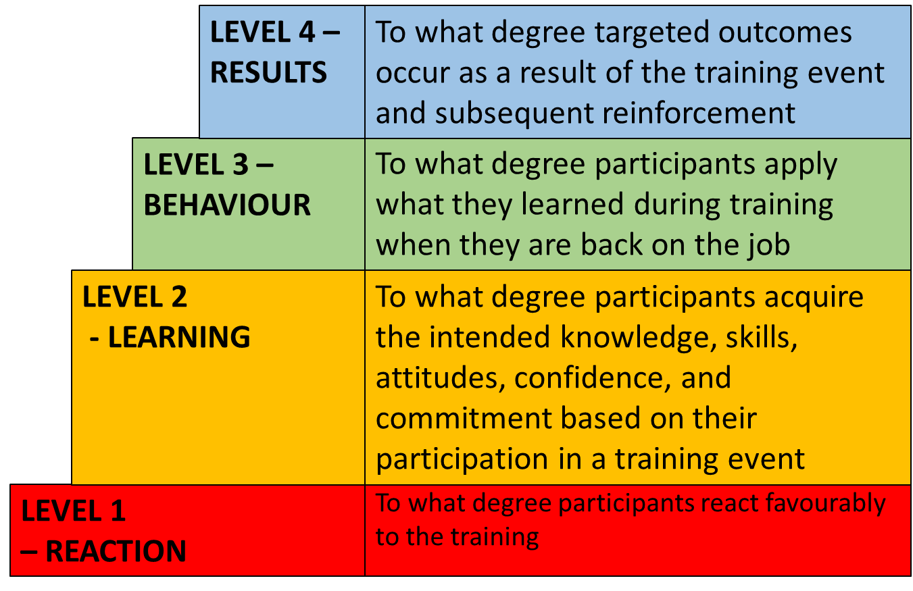
The Kirkpatrick model
Adapted from Kirkpatrick & Kirkpatrick, 2006)

Slide 18
NESTLED
Level 1 (Reaction)
  Post course questionnaire (Student)
Level 2 (Learning)
  Pre and post course questionnaire (Student)
  Focus group (Student)
Level 3 (Behaviour)
  Post course questionnaire (Student)
  Post course questionnaire (Organisation)
Level 4 (Results)
  Post course questionnaire (Student)
  Post course questionnaire (Organisation)

Slide 19
Questionnaires
Likert Scale with some free text responses
Completed in English or native language (free text sections)
Pre Course Questionnaire:
  Emailed out to all participants along with PIS two to three days before the course. Opportunity was given at the start of the course for those who had not completed the questionnaire to do so
Post Course Questionnaire:
  Emailed out four weeks post course
  May be ‘aspirational’ rather than ‘actual’
Pre and Post Questionnaires ‘paired’:
  Unique ID
Organisation Questionnaire
Questionnaires returned to Evaluation lead

Slide 20
Focus Group
Final session of the course
Native language if required and translated locally
Video recorded
Sent to Evaluation Lead for transcription

Slide 21
Ethics and Consent
Application for ethical approval for the evaluation was obtained in line with the institutional requirements of each partner
The evaluation was led by the University of Huddersfield, and the detailed study protocol and data collection instruments were approved by the School of Human and Health Sciences ‘School Research and Ethics Panel’ at the University
Study governance, data management and storage was (and continues) in line with partner institutional protocols related to data protection and integrity

Slide 22
Testing the prototype
Denmark (August 2014)
  Four day course (consecutive days)
  Eleven participants, lecturers or senior lecturers
  Three members of the NESTLED project team facilitated the program along with two technicians from Laerdal Medical

Slide 23
Evaluation
Eight participants completed the pre-course and ten the post-course questionnaires
Data on ‘paired’ eight considered
No responses from organisational questionnaire
To aid analysis, the questions on the questionnaire were divided into three categories:
  Preparing for the simulation-based learning event
  Delivering the simulation-based learning event
  Feedback and evaluation of the simulation-based learning event

Slide 24
Cronbach α scores
 | Category | Cronbach α scores
Pre Course Questionnaire | 1 | 0.795
 | 2 | 0.849
 | 3 | 0.712
Post Course Questionnaire | 1 | 0.743
 | 2 | 0.907
 | 3 | 0.807

Slide 25
Data analysis
Due to the aim and scope of the pilot study, and the limited data available, data analysis was confined to a comparison between the mean of all responses from participants in the pre and post course questionnaires using Wilcoxon Signed Range Test
This analysis showed a significant increase in confidence demonstrated across all 21 questions and across all eight respondents (ρ = .025)

Slide 26
Category | ρ value
1 | 0.012
2 | 0.035
3 | 0.260
Wilcoxon Signed Range Test scores related to the ‘increased confidence’ amongst the participants in each category of questions.

Slide 27
Focus Group data
Generally a positive review of the course
“I really enjoyed that you combined theoretical knowledge and practical simulation in a very competent way. I didn’t sleep at all prior to the simulation.”
“I enjoyed it very much and I had a large learning outcome from this that I can use. We have talked a lot about skills which is interesting, but I think I could use some more time to take it all in but that’s how it is, but more days with this could have been nice.”

Slide 28
What did they learn?
“…I am much more aware of how scrupulous I need to be when designing the scenarios. We must help each other to get the time we need to undertake these things. Also in my mind you cannot do this on your own. You need to be in a dialogue with other people who have the same understanding.”
“I have always been thinking about simulation to perform as a patient is also high fidelity without all this technology. It makes me feel good that you can make good simulation without technology.”

Slide 29
Interestingly…
“I have learned a lot from the debriefing. You need to consider a lot of things I have been reading the text that the students should read. The way you put in, you formulate your questions is so important - you can do it this way, you can do it that way. I will be more aware of both the dynamics of the group. Also of who has been the responsible nurse and talk about that role. These are certain things that I will now be more aware of in the debrief.”

Slide 30
But…
“Could you build more tools into the course for the teachers so you get familiar using them to help me to understand, so it becomes a part of us when we do the debriefing, as we are a little bit insecure sometimes when I watched it on the video? How do we guide students through debriefing so we only do the 25% talking and they do the 75%, because I feel it is the other way round?”

Slide 31
Other suggested areas for improvement
“I would suggest that team dynamics should be addressed on this course. It’s not a criticism but a constructive way.”

Slide 32
Testing the Module
Finland (January – April 2015)
  Five day course spread over several weeks
    Two assignments in between:
      Planning, delivering and evaluating SBL in participants’ own organization
      Embedding SBL into the curriculum in participants’ own organization
  Fifteen participants: Twelve lecturers or senior lecturers, two nurses, one emergency service manager
  Three members of the NESTLED project team facilitated the program

Slide 33
Testing the Module
Tallinn (April – September 2015)
  Five day course spread over several weeks
    Two assignments in between:
      Planning, delivering and evaluating SBL in participants’ own organization
      Embedding SBL into the curriculum in participants’ own organization
  Eight participants: lecturers or senior lecturers
  Two members of the NESTLED project team facilitated the program

Slide 34
Data analysis
Very low response rates for questionnaires
  Finland 1 candidate; Estonia 3 candidates completed both pre- and post-course questionnaires
No responses from organisational questionnaires
Not possible to extract any valid/reliable conclusions from the limited data
Focus groups – undergoing thematic analysis

Slide 35
Early emerging themes
An appreciation for the learning theories as applied to SBL
An appreciation of the ‘scope’ of simulation
Preparing the SBL Event
  Time
  Link with learning outcomes
  Preparation of the students
Debriefing
  New techniques learnt and practiced
Barriers
  Technology
  Time available in simulation suite
  Group sizes
  Time to develop simulation and scenarios
Networking
Notes:
Experiential learning
Communities of practice, legitimate peripheral participation, Social Learning theory (Lave & Wegner)

Slide 37
Adopted definition of simulation
“A dynamic process involving the creation of a hypothetical opportunity that incorporates an authentic representation of reality, facilitates active student engagement and integrates the complexities of practical and theoretical learning with opportunity for repetition, feedback, evaluation and reflection.”
(Bland, Topping and Wood, 2011, p.668)

Slide 38
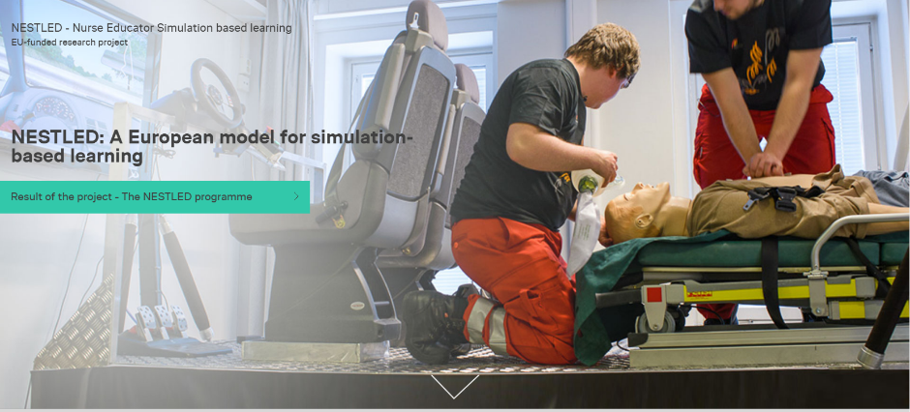
Please check out our website
(www.nestled.eu)

Slide 40
The future…
Laerdal Medical
  The NESTLED program
  Accreditation
Publications
Future collaboration

Slide 41
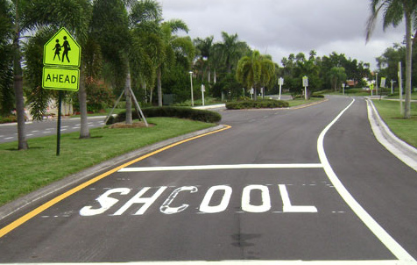
Thank you for listening
Who has got the first question?

Slide 42
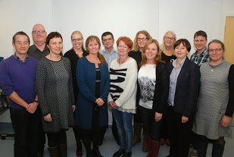

Slide 43
References
Barab, S. & Squire, K. (2004). ‘Introduction: Design-based research: Putting a Stake in the Ground. The Journal of the Learning Sciences, 13(1), pp.1-14. Retrieved from <http://www.jstor.org/stable/1466930>
Bland, A.J., Topping, A. & Wood, B. (2011). ‘A concept analysis of simulation as a learning strategy in the education of undergraduate nursing student’. Nurse Education Today, 31, 664-670 doi:10.1016/j.nedt.2010.10.013
Kirkpatrick, D.L. & Kirkpatrick J.L. (2006). Evaluating training programs (3rd ed.). San Francisco: CA. Berrett-Koehler Publishers, Inc.
Kirkpatrick Partners (2014). ‘The Kirkpatrick Methodology. Retrieved from http://www.kirkpatrickpartners.com/OurPhilosophy/tabid/66/Default.aspx

Slide 44
Topping, A., Bøje, R.B., Rekola, L., Hartvigsen, T., Prescott, S., Bland, A., Hope, A., Haho, P., Hannula, L. (2015). Towards identifying nurse educator competencies required for simulation-based learning: A systemised rapid review and synthesis. Nurse Education Today, 35(11), pp.1108–1113. doi:10.1016/j.nedt.2015.06.003
Wang, F. & Hannafin, M.J. (2005). ‘Design-based research and technology-enhanced learning environments. Educational Technology Research and Development, 53(4), pp.5-23. doi:10.1007/BF02504682

