Slide 1
Keeping The Momentum Going…
Strategies For Staff Engagement
With Reading Lists
Laura Williams
Reading List & Collection Development Librarian
Alison Sharman
Academic Librarian

Slide 2
Presentation Overview:
MyReading Background & Engagement Problem
Previous Marketing Strategies
Current Strategy - Marketing Group Staff Engagement Plan
Current Strategy - Business School Project
Measuring Success – what has worked?
Challenges – what hasn’t worked?

Slide 3

MyReading: The Background
2008: Library received reading lists for only 40% of modules
Many lists contained out of date or inaccurate information
Manual processes for reading list management were laborious and outdated
A systematic, automated approach was required

Slide 4
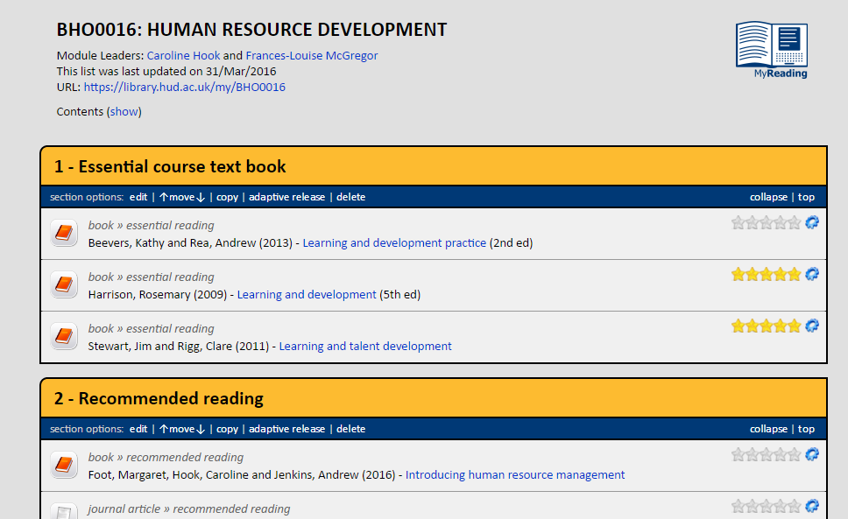
MyReading, an in-house system

Slide 5
Strategies to engage staff
Getting the academics on board…

Slide 6
Focus groups
On-line survey
Academic Consultation
Academics on steering group
Voting on project blog

Slide 7

Biggest driver
Biggest Driver
The then Pro-Vice Chancellor (Teaching and Learning)
http://bit.ly/1Sr6U9D
Notes:
Used his position to send emails to all staff with empty lists and enforce them to use the system.

Slide 8
THE EARLY
MARKETING
PLOYS

Slide 9

Early marketing ploys
Notes:
Tried all sorts of marketing ploys to get the lecturers on side

Slide 10
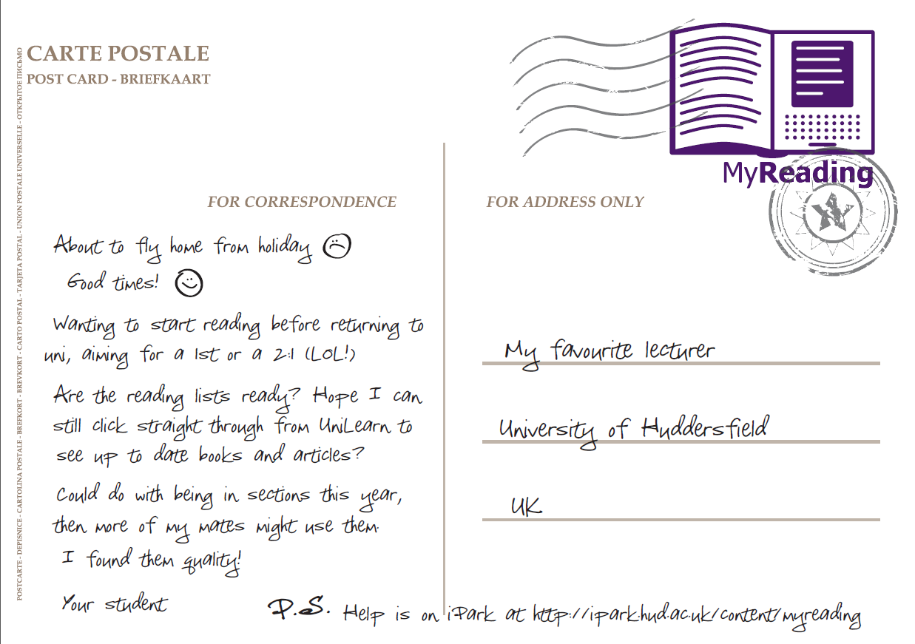

Slide 11
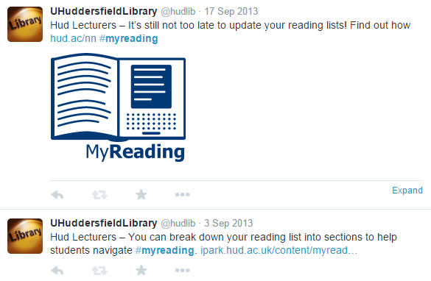
Followed up with #myreading tweets

Slide 12
Student wishlist
Promote them to students
Well structured and annotated
Include more than just books
The right length of the lists
Maintain and update them
Notes:
Compelling evidence is the feedback from students to encourage staff to engage with their reading lists. One library focus group carried out in 2014 and a questionnaire carried out last year that had 772 student responses

Slide 13
“I think that unless you are the reincarnation of Hermione Granger
you are not going to go through and read all those….Lots of students will come here from GCSEs and A levels where they are taught to consume things in a very bite sized manner and this is just like “have everything at once!”
Notes:
This is just one example and has to be my favourite quote that we received from the students

Slide 14
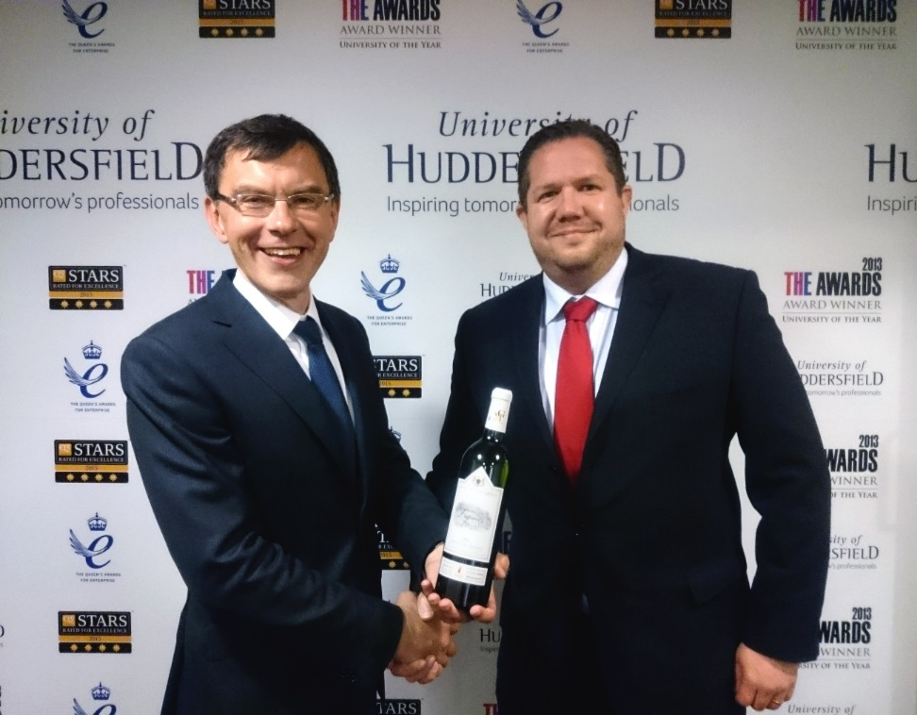
Win a bottle of wine!
Rewarding MyReading champions
Notes:
Arguably the best incentive in persuading staff to engage with their reading list is to offer a prize to the academic with the “best” reading list
Metrics used include:
book loans: a measure of how likely students enrolled on the module are to borrow books
item views: the average number of items on the reading list that students enrolled on the module have looked at
Variety of item types
Last update
Percentage of items with annotations

Slide 15

Notes:
Produced a leaflet for staff. Highlighted the winning reading lists for each School complete with a URL for staff to get inspiration for the design of their lists./

Slide 16
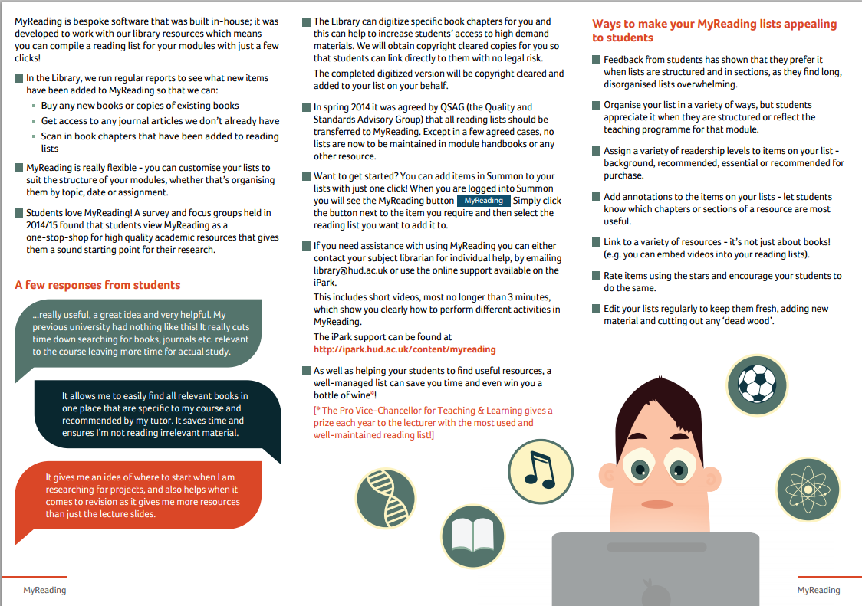
Notes:
Also used the student feedback to show academics how they can make their reading lists more appealing.

Slide 17

Award winning
marketing campaign

Slide 18
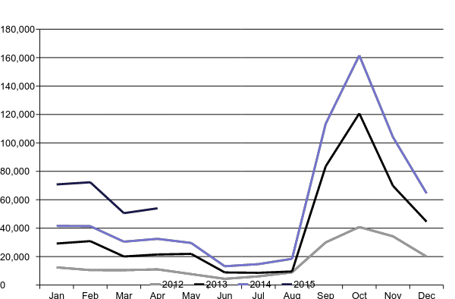
Chart showing MyReading use from
Jan 2012 – April 2015
Notes:
We were able to gather statistics on MyReading usage; we define usage as the number of times a list is accessed and how many times items in the lists are clicked on.

Slide 19
KEEP THE
MOMENTUM
GOING...

Slide 20
DEVELOPING
A STAFF ENGAGEMENT PLAN

Slide 21

MyReading Champions: Getting
the award winners on board

Slide 22

Keep academic staff
involved in developments
Invited two academics to join the MyReading steering group

Slide 23

“Learning Bytes sessions are
a series of informal one-hour lunchtime sessions for all staff – each one will focus on a different pedagogical need and allow for discussion and sharing of best practice alongside short demonstrations”
Notes:
“Learning Bytes sessions are a series of informal one-hour lunchtime sessions for all staff – each one will focus on a different pedagogical need and allow for discussion and sharing of best practice alongside short demonstrations where appropriate.”
informal training sessions – running a reading list Learning Bytes at lunchtime
academic staff on the programme to share knowledge and best practice - value in experiences of people who use the system

Slide 24
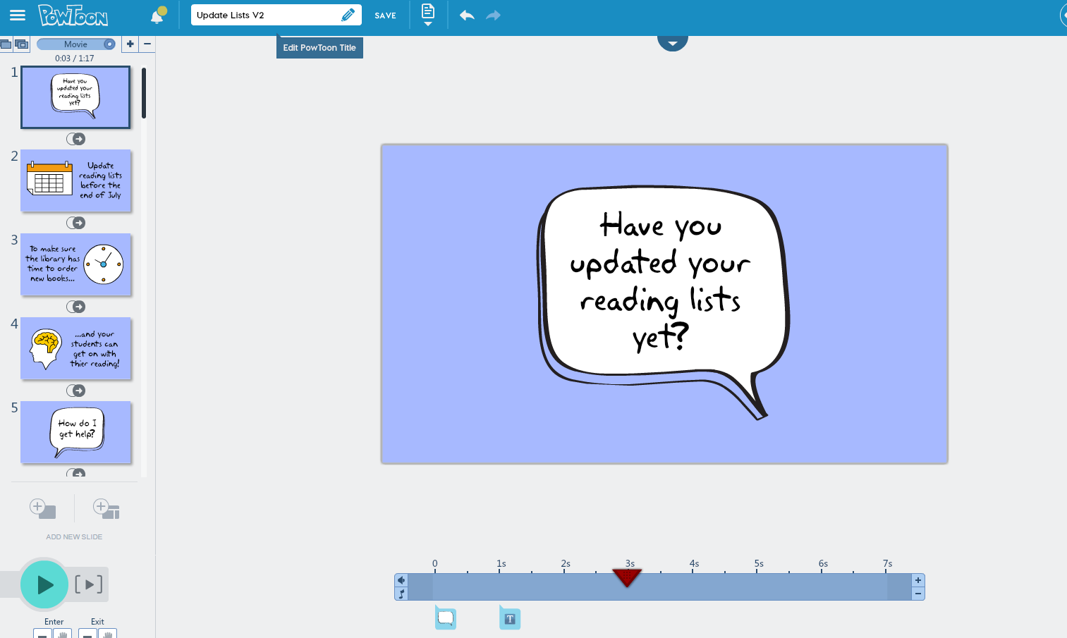
PowToon: New Video Resources
Notes:
Powtoon – using Powtoon animation software create new promotional and training resources.
currently producing a short copyright video to raise awareness of copyright issues

Slide 25
THE BUSINESS SCHOOL READING LIST PROJECT

Slide 26
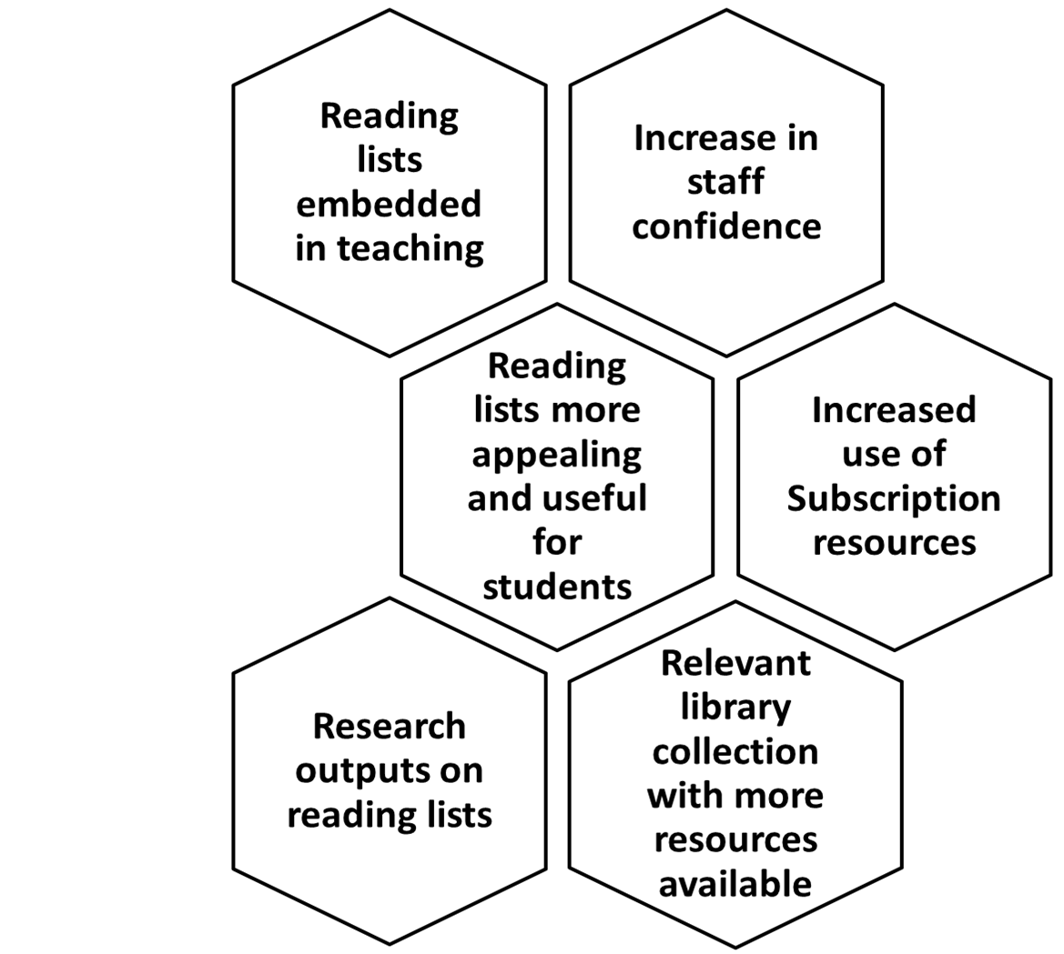
PROJECT
DELIVERABLES

Slide 27

Reading List Audit for Business School Departments
Notes:
reviewing reading lists for each department
contacting staff who haven’t updated lists
for more than 13 months to find out why
often just the reminder helps –
been lots of take up for one to one training

Slide 28
New training workshops
“The session was very useful and my reading list looks much better already!”
Notes:
important opportunity for staff to update their reading lists – training becomes a good use of their time
Remember to seek out other opportunities for training and promoting the system, for example department away days

Slide 29
Promote Yourself With a Postcard

Slide 30
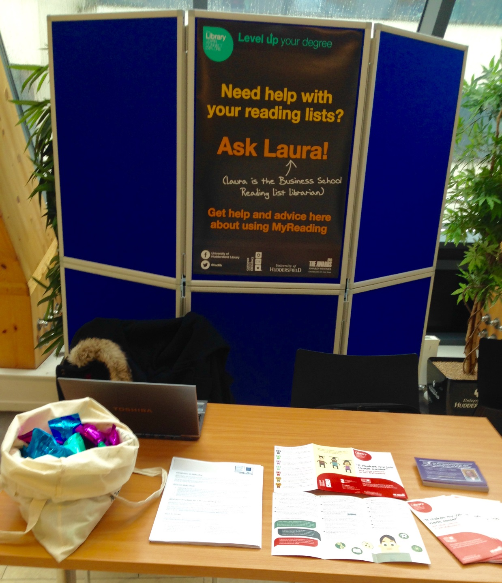
Drop-in sessions
and
roving in
Business School

Slide 31
MEASURING SUCCESS: WHAT HAS WORKED?

Slide 32
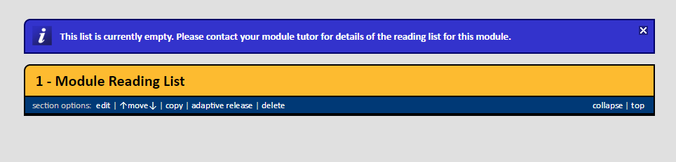
Reduced number of empty reading lists
Now only 6 empty lists for the Business School compared to 25 in October 2015

Slide 33
Monthly usages stats for Business are up compared
to last year. More items added each month.
Usage going up – more items added
each month compared to last year!

Slide 34
CHALLENGES
Getting the timing right
Resources to develop
system
Some people will never engage
Other pressures on academics
Embedding MyReading in teaching
Notes:
Getting the timing right – what works for academics?
Remember reading lists are just one of many things they have to do
Embed it in their teaching –can we change approach to teaching?
Software development – a downside to in-house system is that there are many other demands on Dave

Slide 35
Our Top Tips for Engagement
USE THE STUDENT VOICE
TIMELY REGULAR REMINDERS
CREATE A BIT OF COMPETITION

Slide 36
Slides now available
Slides from this presentation now online at:
http://eprints.hud.ac.uk/27978/

Slide 37
Recent presentations
“What students really think of their reading lists: reading list software at the University of Huddersfield”
http://eprints.hud.ac.uk/26537/
”Take your degree to the next level: marketing MyReading at the University of Huddersfield”
http://eprints.hud.ac.uk/26489/
“Online Reading Lists: Winning Over The Business School”
http://eprints.hud.ac.uk/26646/

Slide 38
Any Questions?

