Slide 1
Help me, data! How library analytics tools can help you in your role
UKSG 2016: Jo Alcock, Jo Lambert, Graham Stone
Photo by e y e / s ee CC -BY

Slide 2
Session overview
Introduction to selected Jisc library analytics tools JUSP & IRUS-UK
Case studies from Aston, Reading & Imperial
University of Huddersfield perspective
Analytics services in development
Q&A

Slide 3
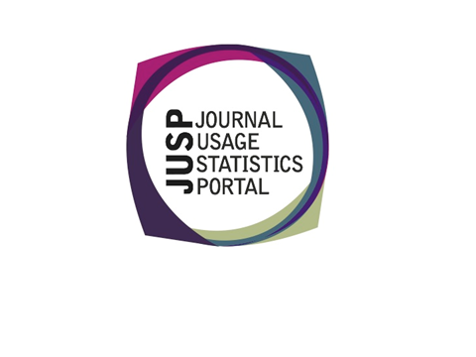
Library analytics tools

Slide 4
Journal Usage Statistics Portal (JUSP)
Supports libraries by providing a single point of access to e-journal usage data
Assists management of e-journals collections to inform evaluation and decision-making processes
Enables usage comparisons and trend analysis

Slide 5
Using JUSP
Making effective use of staff time
Assisting academic departments in understanding resource use
Data for regular reporting and decision making
Informing decisions for substitutions and cancellations
Benchmarking usage
Use cases:http://www.jusp.mimas.ac.uk/use-cases/
Photo by MacEntee CC-BY
Photo by Indigo Skies Photography CC-BY

Slide 6
Institutional Repository Usage Statistics (IRUS-UK)
A national aggregation service, enabling UK IRs to share/expose usage statistics at the individual item level, based on a global standard – COUNTER
Collect raw download data from UK IRs for *all item types* within repositories
Process those raw data into COUNTER-compliant statistics

Slide 7
Using IRUS-UK
Providing standards-based, reliable repository statistics
Reporting to institutional managers & researchers
Analysing trends over time
Benchmarking
Supporting advocacy
http://www.irus.mimas.ac.uk/help/support/
Photo by .craig CC-BY

Slide 8
Case study: Aston University
“Has implementation of a discovery service impacted use of our journals?”
Aston University

Slide 9
Case study: University of Reading
“Which items in our repository are being downloaded?”
University of Reading

Slide 10
Case study: Imperial College London
“How can we increase our internal advocacy for Open Access?”
Imperial College London

Slide 11
Case study: University of Huddersfield
Using JUSP to assess the 2016 Taylor and Francis offer
Using IRUS to benchmark against other Irs
Using JUSP/IRUS to assess GOA use

Slide 12
Using JUSP to assess the 2016 Taylor and Francis offer
December 2015 – faced with a complex upgrade to the Taylor & Francis Journals Collections 2015-2017 agreement
2015 agreement
‘2016 upgrade’ option (with Maney titles)
Subscription to the 2015 FRESH Collection
Special offer to continue Huddersfield’s Bloomsbury Visual Culture Collection

Slide 13
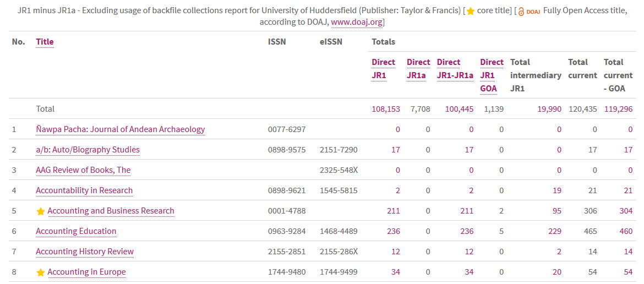
Using JUSP to assess the 2016 Taylor and Francis offer
Used JUSP to obtain usage for
T&F
Maney
Berg (Bloomsbury Collection)
JR1 reports excluding backfile usage and GOA
Allows us to get a truer picture
Core titles pulled across from KB+

Slide 14
Using JUSP to assess the 2016 Taylor and Francis offer
Once we understood the agreement it took less than 1 day to make the various decisions
Estimated value of 2015 vs. 2016 options
‘Worth’ of titles leaving the ‘2016 upgrade’
‘Worth’ of Maney titles in 2016 option
Including adding Maney titles to ‘core’ titles
‘Worth’ of subscription to FRESH collection
Forecast CPU of Bloomsbury collection

Slide 15
Using JUSP to assess the 2016 Taylor and Francis offer
Outcomes
Kept the 2015 collection
Titles staying in the package were more value than Maney
Kept ‘core’ titles to a minimum
Didn’t take the FRESH collection
Usage not good enough for majority of titles
Didn’t continue the Bloomsbury Collection
Forecast over £8 per download
Saved approx. £15K plus ongoing subscriptions

Slide 16
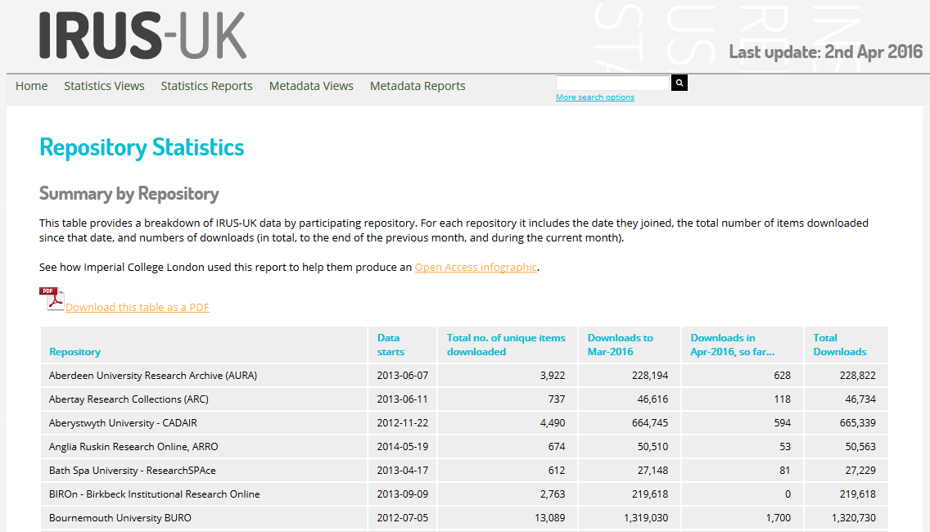
Using IRUS to benchmark
We use a combination of data to tell good news stories in the University
e.g. Northern Collaboration
Repository | Total Downloads
University of Salford | 2,753,805
White Rose | 1,985,270
University of Huddersfield | 1,275,463
Lancaster EPrints | 1,259,103
Manchester eScholar | 1,117,935

Slide 17
Using IRUS to benchmark

Slide 18
Using JUSP/IRUS to assess GOA use
COUNTER 4 statistics allow us to investigating the use of gold open access content within subscriptions.
Two libraries in the U.S. have evaluated the gold open access usage from Elsevier, NPG, Sage, Springer, and Wiley
Emery, Jill and Bobal , Alison. (2015). Gathering the Needles Evaluating the Impact of Gold Open Access Content with Traditional Subscription Journals. Paper presented at the 35th Annual Charleston Conference: Issues in Book and Serial Acquisition, 4-7 November 2015, Charleston, South Carolina. http://works.bepress.com/jill_emery/52/
Paper to be published in Insights in July 2016

Slide 19
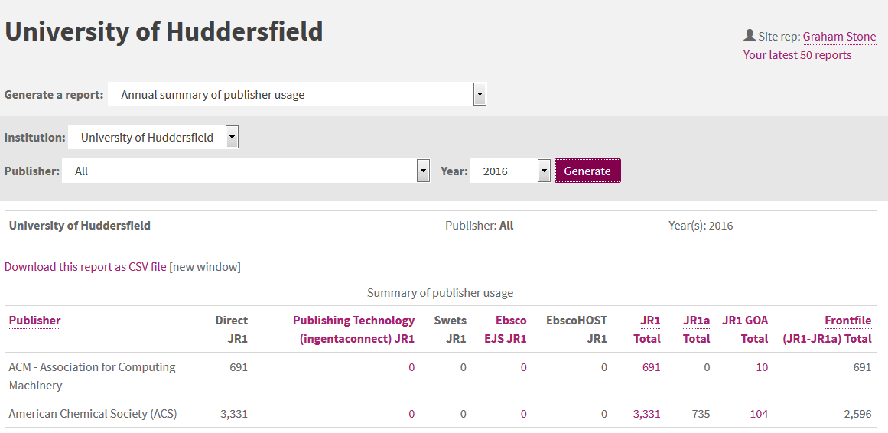
Using JUSP/IRUS to assess GOA use
JUSP gives us a GOA and JR1-JR1A reports
Allows us to work out the % of GOA and compare with any offsetting

Slide 20
Using JUSP/IRUS to assess GOA use
But what if we could use IRUS to find out the green and gold OA to add the JUSP GOA report?
Would give us a truer picture
Would access via the publisher website be more than the Repository?
Does this give us an idea of how successful our Repositories are?

Slide 21
Using JUSP/IRUS to assess GOA use
But what if we could do this at a national level?
An OA article could be at several repositories
Could IRUS give us this information?
It could give us a picture of use and much more?
Do GOA articles get accessed more in Repositories or at publisher pages?
What does this tell us about the success of either?
Of use to both libraries AND publishers

Slide 22
I want data to…..
“benchmark cost & volume of APCs last year for my institution with a comparable organisation”
“understand proportion of green/gold publications to model future APC costs”
“identify collection strengths and manage special collections”
“benchmark performance of my institution with a comparable institution”
“support decision making around research data storage resourcing, and to ensure compliance with funder mandates”
“report to RCUK & COAF in a designated report format”

Slide 23
Analytics services in development
Copac Collection Management (CCM)
Jisc Monitor (from Aug 16)
Monitor UK
Monitor Local
Business intelligence shared service for UK HEI
IRUSdataUK
Photo by Glas CC-BY

Slide 24
URLs
JUSP
IRUS-UK
CCM
Jisc Monitor
IRUSdataUK
Business intelligence SS
http://jusp.mimas.ac.uk
http://www.irus.mimas.ac.uk
https://ccm.copac.jisc.ac.uk
https://www.jisc.ac.uk/rd/projects/monitoring-open-access-activity
http://www.jusp.mimas.ac.uk/irusdata/
https://www.jisc.ac.uk/rd/projects/business-intelligence-project

Slide 25
Q&A
Do you recognise the scenarios described?
What additional questions do you have?
What would you like to be able to do with the data that is not currently possible?

