Slide 1

Pods and Pads: The is...
Kathryn Hobson
Customer Support Manager
18th June 2014

Slide 2
Strategic background
New space and new service
What do I bring?
Challenges
The Future

Slide 3
Strategic Background - 2007
New Vice Chancellor
New strategy map
Improving the student experience
Student Centre created at library entrance floor (accessible student support services in a single location)

Slide 4
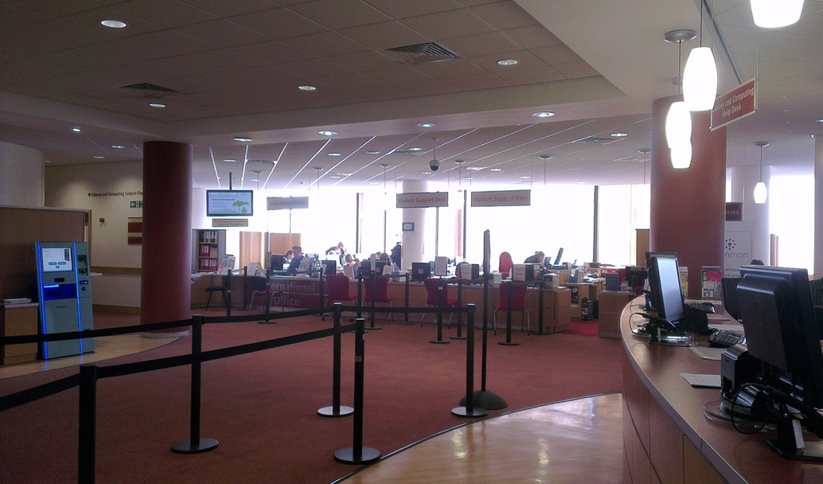
Student Centre - 2007

Slide 5
Strategic Background - 2011
Increasing importance of the student experience
Desire for continuous improvement amongst the services
Planned construction of a new “Learning and Leisure Centre”
2-phased project:
- Phase 1: To pilot a new collaborative approach to service delivery within the Student Centre
- Phase 2: To use the lessons learnt to create a new student support service in the new Learning and Leisure Centre

Slide 6

Strategic Background – Project Conclusions
Positive aspects:
One central service point received favourably by students
Supported pre-pilot proposition that 70%+ of enquiries were routine and could be dealt with by generalists
Evidenced demand for services during off-peak opening hours

Slide 7

Strategic Background – Project Conclusions
Challenging aspects:
‘Management by committee’ not sustainable
Staffing model not sustainable
Staff resistance and lack of customer focus

Slide 8




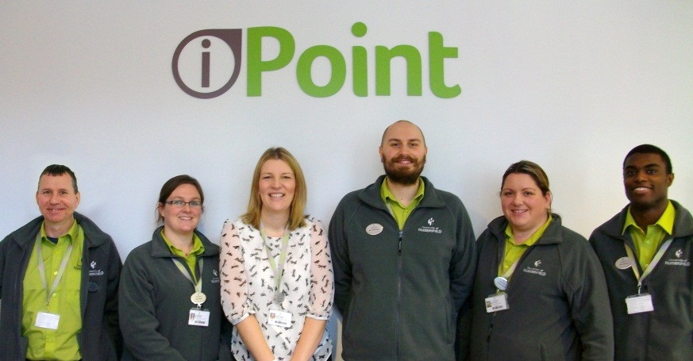


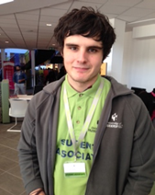


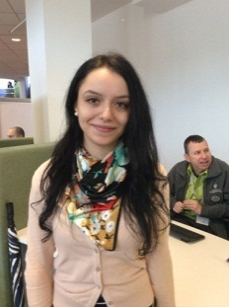


New Staff

Slide 9
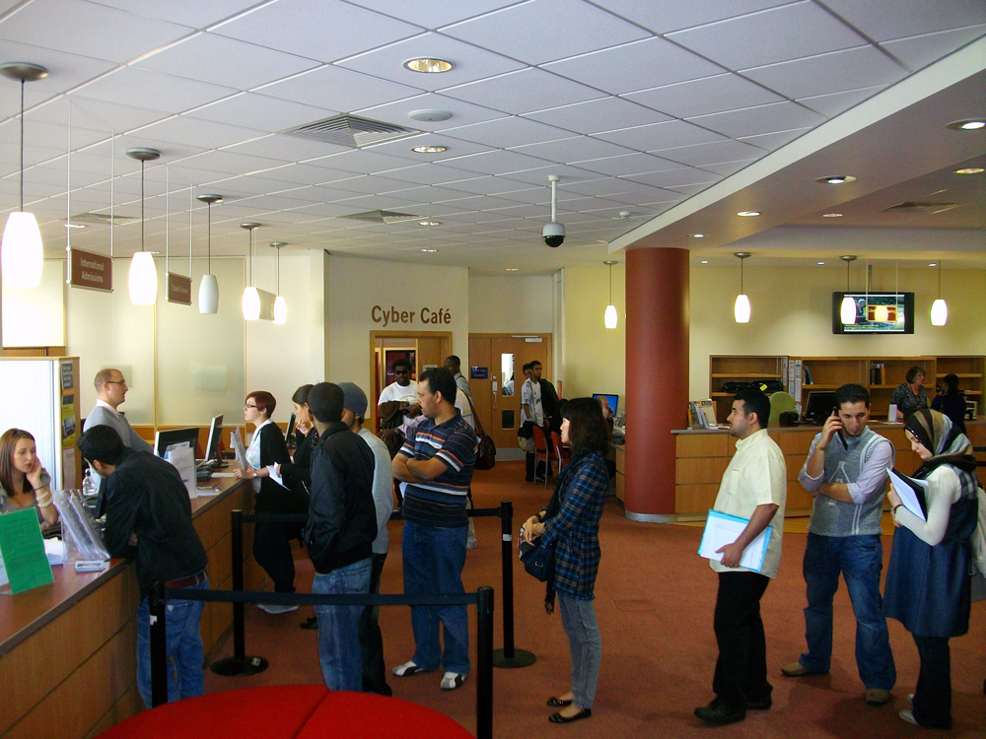
From this in 2011...

Slide 10
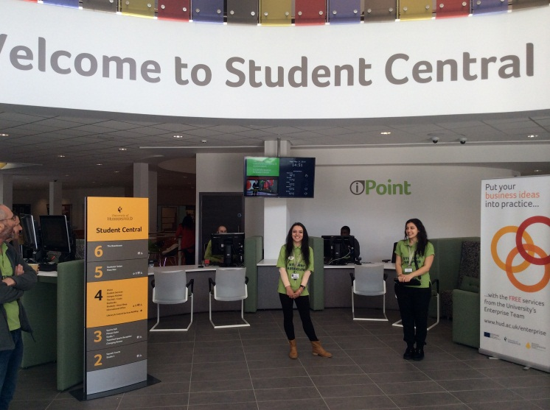
To this in 2014...

Slide 11
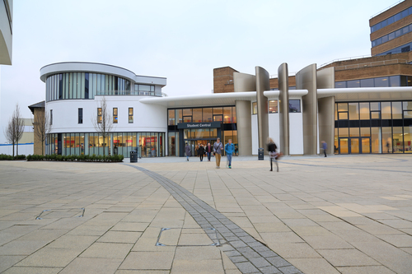

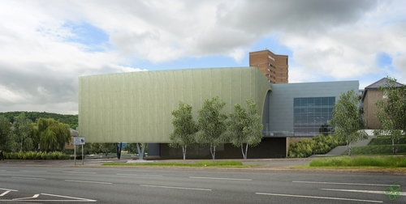
New Space

Slide 12
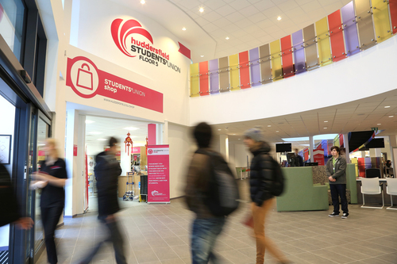
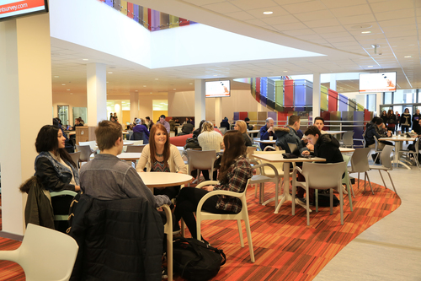
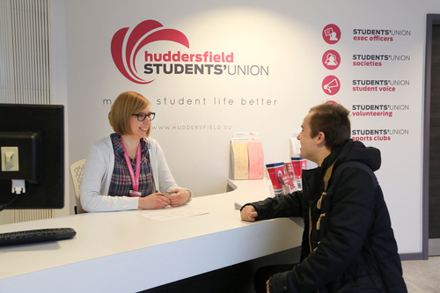

New Space

Slide 13
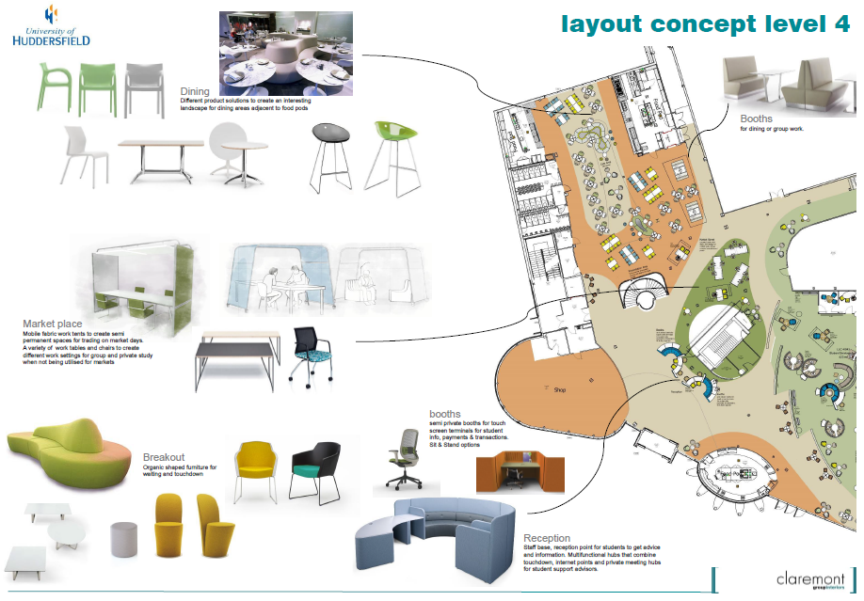
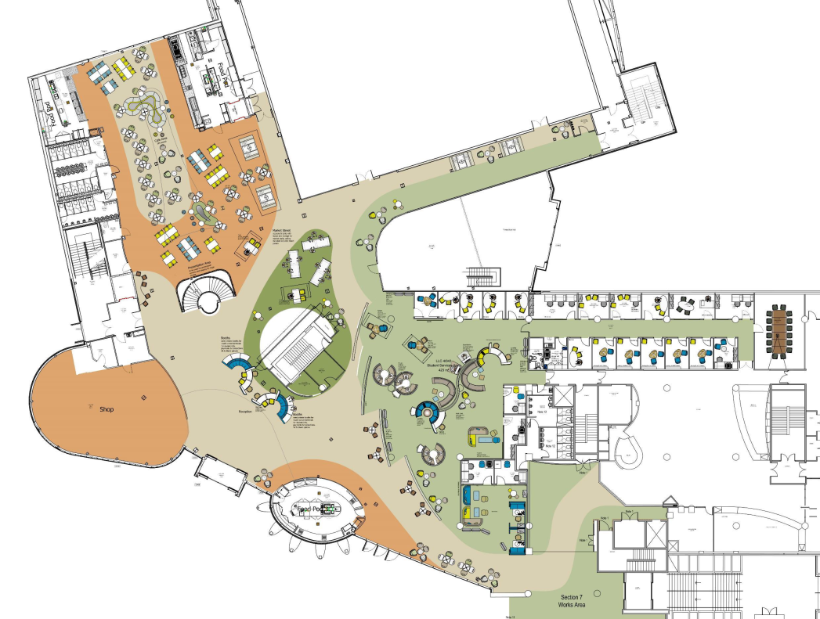
New Space – Professional Services

Slide 14
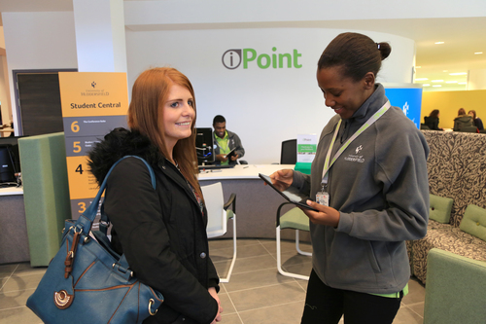
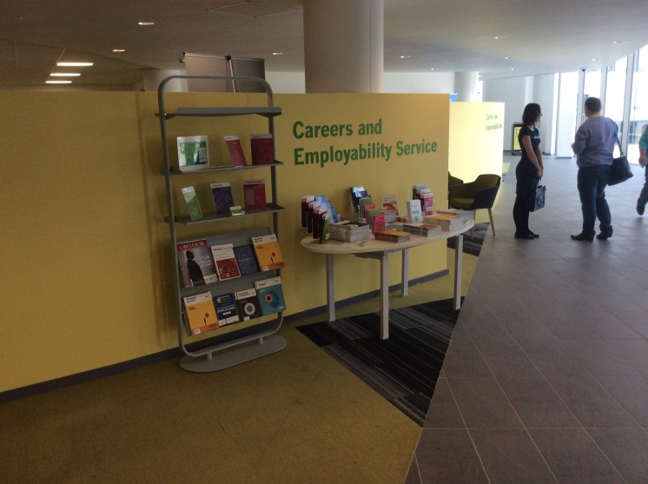
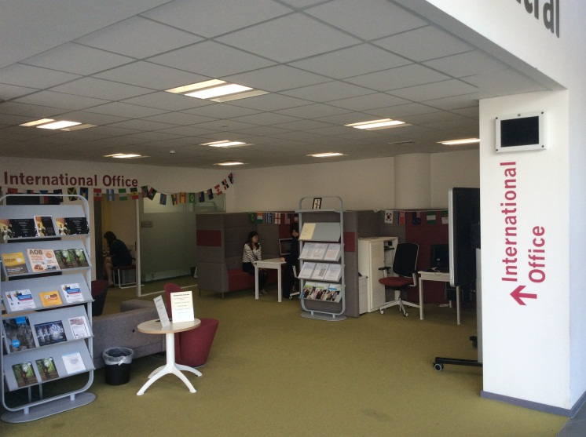
New Space – Professional Services

Slide 15
New Space
Student Central Video Clip

Slide 16
New Services – Service Portfolio
First-line student support
Reception for Student Central
iGuide

Slide 17
New Services – Service Portfolio
First-line student support
“Broad but shallow knowledge”
Initial partners – Admissions and Records Office, Student Finance Office, International Office, Careers and Employability, Wellbeing and Disability, Registry
Subsequent partners – Schools and Colleges Liaison Service, Conferencing, Vice Chancellor’s Office, International Marketing, University Reception, Research and Enterprise, Police Liaison, Academic Schools

Slide 18

Service Delivery Model - Before
Admissions and Records Office
Registry
International Office
Wellbeing and Disability
Careers and Employability
Student Finance Office

Slide 19


New Service Delivery Model
Admissions and Records
Registry
International Office
Wellbeing and Disability
Careers and Employability
Student Finance Office

Slide 20
New Services – Service Delivery
Strong customer service ethic
Customer base
The place to go if you don’t know where to go!
Extended opening hours
Approachable
Peer-to-peer support
Reactive and proactive

Slide 21





New Services – What Our Customers Say
Friendly and helpful people
Undergraduate student
Fast, polite,
Efficient
Undergraduate student
Instant assistance, really friendly
Undergraduate student
Conference delegates mentioned how nice it was to be guided by such warm and friendly staff
Head of Careers and Employability Service
...this has made a great positive difference to our applicants and their parents
Schools and Colleges Liaison Service

Slide 22
What Do I Bring?
Strong customer service ethic
Private sector experience/business ethos
Fresh perspective
Neutral standpoint

Slide 23
Challenges
Personal challenges:
- Cultural differences
- Authenticity and establishing myself
Wider challenges:
- Devolved structure
- Challenges associated with working with others
- Services are owned by others
- Vast and varied customer base
- Promotion of the service

Slide 24
The Future
“To inspire our students to enjoy an outstanding University experience” (Strategy map 2013 – 2018)
Service delivery channels
Self-service
Roving support
Enquiry management
Further collaborative working

Slide 25


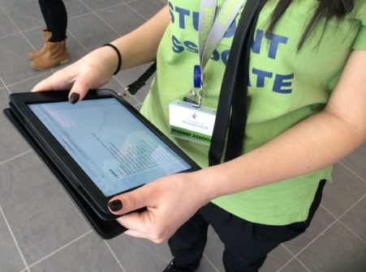
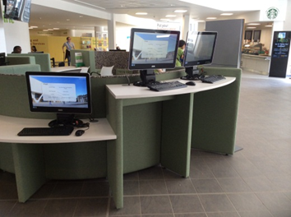
Pods and Pads: The iPoint is...
“...pods and pads, not computers and counters...”

Slide 26

Any Questions?

