Slide 1
Psychogeography, anti-psychologies and the question of social change
Alex Bridger
University of Huddersfield

Slide 2
Psychology
Reading minds?
Brains and lab studies
Causality – attitudes, behaviour & context
Political analysis?

Slide 3
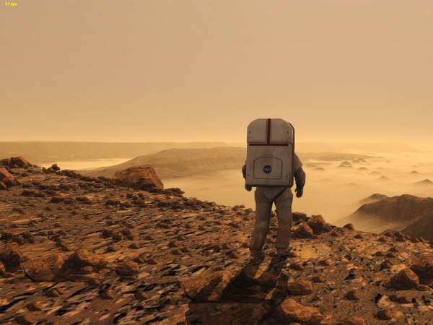
Revolutionary psychology?
Psychology, anti-psychologies and post- Marxist psychology!
Working in and against the discipline
For a politics of space and place

Slide 4
Psychogeographical psychology
Cause and effect
Unconscious processes
Scientific control vs play
‘Mobile’ research methods

Slide 5
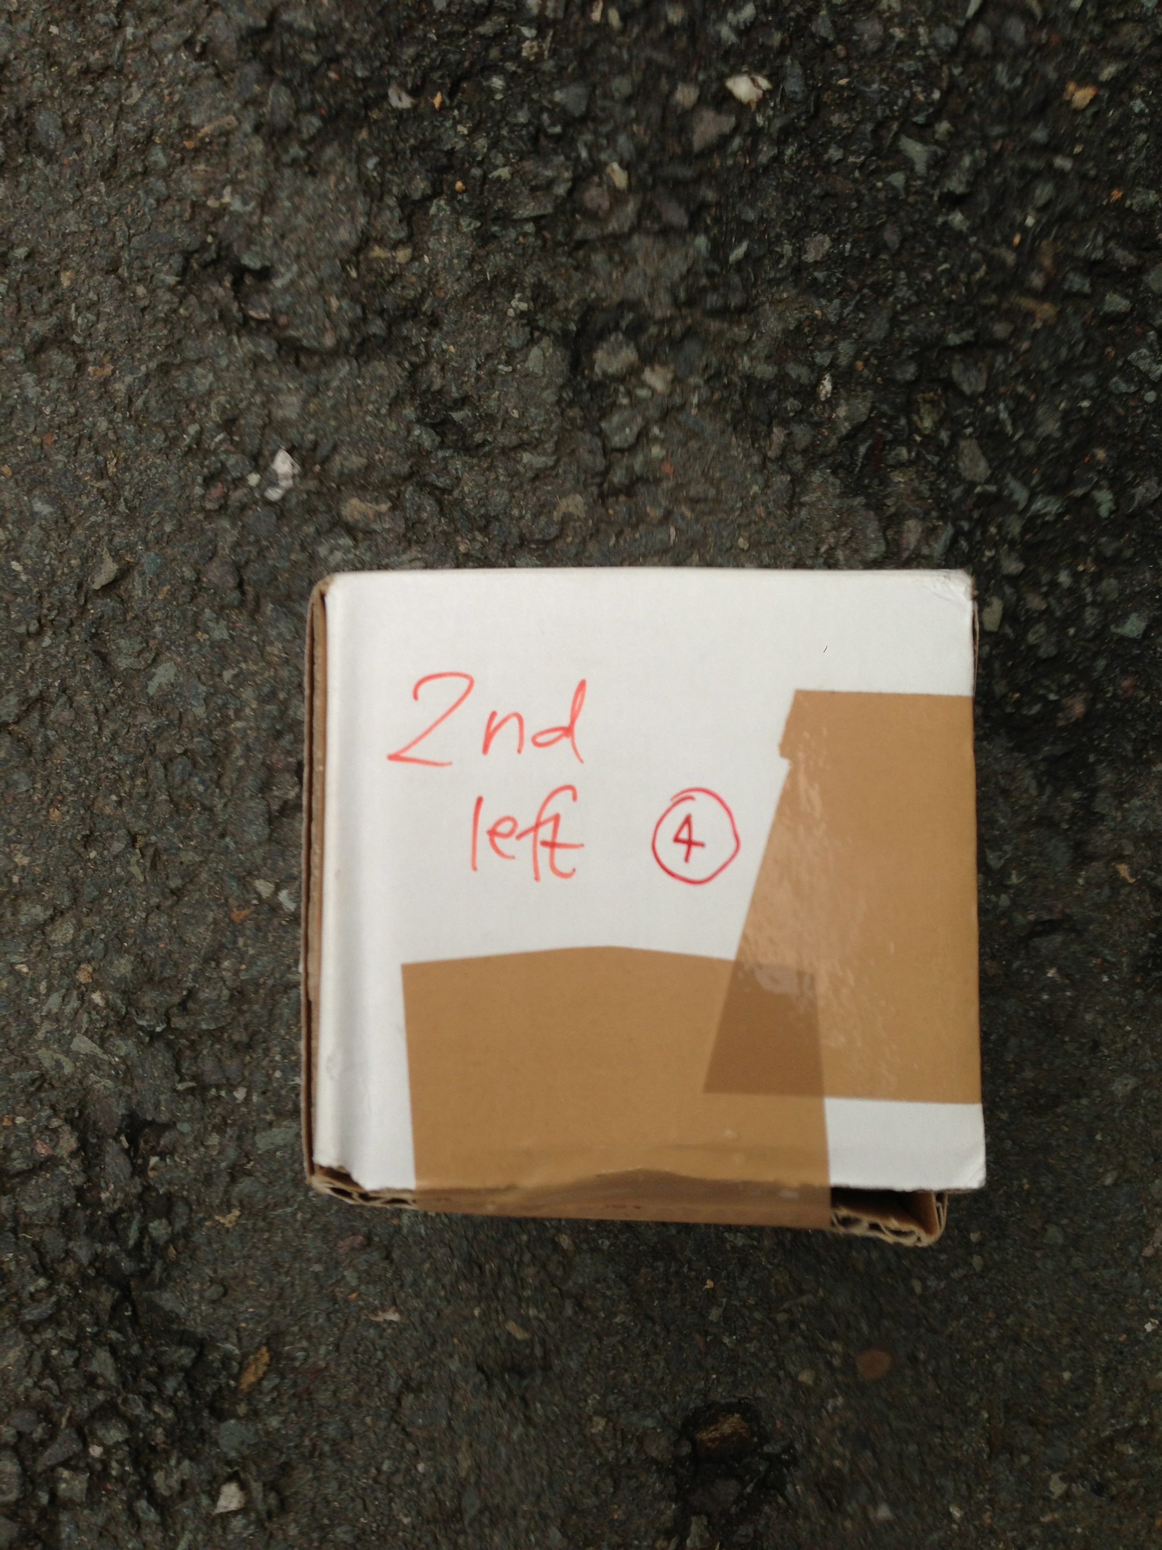
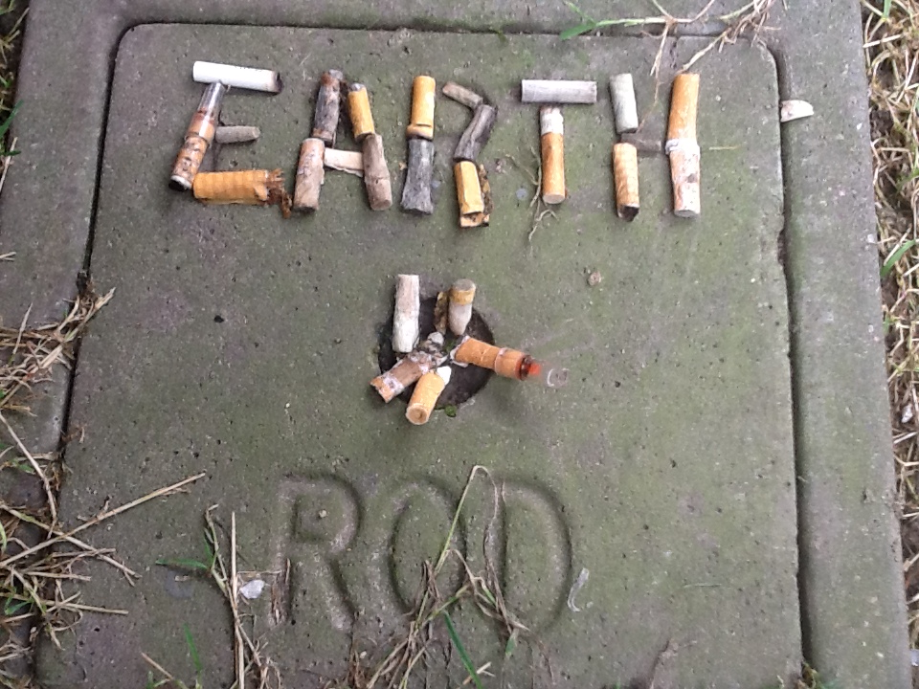
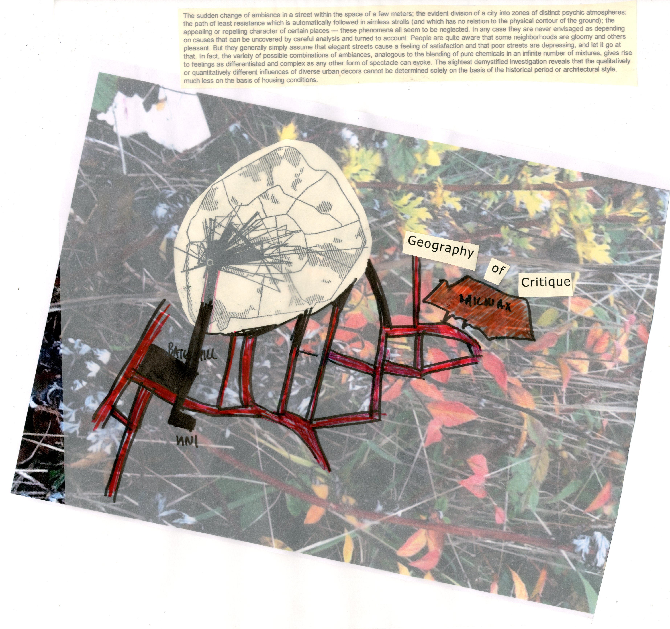
Individual and group work
Dice walks, ‘war’ gaming, map swaps, site specific, scavenging hunts
Individual and group work

Slide 6
New psychogeography

