Slide 1
Online Reading Lists: Winning Over The Business School
Alison Sharman
Laura Williams
2015

Slide 2
MyReading The background
2008: Library received reading lists for only 40% of modules
Many lists contained out of date or inaccurate information
Manual processes for reading list management were laborious and outdated
A systematic, automated approach was required

Slide 3
MyReading, an in-house system
Developed in-house & is fully integrated with Uni systems
To ensure the provision of reading lists is a managed, positive experience for staff and students
MyReading launched summer 2011
Academics create and maintain their own lists

Slide 4
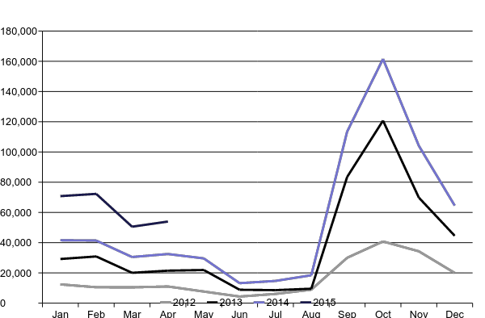
Chart showing MyReading use from Jan 2012 – April 2015
Notes:
We were able to gather statistics on MyReading usage; we define usage as the number of times a list is accessed and how many times items in the lists are clicked on.

Slide 5
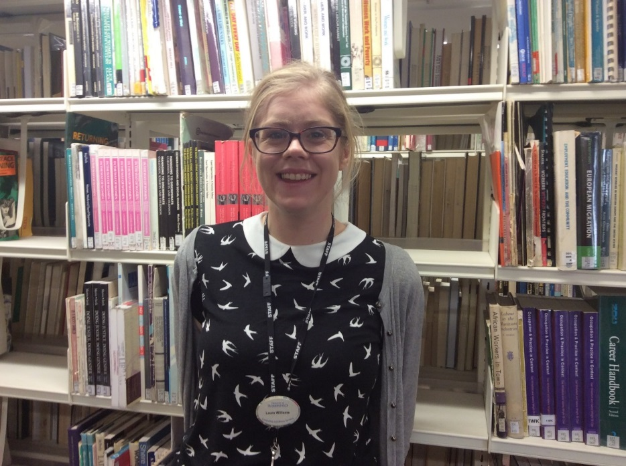
New Business School Post
Reading List and Collection Development Librarian in post
Funded by the Business School
Started with Economics as a pilot, will then roll out to other subjects

Slide 6
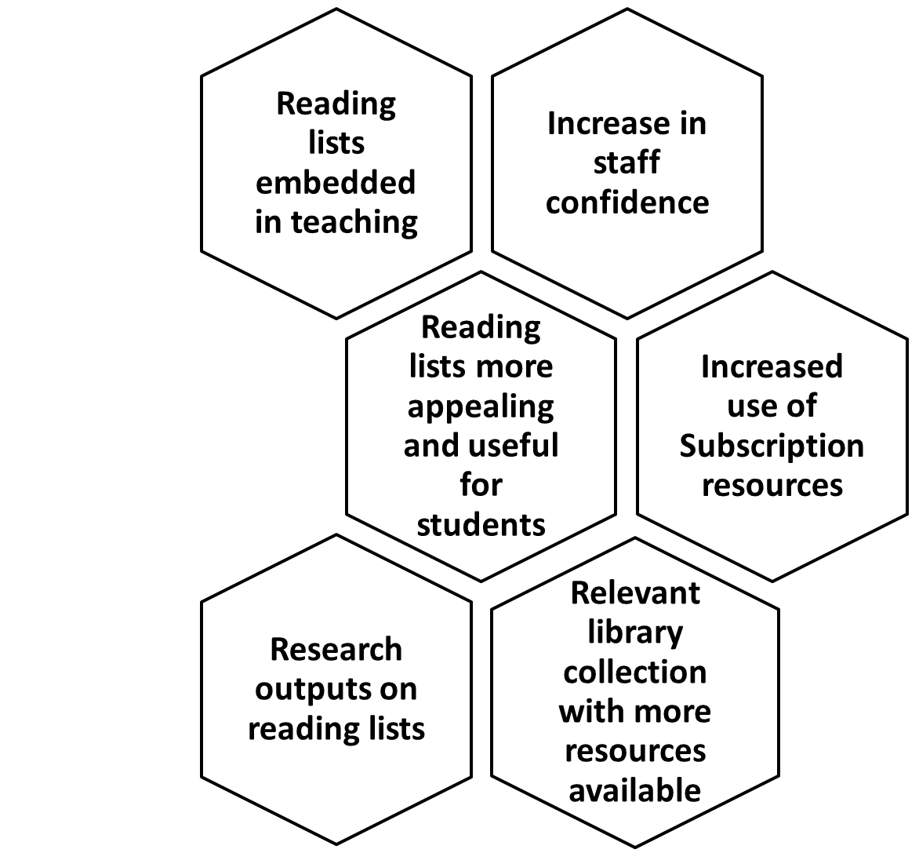
THE PROJECT
DELIVERABLES

Slide 7
The long term strategy and the quick wins
Notes:
Long term plan for the project mapped out – carry out a questionnaire survey and possibly some ethnographic research as well, design and deliver training,
Quick wins are crucial in a project like this. Decided to target staff across business school with empty reading lists. Great quick win to ensure everyone at least has some sort of reading list where appropriate / required.

Slide 8
Making the Most
of Metrics
How can we use our data to inform the project?
Notes:
Lots of data available about the reading lists – able to quickly identify areas needing attention.
Report already created to award prize for best reading list last year – provides a snapshot of the bigger picture. Have added department information to filter list into smaller more useful chunks. Identify patterns and trends.
Will be interesting to compare with report at end of this academic year.

Slide 9
Embedding within the Business School
Notes:
building strong relationships with staff and fully embedding within the business school is key to project success
Understand your customers. Analyse the data and talk to people!
Identify key teams to build initial links with – E-Learning and VLE team
Meet with department heads to seek buy in and support
Business school mentor – member of academic staff – useful to have access to insider knowledge of community.

Slide 10
The Next Steps....
-Training Sessions
-Best Practice Guides
-Knowledge sharing workshops for staff

Slide 11
Any questions?

