Slide 1
Kardashian Analysis
Using Celebrities in Teaching

Slide 2
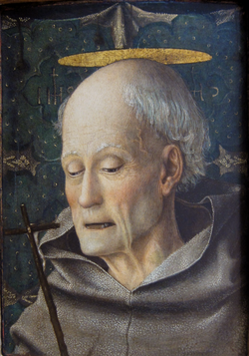
Patrons
St Bernadino of Siena (1380 – 1444)
Patron saint of advertisers and advertising, publicists and PR
His preaching was frequently directed against gambling, witchcraft, sodomy and usury
Depicted with a three sided tablet representing the three bishoprics he turned down
“Whenever you hear sodomy mentioned, each and every one of you spit on the ground and clean your mouth out as well. If they don't want to change their ways by any other means, maybe they will change when they're made fools of. Spit hard! Maybe the water of your spit will extinguish their fire.”
Notes:
Preaching – rather ironic lolz :D

Slide 3
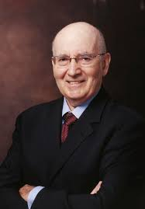
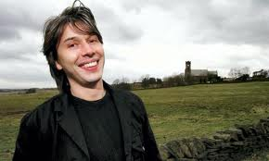
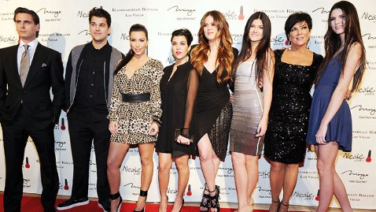
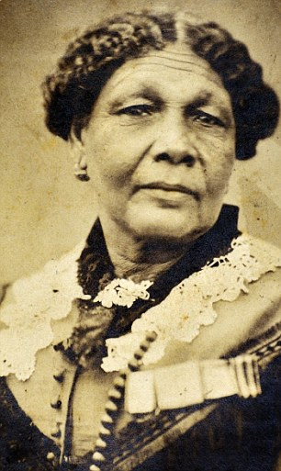
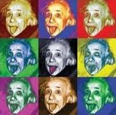
Notes:
Who – knows who this is? (Philip Kotler) Who is familiar with his work? (Maybe not the best patron then)
Kardashians – marketing nothing. The ultimately meaningless marketing.
Patron saint of buzz marketing, viral marketing, self branding etc. Depicted with a selfie stick and plasma facial.
It’s not just marketing!

Slide 4
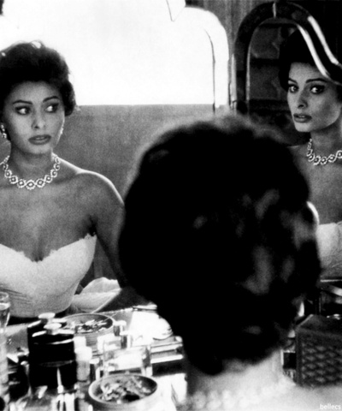
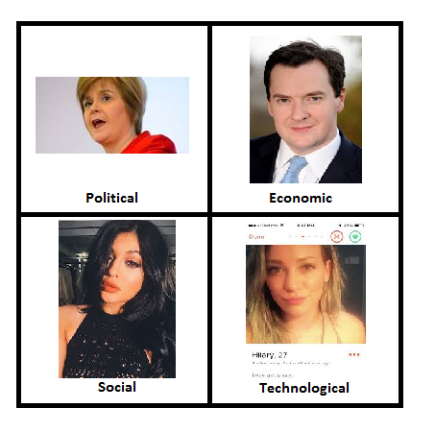
Analysing
What is happening in the world this week?
What does this suggest in terms of wider PESTLE trends?
How might marketing respond to this? (opportunities and threats)
Notes:
Celebrities mirror the wider world. From a marketing perspective they are at the cutting edge – we can learn about social trends and fashions from them.
PEST – easy to trend online but is there substance/change behind that. Builds into the IMC and new vs. old marketing debate. How influential is marketing? – Clearly lots of debate/ideas/conceptual narratives can be dealt with holistically and approachably via this.
News Review a successful example of bringing this into the classroom – few responses first few weeks (Ebola example lol). But then picked up and having really original and detailed discussions by the end.
It enables students to bring in their knowledge/interests/sources.

Slide 5
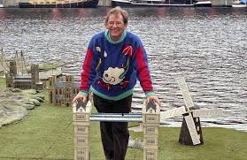
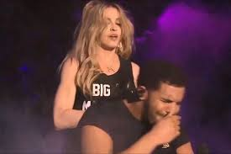
Applying
Brand Rehabilitation
Brand Sustainability
Rebranding
Notes:
Chris Brown
Fred Talbot
Caitlyn Jenner

Slide 6
Modelling
Notes:
Put examples of different models using Kardashians – BCG Box, Positioning map, 4P’s, Etc.

Slide 7
Problem Solving
Notes:
Celebrity Endorsement Activity… Mock up some fake adverts…

Slide 8
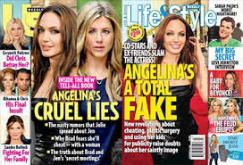
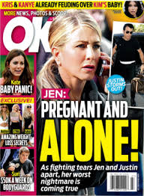
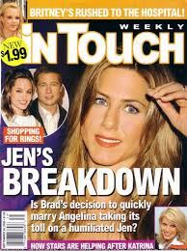
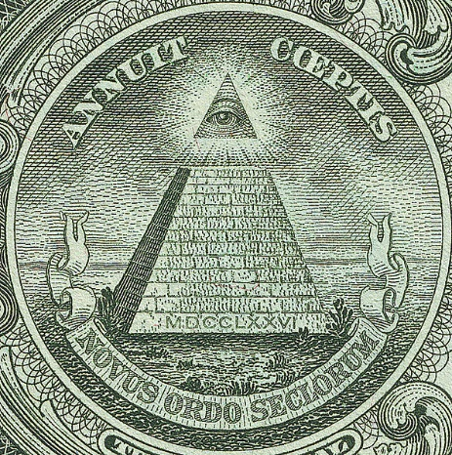
Sourcing
A concerned friend told us: “She’s losing sleep over Brad and Ange’s upcoming wedding. She’s not eating, she’s been drinking to much and she’s spending increasing amounts of time rattling around the grounds of her $15m Beverly Hills mansion.”
Reliability, Validity, Reputation, Independence, Triangulation, Conflicts of interest…
Notes:
Could do the Illuminati example (again its no longer about religion – is now run by Beyonce and Jay-Z rather than the Jews). Joan Rivers was murdered by for exposing Michelle Obama as actually a man.

Slide 9
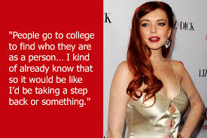
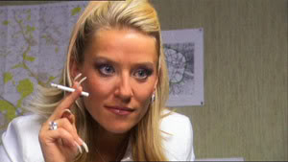
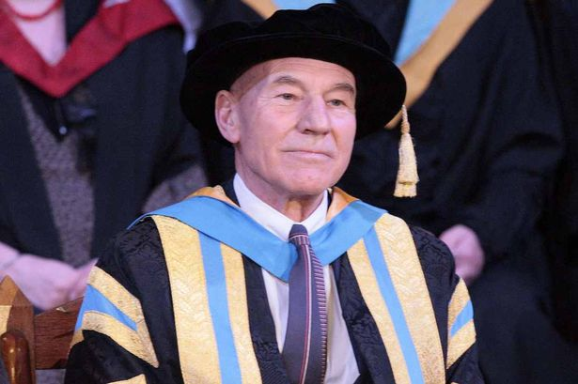
Inspiration
Living the brand
Selling yourself
Aspiring
Keep on Trying
Notes:
I’d like to propose Tanya Turner as our new VC.

Slide 10
Notes:
All I’m trying to do is keep relevant. Try to get students attention. We all know how difficult that is. This is a way of smuggling information out to them. Like a worming table in a dog treat.

