Slide 1
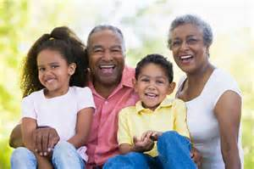
Unsung Heroes : Grandparents caring for their grandchildren while their parent is in prison
“I don’t want sympathy, I love looking after her ! ”

Slide 2
Overview
Pilot study – where we are up to
Background context on children of prisoners
Triad relationship
Why Unsung Heroes ?
Double loss
Impact on relationships
Particular stresses faced by grandparents
Disclosure dilemmas
Isolation and stigma
Practical needs identified
Views expressed by imprisoned mothers

Slide 3
Children of Prisoners – Background Information Disruption far greater for children with an imprisoned mother than imprisoned father
Estimates suggest that there are 200,000 children affected by parental imprisonment at any one time in the UK (MoJ, 2012)
It is estimated that more than 17,240 children were separated from their mother in 2010 by imprisonment (Wilks-Wiffen, 2011)
Only 9% of children whose mothers are in prison are cared for by their fathers in their mothers’ absence (Corston,2007)
Approximately 4,000 children move to live with their grandparents each year following the imprisonment of their mother – 22% of children with a mother in prison (Independent , 2012)
Rest of children are cared for by other family members, in foster care or adopted.

Slide 4
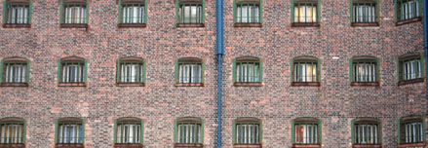
Pilot study
Very early stages!
Emerged from COPING findings that identified significant role of grandparents in this context
3 interviews with grandparents (UK based)
2 focus groups with imprisoned mothers with children cared for by grandparents (HMP Askham Grange & HMP Styal)
Interview with Laura Teahan, Grandparents Association
Interviews and focus groups also conducted in Trinidad, Romania and Uganda

Slide 6
Why Unsung Heroes?
Preventing children being received into Care following their parent’s prison sentence
Little financial support
Penalised for being organised
Willingness to make sacrifices

Slide 7
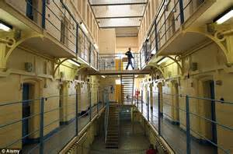
Double Loss
Grandparents own child lost to prison
Grandparent loses grandparent role as assumes responsibilities as primary carer

Slide 8
Impact on relationships
Effects on other grandchild relationships (and wider familial relationships
Disruption to grandparent-parent-child relationships due to imprisonment/reasons for imprisonment – double loss

Slide 9
Impact on Relationships
Impacts on relationships with partner
Grandparents often relatively young
Those of retirement age have to rethink plans
Impact on wider familial relationships – strained but some supportive/moves into friendship
Triple impact of caring (‘kinship’ carer of child, own children, elderly parent needing assistant)

Slide 10
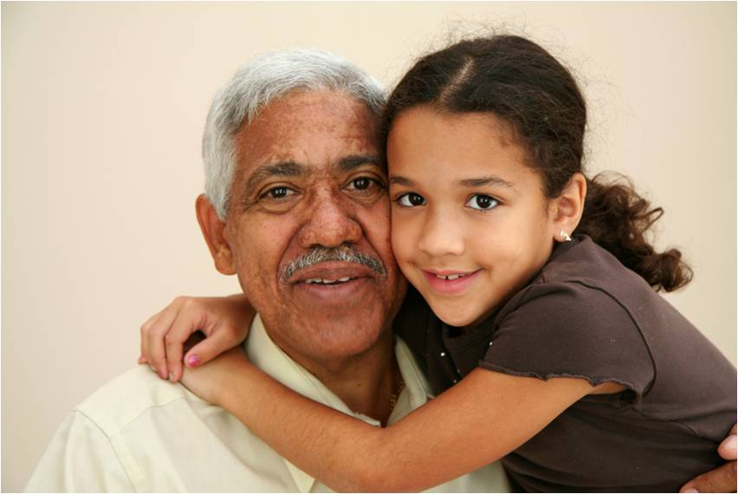
Stress
Grandparents absorbing effects of their children’s criminal lifestyle
Not always thanked for looking after grandchild – sometimes actively undermined
Uncertainty re long term arrangements - Court

Slide 11
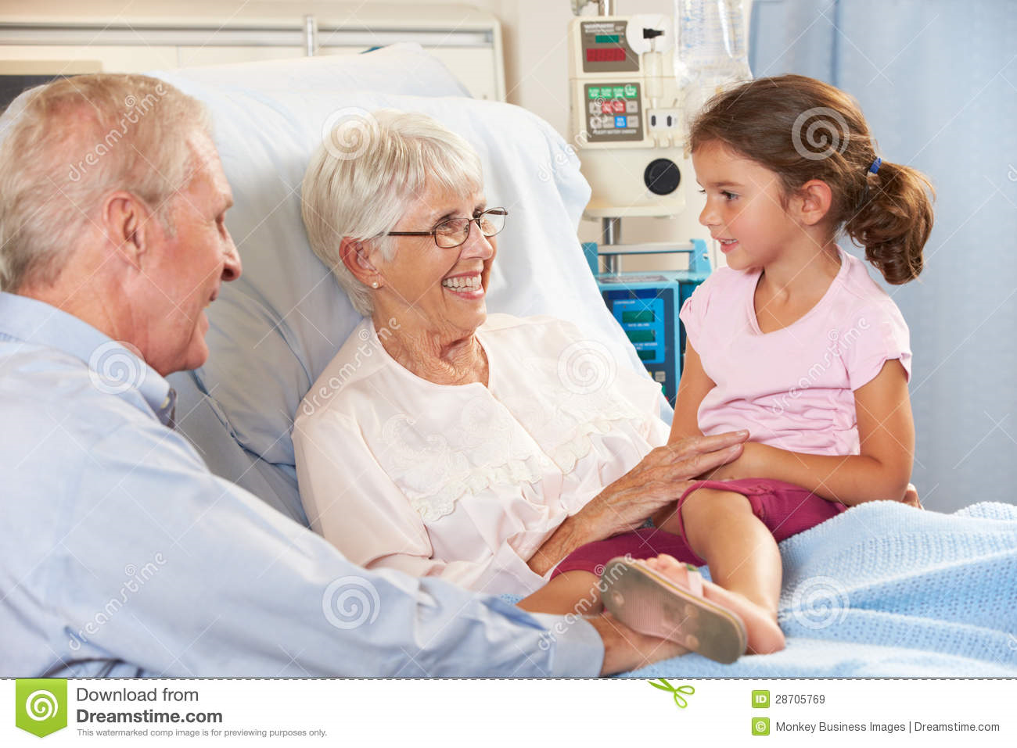
Impact on Health
“ I had to get over my operation pretty quick!”

Slide 12
Dilemmas re Disclosure
What to tell grandchild?
NGOs advise to be honest in age appropriate way – easier said than done - dishonesty confuses child – “ambiguous loss”(Bocknek et al.,2009)
Regrets about not being honest from the start from some participants

Slide 13
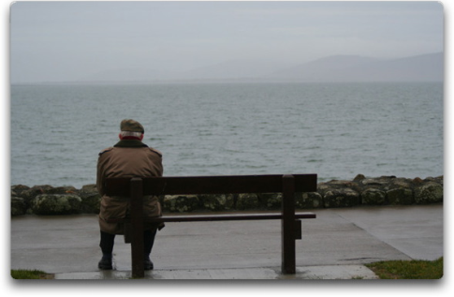
Isolation and Stigma
Feelings of isolation
Alienation from immediate community. One of our participants lived in a small village and commented:
“People don’t speak to me because they know I have a son in prison and a daughter-in-law addicted to heroin”.
Problems of looking after grandchildren who have “abandonment issues”.

Slide 14
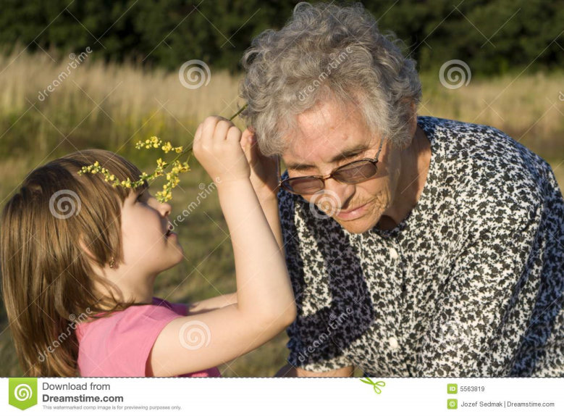
Stigma
No hiding fact that grandparent not mother – forced to find explanation
“They know there is something wrong in your life…”
(They ask you) “why are you looking after these children? …it used to embarrass me, but now I just say ‘my son takes drugs, he’s been in jail’ ”

Slide 15
Practical needs
Talk of lack of ‘official’ support
Lack of communication from social workers to grandparents regarding liaison with schools.
One grandmother felt she had been “abandoned by the school” when a social worker became involved.
Creating own support networks
Clear about what their needs are
One grandmother commented “no one’s catching us there is no safety net for us”.

Slide 16
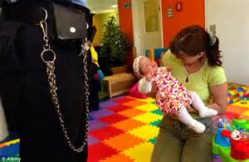
Views of imprisoned mothers

Slide 17
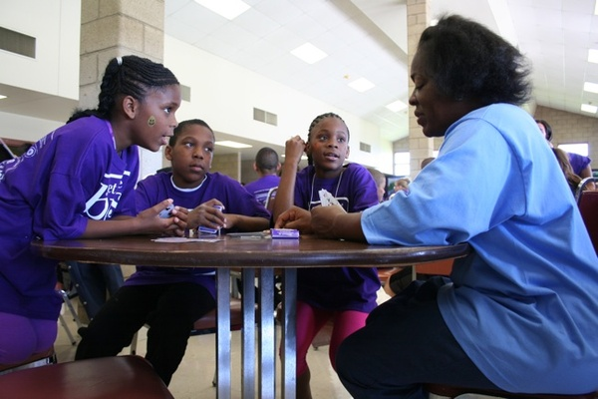
Views of imprisoned mothers
Visits reinforcing mothers absence from day to day children’s lives:
“All my family are discussing my daughter across me and what she is doing” .

Slide 18
Views of imprisoned mothers
Gratitude – for sacrifice – e.g. one grandmother sleeping on couch to allow grandchild a bed
“You feel guilty, they have stepped up to the plate”
Roles – different parenting styles – e.g. discipline - clothes
“I know I am a mum but I don’t feel like a mum”
Missing all the important landmarks, starting school, birthdays
Try to discipline son on home visits but he just says:
“you haven’t been there for 13 years”
“Me and my mum we talk things through, we have to!”
Managing release – grandmother staying for a few weeks to make transition – despite desperate to take control of mothering role again
“I can’t wait to get back out there”

Slide 19
References
Baroness Corston (2007) A Review of Women with Particular Vulnerabilities in the Criminal Justice System, London: Home Office
Bocknek, Sanderson & Britner (2009), Ambiguous Loss and Posttraumatic Stress in School-Age Children of Prisoners, Journal of Child and Family Studies,18:323–333
Ministry of Justice (2012) Prisoners’ childhood and family backgrounds, London: Ministry of Justice
Vallely and Cassidy (2012), Mothers and prison: thousands of children being brought up by grandparents, Independent newspaper.
Wilks-Wiffen, S. (2011) Voice of a Child, London: Howard League for Penal Reform

