Slide 1
Scholarly publishing in the library
The Institution as a Publisher
22 October 2015, Bangor University
Graham Stone
Information Resources Manager
http://eprints.hud.ac.uk/25755/
This work is licensed under a Creative Commons Attribution 3.0 Unported License

Slide 2
University of Huddersfield Press Re-Launched 2010
Re-launched as an open access press*
Scholarly monographs
Peer reviewed journals
Sound Recordings
*We are still working on the OA bit!

Slide 3
University of Huddersfield Press Aims and objectives
To encourage new and aspiring authors to publish in their areas of subject expertise
Scholarly monographs related to specific areas of research in the University, one off conference proceedings and titles of local, regional or national interest
Journals and other specialist series such as annual conference proceedings
Sound recordings (via Huddersfield Contemporary Records)

Slide 4
University of Huddersfield Press Aims and objectives
The principles governing the Press going forward are that:
All material published should be of high quality and peer reviewed
As a general rule, material should be published on Open Access via the University Repository, in order to maximise the potential for dissemination to as wide an audience as possible. Publications may also be made available by print-on-demand.
The Press will operate on a cost recovery profit sharing model, with any surplus being reinvested into the Press
The vision of the Press is to produce a ‘robust scholarly ecosystem’

Slide 5
University of Huddersfield Press Governance
Prof Tim Thornton Deputy Vice-Chancellor (Chair)
Sue White Director of Computing and Library Services
Prof Chris Cowton Dean of the Business School
Prof Janet Hargreaves Associate Dean, School of Human and Health Studies
Dr Martyn Walker Head of Dept, Post-Compulsory Education and Training
Prof Monty Adkins Professor of Experimental Electronic Music
Dr Tracy Turner Deputy Director of Research and Enterprise
Graham Stone University Press Manager
Rebecca McCall University Solicitor
Megan Beech Marketing Officer - Research and Enterprise
Lisa Ward Head of Teaching and Learning Institute

Slide 6
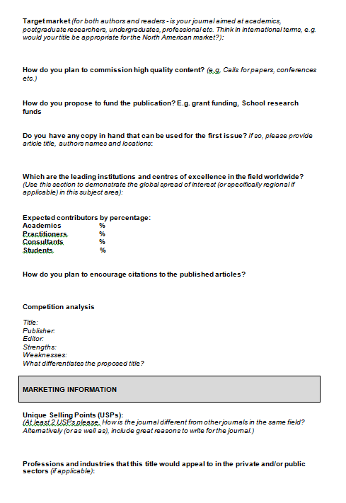
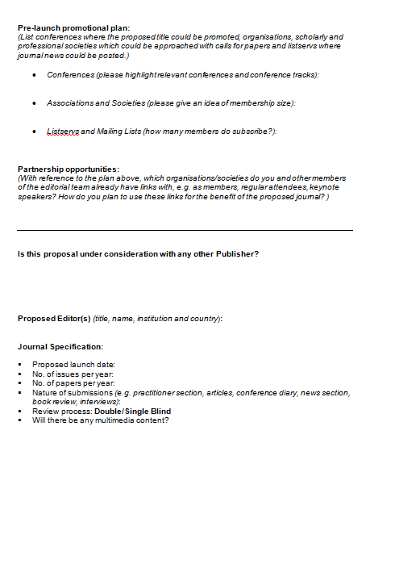
University of Huddersfield Press Proposals
Proposal forms submitted to the Press Board for journals and books
Usually after initial meeting
Sample chapters for monographs sent for peer review
Journal Ed. boards scrutinised
Marketing proposal requested

Slide 7
University of Huddersfield Press Author attitudes
Journals
Open access seems to be the accepted norm for journals – it has never come up for discussion!
Policy not to charge APCs is attractive
Monographs
Initial publications were not OA as agreements pre-dated the ‘re-launch’
One retrospective conversion to OA has now happened
An embargoed OA monograph is about to go live
New authors are all keen to go OA plus PoD copies
So far, no issues with CC BY

Slide 8
University of Huddersfield Press Open Access Monographs
12 monographs published since 2011
6 OA monographs
PDF on OA
Print on sale via the University online store, Amazon, Waterstone’s etc.

Slide 9
University of Huddersfield Press Monograph costs
£4,000 for up to 100,000 words
Costs to be paid by funder, Research Centre, QR money, Computing and Library Services
Admin/staffing costs met by CLS
UCL have similar charges, however, all charges are waved for UCL authors
OA with PoD restricted to around £25 per copy
70 sales would give a surplus of £1,750
This surplus would then be used for marketing and recurrent expenditure for the Press

Slide 10
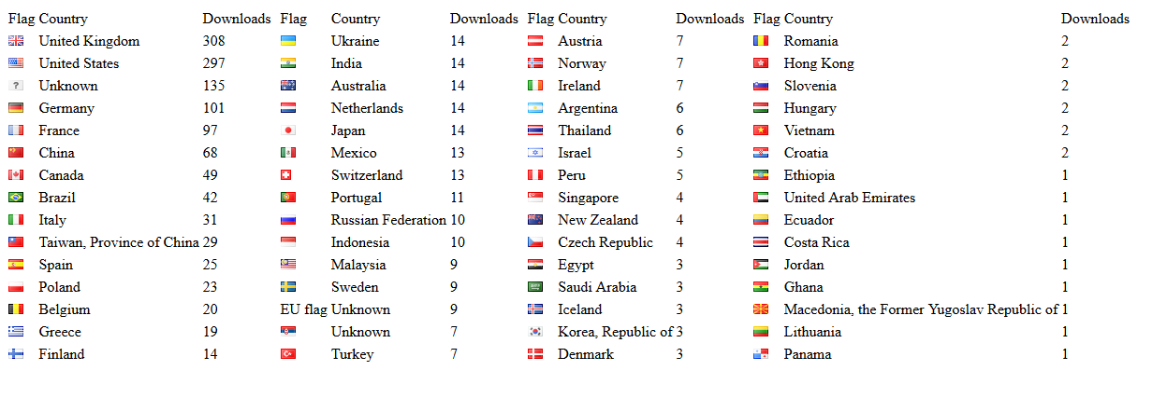
University of Huddersfield Press Noise in and as music
Published Oct 2013
83 copies sold
1,867 copies downloaded

Slide 11
University of Huddersfield Press Shibusa: extracting beauty
Published Mar 2012
76 copies sold
OA from April 2014
584 copies downloaded

Slide 12
University of Huddersfield Press Discoverability
Google
Via OAI-PMH compliance in the Repository
Library web scale discovery
DOAB membership
Jisc/OAPEN Open Access Monograph Service

Slide 13
JISC Digital infrastructure: campus-based publications May - Oct 2011

Slide 14
Huddersfield Open Access Publishing Proposal
The HOAP project attempts to bring together the two systems of delivering OA research articles
OA repositories
OA journals
The project has developed a low cost, sustainable OA journal publishing platform using EPrints Institutional Repository software

Slide 15
University of Huddersfield Press OA journals
Based on the Jisc HOAP project (2011)
7 current Journals
+1 archived title
Hosted via the University Repository
Preserved in Portico

Slide 16
University of Huddersfield Press Teaching in Lifelong Learning
Back-run of 42 articles
CrossRef membership
200 DOIs added to references
Licence to Publish (LtP)
Allows the author to retain the copyright under a CC BY licence
Membership of COPE
A forum for editors and publishers of peer-reviewed journals to discuss all aspects of publication ethics

Slide 17
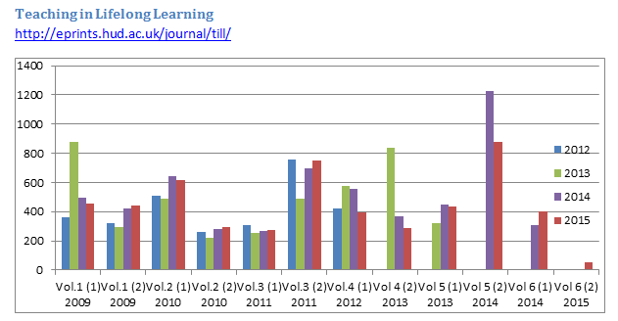
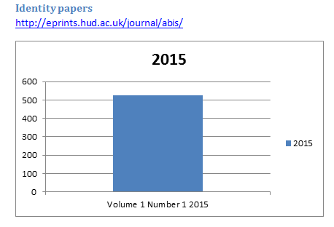
University of Huddersfield Press Usage

Slide 18
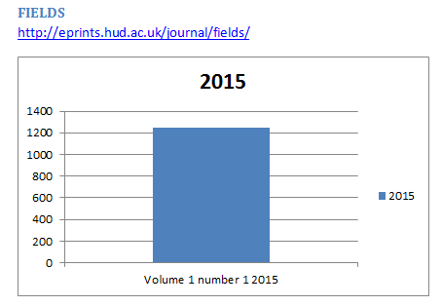
University of Huddersfield Press Fields: journal of Huddersfield student research
Fully peer reviewed by academic staff
3 submissions per School (up to 21 articles)
Combination of best dissertations and student submissions
Writing workshop held in July
Peer reviewed by School Ed. Boards in September
Peer reviewed by Fields Ed. Board in October
Published in January/February
Stone, G., Jensen, K. & Beech, M. (2016). Publishing undergraduate research: linking teaching and research through a dedicated peer reviewed open access journal. Journal of scholarly publishing.

Slide 19
University of Huddersfield Press Fields: journal of Huddersfield student research
The experience of writing for the journal has certainly been a positive one. It has allowed me to develop publication skills, improve my academic work and take on board different perceptions and criticisms. The opportunity has also allowed me to revisit a piece of work that I am particularly proud of and present it to a wider audience.
Reece Goscinski commenting on To What Extent Does the Ideological Construct of Collectivism Continue to Govern the British Trade Union and Labour Movement? Fields: journal of Huddersfield student research, 1 (1). e11.

Slide 20
University of Huddersfield Press Journal discoverability
Google
Via OAI-PMH compliance in the Repository
Library web scale discovery
DOAJ membership
TiLL
Journal of performance magic
Scopus/A&Is?

Slide 21
University of Huddersfield Press DOAJ seal
To qualify for the Seal the journal must:
have an archival and preservation arrangement in place with an external party such as CLOCKSS, LOCKSS, Portico;
provide permanent identifiers in the published content such as DOIs;
provide article level metadata to DOAJ;
embed machine-readable CC licensing information in article level metadata;
allow reuse and remixing of content in accordance with a CC BY, CC BY-SA or CC BY-NC license;
have a deposit policy registered in a deposit policy directory such as SHERPA/RoMEO;
allow the author to hold the copyright without restriction
To date, 88 out of 10,619 journals in DOAJ have qualified for the Seal

Slide 22
University of Huddersfield Press Cost benefits for TiLL

Slide 23
University of Huddersfield Press Journal costs
Set up costs
£750 for landing page and coding (paid by School or Research Centre)
Recurrent costs
£2750 + £50 per year for DOIs
Staffing costs – CLS
Maintenance costs included in Repository hosting charges

Slide 24
University of Huddersfield Press OA journals - Growing the author pool
New titles planned
1 launching in 2016
1 in development
2 at proposal stage
Attracting societies, charities and research institutes

Slide 25
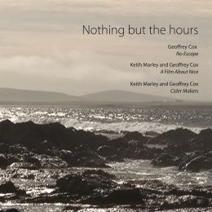
Huddersfield Contemporary Records
7 CDs & 1 DVD
1 Digital download album
Published with CeReNeM and /hcmf
Distributed via NMC

Slide 26
University of Huddersfield Press REF 2014
UoA 35: Music, Drama, Dance and Performing Arts
100 research outputs
11% included a Press publication (sometimes as part of a portfolio item)
4th in UK for research impact
1st Yorkshire
1st post-92 overall
QR funding per item has been calculated, which shows the true return on investment for the Press

Slide 27
University of Huddersfield Press REF 2014
UoA 35: Music, Drama, Dance and Performing Arts
100 research outputs
11% included a Press publication (sometimes as part of a portfolio item)
4th in UK for research impact
1st Yorkshire
1st post-92 overall
QR funding per item has been calculated, which shows the true return on investment for the Press

Slide 28
University of Huddersfield Press Sustainability and innovation
In order to be sustainable and innovate in future years the Press needs:
Additional staffing
A publications and marketing manager has been proposed
Otherwise there is a risk that it will become a victim of its own success
Sustained funding from the University
This will allow greater freedom to help develop future monographs/journals
It will also allow the Press to grow at a sustainable rate

Slide 29
University of Huddersfield Press Collaboration
We don’t actually know how many UK university presses there are!
21 in 2002, 17 in 2004… (Hardy & Oppenheim, 2004)
Oxford, Cambridge, Bristol (Polity Press), Wales, Manchester, Liverpool and Edinburgh (7)
Buckingham, Chester, Hertfordshire, Huddersfield, Imperial, Institute of Education, UCL, UCLan, Westminster and York (10 – Cond, 2014)
Cardiff, White Rose and St Andrew’s University Presses can be added

Slide 30
University of Huddersfield Press Collaboration
Northern Collaboration Shared Press Meeting in 2014
The need for a piece of research to understand the lay of the land regarding UK University Presses and what they publish
Work on a set of best practice guidelines to assist New University Presses
Not a shared platform!
Develop a UK/European chapter of the Library Publishing Coalition
Membership?
Annual conference?

Slide 31
University of Huddersfield Press
http://unipress.hud.ac.uk/
Graham Stone
g.stone@hud.ac.uk
@Graham_Stone
http://eprints.hud.ac.uk/25755/
This work is licensed under a Creative Commons Attribution 3.0 Unported License

