Slide 1
Exploring e-portfolios in a discipline specific context
Vidya Kannara and Dr Amanda Tinker
ALT Conference
University of Manchester
8 – 10 September 2015

Slide 2
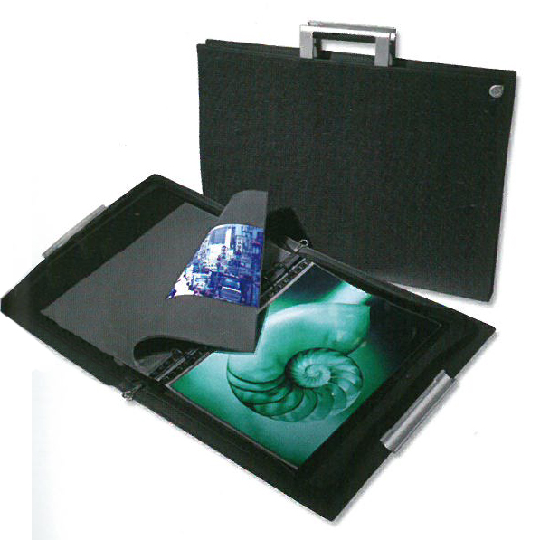
Tradition of the Design Portfolio

Slide 3
Tradition of the Design Portfolio
“By definition, a design portfolio is a grouping of loose sheets collected in a portable case”
“By the middle of the twentieth century...a portfolio, of a carried case, similar to those that architects produce, became a routine appendage for any aspiring student.”
“‘Send me your URL’ is fast becoming a more common request than ‘bring in your portfolio’. But according to many design leaders, a website is generally considered an introduction – a preview to the print portfolio that will follow.”
Eisenman (2006, pp.9-10)
“The ‘Exit Portfolio’ - ....the portfolio you [the student] will use when you complete your education and are stepping into the workforce full time...you are exiting the educational phase of your life as an architect, interior designer, or landscape architect. This is when your portfolio will receive the most scrutiny by several, if not many, practitioners”.
Bender (2012, p.28)

Slide 4
Project Aim and Objectives
To share, map and review current e-portfolio practice, with a view to developing a School Strategy.
To investigate and share current good practice within the School.
To map current e-portfolio activity within the School and its relationship to the institutional VLE.
To review current e-portfolio technology, including open source tools and e-portfolio tools/activity in other arts-based universities.
To develop a School strategy/approach and make recommendations to inform university e-portfolio initiatives.

Slide 5
Method
Questionnaire
School event
Two focus groups
Evaluation criteria form

Slide 6
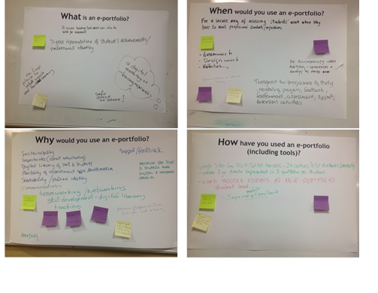
Perceptions and Practices What, When, Why and How?
Different ‘definitions’
Reflection (PDP, blogs)
Visual showcase (outward facing, exit portfolios)
Module vs. course level
Open source solutions

Slide 7
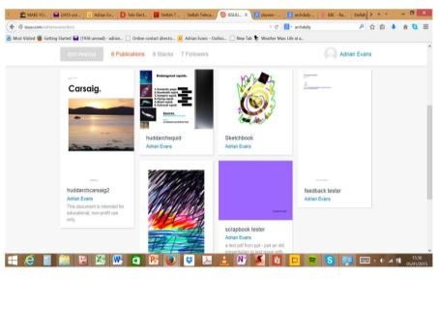
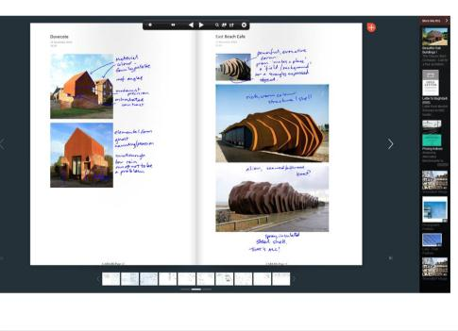
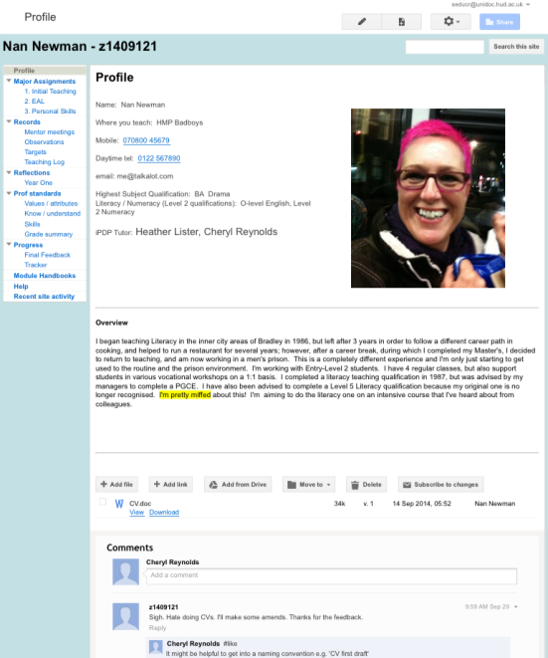
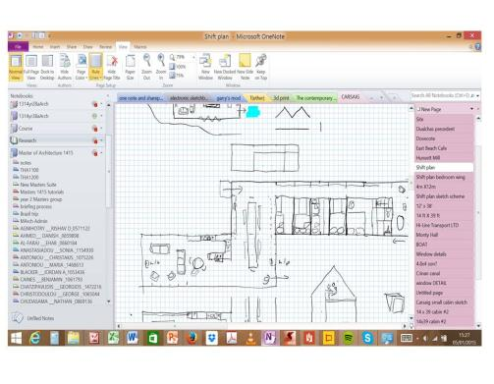
Sites

Slide 8
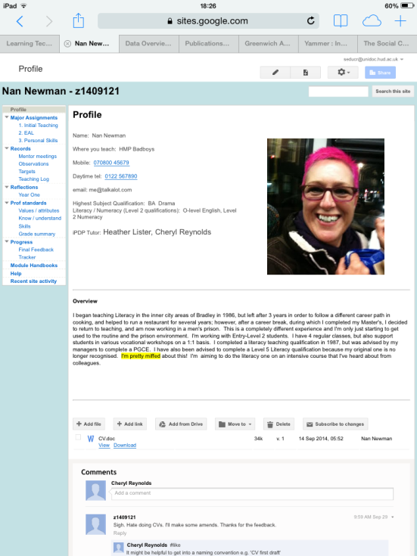
integration with university systems
Privacy/security
Copyright
Multiple purposes
External or Internally facing
ease of use
Creative Expression

Slide 9
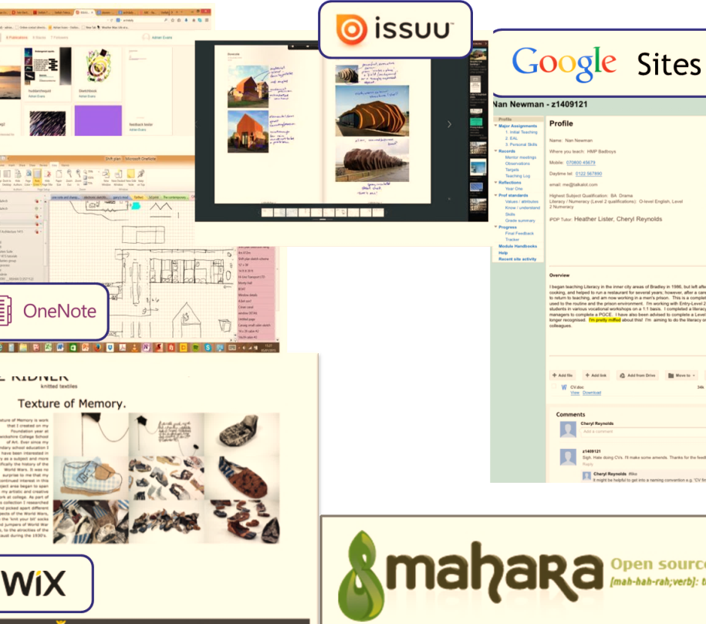
Focus Group
Characteristics
E-portfolios
Developmental
Progressive
Holistic
Reflective
Story/Narrative
PDP
Digital Identity
Repository
Record of Achievement
Curation
Collaboration
Moderation
Integration (Course, Institutional systems)
Flexible
Creative expression
Sustainable/Portable
Purpose
Audience
Subject discipline
Time
Differentiation
Learning log vs. Exit portfolio
Formative vs. Summative Assessment
Content vs. Presentation
Flexible vs. Rigid
Creative vs. Standardised
Tactile vs. Virtual
Supplement vs. Replacement
Free tools vs. Institutional
Tensions
Motivation
Feedback (Student ↔ Staff)
Assessment
Audience (Tutor, Peer, Industry)

Slide 10
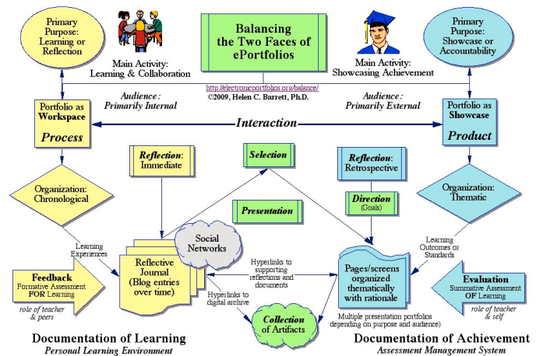
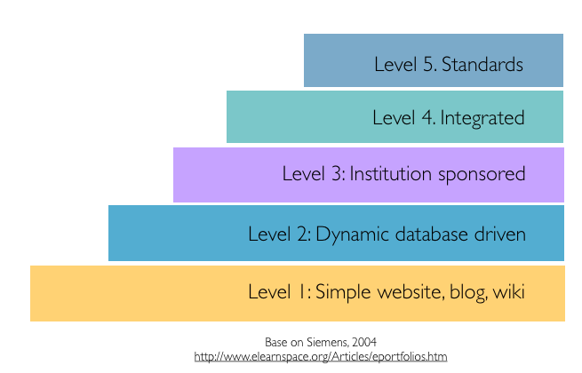
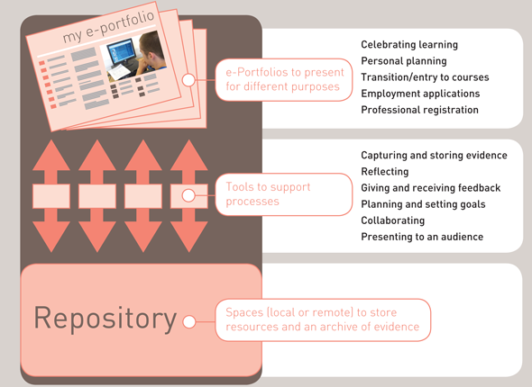
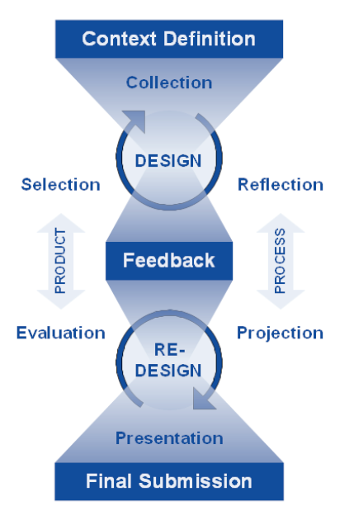
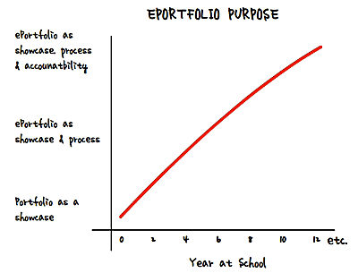
Siemens (2004)
Barrett (2011)
Hartnell-Young et al (2007)
Himpsl-Gutermann (2012)
Rate (2010)

Slide 11
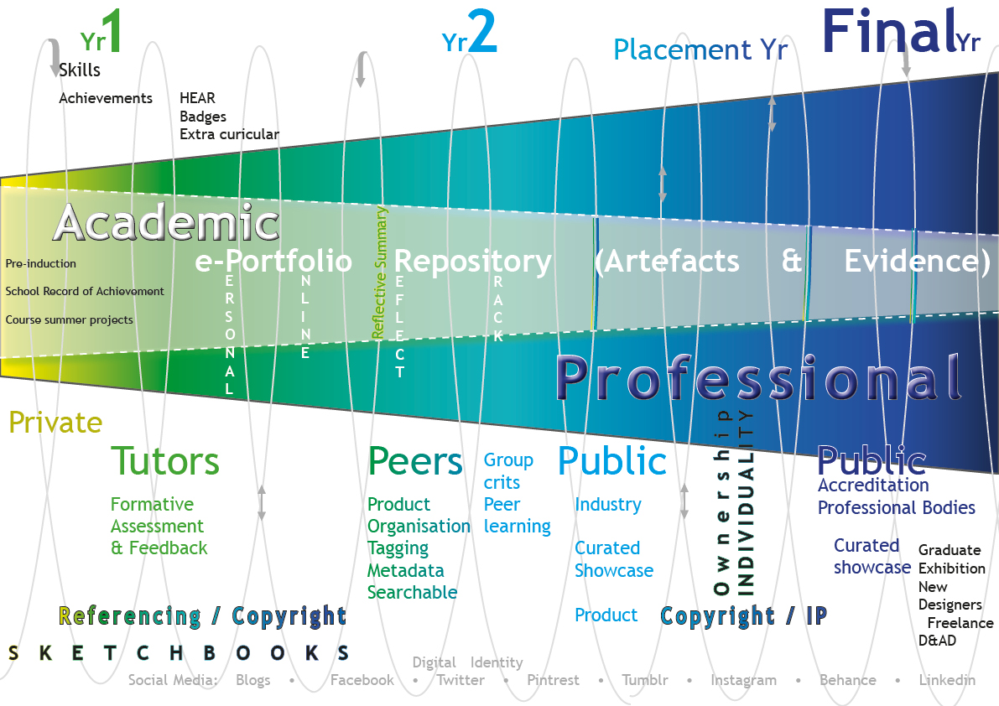
Our model
Dr. Amanda Tinker & Vidya Kannara – University of Huddersfield

Slide 12
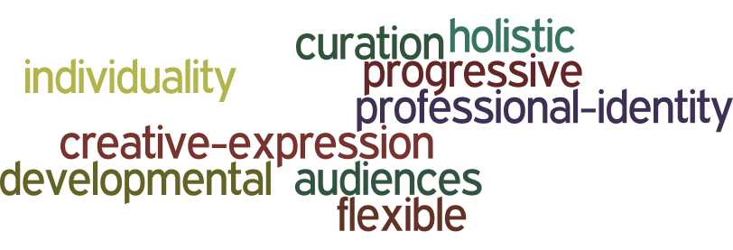
Conclusion and Future Directions
E-Portfolios
Yet, in transition and in tandem....
Currently viewed as a welcome addition (not replacement) to the tactile, physical portfolio.
Raise awareness of e-portfolio potential amongst staff
Capture student perceptions
Pilot our e-portfolio ‘journey’ model and appropriate tools with 1-2 courses
Connect and combine e-portfolio activities across the University
Disseminate findings to inform University strategy

Slide 13
References
Barrett, H. (2011). Balancing two faces of e-portfolio. Retrieved from: http://electronicportfolios.org/balance/balancingarticle2.pdf
Bender, D.M. (2012). Design portfolios: moving from traditional to digital, 2nd edition. New York: Fairchild Books.
Eisenman, S. (2006), Building design portfolios : innovative concepts for presenting your work. Beverly, Massachusetts: Rockport Publishers.
Hartnell-Young, E., Harrison, C., Crook, C., Pemberton, R., Joyce, G., Fisher, T. and Davies, L. (2007) Impact study of e-portfolios on learning, BECTA evidence and research directorate. Retrieved from http://partners.becta.org.uk/upload-dir/downloads/page_documents/research/impact_study_eportfolios.pdf
Himpsl-Gutermann, K. (2012). E-portfolios in der universitären Weiterbildung. Studierende im Spannungsfeld von reflexivem lernen und digital career identity. Boizenburg: Verlag Werner Hülsbusch, p.262.
Rate, N. (2010). Why use e-portfolios? - CORE breakfast seminar with Nick Rate. Retrieved from: http://www.core-ed.org/about/media-releases/breakfast-seminars/why-use-e-portfolios-core-breakfast-seminar-nick-rate
Siemens, G. (2004) eportfolios Retrieved from: http://www.elearnspace.or/Articles/eportfolios.htm

