Slide 1
MyReading: taking students’ degrees to the next level
Alison Sharman
Academic Librarian
University of Huddersfield
@asharman

Slide 2
My talk
This talk will outline
  Why reading list software was developed at the UoH
  Why we decided to create an in-house system
  The many features of the software
  How we sought buy-in from the academics
  The recent marketing campaign aimed at students
  What students really think of their reading lists!

Slide 3
Background
Teaching and Learning Committee agreed in June 2008
Reading Lists should be updated by academic staff on an annual basis with copies of all made available to library staff
Librarians will promote current awareness to academic staff ……
A reading list template will be adopted …..

Slide 4
The story in 2010…
Library received lists for only 40% of modules
Lists contained out of date or inaccurate information
Manual processes for reading list management laborious and outdated
Systematic, automated approach required

Slide 5
A new approach was required to…
Improve the student experience:
  comprehensive availability of reading lists
  Better access to reading list items, e.g. access to full text
Inform collection development
Incorporate the various process in the life cycle of the reading list
  e.g. integration with library acquisition processes
Make best use of resources and ensure value for money

Slide 6
Our wish list...
Easy to use front-end for students
Academics maintain and update their own lists
Simple workflows for adding material from the then OPAC and Summon
Integrated approach with existing university platforms, e.g. Blackboard, Summon, OPAC and ASIS

Slide 7
...and there’s more!
Seamless integration with library ordering processes
Automatic updating of links to the OPAC, e.g. When we buy an e-book, any lists using a print edition have the e-book link added automatically
Automatic updating of article links so that when we change subscriptions, links don’t break
A “social layer” that allows students to fully interact with their reading lists...
  ratings, notes, comments, discussions, etc

Slide 8
Why build it “in house”?
Commercial offerings didn’t have the deep integration into our other systems that we felt would be needed:
  Student Records
  Library Management System
  E-Resource products (Summon, 360 Link, etc)
  VLE
  Off-air TV recordings

Slide 9
Project Steering Group
Chair: Pro-Vice Chancellor (Teaching and Learning)
Head of Library Services.
Head of Computing Services.
Head of Department (X2)
Member of QSAG
SU VP Education
Academic Librarians
Systems Manager
Project Manager

Slide 10
Technical team established
Systems Manager
Representatives from Academic and Subject Librarians
Acquisitions staff
Librarian responsible for document delivery
Learning Technologist with responsibility for Blackboard

Slide 11
Overall Project Goal
Ensure the provision of reading lists is a managed, positive experience for students

Slide 12
Academic consultation
Academic consultation vital to success of project
  Focus groups with academics
  Online survey for collection and analysis of comments
  Presentations in university departments
  Project blog to collect feedback
  Online voting system to prioritise developments

Slide 13
Integration with Blackboard
MyReading went live in Blackboard at the start of the academic year 2011/2012
Reading list button on every module noticeboard
Lists submitted before July 2011 were added to the software by library staff

Slide 14
Reading list policy produced
Set out the
  Purpose: coherent integrated approach to the communication of required reading between academics and students and that the library is able to meet student expectations for adequate resource provision
  Scope: clearly outlines what titles the students are expected to buy and what will be stocked by the library
  Responsible authorities
  Policy statements: what both academics and students can expect
  Monitoring

Slide 15
Reading list policy produced
Essential: you must read/view this
Recommended: you are advised to read this
Background: this will help you to broaden and deepen your understanding of this subject
Recommended for Purchase: This is an essential item and you will need to use this extensively throughout the module
Notes:
Still frustrating that a lot of academics don’t use these categories. Very useful for international students. Directs their reading.

Slide 16
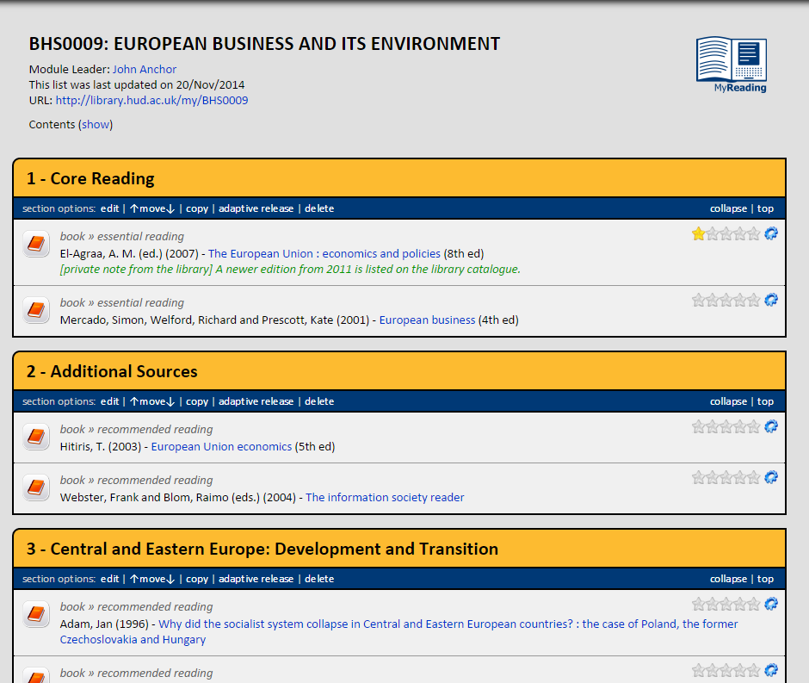
So what does it look like?

Slide 17
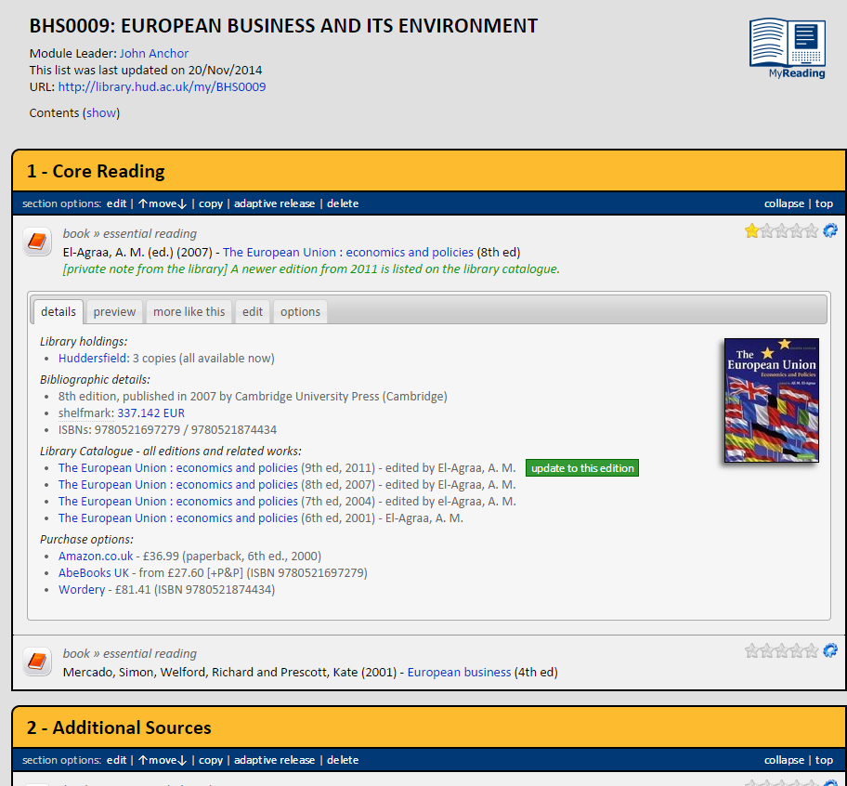

Slide 18
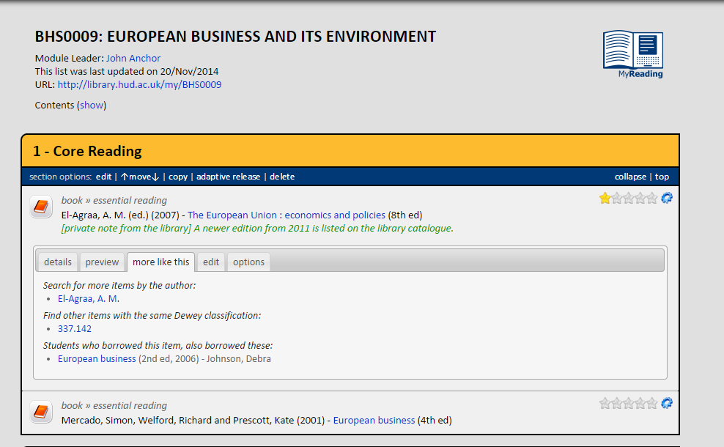

Slide 19
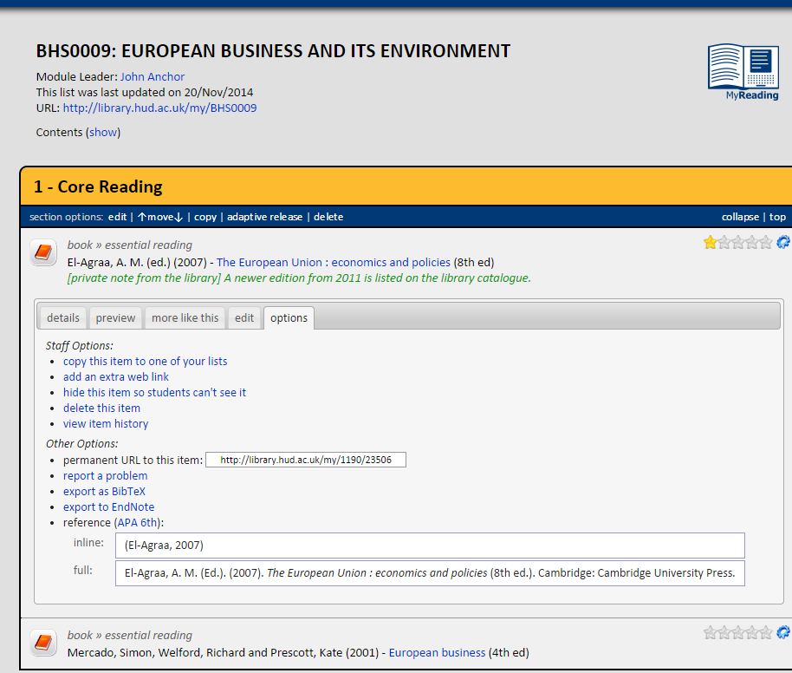

Slide 20
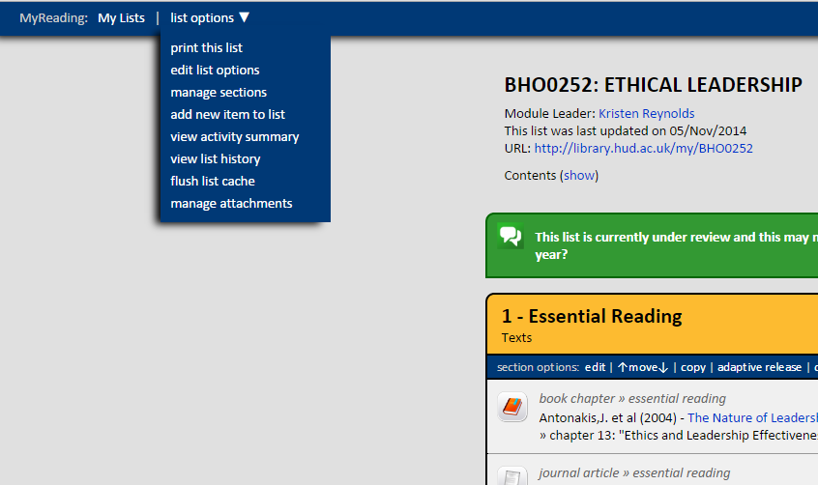
More options for academics

Slide 21
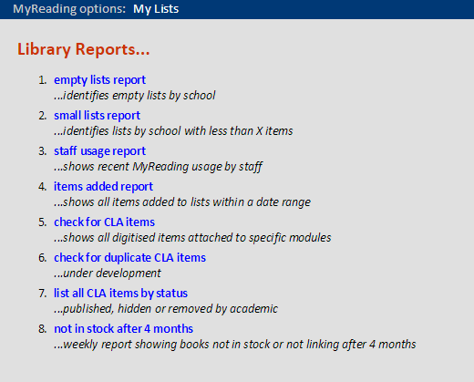

Slide 22
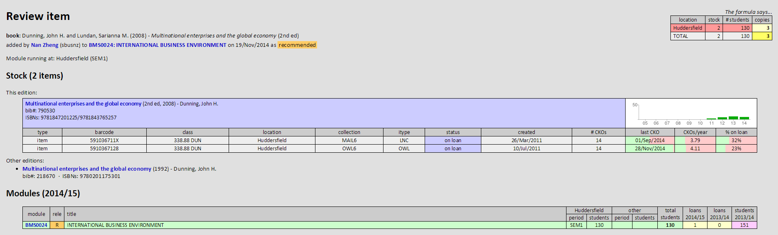
Items added

Slide 23
Current Usage
For the latest stats, go to:
http://library.hud.ac.uk/myreading

Slide 24


Marketing to students
  In collaboration with Fifth Planet Productions, an animation was produced
  Graphics used to produce posters/flyers
  Pencil: Reading lists – take your degree to the next level
Notes:
A local company comprising University of Huddersfield graduates that had previously been used by the SU

Slide 25
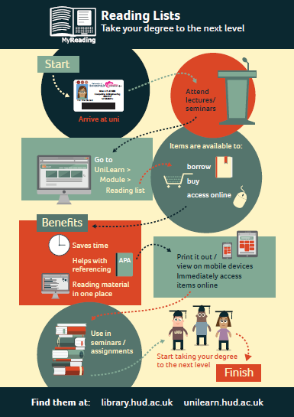

Slide 26
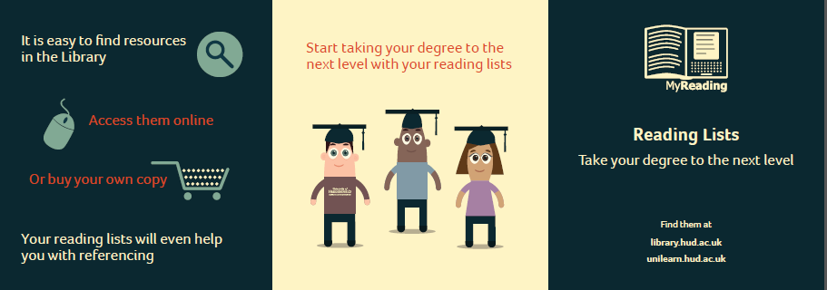

Slide 27


Slide 28
Marketing to academics

Slide 29

Postcard

Slide 30
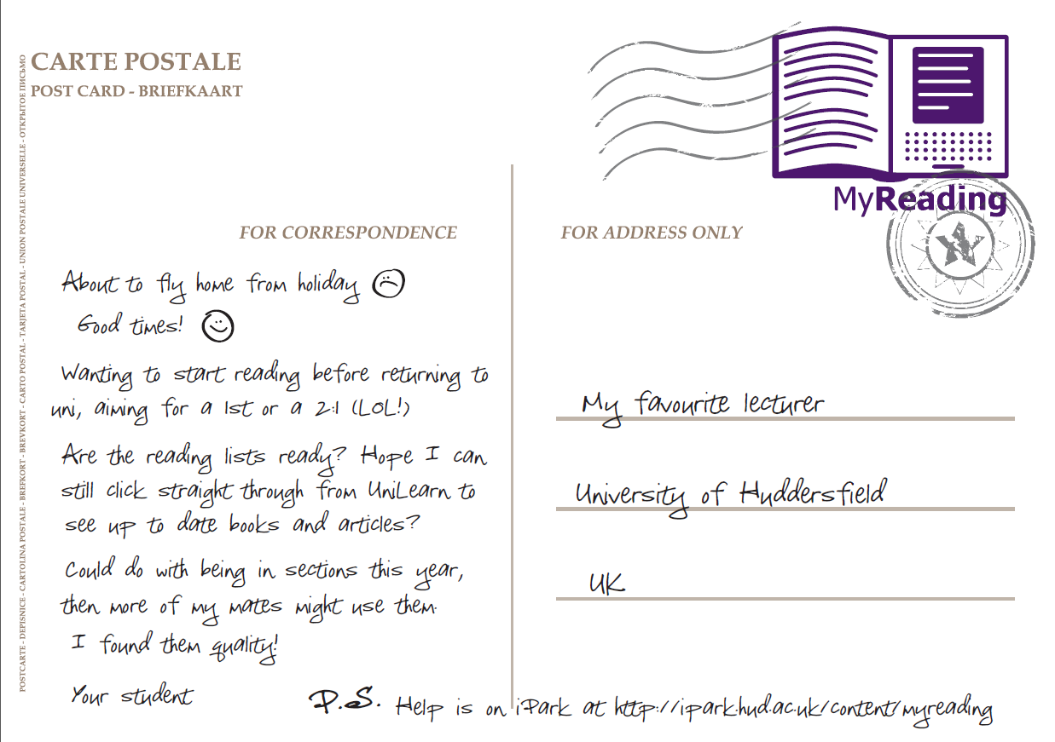

Slide 31
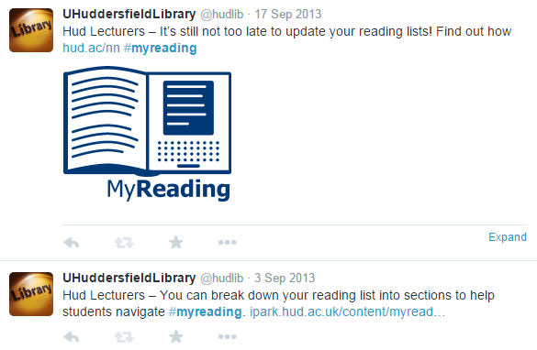
Followed up with #myreading tweets

Slide 32
What do students really think to their reading lists?
MyReading officially launched summer 2011
Now firmly embedded for staff and students alike (or so we thought!)
Need to evaluate MyReading in terms of impact on student experience and usability
Next steps for development – what do students want?

Slide 33
Focus group composition & methodology
8 undergraduate students
All library student helpers – possibility of bias?
A range of subjects covered – Music Journalism, Computing, Childhood Studies, English Literature, Pharmacy, Photography, Psychology
Used a pre-planned interview of open questions to guide discussion
Notes:
Focus group took place in May 2014
Possible bias – maybe students who choose to work in the library would tend to be more motivated to read and use their reading lists? But we found that half of the students in the focus group had hardly or never used MyReading!
None of the students have to use or know about MyReading as part of their job.
We used an interview guide but digressed from it quite frequently to follow up on responses.
There were several important points regarding design and usability which the library will be using for further developments but I am focussing on the points which are relevant to lecturers for this session.

Slide 34

First the good news!
MyReading is perceived by students to make readings more accessible
Amongst those who regularly make use of MyReading, it was felt to have made a positive impact on their ability to find relevant reading for assignments
So we are obviously doing some things right
But there was also some less good news…
Notes:
The focus group did highlight some points of less good practice but it was clear from discussions that those who use MyReading find it hugely beneficial and those who had given up on it were surprised when we demonstrated it to them and generally said they were keen to use it from now on.
A point of terminology – students don’t recognise the term MyReading at all, even though it appears on their reading lists! They generally refer to it as “Reading lists on UniLearn”. So the quotes I’m using from students don’t refer to MyReading at all.

Slide 35

Lecturers could promote reading lists more
You are encouraged to interact with reading lists at the start of your course but that is the only time.
Notes:
This one speaks for itself – if you are going to put time and energy into creating a list, it makes sense to promote it regularly too, not rely on students to remember where it is and why it’s important.

Slide 36

Lecturers could promote reading lists more
I’ve never seen this before…. I don’t even know if there’s anything uploaded to our reading lists to be honest.

Slide 37

Lecturers could promote reading lists more
The only way they are going to [realise reading lists are a useful resource] is if lecturers say “this is available, we expect you to use these tools”, but they just don’t.

Slide 38

Lecturers could promote reading lists more
Advised them to:
  Blow their own trumpet about their reading lists!
  Remind students about them termly
  Making sure they are up to date, organised into sections and annotated where appropriate will encourage students to use them
  Use the new animation to get students’ attention

Slide 39
Lack of consistency in location of reading lists
Yes, all lecturers differ in the way they put their subject areas on UniLearn… some lecturers put reading lists in learning resources, some put them under reading lists, some put them in both places.
Notes:
Students in the focus group agreed that the most logical place for reading lists to appear was behind the reading lists tab in UniLearn – this is where they will appear by default if a reading list is created in MyReading.

Slide 40
Lack of consistency in location of reading lists
My lecturers say “it’s on UniLearn” but you have to click through about a million different links to find it. You eventually find it under a random heading, it’s horrible!
Notes:
This is obviously not a great experience for students – this particular student had given up on using her reading lists completely due to bad early experiences of trying to access them.

Slide 41
Lack of consistency in location of reading lists
A lot of lecturers just put some readings at the end of PowerPoint slides and say “refer to your module handbook” and then they will put a copy of that module handbook online and that’s the only thing on UniLearn that some people interact with.
Notes:
If new readings are mentioned during lectures, they should always be added to the list on MyReading so that students can benefit from links to full text or the location of books in the library.
Scanned copies of module handbooks or Powerpoint presentations attached to UniLearn aren’t linked into library systems so they don’t make it easy for students to locate resources (some may say this is a good thing!) but also, the library doesn’t know what you have added to this list so can’t order the necessary copies!

Slide 42
Advising academics to…
Check that reading lists are easily accessible under the Reading Lists tab on UniLearn
If the reading list button has been removed, a Learning Technology Advisor can help with restoring it
For refresher training on MyReading, use the screencasts at http://ipark.hud.ac.uk/content/myreading (link on MyReading too)
The reading list policy endorsed by QSAG now says that reading lists should now all be created in MyReading for students to view on UniLearn rather than in module handbooks

Slide 43

Overwhelming length of some reading lists
I think that unless you are the reincarnation of Hermione Granger you are not going to go through and read all those…. Lots of students will come here from GCSEs and A levels where they are taught to consume things in a very bite sized manner and this is just like “have everything at once!
Notes:
This was a point on which students were unanimous. They agreed that long reading lists without meaningful sections were off-putting and deterred them from using reading lists.

Slide 44

Overwhelming length of some reading lists
I know there is a difference between higher learning and learning at school but maybe [readings] should be released in chunks so that they are actually relevant to what you are studying that term.
Notes:
This particular student was a keen user of reading lists, partly because early in his course one lecturer had used “adaptive release” of readings for her modules week by week and told students that the readings would be discussed in that week’s seminar or lecture. He and other students on his course (he reported) felt that this had been beneficial and had hooked them into using reading lists early on.
I know that some lecturers will not like this idea at all and will regard it as spoon feeding but there may be something to be gained, particularly for first years, in using MyReading in this way to ensure their buy-in for the future.

Slide 45
Advising academics to…
Ensure lists don’t grow too much year on year
As new items are added, consider whether some older ones can be removed
Make lists as easy to navigate as possible by using section headings and assigning helpful readership levels (background, recommended, essential, recommended for purchase)
Consider using adaptive release
Notes:
Reading list length is a tricky one – we can’t tell you how long your lists should be and there is no maximum length set in the reading list policy.
Many lists I look through have everything as “recommended” – this doesn’t make it easy for students to know what is most important to read.

Slide 46
Getting academic buy-in

Slide 47
Metrics equal prizes!
Offered a prize to the academic with the “best” reading list
Metrics used include:
  book loans: a measure of how likely students enrolled on the module are to borrow books
  item views: the average number of items on the reading list that students enrolled on the module have looked at
  Variety of item types
  Last update
  Percentage of items with annotations

Slide 48
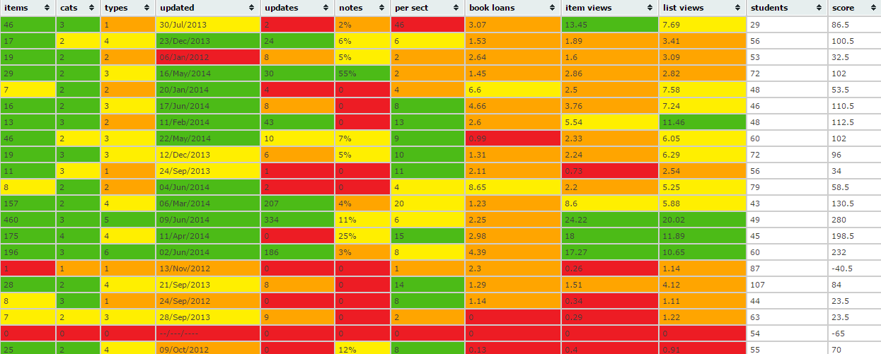

Slide 49
Check out prize winning lists for inspiration
AHE3210: Extraordinary Gentlemen by Merrick Burrow
SIF2012: Food in Society by Jane Bradbury
BMA0070: Governing Risk: Ethics & Audit by Julie Drake
Notes:
Tim Thornton awarded prizes to lists from each school based on the following criteria:
• student engagement - average no of lists/items views per student- additional weighting given to this criteria
• how frequently updated
• use of categories
• use of sections
• use of annotations
• mixture of books and articles
• numbers of items without links
• average publication year of books depending on subject

Slide 50
Finally, a quote from an academic...
MyReading has made the design of research informed teaching and learning so much easier and I have observed the student cohort engaging in wider reading because of the immediate access from Unilearn to library.
Academic from Department of Accountancy

Slide 51
Future plans
Continue to market to academics: got a budget to some run some focus groups
More evaluation: link use of reading lists to student attainment?

Slide 52
More info
Project Blog
http://library.hud.ac.uk/blogs/projects/myreading

Slide 53


Any questions?

