Slide 1
1999 to 2009: Re-Evaluating Secured by Design (SBD) in West Yorkshire
Dr. Rachel Armitage and
Leanne Monchuk
Applied Criminology Centre, University of Huddersfield

Slide 2
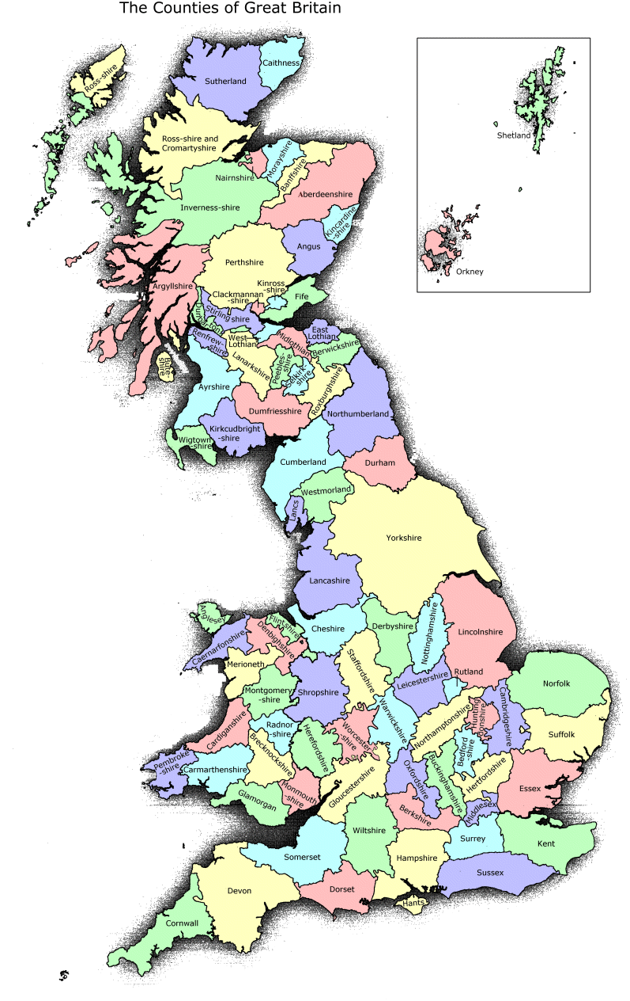
First, where is West Yorkshire?

Slide 3
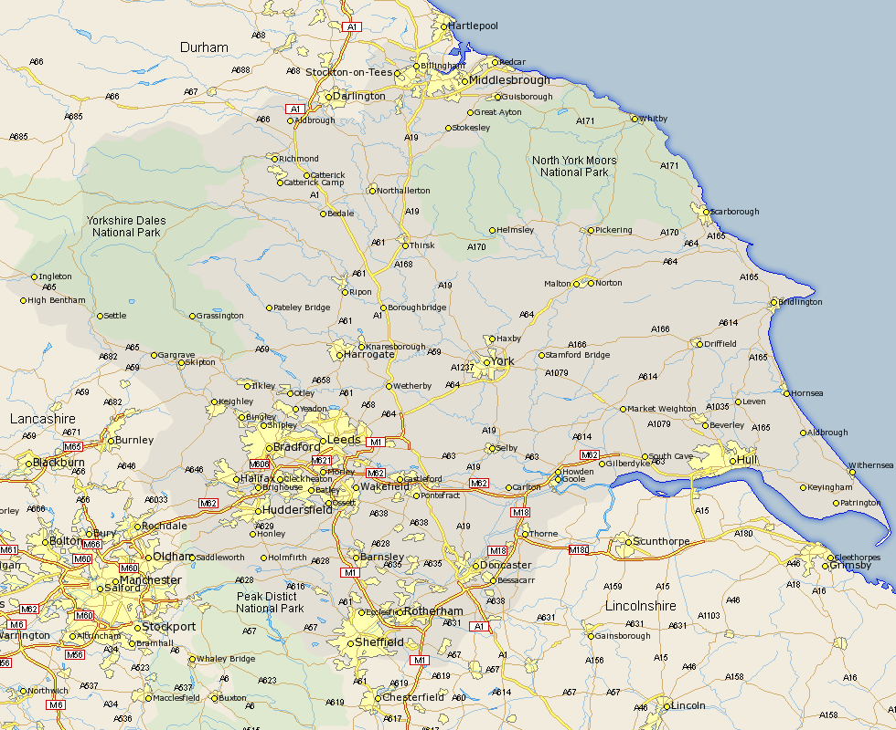
First, where is West Yorkshire?

Slide 4
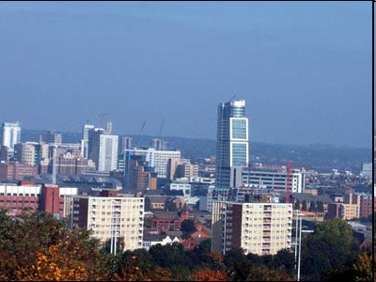
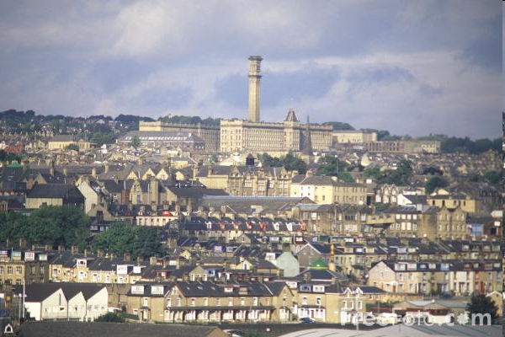
Firstly, where is West Yorkshire?

Slide 5
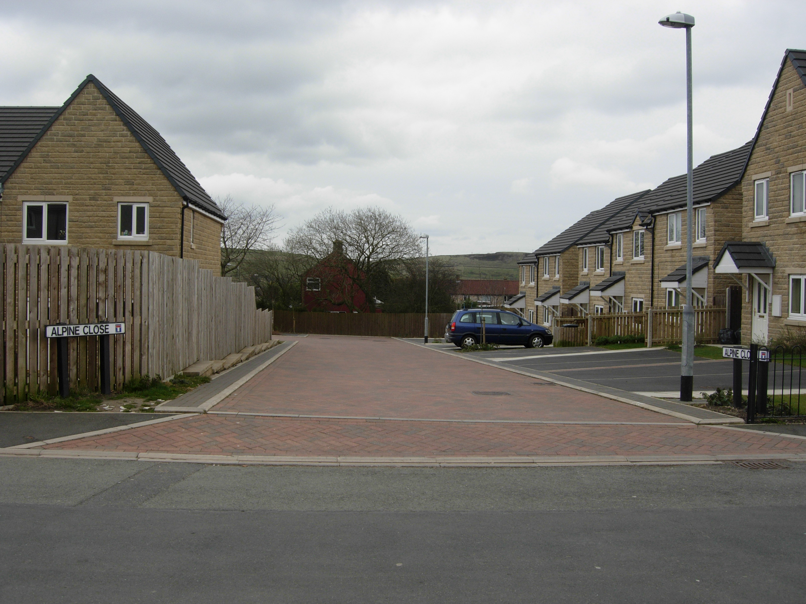
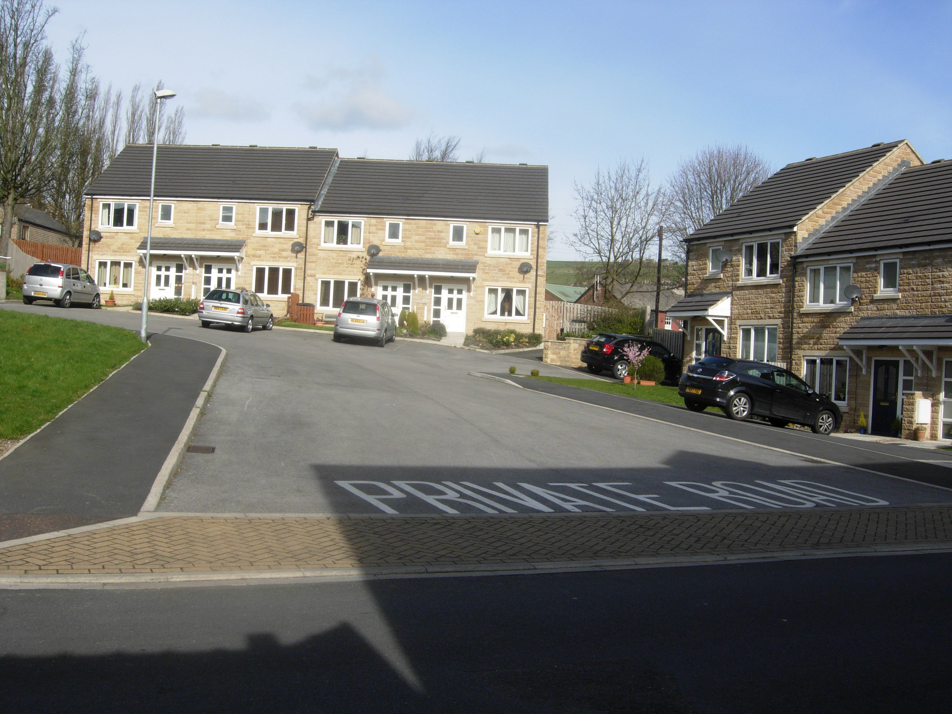
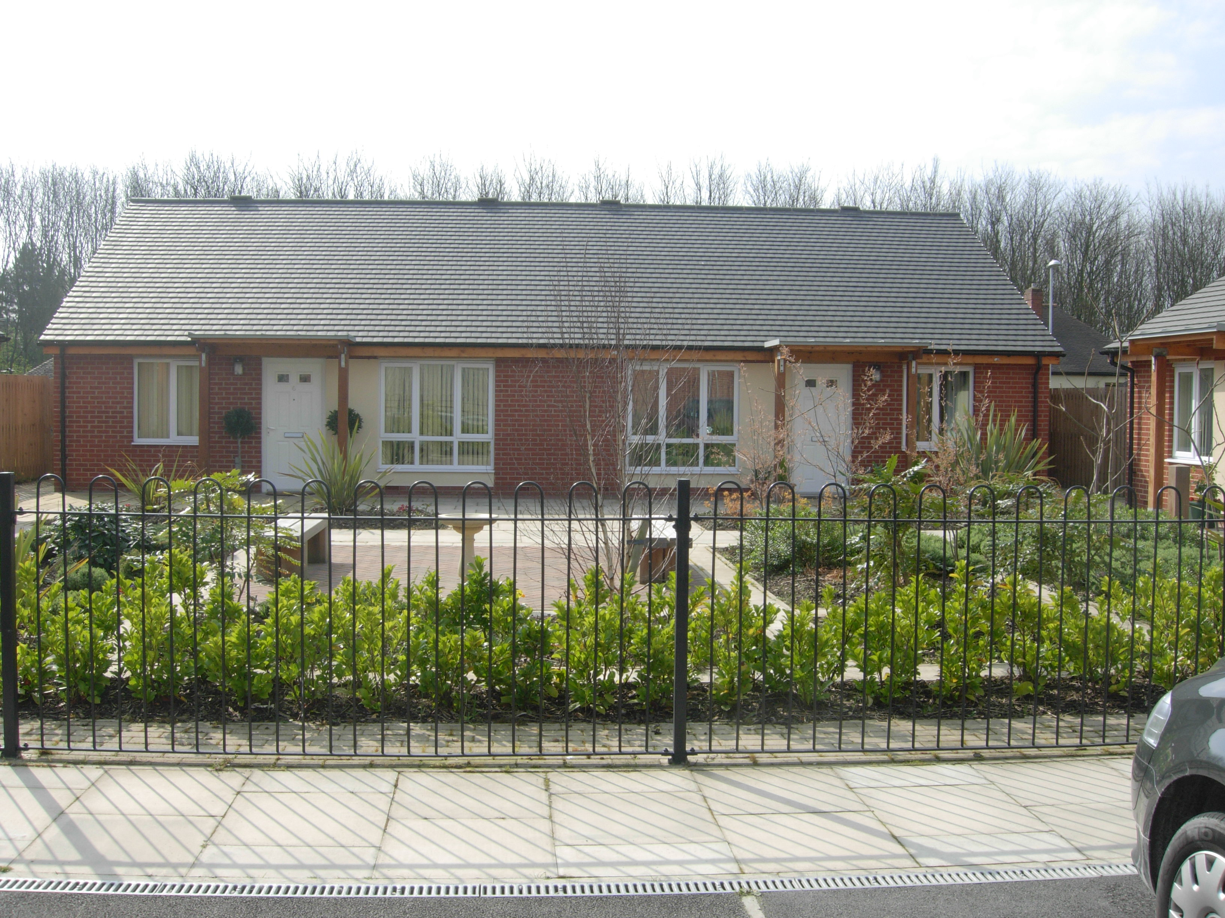
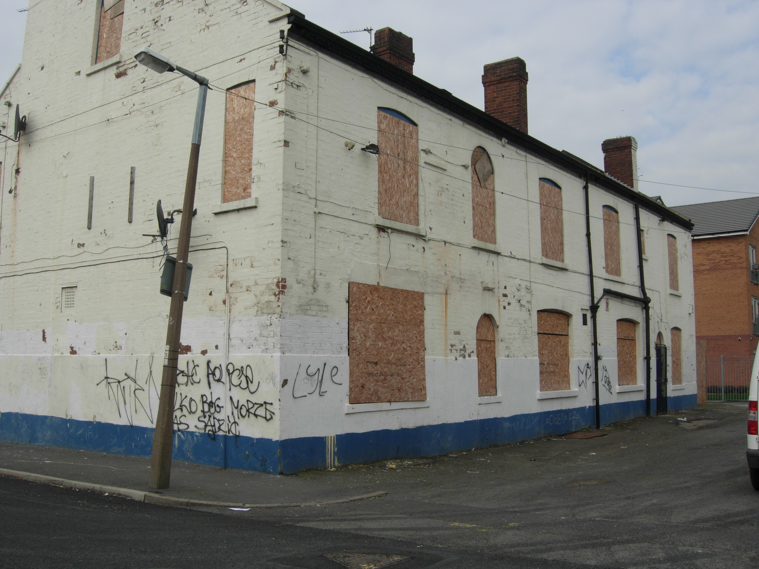
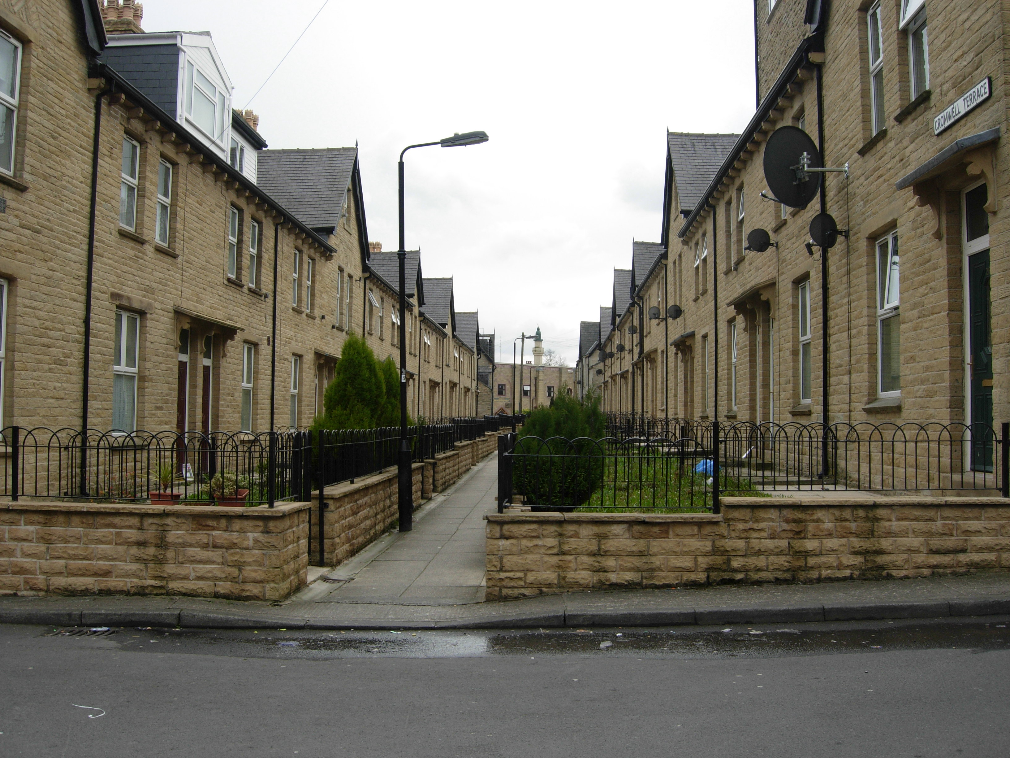
Firstly, where is West Yorkshire?

Slide 6
Secondly, what is Secured by Design (SBD)?

Slide 7
Secondly, what is Secured by Design (SBD)?
UK based initiative, managed by Association of Chief Police Officers Crime Prevention Initiatives Ltd.
Devised in 1989 by police forces based in South of England – aim of countering rise in household burglary.
Aims to encourage developers, planners, architects to design out crime at the planning stage.
Day-to-day delivery by local police Architectural Liaison Officers/Crime Prevention Design Advisors (approx 320 across UK).
Sets standards of compliance based upon….

Slide 8
Physical Security
Sets standards of physical security for property and boundaries.
Maximise security without creating a hostile environment.
Doors BSI PAS 23-1(fit for purpose) BSI PAS 24-1 (attack test)
Windows BS7950
Fencing
Lighting
Notes:
SBD sets standards of physical security for each property and its boundaries.
These standards apply to doors, windows, fencing and lighting with the aim of increasing the effort involved in offending against these properties.
SBD does not aim to create fortress estates in which residents are constantly reminded of the risk of victimisation, but rather it aims to combine effective target hardening measures into the original build of the estate.

Slide 9
Surveillance
Secured by Design maximises natural surveillance through design and layout without compromising privacy.
For example…
Houses are positioned so that entrances face the street.
Foliage, walls and fences must not obstruct sightlines.
Estates also include a mix of dwellings designed for a variety of resident types (family, elderly, couples) to maximise round the clock surveillance.
Notes:
SBD maximises natural surveillance through the design and layout of each estate.
Estates include a mix of dwellings designed for a variety of resident types, thus maximising the likelihood that at least 1 neighbour will be at home throughout the day and night

Slide 10
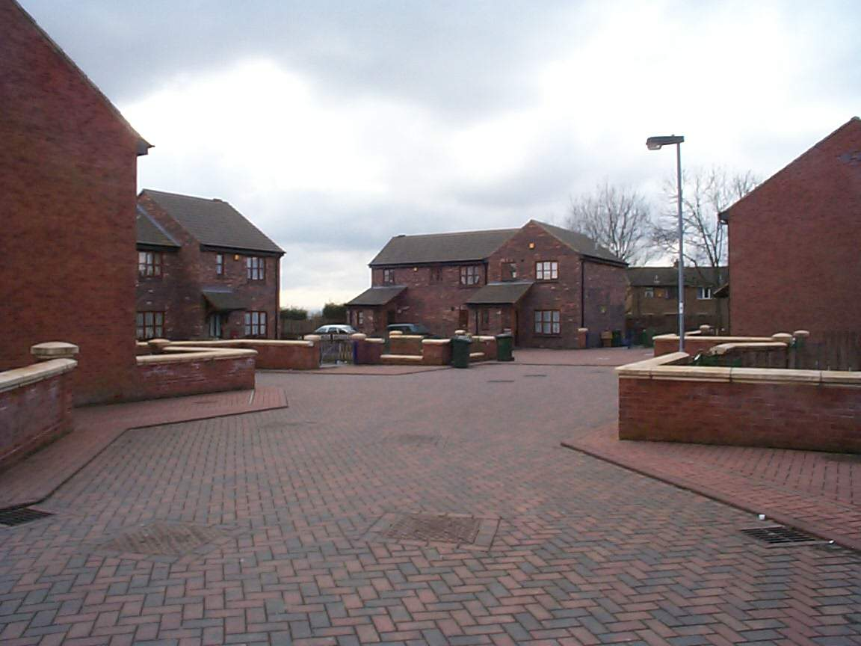
Dwelling entrances face the street, sightlines are not obstructed
Notes:
Houses are positioned to ensure maximum natural surveillance from neighbouring properties.
Dwellings are sited in small clusters with an unobstructed view of neighbours’ homes.
Entrances to dwellings should face onto the street.
Houses aren’t hidden behind foliage or high fences so that if an offender does try to break in, they are clearly visible to neighbours and passers by.

Slide 11
Access/Egress
Estates are designed to include a minimum number of access/egress points.
Based on principle that highly permeable estates (with lots of through movement)……
Provide convenient escape routes for offenders.
Give offenders the opportunity to attach the estate to their ‘awareness space’. If offenders pass through en route to school, friends, leisure activities, they become aware of potential targets.
Make it difficult for residents to distinguish between legitimate users of space or potential offenders. If challenged, an offender can say that they are within public space.
Notes:
SBD estates are designed to include a minimum number of access/egress points.
A permeable estate also gives offenders an excuse to be where they shouldn’t be. For example, if a stranger is walking on a footpath behind your house you have no right to apprehend them and if you do they can simply say that they are on their way to shops/neighbours etc.
A permeable estate also gives offenders an opportunity to attach the area to their awareness space. If they pass through an estate en-route to school, shops, work etc. they become familiar with who lives where, what car they drive, what time they leave for work etc. and they become more confident within their surroundings.

Slide 12
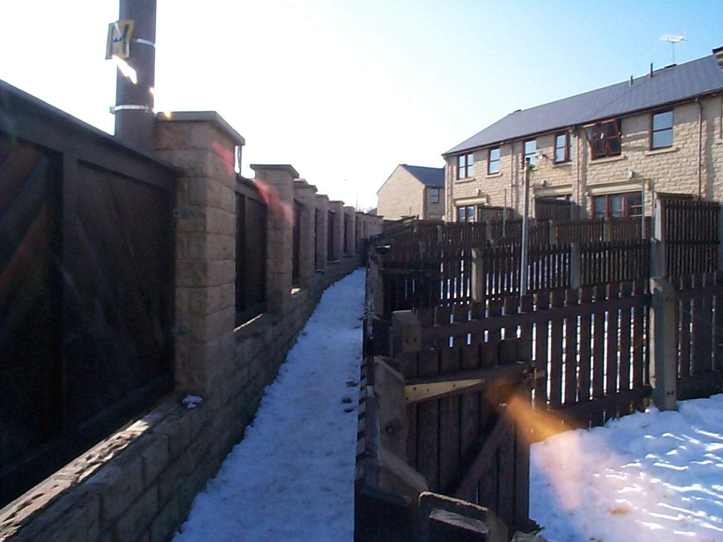
Unnecessary footpaths should be avoided
Notes:
Unnecessary footpaths, such as this, should be avoided.
This footpath leads to nowhere and runs at the back of these gardens.
If footpaths are unavoidable they should be routed at the front of dwellings, they should be located where they will be well used, they should be wide, well lit and with unobstructed views ahead.

Slide 13
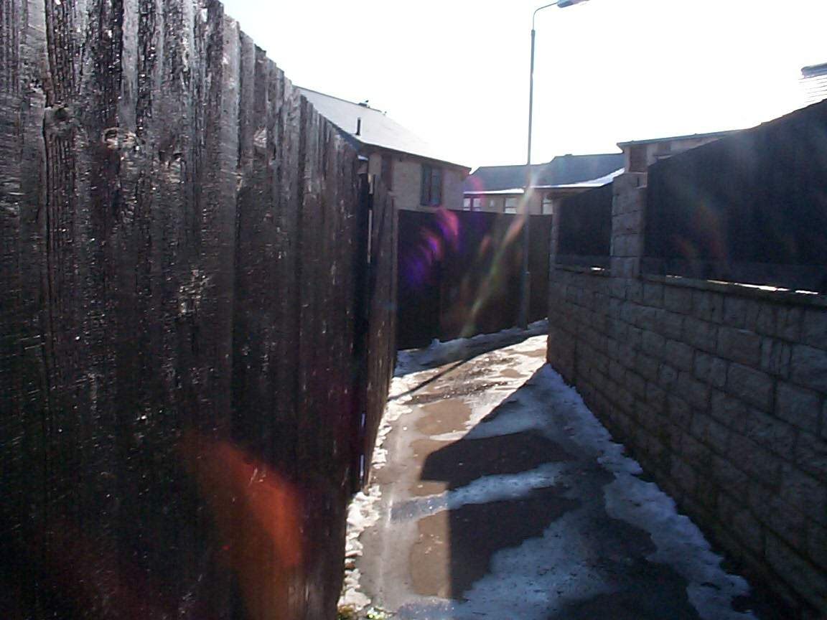
Where necessary, avoid footpaths which are dark, narrow, or have sharp bends
Notes:
Footpath is dark, narrow with a sharp bend obstructing view ahead.

Slide 14
Territoriality
Territoriality - builds upon Newman’s ‘Defensible Space’.
The physical design of a neighbourhood can either increase or inhibit people’s sense of control of the spaces in which they live.
Newman categorised space into public (road in front of property), semi-public (front garden), semi-private (back garden) and private (inside the property) – SBD aims to minimise public and maximise private space.
Like Newman, SBD advocates the principle that space should have a clearly defined ownership, purpose and role so that it is evident to residents who should and more importantly, who should not be in a given area.
Notes:
SBD draws upon Oscar Newman’s theory of ‘defensible space’. Newman argued that poorly designed buildings were discouraging residents from taking a normal ‘territorial’ responsibility for their buildings and public spaces.
He suggests that space should have a clearly defined ownership, purpose and role so that it is evident to residents who should, and more importantly, who should not be in a given area.

Slide 15
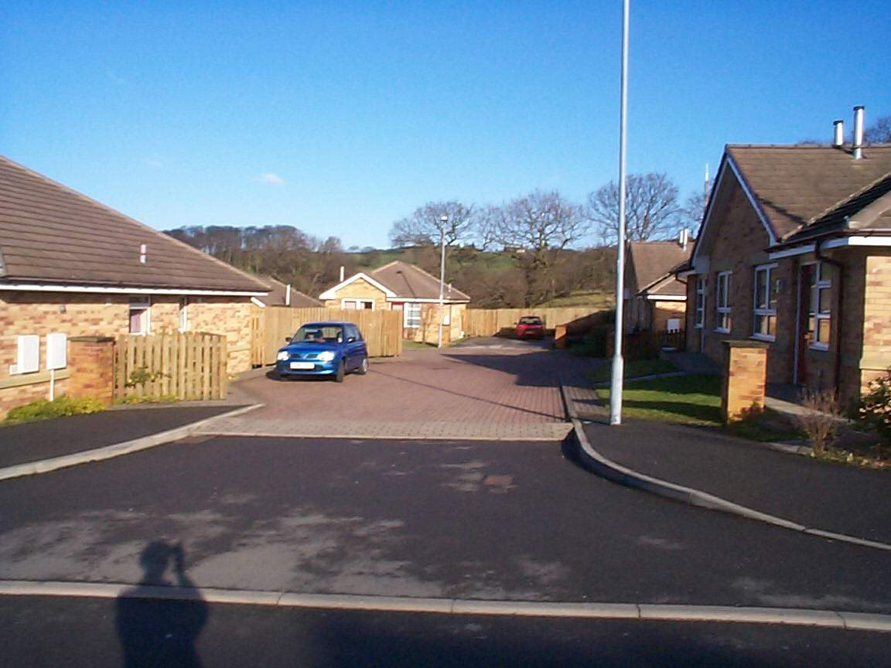
SBD ensures that non-residents know they are entering a private area
Notes:
Entrances to estates are narrowed with a change in road colour and texture to portray the impression to outsiders that they are entering a private area.

Slide 16
Management and Maintenance
SBD estates must have a programmed management system in place to maintain the area i.e. removing litter and graffiti, cutting grass.
Maintaining cleanliness encourages pride amongst residents and portrays an image to offenders that crime and disorder will not go unnoticed.
Notes:
SBD estates must have a programmed management system in place to maintain the area e.g. cutting grass, removing litter and graffiti.
The aim being to portray an image to potential offenders that one more act of crime or disorder will not go unnoticed.

Slide 17
This paper
Presents the findings of a re-evaluation of SBD housing in West Yorkshire, England.
Conducted early 2009.
Funded by University of Huddersfield, ACPO CPI Ltd, West Yorkshire Police – entirely independent.
Builds upon evaluation of SBD conducted in 1999 (Armitage, 2000)

Slide 18
Rationale
In June 2008, Quaver Lane in Bradford become 10,000th SBD property to be built in West Yorkshire
Publicity and interest in the scheme.
West Yorkshire county with most SBD properties (outside London)
2009 marked ten year anniversary of original evaluation of SBD in West Yorkshire (Armitage, 2000).
Need to update sample utilised in 1999 evaluation.

Slide 19
Updating the Sample
Original evaluation looked at 25 SBD and 25 non-SBD estates spread throughout West Yorkshire and began in 1999.
To allow at least one year of crime data post-residents moving in, sample included developments built in 1994-1998.
SBD standard updated regularly, however, 1999 saw major changes:
BS7950 (windows)
PAS 24 (doors)
The sample of SBD properties were did not include these changes.
Even without the changes introduced in 1999, the original study showed that houses built between 1994 and 1998 were improving dramatically.

Slide 20
SBD as an evolving standard
SBD estates
experienced 171%
of burglary of
non-SBD estates
SBD estates
experienced 130%
of burglary of
non-SBD estates
SBD estates
experienced 97%
of burglary of
non-SBD estates
SBD estates
experienced 51%
of burglary of
non-SBD estates
SBD estates
experienced 47%
of burglary of
non-SBD estates

Slide 21
Original sample did not represent an accurate reflection of SBD in 2009

Slide 22
2009 Re-evaluation

Slide 23
Methodology – Police Recorded Crime Data
Police Recorded Crime Data
SBD
Most Recent
Built April 2006-
March 2007
16 developments
342 properties
Same Street
Built April 2006-
March 2007
11 developments
101 properties
Matched Pairs
Built April 2006-
March 2007
16 developments
342 properties
Re-evaluating
Original Sample
2 developments
36 properties
Non-
SBD
West Yorkshire
867,885 properties
Same Street
11 developments
354 properties
Matched Pairs
16 developments
253 properties
Re-evaluating
Original Sample
2 developments
42 properties

Slide 24
Methodology – Self-Reported Crime Data
Self-Reported Crime Data
SBD
Matched Pairs
Built April 2006-
March 2007
16 developments
342 residents
Non-
SBD
Matched Pairs
16 developments
253 residents
11% response rate

Slide 25
Methodology – Visual Audits
Visual Audit Data
SBD
Matched Pairs
Built April 2006-
March 2007
16 developments
342 properties
Non-
SBD
Matched Pairs
16 developments
253 properties

Slide 26
Key Findings – SBD against West Yorkshire
Police Recorded Crime Data
SBD
Most Recent
Built April 2006-
March 2007
16 developments
342 properties
August 2007-July 2008
2 burglaries
5.8 per 1,000 properties*
August 2007-July 2008
19,701 burglaries
22.7 per 1,000 properties*
Non-
SBD
West Yorkshire
867,885 properties

Slide 27
Key Findings – SBD against Same Street
Police Recorded Crime Data
SBD
Same Street
Built April 2006-
March 2007
11 developments
101 properties
August 2007-July 2008
12 offences
118.8 per 1000 households*
0 burglary dwelling offences
0 per 1000 households*
Same Street
11 developments
354 properties
August 2007-July 2008
93 offences
262.7 per 1000 households*
5 burglary dwelling offences
14.1 per 1000 households*
Non-
SBD

Slide 28
Crime Categories recorded within the ‘Same Street’ sample (August 2007-July 2008)
Non SBD
SBD
Significant Difference
Crime Type
No.
Rate
No.
Rate
Assault
24
67.8
0
0.00
p<0.05
Criminal Damage
12
33.9
4
39.6
ns
Burglary Other
7
19.8
2
19.8
ns
Burglary Dwelling
5
14.1
0
0.00
p<0.05
Theft from vehicle
7
19.8
0
0.00
p<0.05
Theft of vehicle + twoc
3
8.5
0
0.00
ns
Other
35
93.2
6
59.4
-
Total
93
262.7
12
118.8
p<0.05

Slide 29
Key findings – SBD and non-SBD Matched Pairs
Police Recorded Crime Data
SBD
August 2007 – July 2008
44 crimes
128.7 per 1000 households
2 burglary dwellings
5.9 per 1000 households
Matched Pairs
Built April 2006-
March 2007
16 developments
342 properties
Non-
SBD
August 2007 – July 2008
42 crimes
166 per 1000 households
2 burglary dwellings
7.9 per 1000 households
Matched Pairs
16 developments
253 properties

Slide 30
Crime Categories recorded within the ‘Matched Pairs’ sample (August 2007-July 2008)
Non SBD
SBD
Significant Difference
Crime Type
No.
Rate
No.
Rate
Assault
7
27.7
17
49.7
ns
Criminal Damage
12
47.5
8
23.4
ns
Burglary Other
1
4.0
2
5.9
ns
Burglary Dwelling
2
7.9
2
5.9
ns
Theft from vehicle
1
4.0
2
5.9
ns
Theft of vehicle + twoc
0
0
3.0
8.8
ns
Other
19
75.1
9.0
26.3
ns
Total
42
166.0
44
128.7
ns

Slide 31
Re-evaluating Original 1999 Sample
Police Recorded Crime Data
SBD
Re-evaluating
Original Sample
2 developments
36 properties
Non-
SBD
Re-evaluating
Original Sample
2 developments
42 properties

Slide 32
1999 – 2009: Matched Pair One
SBD performs better than (or same as) non-SBD for both time periods.
Crime on SBD remained same.
Crime on non-SBD increased by 700%
Development
Number of Properties
Number of Crimes 1999/2000
Crime Rate per 1000 in 1999/2000
Number of Crimes 2007/2008
Crime Rate in 2007/2008
SBD Street
14
1
71.43
1
71.43
Non-SBD Street
14
1
71.43
8
571.43

Slide 33
1999 – 2009: Matched Pair Two
SBD performs better than non-SBD for both time periods.
Crime on SBD increased by 200%.
Crime on non-SBD increased by 20%.
Development
Number of Properties
Number of Crimes 1999/2000
Crime Rate per 1000 in 1999/2000
Number of Crimes 2007/2008
Crime Rate in 2007/2008
SBD Street
22
1
45.45
3
136.36
Non-SBD Street
28
5
178.57
6
214.29

Slide 34
Sustainability of Crime Reductions 1999-2009
SBD performs better than (or same as) non-SBD on both pairs in both time periods.
Pair one - SBD sustained crime reduction, non-SBD saw crime increase.
Pair two – SBD saw crime increase at a greater rate than non-SBD

Slide 35
Key Findings – Self-Reported Crime Data
Self-Reported Crime Data
SBD
3% victim of burglary
3% victim of theft of vehicle
6% theft from vehicle
Matched Pairs
Built April 2006-
March 2007
16 developments
342 residents
Non-
SBD
6% victim of burglary
6% victim of theft of vehicle
17% theft from vehicle
Matched Pairs
16 developments
253 residents

Slide 36
Key Findings – Self-Reported Crime Data
Crime Category
Percentage of SBD respondents - 2009
Percentage of non-SBD respondents – 2009
Theft of Vehicle
3% (1)
6% (2)
Attempt Theft of Vehicle
3% (1)
14% (5)
Theft from Vehicle
6% (2)
17% (6)
Attempt Theft from Vehicle
6% (2)
11% (4)
Theft of Bicycle
3% (1)
6% (2)
Attempt Theft of Bicycle
0% (0)
7% (3)
Burglary Dwelling
3% (1)
6% (2)
Attempt Burglary Dwelling
3% (1)
14% (5)
Theft of Property from Outside Dwelling
9% (3)
17% (6)

Slide 37
Key Findings – Visual Audits
Visual Audit Data
SBD
Matched Pairs
Built April 2006-
March 2007
16 developments
342 properties
Non-
SBD
Matched Pairs
16 developments
253 properties

Slide 38
Key Findings - Visual Audits
Visual audit measured 28 factors – graffiti, litter, lighting etc.
Zero being positive and five negative.
Maximum score - 28 x 5 = 2240, minimum score = 0.

Slide 39
Key Findings - Visual Audits
Of 16 matched pairs:
3 showed SBD to score higher (negative).
1 showed SBD and non-SBD to score the same.
12 showed SBD to score lower (positive).
Of the 32 developments, the best five (lowest score) were all SBD.
Of the 32 developments, the worst five (highest score) contained 4 non-SBD and 1 SBD.

Slide 40
Conclusions
Variety of methods and datasets to establish:
Whether SBD properties experience less crime than non-SBD properties.
Whether residents living in SBD properties have lower levels of fear of crime than non-SBD counterparts.
Whether SBD developments show less visual signs of disorder than non-SBD developments.
Whether SBD has maintained its effectiveness as a crime reduction measure.

Slide 41
Conclusions
SBD versus ‘West Yorkshire’
Burglary rates are lower within the SBD sample (5.8 per 1000 households as compared to 22.7).
All crime categories lower in SBD sample
SBD versus non-SBD ‘Same Street’
Burglary rates are lower within the SBD sample (0 burglaries per 1000 households as compared to 14.1).
All crime categories (with exception of criminal damage) lower in SBD sample.
SBD versus non-SBD ‘Matched Pairs’
Burglary rates are lower within the SBD sample (5.9 burglaries per 1000 households as compared to 7.9).
Assault, vehicle crime and burglary other higher in SBD sample.

Slide 42
Conclusions
1999 versus 2009
For both matched pairs SBD was performing either the same or better than non-SBD in both time periods of 1999/2000 and 2007/08
Pair one sustained crime reduction, non-SBD saw crime increase; pair two – SBD saw crime increase at a greater rate than non-SBD
Self-Reported Crime
Twice as many non-SBD residents had experienced a crime within the previous year.
For all crime categories, the proportion of SBD respondents experiencing the crime was lower in the SBD sample.
Visual Audits
SBD sample scored lower than non-SBD sample (317 against 388).
Of the 16 matched pairs, 3 revealed SBD to perform worse than non-SBD, 1 showed the same score and 12 showed SBD to perform better.

Slide 43
Conclusions
Original evaluation positive so why re-assess?
To be complacent about the merits of any crime prevention measure is to ignore the evolving nature of crime.
“Knowledge of what works becomes a wasting asset that needs constant replenishment” (Ekblom, 2002, p. 38).
SBD has continued to reduce crime and the fear of crime and SBD estates show less signs of visual disorder.
The effectiveness of SBD developments built more recently has exceeded that shown in the original evaluation.
However, the re-evaluation has identified particular SBD schemes which are not performing well - allowing interventions to halt any further decline.

Slide 44
Thank-you for listening
r.a.armitage@hud.ac.uk
+44 1484 473854

