Slide 1
Yes, No, Definitely, Maybe! What Works in Designing out Crime from Residential Housing, and what are the Implications for Policy and Practice? Dr. Rachel Armitage Reader (Criminology) Applied Criminology Centre University of Huddersfield

Slide 2
Today’s presentation
Review the evidence on what works in designing out crime from residential housing.
Highlight practical issues raised within the UK.
Bring together the evidence-base.
Offer guidance on how to avoid problems.
Although review of evidence is international, specific case studies are UK based.
Many of the problems and solutions are transferable.

Slide 3
CPTED in the UK – the last 15 years
Huge progress in this field since 1998.
Increasing recognition that design can impact upon crime and that crime reduction is not sole responsibility of the police.
Academic research, policy (planning and crime reduction) and practical application.
Accepted recognition that design can influence crime...however, little attention paid to which specific features influence crime.
Conflicting policies – agree that crime is important consideration in design, but differ on how this should be achieved.
Confusion amongst practitioners.

Slide 4
Major UK study (2010)
As a means of addressing this.
In 2010 UK Home Office funded major project ‘residential design and crime’.
Strengthen and update evidence base on impact of residential design on crime.
Clarify confusion.
Focus on developments classed as good practice/award winning – is ‘good design’ also achieving crime reduction?
Presenting the key findings today.

Slide 5
Brief overview of methodology
Scoping the evidence – 74 policy, guidance and research documents.
International - England, Scotland, Ireland, USA, Canada, Australia, Denmark, Italy, Holland, France (only those written in English).
Analysis of crime:
Macro level – 34 developments, 4091 properties, 3 police forces.
Larger sample but less detailed analysis (compare crime with government’s previous assessment in regular Housing Audit).
Able to look at more properties but relying on assessments already conducted.
Micro level – 12 developments, 2193 properties, 3 police forces.
Smaller sample but very detailed analysis (compare crime against individually assessed features of EVERY property/development).
Features we chose and we assessed.

Slide 6
Focusing on Micro/Case Study strand
12 developments, 2193 houses, 3 police forces.
Research team (for each development):
Conducted interviews ‘on-site’ :
With police Architectural Liaison Officer, Local Authority Planning Officer, Neighbourhood Policing Team
Discussed questions, raised issues while on-site, allowed comments to be set in context.
Completed an Design Features Checklist:
Data relating to 31 design features (property) and 19 design features (development) for EVERY property and development.
Completed a Design Quality Checklist:
Data relating to design quality of EVERY property and development.
Huge source of data to work with.

Slide 7
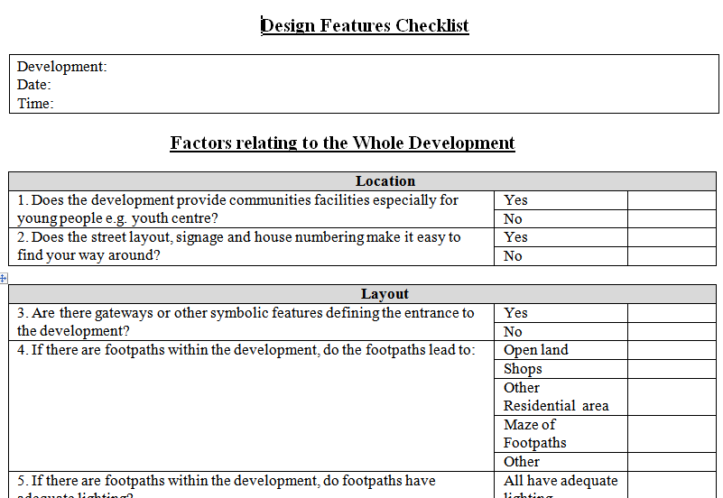
Design Features Checklist

Slide 8
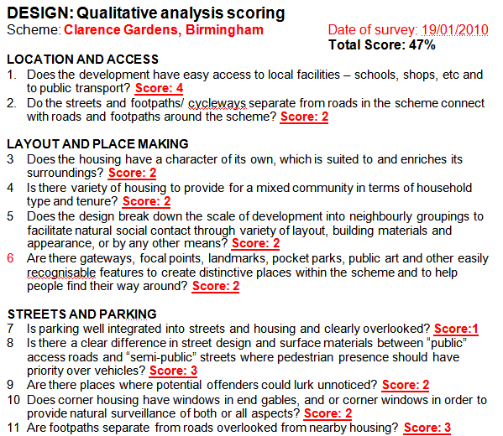
Design Quality Checklist

Slide 9
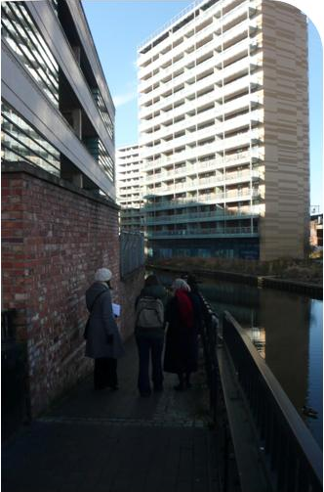
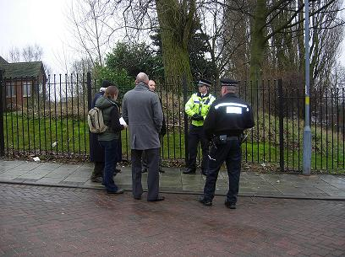
Conducting the interviews
Unique, painstaking methodology – detailed results.
One element which worked well – interviews on site.
Interview and walk-about.
See issues in context.
Challenge if notice other problems.
Agencies talked to each other!

Slide 10
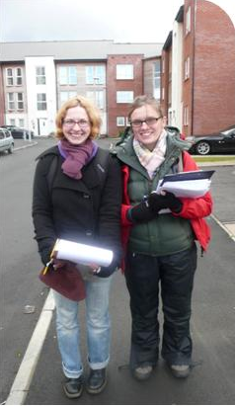
Completing the checklist (2193 properties)
Another element which worked very well.
Physical completion of checklists for every property.
Very time consuming.
BUT able to assess ACTUAL layout and use of every property/development as opposed to making predictions remotely.

Slide 11
Two key themes emerged….
Impact of car parking
Impact of connectivity/through-movement

Slide 12
Impact of car parking on residential design

Slide 13
Car parking and residential crime
The design and layout of car parking provision within residential housing can have a significant impact on crime and anti-social behaviour.
Surprisingly, consistent priority/concern at all sites.
Poorly designed car parking not just linked to vehicle crime, can also lead to problems with:
Theft of and from motor vehicle
Criminal damage.
Youths causing annoyance.
Neighbour nuisance.
Violent crime.

Slide 14
Car parking and crime – what does previous research say?
Brown and Altman (1983):
Studied the features of burgled/non-burgled properties and found that those without a garage were more likely to have experienced a previous burglary.
Cromwell at al (2001):
Used staged-activity analysis to identify features which make a property vulnerable. Burglars found properties without a garage to be more vulnerable to burglary.

Slide 15
Car parking and crime – what did we find?
Macro: Government housing assessors scored properties:
To what extent is... ‘car parking situated as not to detract from the street scene’ (1-3).
A score of 1 would suggest parking which DID detract from the street scene and 3 parking which DID NOT.
As compared to base score of 1:
Developments which scored 2 experienced 40% less vehicle crime and 68% less criminal damage.
Developments which scored 3 experienced 74% less criminal damage than those scoring 1 (no sig diff between 2 and 3 for vehicle crime).
Cars parked away from street scene (garage, car park) experienced lower crime.

Slide 16
Car parking – what did we find?
Micro analysis.
Properties with communal parking experienced higher levels of vehicle crime than on plot parking.
Developments with allocated visitor parking experienced lower crime than those which did not provide visitor parking.

Slide 17
Common Practical Issues
Case studies

Slide 18
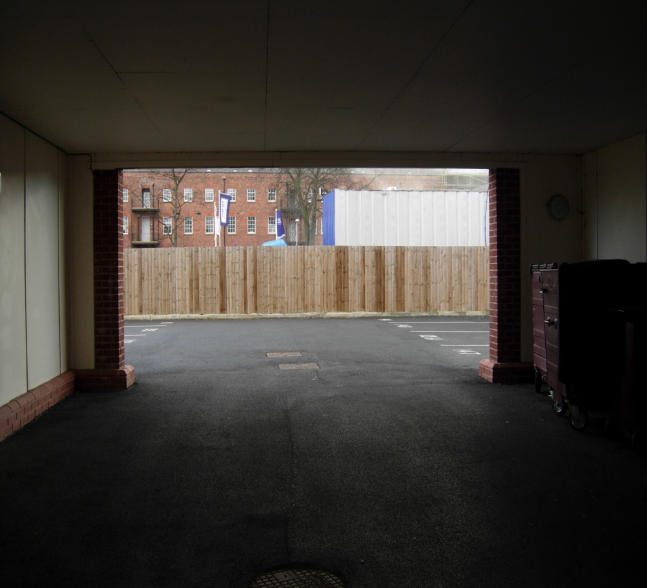
Rear parking courts
Option for parking away from frontages.
By very nature out of view of properties and street users.
Often accessed via archway between/under dwellings.
Archway entrances can be narrow, dark with no surveillance.
Options to gate – but rely on people using them.

Slide 19
Rear parking courts - implications
Many residents, even where no alternative, were not parking in rear parking courts (their allocated parking).
Fear for own safety
Concern regarding safety of vehicle.
Do not want to carry child, bags, work from court to house.
Where unused (and this was most) – rear courts used for anti-social behaviour:
Youths hanging around.
Joy-riding.
The more used for illegal activity, less likely to be used by residents (and the cycle continues).

Slide 20
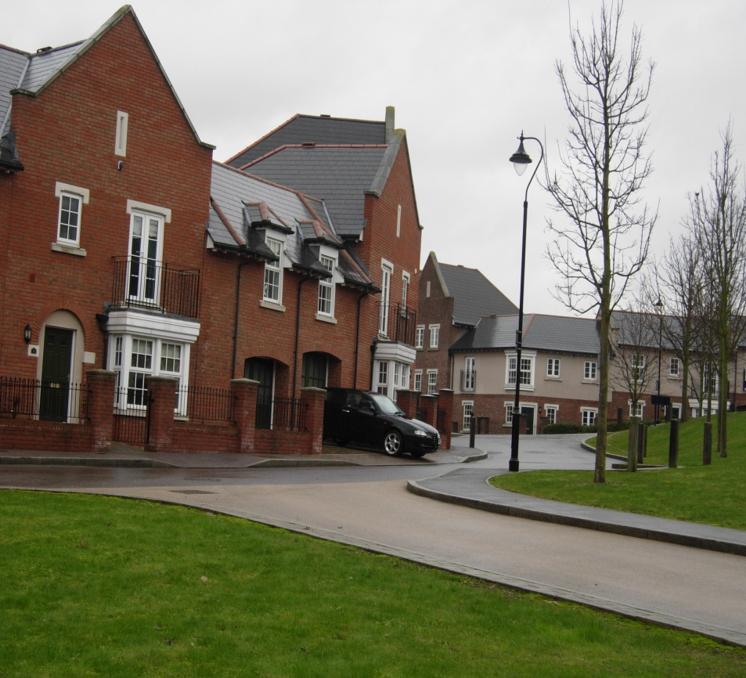
Inappropriate parking solutions
Developer/architect attempt to solve issue of cars dominating which led to unintended, negative consequences.
Driveway too short for car – encourage parking in garage of rear court.
Residents continued to use drive (convenience and safety) with cars left jutting onto street.

Slide 21
Inappropriate solutions - implications
Residents continued to use driveway as a parking space to be close to property:
Safety (their safety and safety of vehicle).
Convenience.
As a consequence, cars left jutting onto the pavement/road – blocking the path.
This design solution made three incorrect assumptions:
Residents are happy for car to be parked out of sight.
Residents do not mind walking a distance to their property.
Residents will use garage as a parking space.
Management companies were employed to enforce parking regulations (cost).

Slide 22
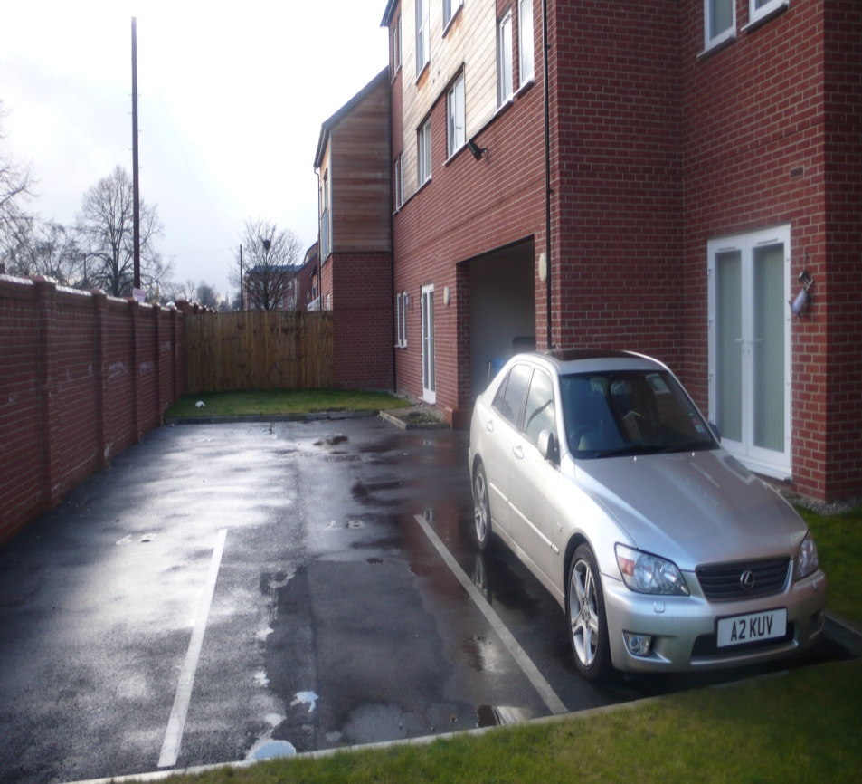
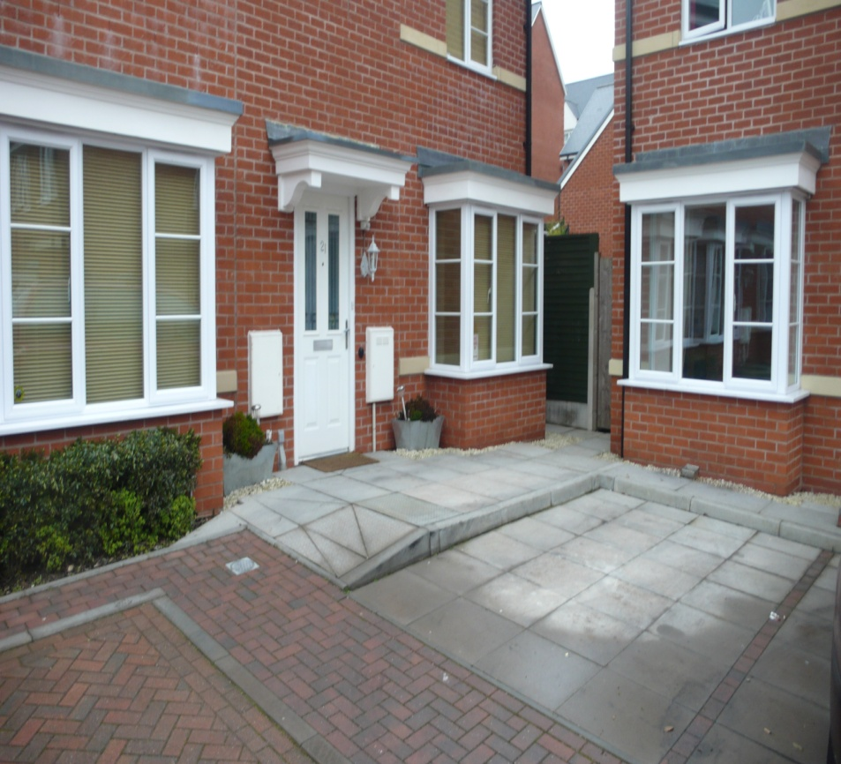
Inconsiderate allocation
Architect/developer had not considered the end user in design of parking.
Two properties each look directly onto parking space.
Space is for one property, so someone is looking out onto neighbour’s car.
If work van, 4x4 could cause problems.
Patio doors almost hit car!

Slide 23
Inconsiderate allocation – implications
Neighbours left angry notes on parked cars.
Analysis of crime statistics - two serious crimes relating to neighbour disputes over parking:
One public order offence
One assault.

Slide 24
Car parking – key research findings
Rear parking courts experience higher levels of vehicle crime and criminal damage and facilitate access to the rear of properties.
Developments with allocated visitor parking experienced less crime.
Developments with communal parking experienced more crime than those with on-plot parking.
Residents prefer to park close to their property, where not provided they will find their own solutions.
Lack of consideration for users can result in expensive retrofit solutions (management companies).
Disputes relating to car parking can lead to more serious violent crimes.

Slide 25
Impact of connectivity on residential design

Slide 26
Connectivity and residential crime
The type of road serving a property/development.
Through road
Cul-de-sac
True (no footpaths) or leaky (external connections).
Linear (can see to the end) or sinuous (no visibility to end).
Movement within and throughout the development.
Presence of footpaths
Where do they lead to?
Rear/side/front of properties.
Length/width
Lighting

Slide 27
Road layout – what does previous research suggest?
Hillier and Sahbaz (2009) argue that: “There are insufficient empirically based studies to form any conclusions regarding the impact of road layout on crime”.
Review of 74 key documents suggests otherwise.
Many methodologically strong studies presenting clear findings relating to impact of connectivity on crime.

Slide 28
What is the problem with connectivity?
Put simply, the connectivity debate centres on following arguments:
Increased connectivity/through movement :
Positive: Less reliance on the motor vehicle.
Positive: More pedestrians using the street creates more eyes on the street/surveillance.
Negative: Increased access/escape for offenders.
Negative: Increased anonymity for offenders (i.e. Just a passer-by).
Negative: Increased opportunity for offenders to become aware of a target.
Review of literature favours argument that increased connectivity leads to increased crime, but ...
One methodology has produced very different findings.
Our study revealed that you can develop with high levels of connectivity IF this is done with security in mind/in consultation with police.

Slide 29
Summary of studies: Increased connectivity = increased crime (variety of methodologies)
Being located on a development with high levels of connectivity INCREASES risk of crime. | Bevis and Nutter (1977), Rubenstein et al (1980), Taylor and Gottfredson (1987), Van der Voordt and Van Wegen (1990), Poyner and Webb (1991), Beavon et al (1994), Mirlees Black et al (1998), Rengert and Hakim (1998), Hakim et al (2001), Taylor (2002), Nubani and Wineman (2005), Yang (2006), Armitage (2006), Armitage et al (2010).
Being located on a travel path INCREASES risk of crime. | Letkemann (1973), Brantingham and Brantingham (1984), Feeney (1986), Gabor et al (1987), Poyner and Webb (1991), Wiles and Costello (2000), Rengert and Wasilchick (2000).
Being located on a cul-de-sac REDUCES risk of crime. | Bevis and Nutter (1977), Johnson and Bowers (2010), Armitage et al (2010).
Closing off streets reduces crime. | Matthews (1992), Atlas and LeBlanc (1994), Newman (1995,1996), Lasley (1998), Zavoski et al (1999), Eck (2002).
Notes:
A range of studies conducted using a variety of methodologies have concluded that increased connectivity increases crime risk.
Pulling out the findings from two of these studies ...particularly rigorous.

Slide 30
Johnson and Bowers (2010)
118,161 homes (UK).
All things being equal, relative to a property on a local road (connect neighbourhoods),a property on a major road (connect towns, cities) …
Expected increase in burglaries of 22%.
For properties on private roads (no connections), relative to local roads…
Expected decrease in burglaries of 43%.
For a street segment....for each additional link to other roads the predicted burglary count increased by 3%
Culs-de-sac safer than through roads.
Sinuous culs-de-sacs safer than linear.

Slide 31
Armitage et al (2010)
6,000 properties (UK).
Compared to ‘true cul-de-sac’ (no connections), a property on a through road experienced…
93% more crime.
Compared to ‘true cul-de-sac’ a property on a ‘leaky cul-de-sac’ (connections) experienced…
110% more crime.
As with Johnson and Bowers (2010) the study identified that crime risk was lower on…
Sinuous as opposed to linear culs-de-sac.

Slide 32
Road layout: what does previous research suggest?
In his review of the evidence, Taylor (2002) concludes that:
“Neighbourhood permeability is....one of the community level design features most reliably linked to crime rates, and the connections operate consistently in the same direction across studies: more permeability more crime” (Taylor, 2002, p.419).
Assertion, is not entirely correct as several studies – those conducted using Space Syntax methodologies, have concluded that increased levels of connectivity have a beneficial impact on crime.
Space Syntax is a mathematical approach which (remotely) takes account of street network and how each street segment connects to other streets in the area.

Slide 33
Summary of studies: Increased connectivity = less crime (Space Syntax)
Being located on a development with high levels of connectivity REDUCES risk of crime. | Hillier and Shu (1998), Shu (2000), Hillier (2004), Hillier and Sahbaz (2009).

Slide 34
Road layout – what does the research say?
Historically (unhelpfully) presented as a polarised debate.
Disparity likely to relate to methodological differences.
Space syntax is computerised method which has to make some presumptions about layout, movement and ACTUAL USE.
Where development is physically assessed fieldworkers can make clearer distinctions regarding layout, official and unofficial footpaths and observe ACTUAL movement.
Rather than focus on differences, what are consistent findings and how can we compromise?
Consistent finding across all methodologies is that ‘leaky’ culs-de-sac are the least safe.
Compromise - detailed case study analysis (UK) showed developments can have high levels of connectivity and low crime.

Slide 35
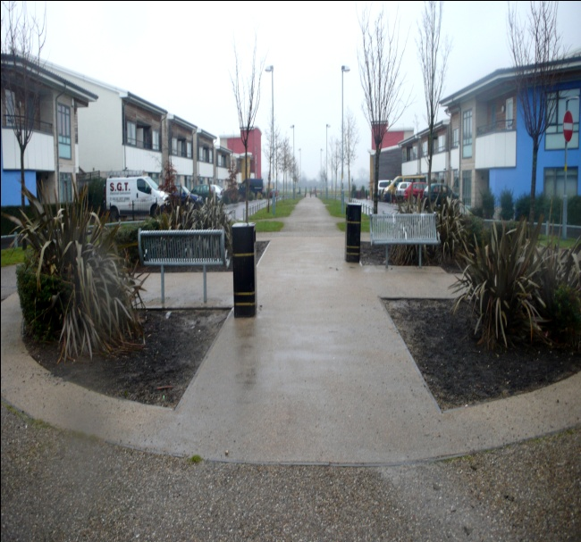
Road layout – footpaths
Example of compromise...
One development in UK, high crime area. Large number of footpaths but no burglaries in three year period.
Developers insisted on high levels of connectivity BUT did so with close consultation with police.
All footpaths ran at the front of houses, all required and well-used, wide and well lit.
NO REAR FOOTPATHS!

Slide 36
Issues to consider
Connectivity

Slide 37
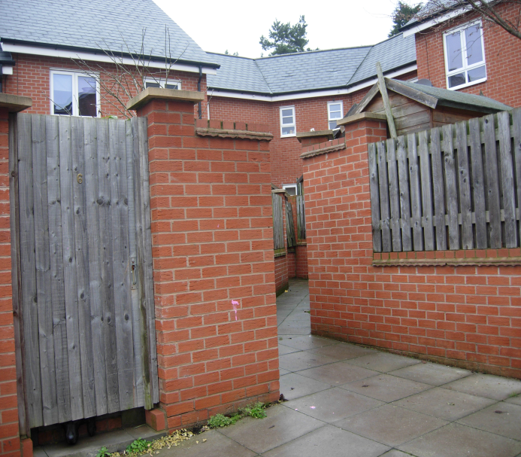
Road layout – footpaths
Major risk to increasing crime...
Rear footpaths.
Little or no surveillance.
Not direct.
Poor lighting.
Hiding places.

Slide 38
Road layout – footpaths
Side and rear footpaths leave properties vulnerable.
Stairway footpath – design expert thought was an excellent feature.
Analysis of offender modus operandi showed large number of burglaries committed with access via this boundary wall.

Slide 39
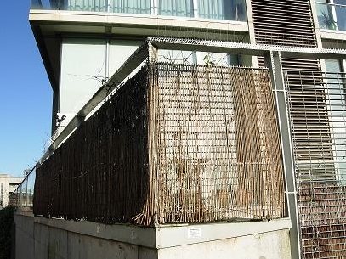
Road layout – footpaths
Corner plots bounded by footpaths – vulnerable to crime.
This property bounded by a canal footpath.
Relatively low crime development.
This property has spikes, anti-climb paint, CCTV.

Slide 40
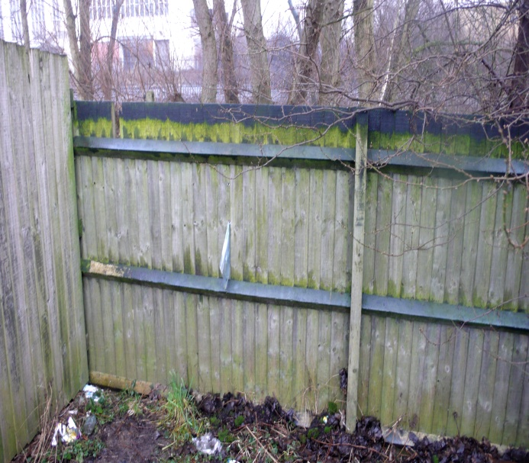
Road layout – footpaths
Although footpaths within developments increase crime risk...
Careful when closing or re-routing footpaths following re-development.
New cul-de-sac had closed access to busy walkway.
Fieldworkers witnessed people climbing (rear garden fence) to gain access.
Anti-climb paint not preventing problem.

Slide 41
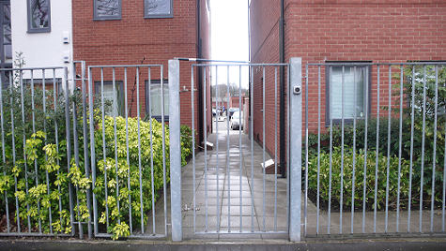
Road layout – gated developments
Gated developments viewed by residents as safest option – research did not confirm this.
Detailed analysis – unpopular with planners, unsuccessful at minimising crime.
Planners felt privacy could be achieved using subtle techniques and expressed view that they would not repeat this design.

Slide 42
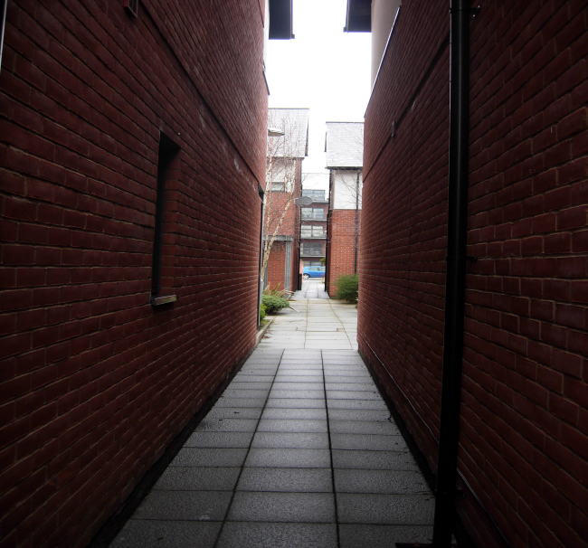
Road layout – gated developments
Main problem was gating at boundary but little further consideration for crime prevention.
High internal connectivity.
Dark, narrow alleys with no surveillance.
Reliance on gates alone.
Notes:
One of the main problems with the gated developments was that, although gated at the boundary, once inside, these developments were highly permeable with an abundance of alleys and pathways which were narrow, dark and with little or no surveillance from surrounding properties.
As if they were relying on the gates to do the job and it didn’t matter what happened inside.

Slide 43
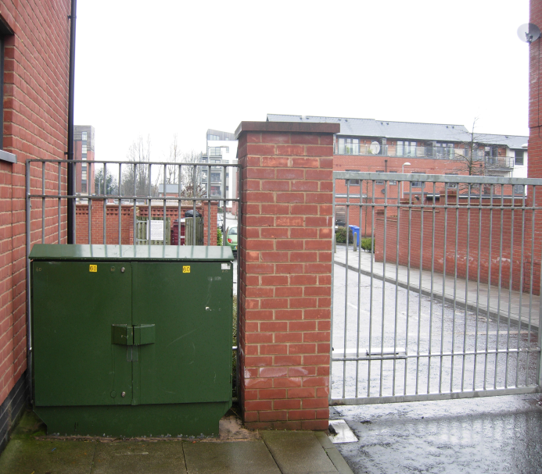
Road layout – gated development
Security of gates compromised by poor positioning of street furniture, street signs and utility boxes.
Climbing aides for offenders.
Analysis of crime data showed that properties near to these points were the most vulnerable.
Notes:
In addition to the internal connectivity, the security offered by the gates was compromised by the poor positioning of street signs, utility boxes and street furniture which acted as climbing aides for offenders wishing to scale the gates. As the developments portrayed an impression of high security, yet offered little in terms of actual protection, it could be argued that the gating acts to entice offenders into the area – portraying an image that the development contains valuable possessions which require additional protection.

Slide 44
Road layout – key findings
The majority of research supports the notion that being located on a development with high levels of connectivity increases risk of crime.
True culs-de-sac experience the lowest levels of crime.
Leaky culs-de-sac experience the highest levels of crime.
Sinuous culs-de-sac are safer than linear.
Gated developments do not experience lower levels of crime.
Footpaths which run at the rear and side of properties increase vulnerability.
Footpaths can be included within a development without increasing crime risk IF planned in close consultation with the police – key to avoid rear footpaths.

Slide 45
Why does this matter – policy and practice?
Why does it matter to be specific regarding impact of individual design features on crime.
Won’t there always be differing findings in research.
Becomes a problem where conflicting findings make it difficult for practitioners to know what guidance to offer or what decisions to make.
UK has seen progress in convincing agencies that you should design in crime prevention, but much slower to confirm HOW.

Slide 46
Why does this matter – policy and practice?
Become a greater priority amidst rapidly changing system within planning for crime prevention in UK.
Changes in police role and planning policy.
Police: reductions in budgets
Review of ALO/CPDA in August 2009 = 305 posts.
Not without problems, but police able to offer advice on most new developments, analyse police data and share knowledge of local crime problems.
Two year period of cuts, crime prevention vulnerable.
Now = 230 posts.
Concern regarding the resources that remain to offer advice regarding crime prevention within design?

Slide 47
Why does this matter – policy and practice?
Compounded by major changes in planning system: deregulation to stimulate growth and give power to communities (cause some concern).
Localism Act (2011):
Thousands of pages of planning guidance (PPGs and PPSs) replaced by 50 page National Planning Policy Framework.
Potential loss of valuable evidence-based guidance.
Neighbourhood Plans.
“Allow communities to come together through a local parish council or a neighbourhood forum and say where they think houses, businesses and shops should go, and what they should look like” (DCLG, 2011, p. 11).
To what extent do local communities possess the knowledge to make evidence based decisions (with less guidance from police).

Slide 48
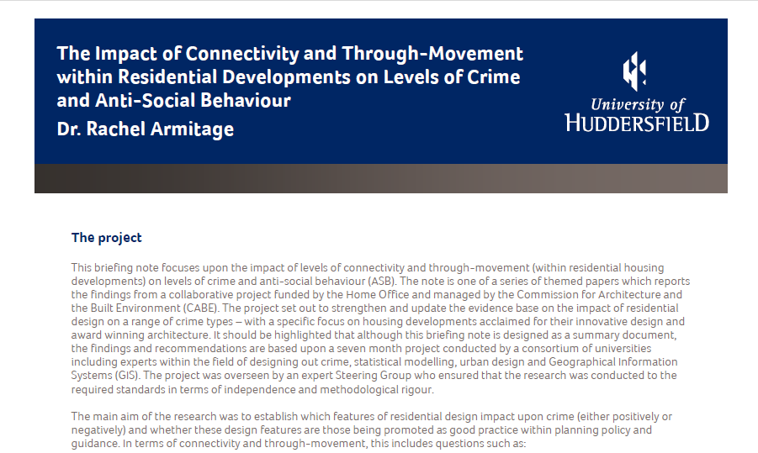
Briefing Notes – Home Office, ACPO, Design Council
Strong view that it is essential, with reduced staff and increased responsibilities, that communities have evidence to make choices.
Decisions they make will influence quality of neighbourhood for years.
First step production of series of clear/simple Briefing Notes (Home Office, ACPO, CABE) .
To be used by those making decisions.

Slide 49
Thanks for listening
Dr. Rachel Armitage
E-mail: r.a.armitage@hud.ac.uk
Web: http://www.hud.ac.uk/acc/staff/drrachelarmitage.php

