Slide 1
Crisis or Opportunity? Tips for Collection Development in an OA World
Jill Emery
Portland State University
Graham Stone
University of Huddersfield
This work is licensed under a Creative Commons Attribution 3.0 Unported License

Slide 2
Reproduced with kind permission from Neil Jacobs, Jisc

Slide 3
OAWAL: Open access workflows for academic librarians

Slide 4
What Is OAWAL?
A work in progress
Crowdsourcing comments through 2015
Goal is to produce an openly accessible wiki/blog reference site for librarians working on the management of open access workflows
To contain best practice guidance and examples of workflows
URL: https://library3.hud.ac.uk/blogs/oawal/

Slide 5
What Is OAWAL?
OAWAL will contain international examples
Aimed at those who may be new to or whose jobs now include OA
OAWAL is agnostic regarding the route to OA
OAWAL was not created to be prescriptive of any one specific business model or philosophical arguments over business model selection
URL: https://library3.hud.ac.uk/blogs/oawal/

Slide 6
What Is OAWAL?
Advocacy
Workflows
Standards
Library as Publisher
Creative Commons
Discovery
URL: https://library3.hud.ac.uk/blogs/oawal/

Slide 7
Advocacy
Internal Library Message on Open Access
Communication of OA Opportunities to Your Academic Community
Mandates/Policies
Promotion of Your Repository
Budgeting for Open Access Publication
Reconfiguration of Staff
URL: https://library3.hud.ac.uk/blogs/oawal/

Slide 8
WORKFLOWS
The ‘traditional’ green model
Gold Open Access
Funder mandates/policies for
green and gold
The effect of gold on workflows and staffing
Pure gold vs. hybrid journals
APC processing services
URL: https://library3.hud.ac.uk/blogs/oawal/

Slide 9
Standards
Open Access Metadata & Indicators
ORCID
FundRef
CrossMark
Preservation & Storage Formats
Alternative Metric Schemes
URL: https://library3.hud.ac.uk/blogs/oawal/

Slide 10
Library as publisher
The new university presses
Hosting
Librarian expertise
Publishing
Challenges
Sustainability
URL: https://library3.hud.ac.uk/blogs/oawal/

Slide 11
Creative commons
The link between CC licences and open access
Copyright and Creative Commons
Funder mandates
Third Party rights and author rights
Commercial Use Questions
Benefits of publishing with a Creative Commons licence
URL: https://library3.hud.ac.uk/blogs/oawal/

Slide 12
discovery
Addition of global OA Content to library catalogues & discovery systems
Participation in OAISter
Necessary Metadata
Exposure of local repository on Google
Indexing of gold OA journals and the need for OA designation
Usage data (PIRUS, IRUS-UK, COUNTER 4)
URL: https://library3.hud.ac.uk/blogs/oawal/

Slide 13
Crowdsourcing
Comments and suggestions from around the world
Australia, the United States (incl. Californian Digital Library and SPARC), South Africa (Stellenbosch University) and the UK (incl. Jisc and SCONUL)
Where does OAWAL overlap with work already in progress? California Digital Library, SPARC, Jisc Monitor
Further discussions at conferences and workshops are planned in 2014/15
We would like to encourage your feedback this afternoon
URL: https://library3.hud.ac.uk/blogs/oawal/

Slide 14
Exercise: The H form
Themes
Identification/selection of OA content
Budget management to support OA production
Promotion of OA options to your academic community
Workflow for OA management
Reconfiguration of staff for OA management
Local content creation

Slide 15
Workshop: The H form
We’ve chosen themes that we hope interest you or tell us what themes you want to explore.
☹ Write down barriers (issues and challenges) to achieving these positive states/words (one per post-it) – 5 mins
As a group add these to the sheet, clustering where themes/duplicates appear. 5 mins
☺ Individually jot down positive words and phrases associated with the theme; what does success look like? (one per post-it) – 5 mins
As a group add these to the sheet, clustering where themes/duplicates appear. 5 mins
As a group write down suggestions for resolving these barriers – the idea space! Turn these into a top 3 priority actions/follow-ups. 10 mins

Slide 16
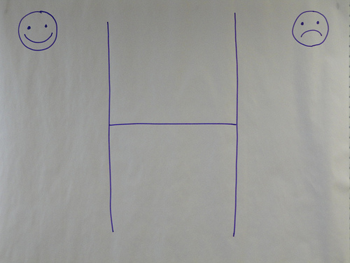
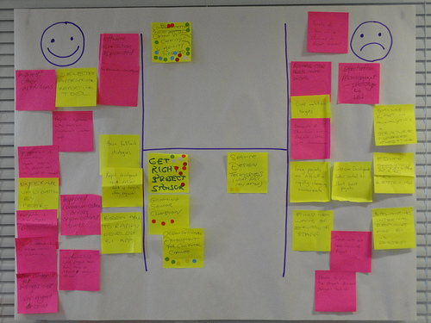
Workshop: The H form
From this:
To this

Slide 17
Further Questions?
https://library3.hud.ac.uk/blogs/oawal/
Jill Emery: jemery@pdx.edu
Graham Stone: g.stone@hud.ac.uk
This work is licensed under a Creative Commons Attribution 3.0 Unported License
http://eprints.hud.ac.uk/22111/

