Slide 1
Cracking the Discovery Code: why discovery appeals to librarians
Graham Stone
Information Resources Manager

Slide 2
Some context
Webscale discovery systems
Pre-harvested content with a single search interface
On the market for approximately 5 years
Summon, Worldcat local, Primo Central, Ebsco Discovery Service
Federated search and link resolvers
Out of scope for this session
Although still important!
…and don’t forget KBART (more on that later)

Slide 3
UK’s 1st Summon customer 2009

Slide 4
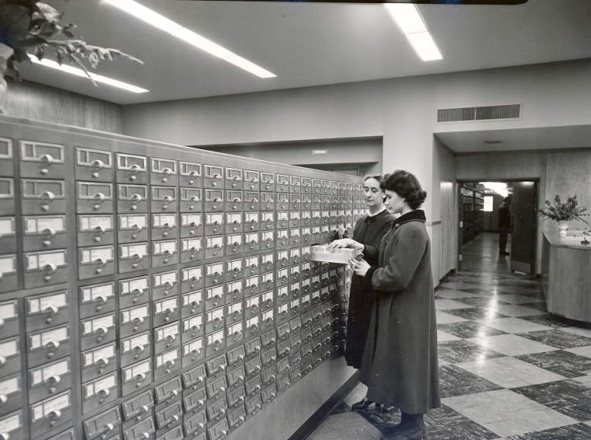
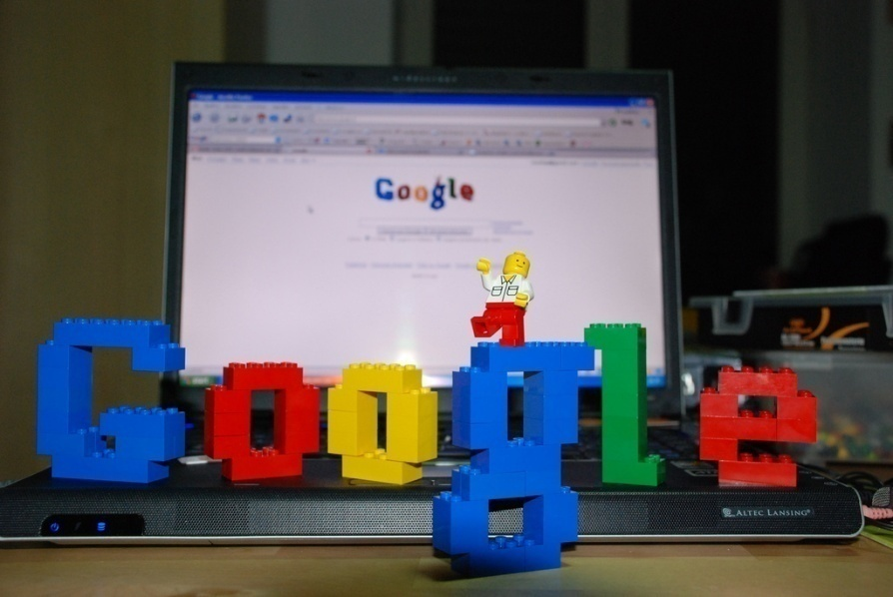
E-resources @ Huddersfield
“Why is Google so easy and the library so hard?” [Tenopir, 2009]
http://www.flickr.com/photos/ppl_ri_images/4019188259/
“Why do we want to teach our users to be librarians?” [Pattern, 2009]
http://www.flickr.com/photos/manfrys/2226178289/

Slide 5
What do we know about webscale discovery?
Web Scale Discovery Services increase accessibility of e-resources and will definitely on the whole increase full-text downloads
Undergraduates generally love discovery services
Librarians reactions towards discovery services are mixed at best
Aaron Tay, Senior Librarian at National University of Singapore
8 things we know about web scale discovery systems in 2013
http://tinyurl.com/naflluz

Slide 6
The usage element
Libraries are under increasing pressure to show value for money
Work on the Library Impact Data Project has shown a link between e-resource usage and attainment/retention

Slide 7
COUNTER downloads Big deal 1

Slide 8
COUNTER downloads Big deal 2

Slide 9
COUNTER downloads Big deal 3

Slide 10
COUNTER downloads Society publisher

Slide 11
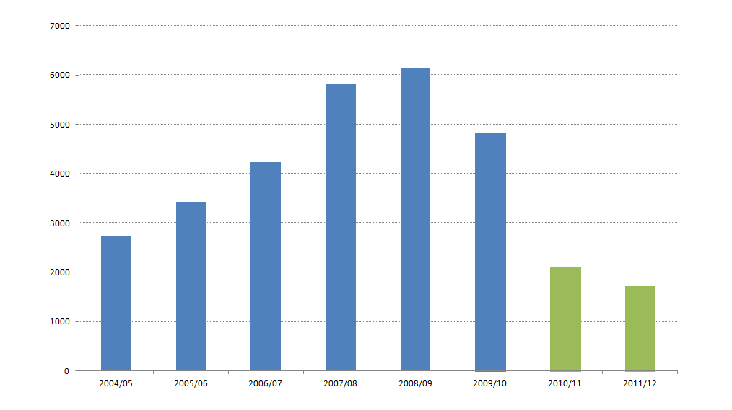
COUNTER downloads Publisher not indexed in Summon

Slide 12
COUNTER downloads Full text aggregator – in Summon!

Slide 13
COUNTER downloads Full text aggregator – not in Summon!

Slide 14
COUNTER downloads A&I database

Slide 15
The bigger picture It’s not just a Huddersfield thing
Grand Valley and Manitoba saw a dramatic increase in FT downloads for e-journals and a drop in A&I after Summon implementation
UTSA saw FT downloads increase by 23% after Summon implementation
ODU saw increases after implementation of WorldCat Local
“…lowest amount of usage in a single month for the year of 2011 was higher than the highest usage month in 2010”

Slide 16
The user’s view Enhancing the student experience
https://flic.kr/p/ohRcCA

Slide 17
Abdul PHD student and part-time lecturer
Summon is bloody brilliant… …It gives fast, efficient and above all relevant search results

Slide 18
Nicole Undergraduate student
You’ve not got as many fiddly bits to do; you just type in what you want. It’s almost like Google Scholar, so I like it for that.

Slide 19
Senior Lecturer University of Huddersfield
I love Summon, even an idiot like me can use it

Slide 20
The librarian’s view Culture shock?
https://flic.kr/p/btbrEW

Slide 21
Dave Pattern University of Huddersfield
If your idea of a “good time” is to scare undergraduates in training sessions by showing them journal database interfaces — “it’s OK, I’m a friendly librarian and I’m here to show you just how hard it can be to find an article!” — then it’s probably high time you sought medical counselling ;-)”

Slide 22
Pete Coco Grand Valley State University via ILI-L List
What Summon frees me to do... ...particularly in freshman courses, is to focus more on the concepts of information literacy that this system so elegantly demonstrates. What is peer-review? Why does it matter? What is the difference between Google and the library? How does Google decide what to show you? Summon? Why isn't the stuff in Summon in Google?”

Slide 23
Dr Antony Osborne Academic Librarian, University of Huddersfield
The greatest impact on the way we teach information literacy is that it feels much simpler than having to go through lots of different databases with students

Slide 24
Cancellation and acquisition A deal breaker?
TERMS top 14 deal breakers when licensing electronic resources
#10 Ability to use the resource and resource records with third party discovery tools
https://library3.hud.ac.uk/blogs/terms/terms/acquiring-new-content/

Slide 25
References
Graves, T., & Dresselhaus, A. (2012). One academic library, One year of web-scale discovery. The Serials Librarian, 62(1-4), 169-175. doi: 10.1080/0361526X.2012.652915
Kemp, J. (2012). Does web-scale discovery make a difference? Changes in collections use after implementing Summon. In M. P. Popp & D. Dallis (Eds.). Planning and implementing resource discovery tools in academic libraries (pp. 456-468). Hershey, PA: IGI Global.
O'Hara, L. (2012) Collection Usage Pre- and Post-Summon Implementation at the University of Manitoba Libraries. Evidence Based Library and Information Practice, 7(4), 25-34. http://ejournals.library.ualberta.ca/index.php/EBLIP/article/view/12166
Thoburn, J., Coates, A., & Stone, G. (2012) Simplifying resource discovery and access in academic libraries: Implementing and evaluating Summon at Huddersfield and Northumbria Universities. In M. P. Popp & D. Dallis (Eds.). Planning and implementing resource discovery tools in academic libraries (pp. 580-597). Hershey, PA: IGI Global. http://eprints.hud.ac.uk/12138/
Way, D. (2010). The impact of web-scale discovery on the use of a library collection. Serials Review, 36(4) 214-220. doi: 10.1016/j.serrev.2010.07.002
Emery, Jill and Stone, Graham (2013) TERMS: Techniques for electronic resources management. Library Technology Reports, 49(2). pp. 5-43

Slide 26
Thank you!
Graham Stone
g.stone@hud.ac.uk
@Graham_Stone
#6terms
http://eprints.hud.ac.uk/21270
This work is licensed under a Creative Commons Attribution 3.0 Unported License

