Slide 1
The impact of library usage: from research project to the development of a shared library analytics service for UK academic libraries
Graham Stone
Information Resources Manager

Slide 2
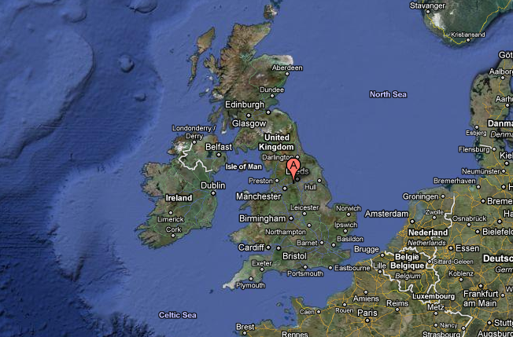
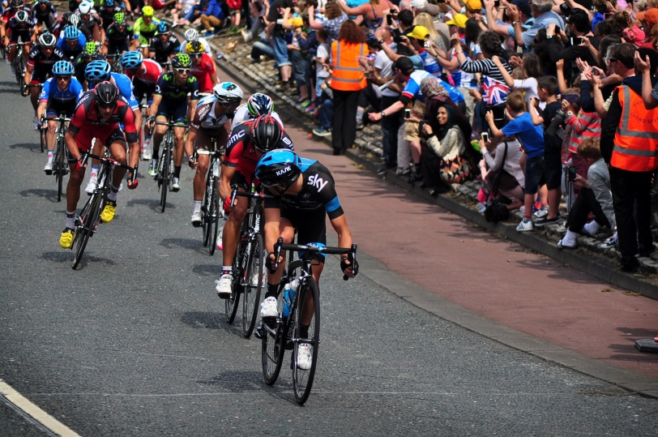
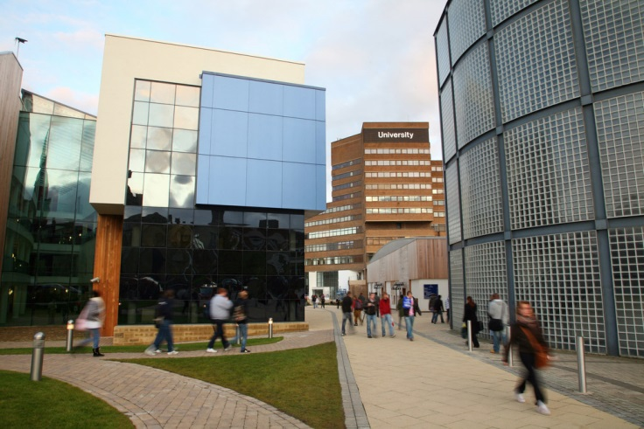
About the University of Huddersfield
1825: Founded as Huddersfield Scientific and Mechanic Institute
1992: Became the University of Huddersfield
2003: Patrick Stewart became Chancellor
2014
24,000+ students
Times Higher Education University of the Year
Stage 2 of the Tour de France!

Slide 3
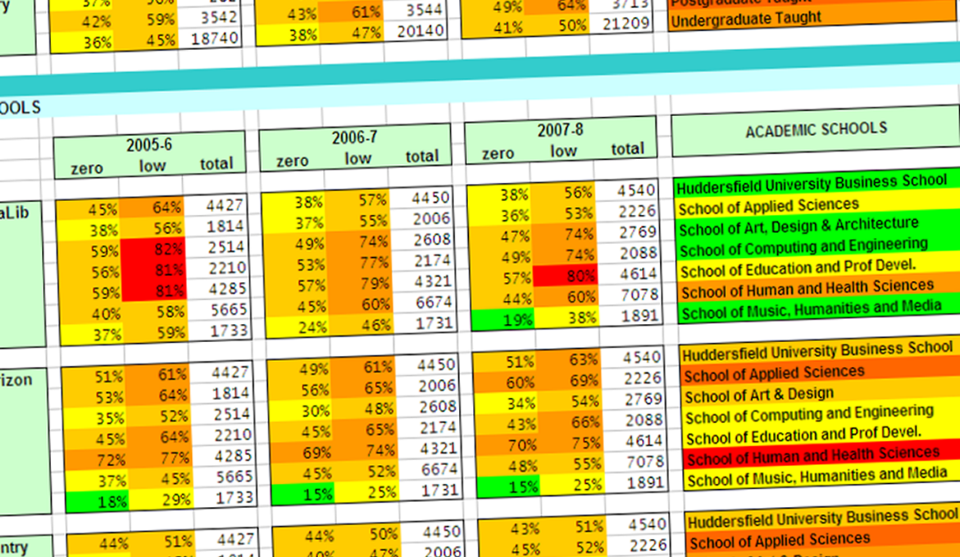
Using Usage Data since 2005…
…to improve existing services
…to gain insights into user behaviour
…to measure the impact of the library

Slide 4
Library Impact Data Project

Slide 5
To support the hypothesis that…
“There is a statistically significant correlation across a number of universities between library activity data and student attainment”

Slide 6
Library Impact Data Project 1 Original data requirements
For each student who graduated in a given year, the following data was required:
Final grade achieved
Number of books borrowed
Number of times e-resources were accessed
Number of times each student entered the library, e.g. via a turnstile system that requires identity card access
School/Faculty

Slide 7
Library Impact Data Project Phase I
Showed a statistical significance between:
Final grade achieved
Number of books borrowed
Number of times e-resources were accessed
Across all 8 partners
Not a cause and effect relationship

Slide 8
Library Impact Data Project
Phase I looked at over 33,000 students across 8 universities
Phase II looked at around 2,000 full time undergraduate students at Huddersfield

Slide 9
Library Impact Data Project 2 Additional data
Demographics
Discipline
Retention
On/off campus use
Breadth and depth of e-resource usage
Entry data
Correlations for Phase 1

Slide 10
Library usage Country of domicile

Slide 11
Library usage Aggregated subject groups

Slide 12
Library usage Retention
Looking at one year of data for every student
Using a cumulative measure of usage for the first two terms of the 2010-11 academic year
Only looking at people who dropped out in term three
All the students included in this study were at the university in the first two terms, and they have all had exactly the same opportunity to accumulate usage.

Slide 13
Library usage Retention

Slide 14
Library usage Retention
Identifying retention issues and our impact on lowering them as part of a University dashboard
Engagement
Workload
Performance
Thanks to Lee O’Farrell,
University College Dublin,
for the inspiration for this image

Slide 15
Number of e-resources accessed Depth and breadth

Slide 16
Other factors Number of e-resources accessed
Both borrowing books and logging onto electronic resources does not guarantee the item has been read, understood and referenced
Heavy usage does not equate to high information seeking or academic skills
Non-use of library resources does necessarily mean students are using poor quality information

Slide 17
Adding value@Huddersfield A mixed methods approach
Library analytics can help to identify the “context”
Look at specific subjects in order to gain a further understanding
holding focus groups with target areas
Create an action plan to engage with academic colleagues
Showing value for money and the impact of the service on the student experience

Slide 18
Adding value@Huddersfield A mixed methods approach
Two spin off projects
Roving Librarian
Taking the library to social spaces and resource centres within all schools to reach students who may otherwise be library non-users
Lemon Tree (now known as Librarygame)
A fun, innovative, low input way of engaging students now used by Huddersfield, Glasgow, and Manchester universities

Slide 19
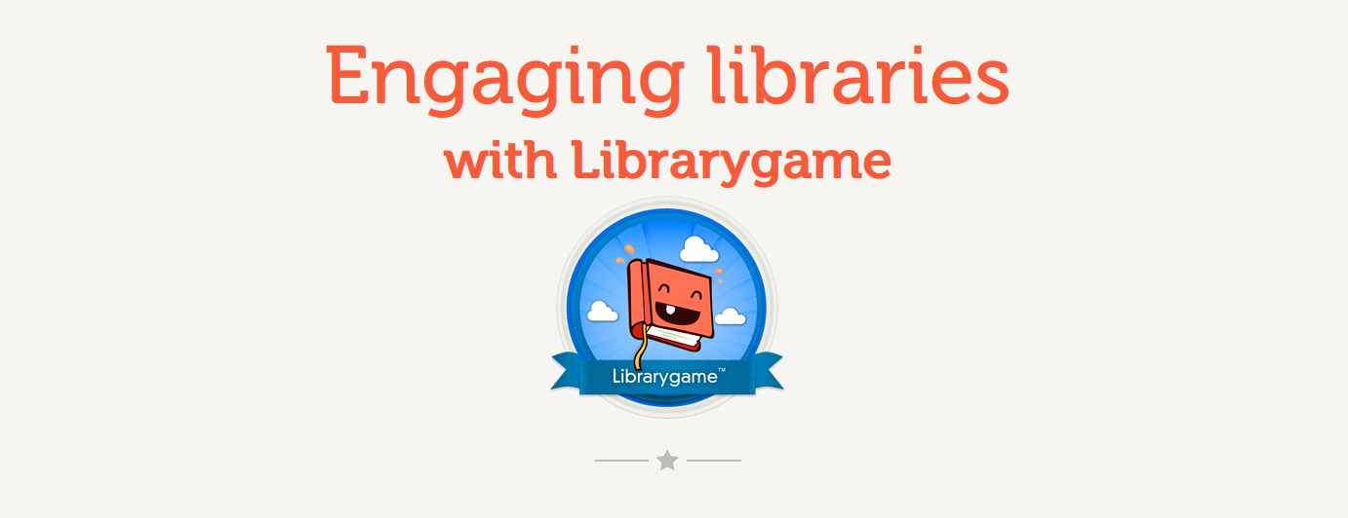
Copyright © 2013
Librarygame by Running in the Halls

Slide 20
Drivers for change 1
And we know all this is firmly on Libraries’ radars
Our survey:
How important will analytics be to academic libraries now and in the future, and what is the potential for a service in this area?
Notes:
And while Huddersfield was the only institution experimenting with data to quite this extent, of course all of this has been very much on most Library’s radars for a while now. Indeed, some of the more competitive library system vendors are building in analytics tools so that some usage data can be tracked on an institutional level.
Just over a year ago we worked with RLUK and SCONUL to conduct a survey to fully understand how important analytics will be to academic libraries now and in the future, and to see also what opportunities there might be for a shared service in this area.

Slide 21
Significant appetite for analytics services
There’s a significant appetite (96%) for analytics services…
…but hesitation over sharing entry data and other student data than other forms of usage data
Only 46% would be willing to share data if the institution was named…
…but if institutional identity can be anonymised, that changes to 91%

Slide 22
Is this a current strategic priority?

Slide 23
What about the next five years?

Slide 24
Notes:
Cue the Library Analytics and Metrics or LAMP project.
We started our work early last year, following on from the survey results and also the work of the Library Impact Data project

Slide 25
JiscLAMP Library Analytics and Metrics Project
Looking at the benefits of scale
To develop a prototype shared library analytics service for UK academic libraries
Envisioned as a data dashboard
Enabling libraries to capitalise on the many types of data they capture in day-to-day activities
To support the improvement and development of new services and demonstrate value and impact in new ways across the institution

Slide 26
JiscLAMP Project partners

Slide 27
JiscLAMP A brief (important) word on ethics
Should we be holding and analyzing this kind of data
Data protection issues and ‘Big brother’ concerns
All students pay the same fees – shouldn’t they be treated the same?
But what if we didn’t do this
What would the reaction be if it was found that we had this data but didn’t act on it?
We have a duty to care for the individual wellbeing of our students

Slide 28
Job stories Consulting with the community

Slide 29
JiscLAMP Normalisation of Data

Slide 30
JiscLAMP What did we achieve?
LAMP project outputs
We managed to clean up and process the data from all of the partners
We created a prototype – our analytics engine
We performed a benchmarking exercise
We showed that the idea of a shared library analytics service was feasible

Slide 31
JiscLAMP What can we do with the data?
We can demonstrate usage by cohorts:
Department Degree name Course Course ‘type’? Gender/Ethnicity/Nationality/Disability/Age Level of attainment Attendance mode (full time/part time) UCAS points
We can demonstrate correlations between usage and attainment/usage and cohort)

Slide 32
Phase 2: May 2014 – July 2015
Notes:
Cue the Library Analytics and Metrics or LAMP project.
We started our work early last year, following on from the survey results and also the work of the Library Impact Data project

Slide 33
JiscLAMP Phase 2 Work Package (draft)
WP1: Project Management Management of the project including: planning; coordination; monitoring progress; advocacy; reporting | WP2: Data and infrastructure Development of the current database and data analysis/translation of functionality | WP3: Interface Prototype User interface prototyping and development | WP4: Community Engagement and Support Driving wider community engagement and specifically reflecting community support requirements | WP5: Communications Communications and dissemination of project outputs and prototype service | WP6: Sustainability Sustainability and transition of project to service

Slide 34
JiscLAMP The data dashboard

Slide 35
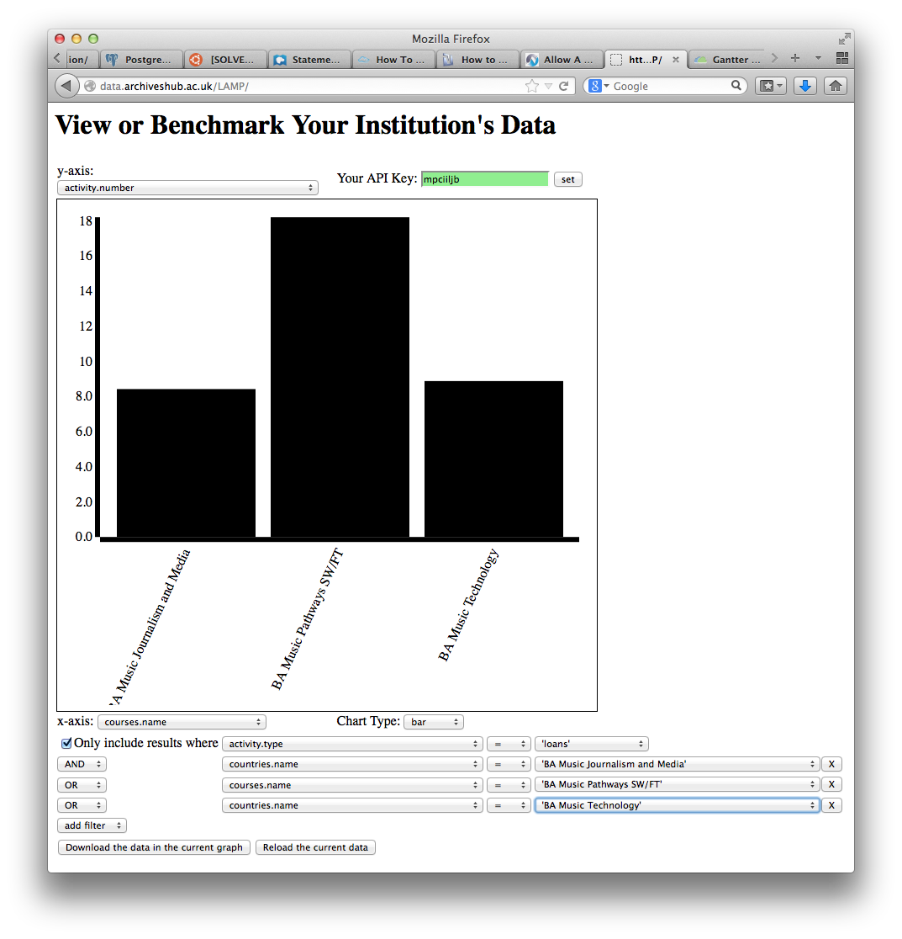
JiscLAMP The ugly prototype

Slide 36
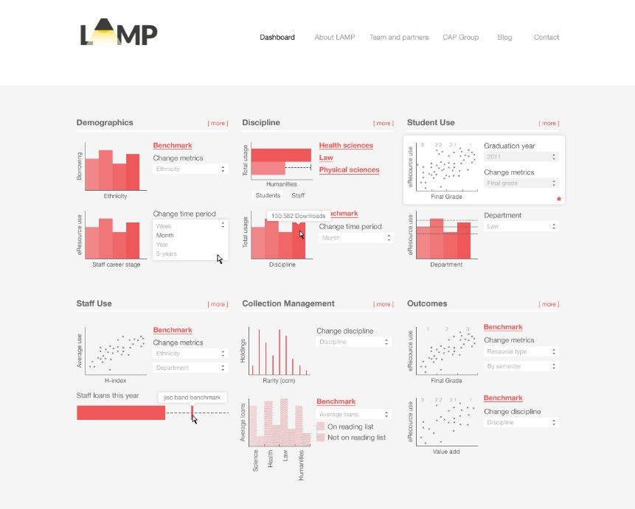
JiscLAMP The wireframe

Slide 37
Where do we go from here? Our key areas for focus 2014-15
Merge data from multiple systems
Library, student registry, IT services
Make the data beautiful and compelling through iterative testing and development
Contribute to the institutional analytics mission
Usage data to ‘profile’ individuals
e.g. Key usage indicators by discipline

Slide 38
Community Engagement and Support
Development of support materials and training based on community requirements e.g., advice and guidance, toolkit etc.
Library Impact Data Project Toolkit: Phase 2
Value of Academic Libraries, developed for ACRL by Megan Oakleaf
Academic Library Value: The Impact Starter Kit

Slide 39
References
The original project
White, Sue and Stone, Graham (2010) Maximising use of library resources at the University of Huddersfield. Serials, 23 (2). pp. 83-90
LIDP
Stone, Graham and Ramsden, Bryony (2013) Library Impact Data Project: looking for the link between library usage and student attainment. College and Research Libraries, 74 (6). pp. 546-559
Stone, Graham and Collins, Ellen (2013) Library usage and demographic characteristics of undergraduate students in a UK university. Performance Measurement and Metrics, 14 (1). pp. 25-35
Collins, Ellen and Stone, Graham (2014) Understanding patterns of library use among undergraduate students from different disciplines. Evidence Based Library and Information Practice, 9 (3) (In Press)
LAMP
Showers, Ben and Stone, Graham (2014) Safety in Numbers: Developing a Shared Analytics Service for Academic Libraries. Performance Measurement and Metrics, 15 (1/2). pp. 13-22
Library Analytics bibliography
https://library3.hud.ac.uk/blogs/lidp/project-outputs/library-analytics-bibliography/

Slide 40
Thank you! http://jisclamp.mimas.ac.uk
Graham Stone
g.stone@hud.ac.uk
#lidp #jiscLAMP
http://eprints.hud.ac.uk/21047
This work is licensed under a Creative Commons Attribution 3.0 Unported License

